Slide 1
Cloud Digital Repository Automation
Matthew Brockman, Chris Hill
Multimedia, Hypertext, and Information Access, CS-4624
Edward A. Fox
Virginia Tech, Blacksburg VA 24061
5/2/2018

Slide 2
Outline
Continuous Integration and Continuous Deployment Overview
Tools Used
Completed Pipeline
Analyzing Our Cost
Final Thoughts
Final Work before Submission to VTechWorks

Slide 3
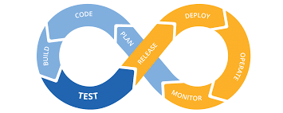
CI/CD
Continuous Integration and Continuous Deployment
Software engineering practice
Used in Agile environments
One of the main, and most difficult components of the DevOps process

Slide 4
Fedora4
Our Task: CICD for Fedora4
Any Development Change prompts a build/test/deployment
Manage bugs and feature changes more efficiently
Always has a updated and working version of the application
Overhead for deployment and manual unit testing becomes automated
Helps the Fedora Dev team

Slide 5
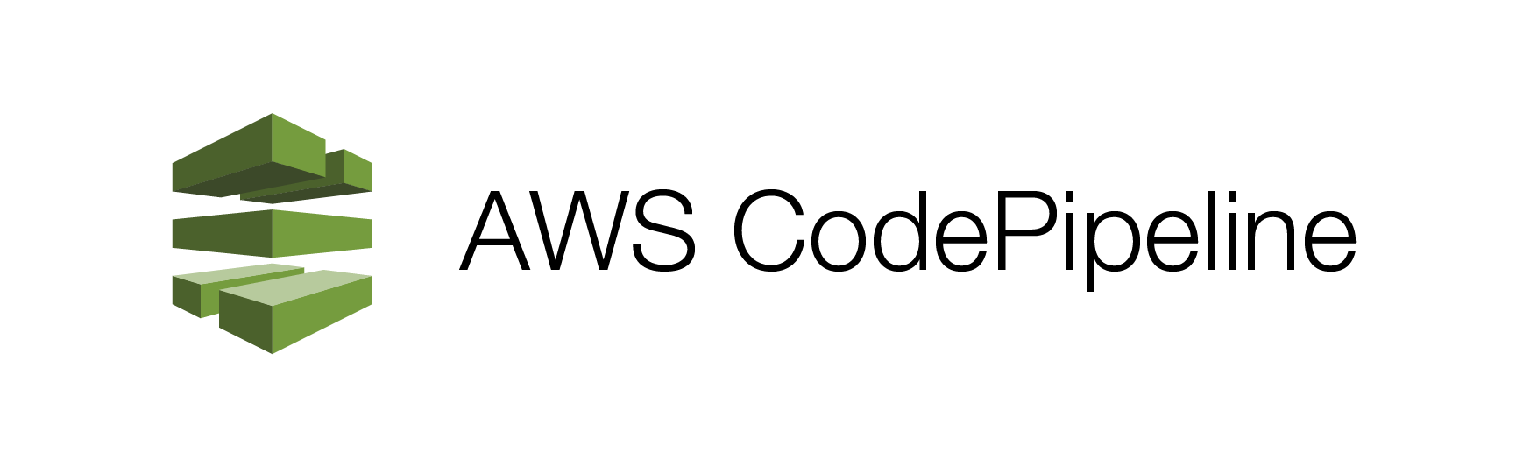
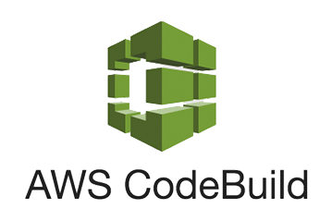
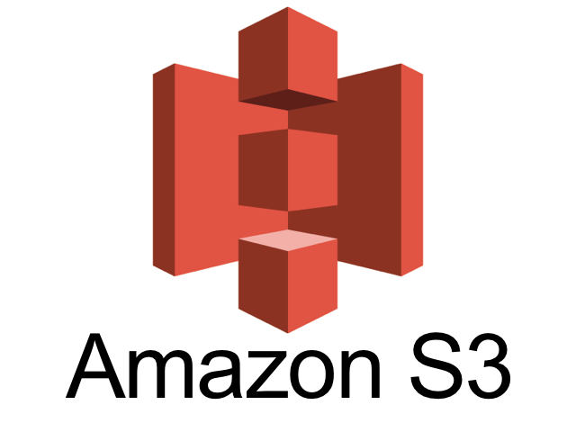

Our AWS Stack
CodePipeline
CodeBuild
Simple Cloud Storage Service (S3)
Elastic Beanstalk
CloudWatch
AWS Elastic Beanstalk

Slide 6
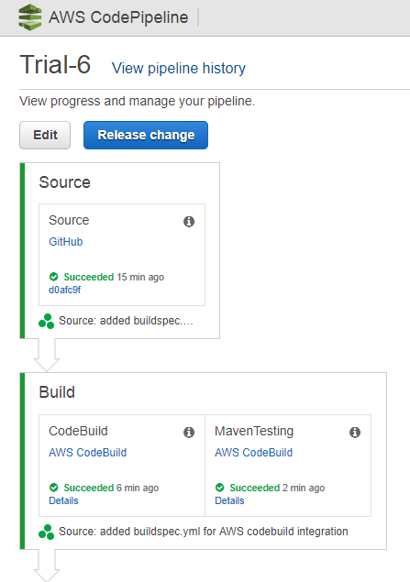
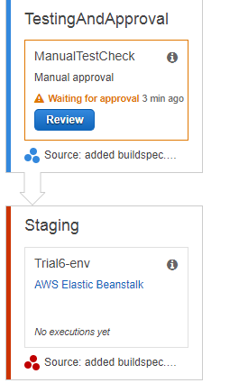
Finished Pipeline
Final View:
Awaiting Review
No Deployment
Email based Approval
Email subscription can be setup/modified easily

Slide 7
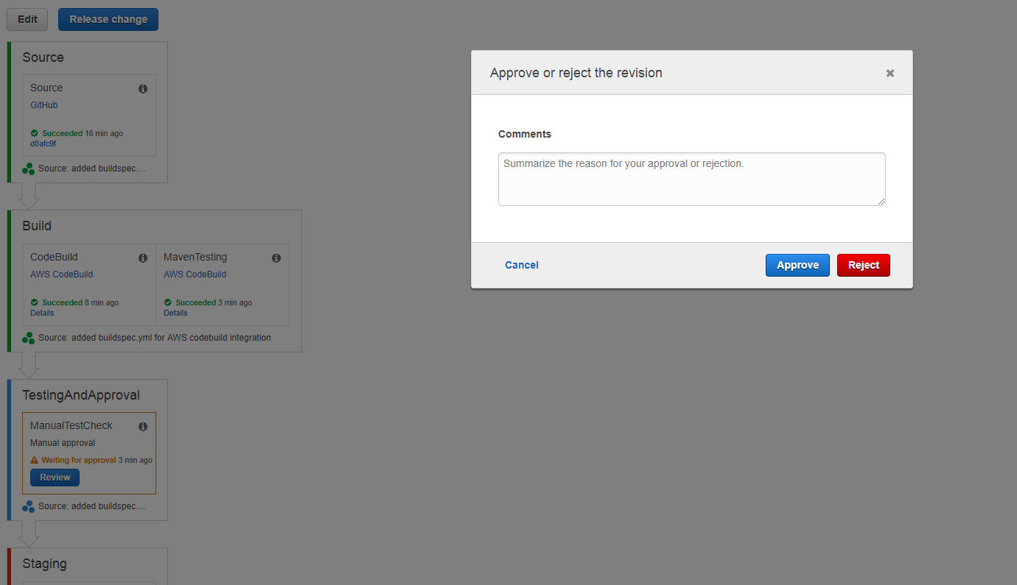
Finished Pipeline

Slide 8
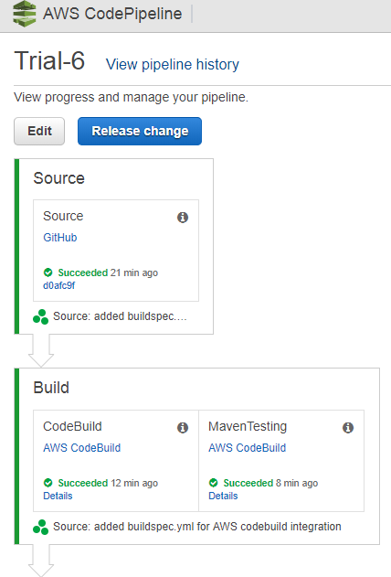
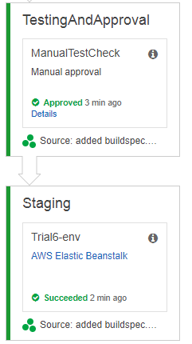
Finished Pipeline
Final View:
Finished and all Green
Each Stage Completed
  Pipeline triggered from source change

Slide 9

Total Costs from the Pipeline
Minimal Costs
Amazon S3
  $0.023 per first 50 TB
CloudWatch
  Free / Logging Service
Possible Larger Costs
CodeBuild
  Build Minute Based
Elastic Beanstalk (ie EC2)

Slide 10
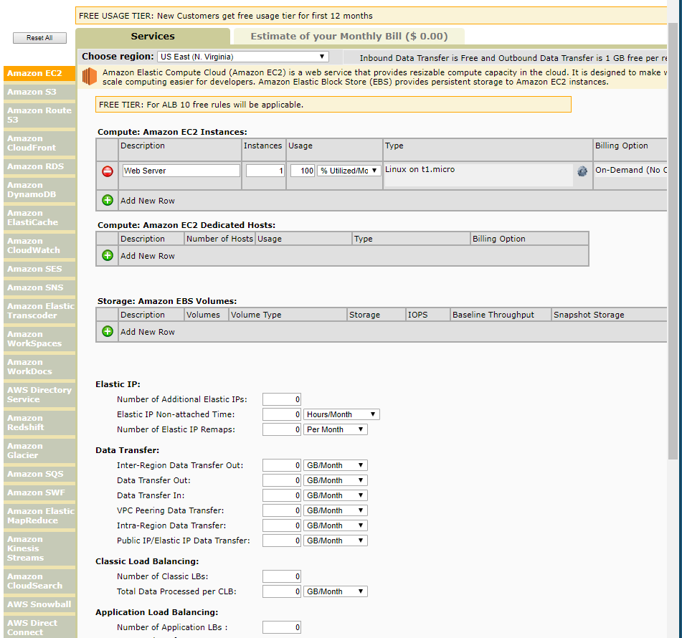
Total Costs
EC2 instance At 100% utilization
Hosting Opt 1
$35 a month
Upfront cost for a dedicated server
Hosting Opt 2
$103 per year
CodeBuild daily builds
$21.90 per year
CodePipeline pipeline
$1.00 per pipeline
Roughly
$126 to host and build per year

Slide 11
Final Thoughts
Groundwork Pipeline
  Minimal changes needed to handoff permissions and access tothe Pipeline with transitioning to client
  Room for more stages, configurations, and plug-ins
Providing an AWS starting point for the Fedora4 team
Modest cost for an automatic process

Slide 12
Finishing Touches
Document of AWS roles/users so that Fedora devs can follow and modify the Pipeline
Cleaning up unused AWS resources (Storage/Invalid Builds)
Screenshots/Commenting our Configs
Finalizing a cost spreadsheet
Synthesizing our Final Report
  Including Cost spreadsheet, AWS accounts, permissions, and screenshots we have been using for the AWS stack

Slide 13


Acknowledgements
Client: Yinlin Chen ylchen@vt.edu (540-231-0271)
Fedora4 Development Team and DuraSpace Organization

Slide 14
References
AWS CodePipeline/CodeBuild/CodeDeploy/ElasticBeanstalk :
https://docs.aws.amazon.com/codepipeline/latest/userguide/codepipeline-user.pdf
https://aws.amazon.com/documentation/elastic-beanstalk/
https://aws.amazon.com/documentation/codebuild/
https://aws.amazon.com/documentation/s3/
https://aws.amazon.com/codebuild/pricing/
https://aws.amazon.com/ec2/pricing/
Monthly Calculator:
https://calculator.s3.amazonaws.com/index.html
Images (in order):
https://loadimpact.com/integrations/performance-testing-aws-codepipeline
https://docs.aws.amazon.com/codepipeline/latest/userguide/welcome.html
https://aws.amazon.com/blogs/security/how-to-audit-cross-account-roles-using-aws-cloudtrail-and-amazon-cloudwatch-events/
https://www.flickr.com/photos/pictures-of-money/17309480255
https://cloudacademy.com/blog/elastic-beanstalk-lab/

