Slide 1

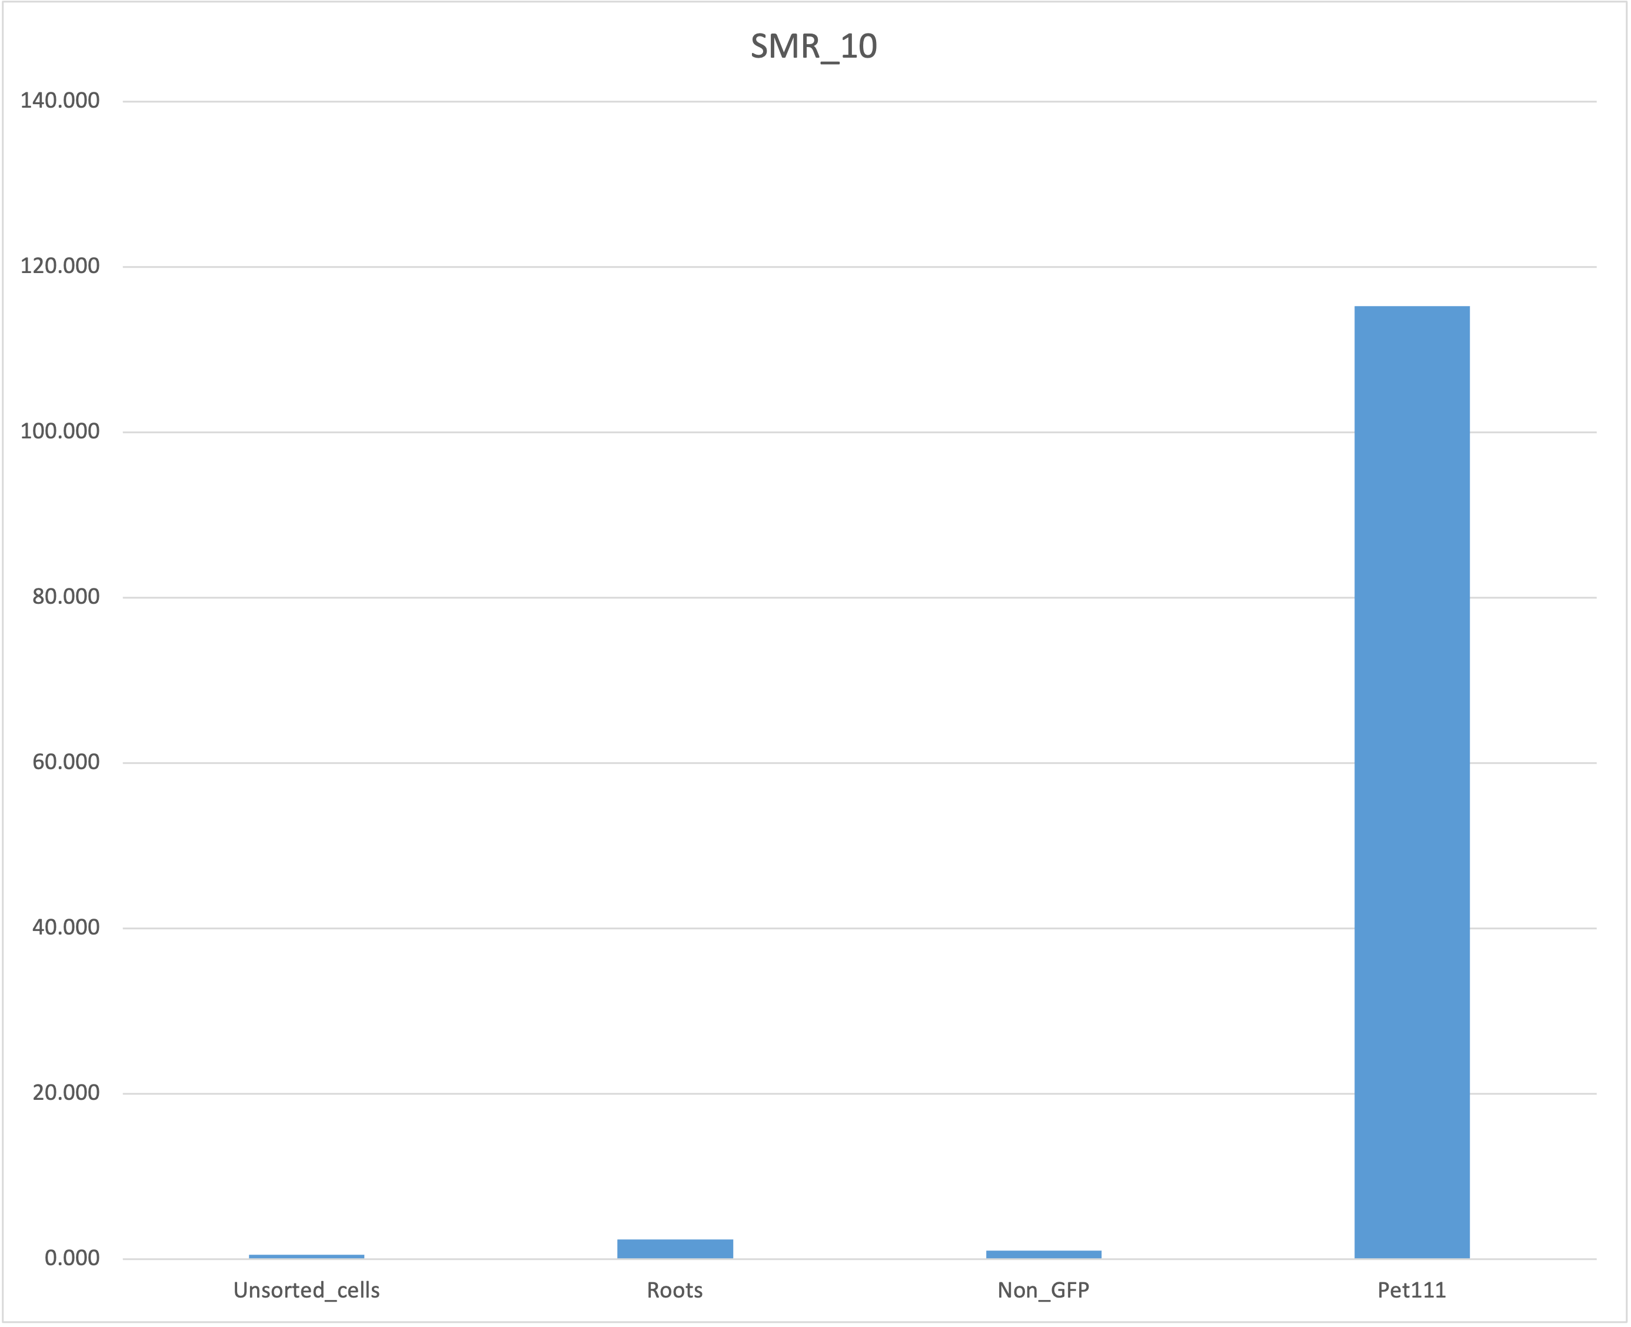
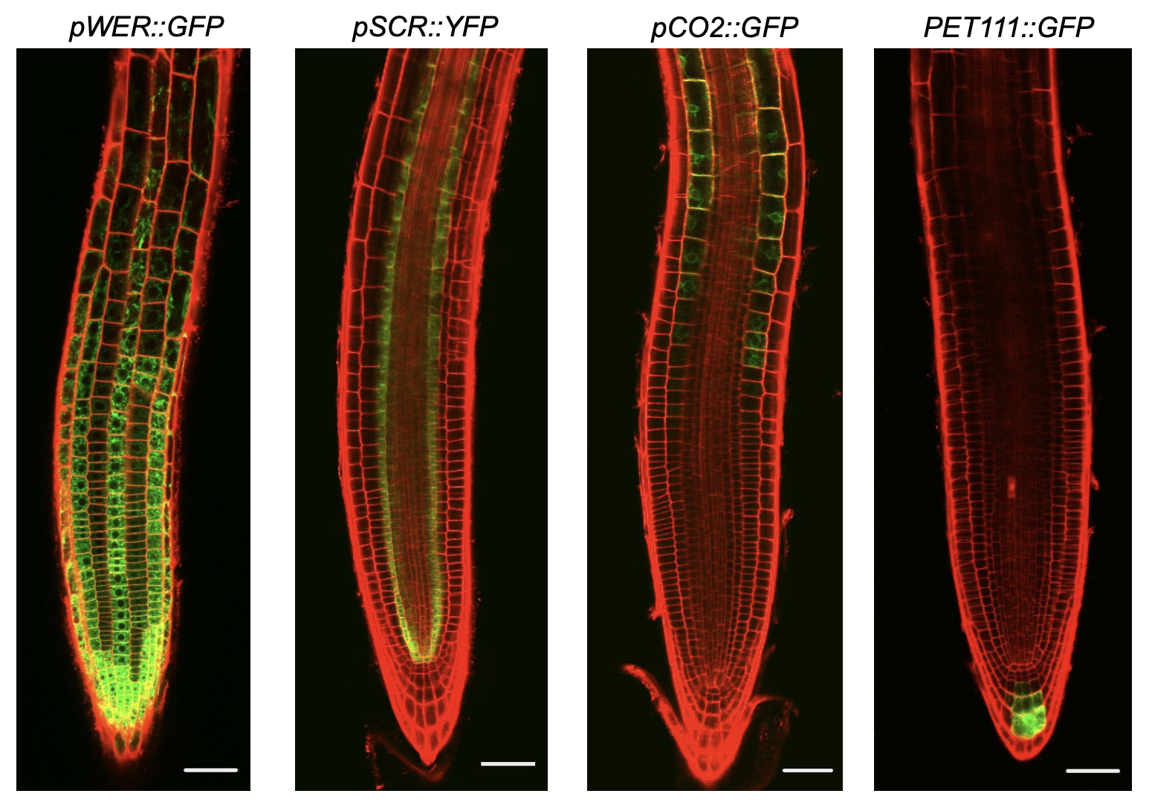
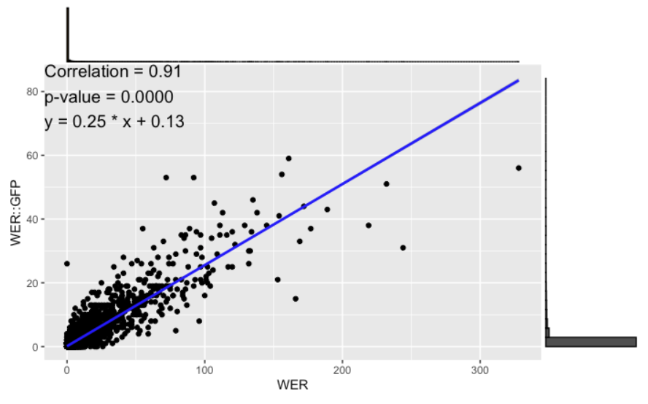
scGFP: A Single-Cell RNA-Seq Study of Correlation Methods for Promoter-Reporter and Native Gene Expression
Tran N. Chau, Razan Alajoleen, Sanchari Kundu, Bastiaan Bargmann, Song Li
School of Plant and Environmental Sciences, Virginia Tech, Blacksburg, VA, 24061
INTRODUCTIONS
Single-cell RNA sequencing (scRNA-seq) enables the exploration of transcriptomic heterogeneity at the individual cell level, facilitating the identification of distinct cell types, rare populations, and dynamic gene expression patterns over time. This technique has advanced plant biology by enabling cross-species comparisons and uncovering gene regulatory networks. While gene co-expression networks are essential for understanding these networks, commonly used correlation methods have primarily been applied to microarray and bulk RNA-seq datasets, with limited validation in single-cell contexts. This study uses an Arabidopsis scRNA-seq dataset to evaluate the performance of various correlation methods in comparing promoter-reporter genes with their native counterparts, addressing challenges such as zero-inflation and demonstrating the benefits of pseudo-bulk analysis and imputation techniques for improving correlation accuracy.
RESULTS
VALIDATION
BACKGROUNDS
Promoter-reporter systems provide a powerful tool to visualize gene activity in specific cell types.
Confocal images highlight distinct spatial expression patterns from different promoters in roots.
This study evaluates correlation methods for single-cell RNA-seq to ensure promoter-reporter expression reflects native gene activity.
Figure: The line plot displays the average correlation of target genes for each TF in the original data (purple) and imputed data (yellow).
Figure: Six methods was used to conduct comprehensive correlation analysis to quantify promoter-reporter and native gene expression relationships.
Figure:
pWER::GFP shows fluorescence in the epidermis
pSCR::YFP highlights endodermal cells
pCO2::GFP displays signal in cortical cells
PET111::GFP exhibits fluorescence near the root tip
Figure: Scatter plots with fitted lines illustrate the
relationship between gene expression and correlation for each TF.
Figure: Wet-Bench Validation
Using qPCR
Figure: UMAP plot shows cell type cluster
Figure. The line plot displays the average
gene expression patterns of WER::GFP and
the WER gene across different cell types.
CONCLUSION
Promoter-reporter showed strong correlations with native genes, but zero-inflation posed challenges.
Pearson performed well, CS-CORE struggled with low-expression genes, highlighting the need for careful method selection.
Pseudo-bulk analysis improved correlation by addressing zero-inflation.
AE and VAE imputation enhanced transcription factor target gene correlations.
qPCR validated PET111 expression in GFP-positive cells.
MOTIVATIONS
To assess how accurately promoter-reporter systems reflect native gene expression at the single-cell level, initial visualizations revealed strong similarity between native and promoter-reporter gene expression patterns.
Figure: Feature plot showing the gene expression patterns of WER::GFP and the WER gene, where each dot represents a cell. Darker purple indicates higher expression, lighter purple indicates lower expression.
Strong correlation observed between native and promoter-reporter genes, but many cells did not express either gene across all samples.
Pseudo-bulk analysis mitigates the impact of zero-inflation in single-cell data by averaging gene expression within clusters.
Pseudo-bulk analysis increases the correlation between promoter-reporter and native genes.
pWER::GFP
WER
REFERENCES
1. Islam, M. T. et al. Advances in the Application of Single-Cell Transcriptomics in Plant Systems and Synthetic Biology. BioDesign Research 6, (2024).
2. Bawa, G., Liu, Z., Yu, X., Qin, A. & Sun, X. Single-Cell RNA Sequencing for Plant Research: Insights and Possible Benefits. Int J Mol Sci 23, 4497 (2022).
3. Ruprecht, C. et al. Phylogenomic analysis of gene co‐expression networks reveals the evolution of functional modules. The Plant Journal 90, 447–465 (2017).
4. Hou, J. et al. Distance correlation application to gene co-expression network analysis. BMC Bioinformatics 23, 81 (2022).
5. Su, Chang, et al. "Cell-type-specific co-expression inference from single cell RNA-sequencing data." Nature Communications 14.1 (2023): 4846.
ACKNOWLEDGEMENT
Figure: Correlation between the average gene expression of promoter-reporter and native genes
in the cell type clusters, using Pearson (top) and Spearman (bottom) methods.
Sample | Number of promoter-reporter reads | Number of native reads
WER | 1719 | 9118
CO2 | 563 | 2906
PET111 | 184 | 4066
SCR | 244 | 526
Figure. Scatter plot shows the Pearson correlation
Figure. Table showing the number of
promoter-reporter and native reads.
Figure: The correlation between promoter-reporter and native genes is displayed for original and imputed data using AE and VAE across all samples, with Pearson correlation on the top and Spearman correlation on the bottom.

