Slide 1

Comparison of Offshore Wind Turbine Reliability
Aris Christou, Patrick McCluskey, Yizhou Lu and Tatiana Delorm
University of Maryland
College Park MD

Slide 2
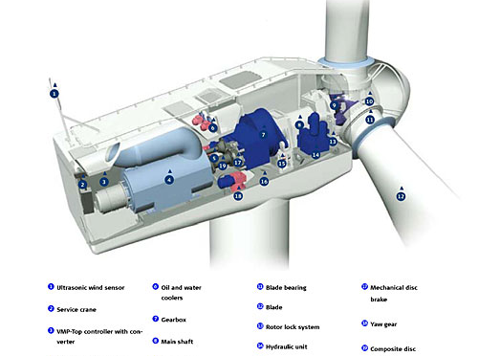
Outline
General study of the failure rate and reliability of the several types of OWT architectures
Comparison of the failure rate of assemblies in OWT drive train and electrical system
Reliability issues of power electronics in power converters

Slide 3
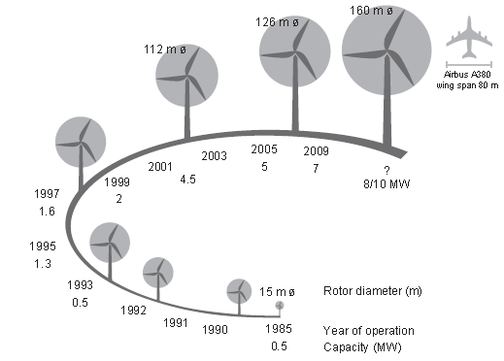
Growth in size of Commercial WT Designs (from EWEA)
NAWEA Symposium 2015
Reliability
Failure Mechanisms
Questions
Conclusion
Introduction

Slide 4
Off Shore Access is Difficult, and Costly: Require Minimum Maintenance and High Reliability

Slide 5
The “Marine Environment”
The “marine environment” refers to the physical, chemical, and biological stressors acting on offshore wind turbines
The primary concern is the effect of salt and moisture content, as sea water, sea air, or salt spray, on corrosion of WT components.
This concern is partially mitigated by the practice of “normalizing the turbine internal atmospheric environment” by removing salt from all air inflows and providing a positive pressure
There are, however, other physical and electrical stresses related to location offshore that can cause failures as well.
  highly variable temperatures
  powerful storms and lightning strikes.
These can cause failures resulting from solder fatigue due to temperature cycling or due to the shock or vibration caused by high winds or waves during storms.
NAWEA Symposium 2015

Slide 6
Main Issue is Reliability and Maintainability
Develop reliability models for comparison of key technologies.
Integrate Physics of Failure Models to Predict Reliability
Assess life expectancy of wind turbine hardware under anticipated life cycle loading conditions and accelerated stress test conditions.
Predict Effect of turbine degradation on grid performance
Reliability
Failure Mechanisms
Questions
Conclusion
Introduction
NAWEA Symposium 2015

Slide 7
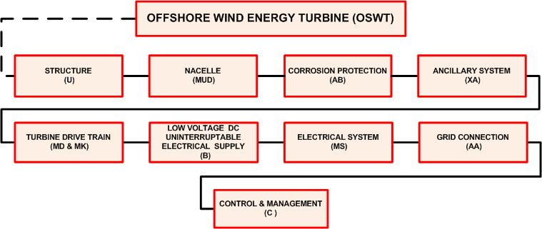
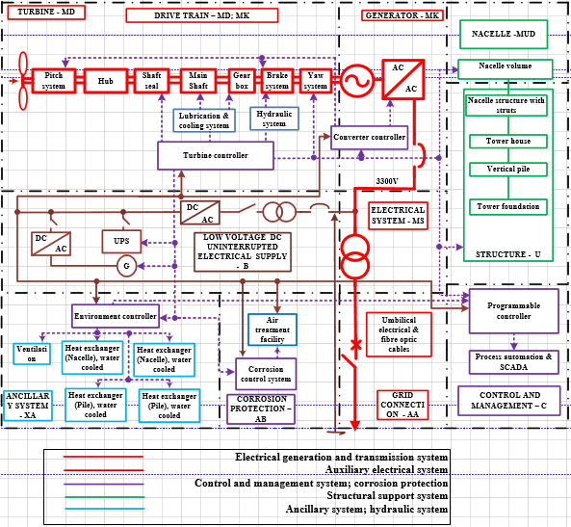
Schematic Diagram of Offshore WT
NAWEA Symposium 2015

Slide 8
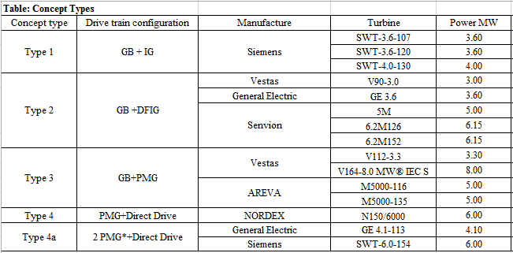


Reliability Comparison Models for Offshore Wind Turbines(OWT)
5 Types of WT architectures (Types1-4a) were chosen for reliability modelling using Reliability Block Diagrams and Parts Count Prediction technique, based on surrogate data from wind turbines, marine and other generic databases (OREDA, MIL-HDBK-217F, IEEE Gold Book, etc.)
NAWEA Symposium 2015

Slide 9
Predicted Total Failure Rate for Types 1-4a OWTs assuming no maintenance
NAWEA Symposium 2015

Slide 10
Reliability Survivor Function of Types 1-4a in 1 year assuming no maintenance
NAWEA Symposium 2015

Slide 11
NAWEA Symposium 2015

Slide 12
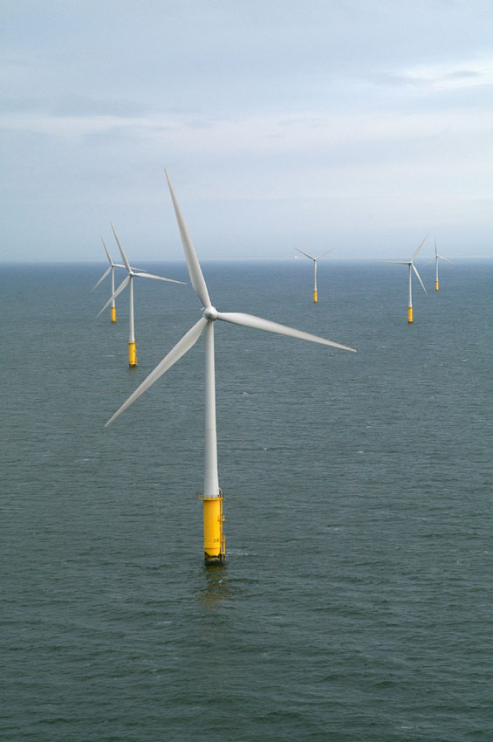
Power electronics are an integral part of offshore wind turbine energy production
University of Maryland research focuses on the power electronics in the nacelle where variable frequency converters modify the AC electric energy created by the wind-driven generators to high voltage AC (50 or 60 Hz) or high voltage DC for transmission to shore and distribution on the grid..

Slide 13
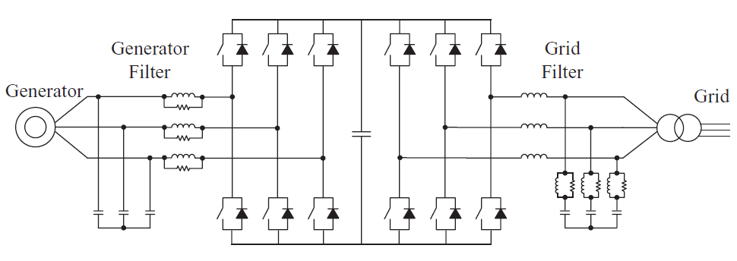
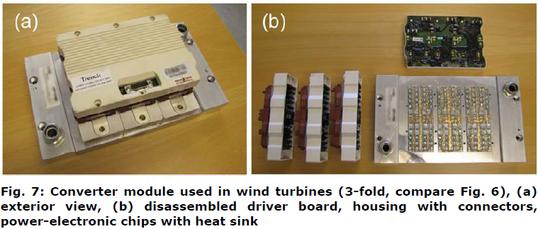
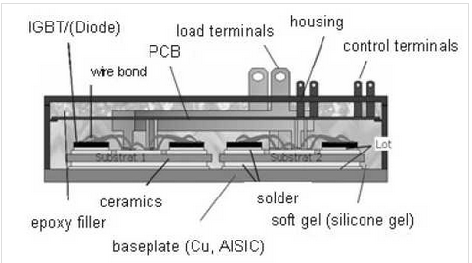
Critical Assembly of Drive Train--Converter
Converter Module with driver board, connections, housing, and power electronic chips with heat sink.
Failure Mechanisms:
Corrosion of interconnects,
Electrochemical migration, Bond wire liftoff and
Solder Joint Fatigue
Back to back connected power module
NAWEA Symposium 2015

Slide 14
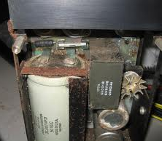
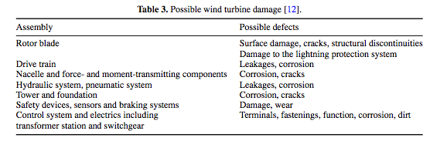
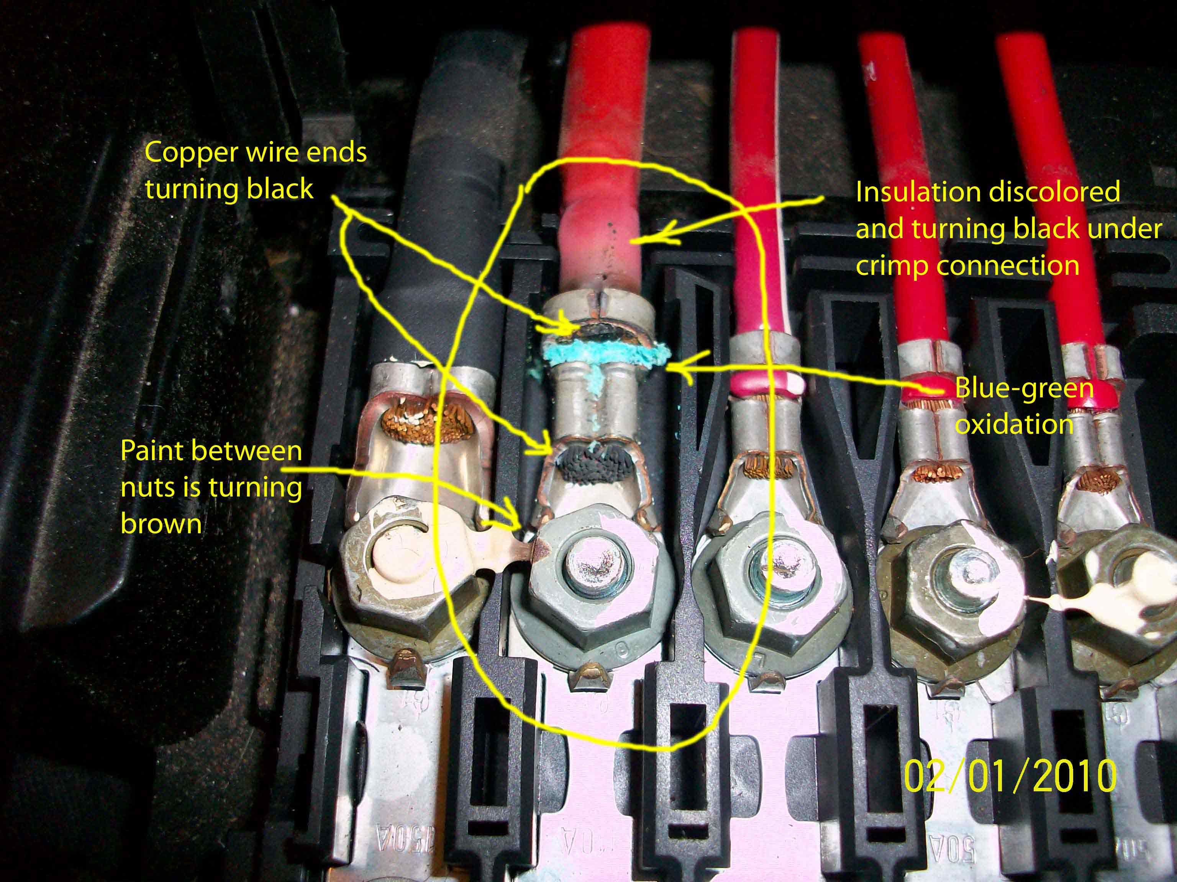
1. Corrosion of Interconnects
Corrosion is the leading failure mechanism for offshore wind turbine
Occurs everywhere in the wind turbine
Multiple corrosion mechanisms active
  General Corrosion
  Crevice and Pitting
  Stress Corrosion
  Erosion / Corrosion
NAWEA Symposium 2015
Reliability
Failure Mechanisms
Questions
Conclusion
Introduction

Slide 15
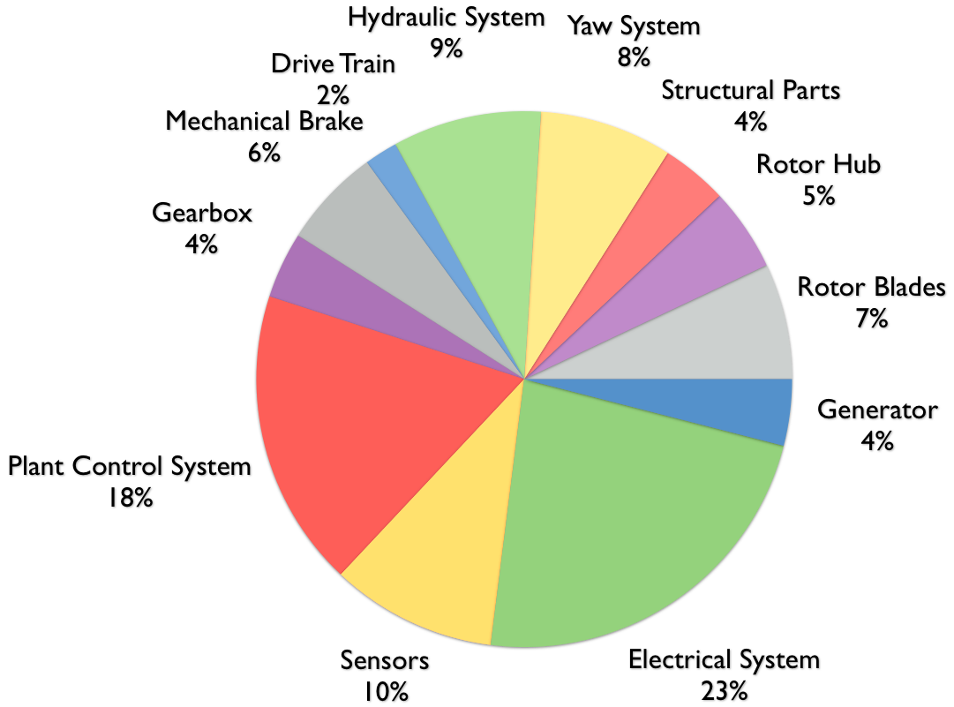
Failure Sites
Statistical failure studies indicate electronics are a major cause of unscheduled maintenance.
Electronics have short repair times but harsh environmental conditions can make wind turbines inaccessible.
Power Electronic Failures can propagate to the grid.
NAWEA Symposium 2015

Slide 16
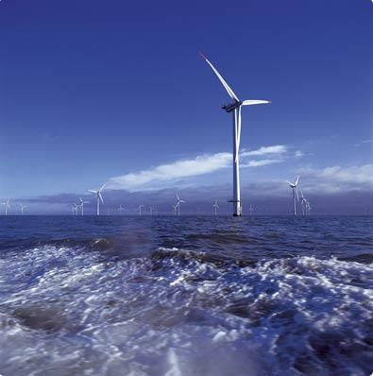
Corrosive Environments and Interconnect Corrosion: Copper Interconnects
Structures located over or within 2500 feet of a body of water containing chloride above 2000 ppm are considered to be marine structures.
Marine environments are characterized by sodium chloride that is easily carried by sea spray, mist or fog.
Temperature, relative humidity, and wet/dry time all effect the corrosion potential
Corrosion of copper in the atmosphere results in a thin layer of corrosion, typically referred to as the patina.
Higher concentrations of chlorides in marine air cause copper to acquire a patina sooner than other locations.
The rate of copper corrosion layer formation varies in different environments:
  Land ≈ 0.5 µm/year
  Marine ≈ 1 µm/year
NAWEA Symposium 2015
Notes:
http://www.pdhcenter.com/courses/m133/m133content.pdf
http://www.dot.state.fl.us/structures/StructuresManual/CurrentRelease/DesignGuidelines/SDG1.3EnvClassifications.htm

Slide 17
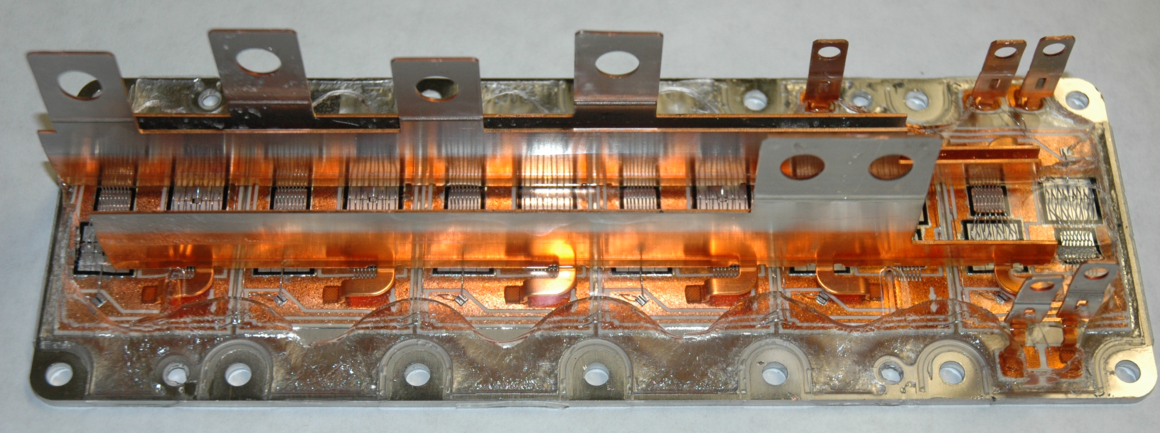
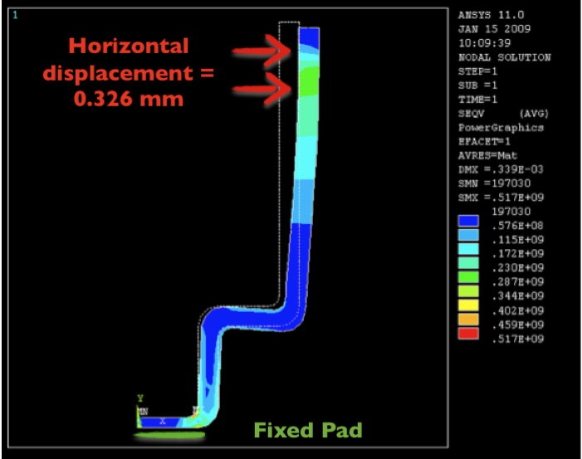
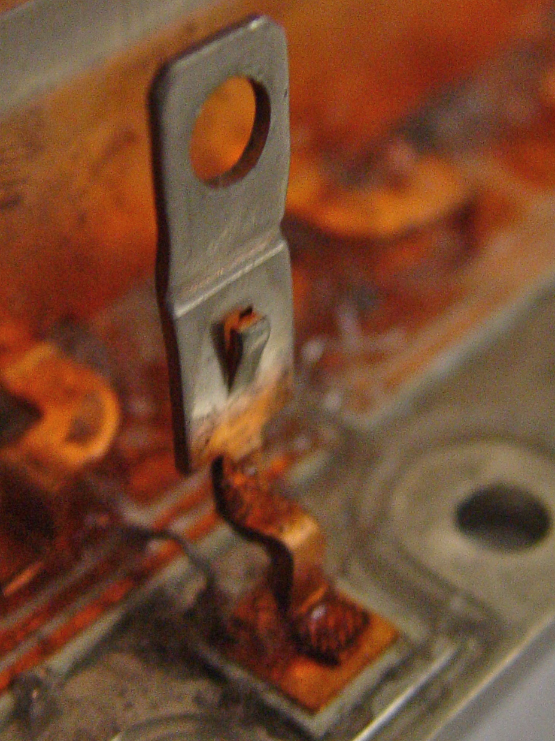
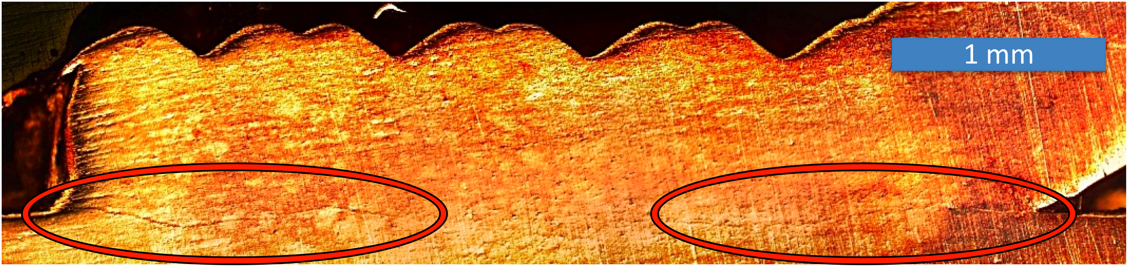
Copper Interconnect Corrosion in Power Converter
NAWEA Symposium 2015

Slide 18
2. Electrochemical Migration
Electrochemical migration (ECM) is the growth of conductive metal filaments on or in a printed circuit board (PCB) under the influence of a DC voltage bias [IPC-TR-476A].
+
-
DC voltage source
Plating
Solder alloy
Anode (Cu): electrodissolution
Ion transport
Cathode (Cu): electrodeposition
Substrate
Necessary Conditions for ECM
  Electrical carriers (such as ions).
  A medium, usually water, to dissolve the ionic materials and sustain them in their mobile ionic state.
  Electrical potential between the electrodes to establish an ionic current in the liquid medium.
Stages of ECM
  Path formation
  Electrodissolution
  Ionic transport
  Electrodeposition
  Filament growth
NAWEA Symposium 2015

Slide 19
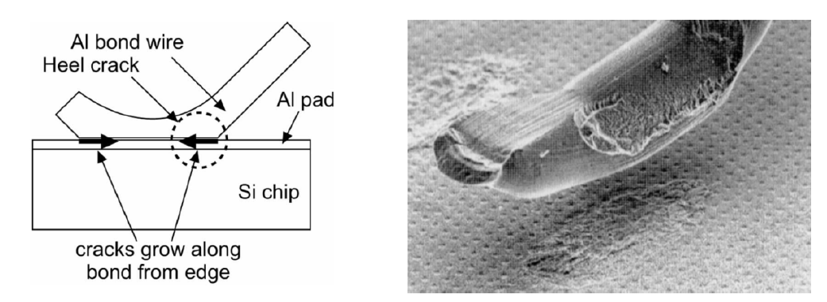
3. Bond wire lift-off
Bond wire lift-off is caused by cumulative damage due to crack growth at the interface between the chip and the bond wire, resulting from temperature swings in combination with the difference in thermal-expansion coefficients (CTE) of Si and bond wire material.
NAWEA Symposium 2015

Slide 20
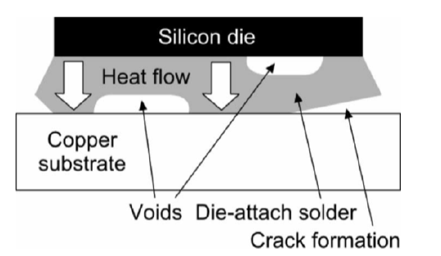
4. Solder Joint Fatigue
The root cause for solder fatigue and cracking is also the CTE mismatch between adjacent materials while subject to power cycles. Frequently, the crack propagation starting from the edges of the solder contact area to the center, leading to an increasing delamination. Also, voids may form at the interface, exaggerating the delamination.
NAWEA Symposium 2015

Slide 21
Conclusions: OSW Reliability Research
Significant reliability problems remain
  Off-shore possesses new challenges
  Present investigations is a start in understanding the offshore environment and reliability of wind turbines.
Future Work: Focus on corrosion and fatigue on Power Electronics.
Apply techniques to make a better prediction of time to failure, failure rate and reliability
  Baysian Analysis and Particle Filtering
  Refined CALCE Physics of Failure Models
NAWEA Symposium 2015
Reliability
Failure Mechanisms
Questions
Conclusion
Introduction

Slide 22
Thanks for your attention!
Reliability
Failure Mechanisms
Questions
Conclusion
Introduction

