Slide 1
ThermaSENSE App
Ansh Gwash, Jack Gable, Yizhe Liu
CS 4624 Multimedia, Hypertext, and Information Access Capstone
Dr. Fox
Virginia Tech, Blacksburg, VA 24061
12/5/2022
Notes:
jack

Slide 2
Overview
3
14
4
15
5
17
11
18
Recap
Cloud Updates
Brief recap of our project
Switching from AWS/Amplify to Firebase
Completed Work
Conclusion
What we have done since our last presentation
Wrapping up current tasks, work left for future teams
Board Updates
Timeline
Data identification, Offline buffer, OTA support
Our journey and last upcoming steps
App Updates
Objective Key Results
UI, Capturing BT data, Visualizations, User Accounts
How we are measuring and managing our progress
Notes:
jack

Slide 3
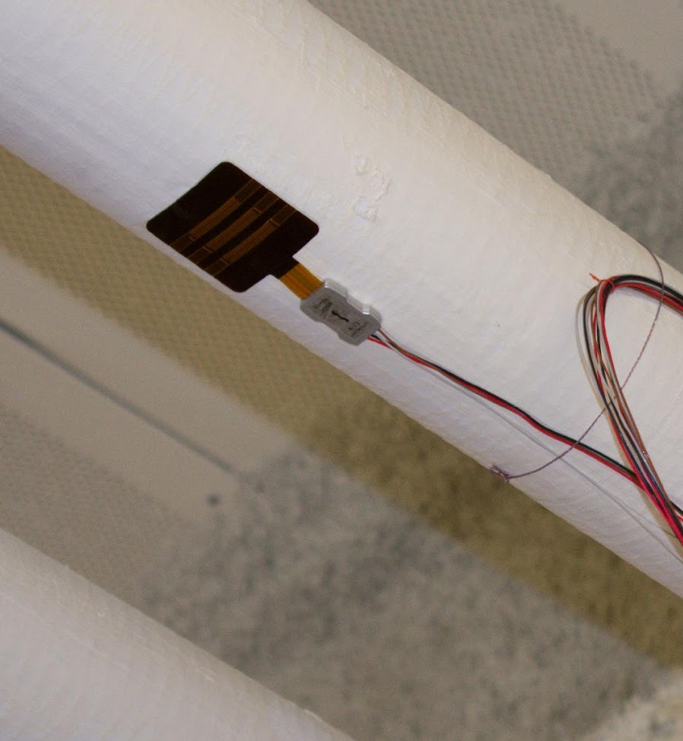
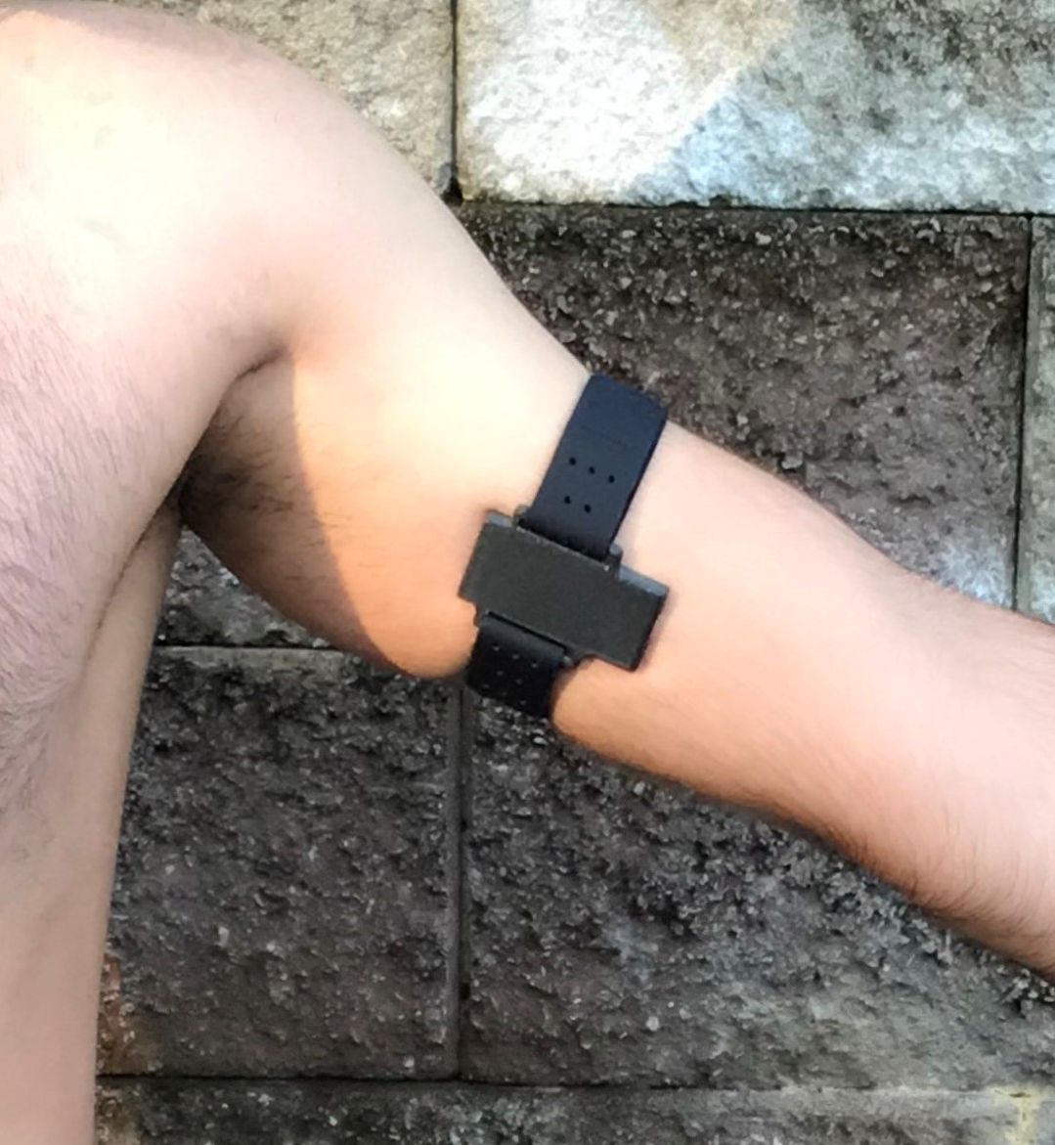
Project Recap
ThermaSENSE devices transmit data via bluetooth. We need to record and visualize this data through an app-to-cloud pipeline.
Notes:
jack

Slide 4
Completed Work

Slide 5
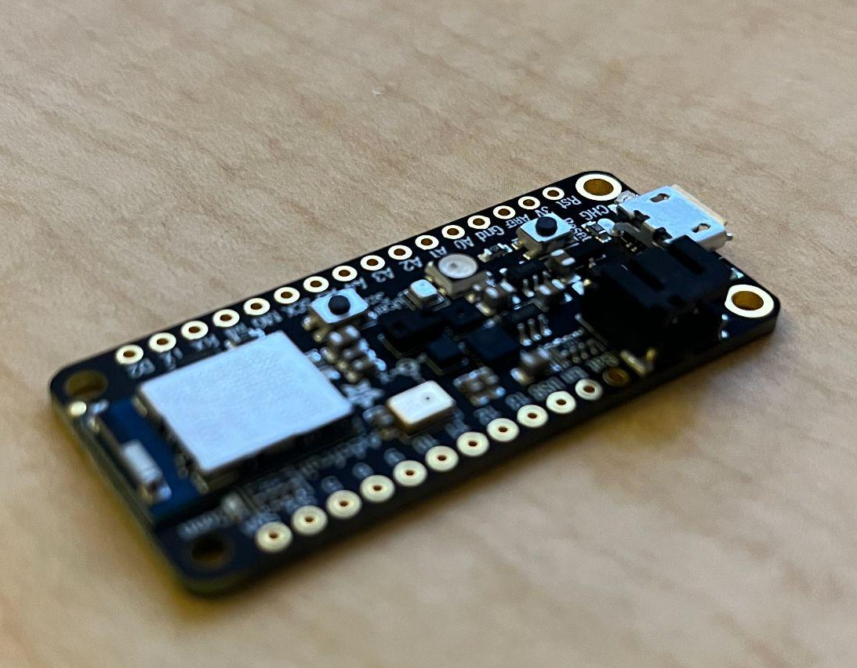
Board Updates
Adafruit nrf52840 Sense
Represents a dummy ThermaSENSE device
Data Identifiers
Buffer
Over the Air Updates
Flexible data formats for the app to process
Offline data stored until reconnected
OTA updates for future firmware changes

Slide 6
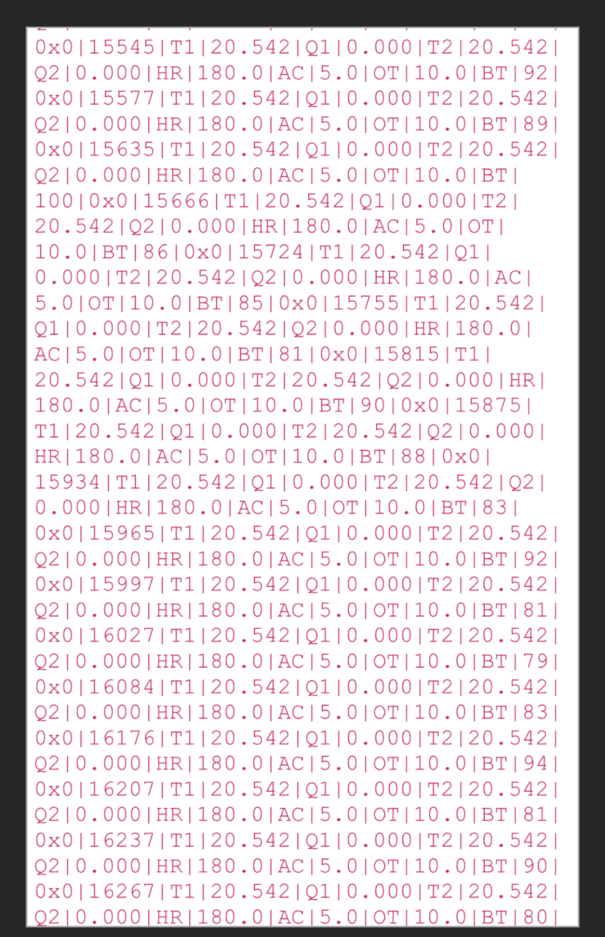
Data Identifiers
|5473|26.659|23.071|28.084|63.751|101|0x0*
|6473|26.660|22.308|28.080|64.819|101|0x0*
|7475|26.662|23.590|28.082|65.613|101|0x0*
|8474|26.663|24.445|28.080|66.589|101|0x0*
|9474|26.665|23.804|28.079|65.704|101|0x0*
|10476|26.666|22.583|28.080|66.711|101|0x0*
|11475|26.668|23.315|28.081|66.833|101|0x0*
|12475|26.670|23.743|28.081|66.803|101|0x0*
|13477|26.672|23.346|28.085|66.376|101|0x0*
|14476|26.675|24.506|28.086|66.589|101|0x0*
|15477|26.677|24.292|28.088|66.772|101|0x0*
|16479|26.679|23.590|28.091|66.589|101|0x0*
|17479|26.682|24.384|28.091|66.559|101|0x0*
|18480|26.685|22.766|28.094|67.139|101|0x0*
|19482|26.687|23.743|28.097|68.604|101|0x0*
|28488|26.715|24.414|28.128|69.458|101|0x0*
Notes:
Jack - On the left is an example we showed in our last presentation of the dummy data we were working with, we relied on the order of that data to parse it in the app. However, if different devices can send different data, or some data is sent in an inconsistent order, we created data identifiers that will be attached with their respective data for future scalability and parsing reliability.

Slide 7
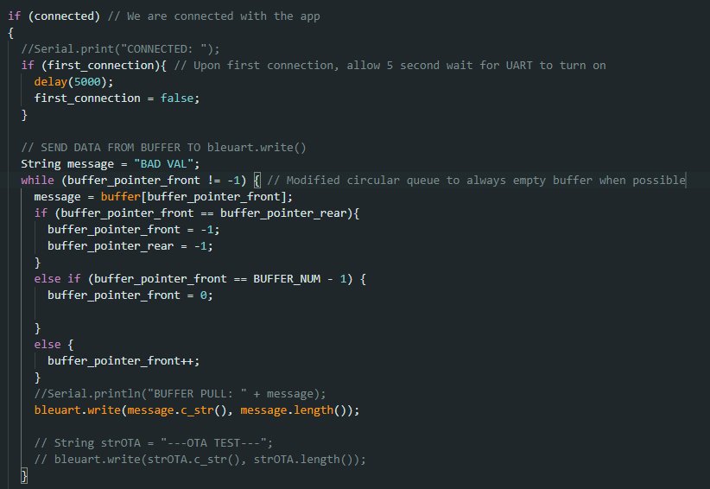
Offline Buffer
If the board cannot connect to
bluetooth, store sensor data in
buffer until connected.
Uses a circular queue to store sensor data, and empty the buffer once the board is connected to the app.
This code is run on constantly on the device, and unloading the buffer using bleuart.write()
Notes:
Jack - Right now, all of the data captured in the device is only sent to the app when it is connected via bluetooth. If we are offline, we want to fill up a local buffer that can go to the app once we connect. This will be done to avoid losing data captured when we are not connected to the app.

Slide 8
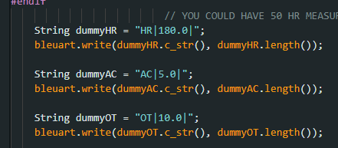
Over the Air Updates
Firmware - Arduino sketches (programs) that can change in the future
Clients may need to update their devices’ firmware in order to be compatible with the app and cloud storage. This update should be done through the app with Bluetooth, called OTA updates.
Examples of placeholder data
Notes:
Jack - in the future, ThermaSENSE may want to push new firmware to their devices. Currently, we have example features such as heart rate, acceleration, and ‘other’ as sections that could turn into relevant data. In order for the code to be updated we are implementing OTA updates that modification of the arduino code.

Slide 9
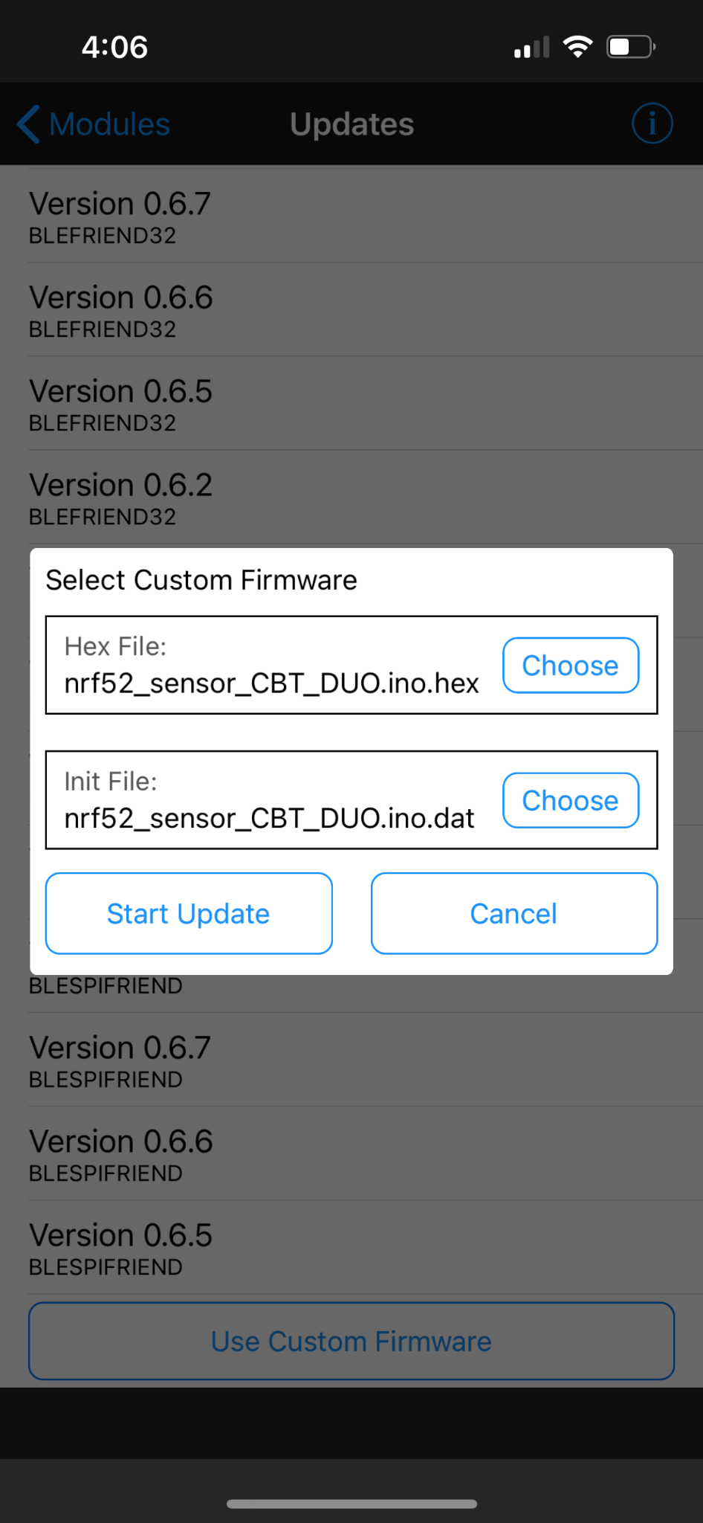
Over the Air Updates
How to send updates to Adafruit nrf52840 board? -
Not supported by Adafruit
Arduino creates a .hex file and .dat file that can be sent as a custom firmware update through the Bluefruit Connect App (app created by Adafruit).
Notes:
Jack - in the future, ThermaSENSE may want to push new firmware to their devices. Currently, we have example features such as heart rate, acceleration, and ‘other’ as sections that could turn into relevant data. In order for the code to be updated we are implementing OTA updates that modification of the arduino code.

Slide 10
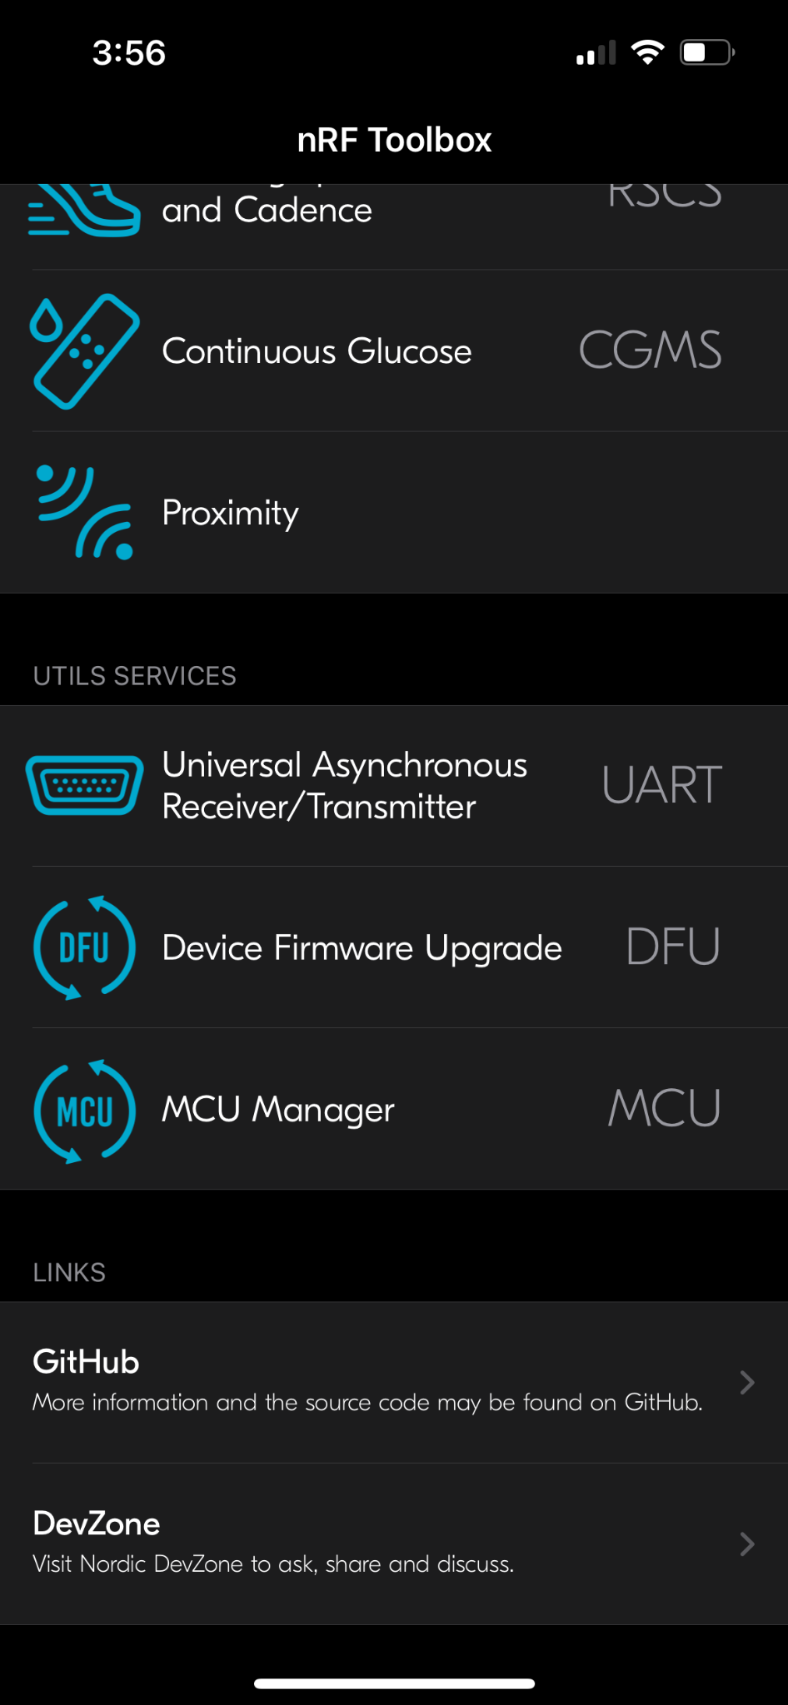
Over the Air Updates
How to send updates to Adafruit nrf52840 board? -
Not supported by Adafruit
Using a third-party nRF Toolbox to send the .zip file of the Arduino sketch directly to the board.
Notes:
Jack - in the future, ThermaSENSE may want to push new firmware to their devices. Currently, we have example features such as heart rate, acceleration, and ‘other’ as sections that could turn into relevant data. In order for the code to be updated we are implementing OTA updates that modification of the arduino code.

Slide 11
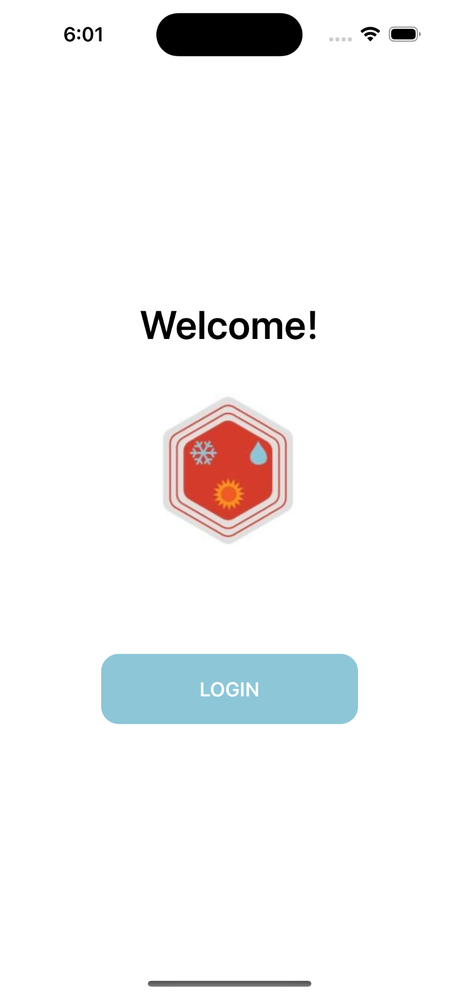
App Updates
ThermaSENSE App
Developed with Swift and Xcode
Login / Signup
Dashboard
Uses OAuth to authenticate users and let them sign in
Visualizing the data in app based on the caught data and historical cloud data

Slide 12
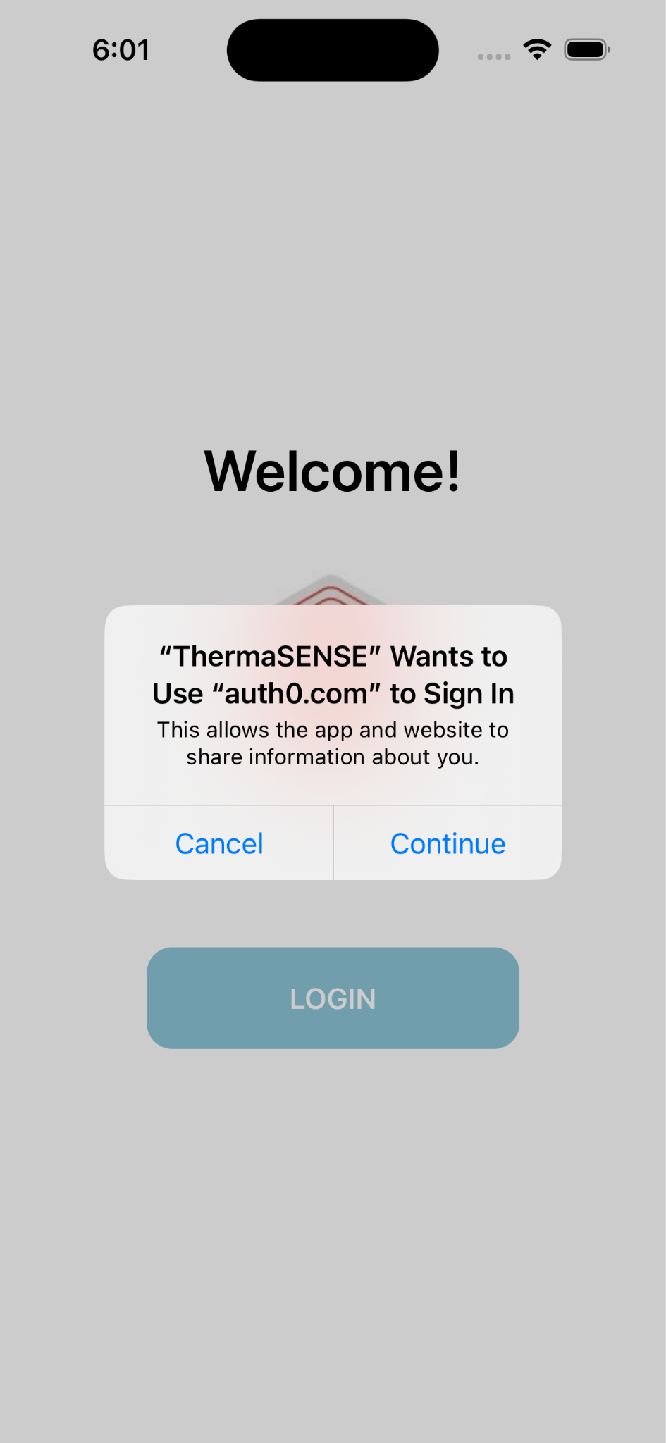
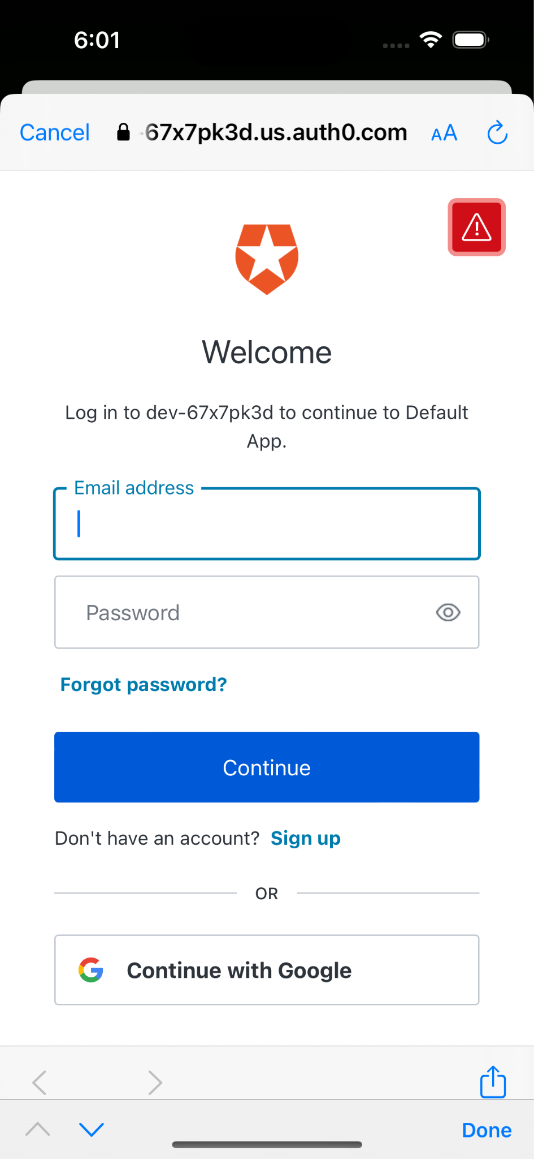
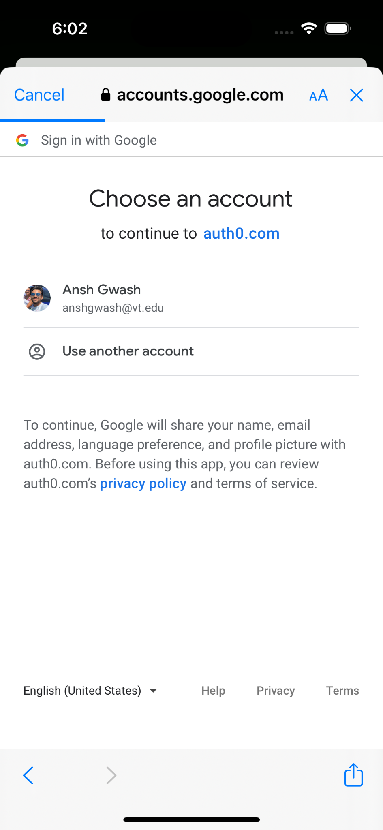
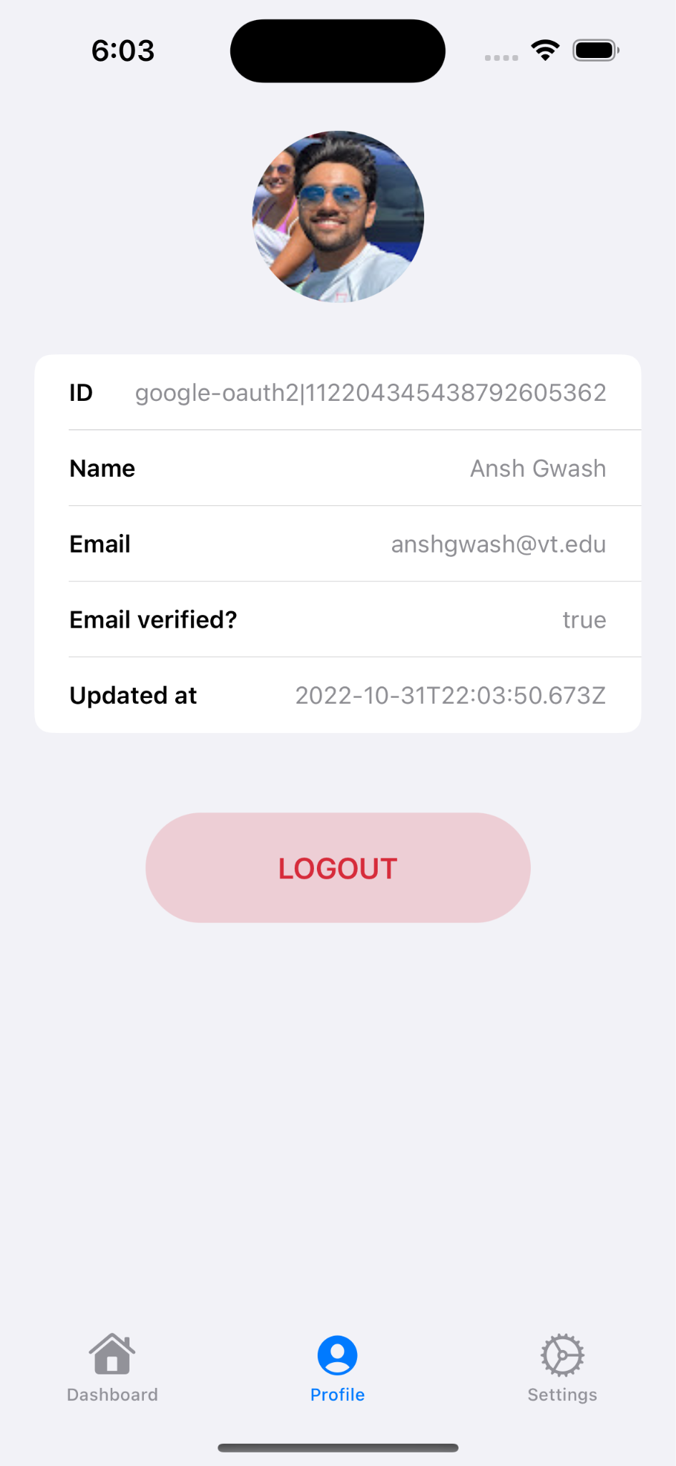
Login / Signup

Slide 13
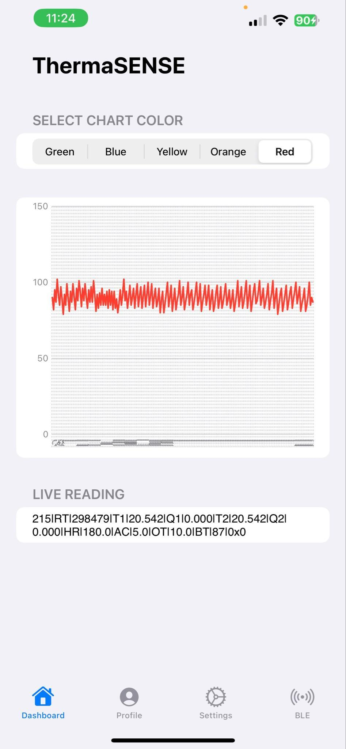
Dashboard
Live visualization of the sensor data
Live reading of the raw sensor data
(This will be stored in the cloud)
Toolbar at the bottom for navigation
Notes:
We will be working with the web team for UI/UX consistency

Slide 14


AWS PROBLEMS

Slide 15
Conclusion

Slide 16
Final Week Tasks
Documentation
Finalize cloud connections
Bring all builds into one app
Walkthrough with client - how to update board code, app, and manage cloud

Slide 17
Future Work
OTA firmware updates from iOS app
Data visualization improvements (i.e. interactions with the graph, customized views)

Slide 18
Timeline/Milestones
11/2 - MVP | 12/7 - Final Deliverables
Account creation / login Transmit refined BT data Offline buffer Data visualization in app App dashboard | Finish documentation App integration Cloud implementation Final UI consistent with Web

Slide 19
Objective Key Results
Data Collection and App to Cloud Pipeline 96% | Data Processing and Visualization 100% | Cloud Integration 100%
Transmits sensor data from device to iOS app to cloud Future work required for OTA support | Refine BT sensor data Data visualization in the app via graphs Pull historical data into app from cloud | Store user data in Firebase Admin account to view all users

Slide 20
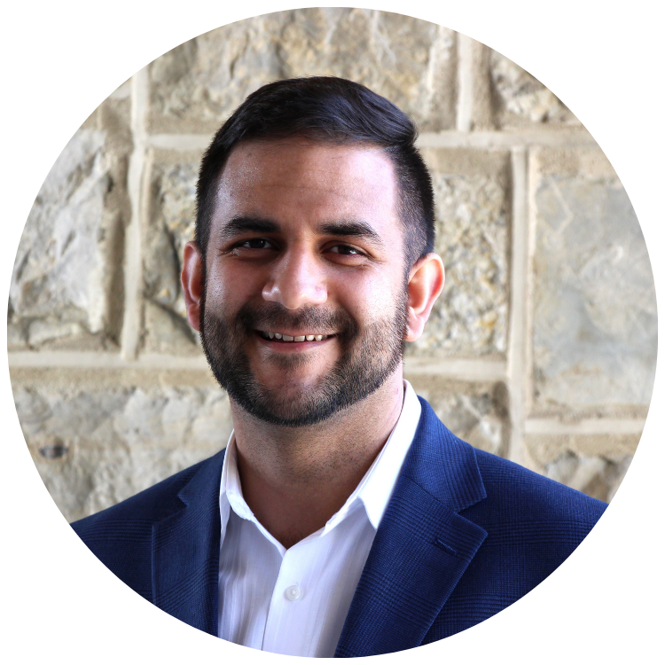
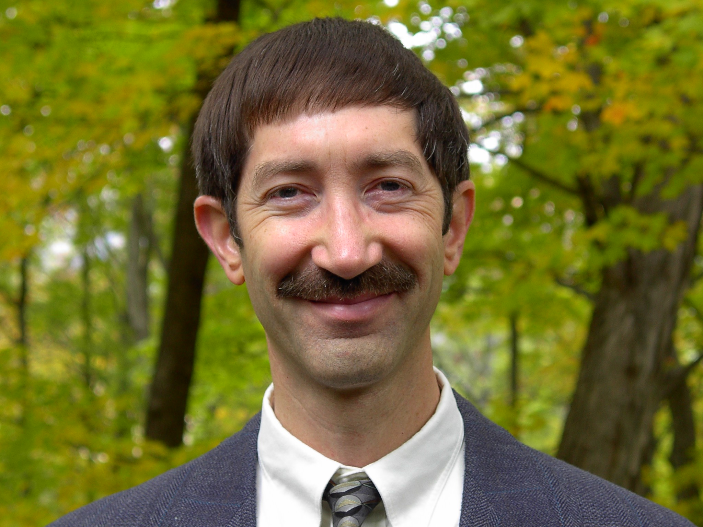
References
Core Bluetooth: https://developer.apple.com/documentation/corebluetooth
OTA Update: https://www.arduino.cc/en/Tutorial/ota-getting-started
AWS SimpleDB: https://aws.amazon.com/simpledb
Swift Charts: https://developer.apple.com/documentation/charts
Ali Roghani ThermaSENSE Founder and Contact Person
Dr. Edward Fox
CS 4624 Advisor

