Slide 1
Overcoming Wind Deployment Challenges
Patrick Gilman
Wind Deployment Manager
Wind and Water Power Technologies Office
US Department of Energy

Slide 2
Bottom line, up front
Wind deployment offers significant environmental benefits
Wind needs to be a good neighbor: future deployment dependent on avoiding or mitigating impacts to wildlife, human communities and other policy priorities
Technology can help solve these challenges
  Bats
  Birds, especially eagles
  Radar

Slide 3
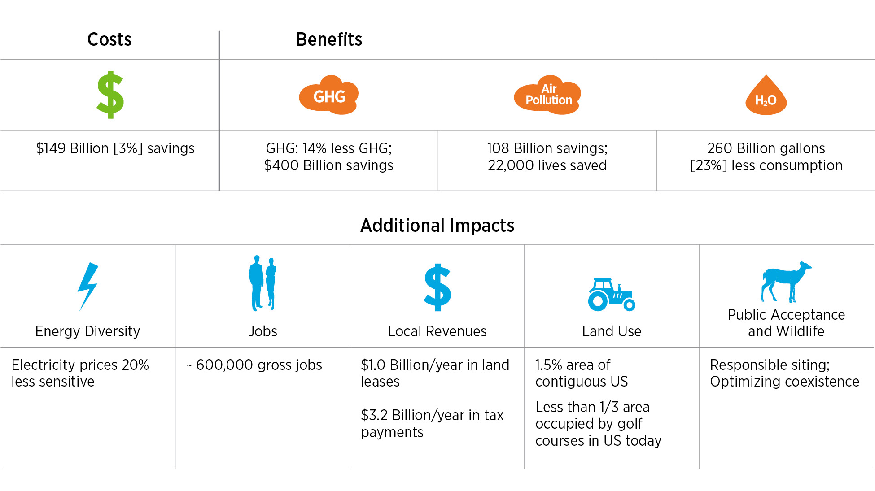
The Wind Vision Report
Benefits by 2050
The Potential Benefits of 35% of the Country’s Electricity Coming from Wind Energy by 2050
$

Slide 4
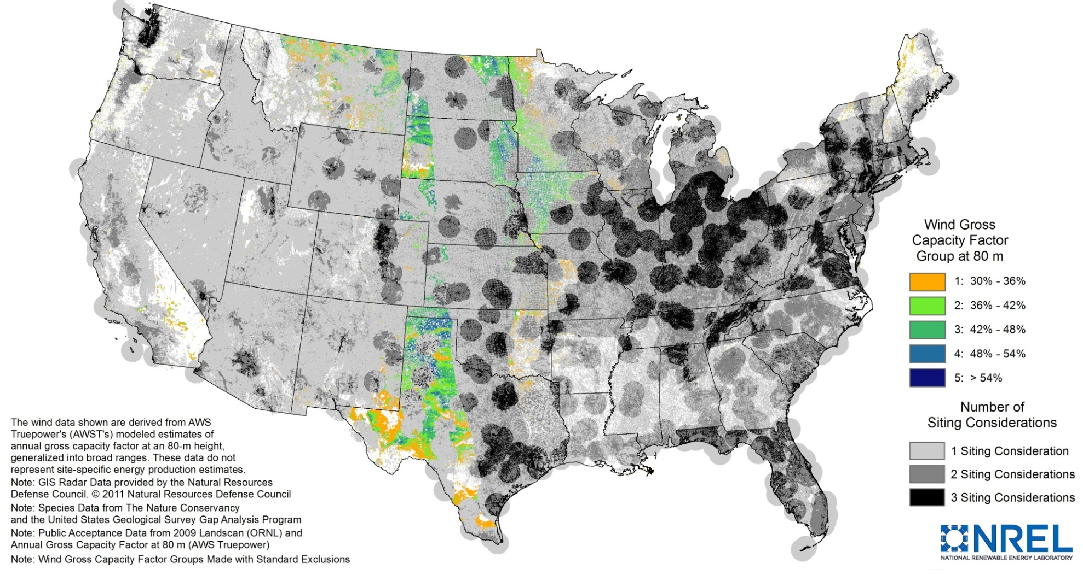
Challenges to Siting and Deployment
Wind has many neighbors: Public acceptance, radar, and wildlife considerations for just a few species influence the vast majority of the resource – Siting just behind policy uncertainty as an issue for industry
NREL Unpublished Analysis for DOE
Notes:
Bottom line is that aggressive deployment targets aren’t likely possible to reach without doing so. In a competitive environment, uncertainty kills projects, and these issues generate huge uncertainty.
Bullet 1: These considerations drive up the cost for project development, can force costly operational restrictions and reduce the availability of good wind resource areas.
Bullet 2: Low conflict sites in many markets – the low-hanging fruit – are largely disappearing. And as regulation tightens (largely due to factors unrelated to wind energy), developing in any given site is getting more difficult. Finally, as the complexity associated with wind deployment increases, acceptance tends to decrease
As wind energy deployment has grown, “easy” sites with access to transmission and low potential conflict with wildlife and local communities have largely been developed
As our understanding of wind impacts to wildlife increases, so do the regulatory requirements for siting in sensitive habitat. However, research to understand, accurately characterize, and mitigate these risk is lagging behind regulatory requirements, creating significant regulatory uncertainty across the wind industry

Slide 5
Key Regulatory Drivers
Law or Reg.
What does it cover?
Key Issues for Wind
Migratory Bird Treaty Act
Prohibits “take” of 1200+ bird species
No permits; Siting Guidelines
Bald and Golden Eagle Protection Act
1940: Prohibits “take” of Bald and Golden Eagles
Permits for Bald and Golden Eagles
Endangered Species Act (ESA)
Prohibits the "take" of listed species through direct harm or habitat destruction
Endangered Bats, Whooping Crane, Lesser Prairie Chicken
15 CFR 77
Regulates safe use of the national airspace and evaluates obstructions to it
Long range surveillance and air terminal radars; military missions
Notes:
Numerous species- and habitat-specific concerns
Collaboratives are proving successful formula for engaging stakeholders
Solutions often data-driven
Need for science-based results

Slide 6
Wildlife challenges:
Impacts to eagles, bats, prairie grouse
- Populations stable or increasing
- Wind-related mortality low at most sites
- New permitting regime requires applicants to establish
- Research legally and statistically difficult to conduct
- White Nose Syndrome (WNS) decimating cave bat populations: 90%+ mortality
- Wind impacts mostly non-T&E tree-roosting migratory bats but significant fraction of known mortality
- Risk to development driven by current, future listing under ESA
- Mortality strongly correlated with low wind speed, high temperature
- Greater Sage-Grouse, Lesser Prarie Chicken, Greater Prairie Chicken
- Concern about habitat impacts, NOT direct mortality
- Habitat impacts hardest to measure, but plenty of tools to address
(Predicted take) – (Take reduced onsite) = (Take to be compensated for)

Slide 7
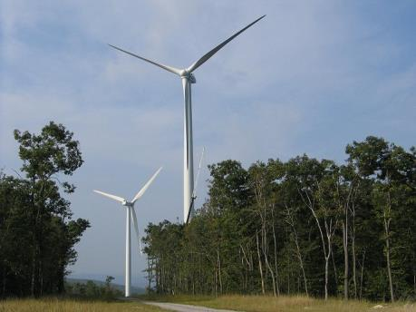
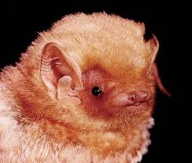
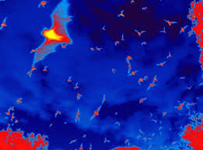
Bats: Operational Curtailment
State of the Science
Most studies have found more than 50% reduction in mortality when cut-in speeds raised 1.5 m/s above manufacturer settings
Low-speed idling also reduces mortality
Revenue loss can be unacceptable
Research Needs
Refine curtailment treatments using additional weather/environmental and bat activity covariates to reduce curtailment time and maintain effectiveness
Detailed evaluation of low-speed idling

Slide 8
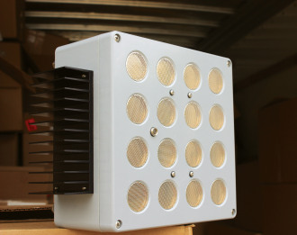
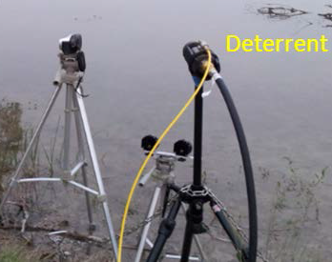
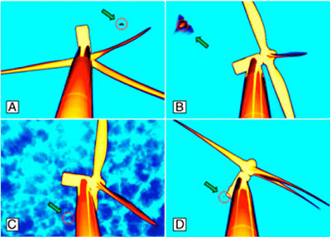
Bats: Deterrent Technologies
State of the Science
2 Ultrasonic Acoustic Deterrents developed and field tested since 2006, but require additional refinement
Devices have effectively deterred bats in lab settings, but full-scale testing results to date have been mixed
Research Needs
Understanding bat behavior around turbines
Understanding bat behavior and physiology to inform new deterrent innovation
Further field testing of existing technologies in various locations and environments to determine and validate efficacy
DOE recently announced 5 awards for $2M to advance bat deterrents

Slide 9
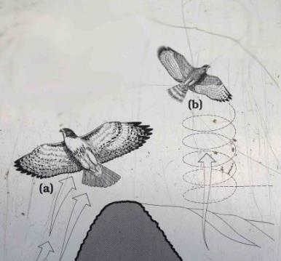
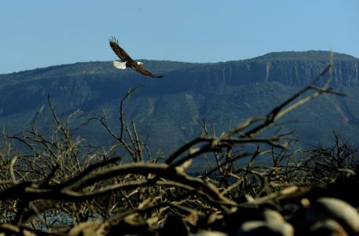
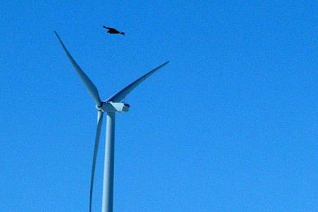
Eagles: Risk Assessment
State of the Science
Research on eagle foraging, and migration has helped understand how eagles use the landscape
Currently developed sites have ID’d high-risk turbines to inform selective turbine shut-down during high-risk migration periods
Few publically available data exist to refine current risk models
Research Needs
Improved characterization of risks to eagles at a given wind site
Understanding/predicting habitat use to inform wind siting
Improved technologies for telemetry

Slide 10
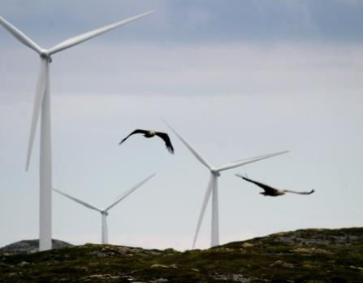
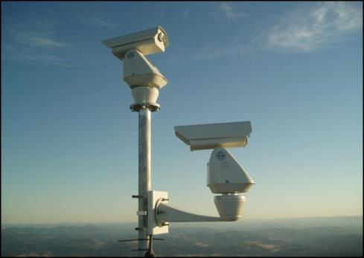
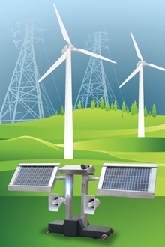
Eagles: Detection and Deterrence
State of the Science
Biologists in lawn chairs with binoculars
Numerous camera/acoustic systems are being deployed at tested around the US – to date, data from results is limited
Research Needs
Rigorous field testing of existing technology to assess efficacy
Studies on eagle physiology to help inform innovative deterrent technologies
Computer vision technology to automate detection and deterrence, or operational curtailment

Slide 11
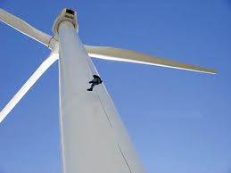
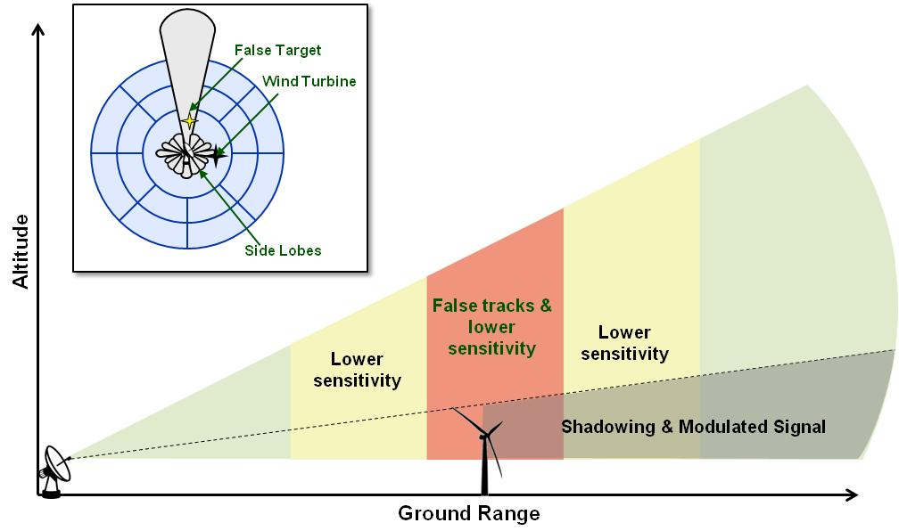
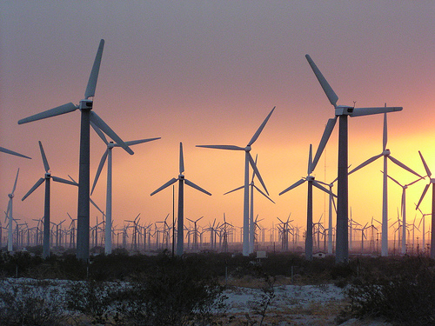
Impacts on Radar
Turbines are growing in size and number
Decreased Sensitivity (P_{D})
False Targets (P_{FA})
Corrupted Track Quality
Concern for:
Flight Safety
Homeland Air Security
Approved for Public Release
MSJA#: MS-64100A
SAND #2012-9809

Slide 12
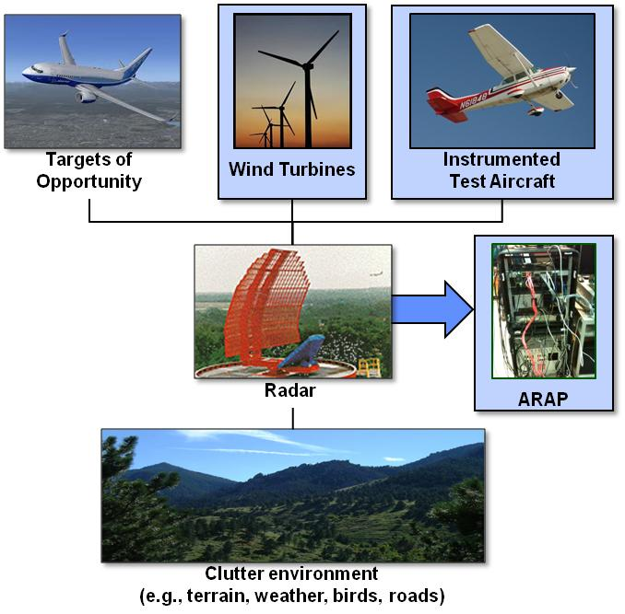
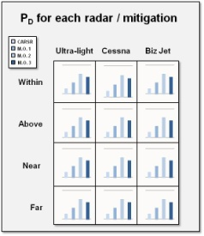




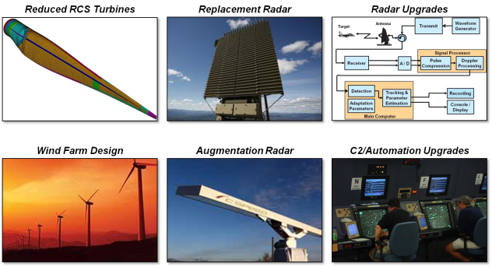
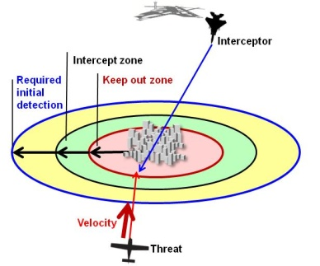
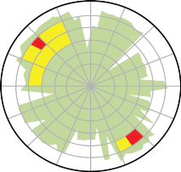
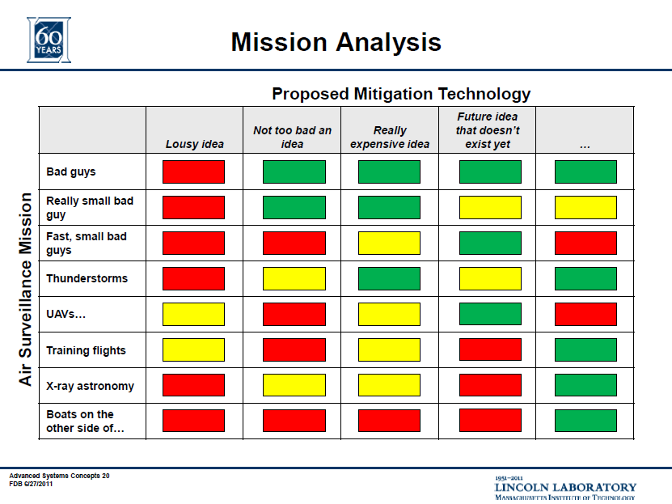
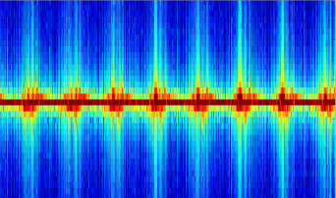
Interagency Field Test & Evaluation
Evaluate wind turbine impact and industry mitigations
Steering Committee
DOE, DoD, DHS, FAA
Flight Tests & Analysis
System Analysis
Industry Mitigations
2-year, jointly funded program
3 flight campaigns
  CARSR (Tyler, MN)
  ASR-11 (Abilene, TX)
  ARSR-4 (King Mountain, TX)
Invite selected mitigations
  Selected 11 concepts to assess
System analysis of mission impact
Interagency Field Test & Evaluation Products
City
Characterize Current Impact
Assess Proposed Mitigations
Data for Future R&D
Approved for Public Release
MSJA#: MS-64100A
SAND #2012-9809

Slide 13
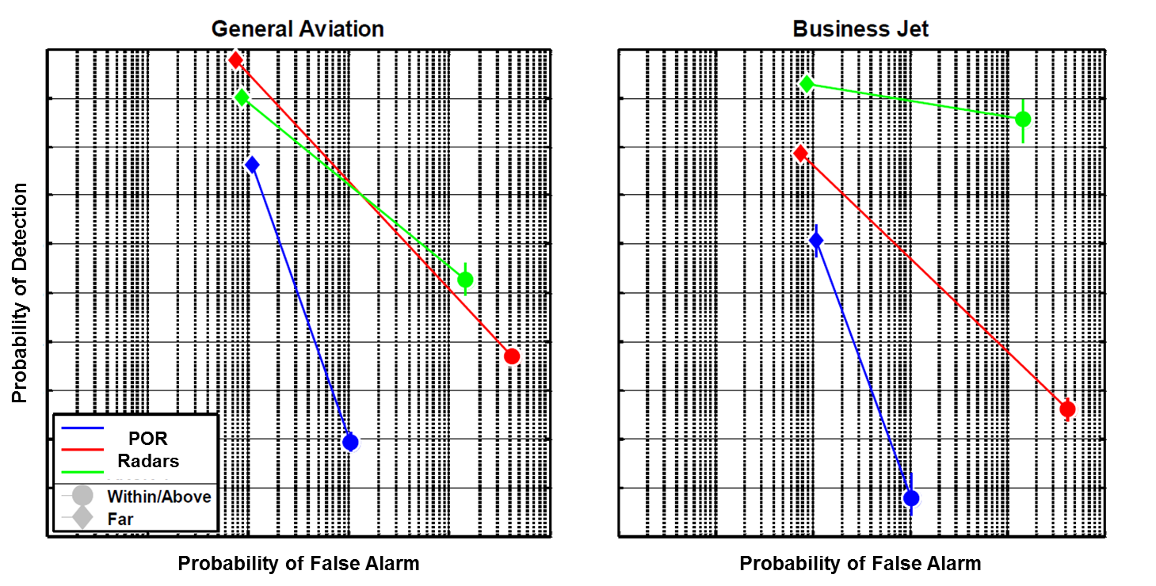
Performance of Existing Radars
Existing primary surveillance radar performance significantly
impacted in regions near and above operating wind turbines
SOURCE: IFT&E Industry Report: Wind Turbine – Radar Interference Test Summary, SAND2014-19003, Sep 2014
http://energy.gov/eere/wind/downloads/interagency-field-test-evaluation-wind-turbine-radar-interference-mitigation

Slide 14
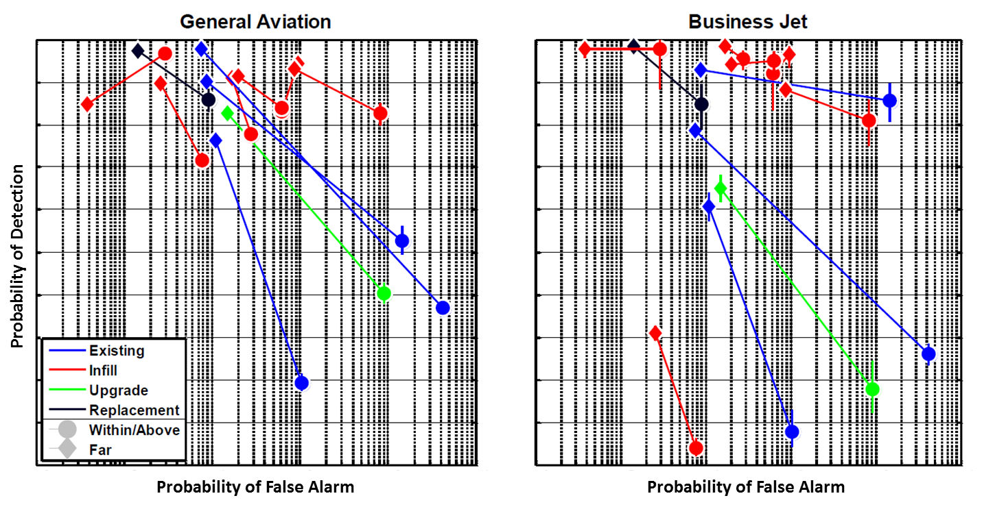
Performance of Existing Radars and Tested Mitigations
All systems tested were impacted by wind turbines; however, many of the mitigation systems were significantly less impacted than existing radars
SOURCE: IFT&E Industry Report: Wind Turbine – Radar Interference Test Summary, SAND2014-19003, Sep 2014
http://energy.gov/eere/wind/downloads/interagency-field-test-evaluation-wind-turbine-radar-interference-mitigation

Slide 15
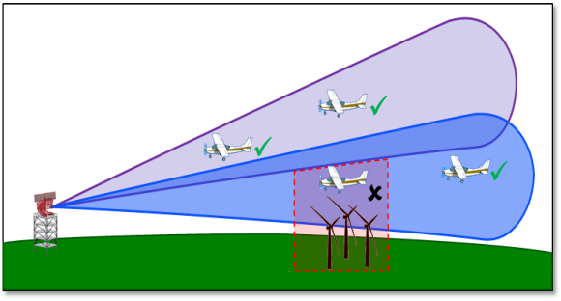
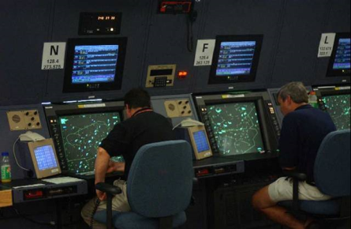
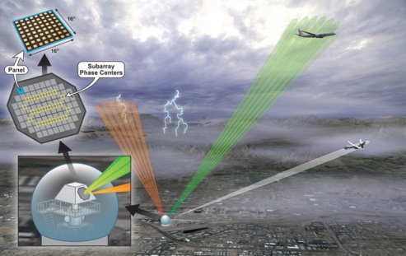
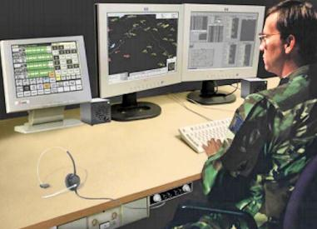
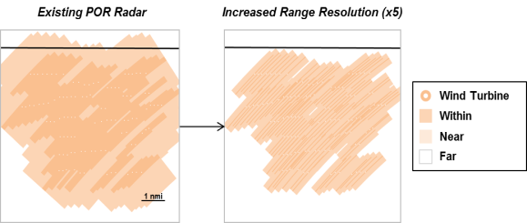
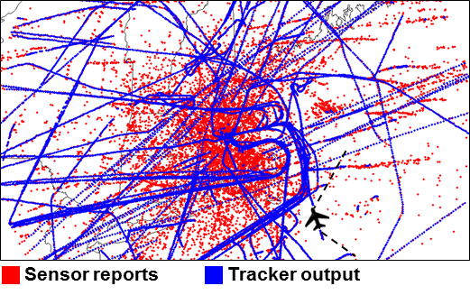
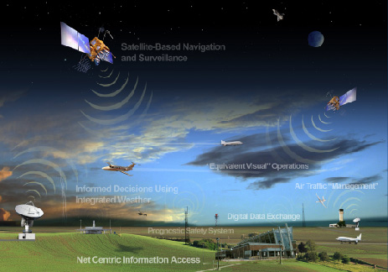
Interference Mitigation R&D Needs
Existing Radar
Algorithm Upgrades
C2/Automation Systems
Future Systems
Multi-beam turbine nulling
Increased range resolution
Radar network tuning
Advanced sensor fusion
Mitigation requirements
for next-gen surveillance

