Slide 1
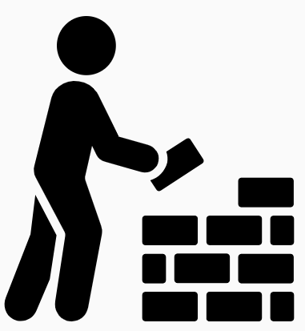
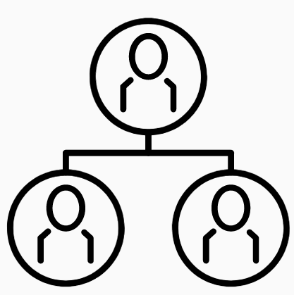
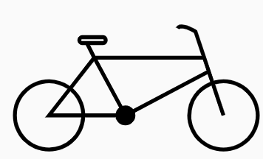
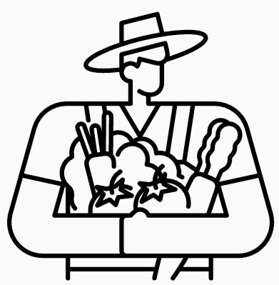




Part I of II
In Service of Others:
Honoring Others’ Copyrights -- and Making Your Work Useful (to others)
© Anita Walz. Licensed under CC BY 4.0
http://hdl.handle.net/10919/112264
© BBicycle by Fahmihorizo - CC BY 3.0 https://thenounproject.com/search/?q=bicycle&i=1272852
© Photography by monkik CC BY 3.0 https://thenounproject.com/search/?q=photography&i=2588421
© Bucket by Ema Dimitrova, BG - CC BY 3.0 https://thenounproject.com/term/bucket/71705
© Family by Andrei Yushchenko CC BY 3.0 https://thenounproject.com/search/?q=family+tree&i=2558850
© Harvest by Chattapat CC BY 3.0 https://thenounproject.com/search/?q=harvest&i=3973361
© Build by Adrien Coquet CC BY 3.0 (flipped) https://thenounproject.com/search/?q=build&i=2085889
@ Graduates by ProSymbols CC BY 3.0 https://thenounproject.com/icon/graduates-1971073
Notes:
Today’s topic is “In Service of Others: Honoring Others’ Copyrights -- and Making Your Work Useful (to others)”
In this presentation we will explore copyright through a series of analogies. Our goal is to help you understand what copyright is (and isn’t), how you already interact with copyright every day, and how to extend the usefulness of what you make so that others can actually use it, while honoring others’ copyrights.

Slide 2
By the end of this presentation you should be able to:
Articulate copyright-related barriers in teaching, learning, and sharing
Describe what can be under copyright, how it gets there, who is a copyright holder, and how long copyright lasts.
Articulate the default position of copyright regarding “ownership” and implications for using works you “find online” and the ownership status of student works.

Slide 3
How copyright Is like a bicycle
Ownership
Context
Permission
© BBicycle by Fahmihorizo - CC BY 3.0 https://thenounproject.com/search/?q=bicycle&i=1272852
Notes:
Suppose you own a bicycle [or other very useful, mainstream item which is common for your audience to own - e.g. snow shovel, public transit pass, physics textbook, gaming console, etc.].
[interactive exercise] Please raise your hand if you own a bicycle. [Hawa raises hand.] If Javier wants to borrow Hawa’s bicycle, can he? [discussion] No, he needs to ask. And if Hawa does not respond, can he borrow it? If Hawa says he can borrow it on Tuesday from 11-12, does that mean he can also use it on Wednesday from 9-10, or for the rest of the year? If he has permission to use it for class can he also use it in a competitive bike race? Can he paint it a different color? Since Hawa gave permission to Javier, does that mean Max can also use Hawa’s bicycle? No, of course not.
Copyright is a lot like this bicycle example. In the same way that someone owns an unlocked, unaccompanied bicycle, someone likewise owns the digital artifact you found freely on the web, the picture published in a book you own, the architectural model your classmate built, or the cool diagram you saw on a conference poster. In the same way as borrowing a bicycle, you must obtain some sort of permission to use in-copyright works when those rights don’t belong to you. This includes student academic work -- because students own their own work!

Slide 4
Two Dilemmas … when creating with sharing in mind
May I use portions of others’ original works in my open educational resource? How do I do this legally, ethically, and technically?
I want others to use my work in flexible ways. Of what do I need to be mindful when planning to create and share my work?
© Build by Adrien Coquet CC BY 3.0 (flipped) https://thenounproject.com/search/?q=build&i=2085889
Notes:
Well, this poses a problem doesn’t it because we WANT to draw on a lot of sources when we create. Our work is often better when we draw on others’ expertise and what they have made.
There are two questions here: 1) How to use others’ work legally and ethically, and 2) Making your work useful for others who may need to customize or adapt it to fit their use.

Slide 5
Implicit expectations of parity
How we want
others to share. How we share.

Slide 6
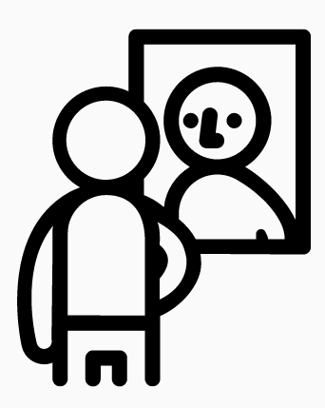
Principle 1: Unless otherwise marked, always assume that every artifact’s copyrights are owned by someone.
You are a copyright holder.
Your students are copyright holders.
People and organizations that created
things you read, watch, and listen to in
any medium -- including things that are freely available on the internet -- are copyright holders.
© Man in the mirror by HeadsOfBirds CC BY 3.0 https://thenounproject.com/search/?q=mirror+reflection&i=1221065
*Item in the Public Domain are an exception. We’ll talk about these a bit later.
Notes:
We are going to explore a number of “practical copyright principles” that you can implement in your work:
Principle 1: Always assume that every artifact is owned by someone. Like a bicycle, unless clearly marked, or you have a highly informed reason to know otherwise you should always assume that every created thing you see or hear which is somehow “recorded” or “hosted” (legal people use the phrase “recorded in a fixed medium”) is owned by someone. This also includes content you don’t have to pay for that you see on the internet.

Slide 7
Application:
Who owns images you find on Google?
What about content found in physical or electronic books, DVDs and/or streaming media owned by or to which you (or your library) subscribe?
True or false: An employer may own work-related, creative output of its employees.

Slide 8
Answers:
Who owns images you find on Google?
Likely other people.
Who owns content found in physical or electronic books, DVDs and/or streaming media owned by or to which you (or your library) subscribe?
The copyright holders of the materials. Likely other people.
True or false: An employer may own work-related, creative output of its employees.
True

Slide 9
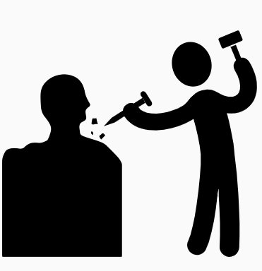

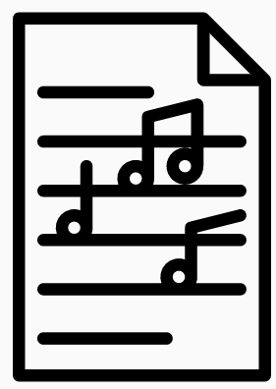

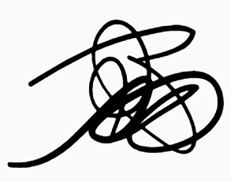
Principle 2: Copyright is automatic. Copyrights are established the moment a creative work is fixed in a medium.
Automatically in copyright when made Not in copyright
Ideas, facts, data, common knowledge
Narrative, image, song… when there is no record
Works clearly donated to the Public Domain
Published in the US pre-1926*
Created by U.S. Government employees acting in an official capacity
Creative works in a fixed medium
(even when a © mark is not added!)
*The entry date of works into the Public Domain in the U.S. advances each year. As of Jan 1st 2023, it will be works published pre-1927. On Jan 1, 2024 it will be pre-1928, and so on. For more info, see: https://copyright.cornell.edu/publicdomain
© Sculptor by Krisada CC BY 3.0 https://thenounproject.com/search/?q=sculptor&i=1059044
© Document by IconMark CC BY 3.0 https://thenounproject.com/search/?q=document&i=3536167
© Photography by monkik CC BY 3.0 https://thenounproject.com/search/?q=photography&i=2588421
© Save by PrimeIcons CC BY 3.0 https://thenounproject.com/search/?q=save&i=1929682
© Scribble by Alice Noir CC BY 3.0 https://thenounproject.com/search/?q=scribble&i=713357
© Music sheet by iconixar CC BY 3.0 https://thenounproject.com/search/?q=sheet+music&i=3478850
Notes:
Principle 2: Copyright is automatic. Copyrights are established the moment a creative work is fixed in a medium -- even if you never add a copyright symbol © to the work. A copyright is established by its creator the moment when they press “save.” as soon as one’s pen hits the paper to create a doodle, the moment when your smartphone camera takes a video or a picture, and so on. . .
This means that unless your employer, sponsor, or work agreement or policy says otherwise, you have complete ownership over your original work! If you are a university student, you own your work (unless you’re an employee.) You are a copyright owner!

Slide 10
Application: Which of the following are in-copyright?
(and why?)
Recorded music from 2007 Photos I took with my phone
Pictures found using Google Famous person’s birthday
Your phone’s ring tone TikTok video
Photos taken by your child Unpublished journal article
Published journal article Song you wrote but didn’t write down or record
E = mc² 3.141592653589793238462643383279502884197169399375105…
Notes:
Based on what you’ve learned so far . .. which of the following are in-copyright, and which are not? What questions do you have about these?
[do the activity interactively in class]
Great! Let’s move on.

Slide 11
Application: Which of the following are in-copyright?
(and why?)
Recorded music from 2007 Photos I took with my phone
Pictures found using Google Famous person’s birthday
Your phone’s ring tone TikTok video
Photos taken by your child Unpublished journal article
Published journal article Song you wrote but didn’t write down or record
E = mc² 3.141592653589793238462643383279502884197169399375105…
Clue: Highlighted items are copyrightable
Notes:
Based on what you’ve learned so far . .. which of the following are in-copyright, and which are not? What questions do you have about these?
[do the activity interactively in class]
Great! Let’s move on.

Slide 12

Principle 3: All published works are destined for the Public Domain (i.e. freedom from Copyright) … but it takes a long while for them to get there.
© Graduates by ProSymboles CC BY 3.0 https://thenounproject.com/icon/graduates-1971073
Notes:
Principle 3: All published works are destined for ‘freedom from Copyright’ and will join the Public Domain … but it takes a long while for them to get there. When copyrighted materials reach a certain age, they “graduate” from Copyright and join the Public Domain and are free from copyright restrictions. (Note that “I found this free online” is not the same as being in the Public Domain.) Original works may also be donated or clearly marked by their maker as donated to the Public Domain (CC0). However, works made by U.S. Federal Employees during their official duties are automatically in the Public Domain in the United States.
How long does it take for something to enter the Public Domain -- of course it “depends” but for works created and published by an individual it can take a lifetime -- PLUS 70 years!

Slide 13
Three categories of copyright ownership
My original work
(If you did not sell or give away exclusive rights)
Someone else’s work
Works in the Public Domain: Marked as Public Domain or created by a U.S. Gov Employee, or published in the U.S. pre 192X*
© Bucket by Ema Dimitrova, BG - CC BY 3.0 https://thenounproject.com/term/bucket/71705
* Note that this is a rolling wall. Note also depending on the type of material, how they were published etc, that newer materials may also be in the Public Domain. See details at: https://guides.library.cornell.edu/copyright/publicdomain.
Notes:
So, in summary, works fall into three different categories -- works YOU made, whose rights you did not sell or give away, works someone else made, and works in the Public Domain.

Slide 14
Application
What is the Public Domain? How does a work get into the Public Domain?
Advanced:
As of January 1, 2022, works published in the U.S. prior to 1927 are in the Public Domain. However, this is a rolling date that changes every year. If it is no longer 2022, use Cornell University’s “Copyright Term and the Public Domain Guide” at https://guides.library.cornell.edu/copyright/publicdomain to determine what works registered or first published in the U.S. are in the Public Domain.

Slide 15

Principle 4: Copyrights can be thought of as a creator’s monopoly -- in duration and use -- over a bundle of different rights
A bundle of different rights authors automatically get from creating original works in a fixed medium. Relevant here are exclusive rights to:
Copy
Create “derivatives” or copies with changes
Publicly display and distribute
Unlike vegetables, copyrights last your whole life + 70 years
© Harvest by Chattapat CC BY 3.0 https://thenounproject.com/search/?q=harvest&i=3973361
© Family by Andrei Yushchenko CC BY 3.0 https://thenounproject.com/search/?q=family+tree&i=2558850
© Cemetary by Victoruler CC BY 3.0 https://thenounproject.com/search/?q=graveyard&i=3339647
© Trade by Wichi Wi CC BY 3.0 https://thenounproject.com/search/?q=trade&i=3683592
Notes:
Principle 4: Copyrights can be thought of as a creator’s monopoly over a bundle of different rights -- There are several different protected rights -- a bundle -- relevant rights in the bundle for our purposes are rights to copy, create other versions, publicly display, and distribute the work. Unless a work is clearly a “work for hire,” or you’re a U.S. Federal Employee creating things in the course of your official work, you have a monopoly on these rights. Again, these last the author’s lifetime, plus 70 years before graduating to the Public Domain.

Slide 16
Application
Describe the monopoly an author/creator obtains when making something.
How does the author/creator obtain this monopoly?
What do these monopoly rights include?
How long do these rights last (and what happens to these rights when an author dies?)

Slide 17
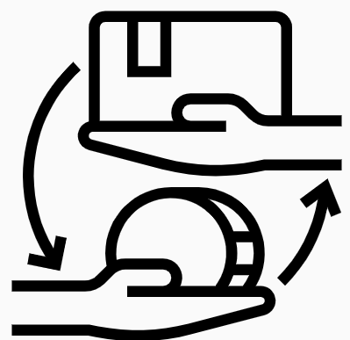
Principle 5: A creator/author may commoditize, license, donate, etc. parts or the whole of the bundle of rights
A commodity: The author may retain, sell, donate, and/or license irrevocably -- or for limited times, places, and mediums, or uses involving parts of or the whole bundle, to one party (exclusive) or with potential for various agreements with different parties (non-exclusive). (An author is not required to do any of these things. They may instead choose to do nothing.)
© Harvest by Chattapat CC BY 3.0 https://thenounproject.com/search/?q=harvest&i=3973361
© Trade by Wichi Wi CC BY 3.0 https://thenounproject.com/search/?q=trade&i=3683592
Notes:
Principle 5: Copyrights are a “bundle” of rights that can be retained, sold, donated, and/or licensed . . . as parts or as a whole whole, to one party (exclusive) or to many, for limited times or for all time, limited geographies or to all geographies . . . .
Copyright law establishes such works automatically as a commodity, and just with a bicycle, the owner does not have to share . . . It is pretty clear that as a bicycle owner you have rights to lend it out, sell it, keep it, paint it, take it on a world tour, and ride it wherever it is legal to do so.
What are some things one might want to do with a copyrighted work one owns? What are somethings others might ask to do with that work?

Slide 18
Application
Which of the following can a copyright owner do with their original writings or other creative works in a fixed medium? Which of these are mutually exclusive (i.e. for which could a copyright owner not do both?)
Sell film rights separately from book publication rights
License an exclusive right to distribute copies
Release under a Creative Commons license
Give away rights to make other versions or sequels
Donate works to the Public Domain

Slide 19
Continue to
Part II of “In Service to Others” (PPT)
Part II of “In Service to Others” (slides)
© Anita Walz. Licensed under CC BY 4.0
http://hdl.handle.net/10919/112264

