Slide 1
SoLid: Recent Results and Future Prospects
Jonathan Link
Center for Neutrino Physics, Virginia Tech
Aspen Winter Conference on Particle Physics
January 16, 2016

Slide 2
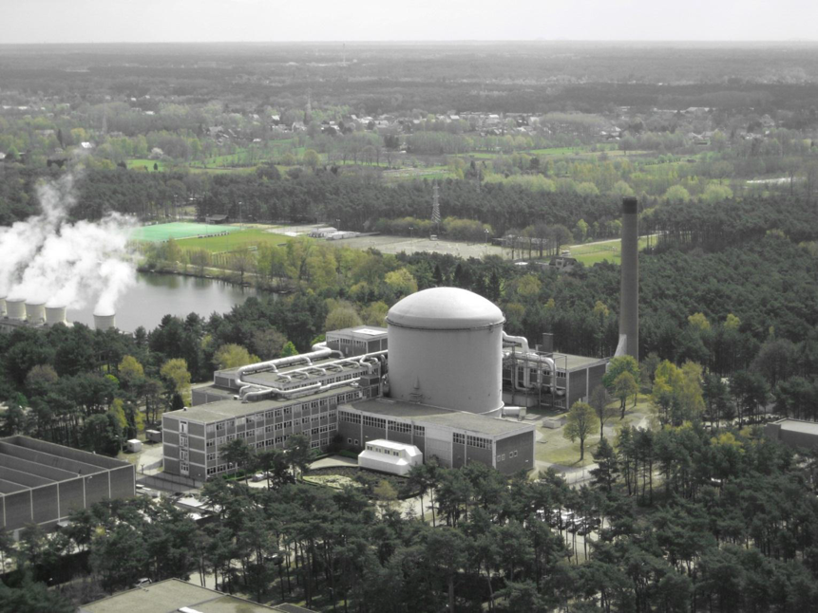
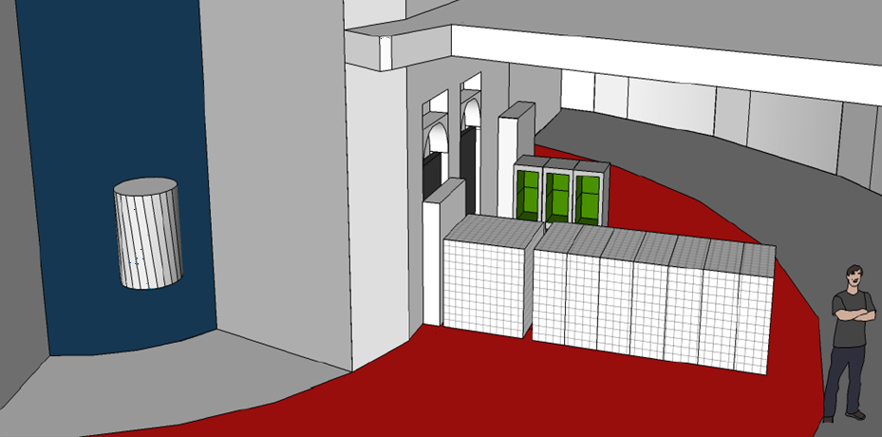
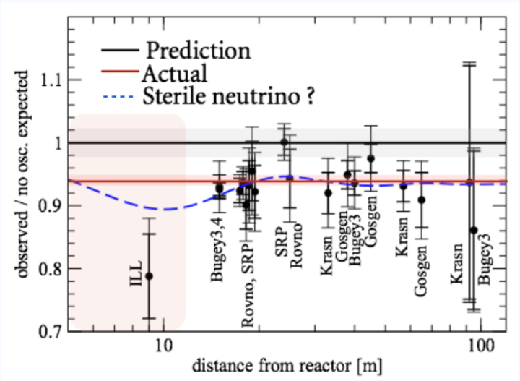
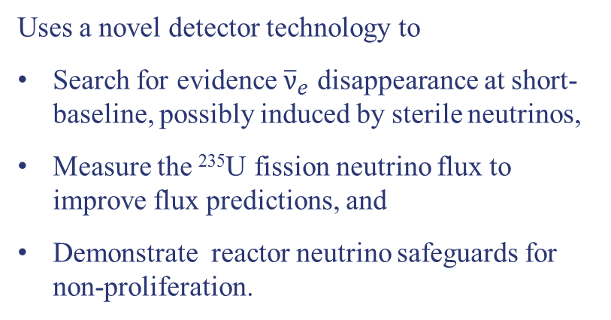
The SoLid Experiment
BR2 Hall
Reactor Core
5.5 meters
SoLid Detector Modules
(3 tons)
Uses a novel detector technology to
Search for evidence ${\overline{ν}}_{e}$ disappearance at short-baseline, possibly induced by sterile neutrinos,
Measure the ²³⁵U fission neutrino flux to improve flux predictions, and
Demonstrate reactor neutrino safeguards for non-proliferation.
Adapted from PRD83, 073006

Slide 3
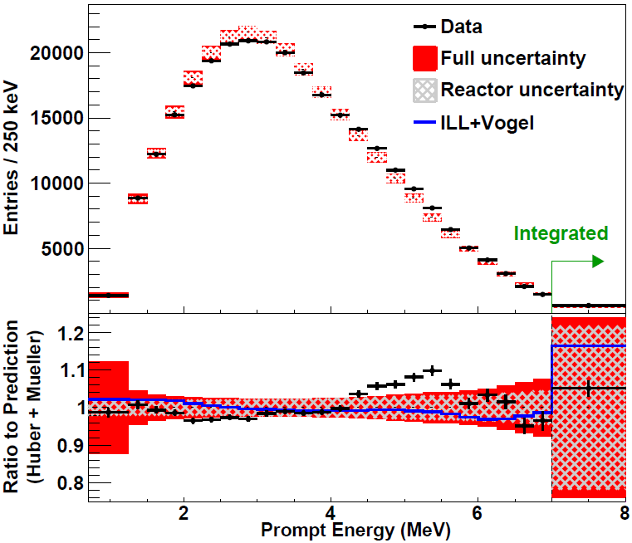
The SoLid Experiment
BR2 Hall
Reactor Core
5.5 meters
SoLid Detector Modules
(3 tons)
Uses a novel detector technology to
Search for evidence ${\overline{ν}}_{e}$ disappearance at short-baseline, possibly induced by sterile neutrinos,
Measure the ²³⁵U fission neutrino flux to improve flux predictions, and
Demonstrate reactor neutrino safeguards for non-proliferation.
From arXiv:1508.04233

Slide 4

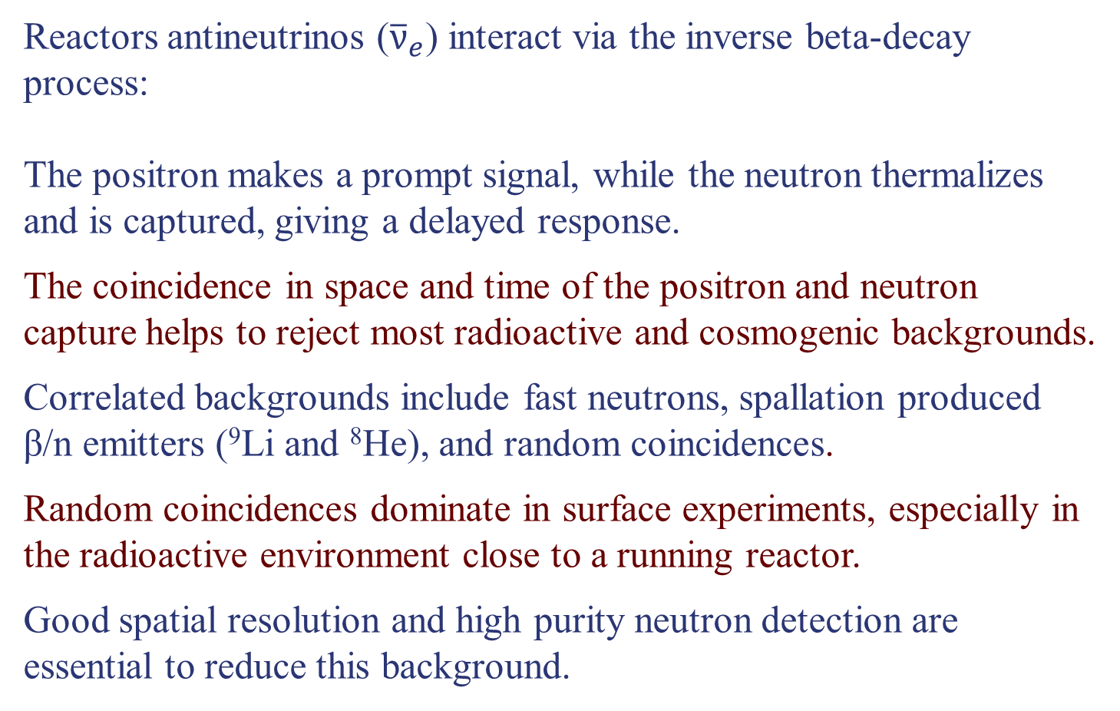
Reactor Neutrino Detection and Backgrounds
Reactors antineutrinos (${\overline{ν}}_{e}$) interact via the inverse beta-decay process:
The positron makes a prompt signal, while the neutron thermalizes and is captured, giving a delayed response.
The coincidence in space and time of the positron and neutron capture helps to reject most radioactive and cosmogenic backgrounds.
Correlated backgrounds include fast neutrons, spallation produced β/n emitters (⁹Li and ⁸He), and random coincidences.
Random coincidences dominate in surface experiments, especially in the radioactive environment close to a running reactor.
Good spatial resolution and high purity neutron detection are essential to reduce this background.
${\overline{ν}}_{e}$ + p → e⁺ + n

Slide 5
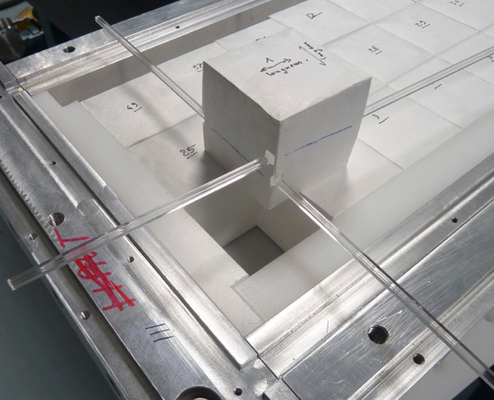
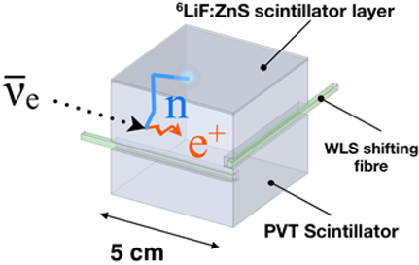
The Novel SoLid Detector Concept
Primary neutrino interactions are detected in 5 cm, optically isolated cubes of plastic scintillator, which are read out by wavelength shifting fibers in two dimensions.
Neutrons are tagged in thin sheets of ⁶Li-loaded, silver activated zinc sulfide scintillator: ⁶LiF:ZnS(Ag).
ZnS(Ag) releases light with a 200 ns mean emission time which forms a very pure, high efficiency neutron tag.
The cube segmentation results in unprecedented spatial resolution which is used to significantly reduce random coincident backgrounds.
⁶Li + n → ⁴He + ³H

Slide 6
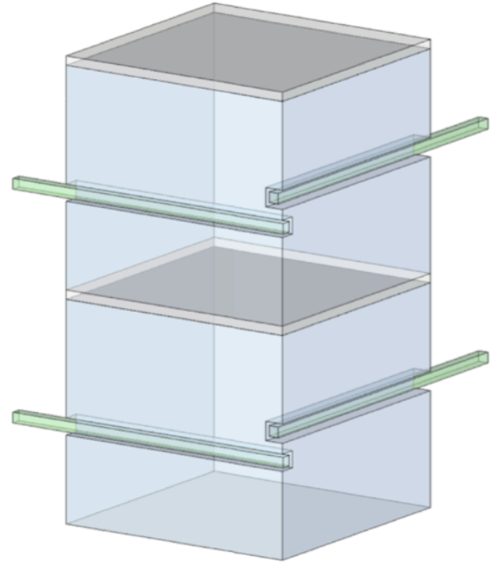
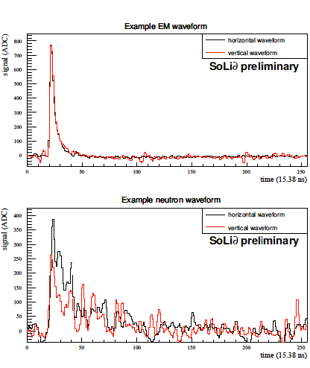

The Novel SoLid Detector Concept
$${\overline{ν}}_{e}$$
e⁺
Neutron
Capture
Positron (e⁺)
p
Detected Light
n
⁴He
⁶Li
³H
Time
10 ns
~50 μs
200 ns

Slide 7
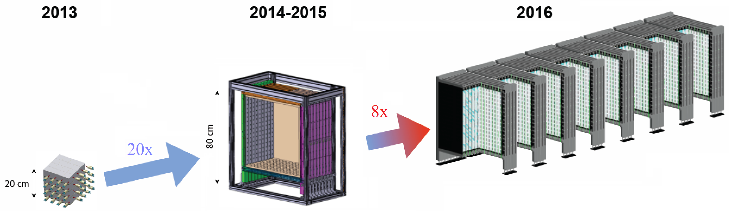
SoLid Detector Development
(Phase I)
8 SoLid Modules
2 tons, 11,520 cubes 2592 channels
NEMENIX
8kg, 64 cubes and 32 channels
SoLid Module 1 (SM1)
288kg, 9 detector planes of 16×16 cubes
Proof of Concept
Demonstrate neutron PID
Measure Backgrounds
Measure Coincidence Rate
Real Scale Systems Test
Demonstrate scalability
Test Production (schedule & procedures)
Demonstrate Power of Segmentation
Real Scale Systems Test
Implement Neutron Trigger
Optimize Production
Optimize Performance
Do Initial Oscillation Search
> 40 days Reactor on Data
(~3 reactor cycles)
1 week Reactor on Data
2 months Reactor off
Anticipate 1 year of Phase I Data

Slide 8
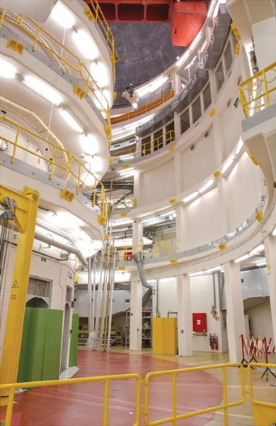
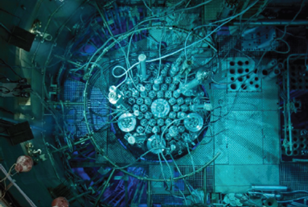
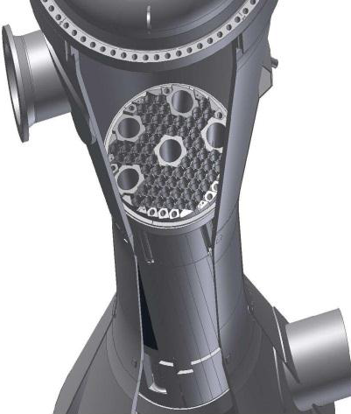
The BR2 Reactor at SCK•CEN (Mol, Belgiun)
Compact Source (50 cm effective core diameter)
High Power (40-80) MW typical operating range)
Highly Enriched ²³⁵U Core
150 days/year Duty Cycle
Low reactor correlated neutron and gamma rates
Large available floor space covering baselines of 5.5 to 12 meters.

Slide 9
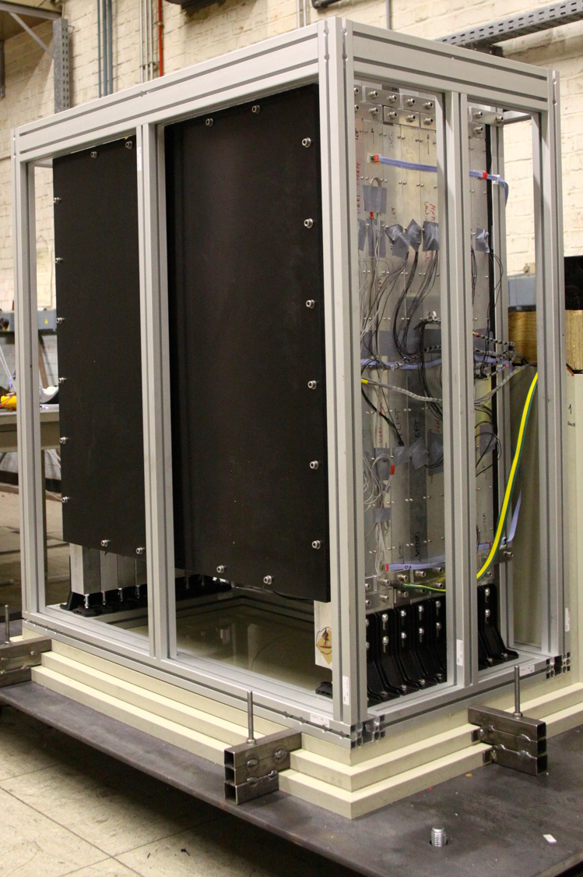
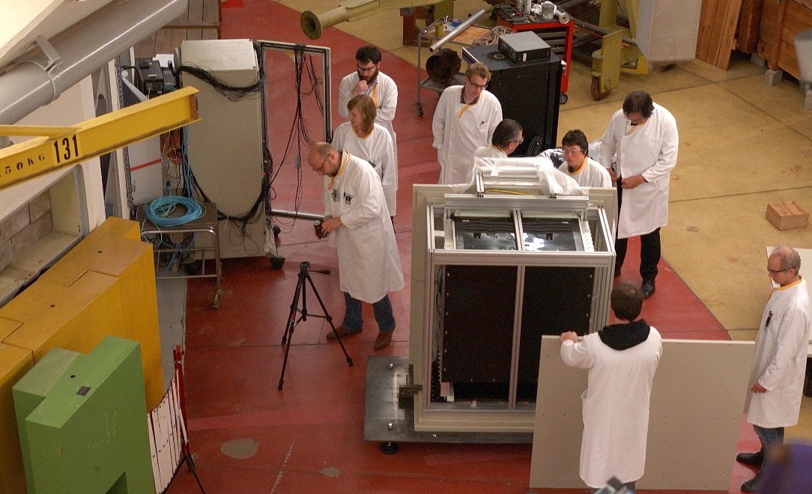
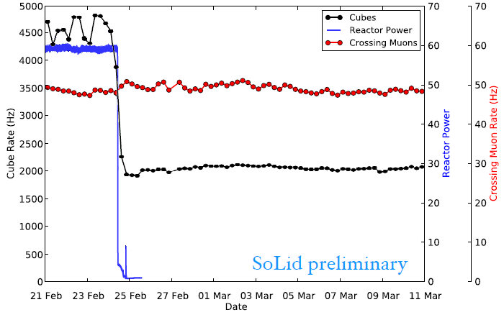
SM1 Test Run at BR2

Slide 10
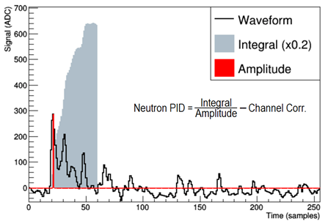
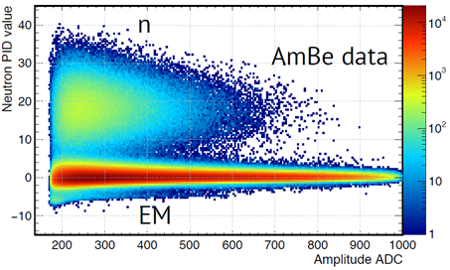
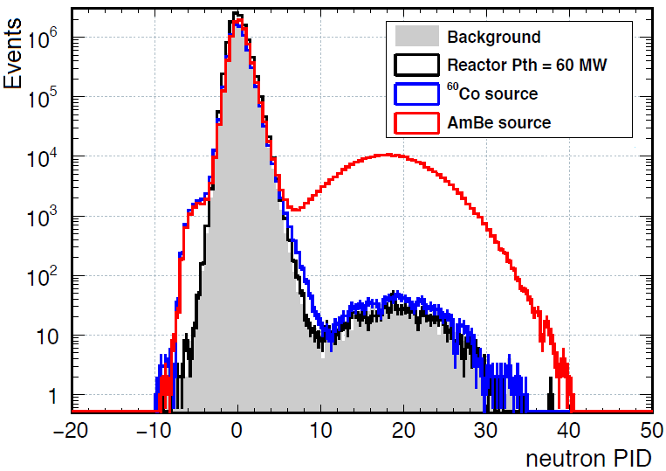
Neutron Identification in SM1
SoLid Preliminary
SoLid Preliminary
Neutron ID is based on the ratio of signal pulse integral to its amplitude.
Neutron source data confirms a clear separation between neutron and electromagnetic events.
SoLid Preliminary

Slide 11
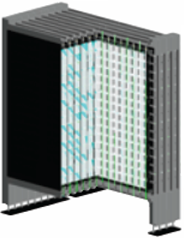
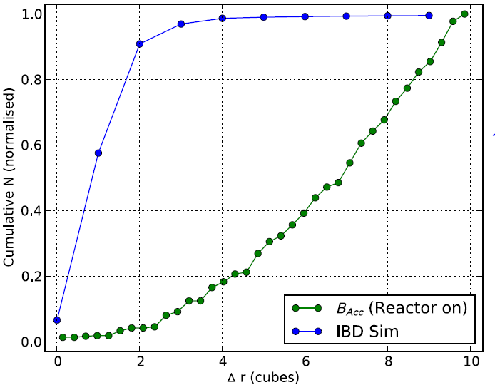
Inverse Beta Decay Analysis
First data processing completed:
Data reduction, filtering, calibration and reconstruction
SM1 MC response tuning is ongoing
Study of background events and selection cuts has started
With cube segmentation we expect a signal/background of about 2
Aim for result early this year
n
Δr
e⁺

Slide 12
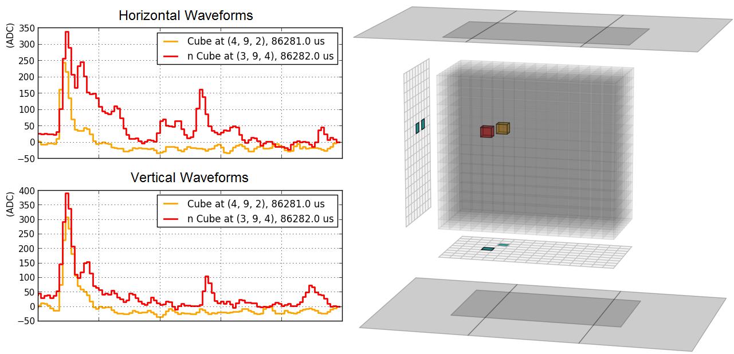
Antineutrino IBD Candidate Event
Prompt
Delayed

Slide 13
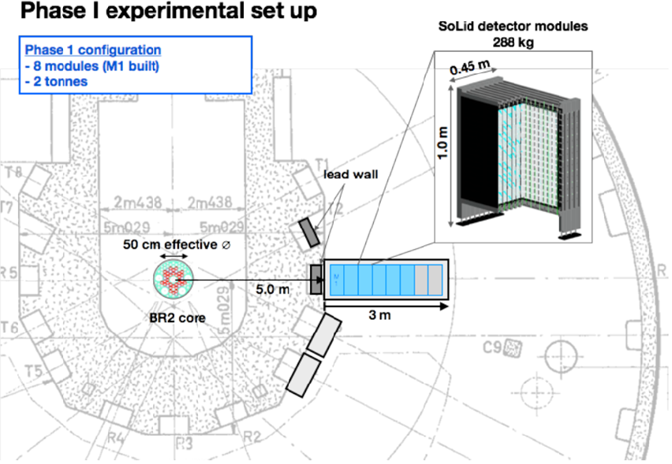
SoLid Run Plan (2016)
150 Days of Reactor on

Slide 14
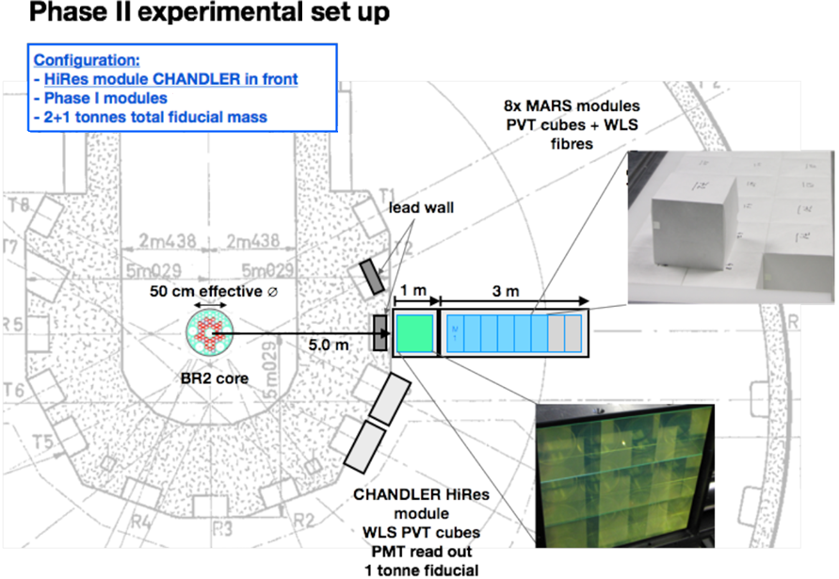
SoLid Run Plan (2017-2020)
450 Days of Reactor on

Slide 15
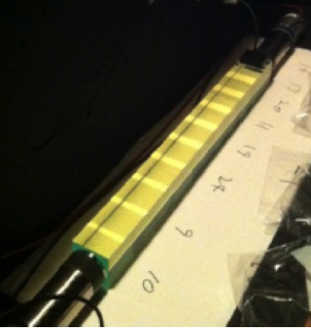
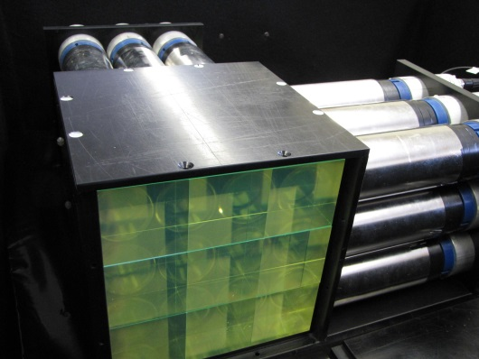
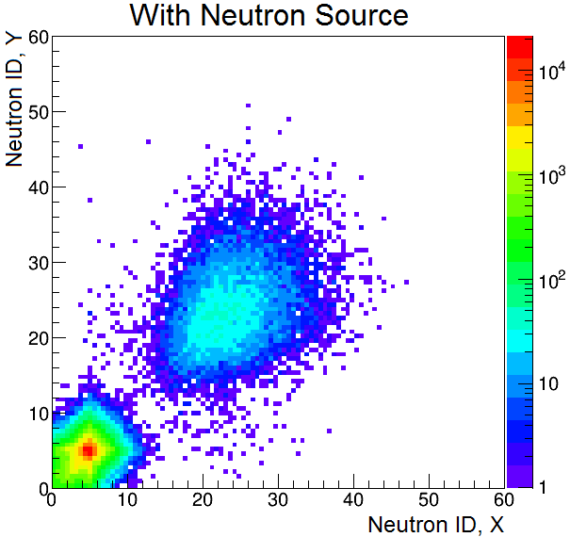
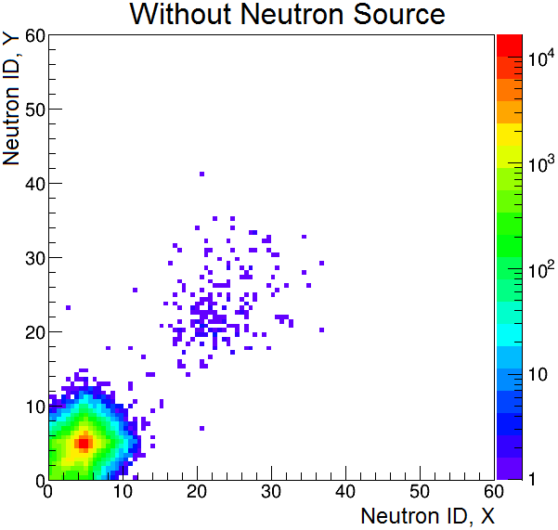
CHANDLER R&D Effort
Cube String Studies have been used to study light production, light collection, light attenuation, energy resolution and wavelength shifter concentration.
MicroCHANDLER is a 3×3×3 prototype which we are using to test our full electronics chain, develop the data acquisition system, study neutron capture identification and measure background rates.

Slide 16
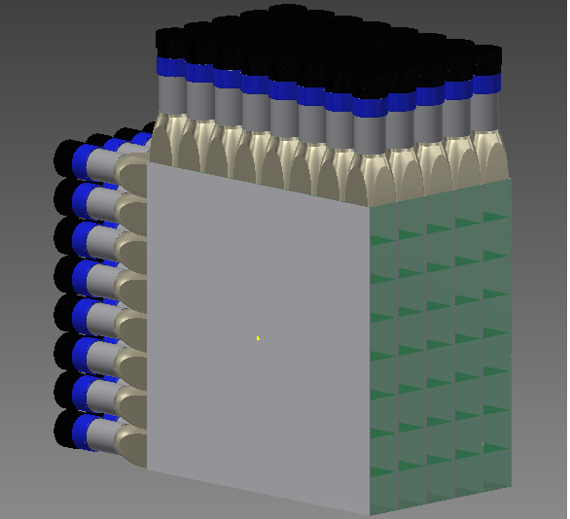
CHANDLER R&D Effort
Cube String Studies have been used to study light production, light collection, light attenuation, energy resolution and wavelength shifter concentration.
MicroCHANDLER is a 3×3×3 prototype which we are using to test our full electronics chain, develop the data acquisition system, study neutron capture identification and measure background rates.
MiniCHANDLER is a fully funded systems test (8×8×5) which is currently under construction and will be deployed at a commercial nuclear power plant. It will be operational winter 2016.

Slide 17
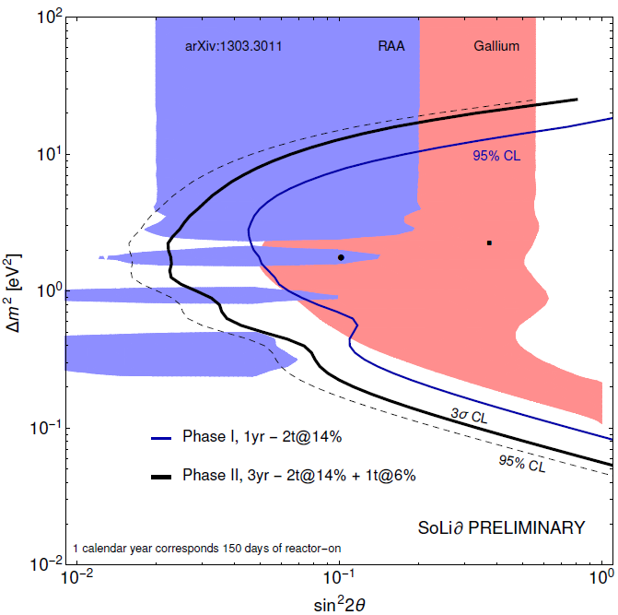
SoLid and CHANDLER Sensitivity
The combined sensitivity for the SoLid/CHANDLER deployment at BR2 is compared to the Gallium and Reactor Anomalies.
The one-year, Phase I SoLid deployment covers most of the low Δm² part of the Gallium Anomaly at 95% CL.
Adding CHANDLER to the three-year Phase II extends the coverage to higher Δm² and pushes the reach well into the Reactor Anomaly.
These sensitivities are purely oscillometric, based on energy spectrum and baseline information alone.
Oscillometric Sensitivity Only

Slide 18
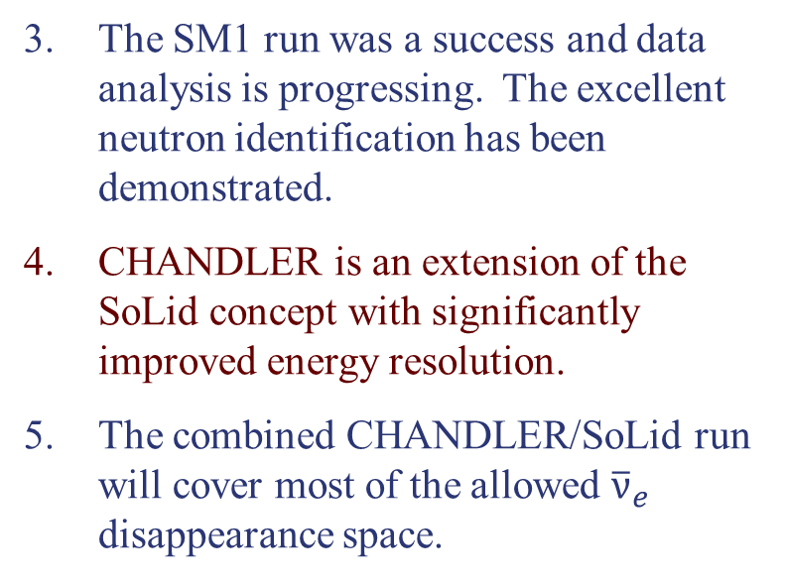
Conclusions
The SoLid experiment will make a very sensitive search for reactor antineutrino disappearance using a novel compact detector.
The high spatial resolution and pure neutron tag are designed to significantly reduce background rates.
The SM1 run was a success and data analysis is progressing. The excellent neutron identification has been demonstrated.
CHANDLER is an extension of the SoLid concept with significantly improved energy resolution.
The combined CHANDLER/SoLid run will cover most of the allowed ${\overline{ν}}_{e}$ disappearance space.

Slide 19
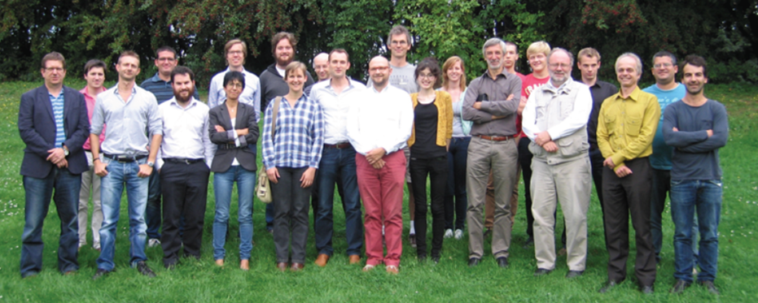

The SoLid Collaboration

