Slide 1
Preserving 3D Data in the OAIS Reference Model
Alex Kinnaman
Digital Preservation Coordinator
Virginia Tech University Libraries

Slide 2
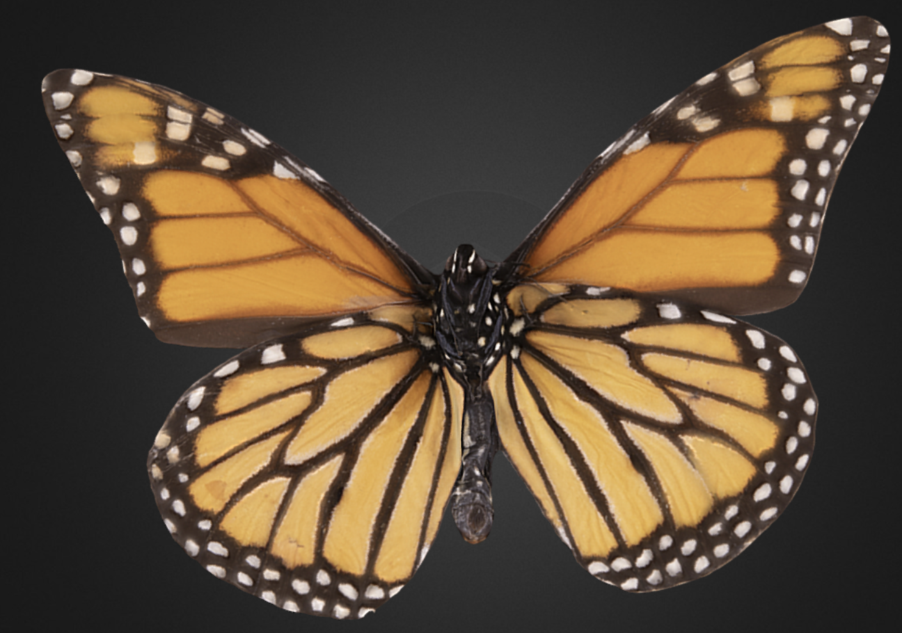
Collaborators
Nathan Hall
Nicholas Polys
Maureen Saverot
Michelle Stocker
Sterling Nesbit
Shuahai Xiao
Paul Marek
Notes:
All of these individuals are Virginia Tech professionals who either provided datasets, insight, or direction in this initial pilot study. Many thanks!

Slide 3
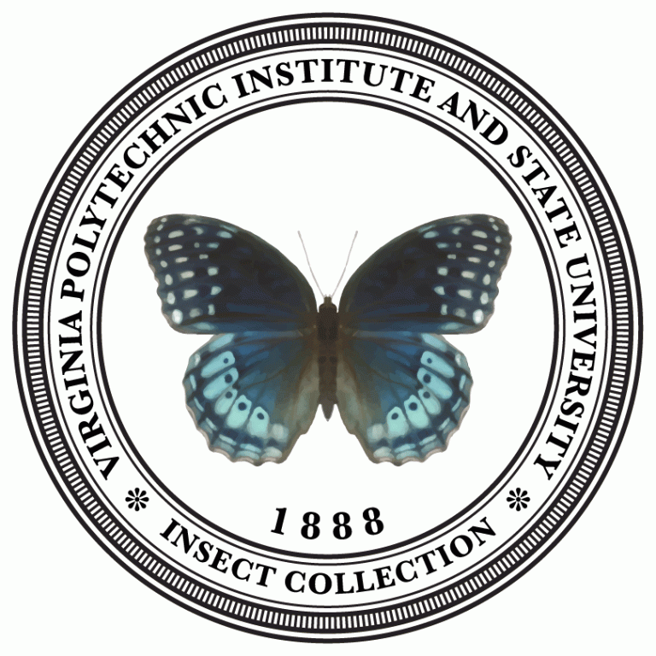
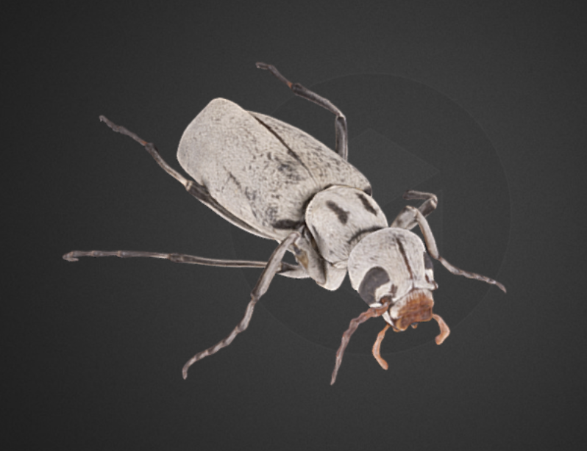
Background
Grant: “Entomo-3D: Digitiziting Virginia Tech’s Insect Collection”
  CLIR Digitizing Hidden Special Collections
Utilizing photogrammetry to digitize an educational collection of insects
How do we preserve 3D and Virtual Reality (VR) content?
Notes:
A bit of background: Virginia Tech University Libraries recently received a CLIR grant for our project Entomo-3D, a 3D and 2D digitization project for the Virginia Tech Insect Collection. These insects are used for educational purposes, but given their fragile state it is difficult to interact with them. Enter 3D and virtual reality! We are using photogrammetry and multiple softwares to digitize a portion of this educational collection in 3D, and the rest of the collection in still images, to aid the Entomology department in allowing more to enhance interaction with this vast collection of insects.
We have digitization and preservation workflows for 2D items, but 3D items are a unique challenge.

Slide 4
Problems & Research Questions
Reproducibility Problems:
No community-adopted standards for creation or preservation (e.g. TDR)
Proprietary software/formats
OBJ, a popular format, is no longer supported or updated
Quickly evolving and highly complex objects
Research Questions:
What are the benefits and challenges of the OAIS model in preserving 3D data across disciplines?
What are the essential steps of the 3D process to preserve for re-use across disciplines?
Notes:
As we conducted our initial literature review on 3D preservation and interoperability and started having some conversations with different groups working in 3D, it was clear that there were several problems surrounding the preservation of 3D and VR content. Numerous disciplines are producing 3D data, but without the guidance of published standards or practices that are generalizable across fields or supporting Trusted Digital Repository standards. 3D content is often created using proprietary software with opaque algorithms. Furthermore, some of the most widely adopted file formats used for display (e.g., STL and OBJ) do not meet some of the criteria for archival standards, particularly regarding the use of proprietary file formats and software obsolescence. And finally, many standards address specific aspects of 3D data standardization, but none encompass governance, data object modeling, and technical necessities like packaging and storage, all of which are vital in TDR and TRAC standards. These are quickly evolving, highly complex objects, and all of these problems combined lead to very low reproducibility in the long-term.
Our two primary research questions are 1) What are the benefits and challenges of the OAIS model in preserving 3D data across disciplines? And 2) What are the essential steps of the 3D process to preserve for re-use across disciplines?

Slide 5
R1: Open Archival Information System
Virginia Tech’s current preservation system is based on OAIS, but does it encompass 3D preservation workflows?
Accepted community model, with vocabulary, concepts, and preservation measures
Scales to disciplines
Standards agnostic
Focus on the Designated Community
Main takeaway so far: OAIS impacts what we preserve over how
Notes:
The Open Archival Information System Reference Model, OAIS, is a common reference model for digital preservation because it provides guidance on developing accessible and usable archival repositories with preservation-centric workflows. Our current preservation system at Virginia Tech is based on OAIS, but we wanted to explore the idea that since OAIS is a model, not a standard, it may affect our 3D preservation workflows. This is more difficult to test in the short-term so this is an ongoing question we are investigating, but the reason we chose OAIS in the first place is that it:
Offers an accepted community model, providing a vocabulary, concepts, and a means to measure the level of preservation
Scales to different disciplines and doesn’t restrict types of content
Is flexible enough to include multiple standards and doesn’t dictate what specific standards are required, but ensures that you are in fact using standards
Focuses on the Designated Community and their needs, which leads directly to our second research question
Initially I thought that OAIS would have a more significant impact on how we preserved 3D content, e.g. how items might be packaged, rather than what but it ended up being more the opposite.

Slide 6
R2: What steps and information to preserve?
What information do 3D experts need to open any of these datasets?
Field | Format | Type | Purpose
Paleobiology | STL | CT scan | Educational, 3D printing
Insect Collection | OBJ, X3D | Photogrammetry | Educational, hands-on interaction with fragile specimens
3D reconstruction | X3D | Virtual environment | Education/training on advanced visualization
Notes:
OAIS’ focus on the Designated Community both in access and preservation terms led us to focus more on what steps and information about the 3D process we need to preserve rather than how.
I worked with 3 different 3D experts on the Virginia Tech campus who work with 3 different types of 3D/VR data and formats to get a preliminary overview of what an expert in the field would need to open, understand, and manipulate an unfamiliar 3D dataset. The goal of this was to confirm that the metadata fields we specify in the grant are appropriate, and to determine any additional information that would be ideal to preserve.
In brief, we examined a CT scan of a paleobiology specimen used for 3D printing; the insect collection specimens themselves which are captured with photogrammetry; and some smaller datasets used for a virtual environment rendering of downtown Blacksburg, VA. We traded and explored these datasets to look at the similarities and differences between 3D content types, and had several discussions over what worked well and where challenges arose.

Slide 7
Risks & Threats for 3D/VR data
Software obsolescence
Large files
No support or updates for OBJ, one of the most popular file formats
Proprietary software and hardware
Lack of community-adopted standards for creation and preservation
Limited to no documentation on provenance
Notes:
Several common themes quickly arose from conversations with our 3D artists, particularly the risks and threats to 3D/VR data:
Software obsolescence is a major issue; most older datasets either need to be redone or are generally unusable, with few exceptions.
In the same vein, large files can be difficult to open, and information can be lost if it’s opened in software that is not it’s creation software
We experienced this when our 3D artists traded datasets; one software didn’t automatically apply a specific map to a dataset and when it opened an entire layer was missing and had to be manually replaced.
File format support and updates for OBJ, one of the most popular file formats, ceased about 15 years ago when it’s creation company Wavefront Technologies was bought out in 1995. It’s a popular format because there are no repercussions to using it and you still get proprietary-level quality, but it is also a fragile format. It’s worth noting again that OBJ is very popular, is supported by most 3D softwares, and there is available documentation; however the issue is that this documentation hasn’t been updated and it is not technically supported by a community.
There is a heavy reliance on proprietary software and hardware, which makes for an attractive 3D dataset, but can be difficult to open in other software and to open in the future. It can also limit what information you can keep with the data as you create or reopen content in various softwares.
One example we are currently experiencing is the inability to extract metadata or track metadata and provenance in a software we are using.
To reiterate, there is a lack of standards for creation and preservation.
Generally there is limited to no documentation on provenance, which can seriously inhibit reproducibility and the ability to open the dataset correctly.

Slide 8
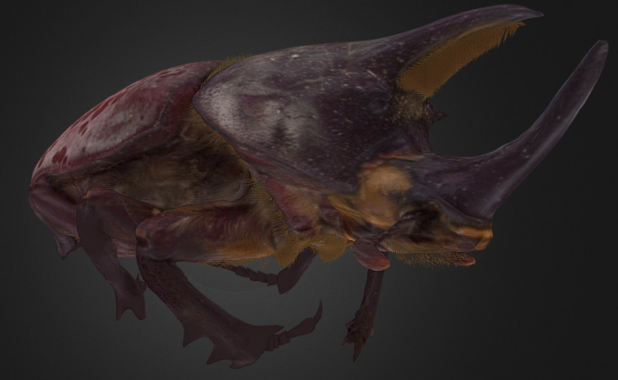
Primary Takeaways
eXtensible 3D (X3D) as the preservation file format
  ISO/IEC 19775-1:2008 standard, non-proprietary, community-supported
  Allows for embedded metadata in the object itself
  Smaller object size
Combined metadata model
  Smithsonian 3D Metadata Model, DarwinCore, DublinCore, and PREMIS
Document provenance and decisions
  Creation software, processing software, reconstruction software
Technical, granular metadata
  Number of images, number of polygons, map names
Purpose of the object determines what information is necessary for understanding and reproducibility
Notes:
Despite being an initial pilot study, we gained valuable information that has already informed our decisions in what metadata and steps we will preserve in this project.
We are using eXtensible 3D (X3D) as the preservation file format. X3D is an ISO standard; it’s non-proprietary and has a large user community supporting it; metadata can be stored in the file itself; and it’s possible to generate a smaller file size by consolidating less stable file formats like MTL and OBJ into an X3D (MTL + OBJ → X3D). This decision alone helps to mitigate some of the risks we discussed, such as avoiding as much proprietary reliance as we can and minimizing file size, and also providing an international standard we can rely on long-term.
We are developing a combined metadata from elements in the the Smithsonian 3D Metadata Model, DarwinCore, DublinCore, and PREMIS to encompass both what we believe is important and what we have the capacity to collect.
Provenance is vital to understanding how a dataset or model was created, so we will be recording provenance information where appropriate, including all of the softwares we use and any major creation decisions that are made that could affect reproduction.
Simultaneously, we will be capturing relevant technical, granular metadata. This includes the modality, the number of images, the number of polygons, the naming conventions for the map textures, all of which are useful for reproduction.
Finally, it’s important to remember that, like other digital content, the purpose of the object determines what information is necessary for understanding and reproducibility. Our insects may not require an entire Smithsonian 3D Metadata schema to be successfully accessible in 10 years; our insects will also not require the same metadata as a CT scan of a bone or a virtual map, not only because of differences in discipline, but because of difference in capture technique.

Slide 9
Limitations & Next Steps
Limitations
Not focusing on access, but the ability to open and use a dataset long-term
Sample of convenience
Our 3D experts are co-collaborators on this project
Next Steps
Send more feelers out into the community
Develop a more formal survey for a larger user study based on these findings
Begin testing how to automate some metadata retrieval
Notes:
We’re aware of our limitations on this pilot project and plan to use this foundational information to collect more in-depth information before the official grant work begins.
First, we’re aware that this particular study does not focus on access from an end-user, but rather the access to the digital preservation coordinator in 10 years needing to open and reproduce these 3D datasets. Immediate access has its own requirements and needs that may overlap with preservation, but the focus is on long-term reuse.
Second, these are samples of convenience; all data sets are open, archived in a repository or publicly available elswhere, and originated at Virginia Tech.
Finally, our 3D experts providing the initial information are co-collaborators on this project and are all central to Virginia Tech.
With that, our next steps are already underway. Our grant team has been putting out feelers into the community to see if others are doing similar work. We also plan to develop a more formal survey for a larger user study based on these findings, focusing particularly on metadata components and provenance information. Finally, we are hoping to begin testing how to automate as much of our metadata retrieval as we can to aid our curators.

Slide 10
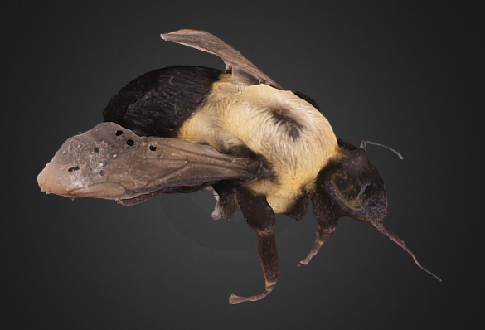
Thank you!
Alex Kinnaman, alexk93@vt.edu
Digital Preservation Coordinator
Virginia Tech University Libraries
Links for the curious:
See a high-res insect: http://metagrid2.sv.vt.edu/~npolys/Web3DHeritage/VT_Insects/Blister_Beetle.html
See all of our completed 3D insect on Sketchfab: https://sketchfab.com/VirginiaTechUnivLibraries/
VT Insect Collection: https://collection.ento.vt.edu/
Notes:
Thank you!
Click the links above to explore a higher-resolution sample insect (the Blister Beetle, my personal favorite) with an example of some of our access metadata; our Sketchfab, the current access location for all of the completed 3D insects; and to view the original Virginia Tech Insect Collection.

Slide 11
Select References
Ball, A. (2012). Review of data management lifecycle models. University of Bath, Bath, UK. Retrieved from https://purehost.bath.ac.uk/ws/portalfiles/portal/206543/redm1rep120110ab10.pdf
Berthelot, M., Nony N., Gugi, L., Bishop, A., and De Luca, L. (2015). The Avignon Bridge: A 3D reconstruction project integrating archaeological, historical and gemorphological issues. The International Archives of the Photogrammetry, Remote Sensing and Spatial Information Sciences, Volume XL-5/W4. doi.org/10.5194/isprsarchives-XL-5-W4-223-2015
Blundell, J., Schmitz Fuhrig, L., Little, H., Pilsk, S., Rossie, V., Snyder, R., Stern, B., Sullivan, B., Tomerlin, M. J., and Webb, K. (2011). Smithsonian Institute’s 3D Metadata Model, v 0.6. Smithsonian Digital Program Office. https://dpo.si.edu/blog/smithsonian-3d-metadata-model
Bollen, K., Cacioppo, J. T., Kaplan, R. M., Krosnick, J. A., Olds, J. L., & Dean, H. (2015). Social, behavioral, and economic sciences perspectives on robust and reliable science. Report of the Subcommittee on Replicability in Science Advisory Committee to the National Science Foundation Directorate for Social, Behavioral, and Economic Sciences, 3, 3. National Science Foundation. Retrieved from https://www.nsf.gov/sbe/AC_Materials/SBE_Robust_and_Reliable_Research_Report.pdf
Boyer, D. M., Gunnell, G. F., Kaufman, S., and McGeary, T. (2017). Morphosource: Archiving and sharing 3-D digital specimen data. The Paleontological Society Papers, 22. doi.org/10.1017/scs.2017.13
Consultative Committee for Space Data Systems. (2012). Reference model for an Open Archival Information System. CCSDS 650.0-B-1. Retrieved from https://public.ccsds.org/Pubs/650x0m2.pdf
Davies, D. G. et. al. (2017). Open data and digital morphology. The Royal Society, 248:1852. doi.org/10.1098/rspb.2017.0194
Laing, A., et. al. (2018). Giant taxon‐character matrices: the future of morphological systematics. Cladistics, 34:3. doi.org/10.1111/cla.12197
Lavoie, Brian F. 2004. ‘The Open Archival Information System reference model: Introductory guide (2nd edition).’ DPC Technology Watch Series Report 14-02, Digital Preservation Coalition. dx.doi.org/10.7207/twr14-02
Lewis, D. (2019). The fight for control over virtual fossils. Springer Nature Publishing, 567. doi.org/10.1038/d41586-019-00739-0
Library of Congress. (2018). Extensible 3D (X3D) File Format Family. https://www.loc.gov/preservation/digital/formats/fdd/fdd000490.shtml
Polys, N. F., Singh, A., and Sforza, P. (2016). A novel level-of-detail technique for virtual city environments. Web3D '16 Proceedings of the 21st International Conference on Web3D Technology, Pages 183-184. dx.doi.org/10.1145/2945292.2945322
Richards-Rissetto, H. and Schwerin, J. (2017). A catch 22 of 3D data sustainability: Lessons in 3D archaeological data management & accessibility. Digital Applications of Archaeology and Cultural Heritage, 6. doi.org/10.1016/j.daach.2017.04.005
Notes:
Select references.

