Slide 1
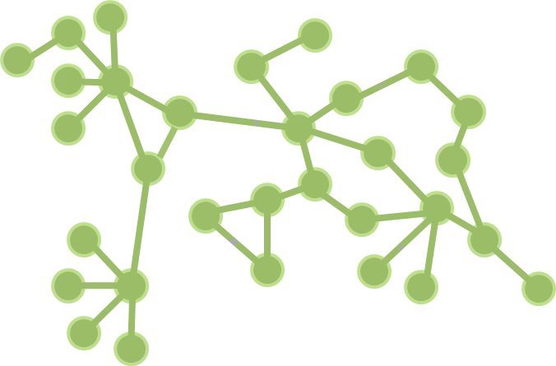





Social networks
and smallholder conservation agriculture in East Africa
KEITH M. MOORE AND JENNIFER N. LAMB
Virginia Tech | Blacksburg, Virginia
CO-AUTHORS:
JAY NORTON | University of Wyoming | Laramie, Wyoming
RITA LAKER-OJOK and JULIAN NYACHOWO| Appropriate Technology–Uganda | Kampala, Uganda
DOMINIC NGOSIA SIKUKU | SEATEC Community Development | Kitale, Kenya
DENNIS S. ASHILENJE | Manor House Agricultural Center | Kitale, Kenya
BERNARD BASHAASHA | Makerere University | Kampala, Uganda
EUSEBIUS MUKHWANA |SACRED-Africa | Nairobi, Kenya

Slide 2
TODAY, WE’LL TALK ABOUT…
mind-set change
conventional farming & conservation agriculture
a bit about the Mt. Elgon region
our research problem
our findings
our conclusion

Slide 3
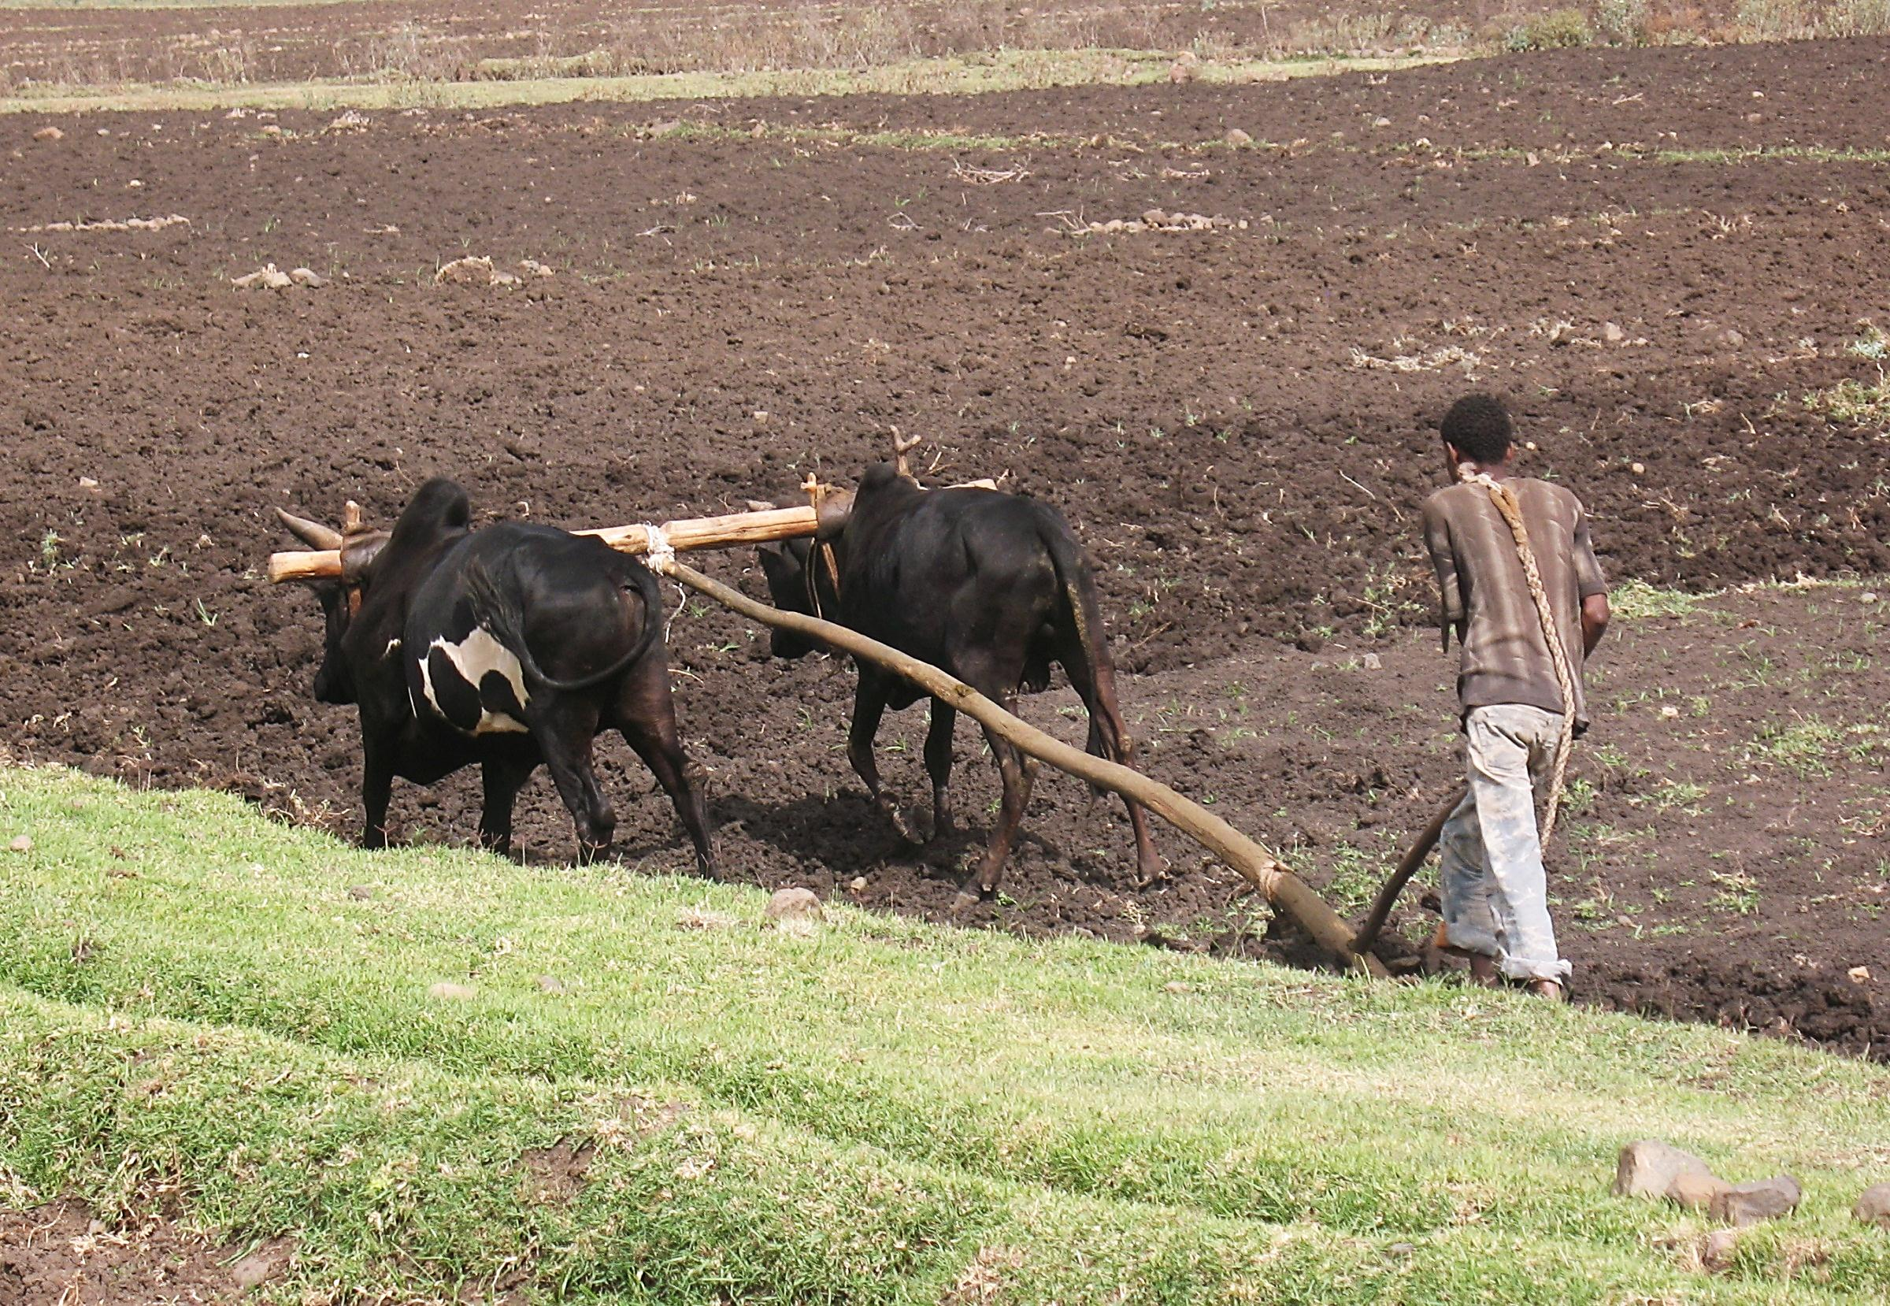
X WHAT NOT TO DO

Slide 4
CONVENTIONAL FARMING & CONSERVATION AGRICULTURE
 | CONVENTIONAL FARMING | CONSERVATION AGRICULTURE
MINIMIZING TILLAGE | X plough/hoe to improve soil structure and control weeds | √ disturb the soil as little as possible to maintain soil health, plant directly into soil
MAINTAINING SOIL COVER | X remove or burn crop residue, leaving soil bare | √ cover the soil as much as possible to protect soil from erosion and limit weed growth
MIXING & ROTATING CROPS | X same crop planted each season | √ mix and rotate crops to maintain and improve soil fertility and prevent pests

Slide 5
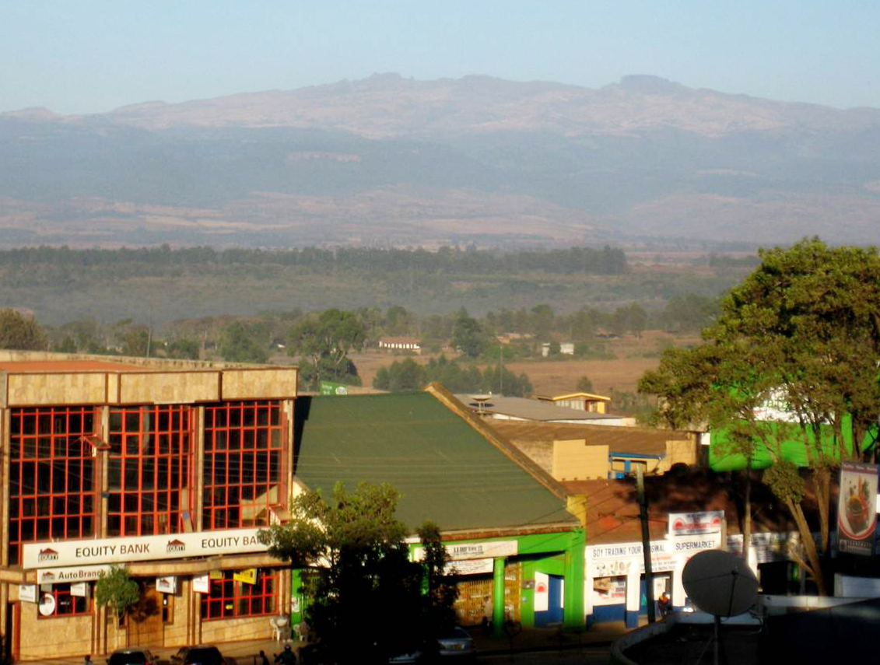
MT. ELGON
BUNGOMA | KAPCHORWA | TORORO | KITALE

Slide 6
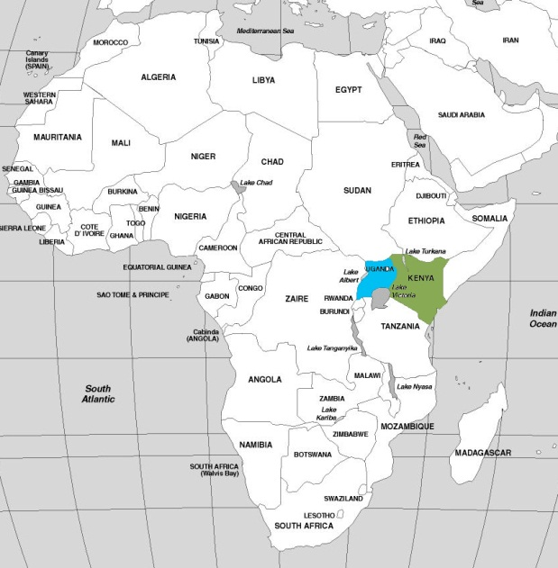
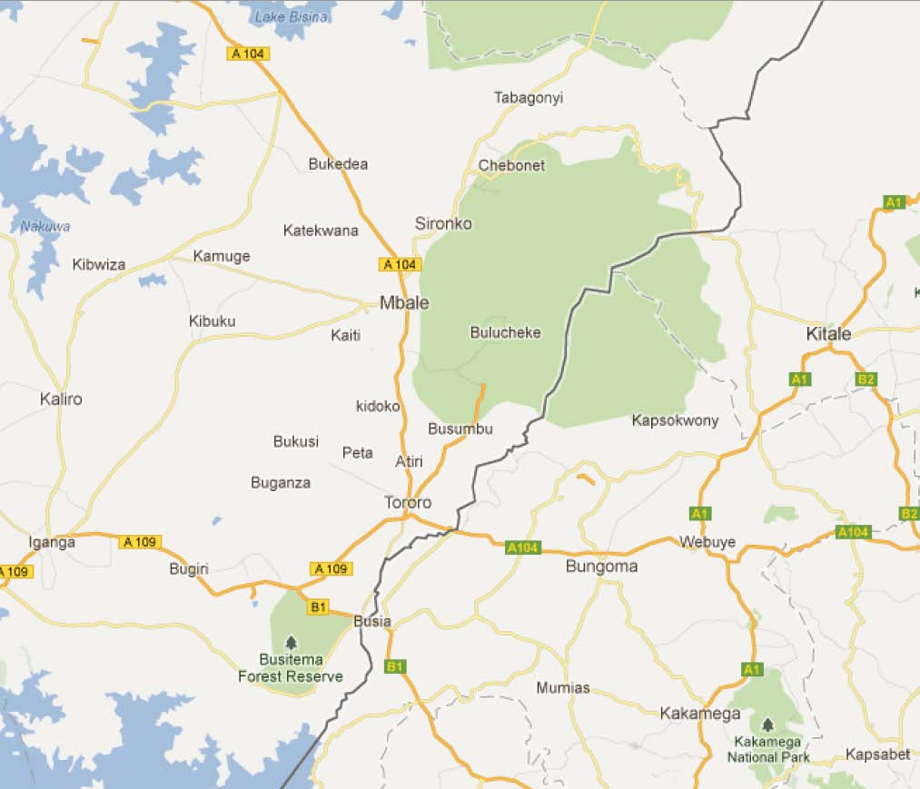
THE COMMUNITIES
BUNGOMA | KAPCHORWA | TORORO | KITALE
Kapchorwa
Map data © Google 2012

Slide 7
OUR RESEARCH PROBLEM
Purpose | How to engage with local mind sets in ways that are transformative and yield positive outcomes
Change agent perspectives |
  Agricultural change agents are trained in conventional production practices and memorized scientific “facts”
Farmer agro-ecological knowledge |
  agro-ecological knowledge and its application in production informs farming discourse in local social networks
Conservation agriculture requires adaptation |
  CA doesn’t fit well with that memorized knowledge and challenges conventional farming wisdom

Slide 8
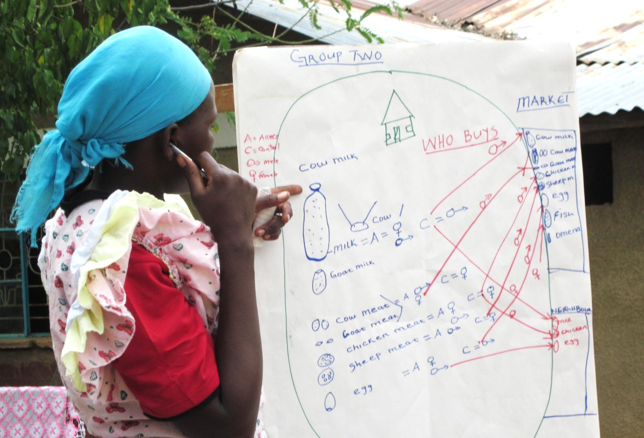
Focus Groups

Slide 9
Mean scores for Kenyan and Ugandan farmers and non-farm agents level of agreement on basic farming perspectives

Slide 10
STATEMENT: One should maintain a permanent crop cover.

Slide 11
STATEMENT: Tillage causes land degradation.

Slide 12
Regression Table 6.1: Modern capital intensive farming
INDEPENDENT VARIABLES | VARIABLE GROUPS |  | ALL |  | BEST MODEL
 | Beta | sig | Beta | sig | Beta | sig
Agro-ecological Zone
Tororo | .166 | .01 | .450 | .02 | .221 | .00
Kapchorwa | -.126 | .06 | .234 | .08
Bungoma | -.034 | .60 | .216 | .04 | .102 | .06
Adj. R² | .053 | .00
Resource endowments
Tractor | -.039 | .54 | .254 | .00 | .237 | .00
Animal traction | -.087 | .12 | -.048 | .41
Area farmed | .007 | .91 | -.017 | .76
Wealth index | .016 | .80 | .084 | .25
Importance of off-farm income | -.081 | .14 | -.063 | .26
Access to credit | .153 | .01 | .089 | .16
Adj. R² | .014 | .09
Personal Characteristics
Age-respondent | .040 | .49 | .043 | .57
Gender-respondent | .024 | .69 | .058 | .31
Education-respondent | -.007 | .90 | -.017 | .78
Female household head | -.015 | .81 | -.090 | .17
Poor health | -.117 | .04 | -.105 | .05
% energy from staples | .088 | .11 | .065 | .21
Adj. R² | .002 | .36
Network connectivity
Extension contact | .224 | .04 | .289 | .01 | .300 | .01
Frequency extension contact | -.271 | .02 | -.378 | .00 | -.390 | .00
NGO Contact | -.013 | .91 | -.007 | .95
Frequency NGO contact | .164 | .15 | .156 | .17 | .185 | .00
Vendor contact | -.100 | .22 | -.131 | .13
Frequency vendor contact | .032 | ,77 | .099 | .37
Average contact frequency | -.018 | .75 | .079 | .58
Total network contact frequency | -.255 | .02 | -.250 | .02 | -.270 | .00
Adj. R² | .087 | .00
Adjusted R² |  |  | .145 | .00 | .150 | .00

Slide 13
Regression Table 6.2: Mixed farming
INDEPENDENT VARIABLES | VARIABLE GROUPS |  | ALL |  | BEST MODEL
 | Beta | sig | Beta | sig | Beta | sig
Agro-ecological Zone
Tororo | -.348 | .00 | -.052 | .89
Kapchorwa | -.014 | .25 | .063 | .64 | .153 | .02
Bungoma | -.299 | .00 | -.285 | .01 | -.197 | .00
Adj. R² | .107 | .00
Resource endowments
Tractor | .161 | .01 | -.109 | .25
Animal traction | -.007 | .90 | .029 | .63
Area farmed | -.015 | .80 | -.004 | .94
Wealth index | .008 | .90 | -.064 | .31
Importance of off-farm income | -.001 | .99 | -.011 | .84
Access to credit | -.013 | .83 | .138 | .03 | .126 | .04
Adj. R² | .008 | .19
Personal Characteristics
Age-respondent | .029 | .62 | .001 | .99
Gender-respondent | -.018 | .77 | -.071 | .21
Education-respondent | .053 | .36 | .024 | .69
Female household head | .038 | .54 | .074 | .21
Poor health | .012 | .83 | .017 | .75
% energy from staples | .021 | .71 | .011 | .84
Adj. R² | -.013 | .94
Network connectivity
Extension contact | -.145 | .18 | -.237 | .04 | -.140 | .01
Frequency extension contact | .012 | .91 | .124 | .30
NGO Contact | -.217 | .05 | -.208 | .07 | -.116 | .05
Frequency NGO contact | .142 | .22 | .108 | .35
Vendor contact | .145 | .08 | .093 | .28
Frequency vendor contact | -.303 | .01 | -.254 | .02 | -.201 | .02
Average contact frequency | .196 | .00 | .279 | .05 | .229 | .00
Total network contact frequency | .242 | .02 | .244 | .03 | .273 | .00
Adj. R² | .078 | .00
Adjusted R² |  |  | .133 | .00 | .149 | .00

Slide 14
Regression Table 7.1:
One should maintain a permanent crop cover
INDEPENDENT VARIABLES | VARIABLE GROUPS |  | ALL |  | BEST MODEL
 | Beta | sig | Beta | sig | Beta | sig
Agro-ecological Zone
Tororo | -.200 | .00 | -.224 | .24
Kapchorwa | -.245 | .00 | -.194 | .15
Bungoma | -.351 | .00 | -.399 | .00 | -.236 | .00
Adj. R² | .076 | .00
Resource endowments
Tractor | .098 | .12 | -.100 | .29
Animal traction | -.108 | .05 | -.014 | .81
Area farmed | -.058 | .32 | -.106 | .06
Wealth index | .076 | .22 | .054 | .39
Importance of off-farm income | -.089 | .10 | -.075 | .18
Access to credit | .083 | .15 | .131 | .04 | .139 | .01
Adj. R² | .040 | .00
Personal Characteristics
Age-respondent | .193 | .00 | .142 | .02 | .182 | .00
Gender-respondent | .159 | .01 | .112 | .05 | .100 | .05
Education-respondent | .006 | .92 | -.034 | .57
Female household head | -.031 | .60 | -.026 | .66
Poor health | -.118 | .03 | -.086 | .11
% energy from staples | .080 | .03 | .061 | .24
Adj. R² | .048 | .00
Network connectivity
Extension contact | -.019 | .86 | -.044 | .70
Frequency extension contact | .060 | .61 | .104 | .39
NGO Contact | -.458 | .00 | -.386 | .00 | -.420 | .00
Frequency NGO contact | .360 | .00 | .290 | .01 | .343 | .00
Vendor contact | .167 | .05 | .156 | .07 | .132 | .01
Frequency vendor contact | -.188 | .09 | -.081 | .46
Average contact frequency | .018 | .77 | -.029 | .84
Total network contact frequency | .100 | .35 | .080 | .46
Adj. R² | .050 | .00
Farming Perspectives
Modern capital intensive | .138 | .01 | .107 | .06 | .105 | .04
Mixed farming system | -.014 | .77 | -.051 | .36
Adj. R² | .015 | .02
Adjusted R² |  |  | .157 | .00 | .153 | .00

Slide 15
Regression Table 7.2:
Tillage Causes Land
Degradation
INDEPENDENT VARIABLES | VARIABLE GROUPS |  | ALL |  | BEST MODEL
 | Beta | sig | Beta | sig | Beta | sig
Agro-ecological Zone
Tororo | -.073 | .27 | -.049 | .80
Kapchorwa | -.173 | .02 | .205 | .14 | .268 | .00
Bungoma | -.089 | .17 | -.007 | .95
Adj. R² | .045 | .00
Resource endowments
Tractor | .051 | .41 | 048 | .62
Animal traction | .065 | .24 | .052 | .39
Area farmed | -.074 | .21 | -.059 | .32
Wealth index | .161 | .01 | .149 | .02 | .143 | .01
Importance of off-farm income | -.023 | .68 | -.008 | .89
Access to credit | -.191 | .00 | -.115 | .08
Adj. R² | .037 | .00
Personal Characteristics
Age-respondent | .012 | .83 | -.004 | .94
Gender-respondent | -.142 | .02 | -.148 | .01 | -.149 | .01
Education-respondent | .060 | .28 | .036 | .56
Female household head | .075 | .22 | .116 | .06 | .109 | .05
Poor health | .007 | .90 | -.001 | .99
% energy from staples | .163 | .00 | .130 | .02 | .132 | .01
Adj. R² | .033 | .01
Network connectivity
Extension contact | .085 | .46 | .028 | .81
Frequency extension contact | -.004 | .97 | .109 | .38 | .106 | .04
NGO contact | -.101 | .38 | -.199 | .08
Frequency NGO contact | .131 | .28 | .183 | .12
Vendor contact | .113 | .19 | .101 | .25
Frequency vendor contact | -.151 | .19 | -.137 | .23
Average contact frequency | .058 | .35 | -.012 | .94
Total network contact frequency | -.029 | .79 | -.034 | .76
Adj. R² | -.003 | .53
Farming Perspectives
Modern capital intensive | -.003 | .95 | .135 | .02 | .130 | .01
Mixed farming system | .053 | .28 | .010 | .86
Adj. R² | -.002 | .56
Adjusted R² |  |  | .104 | .00 | .118 | .00

Slide 16
OUR CONCLUSIONS
Sense-Making |
there are real differences between the agricultural production knowledge of non-farm agents and farmers
Contextual knowledge and mutual understanding |
these differences are driven by farmers’ lived experience of the agro-ecology and the networks that support living in that environment in contrast to memorized science
Receptivity to change |
new ideas may find receptivity on the basis of personal characteristics and resource endowments, but also through grounding concepts in local knowledge
Mind-Set change |
Mind-set change requires negotiating new understandings among network members in the process of making adaptations to production practices

Slide 17
Thank you! Questions?

