Slide 1
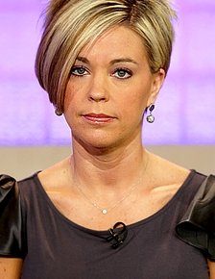
Reddit Shaming Karens
By: Brian Bell, Raymond Cosgrove, and Andrew McGrail
01
CS 4624 Multimedia, Hypertext, and Information Access Instructor Edward A. Fox, Virginia Tech, Blacksburg 24061, 11/30/2021

Slide 2
Outline
Background Information
Pre-planning
Plans + Overview
Our Implementation
Ending + Acknowledgements

Slide 3
Background
Information

Slide 4
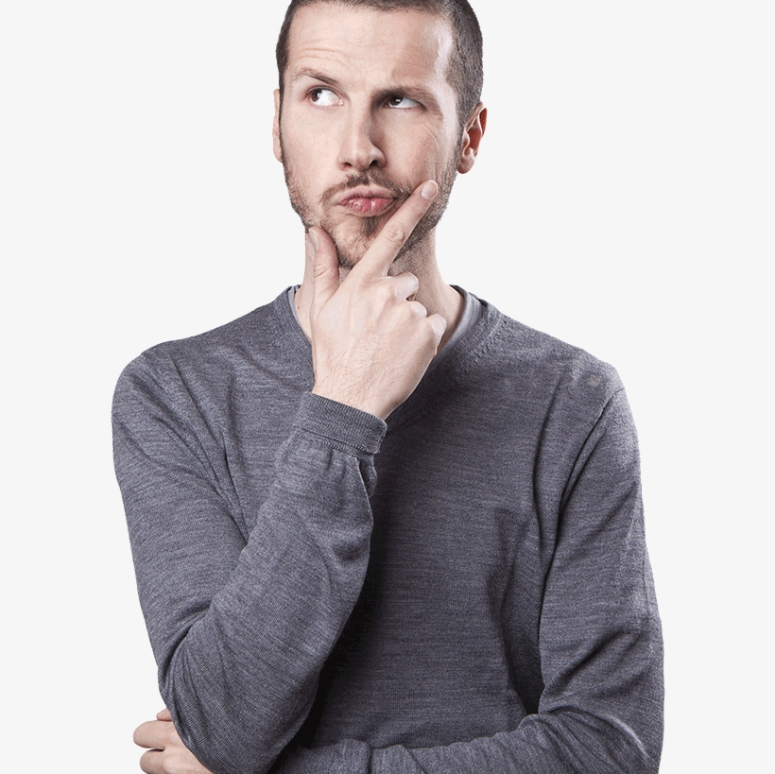
The main question

Slide 5
The question our project aims to help answer is...
How has the usage of the word Karen changed over the course of the global pandemic?
- Dr. Zach

Slide 6

What exactly is a Karen?

Slide 7
The FORMAL definition is...
Karen is a pejorative slang term for an obnoxious, angry, entitled, and often racist middle-aged white woman who uses her privilege to get her way or police other people’s behaviors.
- dictionary.com

Slide 8
Pre-Planning

Slide 9


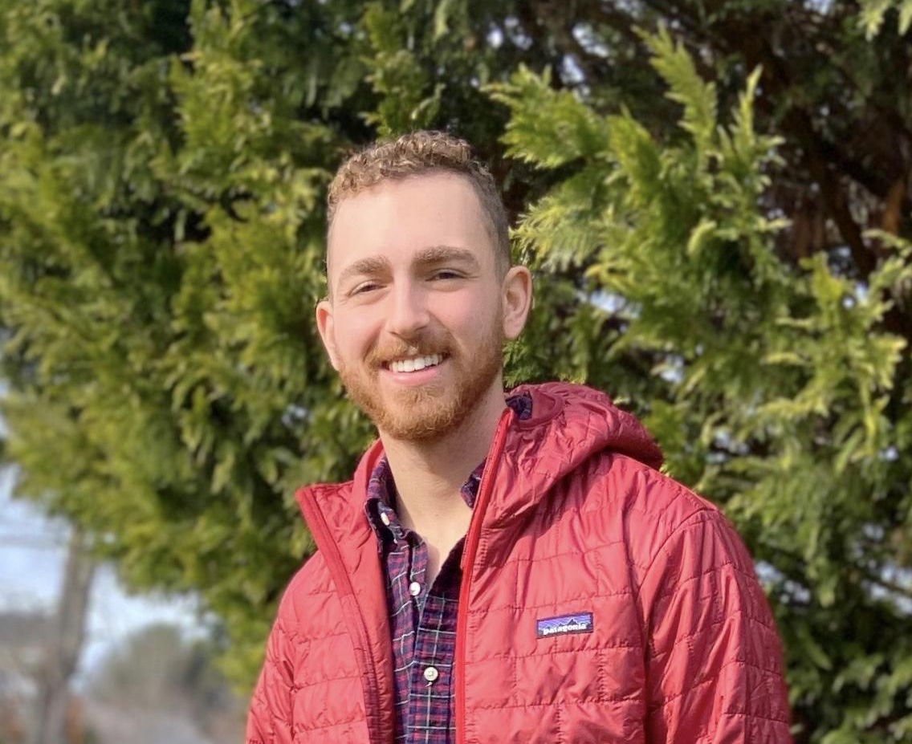
The Team
Name: Andrew McGrail
Tasks: Data Collection, Parsing and Caching
Name:Raymond Cosgrove
Tasks: Natural Language Processing, Contact Person
Name: Brian Bell
Tasks: Data Analysis, Communication

Slide 10

The Timeline

Slide 11
Timeline
Tasks
Aug.
Sept.
Oct.
Nov.
Dec.
Project Planning
Base Scripts (Parsing Data Col.)
Initial Statistics/Trends (D.A.)
Topic Modeling, Testing
Interim Report
Integration Testing
Final Testing, Deployment
Final Presentation, Report

Slide 12
Plans + Overview

Slide 13
Our Approach
Restrict to 18 months before and after the pandemic
Multiple subreddit data sets.
Find significant data trends
Use frequency, depth vs. breadth, context
Compare keyword usages between subreddits
Utilize the power of NLP
Topic model posts to find trends

Slide 14
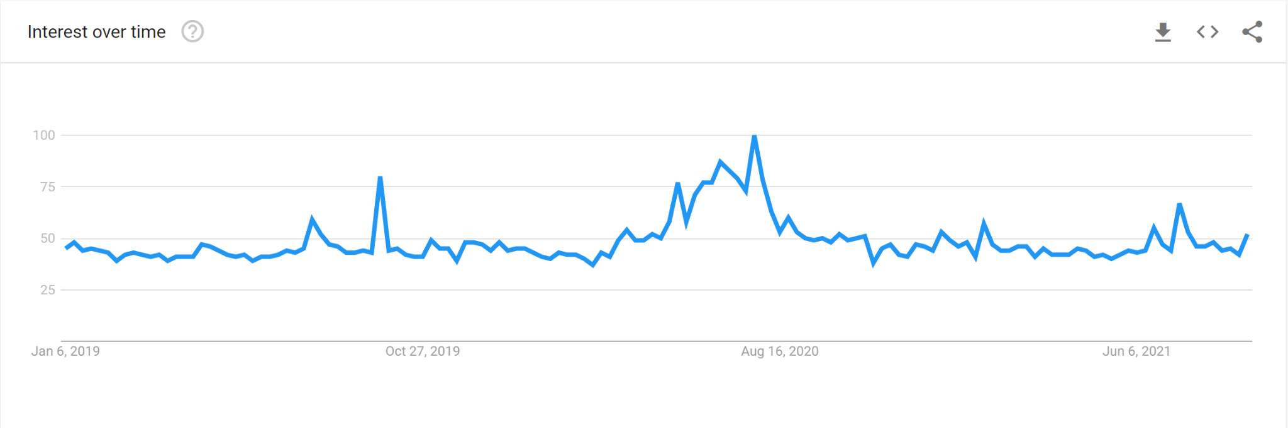
Our Motivation
Percent Interest
Usage spike during pandemic (starting March 2020)
Determine usage triggers
Has keyword changed over time

Slide 15
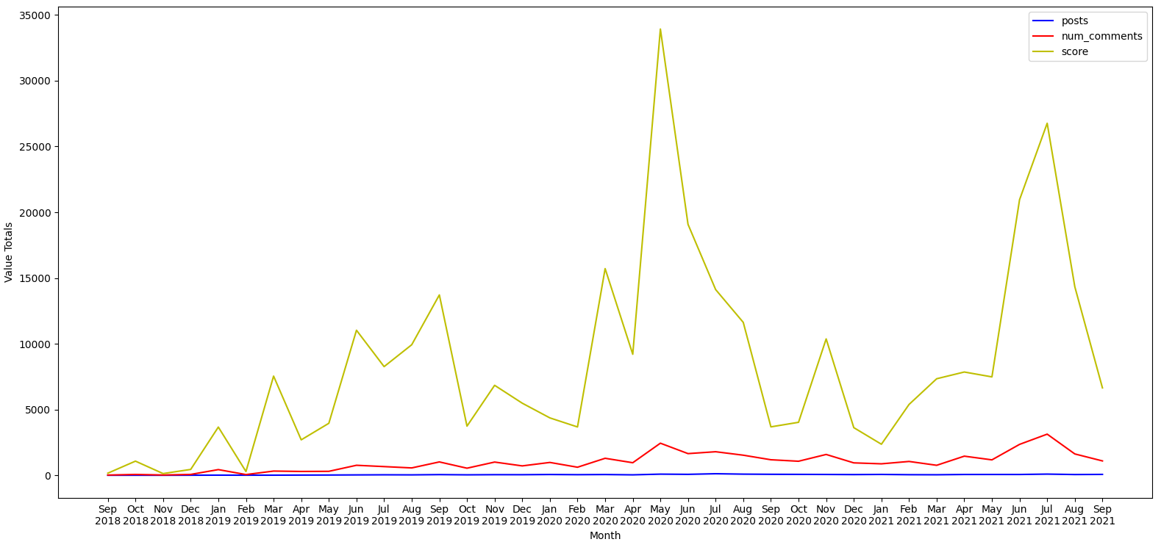
Our Motivation Cont.

Slide 16
Our Implementation

Slide 17

Technicals Details

Slide 18
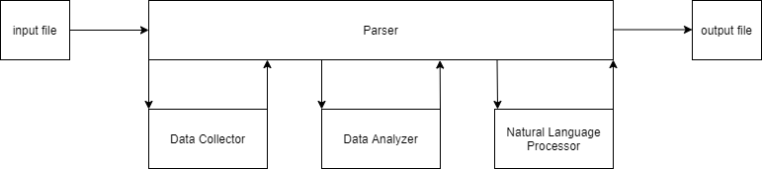
The Architecture

Slide 19
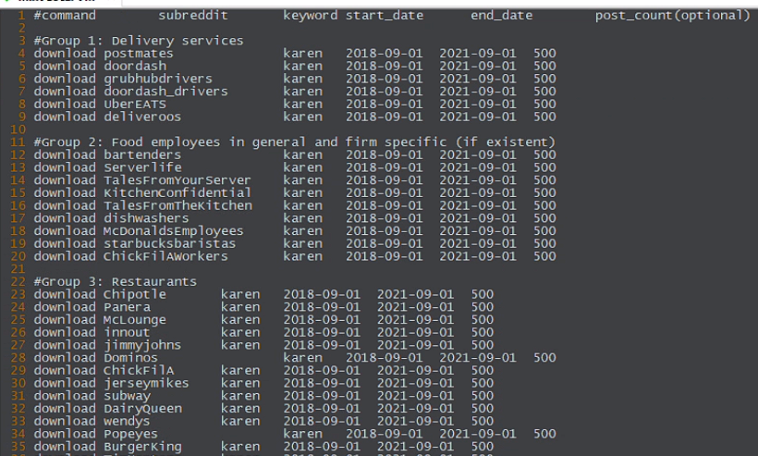
Example Input File
Notes:
Post_count is the number of posts to make per request to data api.

Slide 20
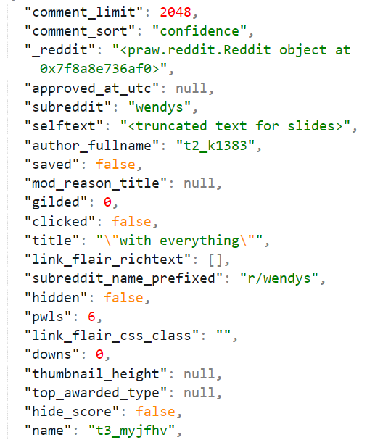
Example Data File

Slide 21
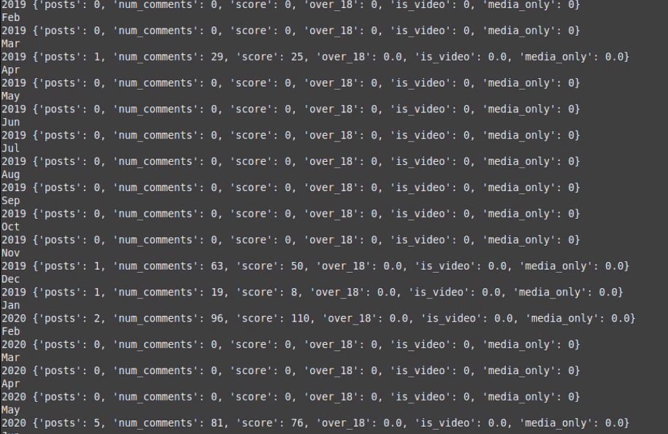
Example Statistics

Slide 22
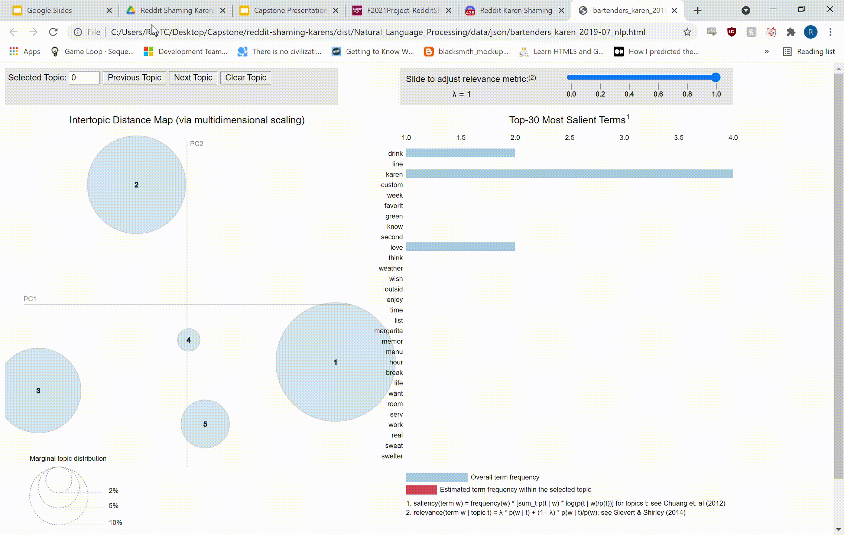
Topic Modeling

Slide 23
Deliverables
Collection of historical Reddit data spanning 36 months
30 subreddits
Keyword statistics within each
Python Executable
Historical data collection
Data analysis and visualization
Natural language processing

Slide 24
Future Plans
Higher Granularity graphs
Graphing options already supported
Per subreddit graphs
Reddit image analysis
Image downloading supported
OCR to pull text from images to process content
Extend to different industries
Framework provided so similar experiments can be conducted

Slide 25
Ending + Acknowledgements

Slide 26
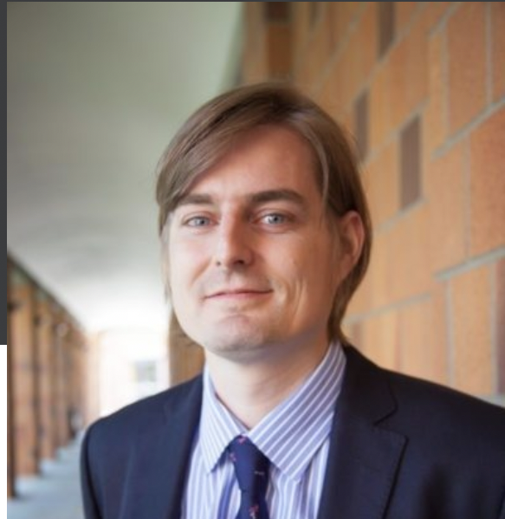
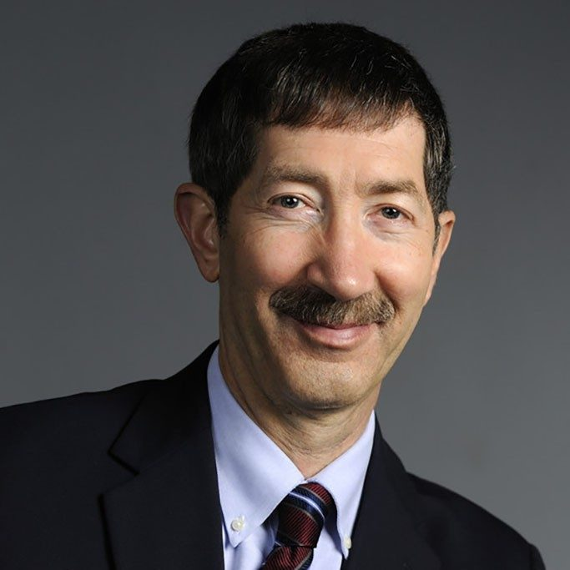
Acknowledgements
Dr. Florian
Dr. Fox
Client
Professor

Slide 27
Credits
https://www.dictionary.com/browse/karen
http://files.pushshift.io/reddit/
https://trends.google.com/trends/explore?geo=US&q=karen

Slide 28
Thank you!
Questions?

