Slide 1
Back to the basics of horse management series
Charley maxwell

Slide 2
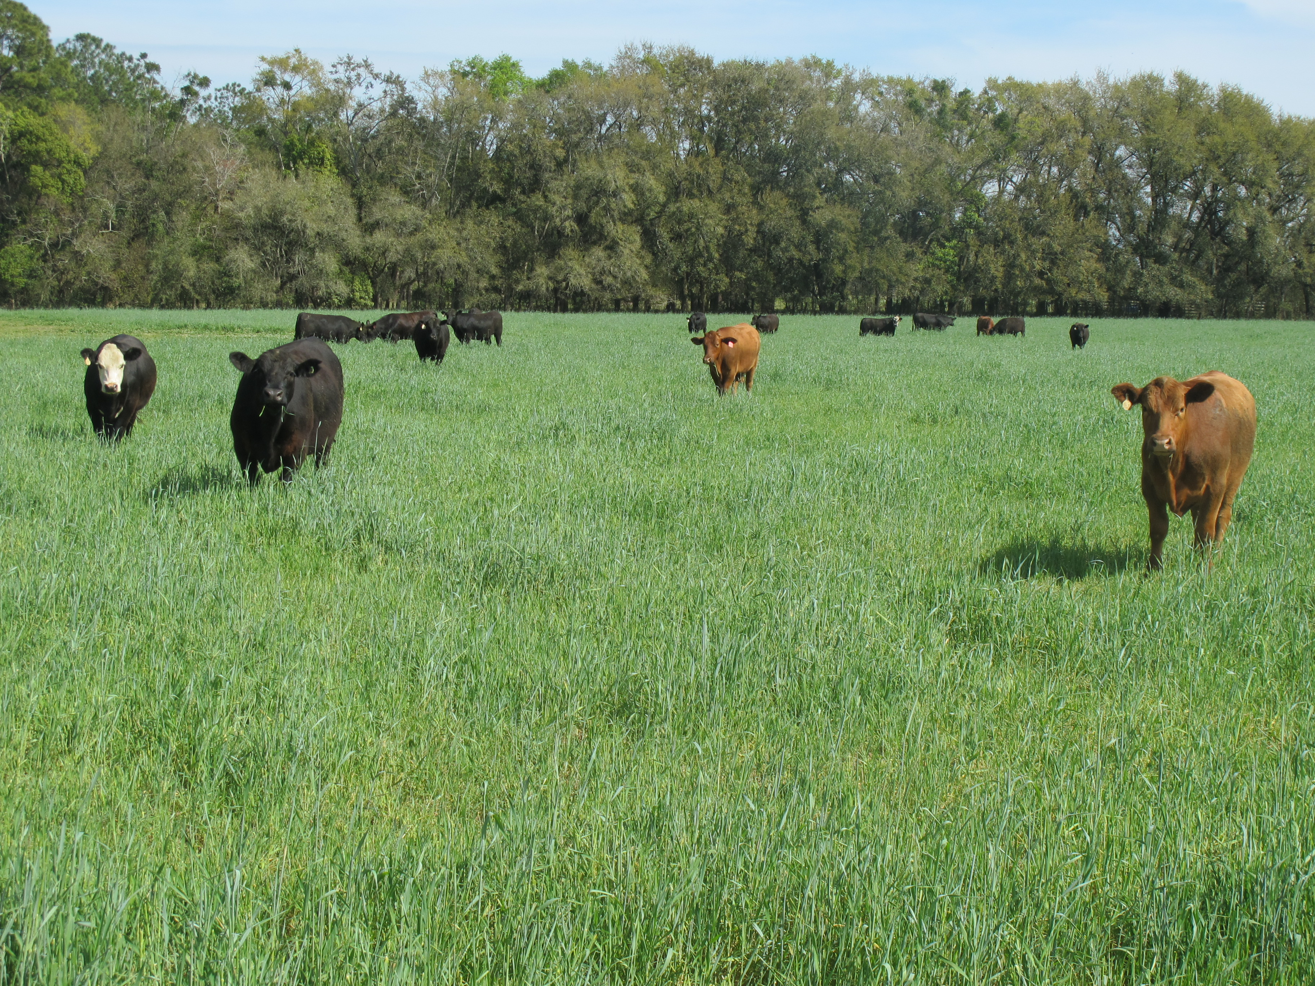
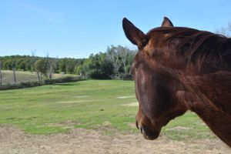
Why this series?
We have a lot of programs available for cattle producers and other livestock owners.
Land management
Nutrition
Nutrient management
Health
In the counties I cover, there are a lot of horses. However, there aren’t many, if any, programs offered to horse owners to better their management and sustainability.
Continuing education for PATH certified therapeutic riding instructors (several are in the area)
VS
Lautnerfarms.com
Pinterest.com

Slide 3
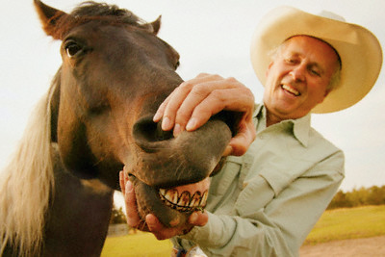
What does it involve?
I am planning for their to be 6 sessions throughout the year.
Soil Sampling and Pasture Management
Deworming
Hoof Care
Vaccinations and First Aid
Nutrition Part 1*
Nutrition Part 2*
The 6 sessions as a whole will be offered as a package to people who would like to complete the whole series.
Discount Rate
Intro meeting before the first session for those horse owners.
Each session will be open to the public, with a fee, as they are held in order to reach a larger audience and those who did not want to commit to all 6 sessions.
www.davisfeed.ca
Notes:
The series will be presented as a multiple month program you can be a part of, those people will get a discount. Each session will be advertised to the general public with a fee associated for each one. Horse people are very busy, especially once show season starts up and some are much more knowledgeable in areas than others.

Slide 4

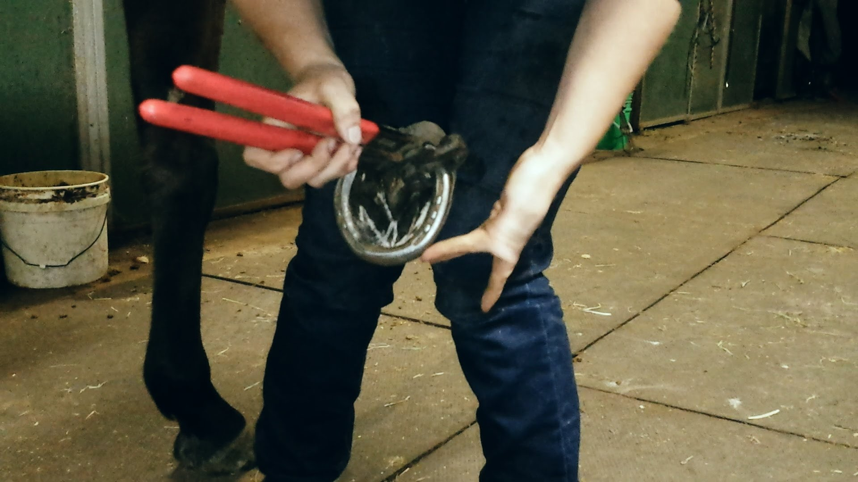
How will it be hands on?
I want there to be minimal lecturing and the participants actively practicing what we are teaching them.
This will likely limit participation size in order to accommodate everyone.
The nutrition section will be the hardest to make hands-on, but we will have to provide a lot of visuals for people to look at and feel where we can.
I would like to mimic what is being done in the Goochland/Powhatan Beef Cattle Production 360 Program where we are, after most sessions, going on farm visits to individually address each participants situation.
www.youtube.com

Slide 5
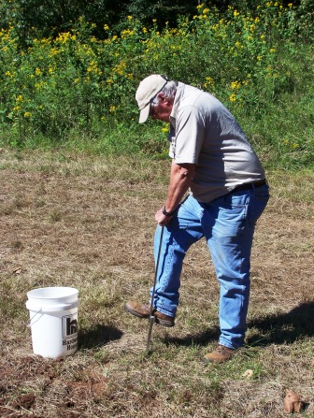
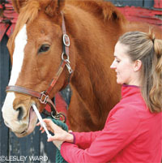
Examples of session activities
Soil Sampling and Pasture Management- do a field walk through, show them how to take a sample while we walk. Point out weeds, talk about grazing management and when to seed, etc. (Maybe even have a seeding demonstration).
Deworming- deworming horses is a hot topic and recently vets are really pushing for strategic deworming. I would like to partner with a vet (probably vets) and have a set day and time participants can bring their fecal samples, observe how a fecal float is prepared and have microscopes to do egg counts.
blackridgeland.com
www.horsechannel.com
Notes:
Deworming: I am thinking that this day might work out best if it is split into two half days as to not monopolize too much of the vets time and to allow people to figure out what there horse needs.

Slide 6
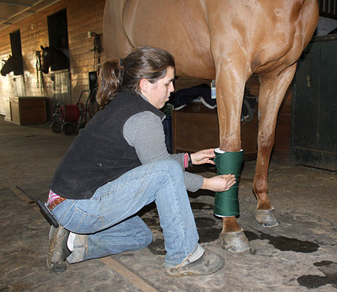
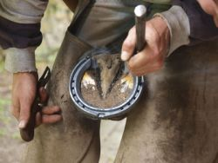
Examples continued
Hoof Care- we would partner with a farrier and a local stable who is willing to have demonstrations done on their horses. This session would cover common hoof problems, how to safely remove a shoe that is loose, proper bandaging of the hoof, etc.
Vaccines and First Aid- we would again partner with a vet on this one. They would cover why vaccines are so important in the horse world, which one’s you need to get for this area and your discipline. We would also cover general first aid, what to do before the vet gets there in order to help them work efficiently. VCPR will be covered as well as record keeping given the nature of the topic.
www.evaequinevet.com
www.southernstates.com

Slide 7
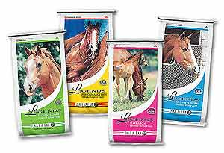
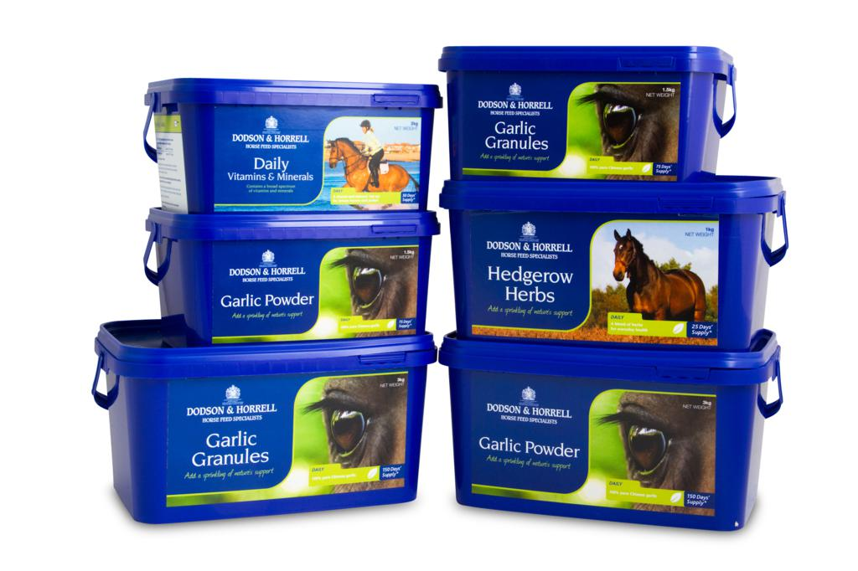
Nutrition…everyone’s favorite topic…
Horse owners are hay buyers 90% of the time…and they have no clue what they’re feeding or how it is made.
Horse owners are also, generally, going to buy whatever feed seems to have the most impressive label because it MIGHT just give them the edge they need to win…
The first part of the nutrition session will cover feeds and supplements along with instructions for hay sampling.
www.bellemeadcoop.com
www.equestrianlifemagazine.co.uk

Slide 8
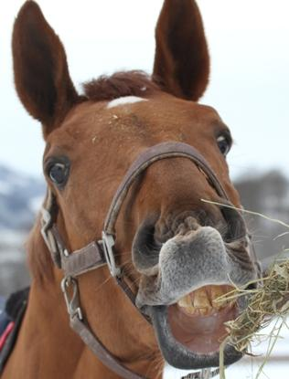
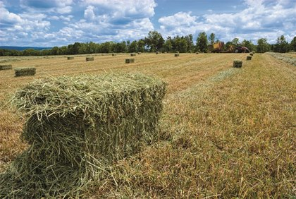
Nutrition continued
The second session would solely be on hay.
How hay is made
Qualities of good hay
Questions to ask when you’re buying hay
Results from the hay tests that they sent off would be back in, so we would cover how to interpret those results.
Nutrition 1 and 2 would go hand in hand
archive.constantcontact.com
www.thehorse.com

Slide 9

Anticipated challenges
Show season…is there really ever a down time?
Repeat each session in both counties, try to flip-flop sessions between the two or just do it in one?

Slide 10
Questions? Suggestions?

