Slide 1



Final Report
CS 5604 Team 2 for End Users
Instructor:
Edward A. Fox
SME:
Satvik Chekuri
Team:
Akshita Teegalapally
Madhuvanti Muralikrishnan
Manoj Paidiparthy
Ramaraja Ramanujan
Romil Khimraj Balar
Shaunak Juvekar
Vivek Murali
Blacksburg, VA 24061
December 13, 2022

Slide 2
Overview

Slide 3
Mission
There is a huge collection of ETDs having large amounts of data that can be utilized.
We will be building a search service and recommendation system that supports ETDs and a front-end for the end user.
Our task is to pre-process, extract and index data, improve search performance and provide recommendation.
We have the following services:
Indexing and Search
Recommendation Engine
Front-end user interface

Slide 4
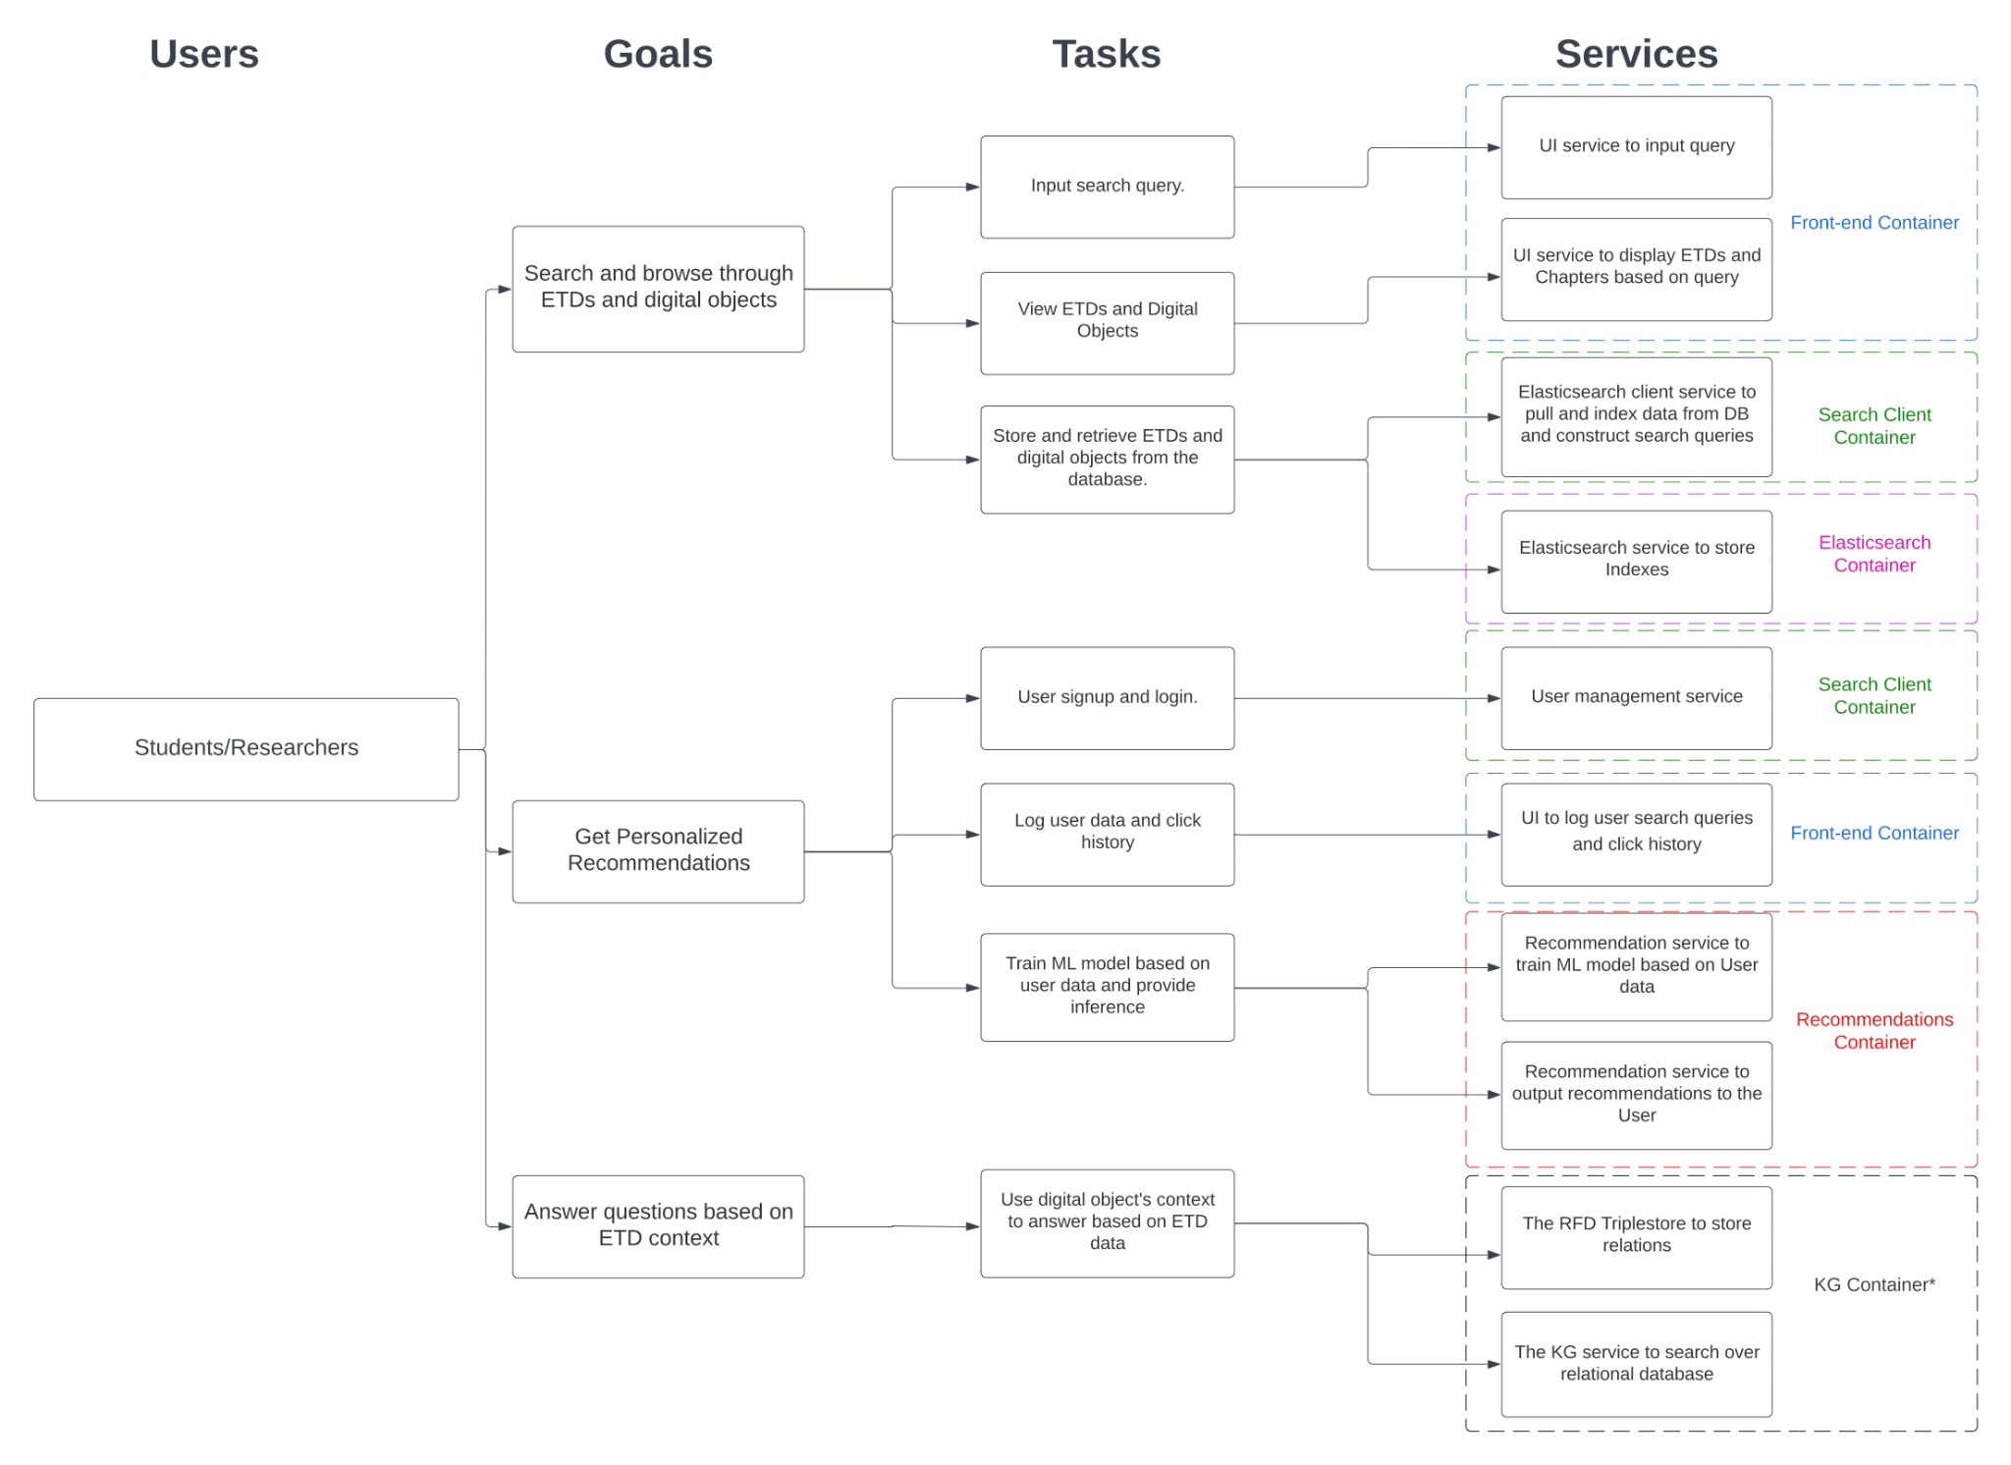
User Workflow

Slide 5
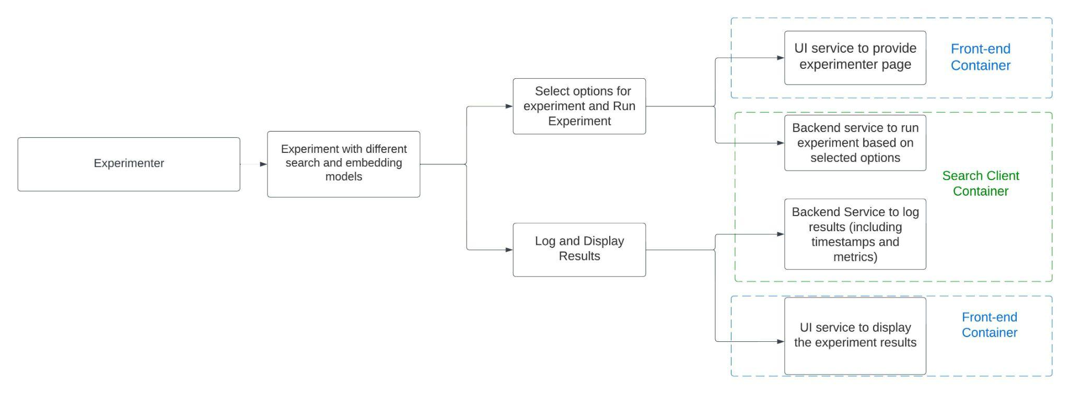
Experimenter Workflow

Slide 6
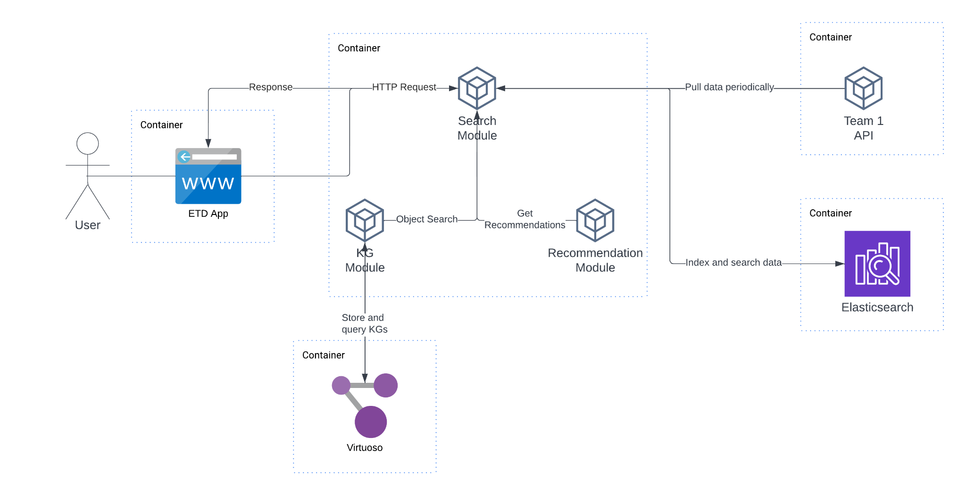
Architecture

Slide 7
Front-end

Slide 8
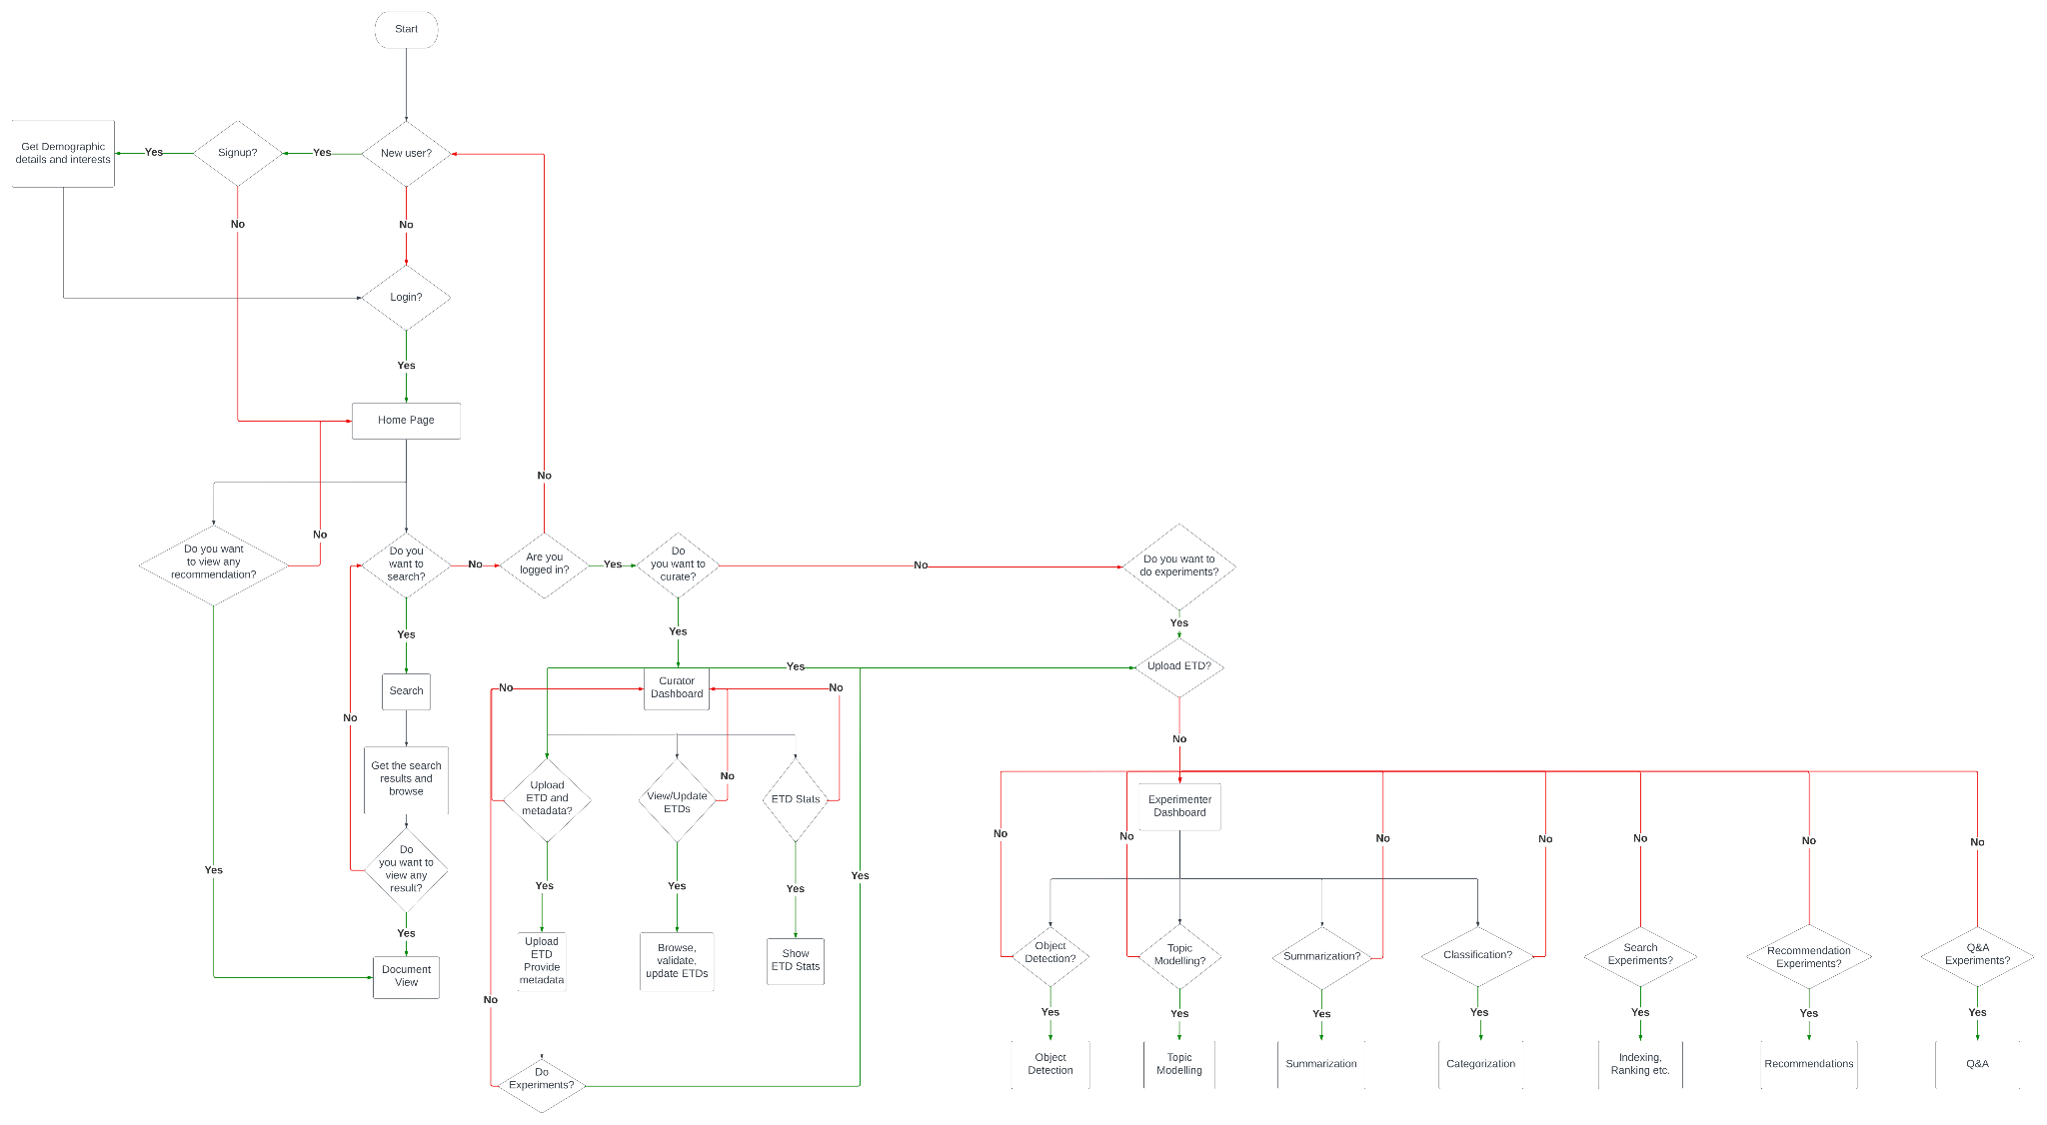
User Flow

Slide 9
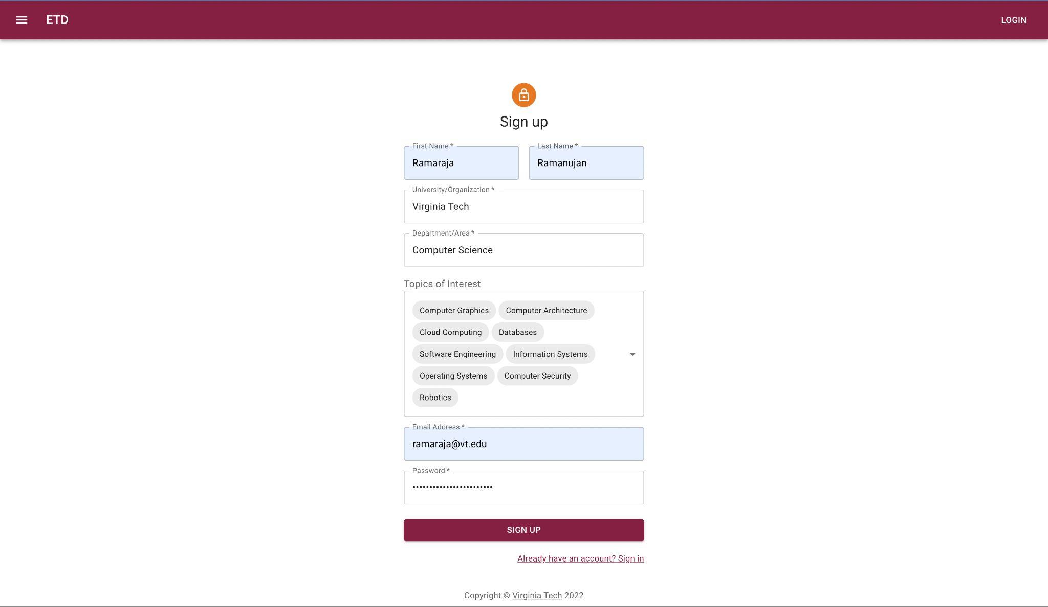
Signup

Slide 10
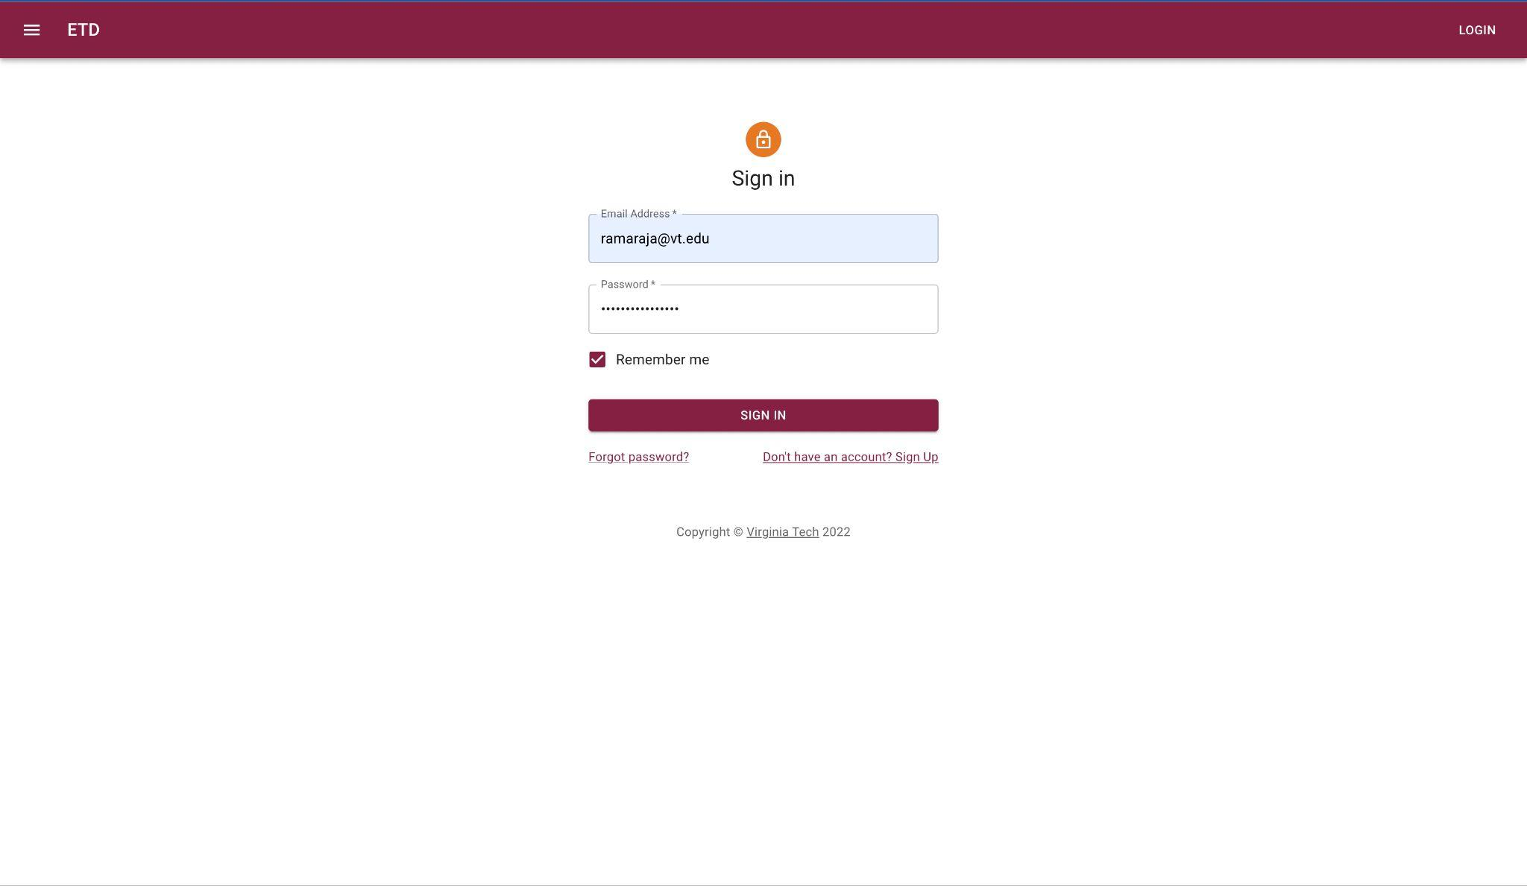
Login

Slide 11
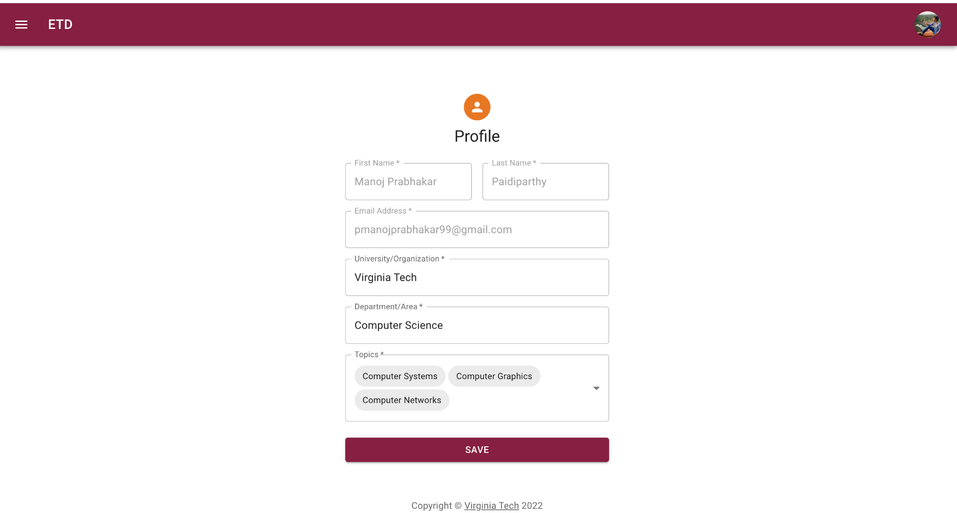
Profile

Slide 12
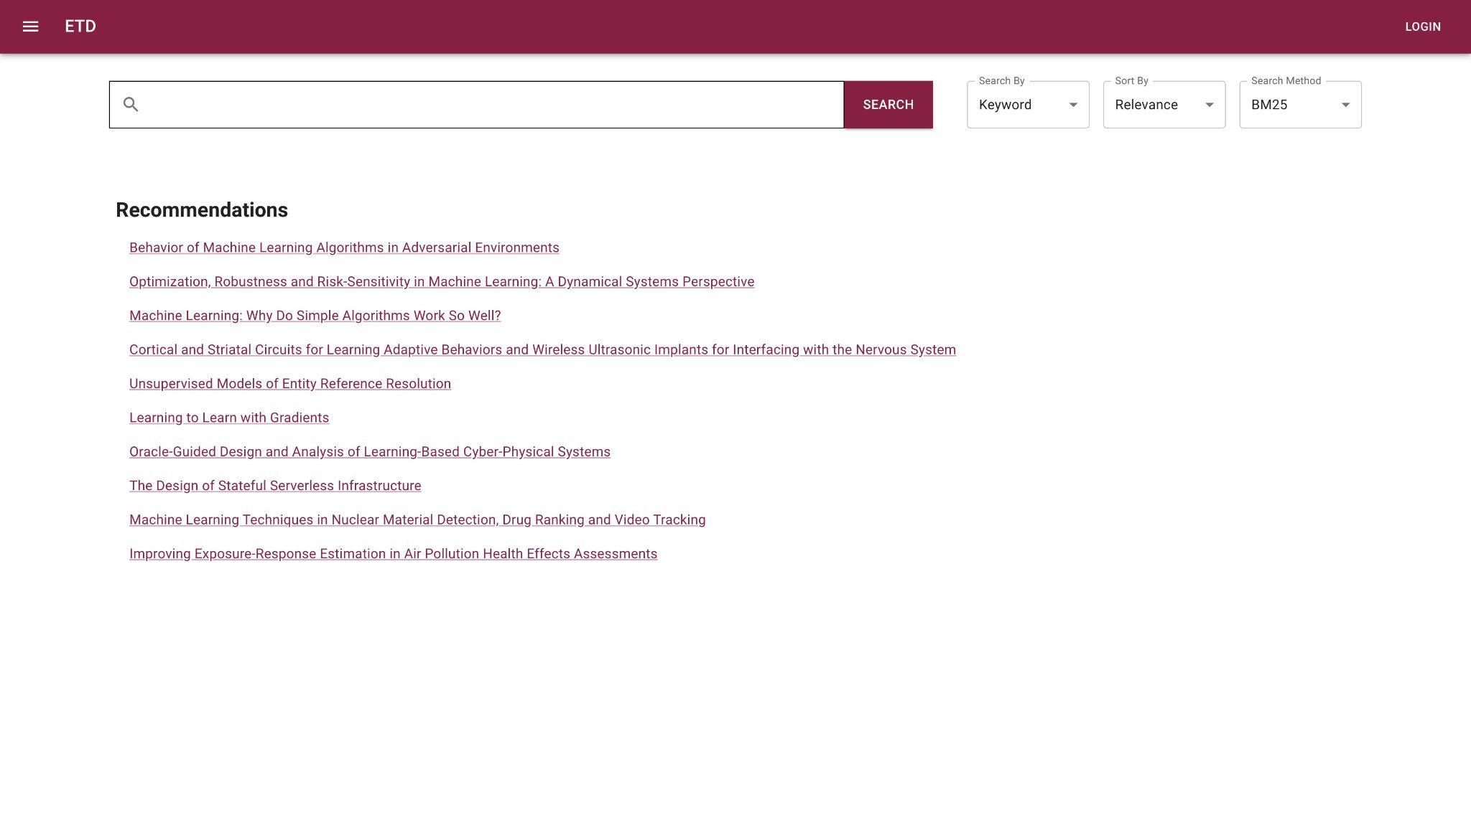
Home

Slide 13

Sidebar Navigation

Slide 14
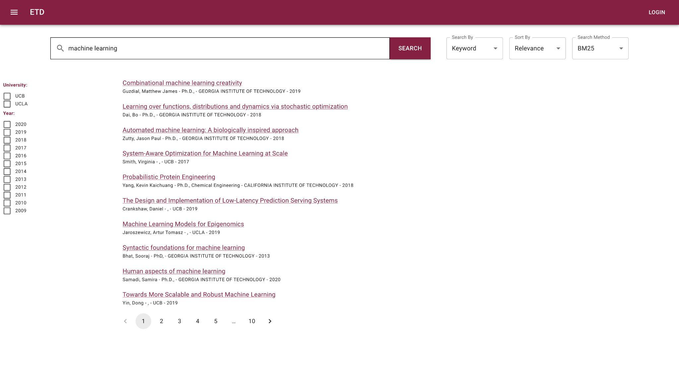
Search Results

Slide 15
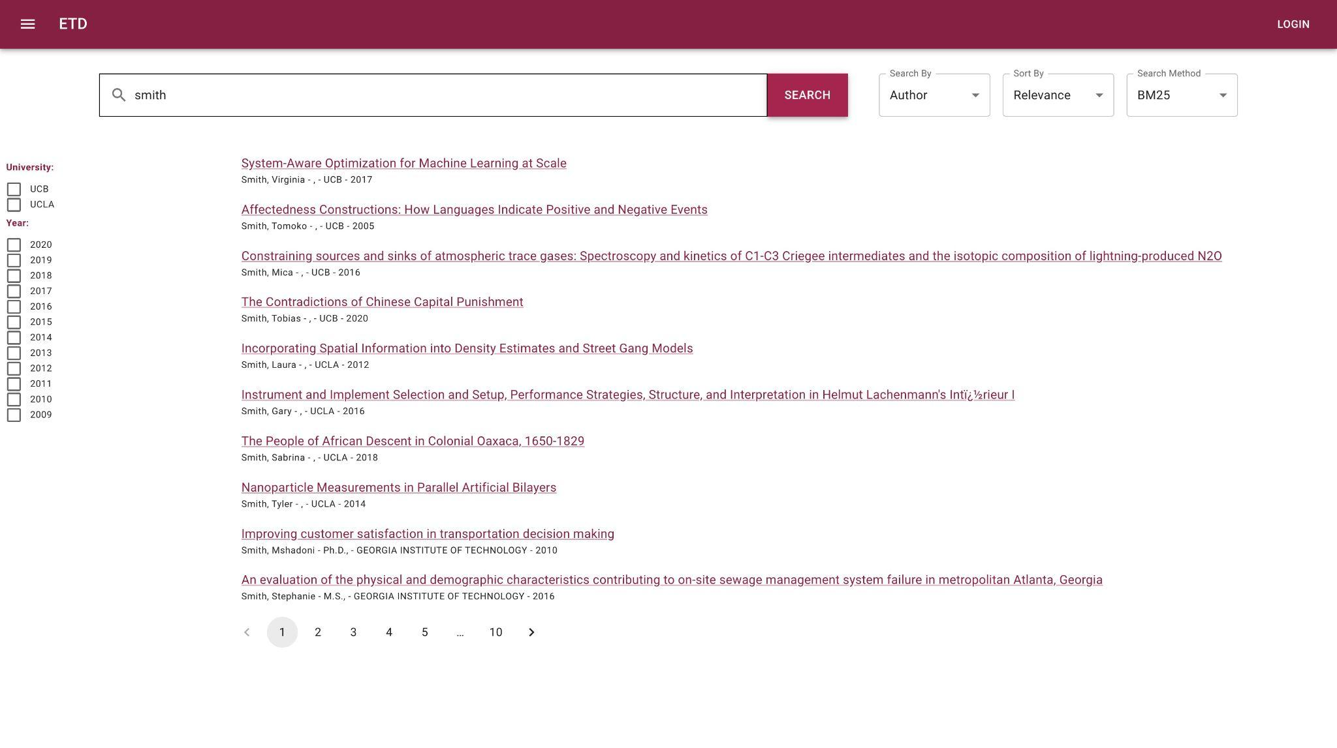
Term Field

Slide 16
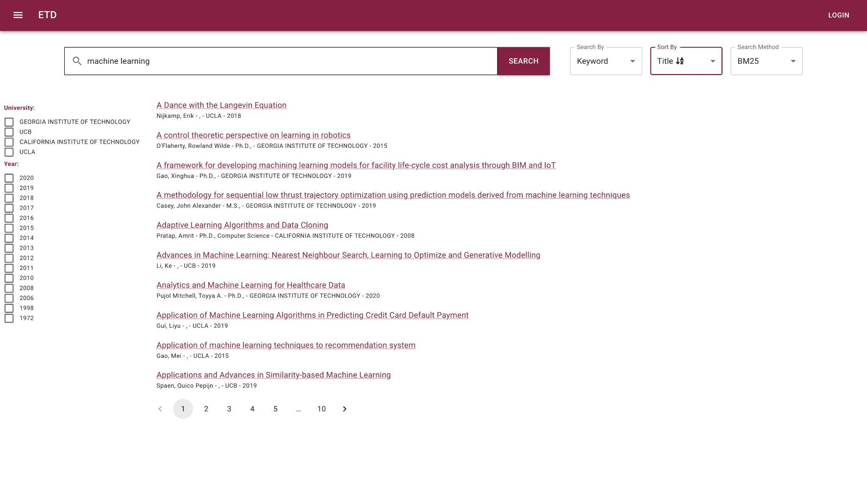
Sorting

Slide 17
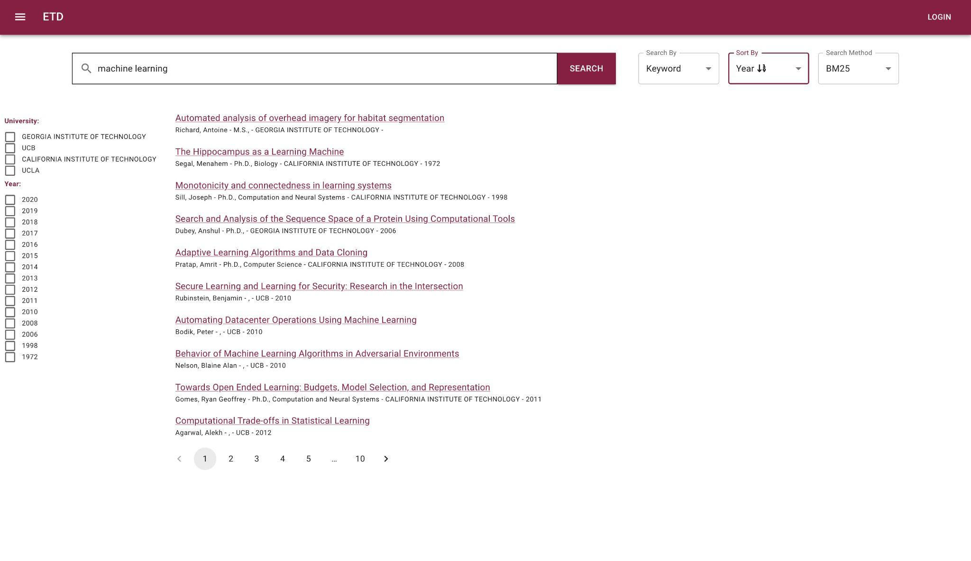
Sorting

Slide 18
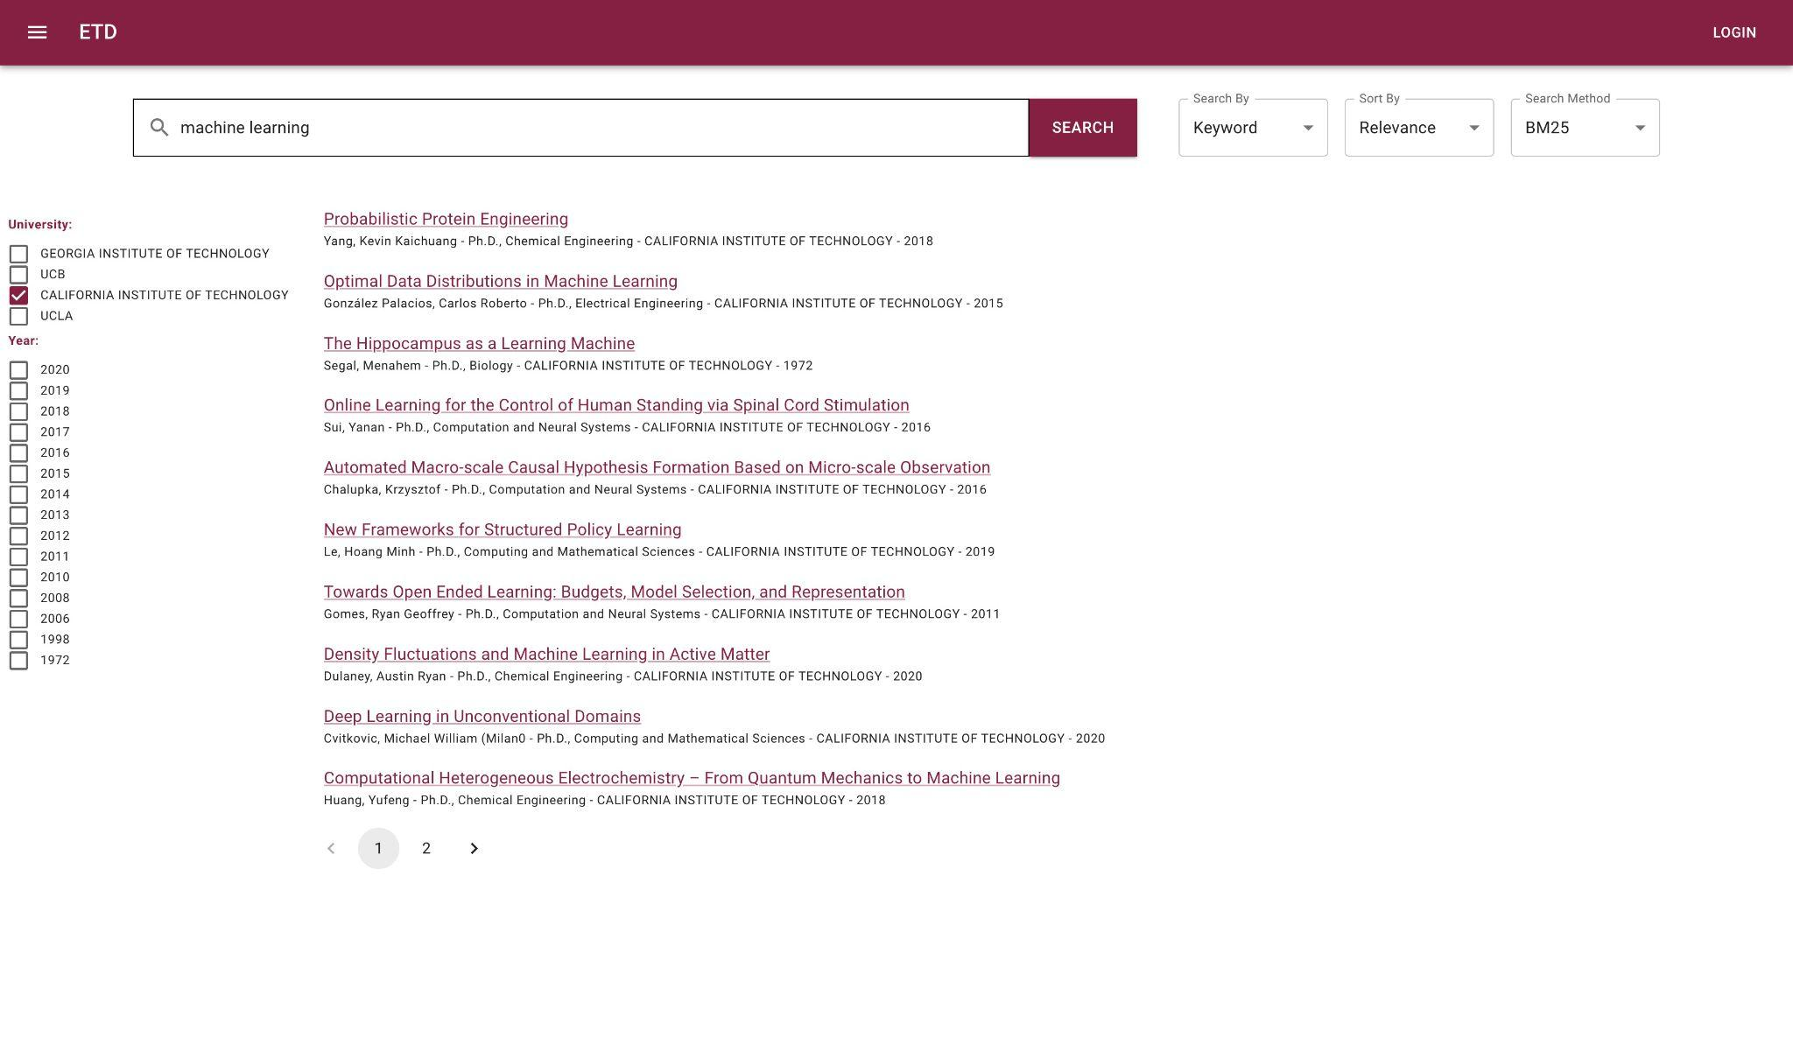
Filters

Slide 19

Filters

Slide 20
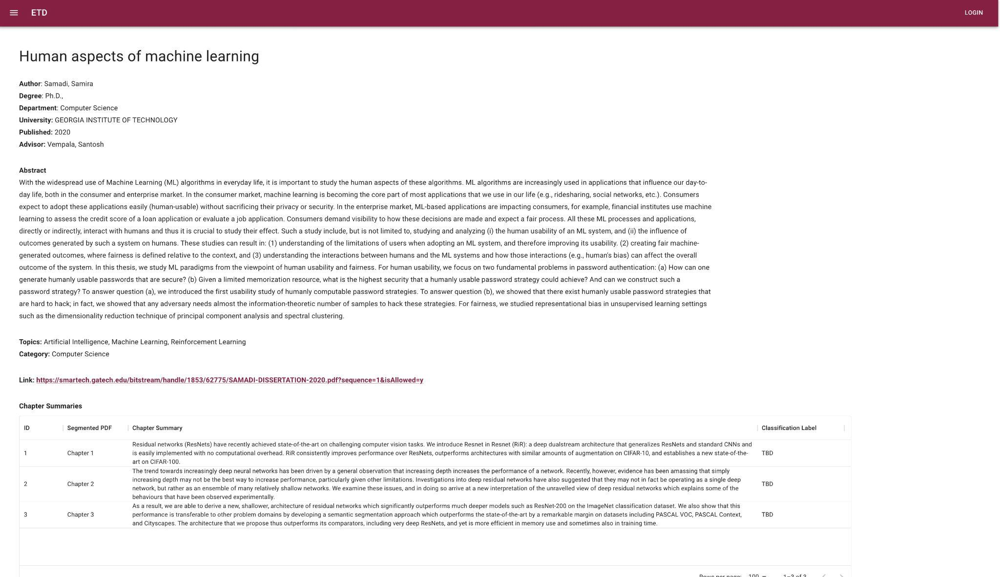
Document View

Slide 21

Method

Slide 22
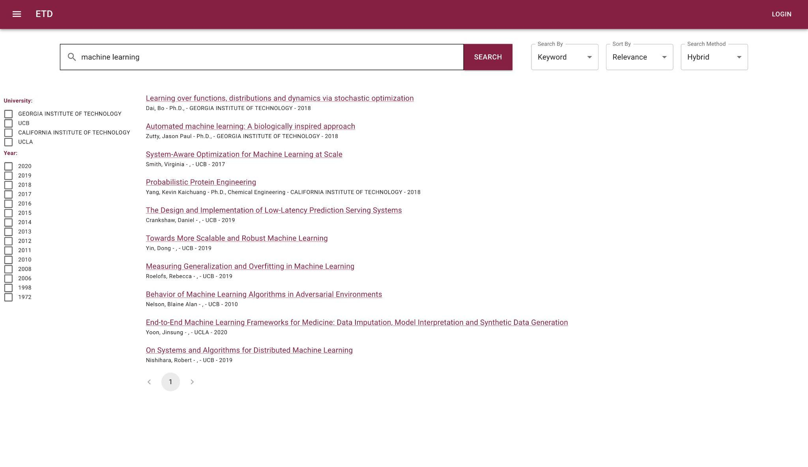
Method

Slide 23
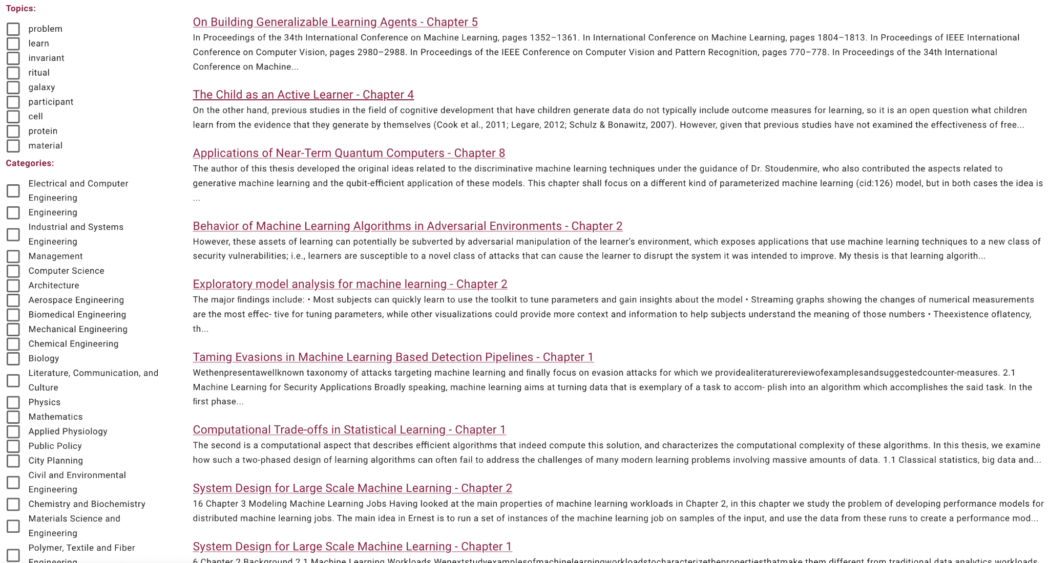
Chapter Search

Slide 24
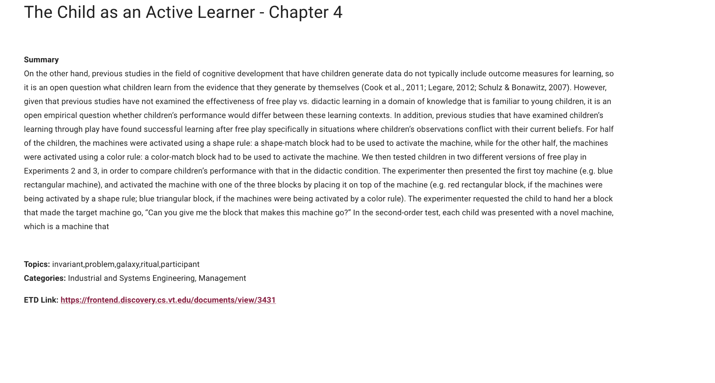
Chapter View

Slide 25
Search

Slide 26
Elasticsearch
Elasticsearch is a search engine built on top of Apache Lucene, a full-text search-engine library.
Traditional SQL database management systems are not designed for full-text searches against large volumes of data. Elasticsearch would let us index and search over the huge collection of ETDs using full-text search.
Elasticsearch uses JSON as the serialization format for documents which facilitates ease of use and compatibility with several open-source analyzers and visualization tools.

Slide 27
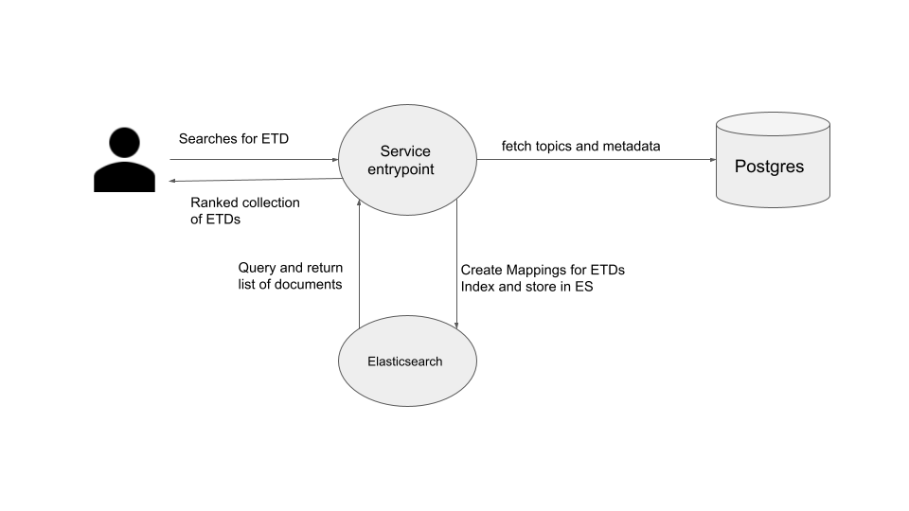
Search Flow
The Search service indexes the available data into Elasticsearch, processes the queries from the Front-end and returns an array of JSON documents.

Slide 28
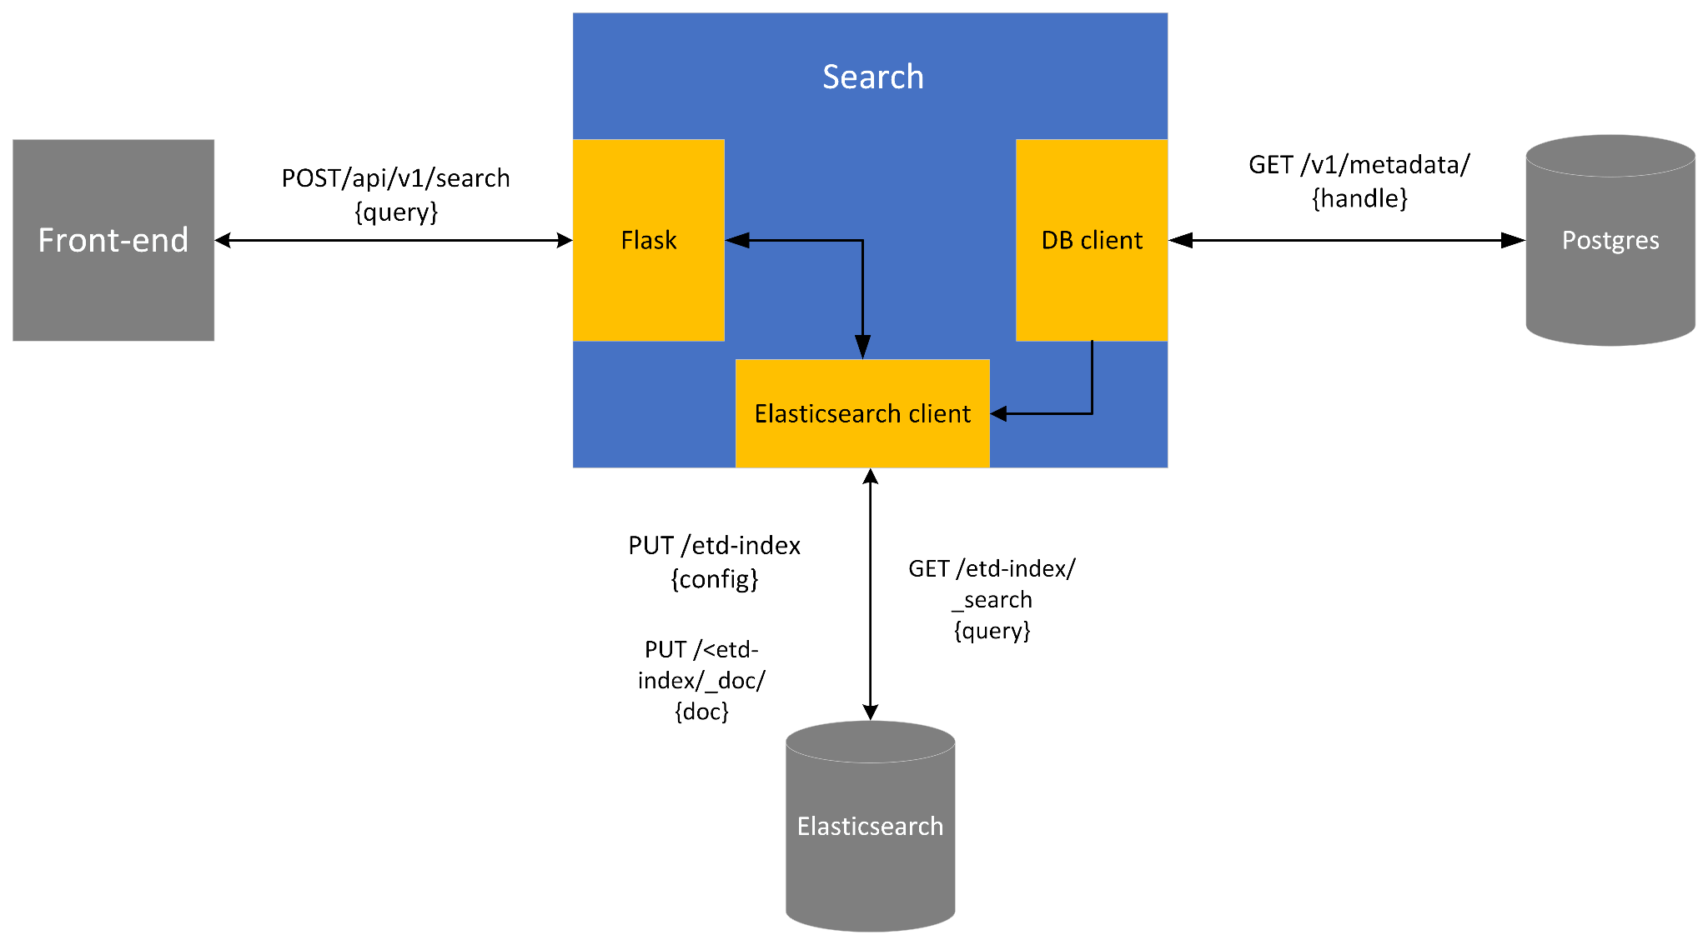
Containerizing Search Service
The Search service runs inside a Docker container which is hosted on the cloud.

Slide 29
Explicit Mapping
We are using explicit mapping to have greater control over the ETD data while indexing it. The table structure below shows mapping for ETD metadata.
Property | Field
title | keyword
author | keyword
advisor | keyword
abstract | text
university | keyword
degree | keyword
year | integer
department | keyword
xml_path | text

Slide 30
Objects Mapping
Property | Field
objects | nested
objects.metadata | object
metadata.bounding_box | text
metadata.page_number | text
metadata.is_image | boolean
topics | objects
topics.name | keyboard
topics.probability | float
summarization | object
summarization.text | text
summarization.algorithm_used | keyword

Slide 31
Indexing ETD Metadata
For accessing the ETD metadata, we pulled it from a endpoint provided by Team-1 using a Python client.
Since we are using explicit mapping, we used the index template specified in IR2 and mapped it to a specific index name.
We used bulk indexing to index the data since this method does
not load all the data into memory before indexing, which improves performance and reduces memory consumption.

Slide 32
Search Methods
BM25 (Default):
Searches and returns results based on a probabilistic model.
kNN search:
Performs semantic search based on embeddings.
Hybrid:
Performs kNN and match based search independently, combines and returns top results based on combined score (e.g., 0.9 * match_score + 0.1*knn_score)

Slide 33
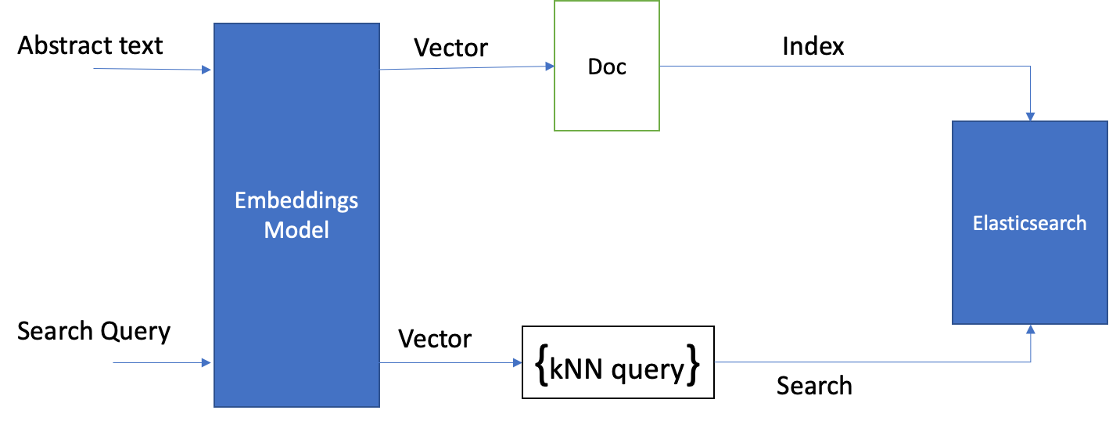
KNN Pipeline

Slide 34
Chapter Search
There are three main tasks in chapter search:
Mapping of the chapter object.
Indexing chapters.
Searching over the chapter index.

Slide 35
Chapter Object Mapping
We created mappings for the chapter object in a file named chapter_template.json.
This template was used to create a new index ‘chapters’.
Property | Field
id | integer
title | keyword
topics | keyword
categories | keyword
summary | text
etd_id | integer
etd_title | keyword
Table: Chapter mapping

Slide 36
Chapter Indexing
We used Team 1’s API to fetch all objects using a GET request.
Postprocessing was performed on the data in order to have the right data format.
We are specifically using the objects with type ‘clean_text’ to index chapters.
This processed data was then indexed into Elasticsearch using bulk indexing.
We have indexed a total of 21537 chapters into ES belonging to 5000 ETDs.

Slide 37
Search query over chapters
Similar to searching over ETDs, we used a Python Elasticsearch client to search over chapter metadata.
For chapters, we use the default BM25 algorithm for searching.
The respective results are then returned to the front-end for display.

Slide 38
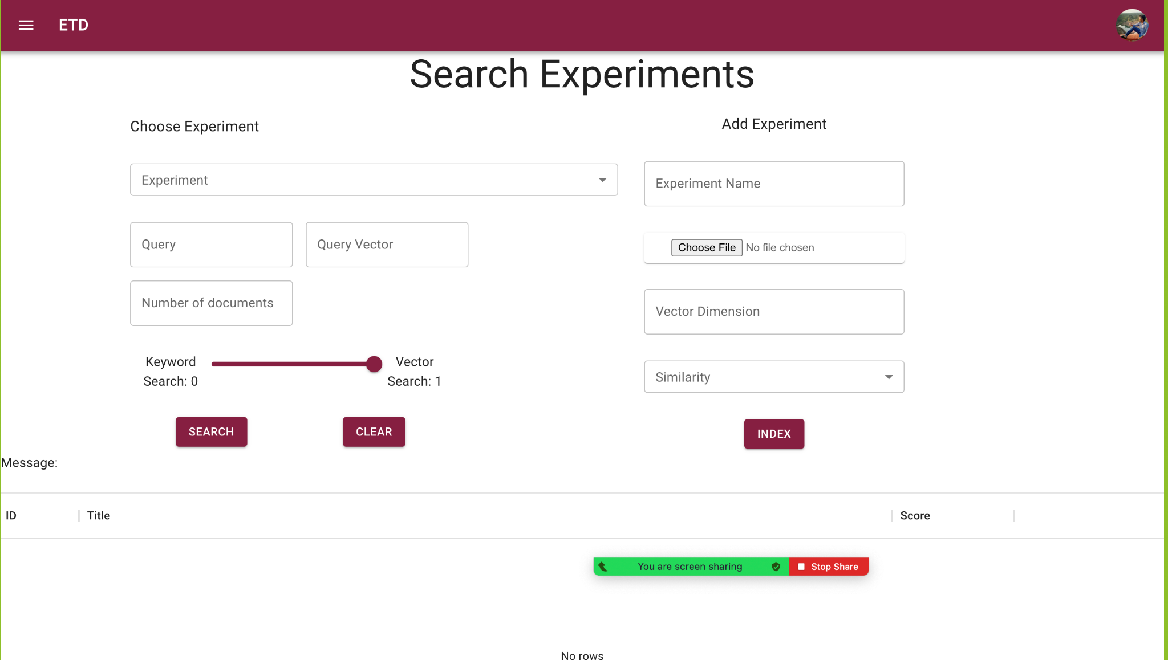
Experimenter Page

Slide 39
Experimenter Page
Default Experiments:
  all-distilroberta-v1
  all-mpnet-base-v2
  all-MiniLM-L12-v2
  LaBSE
Custom experiments per user
  Upload CSV with metadata and custom vectors

Slide 40
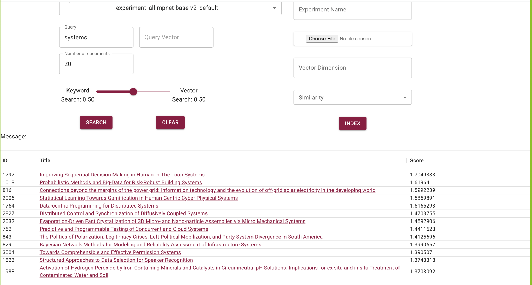
Experimenter Page

Slide 41
Logging

Slide 42
What we are logging
Search Query
Every query the user searches for gets stored
User visits:
Every search result that the user clicks on gets stored

Slide 43
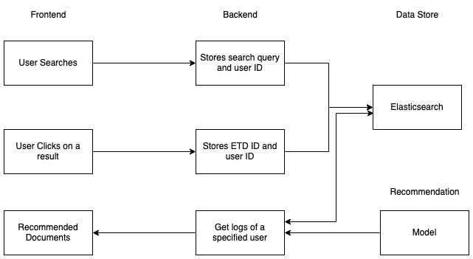
Logging Flow

Slide 44
Recommendation

Slide 45
Objective
Objective : Recommend new ETDs for users to read
How?
Based on user search history and user interactions
Ingested tags for an item
Notes:
43 - 48

Slide 46
What are we recommending?
Documents to each user.
For a registered user, Personalized ETD recommendations based on search history, interaction logs, and user profile in the form of a ‘For you’ section.
For an unregistered user, documents are from from the ‘trending’ topics.

Slide 47
Data
User Interaction
1. Clicks on ETD link
2. Opened ETD PDF
3. Clicked link but didn't open ETD PDF
4. Dwell time for ETD (after clicking on ETD link)
Search Query
1. Degree level
2. Major (CS, ECE, etc.)
User Search History
User Demographic
Addressing cold start:
Interests: the user chooses from modelled topics (Team 3 topics)

Slide 48
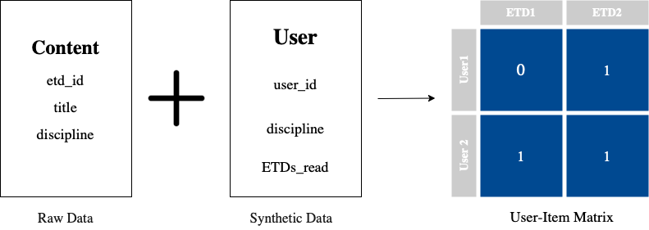
Dataset

Slide 49
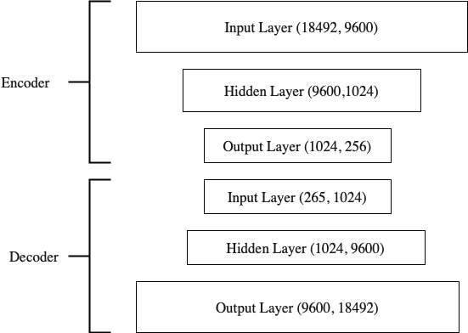
​​
Model Architecture
Autoencoder

Slide 50
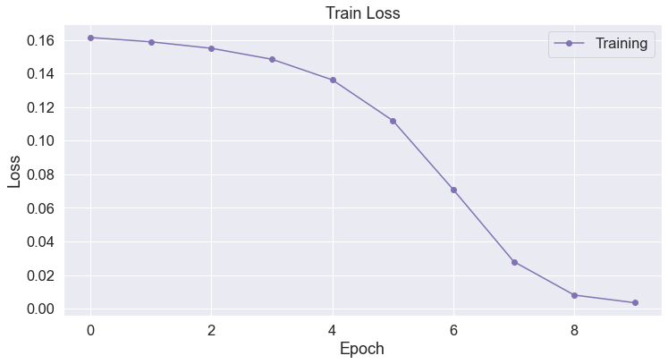
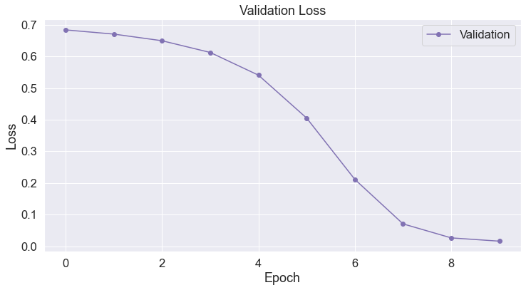
Train and Validation Results

Slide 51
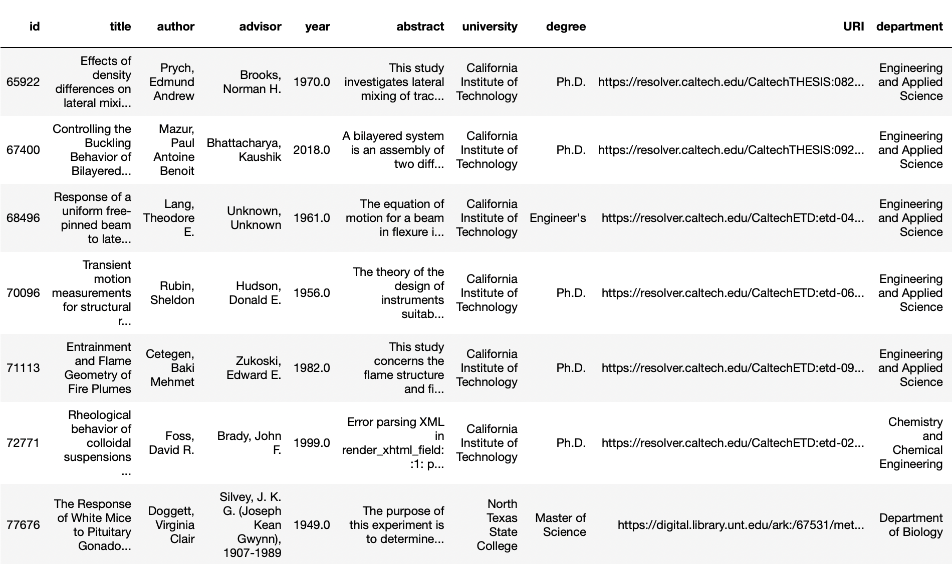
Test Result for User 42

Slide 52
Fine-tuning on user actions
After periodic intervals, we utilize the logged user actions to retrain the model by generating a new user-item interaction matrix dataset.
This fine-tuning helps us generalize the behavior of new and existing users by providing more data on what kinds of users are reading what kinds of ETDs.
With more time and more users, we are able to capture all kinds of user behaviour and therefore provide more accurate recommendations.

Slide 53
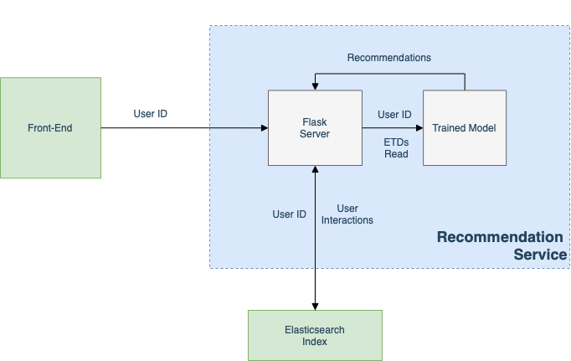
Containerizing Recommendation Service

Slide 54
Knowledge Graph

Slide 55
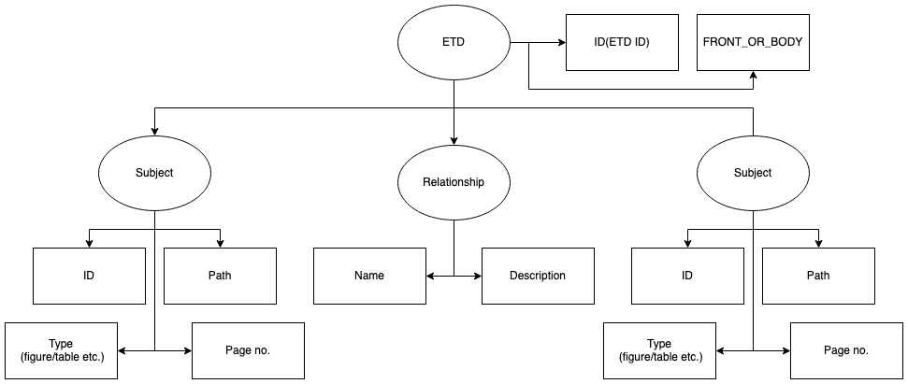
RDF DB Schema
This schema has been provided to Team 1

Slide 56
Cloud Services
Search Service:
https://search.discovery.cs.vt.edu/
Front-end Service:
https://frontend.discovery.cs.vt.edu/
Recommendation Service:
https://recommendation.discovery.cs.vt.edu

Slide 57
Thank You!
Questions?

