Slide 1
CS Information Session Reservation
Nicole Moore, Quentin Simoneaux, Michael Hoff, Barbara O’Connor
CS 4624 Multimedia, Hypertext, and Information Access
Dr. Edward A. Fox
Virginia Tech
Blacksburg, VA 24061
4.23.2020
Notes:
The final presentation will cover testing and assessment, as well as deliverables, accomplishments, lessons learned, and ideas for the future.

Slide 2
Outline
Background
Project Goals & Requirements
Project Deliverables
Project Design
Recent Progress
Demo
Final Implementation
Testing
Plans
Lessons Learned
Ideas for the Future
Acknowledgements
References
Notes:
Made outline bigger/ easier to read

Slide 3
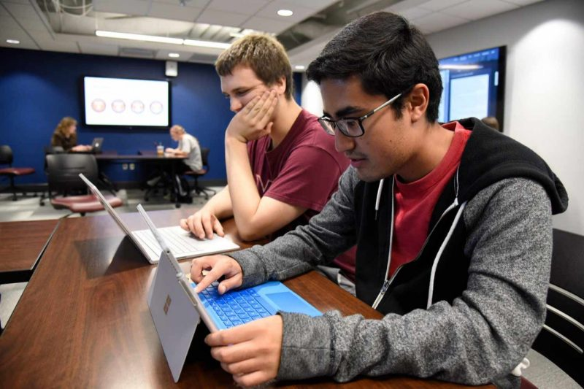
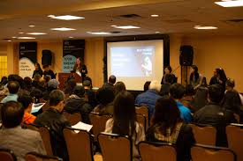
Background - CS Info Sessions
CS info sessions allow prospective students/parents to interface with CS students and staff.
Ambassadors hold sessions with small groups.
CS department can provide important information about program to attendees.
Attendees can ask questions and receive personalized answers.
Notes:
Added slide to explain info sessions and CS ambassadors

Slide 4
Project Goals & Requirements
Goal
Requirements
Desired base functionalities
Automation
Easy to maintain solution
Create CS Info Session sign-up system with emphasis on automation and simplicity
Notes:
The the goal for this project was to create a new online sign up system for CS information sessions,
Requirements:
Minimum functionality: end-to-end process to sign up for information sessions online
Automation: Our clients would like the process to be automated to eliminate wasteful day-to-day tasks that are completed by the CS Admins
Increase ease of use for CS Admins, Ambassadors, and prospective families.
After our team graduates our system should be easily handed off to someone else

Slide 5




Project Deliverables
Collection of tools used by CS Admins, Ambassadors, and prospective families
  Custom sign-up form
  Shared Admin/Ambassador calendar
  Spreadsheet of family data
Automation of processes using these tools

Slide 6
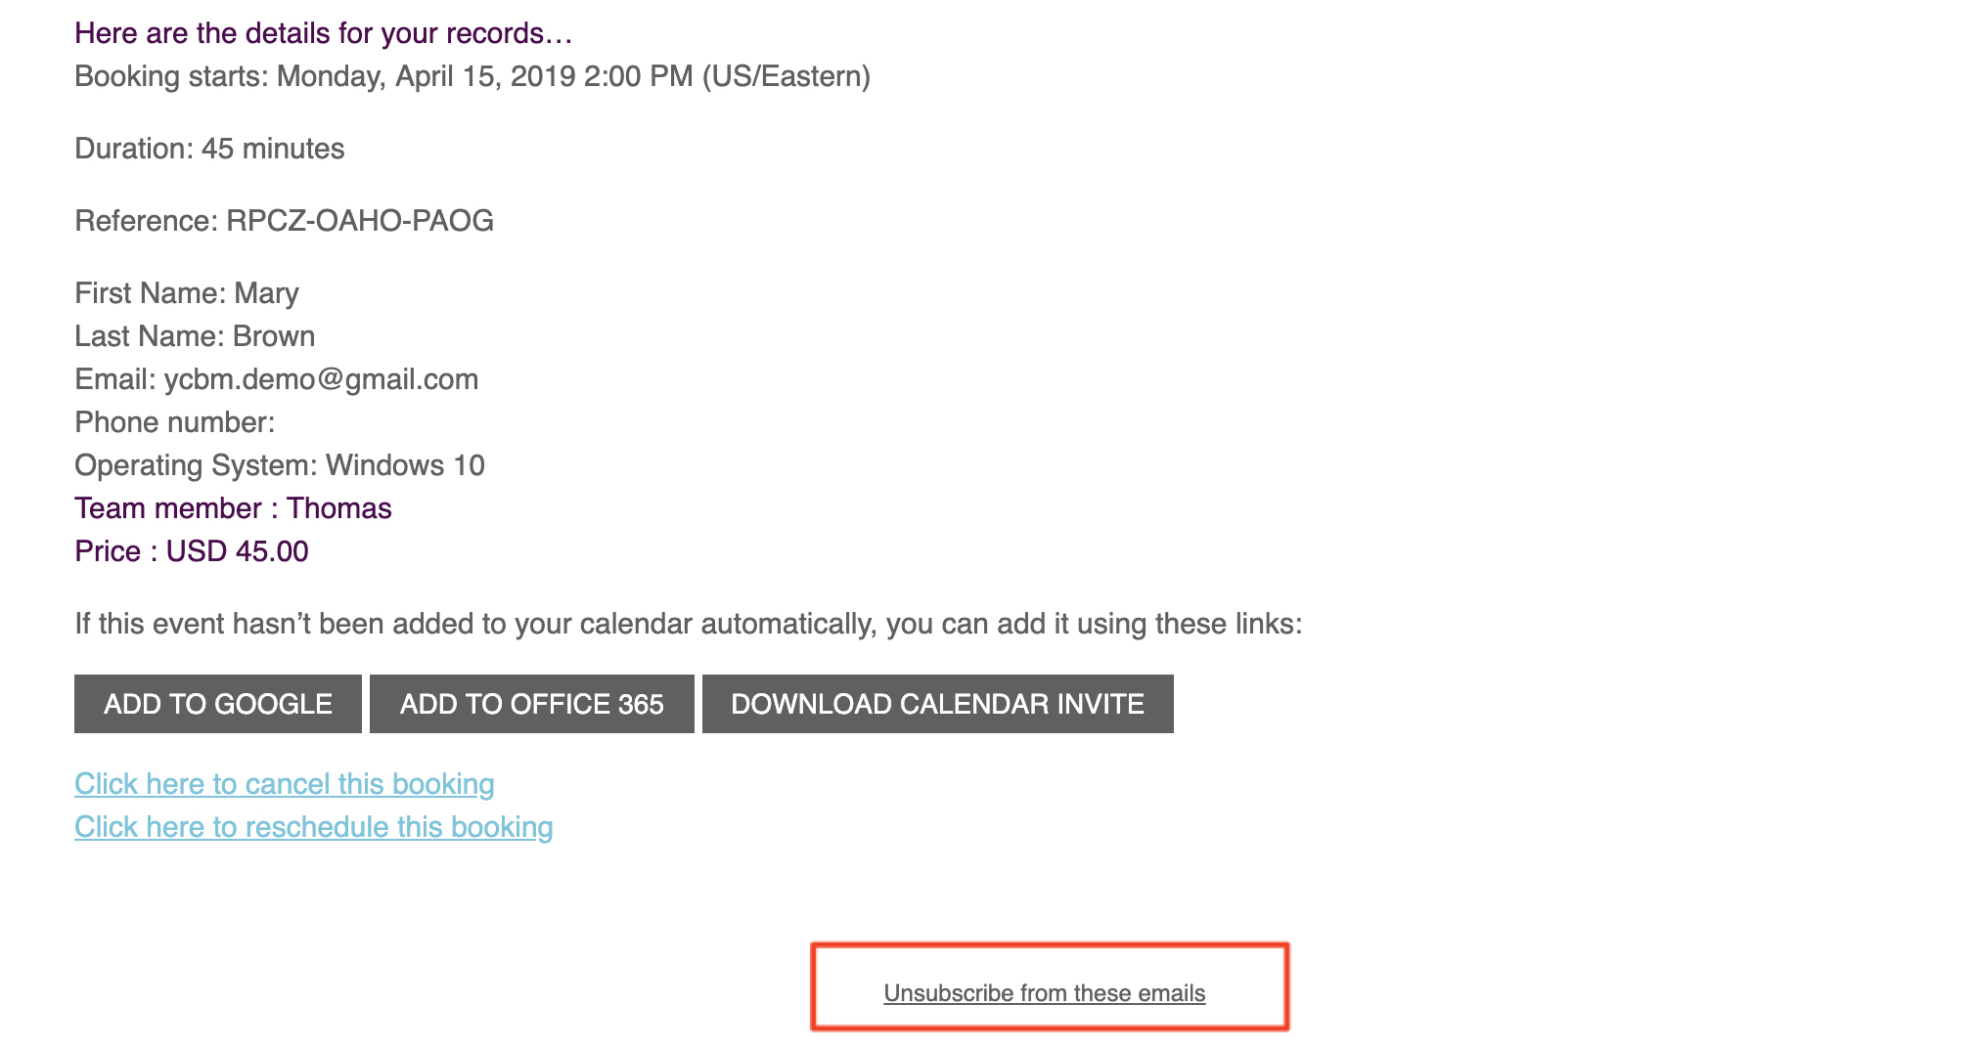

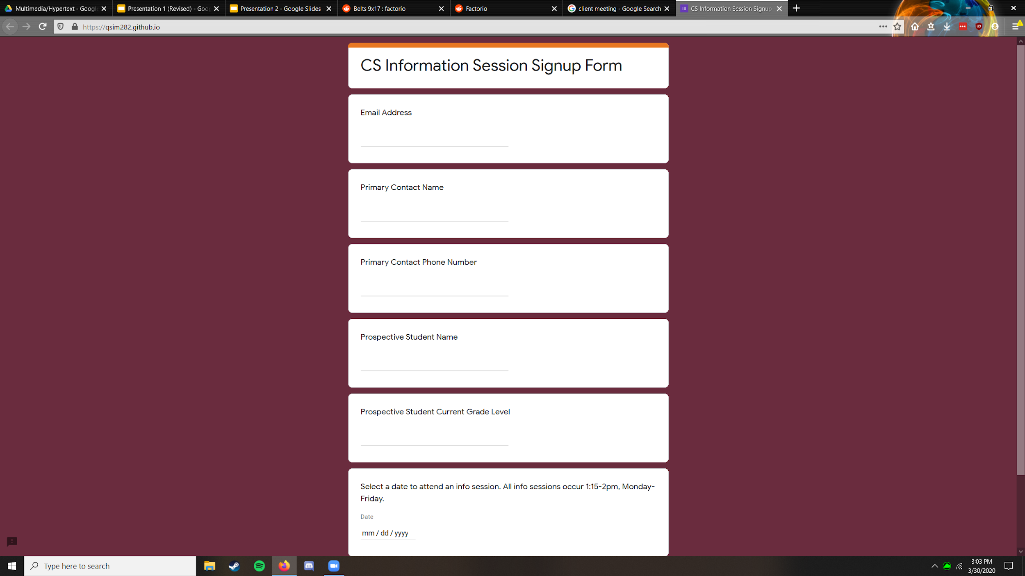
Project Design - Prospective Families
Confirmation Email
START
Prospective Families
Sign Up Form

Slide 7
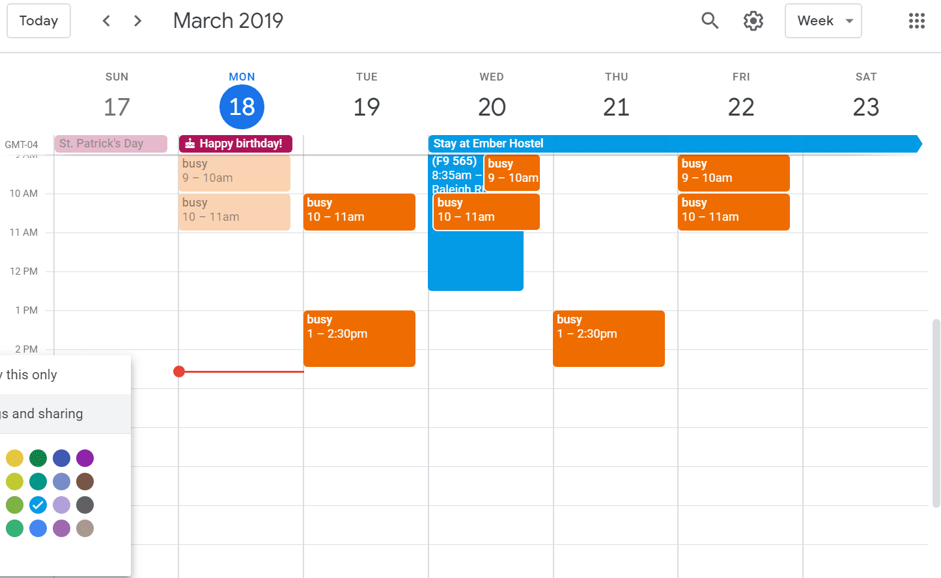
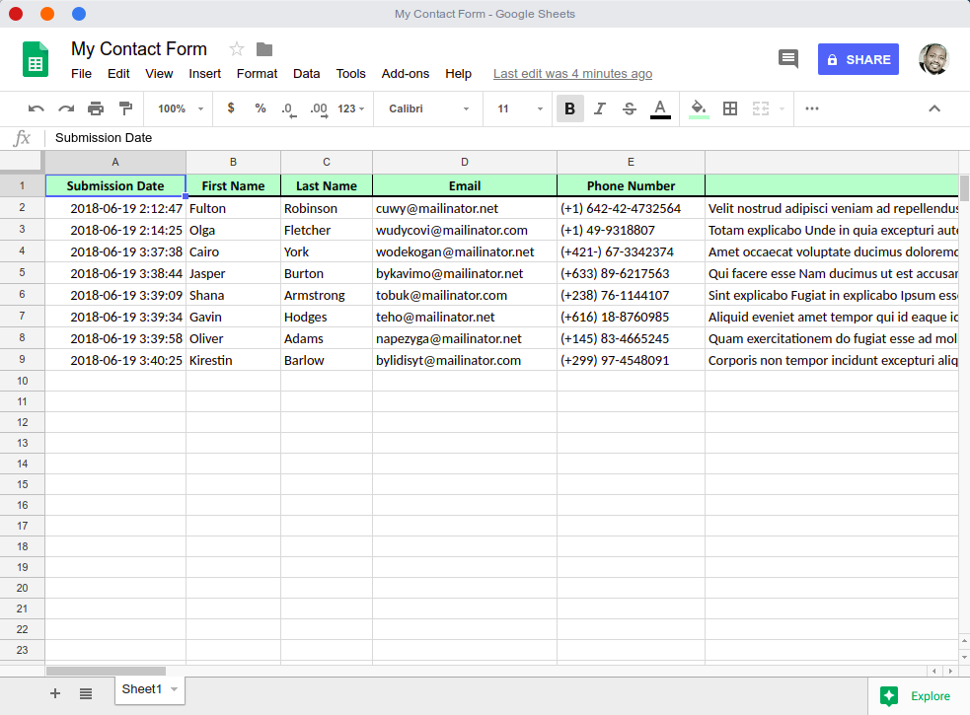
Project Design - CS Administrators
Confirmation Email
START
CS Administrators
Admin Calendar
Info Collection

Slide 8
Project Design - CS Ambassadors
Info Collection
START
CS Ambassadors
Admin Calendar

Slide 9
Project Design
Collection of tools to be used by CS Admins, CS Ambassadors and prospective families:
  Form to sign up
  Spreadsheet to track info
  Calendar for ambassador sign up
Automate end to end process for CS Admins:
  Sign up and reminder notifications
  Update calendar events
  Daily check for ambassador

Slide 10
Recent Progress
Met with client and reprioritized tasks
Updated implementation/added new features
Testing/Assessment
Notes:
Thanks Nicole, next I’ll touch on the progress we’ve made since our last presentation
We met with our client one more time to iron out the remaining tasks we had for our project, and wound up reprioritizing them based on what the client wanted
As a result we wound up updating our implementation to be able to develop
Reprioritized tasks: update event, reminder emails, confirmation emails, styling
GAS: easier to customize and work with, eliminated use of third party applications and add-ons (no more Zapier or event-o-matic)
Testing: will go over that in future slide

Slide 11
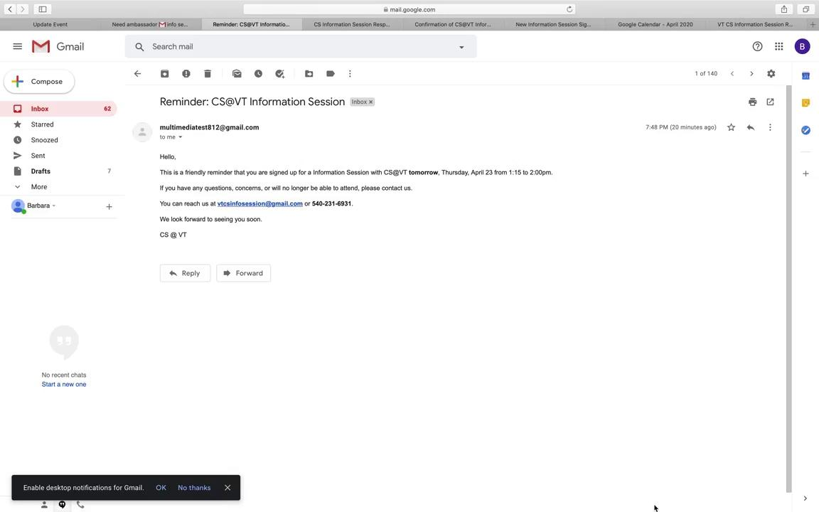
Demo
Notes:
Form → Calendar → admin confirmation email → family confirmation email → spreadsheet → family reminder email day before → check for ambassador email
Prefilled form submit to date with family already signed up to show that it updates event/adds additional people to prexisting one (DON’T SIGNUP WITH VT EMAIL)
Show both types of confirmation emails

Slide 12



Final Implementation
Google Suite applications
  Forms, Sheets, Calendar, Gmail
Google Apps Script
  Time-based and event triggers
HTML/CSS/JavaScript
  Custom sign-up form
Notes:
G-Suite = ease of use for client → tools they’re already familiar with
Google Apps Script = simplified automation → no need for third-party tools
HTML/CSS/JavaScript = prettier looking form looks like the VT style stuff

Slide 13
Testing - Session Attendee
Key Components
Valid contact information
Confirmation Emails
Testing
Tested form submission with variety of use cases
Verified confirmation emails sent with attached info
Assessment
Verified form submission and confirmation emails sent as described by client
Notes:
Key Components:
Valid contact information
Ensure valid email address
Require basic contact information via required fields
Confirmation Email
Confirm event sign-ups to designated email
Send copy of responses
Testing:
Tested form submission with variety of use cases
Verified confirmation emails sent with attached info
Assessment:
Verified form submission and confirmation emails sent as described by client

Slide 14
Testing - CS Ambassador Program
Key Components
Form Info Collection
Confirmation Emails
Calendar Event Creation
Testing
Stress tested form info collection and event creation
Verified confirmation emails sent with attached info
Assessment
Verified info collection, emails, and calendar edits as described by client
Notes:
Key Components:
Form Info Collection
Ensure form submission collection by row
Confirmation Emails
Send confirmation email to CS Ambassador members
Calendar Event Creation
Creation of event on calendar with attendance info
Testing:
Stress tested form info collection and event creation
Verified confirmation emails sent with attached info
Assessment:
Verified info collection, emails, and calendar edits as described by client

Slide 15
TIMELINE
FUTURE
4/22-5/?: Integrate onto CS@VT website
COMPLETED
Apr
3/6: Functional prototype created
3/31: Presentation 2
May
Feb
COMPLETED
Mar
4/1-4/21: Update implementation, testing
4/4: Interim Report due
4/23: Final Presentation
COMPLETED
2/2-2/17: Met with client, initial research, wireframing
2/13: Presentation 1

Slide 16



Work Left
Waiting on approval from Dr. Edwards for integration onto CS@VT website
Update Final Report
VTechWorks Submission

Slide 17



Lessons Learned
During Project | Post Project
JavaScript and HTML, and G Suite capabilities Task delegation and time management Remote team communication | Software Adaptability Time budgeting for logistical challenges Benefits from periodic client meetings

Slide 18



Lessons Learned
In-person vs. remote communication
Thoroughly research third-party tools
Team time management & task breakdown

Slide 19
Ideas for the future
Goal = overall increased automation for client
Tracking hours & events for ambassadors
  Spreadsheet of ambassadors’ hours
  Reminder emails about hours
“Meet the Ambassador” page
Notes:
Goal = overall increased automation for the client via the following ideas
Tracking events and hours for ambassadors
Reminder emails to ambassadors that aren’t meeting minimum requirements
Consolidate all ambassador events/hours into a spreadsheet to track

Slide 20

Acknowledgements
Thanks to our client, the CS Department, and more specifically our primary contacts:
Ruth Labbe Hale, Student Support & Enrollment Specialist, ruth2018@vt.edu
Debbie Zier, Receptionist & Program Support Tech, debzi5@vt.edu

Slide 21
References
https://cs.vt.edu/Undergraduate/ProspectiveStudents.htmlLinks
https://gsuite.google.com/marketplace/app/form_mule_email_merge_utility/968670674230
https://labs.amplifiedit.com/eventomatic/
www.google.com/script/start/

