Slide 1

Genetically Modified Organisms:
Safe and Essential
Dr. Andy Overbay
Teacher In-Service
July 11, 2016

Slide 2
Understanding GMOs
Understanding GMOs begins with a study of the difference in research and marketing. Currently, there are unlimited examples of how marketing and food safety are intentionally blurred.

Slide 3

Expertise Level?
Does the person or organization sharing information have the proper training to evaluate the entire situation?

Slide 4


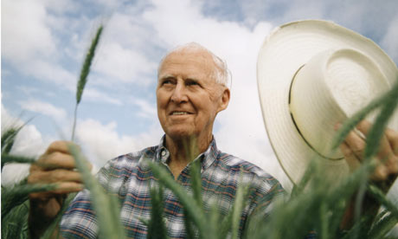
Identify These People
Notes:
"You know, out of all the Lower 9th homes we built, all are producing more energy than they are consuming. They're all pollution-free. This is an amazing story to me.

Slide 5
Actor Defeats Newton’s
Third Law of Thermodynamics
"You know, out of all the Lower 9th homes we built, all are producing more energy than they are consuming. They're all pollution-free. This is an amazing story to me. “
Brad Pitt

Slide 6
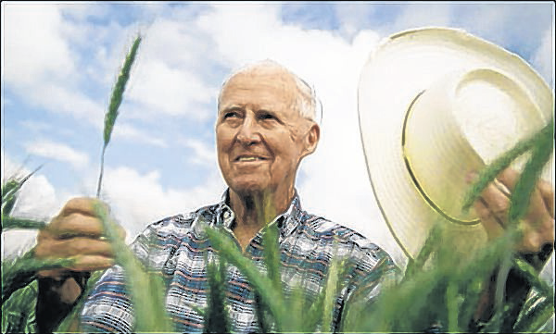
The Man Who Saved a Billion Lives
Dr. Norman Borlaug
1914-2009

Slide 7

Is it marketing?
Does the person or organization sharing their “data” stand to profit from their stance?

Slide 8


What might the down side be of holding back technology?
Can we accurately predict what the future needs will be?

Slide 9
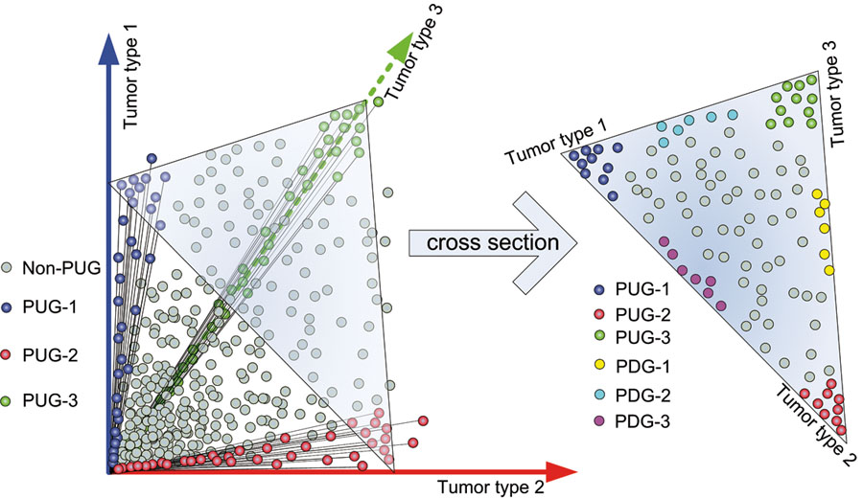

GMOs and Cancer Research
Guoqiang Yu

Slide 10
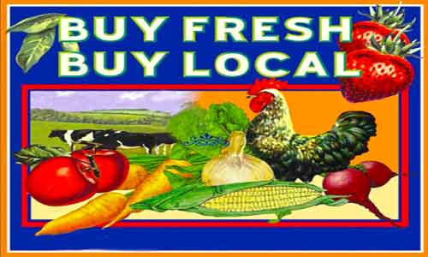
The Null Hypothesis?
Is it ALWAYS true?

Slide 11
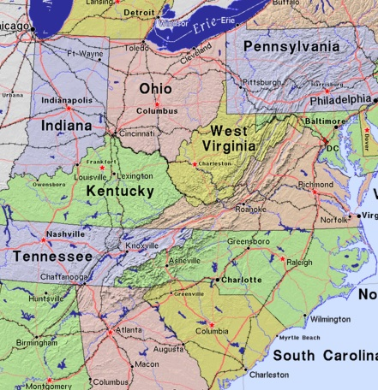

Slide 12
Conclusion?
Doesn’t pass the Null Hypothesis test
“Local…It Might Be Fresher?”

Slide 13

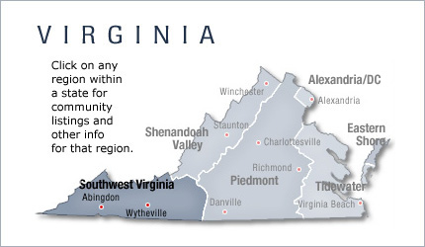
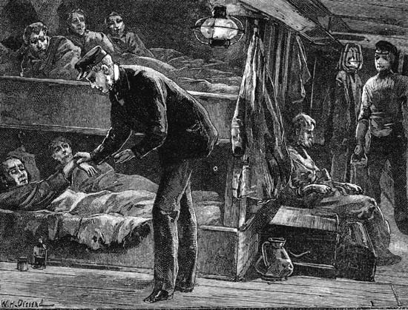
Our Mountain Heritage

Slide 14
Our Strength…Our Advantage

Slide 15
So what is a GMO?
GMOs are simply more technologically advanced hybrids
The World Health Organization defines GMOs as organisms in which the genetic material (DNA) has been altered in a way that does not occur naturally.
The only GMOs commercially available in the U.S. are the following eight crops: soybeans, corn (field and sweet), papaya, canola, cotton, alfalfa, sugar beets and summer squash

Slide 16
Not Natural? Why Grow GMOs?
Plant breeding creates crops that are better able to withstand environmental challenges such as drought, disease and insect infestations
Corn Rootworm…$1 Billion Damage
This allows farmers to grow more food in more places, in the U.S. and in developing countries, while using less land and fewer chemicals.

Slide 17
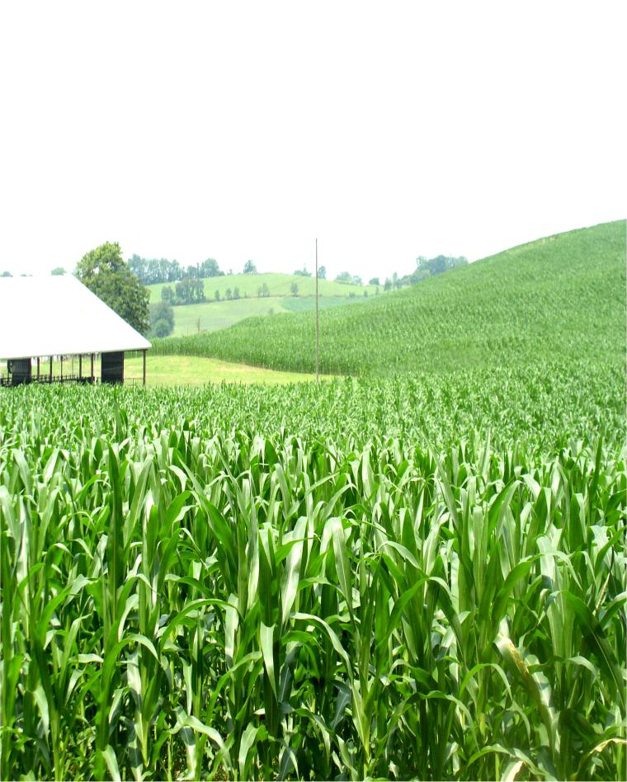
The Facts of GMO Seed
Average cost to develop a hybrid is $136 million
$35 million is for regulatory testing

Slide 18
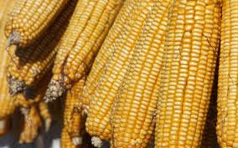
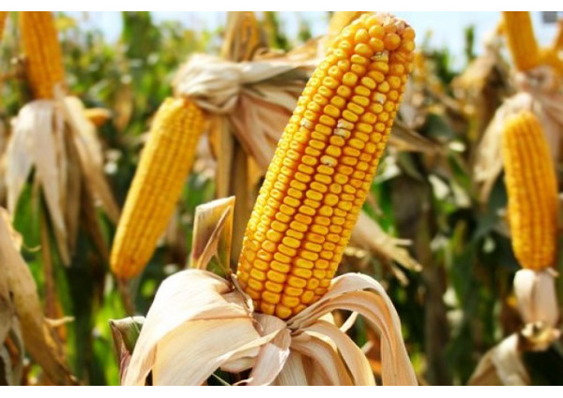
Pick out the GMO Corn

Slide 19

GMO Facts
1. We will have to produce more food by 2050, than we have in the past 10,000 years combined.

Slide 20
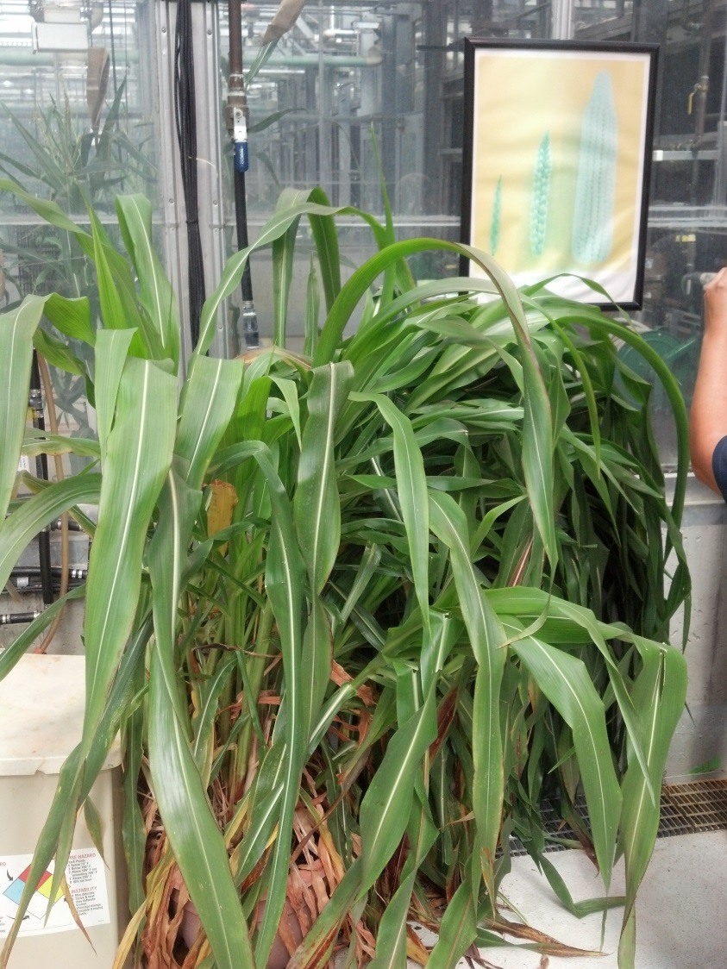
Some GMO Facts
2. We have been breeding plants for over 8000 years.

Slide 21
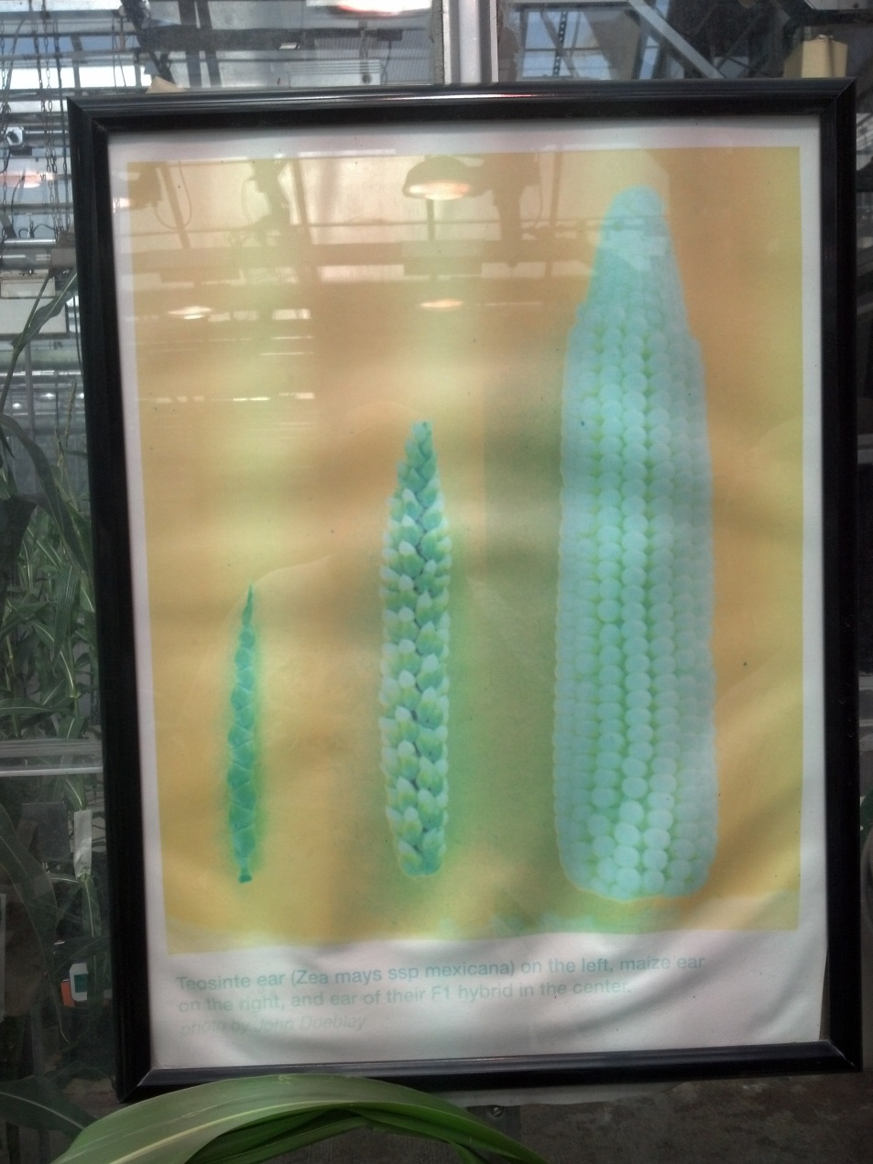
8000 Year Old Corn

Slide 22
Historical Corn Production in the United States
http://ers.usda.gov/data-products/feed-grains-database/feed-grains-yearbook-tables.aspx

Slide 23
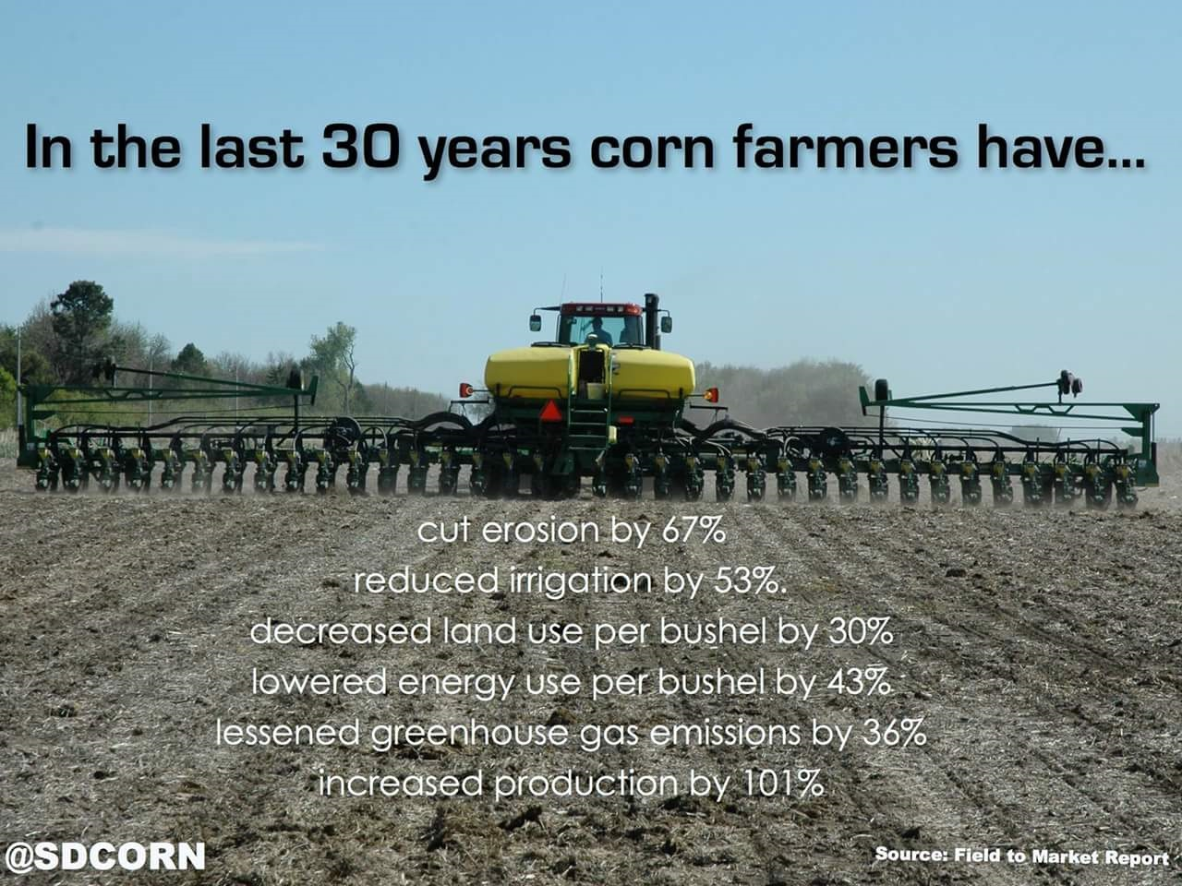

Slide 24
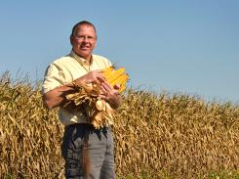
Quiz time!
Name the State in which the National Corn Yield Record was established?
David Hula
Charles City, VA
532 Bushels/Acre

Slide 25

GMO Facts
Research supports the safety of GMO technology in food

Slide 26
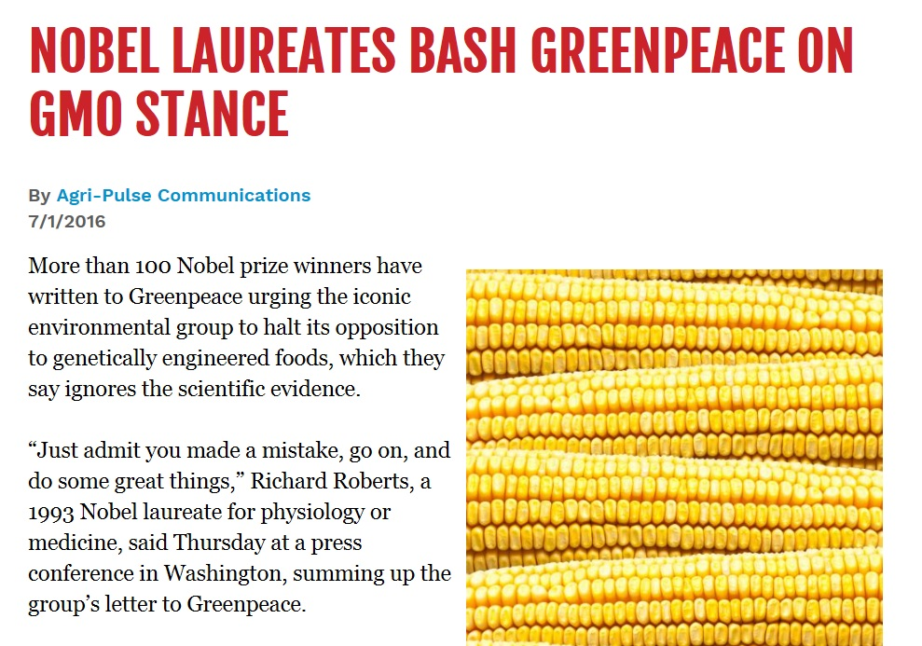
Technology to Feed the World

Slide 27
So Why Does Europe Ban GMOs
Fact….they do not. Two new GM Products were just approved
Corn Resistant to European Rootworm
Potato with enhanced starch production for making paper

Slide 28

Finally…
“I apologize for having spent several years ripping up GM crops…I could not have chosen a more counter-productive path. I now regret it completely.
…I discovered science, and in the process I hope I became a better environmentalist.”
Mark Lynas
British Journalist
Oxford University, January 3, 2013

Slide 29

Global Agriculture

