Slide 1



Securing the Food Industry
An Introduction to Cyberbiosecurity as Related to Food Science and the Food Industry
Except where otherwise noted, this work is licensed under the Creative Commons Attribution 4.0 International License. Excludes images, illustrations, and logos.

Slide 2
Module Topics
Background
  Technology in food science and industry
  Security in food science and industry
Categories of security
Cyberbiosecurity explained
Cyber attacks, stories, and outcomes
Responsibility for cyberbiosecurity
Notes:
Slide objective: Introduce topics to be covered during the lecture

Slide 3
Background: Technology and Food
Modern food includes technology
  Implementation of technology and computers
  Automation
    Process Flows
    Sensors
    Control Points
  Online data and information storage
Results in efficiency
Security?
Notes:
Slide objective: Introduce the integration of technology into the food industry and the implications of the modernization
Modern food, from farm to fork, involves technology. Technology and computers are part of our every day but bring a new level of sophistication and precision to our food industry. Along with use of technology such as email for communication or gps for travel and harvest, automation such as processing equipment, sensors in a food plant or in an agricultural field, data control points monitored using networks and systems as well on online data sharing and storage are commonplace throughout the food supply chain. This data can include consumer data based on sales numbers, personal data of employees filed a stored, or confidential data such as recipe information. The resulting efficiency is desirable and arguably needed to supply adequate food supply for the growing population but this technological integration leaves our data, food manufactures, supply chain, and food supply at risk of cyber attacks.

Slide 4
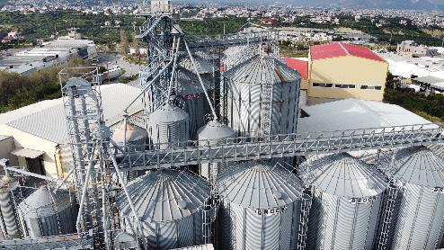
Background: Security and Food
Modern food production requires security
  Physical security
    Facilities including buildings, offices, processing areas, labs, etc.
  Cyber security
    Information technology-based systems¹
  Biosecurity
    Scientific information¹ and biological agents
  Cyber-physical security
    Technology monitoring physical systems
  Cyberbiosecurity
    New discipline
Photo by Evangelos Mpikakis on Unsplash
Notes:
Slide objective: Introduce the categories of security in food
A variety of security categories are already common disciplines throughout the supply chain, each focusing on different aspects of the supply chain. An emerging discipline of cyberbiosecurity is of increasing focus in food and agriculture

Slide 5
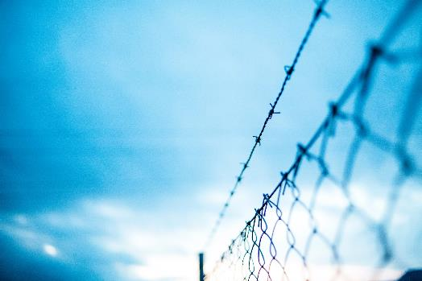
Physical Security
Limiting access of a building, area, process, etc. to authorized persons using barriers and monitoring procedures
Reduces unauthorized access to the area
  Visitors
  Vendors
  Pests
Photo by Markus Spiske on Unsplash
Notes:
Slide objective: Explain physical security and examples of this in food industry
Physical security limits access of a building, area, process, etc. to authorized persons only using barriers and monitoring procedures such as exterior fencing, locked doors, swipe access/key access to areas, etc.
FDA provides guidance for the food industry²
Protect the perimeter
Secure doors and building access
Minimize access
Secure equipment for unloading when not in use
Account for keys
Monitor the facility and perimeter
Provide adequate lighting
Visitor policy

Slide 6
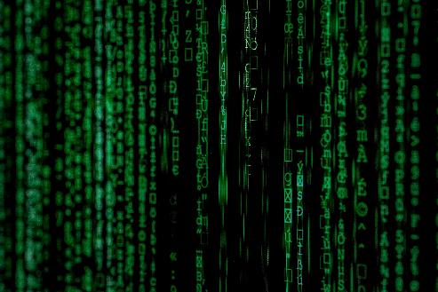
Cyber Security
  Limiting access of technological systems, networks, data, etc. to authorized users using technological barriers and monitoring processes
  Reduces unauthorized cyber access
    Malware
    Hackers
    Temp employees
    Former employees
Photo by Markus Spiske on Unsplash
Notes:
Slide objective: Explain cyber security and examples of this in the food industry
Cyber security aims to secure processes, information, etc. connected which are accessible via cyber space by limiting access of technological systems, networks, data, etc. to authorized users. This could involve computer security and virus protection, access restriction, etc.
FDA recommends²
Restrict access to process control and critical data systems
Remove access when appropriate (new role, new job, etc)
Review virus protection
Validate computer security

Slide 7

Biosecurity
Processes used to protect humans, animals, and biological data from hazards, manipulation, etc.
Reduces concerns for cross contamination/ disease spread
  Human safety
  Animal safety
Protects biological data
  Gene sequence data
  Processing data
Photo by Ashraful Islam on Unsplash
Notes:
Slide objective: Explain biosecurity and examples of this in the food industry
Processes used to protect humans, animals, and biological data from hazards, manipulation, etc. including disease spread to humans or animals from pests, workers, pathogens etc., and protects biological data from manipulation or unauthorized access.
Safety of scientific (biological) information
Safety from biological hazards³
Foreign pests
Pathogens
Agent with potential to cause negative health effects

Slide 8
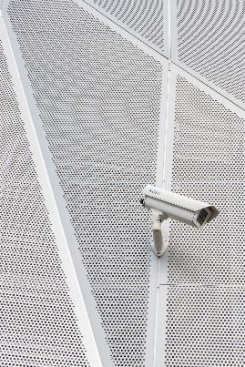
Cyber-Physical Security
Combination of sensors and computing to monitor a physical process or environment⁴ to ensure authorized use and access only
Combines the entire security system
  Security cameras and badge access monitored by security guards
Photo by Mitchell Luo on Unsplash
Notes:
Slide objective: Explain cyber-physical security and examples of this in the food industry
Combination of sensors and computing to monitor a physical process or environment⁴ with the goal of ensuring authorized use and access only. Combines the entire security system. Example: Security cameras and badge access monitored by security guards

Slide 9
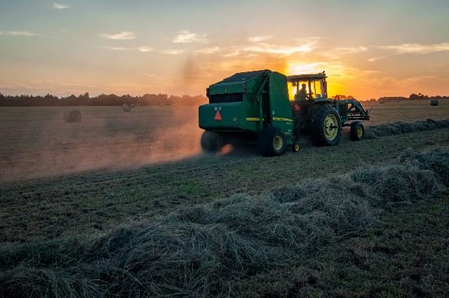
Do we need a new field? ⁵
Existing fields lack life science knowledge and application
Siloed security may not be enough
Multiple viewpoints needed
Photo by Jed Owen on Unsplash
Notes:
Slide objective: Explain why cyberbiosecurity is needed as its own discipline
There are already more than enough security categories. Do we really need another? Yes!

Slide 10
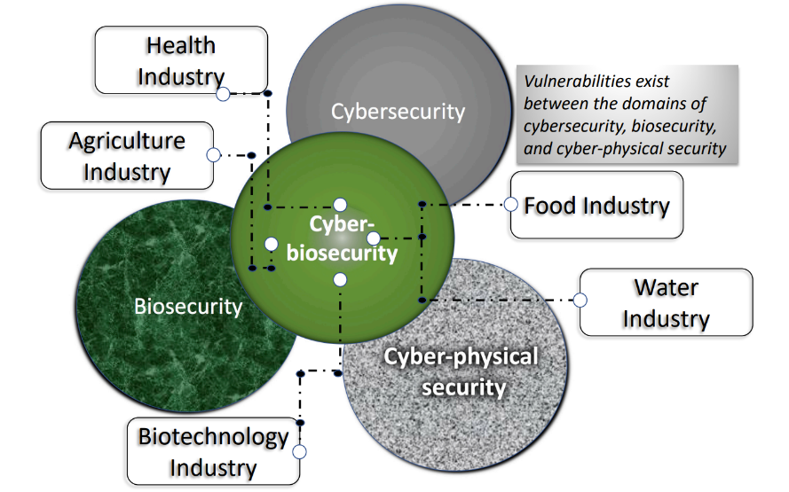
Cyberbiosecurity^{1, 6}
Figure 1⁶ Cyberbiosecurity vulnerabilities exist across industries between cyber security, biosecurity, and cyber-physical security
Emerging discipline
Fills existing security gaps
Notes:
Slide objective: Explain cyberbiosecurity and where this fits in the food industry
Cyberbiosecurity exists at the interface of cyber security, biosecurity, and cyber-physical security.

Slide 11
Cyber Bio What?
Cyberbiosecurity
Internet
Technology
Computers
Virtual
Biology
Data
Measurement
Information
Safety
Barrier
Protection
Resilience
Notes:
Slide objective: Break down the term ‘cyberbiosecurity’ into parts
Cyberbiosecurity as a visual term can look intimidating. Here, we will break down the term to understand the broader discipline. Cyberbiosecurity can be broken in cyber, bio, and security. Cyber is meaning or referencing the internet, technology, computers, and virtual storage or reality. Bio is meaning or referencing biology and biological data, measurements, and information. Finally, security is referencing safety measures or having a barrier or some type of protection. So really, at the core, cyberbiosecurity is talking about protection or the safety of biological data and information that is collected or stored using technology or is accessible via the internet or a virtual space.

Slide 12
A More Formal Definition
Cyberbiosecurity is, “understanding the vulnerabilities to unwanted surveillance, intrusions, and malicious and harmful activities which can occur within or at the interfaces of comingled life and medical sciences, cyber, cyber-physical, supply chain and infrastructure systems, and developing and instituting measures to prevent, protect against, mitigate, investigate and attribute such threats as it pertains to security, competitiveness and resilience”¹
Notes:
Slide objective: Provide a more formal definition of cyberbiosecurity
A more succinct and encompassing (but wordy!) definition of cyberbiosecurity is “understanding the vulnerabilities to unwanted surveillance, intrusions, and malicious and harmful activities which can occur within or at the interfaces of comingled life and medical sciences, cyber, cyber-physical, supply chain and infrastructure systems, and developing and instituting measures to prevent, protect against, mitigate, investigate and attribute such threats as it pertains to security, competitiveness and resilience” as defined by Murch et al. (2018). Definition was proposed with the understanding that revisions will be necessary as the discipline is rapidly evolving.
Let’s break this down to see what this is really saying…

Slide 13
A More Formal Definition: Part 1
Cyberbiosecurity is, “understanding the vulnerabilities to unwanted surveillance, intrusions, and malicious and harmful activities which can occur within or at the interfaces of comingled life and medical sciences, cyber, cyber-physical, supply chain and infrastructure systems, and developing and instituting measures to prevent, protect against, mitigate, investigate and attribute such threats as it pertains to security, competitiveness and resilience”¹
Notes:
Slide objective: Provide a more formal definition of cyberbiosecurity
First things first. Cyberbiosecurity is about vulnerabilities. Not only knowing about them or that they exist but understanding vulnerabilities. These vulnerabilities we want to understand are specific which we’ll get to next.

Slide 14
A More Formal Definition: Part 2
Cyberbiosecurity is, “understanding the vulnerabilities to unwanted surveillance, intrusions, and malicious and harmful activities which can occur within or at the interfaces of comingled life and medical sciences, cyber, cyber-physical, supply chain and infrastructure systems, and developing and instituting measures to prevent, protect against, mitigate, investigate and attribute such threats as it pertains to security, competitiveness and resilience”¹
Notes:
Slide objective: Provide a more formal definition of cyberbiosecurity
Here our definition sates that the vulnerabilities we are concerned about include, “…unwanted surveillance, intrusions, and malicious and harmful activities…” Surveillance and intrusions might seem more concrete than “malicious and harmful activities”. These could be variable depending on who defines them and the specific situations at hand.

Slide 15
A More Formal Definition: Part 3
Cyberbiosecurity is, “understanding the vulnerabilities to unwanted surveillance, intrusions, and malicious and harmful activities which can occur within or at the interfaces of comingled life and medical sciences, cyber, cyber-physical, supply chain and infrastructure systems, and developing and instituting measures to prevent, protect against, mitigate, investigate and attribute such threats as it pertains to security, competitiveness and resilience”¹
Notes:
Slide objective: Provide a more formal definition of cyberbiosecurity
So far, we know we are trying to understand specific vulnerabilities. Here, we see where we are looking for them. “…Within or at the interfaces of comingled life and medical sciences, cyber, cyber-physical, supply chain and infrastructure systems, and developing…” ¹
“within or at the interfaces”¹ seems overwhelming. Specifically, we are including life science, medical science, cyber systems, cyber-physical pieces, supply chains, and infrastructure pieces. We are also including any places where any of these will overlap. That’s a lot of places!

Slide 16
A More Formal Definition: Part 4
Cyberbiosecurity is, “understanding the vulnerabilities to unwanted surveillance, intrusions, and malicious and harmful activities which can occur within or at the interfaces of comingled life and medical sciences, cyber, cyber-physical, supply chain and infrastructure systems, and developing and instituting measures to prevent, protect against, mitigate, investigate and attribute such threats as it pertains to security, competitiveness and resilience”¹
Notes:
Slide objective: Provide a more formal definition of cyberbiosecurity
Here the definition expands even more. Before this, we saw cyberbiosecurity to be focused around understanding vulnerabilities to unwanted activities in a range of different fields. Now, we see cyberbiosecurity also includes prevention and protection against these unwanted actions as well as ability to mitigate (or reduce the severity) and investigate these unwanted actions to the extent of finding the cause.

Slide 17
A More Formal Definition: Part 5
Cyberbiosecurity is, “understanding the vulnerabilities to unwanted surveillance, intrusions, and malicious and harmful activities which can occur within or at the interfaces of comingled life and medical sciences, cyber, cyber-physical, supply chain and infrastructure systems, and developing and instituting measures to prevent, protect against, mitigate, investigate and attribute such threats as it pertains to security, competitiveness and resilience”¹
Notes:
Slide objective: Provide a more formal definition of cyberbiosecurity
Finally, the definition ends with a cap, “…as it pertains to security, competitiveness and resilience.”¹

Slide 18
A Summarized Definition
Cyberbiosecurity is working to understand weaknesses to unwanted actions in biological sciences, the virtual world, and the supply chain as well as create and implement processes to prevent these unwanted actions and reduce recovery time from these actions as related to security, competitiveness and ability to recover.
Notes:
Slide objective: Provide a more formal definition of cyberbiosecurity
When we look at the entire definition again, we can see it a little differently.
Understand, implement, recover
To summarize and simplify: Cyberbiosecurity works to understand weaknesses to unwanted actions in life science, medical science, cyber systems, cyber-physical pieces, supply chains, and infrastructure pieces as well as create and implement processes to prevent these unwanted actions and help recover from unwanted actions as related to security, competitiveness and ability to recover.
This could look like a variety of scenarios. An unauthorized change to a drying oven in a dry cereal facility could cause a food safety concern as the product may contain too much water for the product to be considered safe. A forged or altered Certificate of Analysis from the microbial lab which tested samples of a ready to eat jerky might say the product came back within specification while the actual sample failed testing and requires product to be placed on hold. Cyber security of biological data or data which can impact a biological system (including a person, the food system, or supply chain) is the focus of cyberbiosecurity.

Slide 19
Cyberbiosecurity
Cyberbiosecurity
Internet
Technology
Computers
Virtual
Biology
Data
Measurement
Information
Safety
Barrier
Protection
Resilience
Notes:
Slide objective: Review the term ‘cyberbiosecurity’ in parts
After all that, hopefully this makes more sense than it did a few minutes ago.

Slide 20

Cyber Attack Types⁷
Data injection
Automated system hijacking
Node forgery
Learning algorithms
Photo by FLY:D on Unsplash
Notes:
Slide objective: Introduce categories of cyber attacks
As cyber attacks become more common, securing the food supply against these threats become increasingly vital for the supply chain as well as food safety and security. Attacks can be categorized into four types: Data injection; Automated system hijacking; Node forgery; Learning algorithms

Slide 21
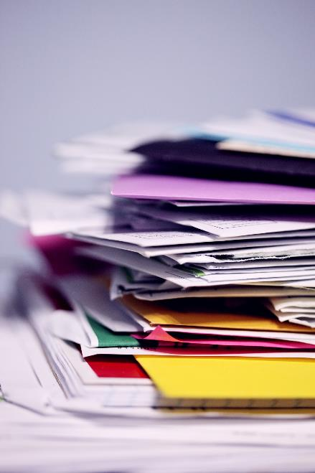
Data Injection⁷
Data is added to a dataset
Can result in misleading analysis/conclusions
  Adding low weights to a shifts final weight dataset
  Adding temperature data to a CCP temperature log
Photo by Sharon McCutcheon on Unsplash
Notes:
Slide objective: Explain a data injection cyber attack
Data injection described a cyber attack which adds data to a data set. This can result in misleading analysis of the data and cause improper conclusions and resulting action which are inappropriate to the true data.
A dataset of finished product final weights could be altered with additional weights added. Adding low numbers to the dataset could result in the company holding or reworking product that was within specifications. Adding high numbers to the dataset could result in the company adjusting their scales to lower the average weight resulting in the true averages to be too low for regulations. Concerns such as these could result in legal issues and loss of revenue.
A dataset containing temperatures for a critical control point could be altered resulting in product being disposed of due to the process seeming out of control from the dataset though the true data was correct and achieving the critical limit.

Slide 22
Automated System Hijacking⁷
Automated system or process is attacked resulting in loss of control
Can alter or stop the process from occurring
  A warehouse robot being hacked leaving a palletizer down
  Reduced production due to being locked out of process controls
Notes:
Slide objective: Explain an automated system hijacking cyber attack
Automated system hijacking describes an automated system or process being controlled or shut down by an attacker. This can alter the process or shut the process down entirely.
A warehouse relying on robots to palletize product to be shipped would lose efficiency if the robots were hacked causing them to work improperly or not at all.
A production line controlled by processing panels would result in down time should a cyber attack leave the process controls locked out.

Slide 23
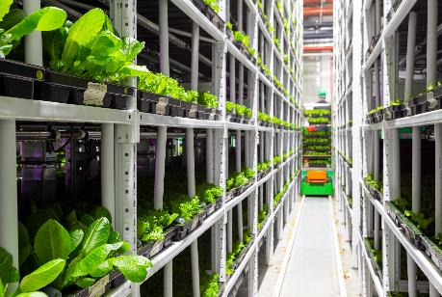
Node Forgery⁷
Photo by Petr Magera on Unsplash
A sensor is mimicked altering the reported data
Results in faulty data
  A soil moisture sensor is mimicked resulting in inadequate irrigation
  A temperature sensor in an oven is mimicked pushing the oven temperature down
Notes:
Slide objective: Explain and node forgery cyber attack
A node forgery attack focuses on sensors collecting and reporting data. In this type of attack, a sensor would be mimicked altering the reported data. These result are similar to those of a data injection attack but the attack occurs at a different point in the process.
A soil moisture sensor is mimicked making it seem the soil is too dry resulting in additional irrigation could flood the crop. Conversely, data making it seem the soil moisture is too high could result in reduced irrigation. Either way, an attack like this could result in inadequate irrigation and potentially cause loss of crop.
An oven temperature sensor providing real-time temperature feedback could be mimicked to report the wrong temperature. Heat setting adjustments could then cause the oven temperature to be too low resulting in low quality product or potentially unsafe product. Another possibility would be the mimicked sensor would indicate the oven temperature is too low causing the heating the be increased resulting in burnt product or a potential safety issue or employees in the area.

Slide 24

Learning Algorithms⁷
Machine learning algorithm is altered
Results in incorrect processing
  An algorithm used to calculate projected sales is altered causing the company to under produce and miss sales
Photo by Dries Augustyns on Unsplash
Notes:
Slide objective: Explain a learning algorithm cyber attack
A learning algorithm attack focuses on altering a machine learning algorithm used for production and planning resulting in inappropriate output from the algorithm.
Altering an algorithm used to calculate projected sales could result in low production rates leaving the company with missed sales.

Slide 25
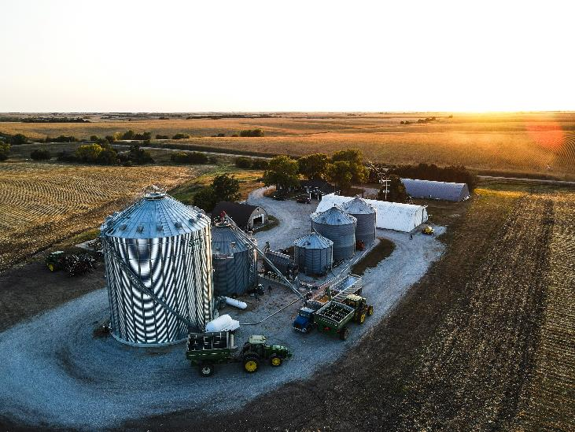
Food Industry Inclusion
Supply Chain Involvement
  Farm to Fork
Agriculture
  Plant breeders
  Growers
Laboratories
  Microbial testing
  Development
Co-Manufacturer
Transportation
Photo by Taylor Siebert on Unsplash
Notes:
Slide objective: Share the complexity of the supply chain and dependency of the food science concerns
Specific food concerns mean very little if the other pieces to the supply chain do not have their own understanding of cyberbiosecuirty risks. Just as traceability requires an understanding of where ingredient and products come from and go, data and information should be considered when thinking about cyberbiosecurity. Additionally, the cyberbiosecurity of the suppliers, distributors, support industries (external laboratories, packaging vendors, equipment vendors, third party auditors, etc)

Slide 26
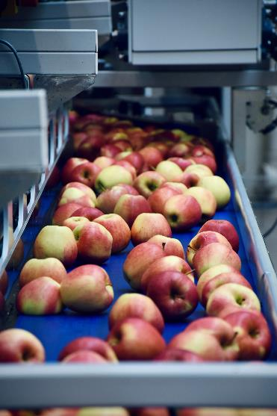
Food Science Concerns
Photo by Arno Senoner on Unsplash
Industrial control systems
Automated processes
Data collection
Data storage and management
Data sharing
Inventory management
Future innovations/novel processing techniques
Notes:
Slide objective: Share specific concerns in food science around cyberbiosecurity
As previously mentioned, food science and the food industry use computers, technology, and automaton constantly. Industrial control system is a general term used cross many fields to describe the variety of control systems used the instruments and equipment they are connected to. Many food processors use some amount of automated processing equipment. Ingredients can be added using valves and scales that only require an employee to oversee the process and wait for alarms. Programs and technology can run the entire batching process to mix ingredients for a food product. Packing a finished good into boxes use to require employees picking up the product and placing them in the box. Now, automated equipment can be used to pack cases without the need for the same number of employees. Data can be collected manually using sensors and programs. This data can then be stored and management all from a computer or virtual system. This same data can be shared with other employees, mangers, other facilities, etc. Basically, data can be collected stored, managed, and shared, all without leaving the virtual world. This is easier than manually collecting, storing, managing, and sharing data but where does this leave the accuracy and security of the data? Inventory management systems are often digital now.
Technology has changed everything and generally made food production easier. There’s options for automation in food processing including electronic monitoring of control points, sensors can be used countless ways such as checking for quality or safety defects and these automated pieces can be set to change or alter the process flow of the food production based on the result. Using computers or other technology can allow quick change overs by saving processing information and simply loading the next process or recipe needed. Food safety data or quality checks can be manually entered on the computer and stored using a variety of software options. The offsite testing data can be entered by the lab and later accessed via laboratory management systems. Even shipping and inventory of product can be controlled with technology such as SAP. While all of these examples make production easier, tampering with any of these examples, set points, alarm systems, stored data, etc. can cause catastrophic issues.
This will include research and development of products and processes.

Slide 27
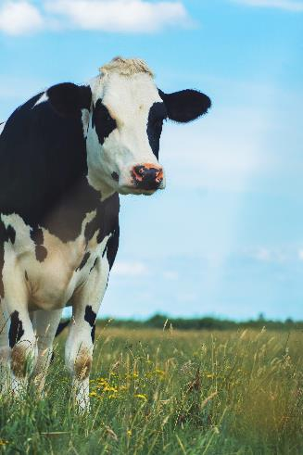
Schreiber Foods
Milk processor in Wisconsin closed due to cyber attack
  Locked all computers (automated system hijacking)
Impacted all plants and distribution centers
  Natural and processed cheese
  Yogurt
  Cream cheese
Days of down time
Milk to be rerouted
Photo by Jean Carlo Emer on Unsplash
Notes:
Slide objective: Explain a true example
https://www.wisfarmer.com/story/news/2021/10/26/schreiber-foods-hit-cyberattack-plants-closed/8558252002/
Schreiber Foods is a milk processor in Wisconsin who experienced a cyber attack in October of 2021. The attack impacted the entire company forcing all locations to shut down and all milk to be rerouted impacting the farmers, cooperatives, plants, companies, and consumers. Much of the Schreiber processing relies on computers leaving the company unable to process for multiple days. Attacks like this are expensive for everyone. Product shortages (cream cheese) were felt by consumers. Employees were unable to report for work leaving potential financial strain on the workers. The company took a huge loss due to down time, recovery efforts, etc.

Slide 28

Florida Water System
City water system had sodium hydroxide setting increased
  From 100ppm to 11,100ppm
  Extremely corrosive
Setting change occurred using remote access
  Automated system hijacking
Employee saw the change occur and immediately corrected
Similar to previous issues in other facilities
Photo by manu schwendener on Unsplash
Notes:
Slide objective: Explain a true example
https://www.bbc.com/news/world-us-canada-55989843#:~:text=A%20computer%20hacker%20gained%20access,it%20and%20reversed%20the%20action
A city in Florida experienced a cyber attack that could have been disastrous had an employee not been alert and acted quickly. In 2021, an employee noticed an attempt to access the system remotely. Assuming it was a supervisor, the employee was not alarmed until they saw the hacker (having gained the remote access to the system) increased the sodium hydroxide setting from 100 parts per million to 11,100ppm. Sodium hydroxide is used in water treatment to control pH but only in small amounts. Larger concentrations are extremely corrosive and are often used to clean pipes and drains. Sodium hydroxide can cause skin and eye irritation as well as hair loss. Swallowing the chemical can leave damage to the mouth, throat, and stomach, cause nausea and vomiting and diarrhea. The employee immediately corrected the setting and remote access to the plant was disabled so no one was ever at risk. If the employee had not seen the change, the story would not have ended so happily. Furthermore, similar attacks have occurred in other water treatment plants.

Slide 29
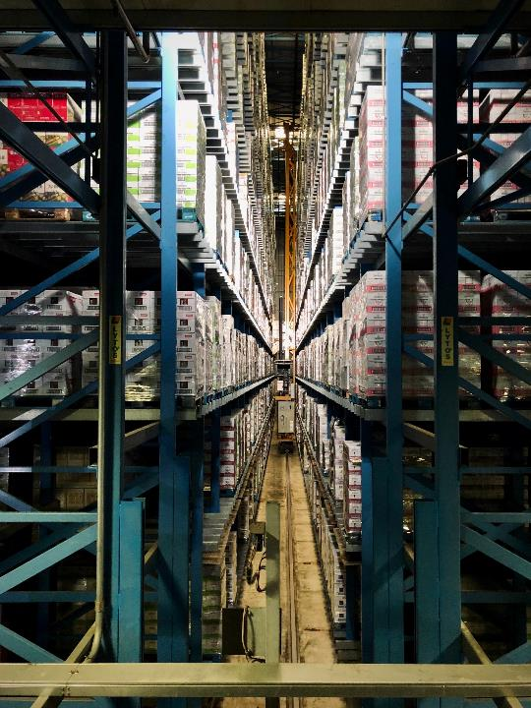
Cyber Attack Impacts
Disruption
  Businesses
  Supply chain
  Economy
Trust Issues
  Data
  Citizens
Photo by Arno Senoner on Unsplash
Notes:
Slide objective: Explain possible impacts of cyber attacks
Cyber-attacks of any degree can have large impacts. They can cause disruption of the business attacked as well as business connected to the targeted business, disrupt the supply chain, and the economy. Cyber-attacks can also create trust issues of data collected or stored in a way that it might be at risk as well as cause citizens to distrust business, government, etc.

Slide 30
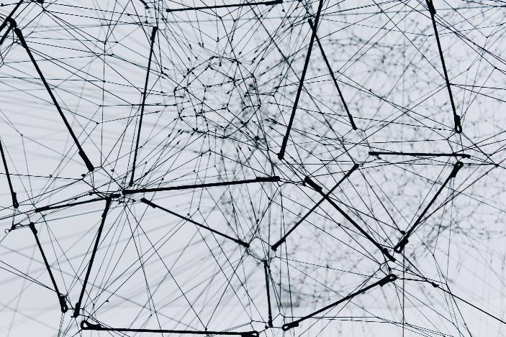
Responsibility⁸
Broad definition
Multidisciplinary
Throughout the supply chain
Collaboration needed
Photo by Alina Grubnyak on Unsplash
Notes:
Slide objective: Explain the need for shared responsibility around cyberbiosecurity
With so many processes involved, who can be responsible for all this? Many food scientists or food industry employees will say it’s up to IT. Most companies will have an IT department or at least one person who keeps computer systems up to date and trouble shoots issues with wifi but with so much of the food industry being integrated with technology, how can they be responsible for everything? They can’t. IT should be aware of the processes and risks throughout the facility but any person, employee, etc. who uses technology, interfaces with automated processes, accesses or shares data stored virtually, uses records stored virtually, etc. is responsible for the cyberbiosecurity of the facility. Collaboration is necessary.

Slide 31
General Best Practices⁹
Train employees on cyber risks and safety practices
Limit access to computers, phones, and other devices through physical barriers and passwords
Always use strong passwords or passphrases that are unique to the user and system and known only by the user
Implement a multi-factor authentication process for logging into systems or databases
Keep software, applications, and devices up to date
Notes:
Slide objective: Introduce some best practices for general management of cyber risks

Slide 32
Contributing Practices
If you see something, say something
  A visitor asking odd questions
  A contractor outside of their assigned area
  An upset employee taking abnormal actions
  Equipment running incorrectly
  A computer monitor operating independently without permission being handed over to a remote support team
Follow up with risk assessments
Notes:
Slide objective: Introduce some best practices for general management of cyber risks in a food environment
Food industry, as well as other industries, often us the phase, “ if you see something, say something”. Employees at all levels should feel empowered to raise concerns they may have including people safety, food safety, and other general concerns. Some of these will play into cyberbiosecurity as well.
Employees who notice a new person in their area should feel empowered to ask that person who they are, what they’re doing, and report concerns to a supervisor. This is a sign of good food safety culture. The new person could be someone from corporate or another plant doing a routine inspection, but it could also be an unauthorized person trying to cause problems for the company.
Correcting settings within their role and escalating concerns to supervisors is part of any food employees responsibilities. Following up on these concerns will require a supervisor or specialist to determine the risks associated with the incident and determine the corrective actions taken were sufficient. Communicating concerns and having a strong food safety culture makes this process easier and assists with identifying cyberbiosecurity issues as well.

Slide 33
References
1. Murch, R. S., So, W. K., Buchholz, W. G., Raman, S., & Peccoud, J. (2018). Cyberbiosecurity: An Emerging New Discipline to Help Safeguard the Bioeconomy. Frontiers in Bioengineering and Biotechnology, 6. https://www.frontiersin.org/article/10.3389/fbioe.2018.00039
2. https://www.fda.gov/regulatory-information/search-fda-guidance-documents/guidance-industry-food-security-preventive-measures-guidance-food-producers-processors-and
3. https://www.ncbi.nlm.nih.gov/pmc/articles/PMC7150240/
4. https://www.rmit.edu.au/news/c4de/what-are-cyber-physical-systems
5. Murch, R., & DiEuliis, D. (2019). Editorial: Mapping the Cyberbiosecurity Enterprise. Frontiers in Bioengineering and Biotechnology, 7, 235. WorldCat.org. https://doi.org/10.3389/fbioe.2019.00235
6. Duncan, S. E., Reinhard, R., Williams, R. C., Ramsey, F., Thomason, W. E., Lee, K., Dudek, N., Mostaghimi, S., Colbert, E., & Murch, R. S. (2019). Cyberbiosecurity: A New Perspective on Protecting US Food and Agricultural System. WorldCat.org. https://doi.org/10.3389/fbioe.2019.00063
7. Drape, T., Magerkorth, N., Sen, A., Simpson, J., Seibel, M., Murch, R. S., & Duncan, S. E. (2021). Assessing the Role of Cyberbiosecurity in Agriculture: A Case Study. Frontiers; WorldCat.org. https://doi.org/10.3389/fbioe.2021.737927
8. Richardson LC, Lewis SM, & Burnette RN. (2019). Building Capacity for Cyberbiosecurity Training. Frontiers in Bioengineering and Biotechnology, 7, 112. WorldCat.org. https://doi.org/10.3389/fbioe.2019.00112
9. Carneiro, Renata, Susan Duncan, Ford Ramsey, Hasan Seyyedhasani, and Randall Murch. 2021. “Cyber attacks in agriculture: protecting your farm and small business with cyberbiosecurity.” Virginia Cooperative Extension. https://caia.cals.vt.edu/content/dam/caia_cals_vt_edu/cyberbiosecurity/2021%20Carneiro%20et%20al%20Cyberattacksinagricultureprotectingyourfarmandsmallbusinesswithcyberbiosecurity.pdf
Except where otherwise noted, this work is licensed under the Creative Commons Attribution 4.0 International License. Excludes images, illustrations, and logos.

