Slide 1


Strategic Management
Chapter 8
Corporate Level Strategy
Unless otherwise noted, this slide deck is (c) Virginia Polytechnic Institute and State University. It is released under a Creative Commons Attribution NonCommercial ShareAlike 3.0 license (CC BY NC-SA 3.0)
Instructor Name | Name of Institution
http://hdl.handle.net/10919/102735
Photo by Jon Sailer on Unsplash

Slide 2
Today’s Objectives – Date Here
What is corporate-level strategy and how does it differ from business-level strategy?
What is vertical integration and what benefits can it provide?
What are the three types of diversification and when should they be used?
What are four methods that a firm can use to implement its corporate strategy?
Why and how might a firm retrench or restructure?
What is portfolio planning and why is it useful?
http://hdl.handle.net/10919/102735

Slide 3
Three Levels of Strategy
Business-level Strategy (Competitive)
  Each business unit in a diversified firm chooses a business-level strategy as its means of competing in individual product markets.
    How to get and maintain a sustainable competitive advantage?
Corporate-level Strategy (Companywide)
  Specifies actions taken by the firm to gain a competitive advantage by selecting and managing a group of different businesses in several industries & product markets. Two questions:
    1. What business(es) should we be in?
    How should we manage the portfolio to achieve synergy / create value?
International Strategy
http://hdl.handle.net/10919/102735

Slide 4
Business-level Strategy (BLS) Versus
Corporate-level Strategy
Corporate Strategy
1. What business(es) should we be in? Level of diversification.
2. How should we manage the portfolio to achieve synergy / create value? Nature of integration
BLS: How to Manage Business #1
BLS: How to Manage Business #2
BLS: How to Manage Business #3
BLS: How to Manage Business #4
http://hdl.handle.net/10919/102735
Notes:
Note that it is diversification, not differentiation. Repeat that three times.

Slide 5
Making Diversification Work
Corporate Strategy is a quest for synergy.
Diversification must create synergy to benefit shareholders.
Why?
> 2
Business 1
Business 2
5-‹#›
http://hdl.handle.net/10919/102735
Notes:
Issue here is the benefits to shareholders (who can diversify risk/return for themselves) vs. managerialism (job protection, higher pay, etc). Ask students how difficult it is for an individual to diversify their portfolio ($9.95 for a person to buy 2 stocks instead of 1 mutual fund, etc) vs. the costs of company diversification (M&A cost, integration, etc).

Slide 6
Business-level Strategy (BLS) Versus Corporate-level Strategy (Cont.)
Corporate Strategy
More Specifically…
1. In what stage of the industry value chain should we participate?
2. What range of products and services should we offer?
3. Where should we compete geographically?
http://hdl.handle.net/10919/102735
Notes:
Note that it is diversification, not differentiation. Repeat that three times.

Slide 7
The Relationship Between Diversification & Financial Performance
Financial Performance
Diversification
http://hdl.handle.net/10919/102735
Notes:
Key task is identifying the optimal point of diversification (width) of the corporation.
How to manage or integrate the businesses to maximize performance of what you have.

Slide 8
How to Diversify
Mechanisms/activities for changing the scope of the firm:
  Mergers and acquisitions
  Strategic alliances
  Joint ventures
  Internal development
http://hdl.handle.net/10919/102735
Notes:
Mergers – accounting firms
Strategic Alliance: Start Bucks & Barnes & Noble, Apple & IBM, Apple & AT&T, Tesla & many
Joint venture – Sony-Ericsson

Slide 9
Mergers/Acquisitions Gone Bad
Mattel acquisition of The Learning Company – ~$3.5 B loss
Daimler-Benz acquisition of Chrysler - $35.5 B loss
Mergers & Acquisitions failure rate = 70% - 90%
Why?
Why do we keep doing them????
  Principal agent problem??
http://hdl.handle.net/10919/102735

Slide 10
Describing Scope: The Level & Type of Diversification Using Revenues
Low Levels of Diversification
Single business
> 95% of revenues from a single business unit
A
Dominant business
Between 70% and 95% of rev. from a single business unit
A
B
Related Diversification
Moderate to High Levels of Diversification
A
Related Diversification
< 70% of revenues from dominant business
B
C
Unrelated Diversification
Very High Levels of Diversification
A
Unrelated-Diversified
B
C
Business units not closely related
SOURCE: Adapted from R. P. Rumelt, 1974, Strategy, Structure and Economic Performance, Boston: Harvard Business School.
http://hdl.handle.net/10919/102735

Slide 11
Managing Corporate Strategy to Achieve Synergy
Related businesses
(horizontal relationships)
  Economies of scope: Leveraging and/or sharing tangible & intangible resources and capabilities
  Market Power: Pooled negotiating power & vertical integration
Unrelated businesses
(hierarchical relationships)
  Value creation derives from corporate office
  Leveraging support activities
    Examples: Restructuring, and Financial Synergies GE
You must match the management of the businesses to the corporate strategy used or corporate performance suffers.
http://hdl.handle.net/10919/102735

Slide 12

What’s Disney’s Strategy?
Source: Trademarks are the property of their respective owners.
Trademarks are the property of their respective owners.
http://hdl.handle.net/10919/102735

Slide 13
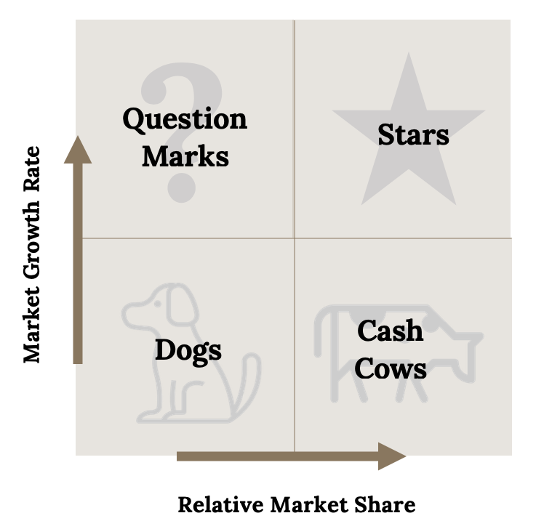
What’s Their Strategy? Related or Unrelated?
http://hdl.handle.net/10919/102735

Slide 14
In-Class Exercise: The Businesses in our Local Region Corporation
 | Retail | Credit | Insurance | Brokerage | Real Estate
Share of Revenue & Trend | 52.00% ⭣ | 5.10% ⭡ | 35.00% ⭡ | 4.90% ⮃ | 3.00% ⭡
Share of Profits & Trend | 18.00% ⭣ | 17.80% ⭡ | 50.20% ⭡ | 6.20% ⮃ | 7.80% ⭡
Market Share | 13% | 21 % | 35% | 8% | 2%
PLOT ON A BCG MATRIX
Circle size indicates revenue contribution
http://hdl.handle.net/10919/102735

Slide 15
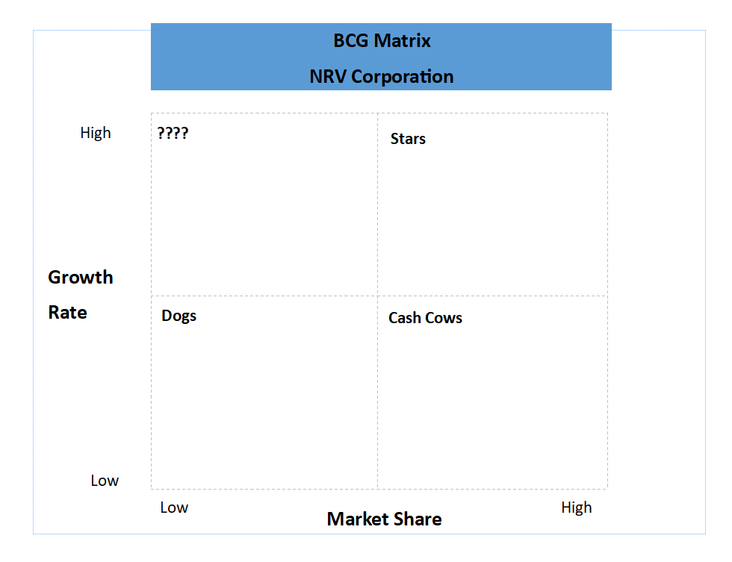
In-Class Exercise: The Businesses in our Local Region Corporation (Cont.)
http://hdl.handle.net/10919/102735

Slide 16
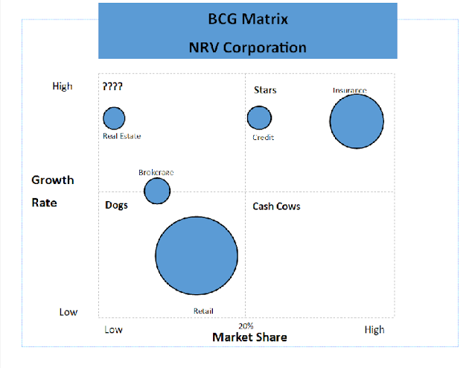
In-Class Exercise: The Businesses in our Local Region Corporation (Cont.)
http://hdl.handle.net/10919/102735

Slide 17
BCG Matrix - Practice
Develop a BCG Matrix for company with these segments. Determine your strategy, and why /justify.
Segment | % of Net Sales | % of Net Earnings | Market Share | Growth
Laundry / Home Care | 28% | 27% | 20% | 5
Cosmetics | 23% | 22% | 14% | 7
Snacks | 17% | 20% | 9% | 2
Baby / Family Care | 16% | 14% | 23% | 4
Grooming | 10% | 13% | 11% | 9
http://hdl.handle.net/10919/102735

