Slide 1
AI-Assisted Annotation of Medical Images
Suha Dewan, Daodao Zhou, Huynh Long, Zipeng Guo
CS4624 - Multimedia, Hypertext, and Information Access
Edward A. Fox
Virginia Tech, Blacksburg VA 24061
11/29/2022

Slide 2
Outline
Background
Timeline
Work Achieved
Challenges and Lessons Learned
Future Work
Acknowledgements

Slide 3
Background
Modify the current source code and package it into a container image in order to deploy it.
Develop a front-end application for users to upload and download new images.
Aid the annotators in receiving images quickly and easily through our web application and performing the predictions on these images.

Slide 4
Timeline
September-October
October
November
December
Source code and tools
Build web application
Clean up
Finish up web application, package container
Familiarize ourselves with the provided source code and tools that we need to complete the project.
Meet with client
Get access to source code
Set up AWS accounts
Use Amplify and React to build a web application for users to upload and download images to the AWS S3
Add finishing touches and make sure everything is cleaned up and ready for final report and presentation.
Finish up our web application with domain name, making sure all functionalities work.
Test Dockerfile and deploy
Finish up report

Slide 5
Work achieved
Web application
  Allows the user to create an account
  Log in
  Upload images to use for the predictions
Updated source code
  Downloads files from S3 buckets
  Runs the model
  Uploads output into another S3 bucket

Slide 6
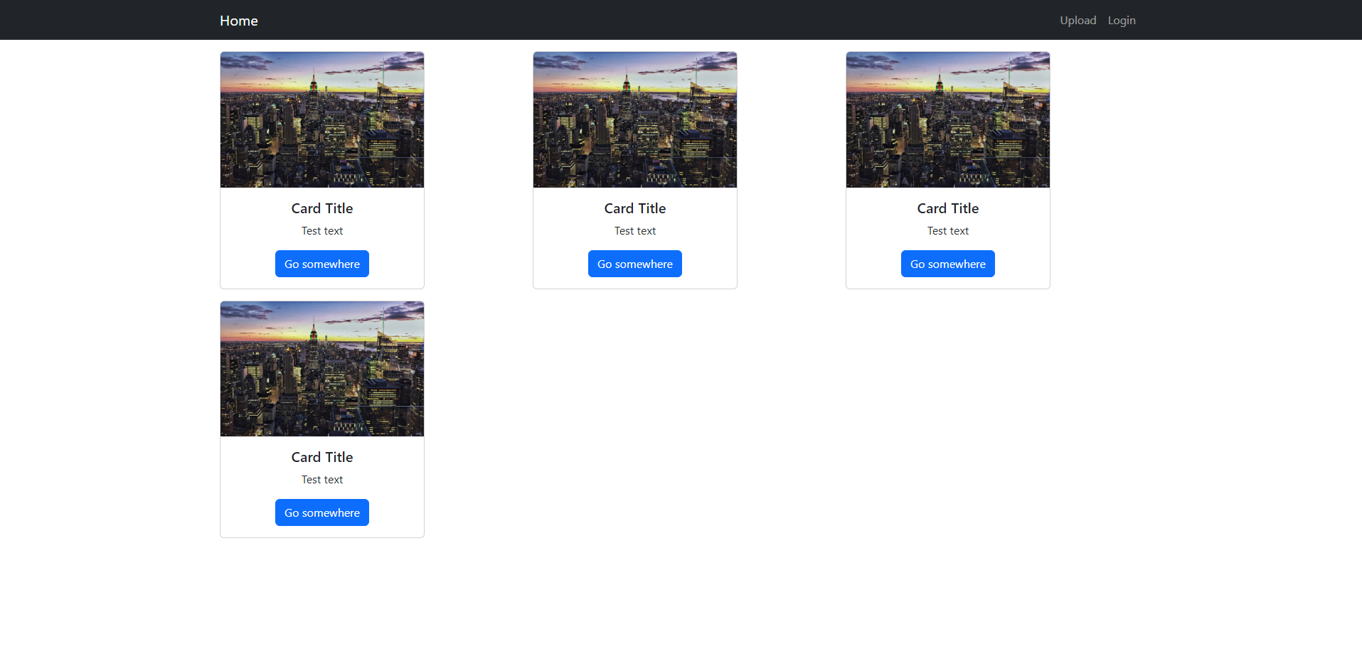
Amplify Website

Slide 7
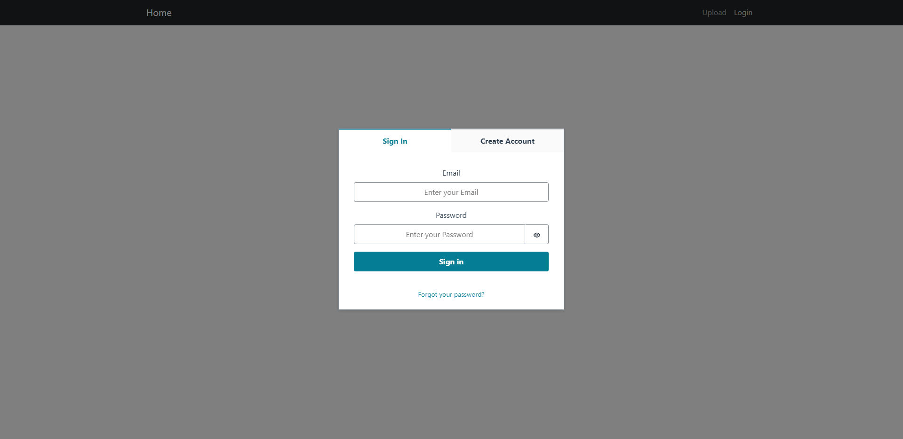

Slide 8
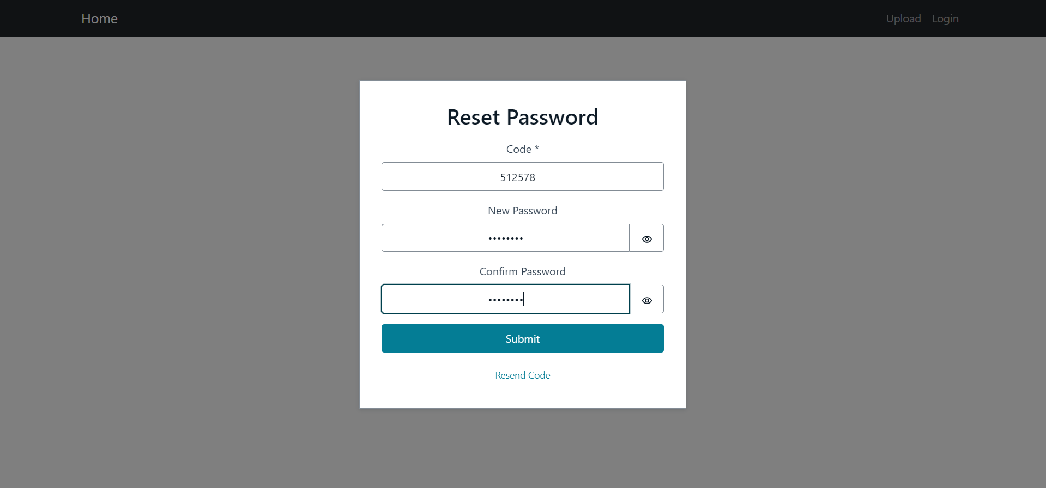
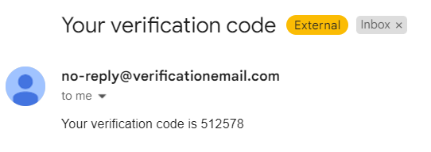

Slide 9
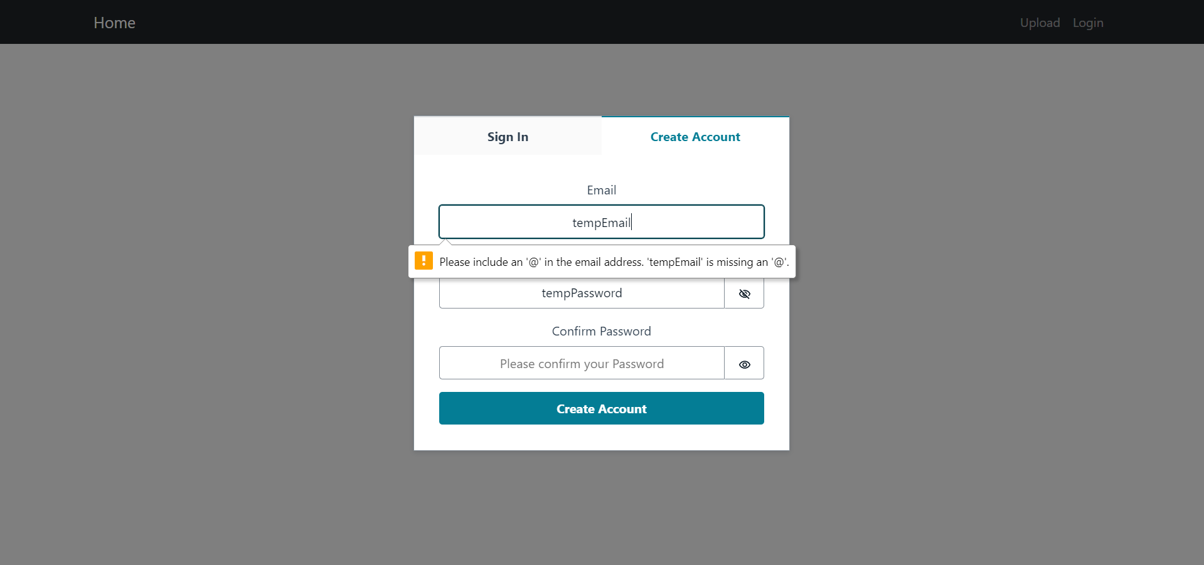
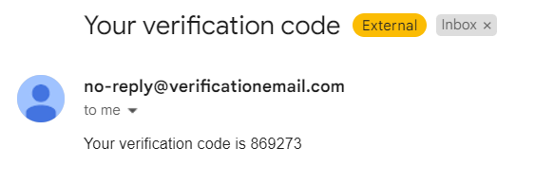

Slide 10
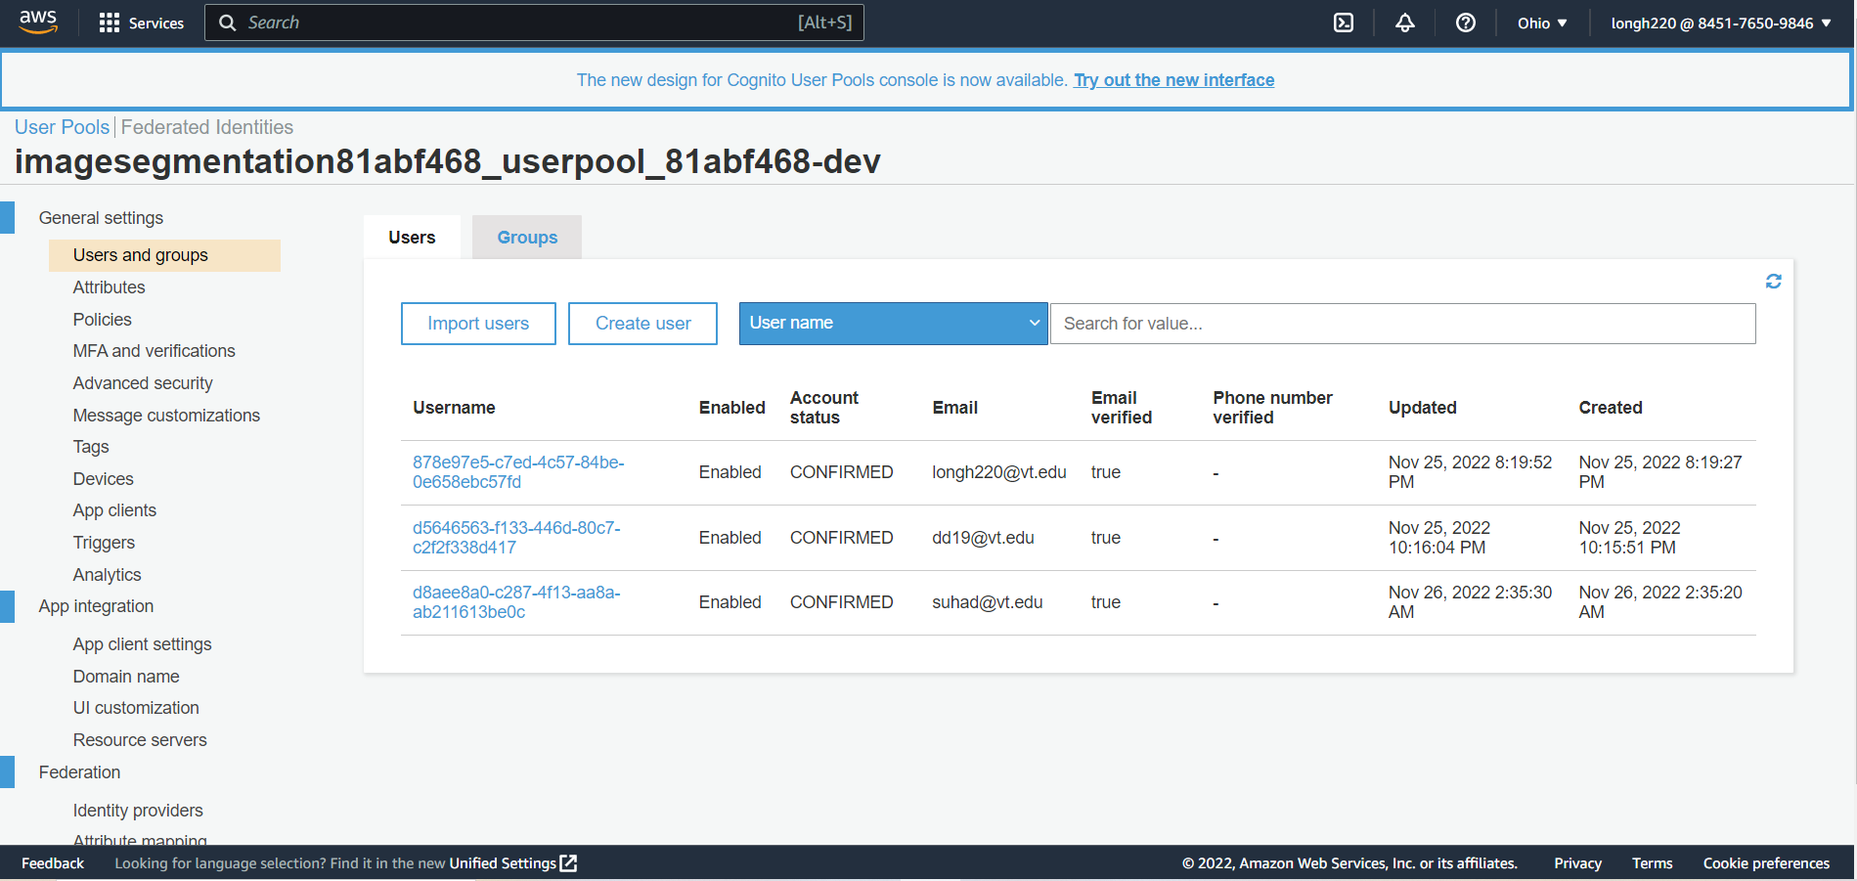

Slide 11
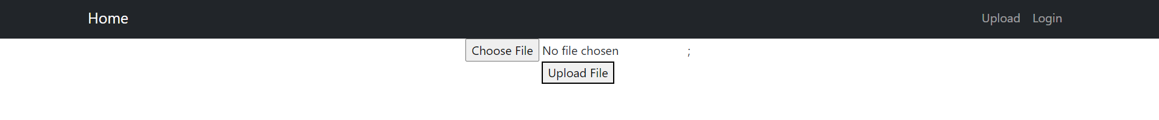
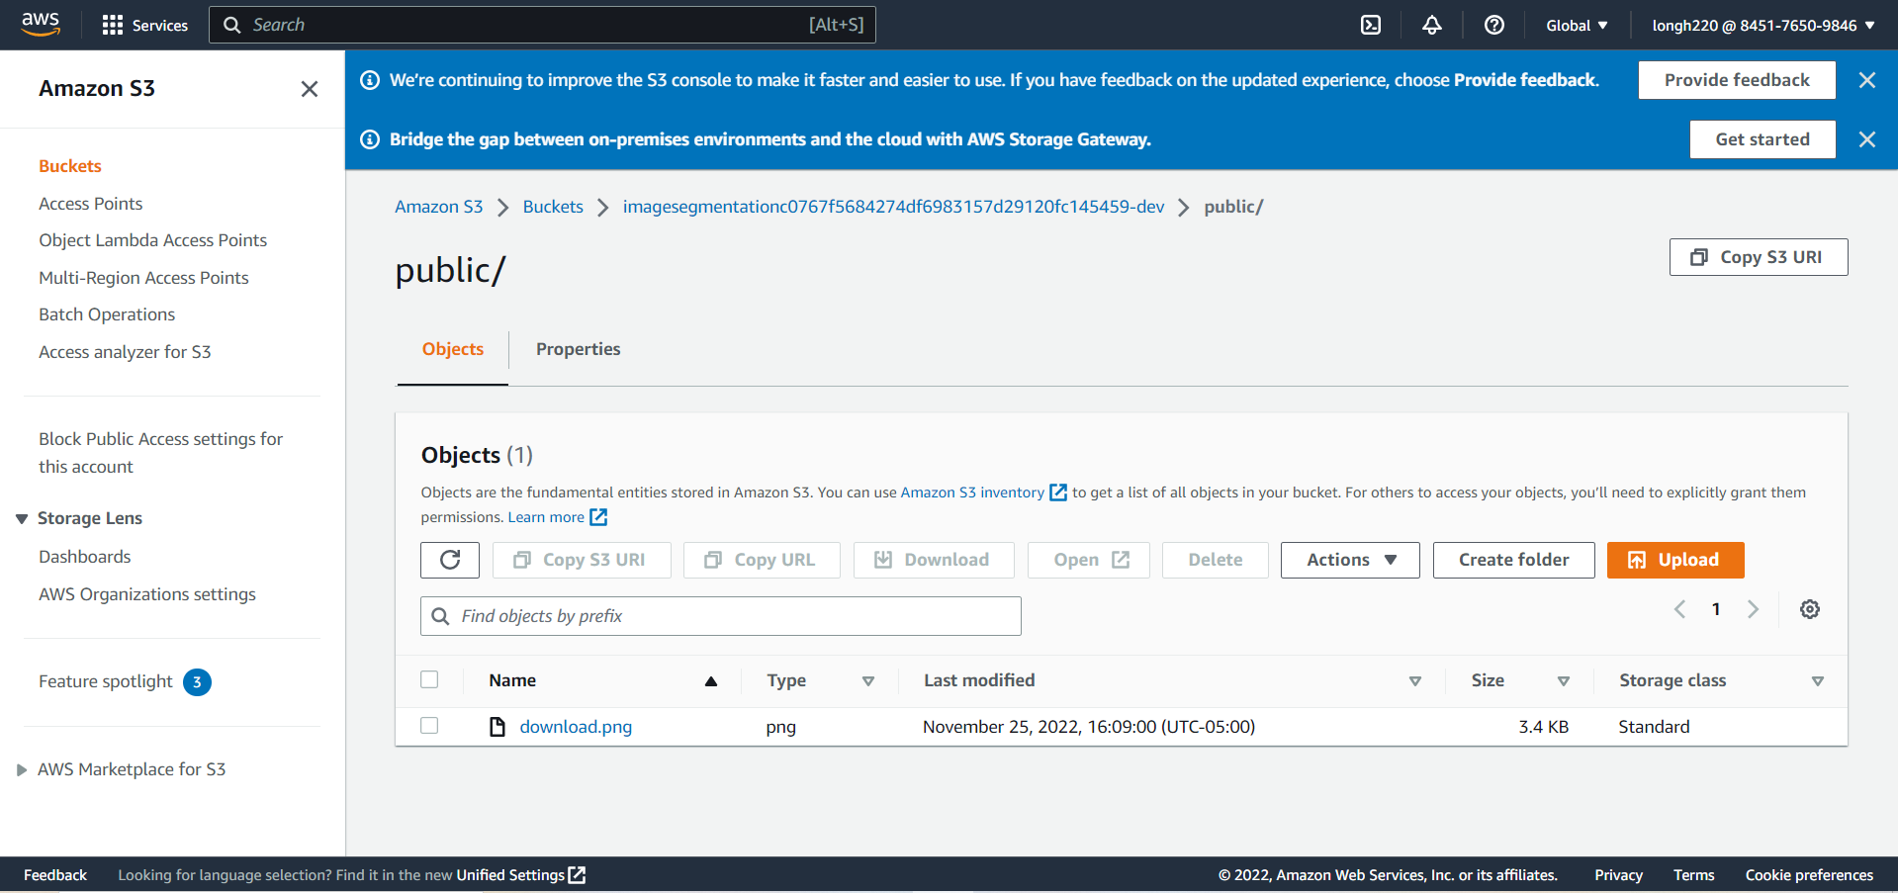

Slide 12
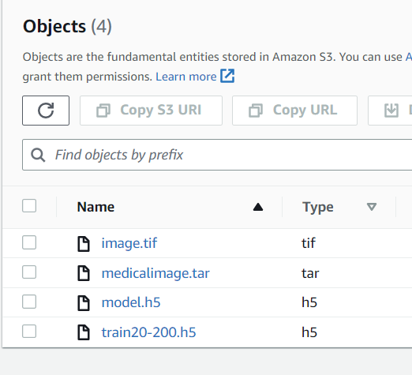
Sagemaker
After user uploads the image through the website, the image goes directly to S3 bucket.
Sagemaker pulls the image and the model from the S3 bucket.

Slide 13
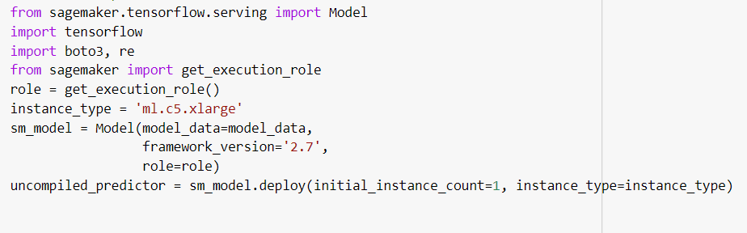
Deploy model and create endpoint

Slide 14
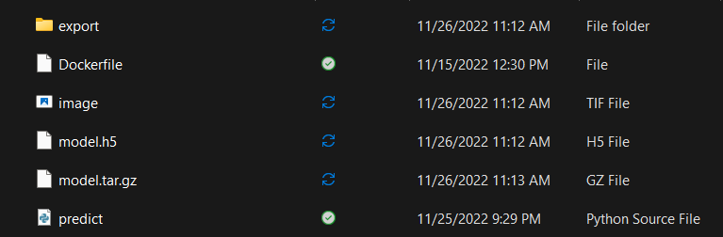
Load the model and start predicting
created the export directory.
convert the pre-trained Keras model to the format AWS wants (.tar.gz).

Slide 15
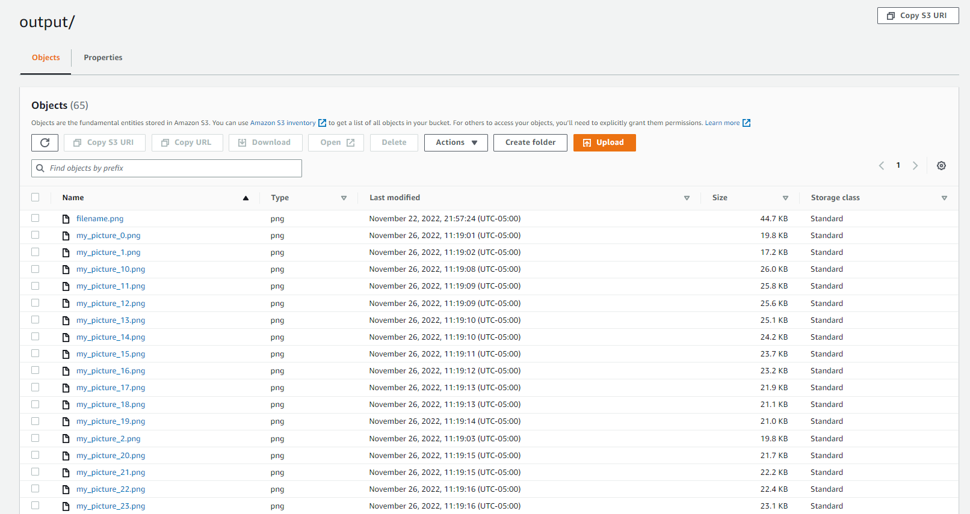
Results
Prediction output saved in another S3 bucket for user to download

Slide 16
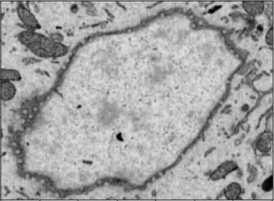
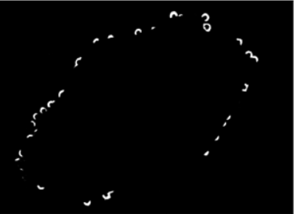
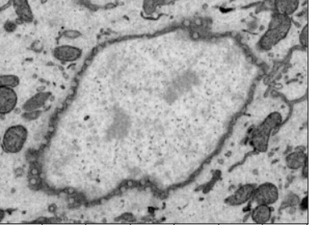
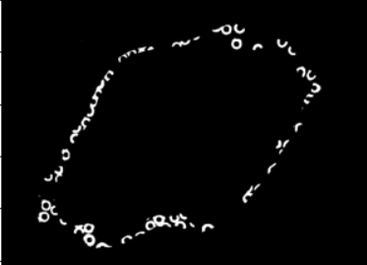
Sample Results
Input Medical Image
Prediction Output

Slide 17
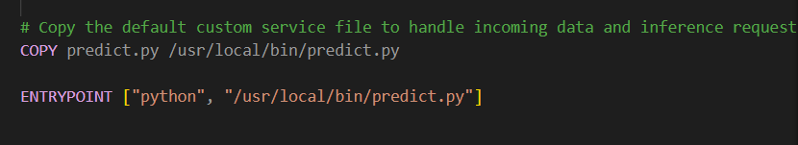
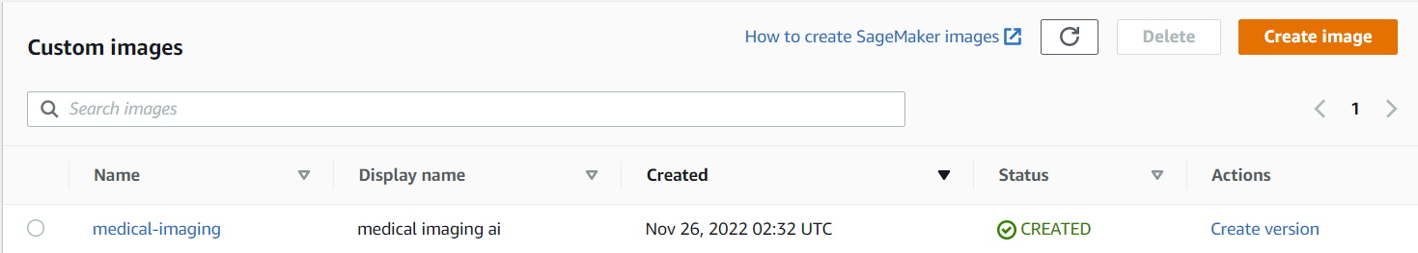
Docker
Upload container image to AWS ECR

Slide 18
Challenges and Lessons learned
AWS permission issues
  Often got stuck at points because of permission issues which wasted a lot of time.
Set up the identity pool in AWS
  Creating an identity and setup are hard.
  Cognito setup takes a lot of time.
  Connecting the upload page and AWS S3 with identity pool needs many configurations.
Leaving notebook instances and endpoints running in AWS
  Unnecessary resource usage.
Time management
  Had a slow start.
  Need to follow a week-by-week schedule.
Communication
  Asking for help when stuck is essential.

Slide 19
Future work
Connecting everything to the website
  Needs to display the output images
Adding extra features
  Allow image descriptions
  Display image bigger when clicked onto
Cleaning up codes

Slide 20
Acknowledgement
Dr. Yinlin Chen
Client
Local AWS expert, researches and creates applications in the cloud (AWS and GCP)
Edward A. Fox
Mentor and advisor

