Slide 1

Introduction to Open Educational Resources (OER)
Anita Walz, Assistant Director of Open Education and Scholarly Communication Librarian
IDEAx 2020 Virtual Conference ~ October 6, 2020
© Anita Walz. Unless otherwise noted, this presentation is licensed with a Creative Commons Attribution 4.0 license. Anyone may modify and redistribute this presentation with attribution. Required attribution: This presentation is adapted from © Anita Walz’s CC BY 4.0 licensed presentation “Introduction to Open Educational Resources” retrieved from http://hdl.handle.net/10919/100283

Slide 2

What you wanted to know . . .
What else would
you like to know?

Slide 3
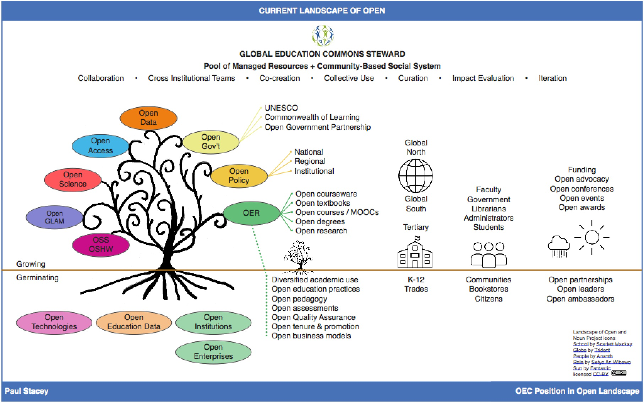
https://paulgstacey.files.wordpress.com/2017/11/landscapeofopenstacey.jpg

Slide 4
Discussion: On a scale of 1 to 5, how familiar are you with open educational resources (OER)?
(1=not familiar; 5=very familiar)

Slide 5
Open Educational Resources (OER) are freely and publicly available teaching, learning, and research resources that reside in the public domain or have been released under an intellectual property license that permits their free use, reuse, modification, and sharing with others.
They include full courses, course materials, modules, textbooks, streaming videos, tests, software, and any other tools, materials, or techniques used to support access to knowledge. - Hewlett Foundation

Slide 6
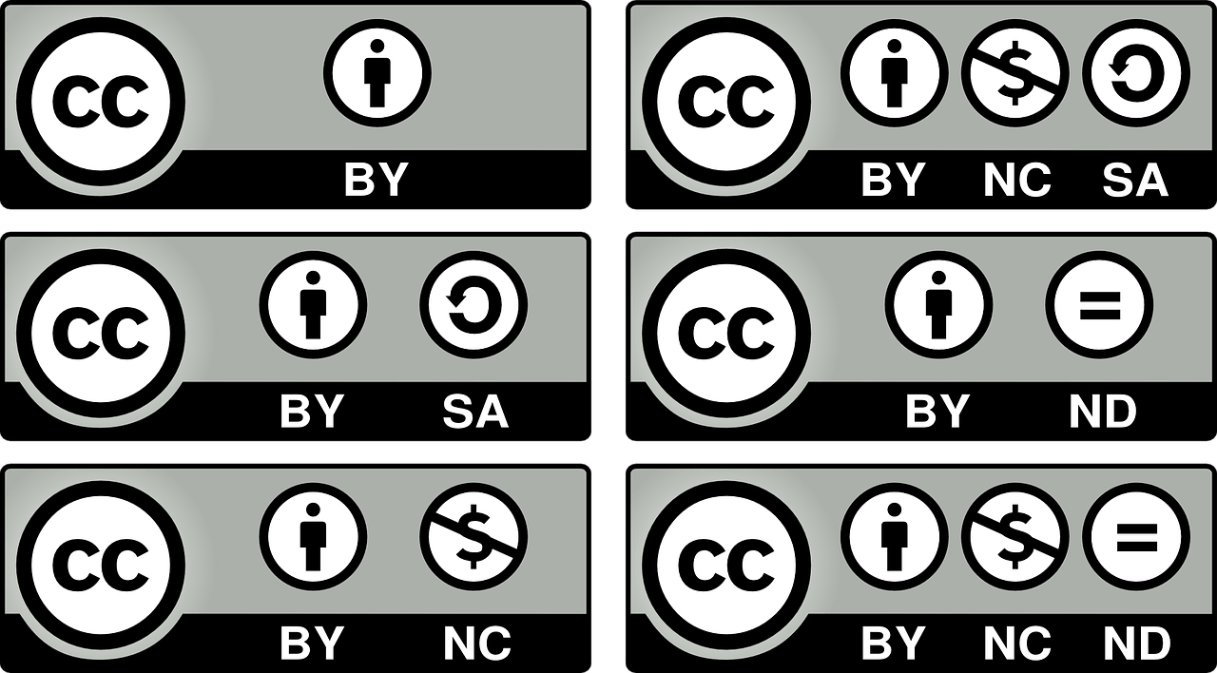

Public Domain
Copyright has expired (pre-1924)
Was never eligible for copyright
Clearly donated to the Public Domain
NOT the same as “free online”
Intellectual property license permitting free use, reuse, modification, and sharing

Slide 7
Examples https://guides.lib.vt.edu/oer
Textbooks: https://guides.lib.vt.edu/oer/opentextbooks
Figures and illustrations: https://guides.lib.vt.edu/oer/images
Simulations: https://guides.lib.vt.edu/oer/labs
Homework: https://guides.lib.vt.edu/oer/homework
Notes:
https://www.flickr.com/photos/wocintechchat/

Slide 8

Creative Commons licenses can help you to:
Share original works by making them more useable to others.
Legally (and easily) incorporate CC-licensed works authored
by others in your own work

Slide 9

Added bonuses:
Using CC-licenses may:
Extend your impact, audience and the reach of your work
Start (and build on) a virtuous cycle of sharing
Save money for your students and other readers

Slide 10
Discussion: Have you heard of Creative Commons licenses before?

Slide 11

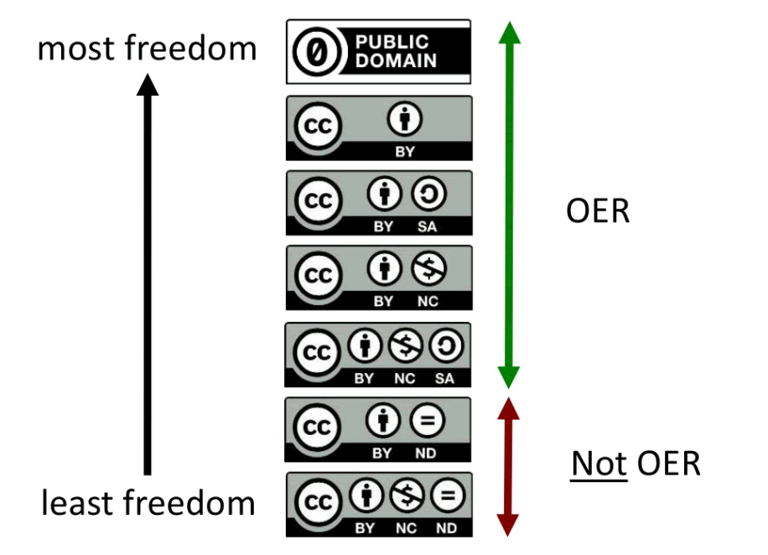

Slide 12


Not all CC-licenses allow derivatives
NOT OER
These licenses (ND) are not “open licenses” as they do not allow derivatives.

Slide 13





Slide 14
BY (Attribution) NC (NonCommercial) SA(ShareAlike) ND(NoDerivatives)

Slide 15




Read more here: https://creativecommons.org/licenses
OER definition: http://www.hewlett.org/strategy/open-educational-resources/
No known copyright
Donated to the public domain (and marked as such)
Creative Commons Attribution License (CC BY)
Creative Commons Attribution Share-Alike License (CC BY SA)
Creative Commons Attribution Non-Commerical License (CC BY NC)
Creative Commons Attribution Non-Commercial ShareAlike (CC BY NC SA)
Open Educational Resources
Notes:
Focus on those that ARE OER.

Slide 16
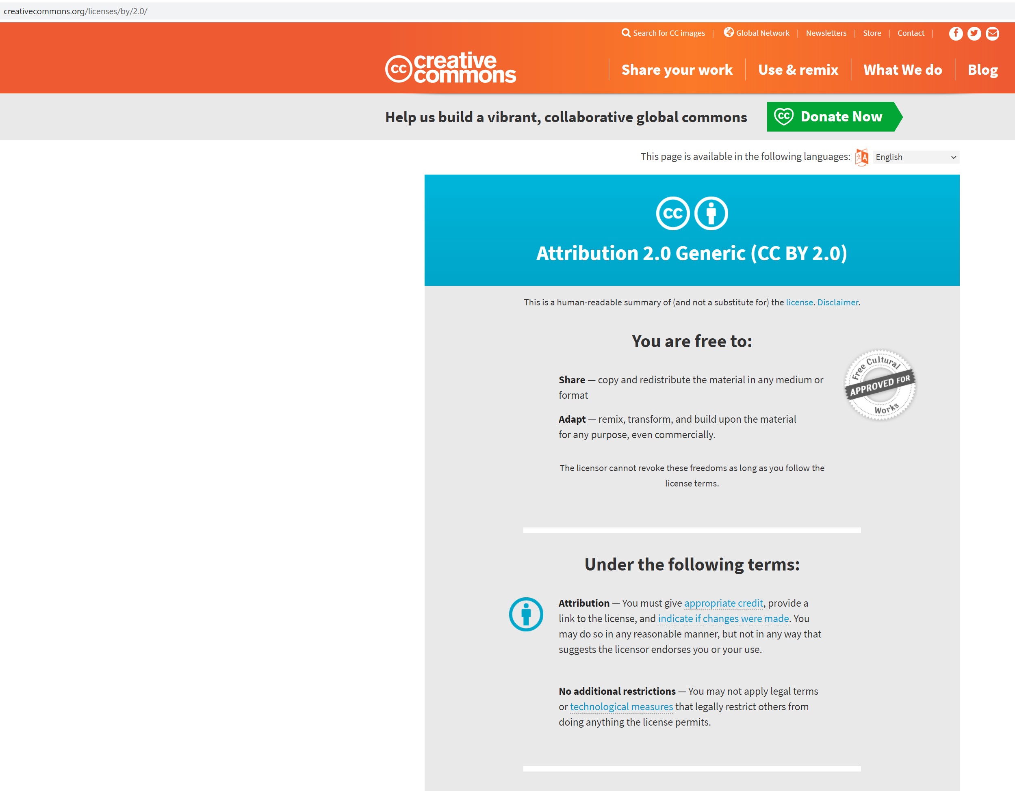

Slide 17
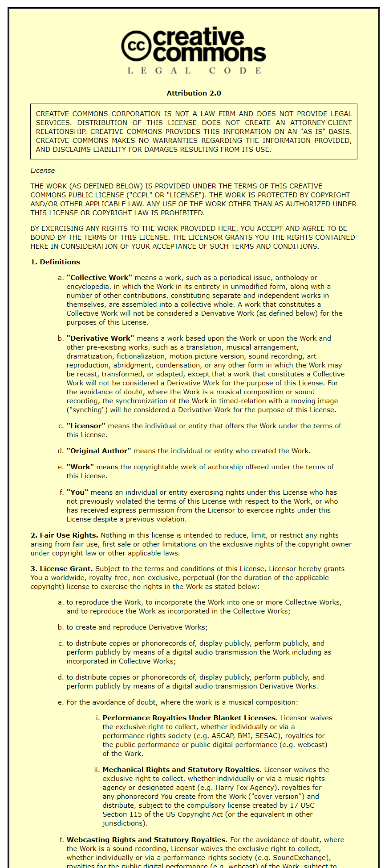
https://creativecommons.org/licenses/by/2.0/legalcode

Slide 18
What can I do with OER?
Retain - Make, own, and control copies of the content (store, manage, download, duplicate)
Reuse - Use the content in various ways (in class, study group, extension, journal article, on the radio, in a video, website etc.)
Revise - Adapt, modify, alter the content (reformat or translate)
Remix - Combine revised or original content with other materials to create something new (i.e. mashup)
Redistribute - Share copies of original content, revised content, or remixes with others
Source: This material is based on original writing by David Wiley, which was published freely under a Creative Commons Attribution 4.0 license at http://opencontent.org/definition

Slide 19
Questions?

Slide 20
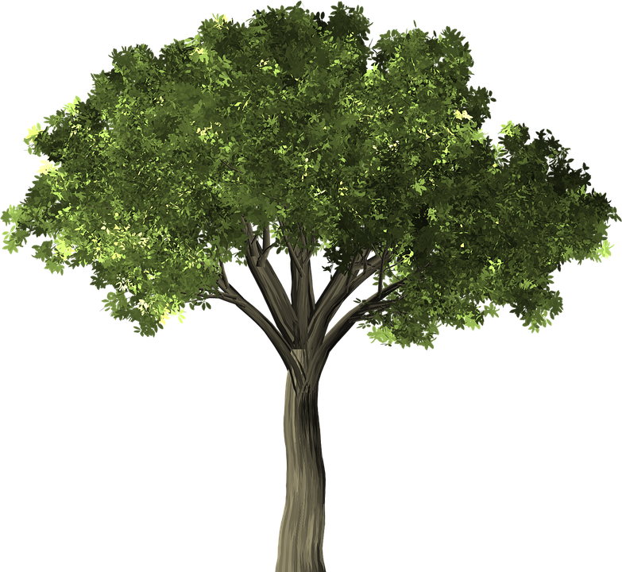
Best practices for creating & sharing OER
Evaluate
Mark
License
Share
EMLS
© Anita Walz. Unless otherwise noted, this presentation is licensed with a Creative Commons Attribution 4.0 license. Anyone may modify and redistribute this presentation with attribution. Required attribution: This presentation is adapted from © Anita Walz’s CC BY 4.0 licensed presentation “Introduction to Open Educational Resources” retrieved from http://hdl.handle.net/10919/100283
Public domain image: https://pixabay.com/en/tree-elm-elm-tree-leaf-green-1484370/

Slide 21
Evaluate
Did I create (and still own) all of the content in the item?
If not, do I have permission for my use of third-party content?
CC-licensed content - requires attribution
Public domain content (pre-1924, © expired, or U.S. Government content*)
Written permission from the author for your specific use(s)**
Fair use (with an informed Fair Use analysis***)
* Public Domain in the U.S. -- Works of a U.S. Government employee within the scope of their official duties
What is the Public Domain? http://fairuse.stanford.edu/overview/public-domain/welcome
** Some permission letters request permission to release the in-copyright work under the same open license as the overall work.
*** For more information see https://librarycopyright.net/resources/fairuse/index.php
EMLS

Slide 22
Mark
Mark 3rd party content within the document
Permission granted by:
Creative Commons license
Public domain (not in copyright)
Author-granted permission (preferably in writing)**
Fair Use (with an informed fair use analysis)
EMLS

Slide 23
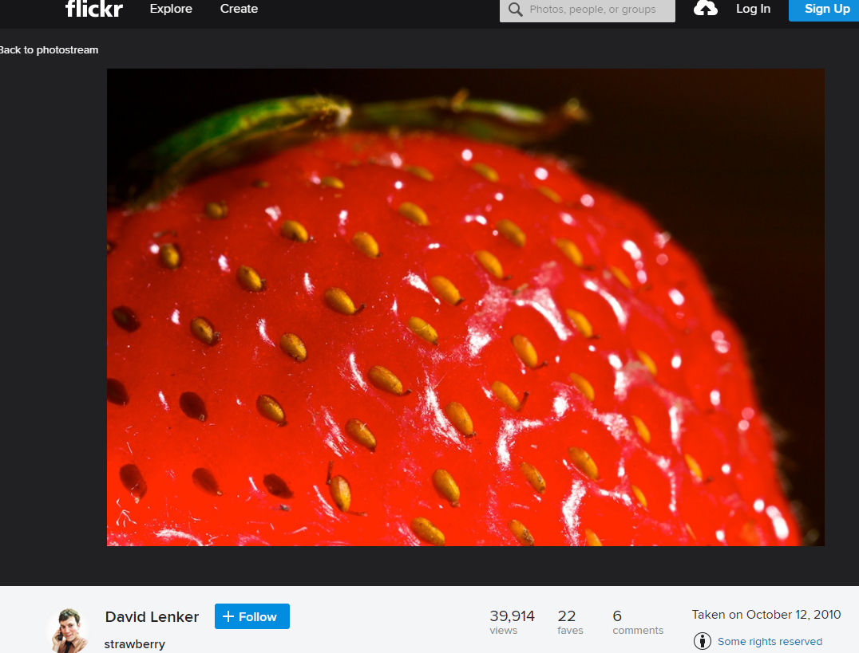
Creative Commons example
EMLS

Slide 24
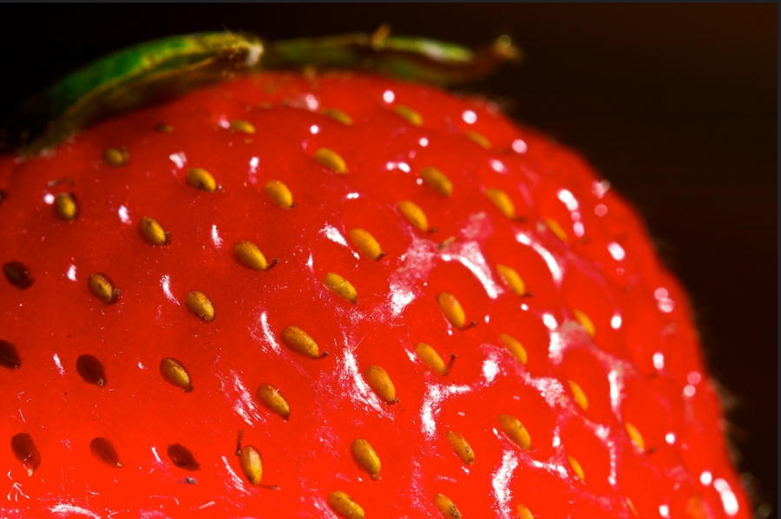
Creative Commons example
Attribution is always required when using CC-licensed materials.
© David Lenker Strawberry CC BY 2.0
EMLS
Best practice for attributing CC-licensed materials: https://wiki.creativecommons.org/wiki/Best_practices_for_attribution

Slide 25
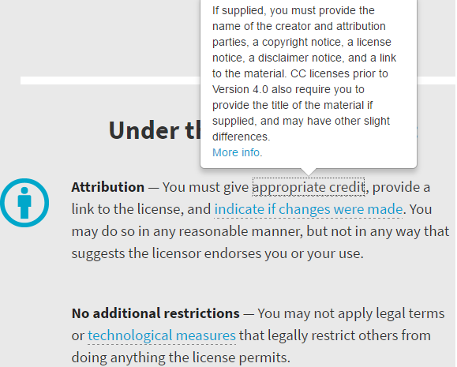
Creative Commons example
© David Lenker Strawberry CC BY 2.0
Attribution is always required when using CC-licensed materials.
© David Lenker Strawberry CC BY 2.0
EMLS
Source: https://creativecommons.org/licenses/by/4.0/
Best practice for attributing CC-licensed materials: https://wiki.creativecommons.org/wiki/Best_practices_for_attribution

Slide 26
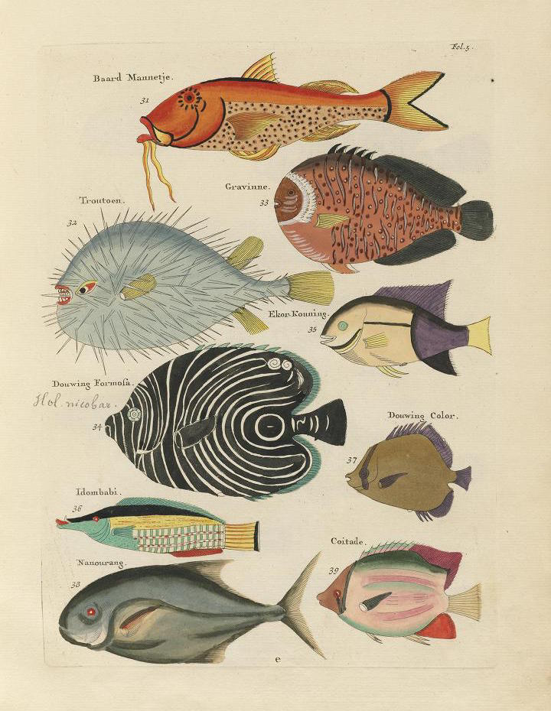
Public domain example
Citations are good scholarly practice.
Attribution of public domain works is not legally required.
Poissons, Ecrevisses et Crabes (1719). Retrieved from: http://publicdomainreview.org/collections/images-from-the-earliest-known-colour-book-on-fish-1754 [Public domain]
EMLS
About the Public Domain: http://guides.lib.vt.edu/oer/PD
More info on finding Public Domain works: http://publicdomainreview.org/guide-to-finding-interesting-public-domain-works-online/

Slide 27
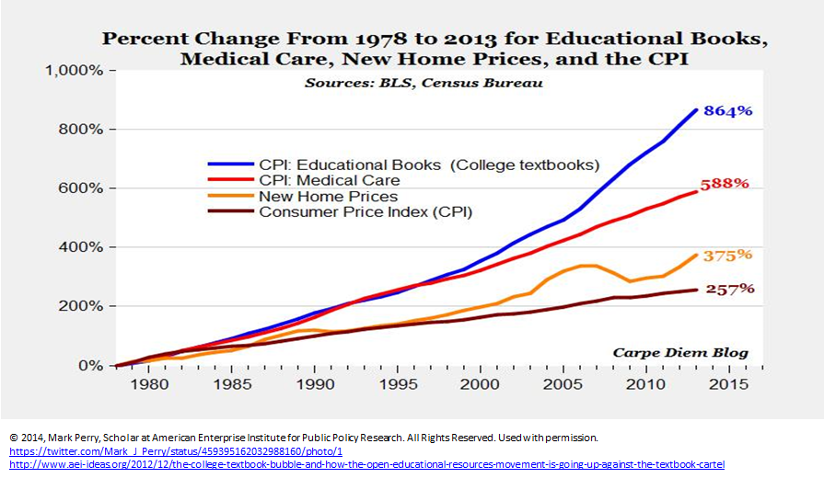
Author permission example
The permission granter may require a particular statement.
Citation is good scholarly practice.
EMLS

Slide 28
Mark
Mark 3rd party content within the document
  Creative Commons Example: © David Lenker Strawberry CC BY 2.0
  Public Domain Example: Poissons, Ecrevisses et Crabes (1719). Retrieved from: http://publicdomainreview.org/collections/images-from-the-earliest-known-colour-book-on-fish-1754 [Public domain]
Permission Example: © Mark Perry All Rights Reserved. Used with Permission
EMLS

Slide 29
License
Example:
© MyName, Publication Year. Unless otherwise noted, licensed with a
Creative Commons Attribution License 4.0
EMLS
Marking CC licensed works to be Machine Readable: https://wiki.creativecommons.org/wiki/Marking_Works_Technical

Slide 30
Share
Share in your usual places:
In print
On your website
Share to avoid eventual broken links and so that others can find your work:
VTechWorks (VT’s institutional repository) https://vtechworks.lib.vt.edu (Google crawls)
Disciplinary repositories (contact your professional society)
Open repositories: OERCommons http://www.oercommons.org
      MERLOT https://www.merlot.org
  Open Textbook Library https://open.umn.edu/opentextbooks/Submit.aspx
More platforms for creating and sharing: http://hdl.handle.net/10919/76739
Tell people about your work:
Social media channels: Twitter, Facebook, Listservs
University communication channels & news services
Tell your colleagues: Face to face
EMLS

Slide 31
Best practices for creating & sharing OER
Evaluate
Mark
License
Share
EMLS
Public domain images: https://pixabay.com/en/tree-elm-elm-tree-leaf-green-1484370/

Slide 32
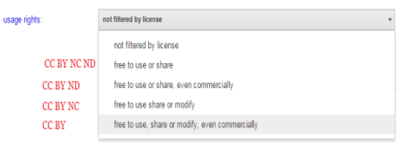
Finding OER, Creative Commons & Public Domain Resources
Google Advanced Search (“Usage Rights” filter)
Images, music, media & video: https://search.creativecommons.org
Open (OER) Textbooks: https://open.umn.edu/opentextbooks
Interactive Simulations: https://phet.colorado.edu
And more: http://guides.lib.vt.edu/oer

Slide 33
Services offered by the University Libraries
Consultations & Referrals: Where do I start? Who can help me?
Copyright, Creative Commons/Open Licensing consultations
Assistance locating & adapting openly licensed content
VTechWorks Institutional Repository
Open Textbook Publishing
Hosting of Open Journals and Open Conference Proceeding
Open Education Initiative Faculty Grants for development of openly licensed learning resources - https://guides.lib.vt.edu/oer/grants
© Anita Walz. This presentation is licensed with a Creative Commons Attribution 4.0 license. Anyone may modify and redistribute this presentation with attribution. Required attribution: This presentation is adapted from © Anita Walz’s CC BY 4.0 licensed presentation “Introduction to Open Educational Resources” retrieved from http://hdl.handle.net/10919/100283

Slide 34
Thank you and discussion
Anita Walz arwalz@vt.edu
@arwalz

