Slide 1
Work Value Characteristics of Construction Professionals
Tyler Beach, EIT
Virginia Tech
Department of Civil and Environmental Engineering
tbeach07@vt.edu
Advisor: Denise Simmons, PhD
Committee Member: John Taylor, PhD
Committee Member: Josh Iorio, PhD
Notes:
What are the work value characteristics of Construction Professionals?
Future research lead to education variables, socio-economic variables,

Slide 2
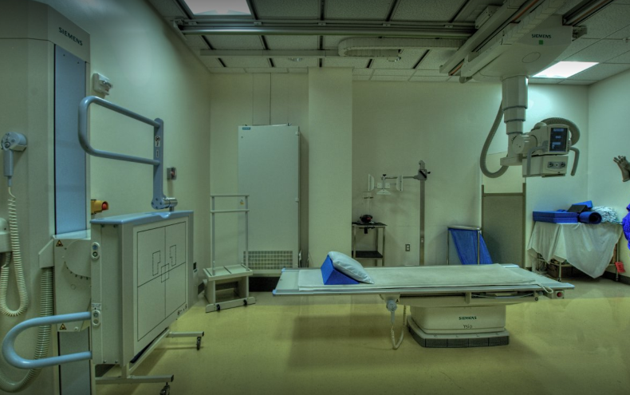
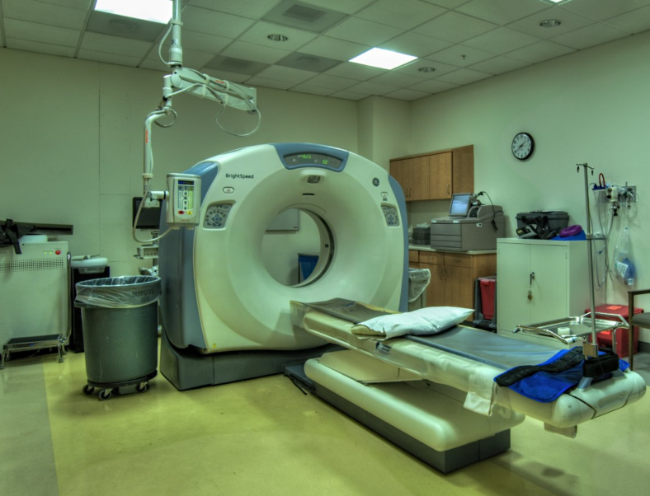
Introduction
https://www.youtube.com/watch?v=Vsayg_S4pJg

Slide 3
Construction Workforce Shortage
1
86% of Construction Companies experiencing difficulty hiring (AGC)
Great Recession
Average Monthly Job Openings 195,000
2016
Notes:
The construction workforce has been experience labor shortages since the 1980’s
Depending on the economy, some periods are worse than others.
2009 recession had a major affect on the workforce which can be seen
144,000 average monthly openings in 2015 (BLS)
195,000 average monthly openings so far in 2016 (BLS)
86% of Construction Companies report difficulty finding workers(AGC, 2015)
Not only skilled or craft workers, but the shortage is also effecting Construction Professionals Future Leadership and Office Personnel (AGC, 2015) (MLSOC Industry Board, Workforce Community of Practice, 2015)

Slide 4
Difficulty Hiring Construction Professionals
2

Slide 5
3
Construction Workforce Shortage
Craft Workers and Construction Professionals
Demographic Differences Contribute to the Shortage (Tucker et al. 1999)
Generational Differences (Becton et al. 2014)
Gender Differences in
Work Values (Elizur, 2004)
Misalignment of Work Values between Generations (Parry & Urwin, 2011)
Difficulty Attracting and Retaining Women in Construction (Menches and Abraham, 2007)
Effecting the Retention and Recruitment of Nursing (Hegney, 2006)
Link between Job Satisfaction and Work Values (Kalleberg, 1977)

Slide 6
Research Questions
4
RQ1A:Do differences between generations of construction professionals exist for the work value factors?
RQ1B: Which generation of construction professionals has the greatest variation of work value factors?
RQ1C: How much variation do Millennials exhibit from other generations of construction professionals?
RQ2A:Do differences between genders of construction professionals exist for the work value factors?
RQ2B: Which of the work value factors have the greatest difference between women and men?
RQ2C: How much variation is exhibited between genders of construction professionals?

Slide 7
Defining Generations
5
“A group of people or cohorts who share birth years and experiences as they move through time together.” (Kupperschmidt 2000; De Meuse and Mlodzik, 2010)
There are 4 Generations in the U.S. Workforce (Becton et al., 2014, BLS, NCCER)
*Silent Generation (1925-1945) | Baby Boomers (1946-1964)
Generation X (1965-1980) | Millennials (1981-2000)
* Silent Generation was not included in the study due to lack of participation
Notes:
4 generations in the us workforce. Not just construction, but all sectors and industries.
First time in U.S. history
Some include the newest generation (Gen 2020 / Gen Z?) after millennials.
So I think it this problem has to do with the interaction between and among generations and their different views of work values
Therefore my hypothesis is intrinsic and extrinsic work values and their/its relationship to career satisfaction does vary by generation.
If true, these differences may contribute to the industry’s lack of appeal by professionals and the departure of construction professionals.
Be upfront about this is recruitment and retention issue!!!!
Average age of construction professional is increasing, this due to a lack of younger workers / generations entering the industry.
Hypothesis: There is a generational divide in the construction that is affecting the recruitment of younger generations into professional construction roles.

Slide 8
Work Values, Job Satisfaction, Recruitment and Retention
6
An individual’s job satisfaction is influenced by their work values (Knoop, 2010)
This misalignment or divide of work values can be effecting the recruitment and retention of construction professionals
A lack of alignment with work values can result in an individual’s decision to leave (Hegney et al. 2006)
Generational differences in work values of construction craft workers
A 2010 study found ”few quantitative” differences (Real et al. 2010)
Notes:
Therefore my hypothesis is intrinsic and extrinsic work values and their/its relationship to career satisfaction does vary by generation.
If true, these differences may contribute to the industry’s lack of appeal by professionals and the departure of construction professionals.
Be upfront about this is recruitment and retention issue!!!!
Average age of construction professional is increasing, this due to a lack of younger workers / generations entering the industry.
Hypothesis: There is a generational divide in the construction that is affecting the recruitment of younger generations into professional construction roles.

Slide 9
Generational Work Values Measured in the Study
7
Different generations may each have their own set of characteristics that influence their work values and career satisfaction (Cennamo & Gardner, 2008; Parry & Urwin, 2011)
The existing literature provides mixed results on the effects of generation on work values and career satisfaction (Becton et al., 2014).
There maybe a misalignment between generational intrinsic and extrinsic work values of construction professionals.
Intrinsic Values – Job characteristics that involve the task itself (Kalleberg, 1977)
Extrinsic Values – Job characteristics that are external to the task (Kalleberg, 1977)
Notes:
The existing literature provides mixed results on the effects of generation on work values and career satisfaction (Becton et al., 2014).
Intrinsic Values – Personal growth, autonomy, interest, creativity, challenging, stimulating
Extrinsic Values – comfort able and convenient, pay and job security, social, contact with people and contribution to society, power

Slide 10
Gender work values
8
The construction industry is aware it has difficult attracting women to its workforce, while other industry’s have had greater success.
Of construction paraprofessionals and professionals only 12.8% are female. (Menches and Abraham, 2007)
Pop culture and mainstream media often reports major differences between men and women in the work place.
The differences between them is sometimes associated with differences in work values.
Existing research has provided mixed results and no great divide has yet to be identified (Elizur, 1994).

Slide 11
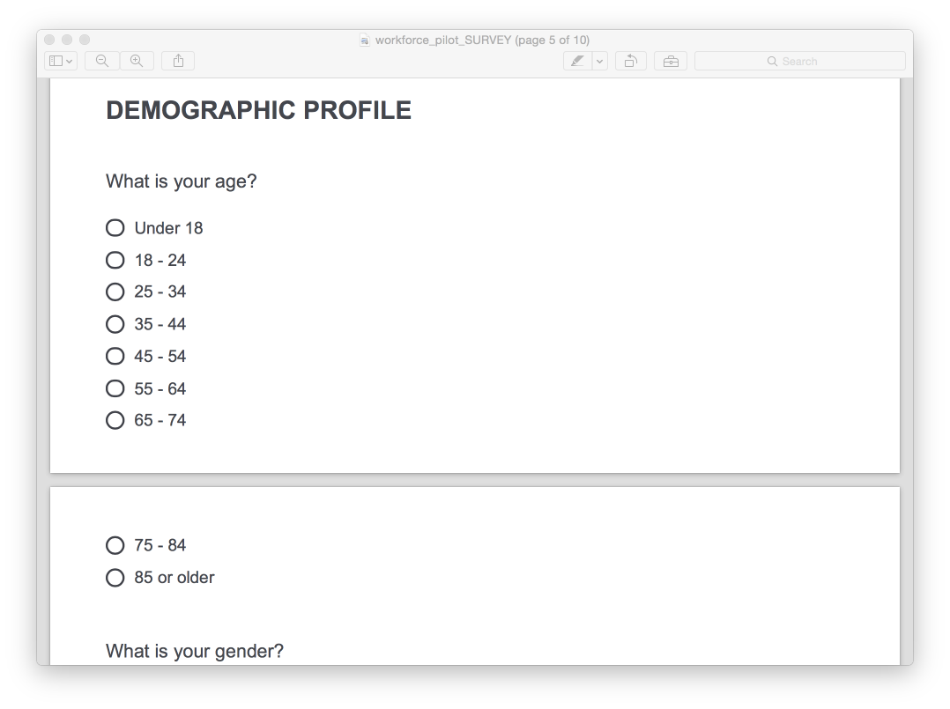
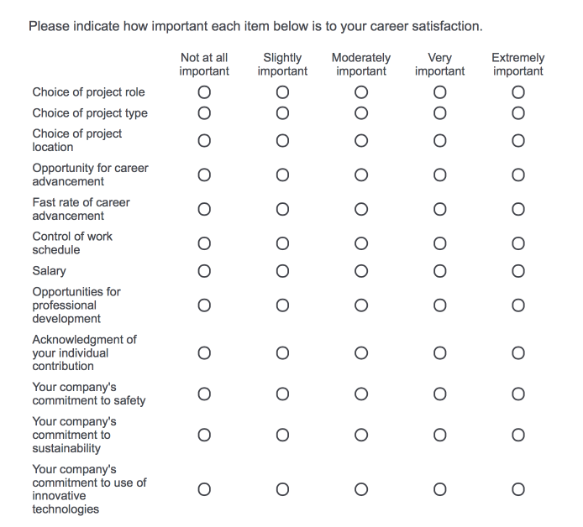
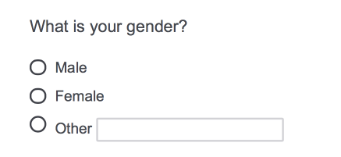
Method
9
Survey and Survey Collection
Collected via MLSoC Industry Board Members and Companies
Career Satisfaction Work Values
Scales
5 Point Likert Scale: 1 = Not at all Important, 5 = Extremely Important
Demographics
Age (Primary Variable Investigated)
Gender (Primary Variable Investigated)
Notes:
Talk about logistics

Slide 12
Survey Participants
10
225 construction professionals; 37 different companies;
Max company revenue = $20,000,000,000; Min company revenue = $2,800,000
21% Project Engineers; 22% Project Managers; 10% Estimators; 19% Superintendents; 23% Senior Management , 3% CEO/President
Notes:
Survey Participants turn into graphs
N=225
21 females, 201 males
76 millennials, 110 gen x, 39 baby boomers

Slide 13
Factor Analysis
11
Rotated Factor Loading (12 Variable)
Project Choice
Professional Progression
Time and Money
Company Vision
Notes:
Helps cluster variables (questions) into factors and remove variables that do not correspond to the constructs being tested. Reduce and combine many variables into more manageable numbers.
Principal components analysis
Eigenvalues are used to select how many factors to use
Shows how strong a correlation the factor is (numbers greater than 1) Kaiser’s criterion
Factor analysis validates survey questions
Choice of Project Location NOT included: the rotated factor loading was evenly distributed among three factors
Acknowledgment of Contribution NOT included: split too closely between two factors

Slide 14
Factor Analysis
12
Variable
Factor
Value
Career Advancement
Rate of Career Advancement
Professional Progression
Intrinsic & Extrinsic
Opportunities for Professional Development
Company Commitment to Safety
Company Commitment to Sustainability
Company’s Vision
Extrinsic
Company Commitment to Technology
Notes:
Why Factor Analysis is important
Validation of Survey Questions

Slide 15
Factor Analysis
13
Variable
Factor
Value
Choice of Project Type
Project Choice
Intrinsic
Choice of Project Role
Salary
Time and Money
Extrinsic
Control of Work Schedule

Slide 16
Data Analysis Methods
14
ANOVA Model
Analysis of Variance – Differences among groups
Tukey Test
Compares all pair combinations of group means
Identifies which pair combination has significant difference
ANOVA + Tukey = Identifies Significant Differences between Generations by Work Value Factor
Two Tailed T-Test
Assume un-equal variance between gender groups

Slide 17
Generation (ANOVA Model & Tukey Test)
15
Professional Progression
Company Vision

Slide 18
Generation (ANOVA Model & Tukey Test)
16
Project Choice
Time and Money

Slide 19
Gender (T-test Results)
17
Professional Progression
Company Vision

Slide 20
Gender (T-test Results)
18
Project Choice
Time and Money
Notes:
There maybe a potential difference in Project Choice between women and men Needs further analysis and investigation
RQ2: Do differences between genders of construction professionals exist for each work values factor? - Is female equal male in no specific direction = two tail t-test

Slide 21
Results
19
Generational differences in the work values do exist, but there is no Great Generational divide.
Millennials differed from Gen Xers – 1 Factor (Career Development)
Millennials differed from Baby Boomers – 1 Factor (Company Vision)
All generations share more in common than they are different.
2 differences between generations out of 12 possible combinations
There is no significant difference between Women and Men.

Slide 22
Implications
20
http://www.economist.com/news/business/21586831-businesses-are-worrying-about-how-manage-different-age-groups-widely-different
https://www.amplify.com/viewpoints/5-ways-tech-has-changed-professional-development
Notes:
There is no great generational divide!
All generations want to progress and share more work values than they differ.
Misalignment of work values may be with individual companies who do not maintain or care for the individuals work values.
Leads to limitations and future work (investigate success of work value alignment with larger and more successful companies.)

Slide 23
Limitations
21
Affects of Other Demographic Factors
Age
Ethnicity
Education
Etc.
Sample Distribution
Larger sample size
More regions
Other sectors
Stage of Life
https://goodstrat.com/2015/02
http://www.rootandroid.org/us/us-maps-united-states-regions
http://serano.com.au/
Notes:
Demographics,
Age, ethnicity, socio economic, education
Sample
Large Distribution to other geographic area
Other areas or sectors of the construction industry
Stage of Life
Missing generation (silent generation)
Better distribution of generations
Future Generation (Gen Z)

Slide 24
References
22
AGC, A. G. C. of A. (2015). “2015 Worker Shortage Survey Analysis.”
Becton, J. B., Walker, H. J., and Jones-Farmer, A. (2014). “Generational differences in workplace behavior.” Journal of Applied Social Psychology, 44(3), 175–189.
BLS, B. of L. S. (2012). The Recession of 2007 - 2009.
BLS, B. of L. S. (2016). “Construction Industry: Job Openings and Labor Turnover Survey.” BLS Database, <http://data.bls.gov/timeseries/JTU23000000JOL?data_tool=XGtable> (Oct. 3, 2016).
Cennamo, L., and Gardner, D. (2008). “Generational differences in work values, outcomes and person‐organisation values fit.” Journal of Managerial Psychology, (K. Macky, ed.), Emerald Group Publishing Limited, 23(8), 891–906.
HEGNEY, D., PLANK, A., and PARKER, V. (2006). “Extrinsic and intrinsic work values: their impact on job satisfaction in nursing.” Journal of Nursing Management, Blackwell Publishing Ltd, 14(4), 271–281.
Kalleberg, A. L. (1977). “Work Values and Job Rewards: A Theory of Job Satisfaction.” American Sociological Review, 42(1), 124.
Knoop, R. (1994). “Work Values and Job Satisfaction.” The Journal of Psychology, Taylor & Francis Group, 128(6), 683–690.
Kupperschmidt, B. (2000). “Multigeneration employees: Strategies for effective management.” The Health Care Manager, Aspen Publishers, 19(1), 65.
De Meuse, K. P., and Mlodzik, K. J. (2010). “A Second Look at Generational Differences in the Workforce: Implications for HR and Talent Management.” People & Strategy, HR People & Strategy, 33(2), 50–58.
Parry, E., and Urwin, P. (2011). “Generational Differences in Work Values: A Review of Theory and Evidence.” International Journal of Management Reviews, Blackwell Publishing Ltd, 13(1), 79–96.
Real, K., Mitnick, A. D., and Maloney, W. F. (2010). “More similar than different: Millennials in the U.S. building trades.” Journal of Business and Psychology, 25(2), 303–313.
Tucker, R., Haas, C., and Glover, R. (1999). “Key workforce challenges facing the American construction industry: An interim assessment.”
Turmail, B. (2015). “NATIONWIDE SURVEY FINDS 86 PERCENT OF CONTRACTORS HAVE DIFFICULTY FILLING KEY CRAFT AND SALARIED JOBS AS DEMAND FOR CONSTRUCTION INCREASES | Associated General Contractors.” AGC.org, <https://www.agc.org/news/2015/09/10/nationwide-survey-finds-86-percent-contractors-have-difficulty-filling-key-craft-and> (Nov. 11, 2015).
Whyte, D. (NCCER). (2013). “Craft Workforce Development 2013 and Beyond.” NCCER, <http://www.nccer.org/uploads/filelibrary/craft_wfd_2013_and_beyond.pdf> (Oct. 30, 2015).

Slide 25
Thank You
23
Questions?
Tyler Beach
tbeach07@vt.edu

