Slide 1


Welcome to the
Preconference!
October 21, 2015
Virginia Library Association Annual Conference
Richmond, Virginia
This work is licensed with a Creative Commons Attribution Only License 4.0, unless otherwise noted. Excludes images, illustrations, and logos.

Slide 2
We are:
Kathleen DeLaurenti
College of William & Mary
Tara Cassidy
Virginia’s Community Colleges
Stephanie Fair
Tidewater Community College
Lucretia McCulley
University of Richmond
Ginny Pannabecker
Virginia Tech
Anita Walz (Lead)
Virginia Tech
Joy Yeager
Tidewater Community College

Slide 3
Session Objectives
Make connections & have fun
What’s “Open” and why it matters
Hands on work with open licenses
Stories from the field: Librarians and OER
Application to your institutional realities
Follow up discussion - can we collaborate?

Slide 4
I’m just learning about open education
I have a strong understanding
I feel strong philosophical alignment
I’m pragmatic about its applications
I’m skeptical but listening
I’m not sure what to do next
I have a vision and a plan
© David Wiley CC BY

Slide 5
“What are some of the barriers to address in making teaching and learning better for students?”
Participant Responses
Potential textbook costs; disconnect between faculty and students; self-directed learning; teaching vs. cool resources;
Why we’re here: workload issues, myths, faculty having time & energy to putting into something new
Cost of textbooks as barrier; economic factors in community;
Cost; communicating with faculty; involving the library to find/evaluate quality, issues with access & ADA compliance; partnerships w/public library/academic library, trying new things to work together with the library
Small staffs; working with new processes; faculty/administration resistance to change; limited funds;

Slide 6
Analyzing OER in the Context of Your Institution
What are the possibilities for your library to develop a strategy on OER?
Ask: Who are the stakeholders in your environment?
Use your Notes handout to capture your thinking about your library and OER.
What are your library’s internal strengths and weaknesses?
What external opportunities and threats do OER pose?
Notes:
Tara - Follow with brief intro to SWOT elements.

Slide 7
Strengths: Internal, positive factors
What are my library’s advantages and unique qualities?
Perceived capabilities?
Innovative aspects?
Notes:
Tara
Librarians are already known as information licensing and evaluation experts. Libraries remove cost barriers to knowledge. Existing training and outreach programs are successful.

Slide 8
Weaknesses: Internal, negative factors
How could my library be improved, if given the resources?
Perceived weaknesses?
How is success measured?
Notes:
Tara
Insufficient staffing. Flat or reduced budget. No institutional mandate.

Slide 9
Opportunities: External, positive factors
What Open trends or conditions may have positive impact?
What kinds of collaboration can OER prompt?
What needs does OER meet?
Notes:
Tara
OER is used worldwide. Creating OER contributes to the knowledge economy and advancement of education. OER early-adopters have ‘lessons learned’ to share.

Slide 10
Threats: External, negative factors
What Open trends or conditions may have negative impact?
Funding concerns?
What are the obstacles to OER use?
Notes:
Tara
Remixing OER creates a licensing minefield for those with low information literacy. OER creates potential for administration to question current library costs. Open material that is not 508 compliant fails underserved groups.

Slide 11
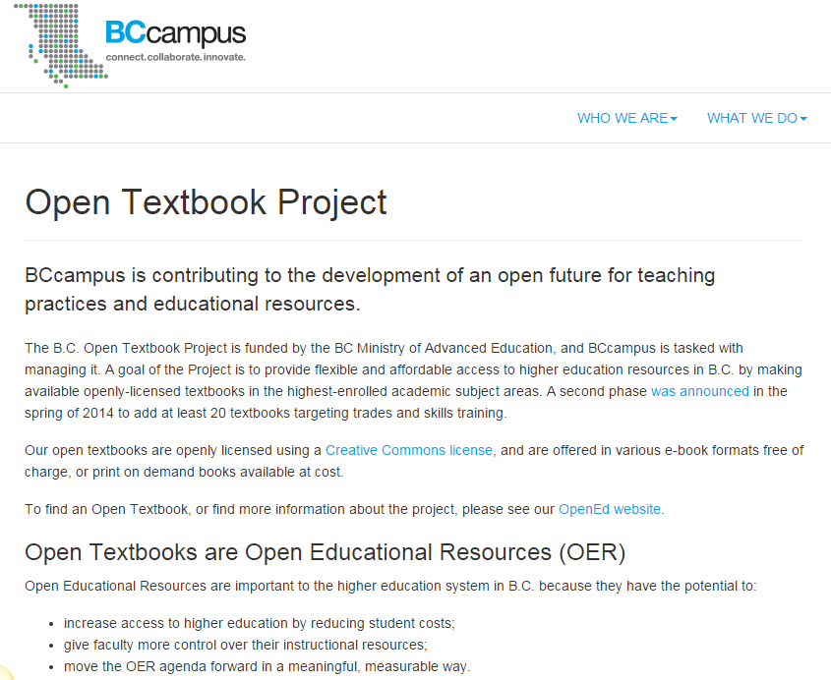
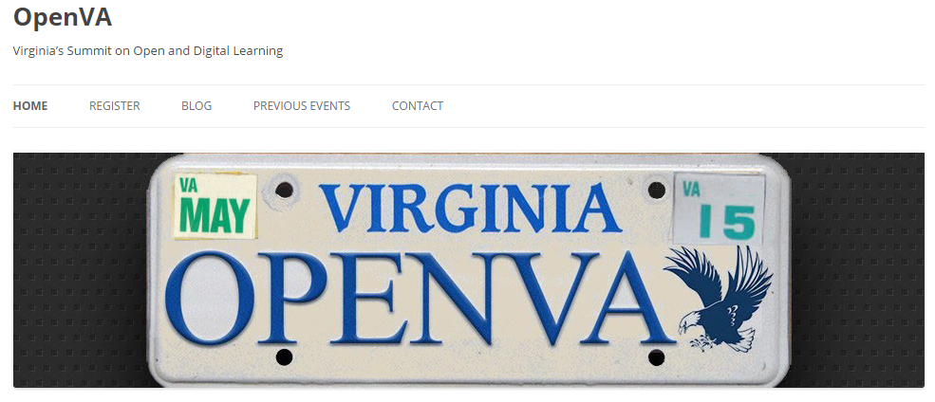


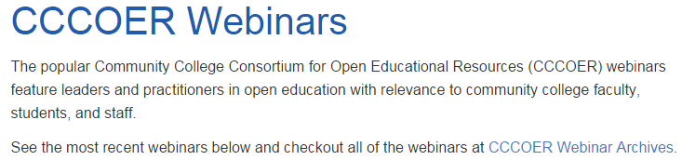

Logos are the property of their respective institutions.

Slide 12


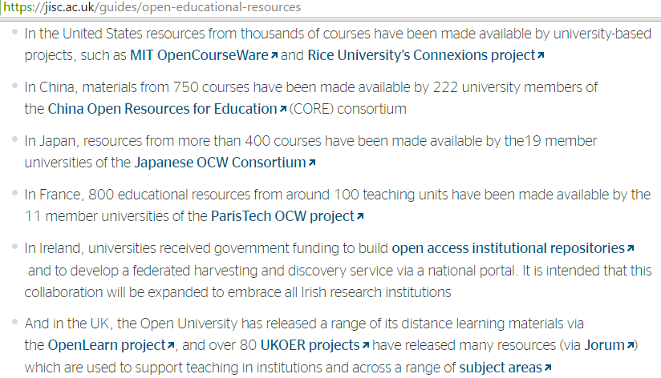

Open Education is Global
http://www.unesco.org/new/en/communication-and-information/access-to-knowledge/open-educational-resources/implementing-the-paris-oer-declaration/

Slide 13
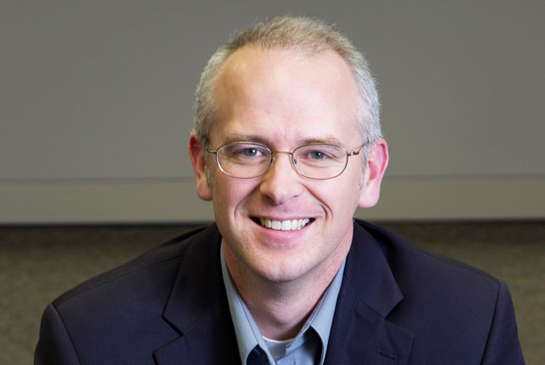
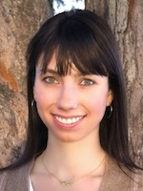
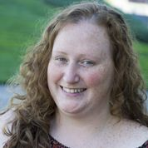

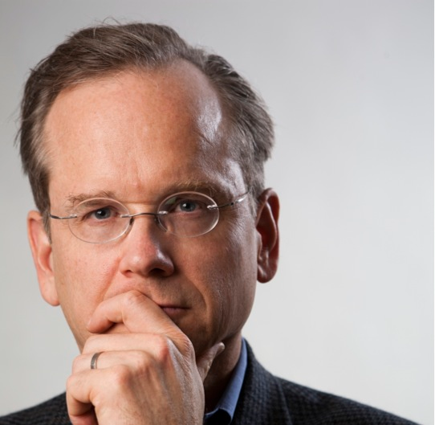
Open Education is National
David Wiley
Nicole Allen
Quill West
Cable Green
Larry Lessig
Images are property of their respective owners.

Slide 14
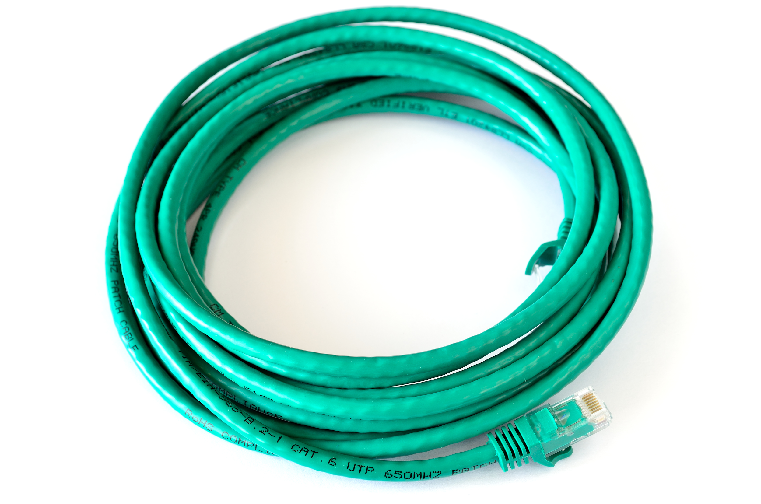
Friday, November 6th @ William & Mary
Join us for an upcoming OER event featuring Dr. Cable Green from Creative Commons!
9am Keynote: Why OER and why now?
10:30am: Session for librarians and academic technologists on being OER leaders on campus
See event recording here: http://tinyurl.com/ofpz8pz
Image sources: Cable Green photo green cable photo

Slide 15
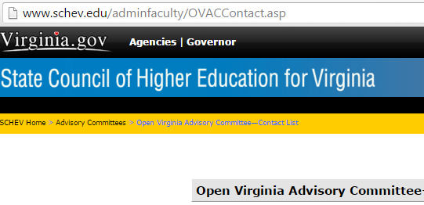
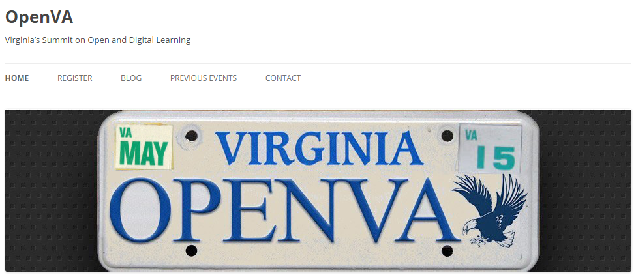
Open Education is Local
http://www.openva.org
Logos are the property of their respective owners.

Slide 16
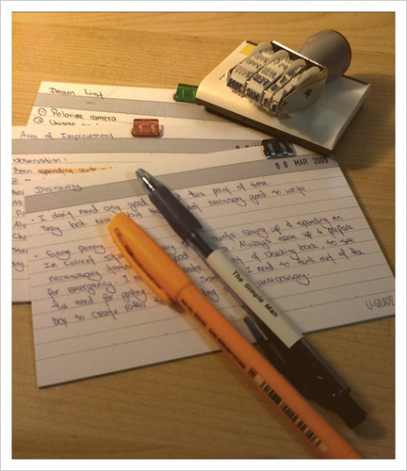
Definition of OER
Write down a brief definition of Open Educational Resources.
Turn to your neighbor and discuss.
Large group
© Koalazymonkey CC BY
Notes:
https://creativecommons.org/licenses/by/2.0/ https://www.flickr.com/photos/koalazymonkey/3342173345/sizes/m/ CC BY koalazymonkey

Slide 17
What are Open Educational Resources?
© Koalazymonkey CC BY

Slide 18
Hewlett Definition of OER
OER are teaching, learning, and research resources that reside in the public domain or have been released under an intellectual property license that permits their free use and re-purposing by others.
© Hewlett Foundation OER Definition CC BY 3.0

Slide 19
Hewlett Definition of OER
Open educational resources include full courses, course materials, modules, textbooks, streaming videos, tests, software, and any other tools, materials, or techniques used to support access to knowledge.
© Hewlett Foundation OER Definition CC BY 3.0

Slide 20


OPEN VS. FREE
© FraserElliot Yes, We’re Open CC BY NC
© SpiderWeb-MarketingSystems A Banner for Advertising CC BY SA

Slide 21


Open VS. Copyright
© Justinc Neon sign: Open 2005 CC BY SA

Slide 22
5 R’S OF OER PERMISSIONS
Redistribute
Reuse Revise Remix Retain
Source: http://opencontent.org/blog/archives/3221

Slide 23
The 5 R’s
1.Retain – the right to make, own, and control
2.Reuse – the right to use the content
3.Revise – the right to adapt, adjust, modify, or alter
4.Remix – the right to combine the original or revised content with other open content
5.Redistribute – the right to share copies of the original content, your revisions, or your remixes
Source: http://opencontent.org/blog/archives/3221

Slide 24


Slide 25
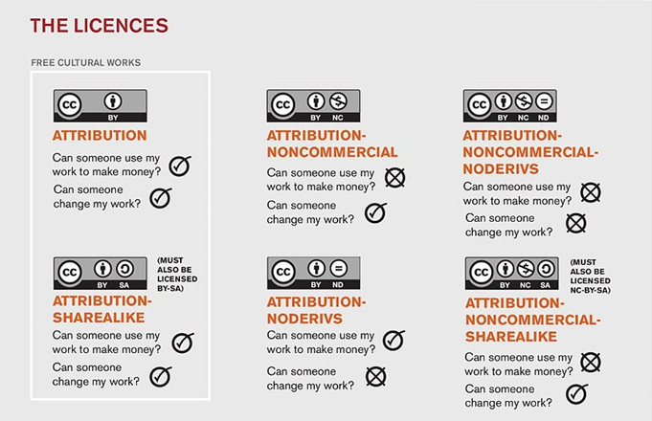
CC Licenses

Slide 26
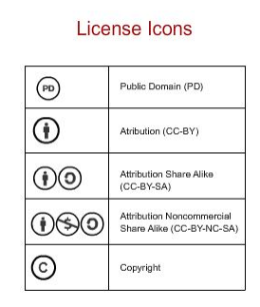
Let’s Practice
License Compatibility Rules
PD cards and CC-By Cards may be remixed with all others except © cards.
CC-BY-SA cards may only be remixed with PD, CC-BY, and other CC-BY-SA Cards.
CC-BY-NC-SA cards may only be remixed with PD, CC-By, and other CC-BY-NC-SA cards
© cards can not be remixed at all
Want to play online? See: The OER Remix Game

Slide 27

Benefits of Open Resources
Joy Yaeger, Reference Librarian, Tidewater Community College
© Justinc Neon sign: Open 2005 CC BY SA

Slide 28

We are Evolving https://vimeo.com/43323388

Slide 29

Next Level of Learning: 5 Rs
Retain - the right to make, own, and control copies of the content
Reuse - the right to use the content in a wide range of ways
Revise - the right to adapt, adjust, modify, or alter the content itself
Remix - the right to combine the original or revised content with other open content to create something new
Redistribute - the right to share copies of the original content, your revisions, or your remixes with others
Source: http://opencontent.org/blog/archives/3221
Image: © computer lab - 4th grade by Woodleywonderworks CC BY 2.0

Slide 30

Life-Long Learning
Ownership and ongoing
© COD Newsroom CC BY 2.0

Slide 31
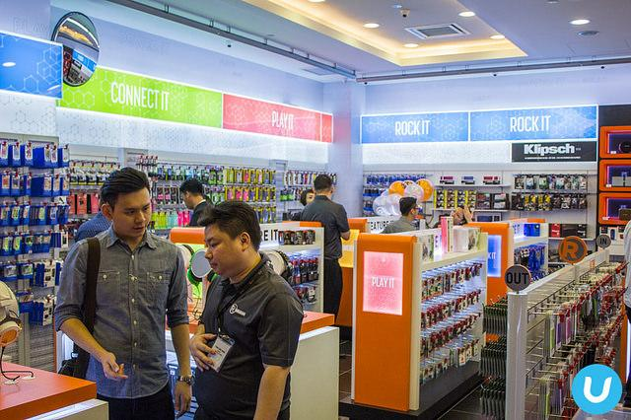
Updated Materials
New concepts and cutting-edge information
© Vernon Chan RadioShack Store Opening @ Sunway Pyramid CC BY 2.0

Slide 32

Promoting Creativity and Exploration
Freedom for exploration
© Ingo Bernhardt Learning and socializing on the beach CC BY 2.0

Slide 33


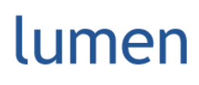

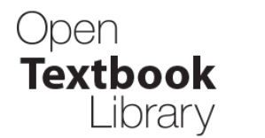
Changing the Format of Education from Old School…
=
To New School
© truds09 “Day 31: Read Up!” CC BY SA 2.0
Logos are the property of their respective owners.

Slide 34
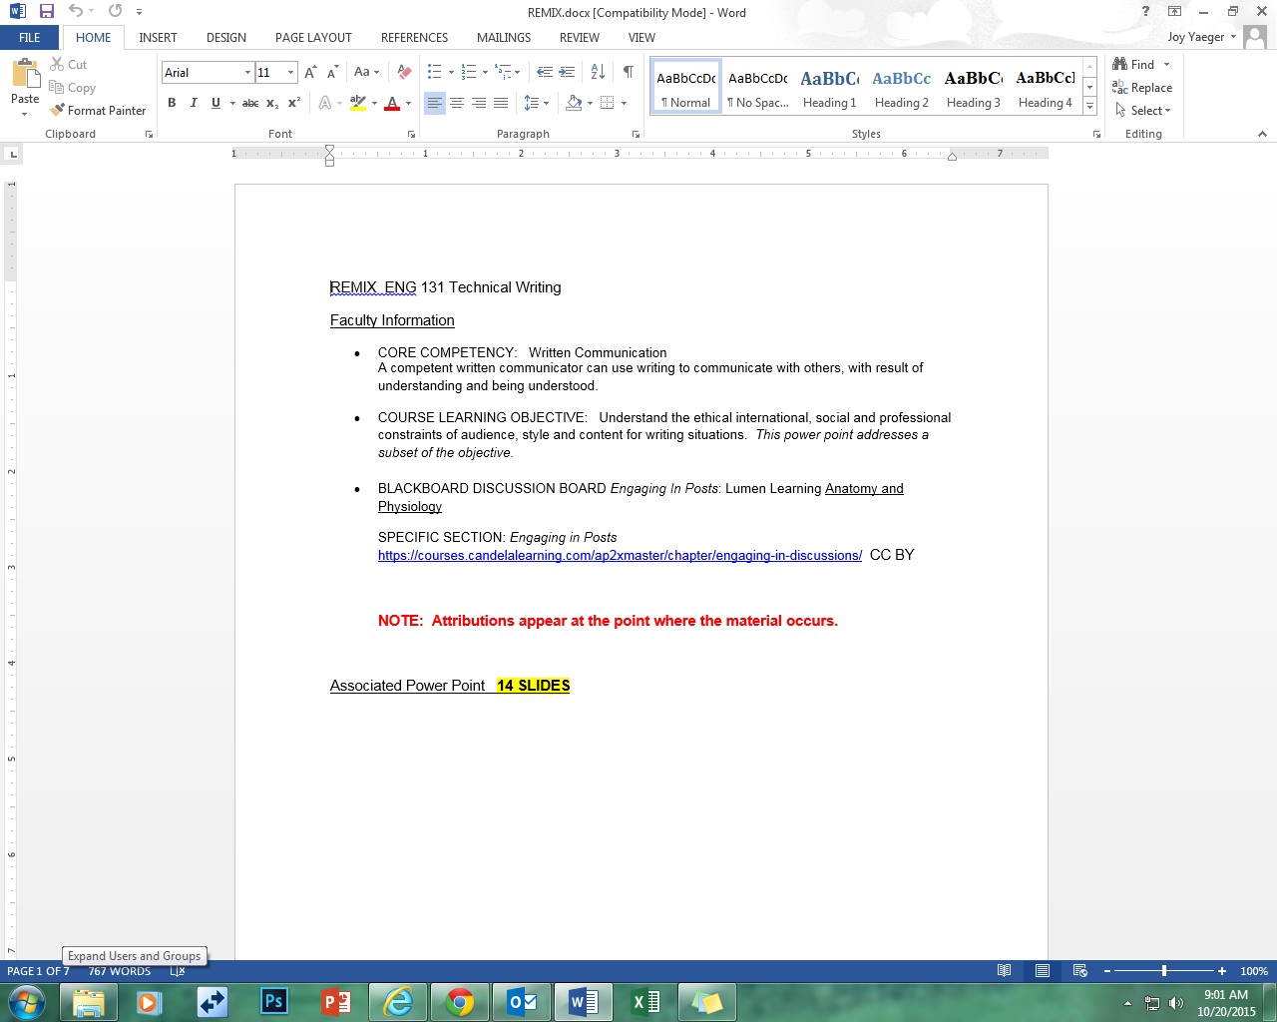
Faculty Examples: Chemistry Example

Slide 35
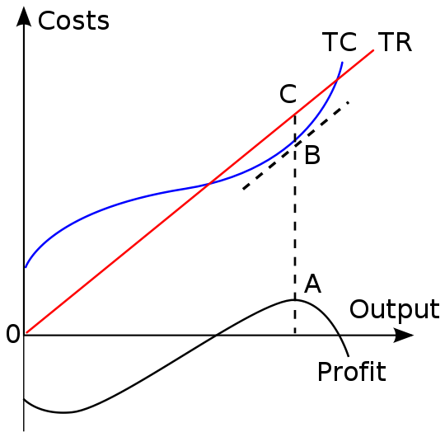


What Is a Business?
Introduction to Business > What Is a Business?
In mainstream economics, the concept of a market is any structure that allows buyers and sellers to exchange any type of goods, services, and information. The exchange of goods or services for money is called a transaction. Market participants consist of all the buyers and sellers of a certain good, thus influencing its price.
This influence is a major study of economics and has given rise to several theories and models concerning the basic market forces of supply and demand . There are two roles in markets, that of a buyer and that of a seller. The market facilitates trade and enables the distribution and allocation of resources in a society.
Can you describe a local market need in your area?
Free to share, print, make copies and changes. Get yours at www.boundless.com
www.boundless.com/business

Slide 36
The Goals of a Business
Introduction to Business > What Is a Business?
Economic value added suggests that a principal challenge for a business is balancing the interests of parties affected by the business, interests that are sometimes in conflict with one another.
Alternate definitions state that a business' principal purpose is to serve the interests of a larger group of stakeholders, including employees, customers, and even society as a whole.
Many observers hold that concepts such as economic value added are useful in balancing profit-making objectives with other ends.
Social progress is an emerging theme for businesses.
Profit Maximization
View on Boundless.com
Free to share, print, make copies and changes. Get yours at www.boundless.com
www.boundless.com/business/textbooks/boundless-business-textbook/introduction-to-business-1/what-is-a-business-22/the-goals-of-a-business-129-10246

Slide 37
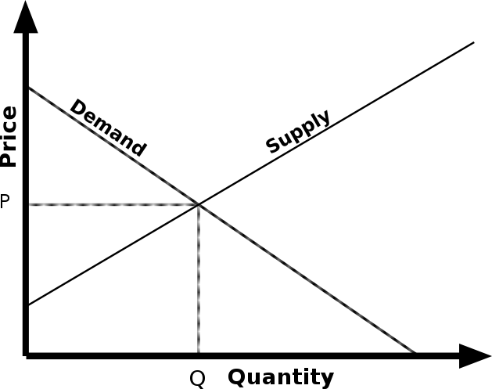
Addressing Market Needs
Introduction to Business > What Is a Business?
A market is one of many varieties of systems, institutions, procedures, social relations, and infrastructures whereby parties engage in exchange.
Many companies today have a customer focus (or market orientation). This implies that the company focuses its activities and products on consumer demands.
Market research is for discovering what people want, need, and believe; and how they behave.
Market segmentation is the division of the market or population into subgroups with similar motivations.
Supply and Demand
View on Boundless.com
Free to share, print, make copies and changes. Get yours at www.boundless.com
www.boundless.com/business/textbooks/boundless-business-textbook/introduction-to-business-1/what-is-a-business-22/addressing-market-needs-131-7861

Slide 38


Profit and Value
Introduction to Business > What Is a Business?
Normal profit represents the total opportunity costs (both explicit and implicit) of a venture to an investor, whereas economic profit is the difference between a firm's total revenue and all costs (including normal profit).
Given that profit is defined as the difference in total revenue and total cost, a firm achieves a maximum profit by operating at the point where the difference between the two is at its greatest.
The value of a firm is linked to profit maximization. A firm looking to maximize its profits is actually concerned with maximizing its value.
Profit and Value
View on Boundless.com
Analysis, Statistics, Charts
Free to share, print, make copies and changes. Get yours at www.boundless.com
www.boundless.com/business/textbooks/boundless-business-textbook/introduction-to-business-1/what-is-a-business-22/profit-and-value-132-10237

Slide 39
Attribution
Introduction to Business
Power Point Presentation:
From Boundliess.com
Title: Addressing Market Needs
Creator: Boundless
Link: https://www.boundless.com/business/textbooks/boundless-business-textbook/introduction-to-business-1/what-is-a-business-22/what-is-a-business-22-powerpoint-templates/
Source: Boundless. “Addressing Market Needs.” Boundless Business. Boundless, 15 Jul. 2015. Retrieved 15 Jul. 2015 from https://www.boundless.com/business/textbooks/boundless-business-textbook/introduction-to-business-1/what-is-a-business-22/addressing-market-needs-131-7861/
License: CC By SA
Picture
Title: Analysis, Statistics, Charts
Creator: Geralt
Link: https://pixabay.com/en/analysis-statistics-chart-graphic-227172/
License: CC0 Public Domain / FAQ Free for commercial use / No attribution required
License: CC By SA
Free to share, print, make copies and changes. Get yours at www.boundless.com

Slide 40
Do we need a break?
(10 minutes)

Slide 41
Librarians leading & supporting OER in Virginia

Slide 42
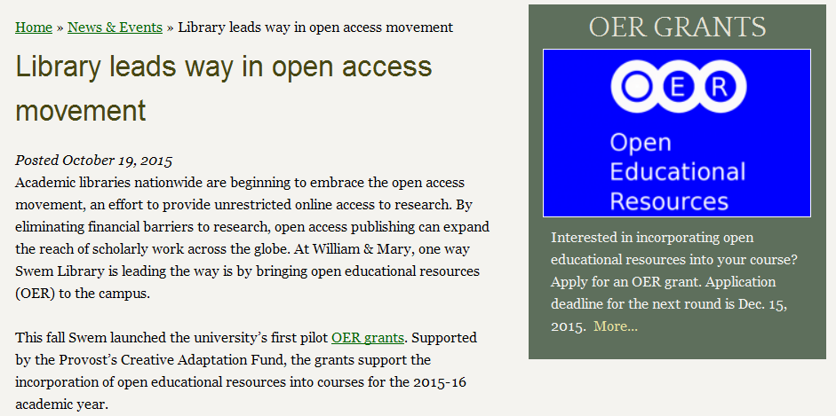
Librarians leading & supporting OER in Virginia
Kathleen DeLaurenti
Scholarly Communications Librarian
College of William & Mary

Slide 43
Librarians leading & supporting OER in Virginia
Joy Yeager and Stephanie Fair
Reference Librarians
Tidewater Community College

Slide 44

Tidewater Community College-Z Degree

Slide 45
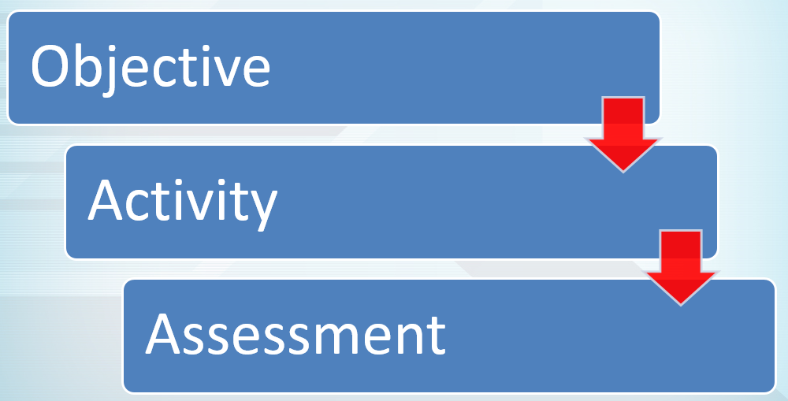
Z-Course Building Blocks
•Objecti

Slide 46
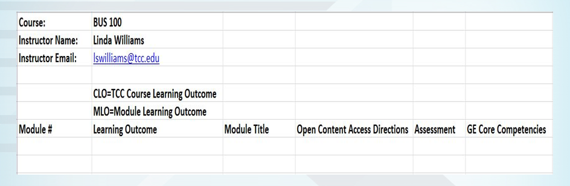
The Process

Slide 47

Pathways at Tidewater Community College History and Beginnings
Began by Linda Williams and supported by administration
Trains faculty in OER concepts and resources for building Z-Courses
OER LibGuide

Slide 48

Then Steps in the Library
Library transition Spring 2015
OER Cohort
Online teaching training and OER training
Rotating instructors by campus
The Pathways Shell www.tcc.edu
( See also: https://courses.candelalearning.com/pathways )

Slide 49
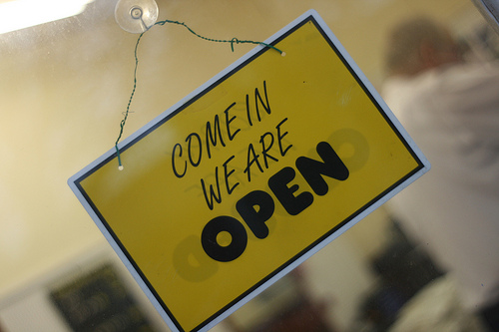
Outcomes
Relationships developed among faculty (consultations)
Increased presence overall at TCC (workshops and training)
Greater involvement in faculty initiatives (impact on governance)
Support for online learning
Plans for Z-Course involvement
Image: Public domain

Slide 50
Librarians leading & supporting OER in Virginia
Anita Walz
Open Education, Copyright & Scholarly Communications Librarian
Virginia Tech

Slide 51
Librarians leading & supporting OER in Virginia
Virginia (Ginny) Pannabecker
Health, Life Sciences, & Scholarly Communications Librarian
Virginia Tech

Slide 52
Librarians leading & supporting OER in Virginia
Lucretia McCulley
Head of Scholarly Communications
University of Virginia

Slide 53
Librarians leading & supporting OER in Virginia
Tara Cassidy
Library Coordinator
Virginia Community College System

Slide 54
Discussion (then a short break)

Slide 55
Analyzing OER From Your Library’s Perspective
Based on what you have seen and heard so far, what is your analysis of OER and libraries?
Use your notes and group members to focus on OER in the context of your institution.

Slide 56
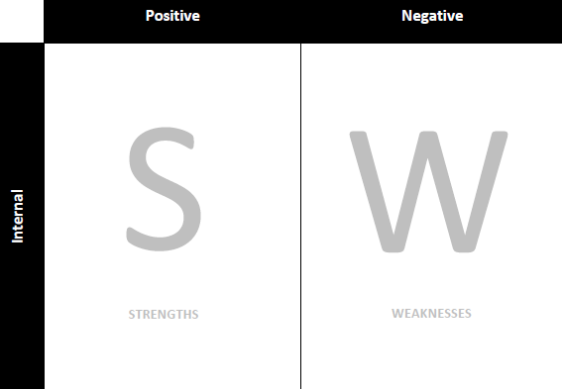
Notes: Strengths & Weaknesses
Based on your understanding of your environment and your stakeholders, identify and list your library's strengths and weaknesses.

Slide 57

Notes: Opportunities & Threats
Based on your understanding of your environment and your stakeholders, identify and list potential opportunities for (and potential threats to) your library relative to OER.

Slide 58
SWOT Achieved! Now, Prioritize Your Four Lists
Based on your analysis, you now have 4 lists.
This is an overall picture of the landscape. What do you need to address?
In each list, determine what areas are the most important, and what can wait.

Slide 59
Anyone Care to Share Your Priorities?
Notes:
Categorize: SWOT

Slide 60
Identify Potential Library Strategies to Engage OER
How should your library engage with OER?
Based on what you have seen and heard so far, what is your analysis of OER and libraries?
Use your notes and group members to focus on OER in the context of your institution.

Slide 61
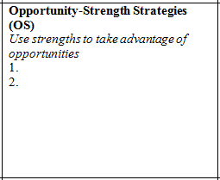
How should my library engage with OER? (OS)
How can we use my library’s strengths to take advantage of the opportunities OER present?
How do these possible strategies connect with my library and/or institutional mission?

Slide 62
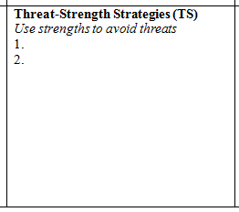
How should my library engage with OER? (TS)
How can we use my library’s strengths to avoid the threats OER present?
How do these possible strategies connect with my library and/or institutional mission?

Slide 63
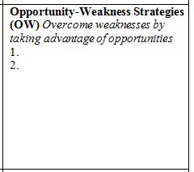
How should my library engage with OER? (OW)
How can my library overcome weaknesses to take advantage of the opportunities OER present?
How do these possible strategies connect with my library and/or institutional mission?

Slide 64
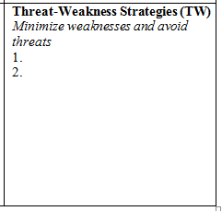
How should my library engage with OER? (TW)
How can my library minimize weaknesses to avoid the threats OER present?
How do these possible strategies connect with my library and/or institutional mission?

Slide 65
Anyone Care to Share Your Strategy Ideas?
Notes:
Categorize: OS, TS, OW, TW

Slide 66
Discussion: Virginia Libraries + OER
Where does the work we are each doing with OER overlap with each other?
Are there opportunities for librarians to work together on open projects that would benefit all of us?

Slide 67
Discussion Ideas (to seed the conversation):
Raising awareness of “open” (grassroots and higher administration levels)
Build a grassroots collection of “open” practitioners and advocates
Make your own work “open” / lead by example
Connect “open” to what we already do (how can we leverage the skills, systems, connections, goals etc. we already have to answer the “how can we make learning better for students” question?)
Planning and leading OER initiatives
Working with faculty who teach (instruction/pedagogy, course design, assessment, finding educational resources)
Identifying areas to prioritize our future professional growth: instructional design, pedagogy, finding OER, project management, strategic planning
Collaborating with others to economize on time and energy, and to reach shared goals
Explore broader aspects of the “open” conversation: Open Pedagogy, Author Rights education, Copyright education, Publishing . . .
Research on efficacy of open http://openedgroup.org/review

Slide 68
