Slide 1
Engagement: Building Social Capital
Dr. Andy Overbay
Senior ANR Agent
Smyth County
VCE Annual Conference 2017

Slide 2
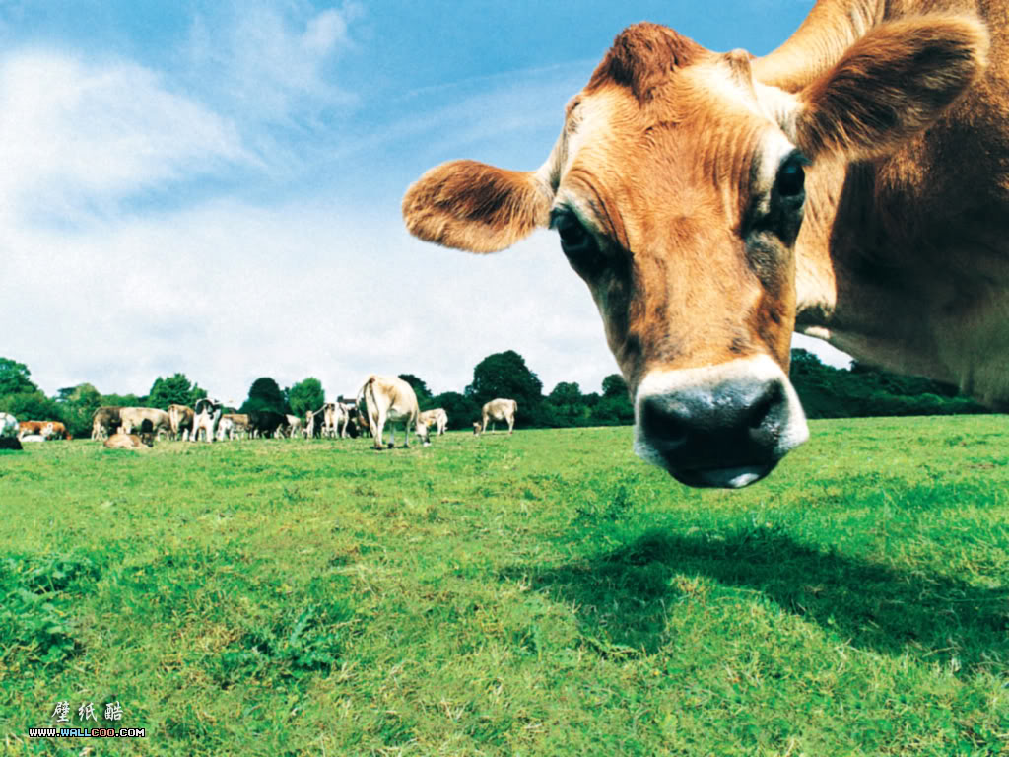
Job #1 Visibility

Slide 3
Visibility
Articles in the local paper
Media and Social Media
Be Seen and Known
Have some fun!

Slide 4
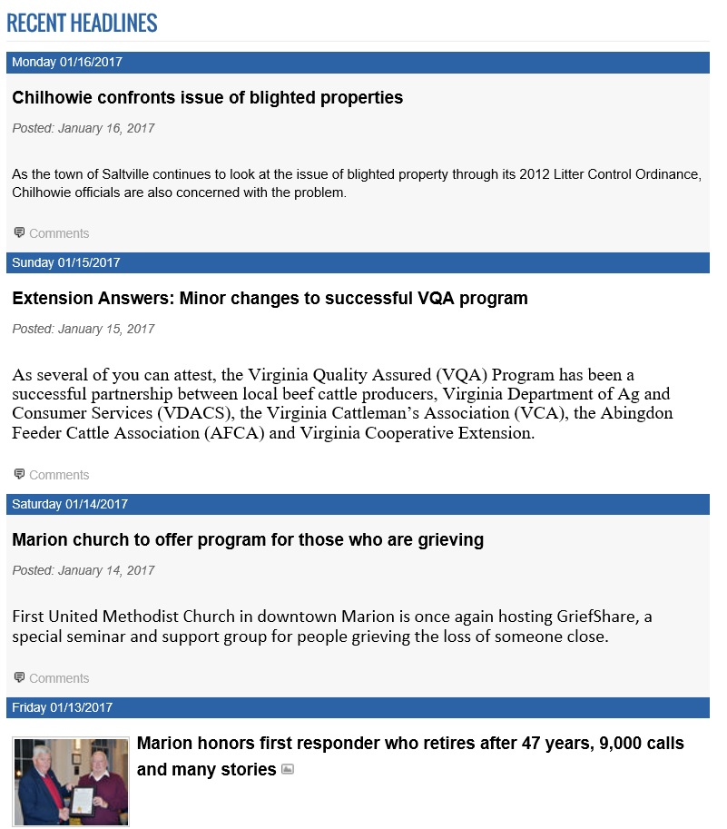
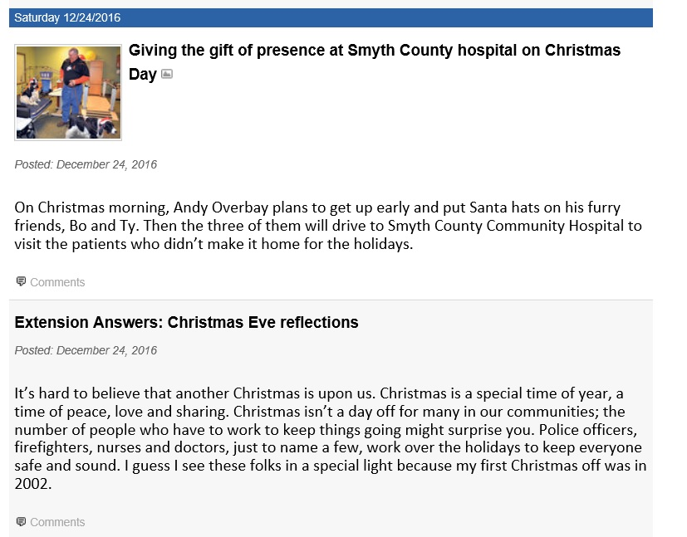

Slide 5
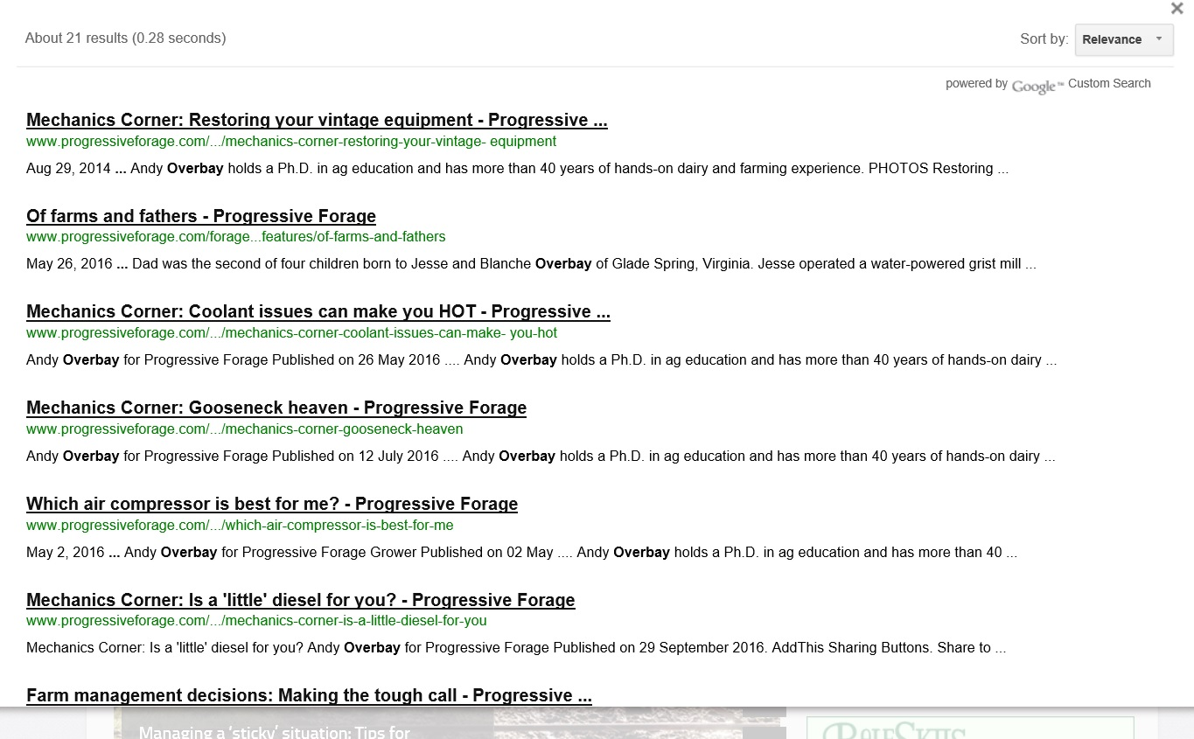

Slide 6
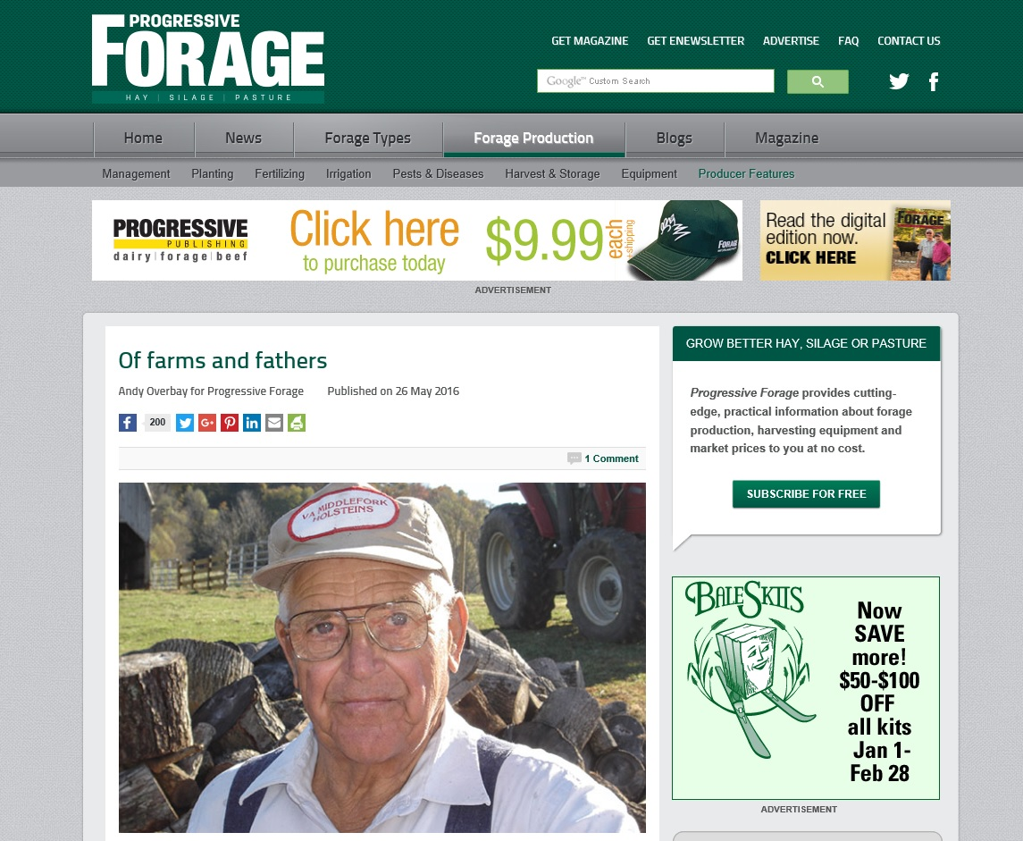

Slide 7
Visibility
Articles in the local paper
Media and Social Media
Be Seen and Known
Have some fun!

Slide 8
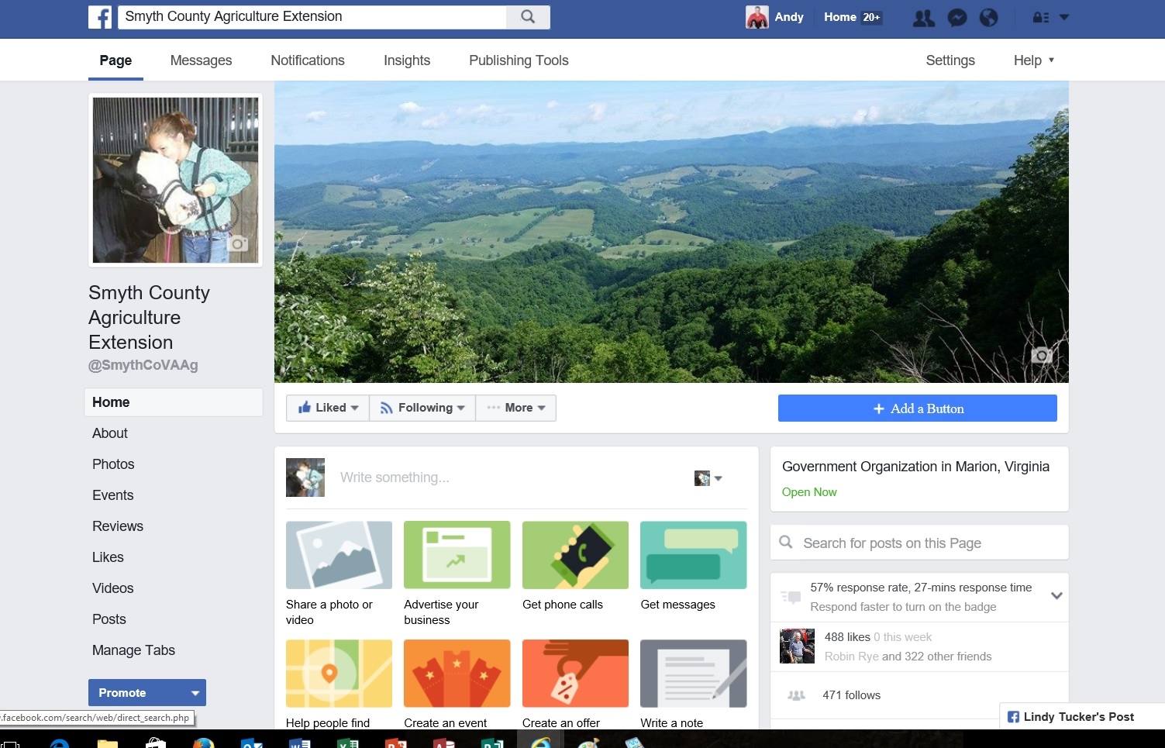
Social Media

Slide 9

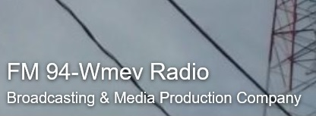
Mass Media

Slide 10
Visibility
Articles in the local paper
Media and Social Media
Be Seen and Known
Have some fun!

Slide 11
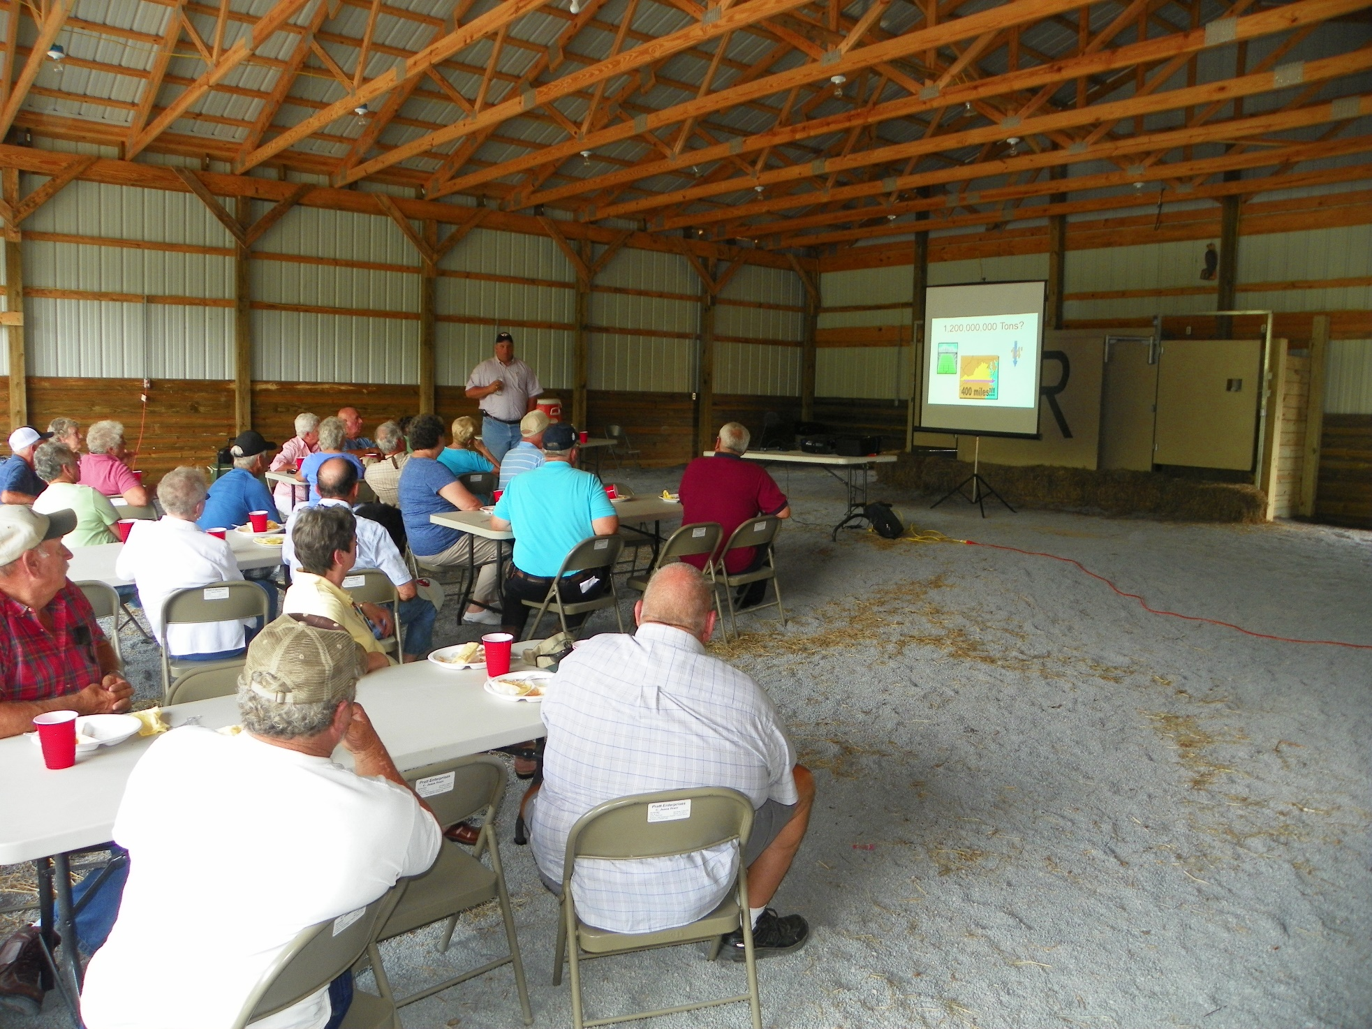
Who’s Invited?

Slide 12
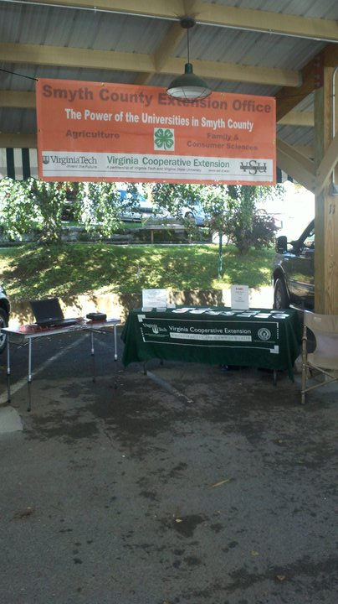
Market Extension at the Farmer’s Market

Slide 13
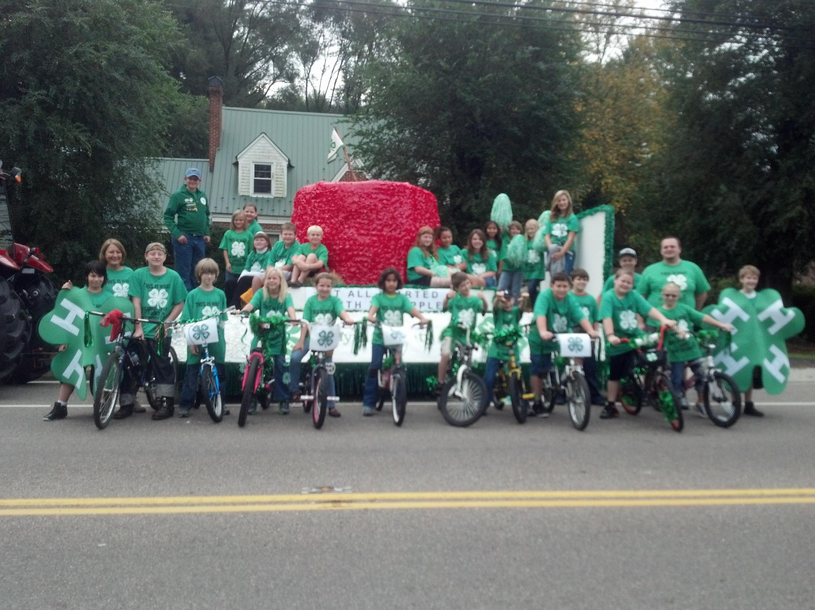
Be a part of every celebration possible

Slide 14
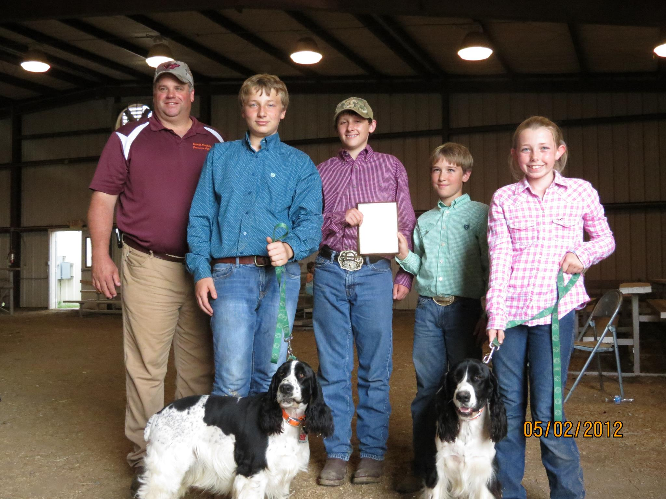
Plant tomorrow’s harvest through 4-H

Slide 15
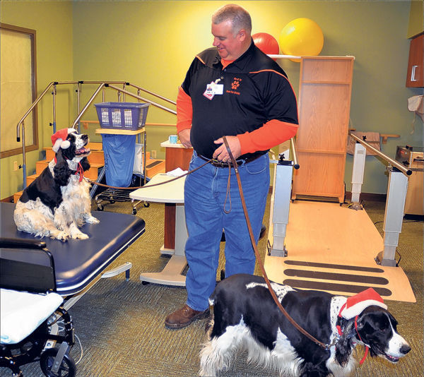
Recruit Volunteers by BEING a Volunteer

Slide 16
Visibility
Articles in the local paper
Media and Social Media
Be Seen and Known
Have some fun!

Slide 17
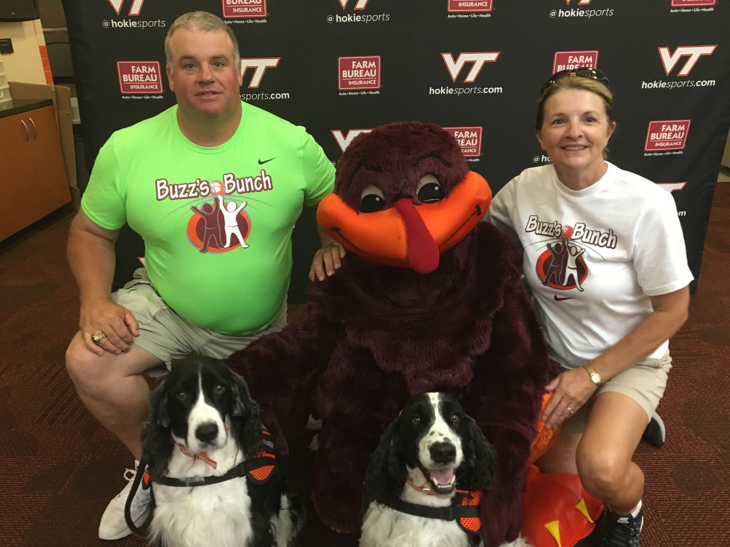
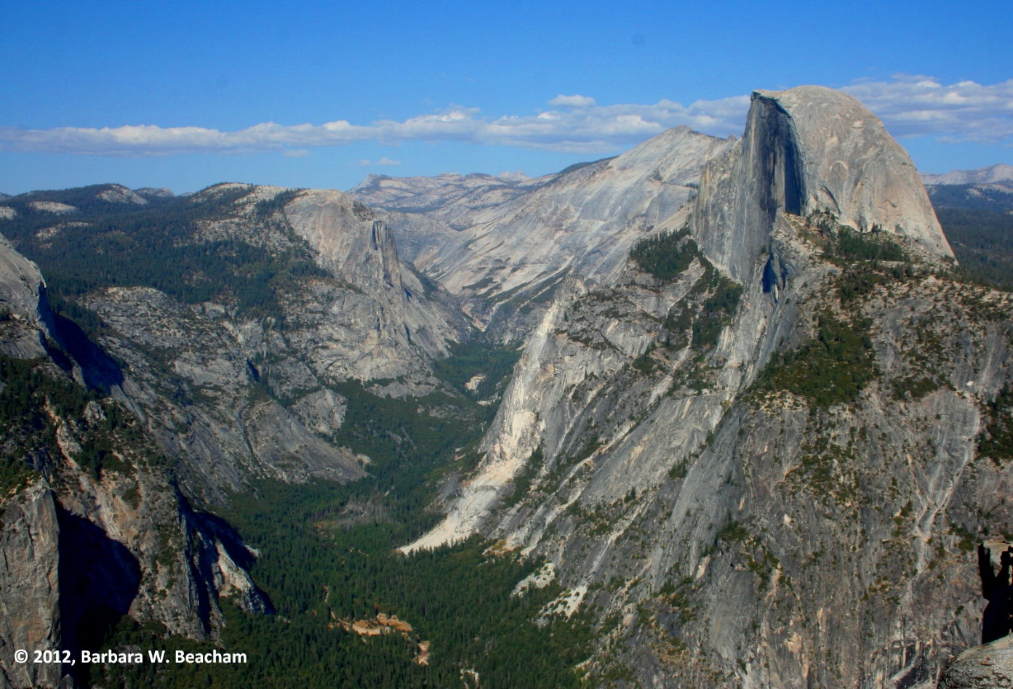

Slide 18
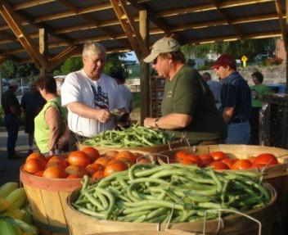
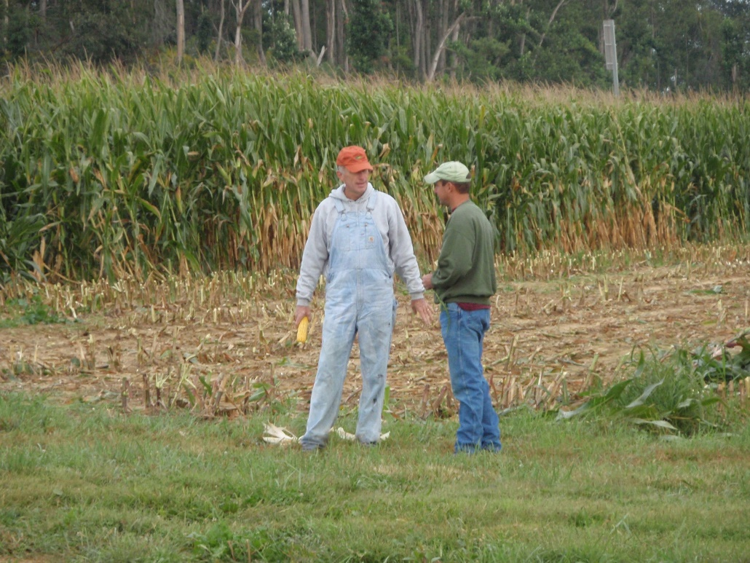
Building Social Capital
Win the respect of respected individuals.

