Slide 1
Practice 10k: Music App
Rylen Bass, Minwu Kim, Johan Lee, Jillian Ylagan
CS 4624: Multimedia, Hypertext, and Information Access, Dr. Edward A. Fox
Virginia Tech, Blacksburg VA 24061
April 30, 2024
Clients: Dr. Annie Stevens and Dr. John Irrera

Slide 2
Outline
1. Problem
2. Clients
3. Final Deliverables
4. Supabase
5. Redux
6. Metronome
7. App Screenshots
8. Timeline
9. Testing
10. Future Work
11. Acknowledgements

Slide 3

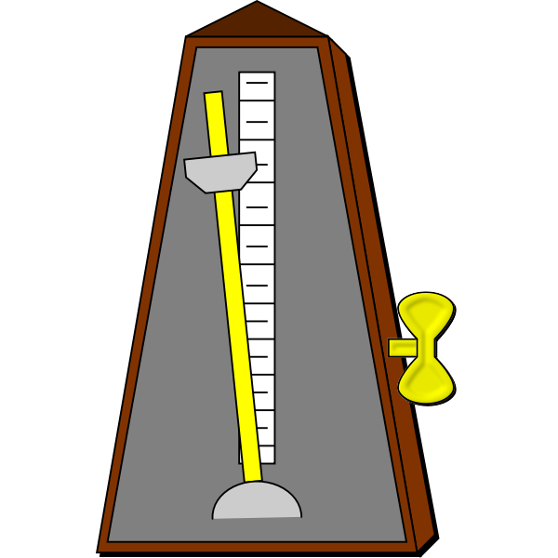

Problem
Professional musicians wish to collect and log data of practice sessions efficiently.
Many practice apps don’t have:
  Audio recording
  Tuner
  Metronome
  Practice portal with logs

Slide 4
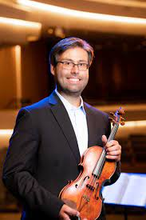
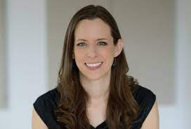
Clients
Dr. Annie Stevens
Dr. John Irrera
Notes:
School of performing arts
Dr John Irrera - assistant professor of violin
Dr Anne Stevens - associate professor

Slide 5
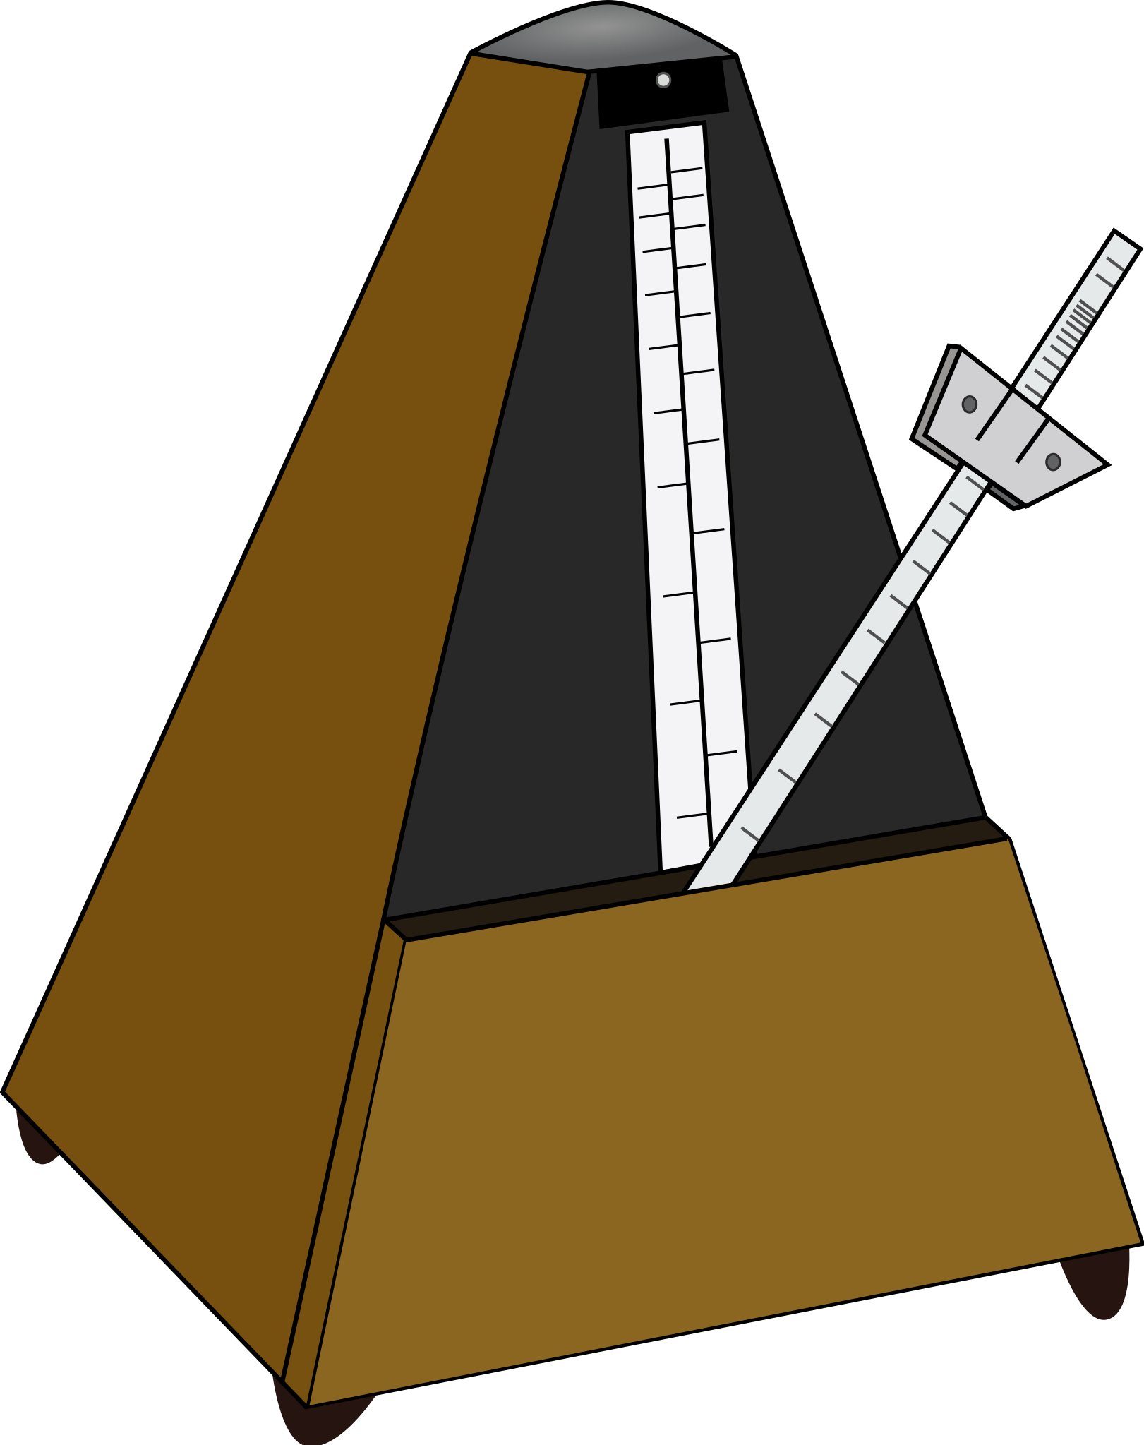

Deliverables
A mobile app designed as an all-encompassing practice hub for musicians.
Back-end conversion from Firebase to Supabase.
Implementation of metronome feature.

Slide 6
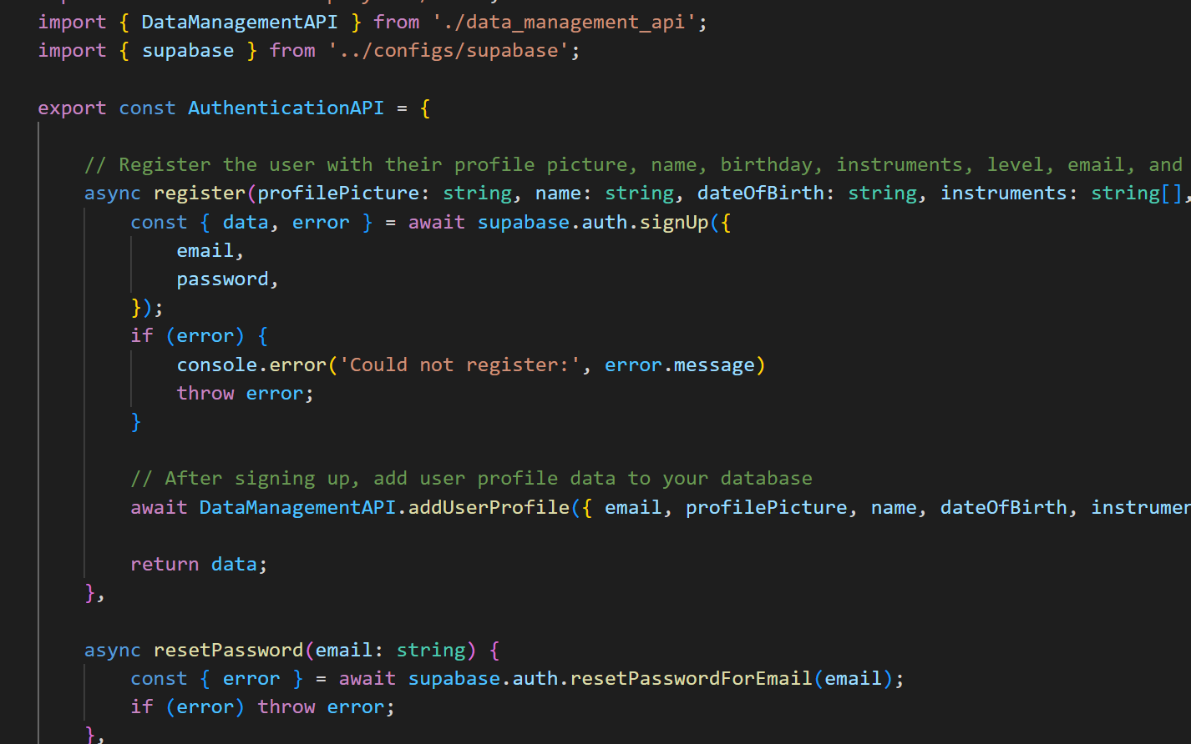
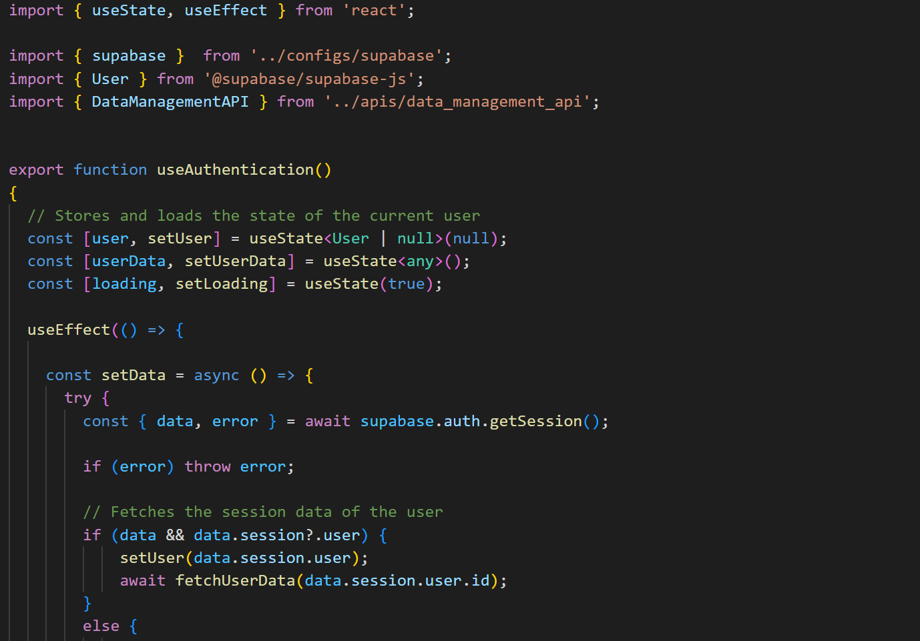
Conversion: Firebase → Supabase
Converted files relating to the API.
Integrated Supabase API for user registration and authentication.
Notes:
Converted DataManagementAPI, AuthenticationAPI and useAuthentication files
Integrated Supabase API into logging in and signing up from the App screen
Set up Supabase project to handle authentication requests and successfully register and authenticate users

Slide 7
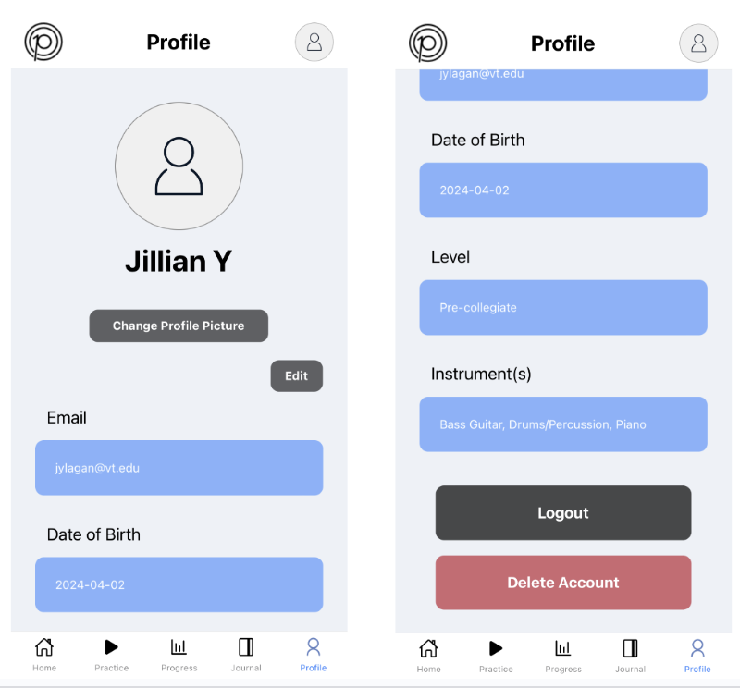
Supabase
Set up tables in Supabase for practice data.
Display user and practice data on app.
Update data in backend when user edits fields.

Slide 8
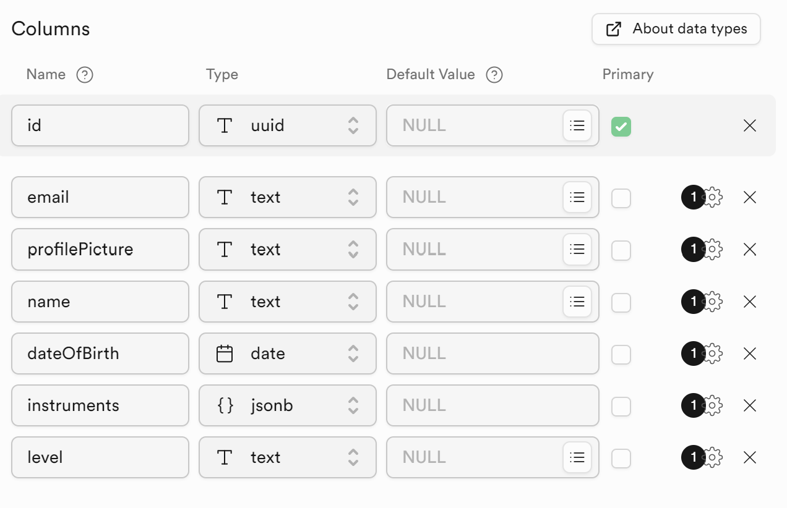
Supabase Table: User Profile

Slide 9
Supabase Table: Practice Data

Slide 10

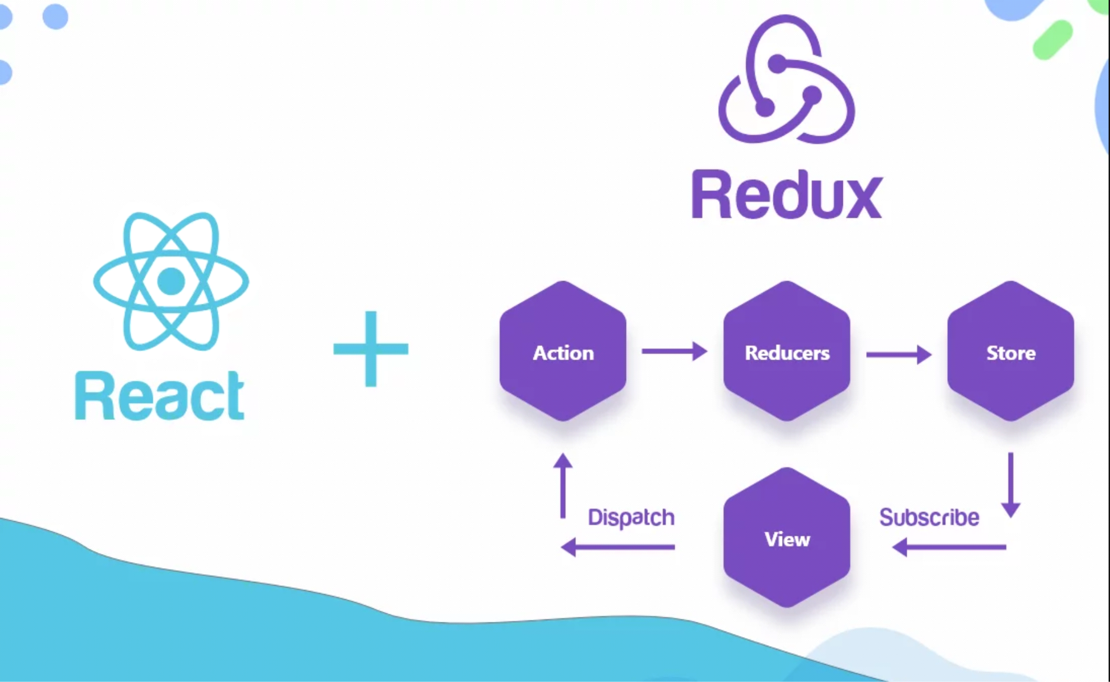
Redux
Redux is an open source JavaScript library for managing global application state.
We use Redux in our project for updating the backend when changes are made by the user on the frontend side of the application, through dispatching.
Notes:
The Redux store stores that state of variables across the application
The Reducer is purely a function that takes the currentState and action and returns a new state. A valid reducer can return the current state
Dispatching is updating the store

Slide 11
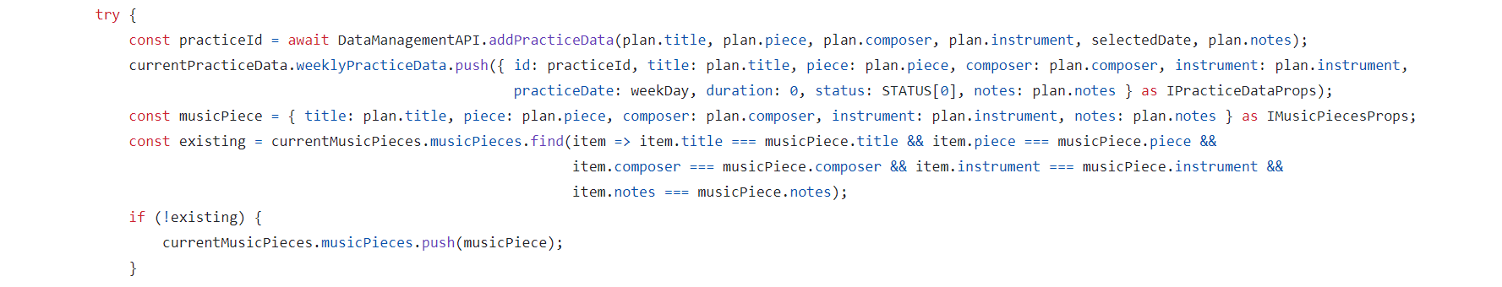
Redux Challenges
In the original code, we directly took practice data from Supabase and manually set their fields to different values according to the user’s input in the UI when updating a practice plan.
Notes:
This resulted in state mutation errors as there was a discrepancy between the application’s state and the data stored in the database. The UI was showing modified data that was taken from the database but was not saved anywhere.
Thus when the application reloaded, the data would be lost and the application would attempt to render data that could not be found, causing a state mutation bug.

Slide 12
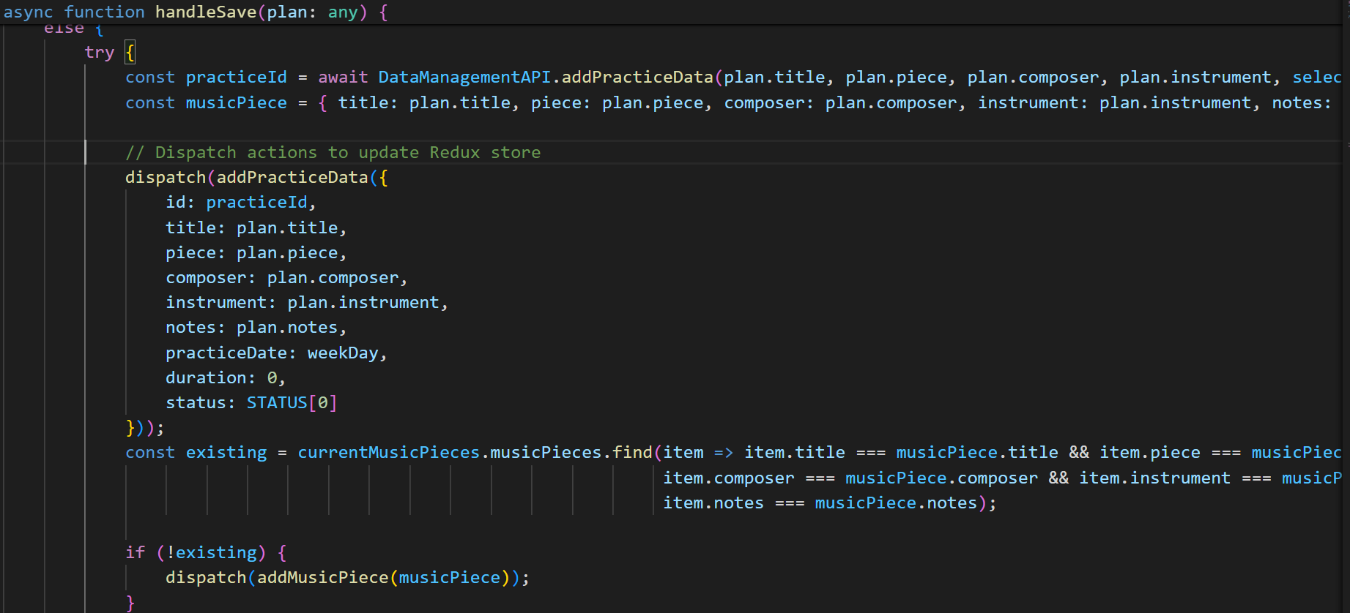
Redux Solutions
In our solution, we dispatch to update the store by using a reducer to return the new state of the practice data in the application and save it.
Notes:
Thereby maintaining a consistent state across the whole application. We did this in a number of other places as well, ensuring that there would be no state mutations or incorrect handling of the application state.

Slide 13


Metronome Integration
Metronome in JUCE framework (C++).
App in React (JS).
Integration:
  iOS: C++ → Objective-C → JS
  Android: C++ → Java → JS
Goal: Show JUCE component as View within React.

Slide 14
Integration Challenges/Steps
Not a well-documented process.
  Lack of resources / examples.
iOS steps
  Define ReactJuceView, subclass RCTViewManager.
Expo Go
  Expo Go to create the host app for metronome instead of JUCE.
  CMake to link JUCE and Expo Go.
Notes:
Not a well-documented process
JUCE is cross-platform so projects typically stay within JUCE; no need for React
Lack of resources / examples
Expo Go
As previously described, we go from C++ to Native to JS
But we need Expo Go to create the host app for metronome instead of JUCE
Use CMake to link JUCE code to Expo Go
iOS related difficulties
JUCE incompatible with VSCode
XCode
Lack of experience with iOS programming

Slide 15
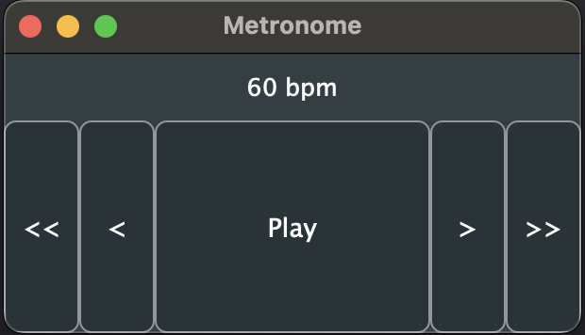
Metronome Implementation
Features:
BPM display
Play/Stop button
<< and >> increment by 10
< and > increment by 1
Hold down buttons to rapidly increment

Slide 16
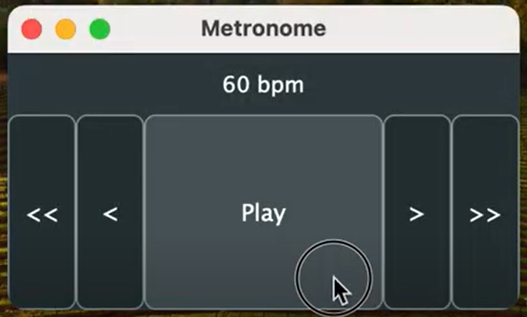
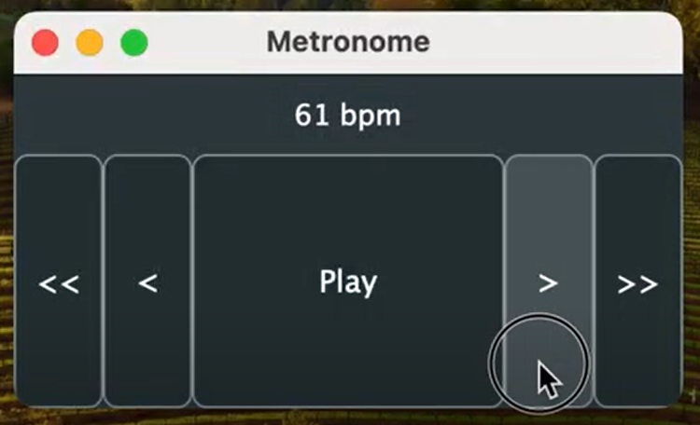
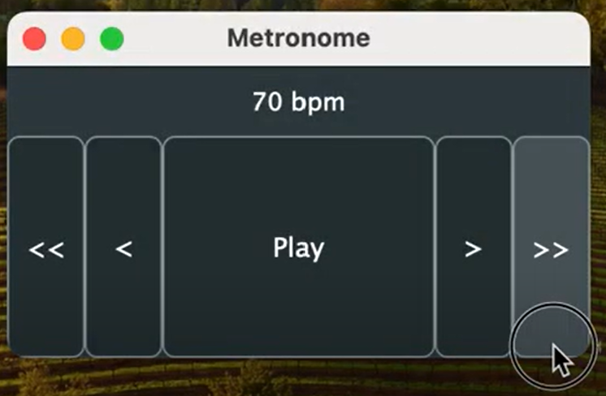
Metronome Demo
Clicking Play to start the metronome.
Clicking > to increment the metronome by 1.
Clicking >> to increment the metronome by 10.
*A video demonstration is included in our project files: “MetronomeDemoVideo.mp4”.

Slide 17
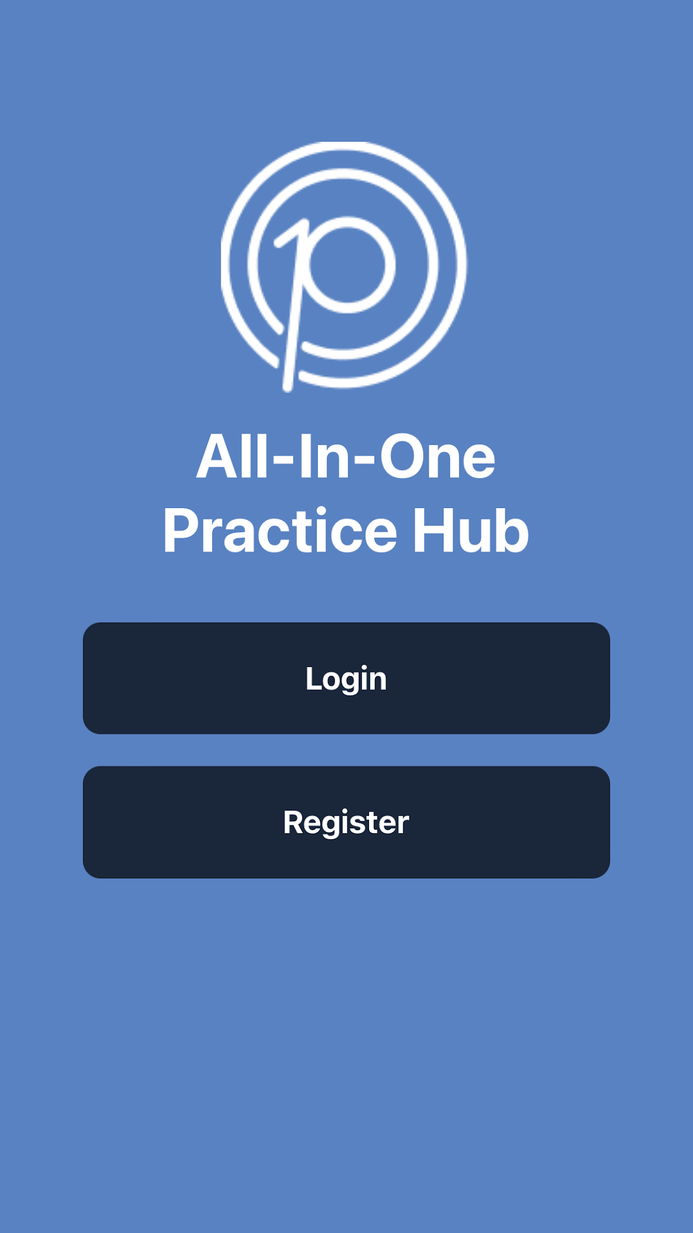
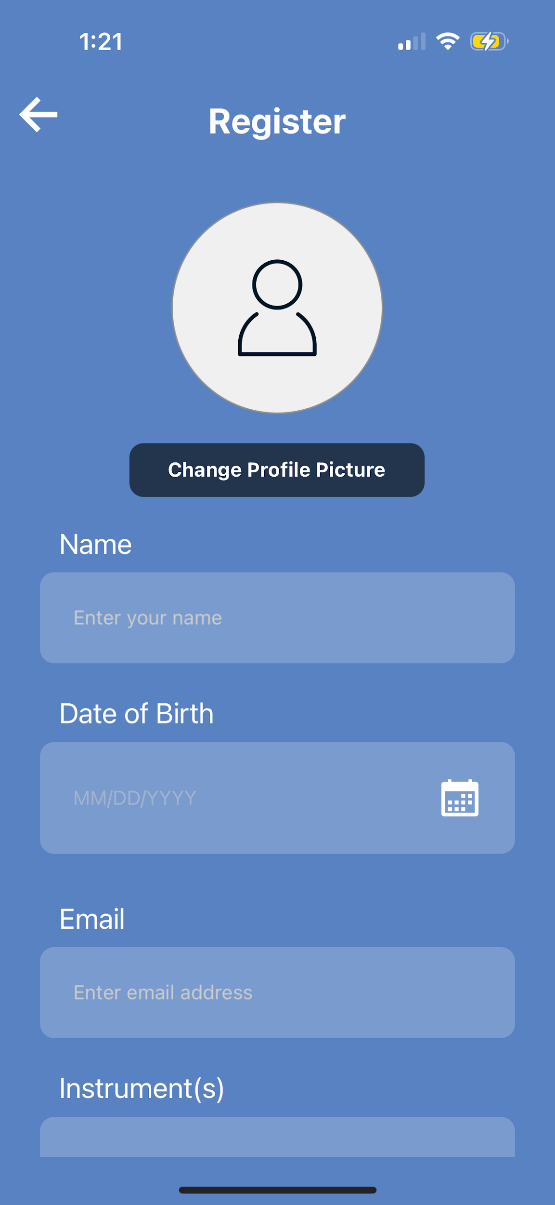
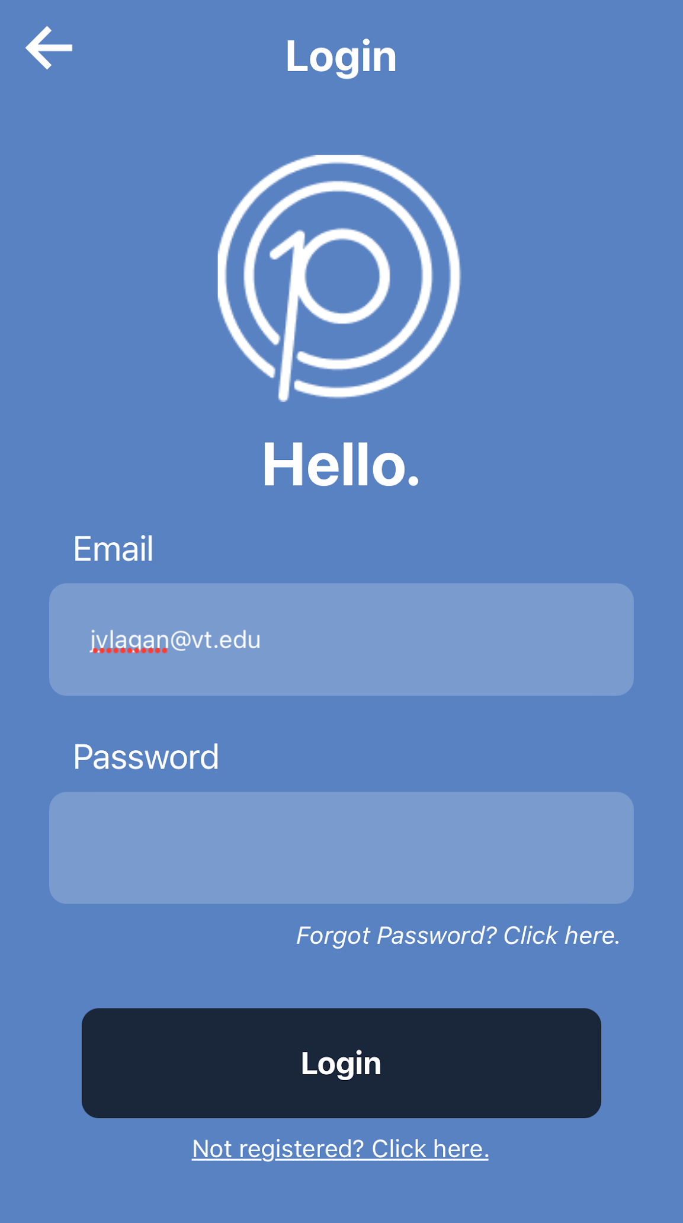
App Screenshots: Login + Registration

Slide 18
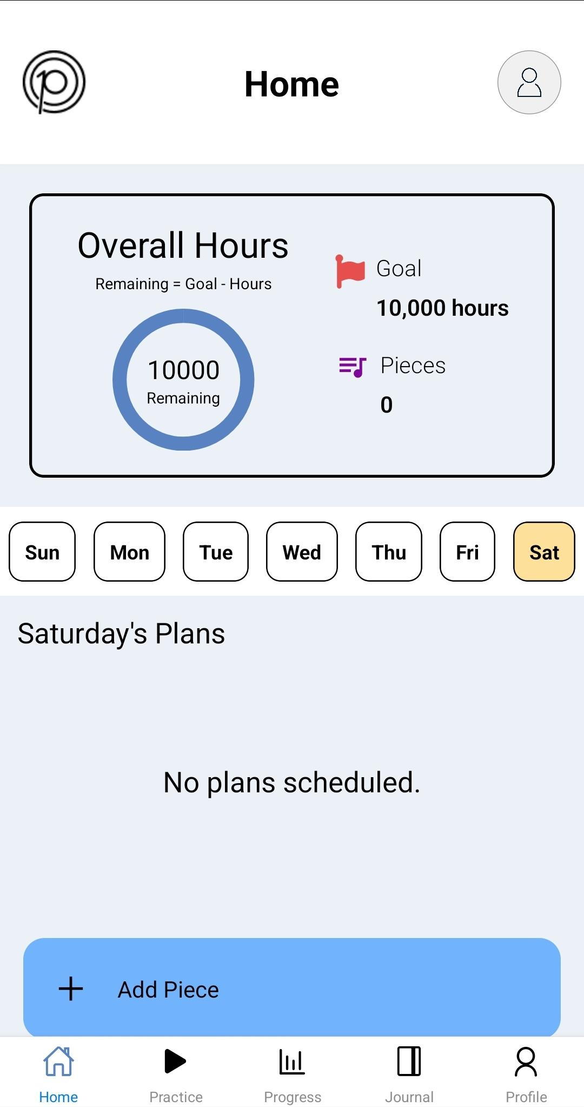
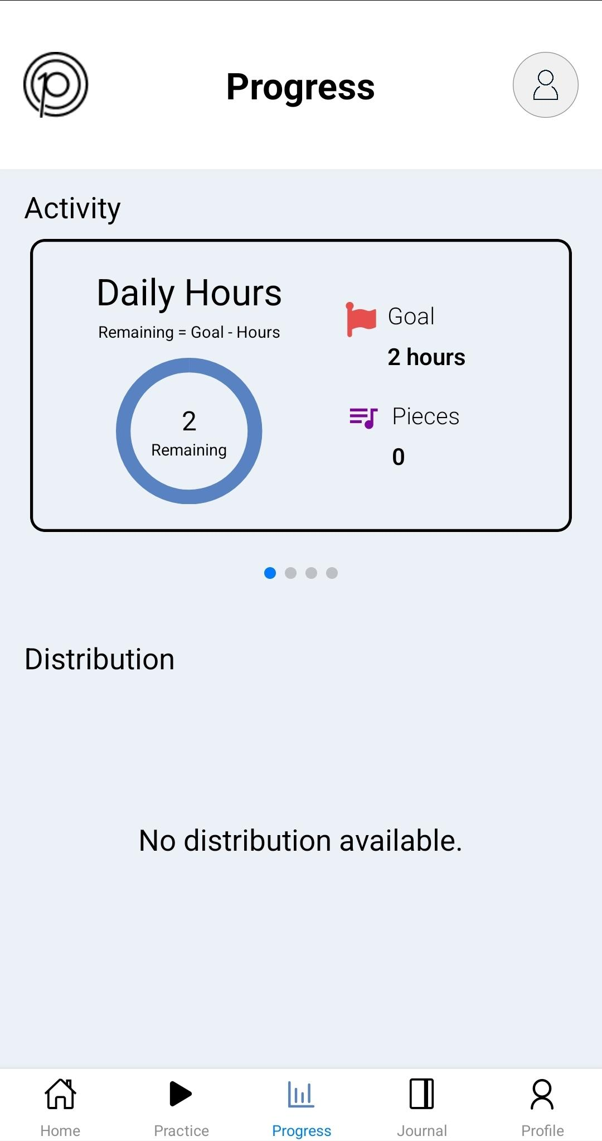
App Screenshots: Home, Progress, Profile

Slide 19
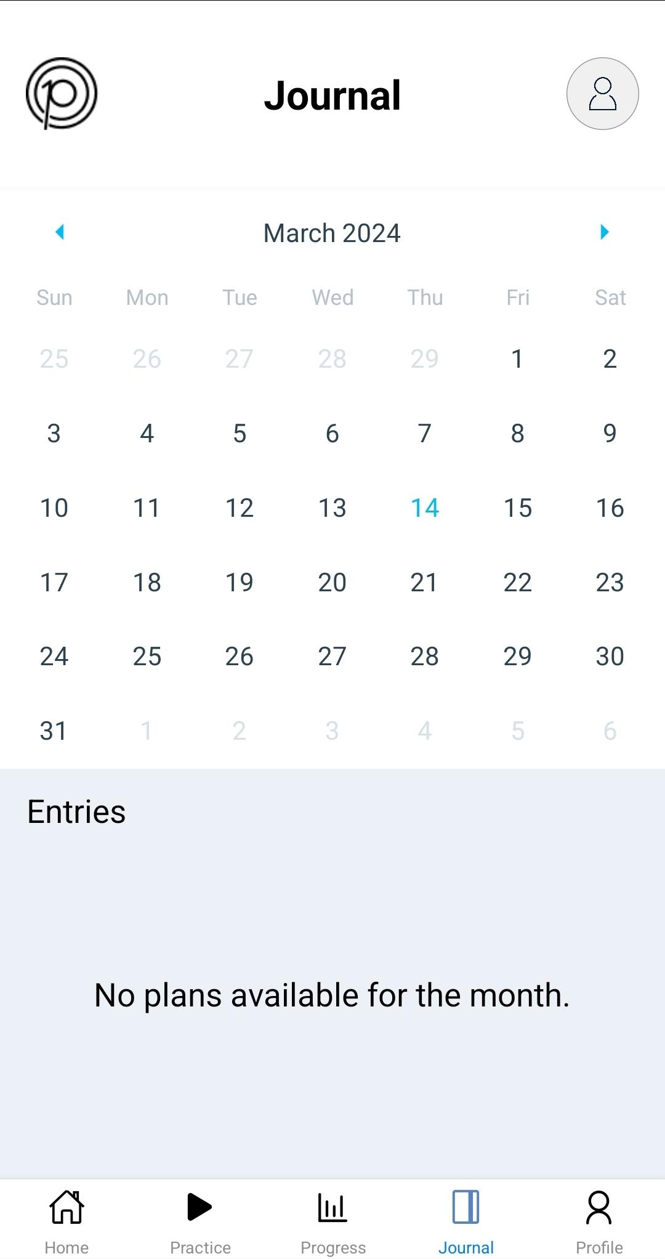
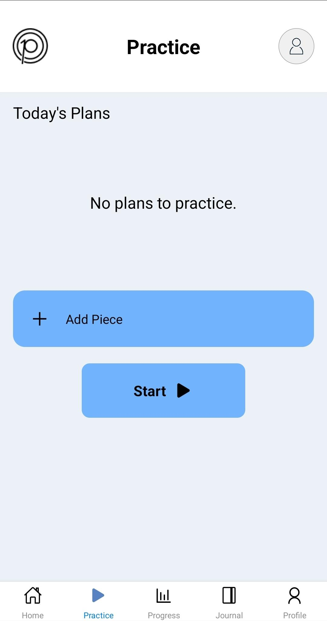
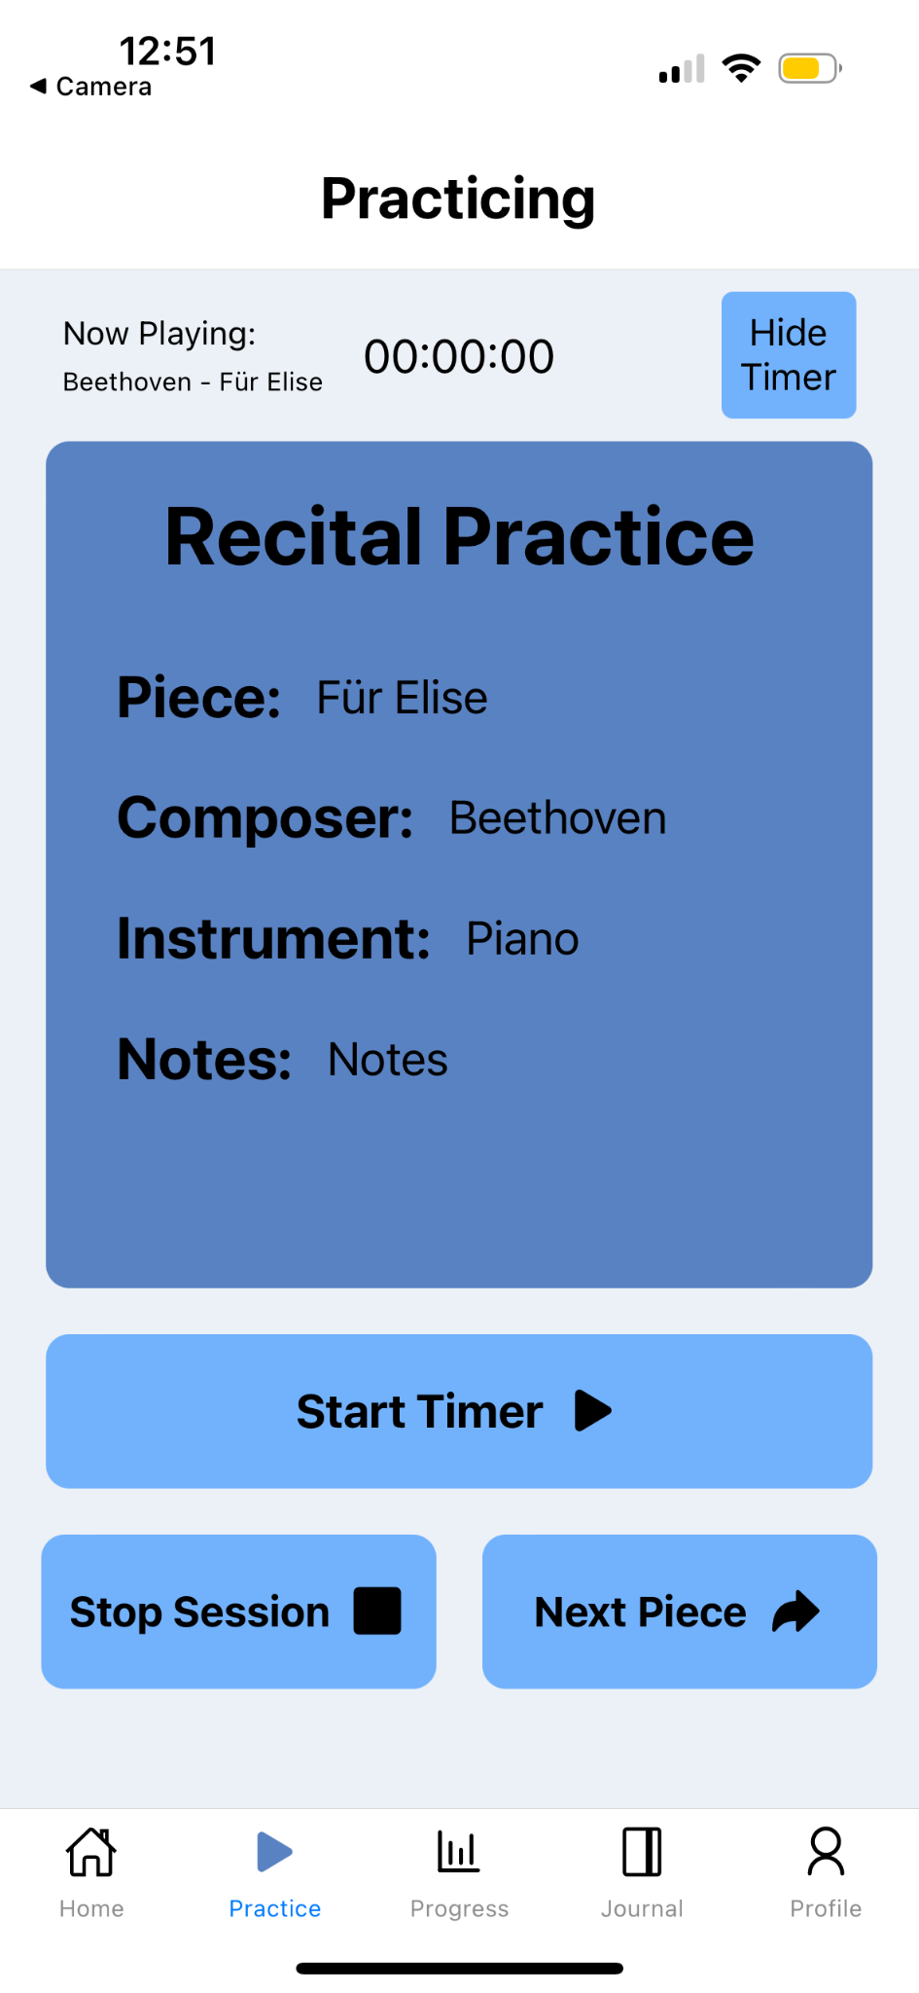
App Screenshots: Journal + Practice

Slide 20
Timeline
Complete basic metronome implementation
Finish Supabase integration and tables
Meet with lead programmer and clients
Finish all manual testing
2/16
4/5
4/11
2/15
3/15
4/5
4/12
Finish preliminary research
Finish additional metronome features (+/- buttons, UI)
Meet with clients for final approval

Slide 21
Testing
Manual Testing: 7 students completed a questionnaire after using the app or metronome.
App Testing
Metronome Testing
Is the layout of the app intuitive to navigate?
Is the beep pleasant to listen to?
Is it easy to tell if user actions have succeeded/failed?
When holding the button, is the timing acceptable?

Slide 22
Testing Results
Layout of the app was intuitive and easy to navigate.
Registration process and adding a practice plan straightforward.
Metronome UI easy and feels pleasant.
Suggestions:
  Ability to change the daily hours of practice for their goals.
  Adding a Scales/Technique component to a practice plan.
  Separate tracking for rehearsals vs. personal practice.
  Different/customizable sounds to differentiate metronome downbeat.

Slide 23


Future Work
Gamification aspects.
Tuner, audio recorder.
Generate weekly logs of practice sessions with checklists and notifications.

Slide 24
Acknowledgements
Clients
Professor
Lead Programmer
Dr. John Irrera
Dr. Annie Stevens
Dr. Fox
Ben Winters
Past Capstone:
Alexander Georgiev
Bailey McKelway
Claire Holmes
Mahlet Zemui
Rahul Aneja

Slide 25
References
Aneja, R., Georgiev, A., Holmes, C., McKelway, B. & Zemui, M. (2023). Practice 10k: Music App. Virginia Tech, CS4624: Multimedia, Hypertext, and Information Access (Fall 2023 Semester) Accessed 29 Apr 2024. https://hdl.handle.net/10919/117115
Bass, R., Kim, M., Lee, J. & Ylagan, J. (2024). Practice 10k: Music App, Virginia Tech, CS4624: Multimedia, Hypertext, and Information Access (Spring 2024 Semester). [GitHub Repository]. Accessed 29 Apr 2024. https://github.com/blwinters/practice-10k/tree/main
See report for other references

Slide 26
Q & A

