Slide 1
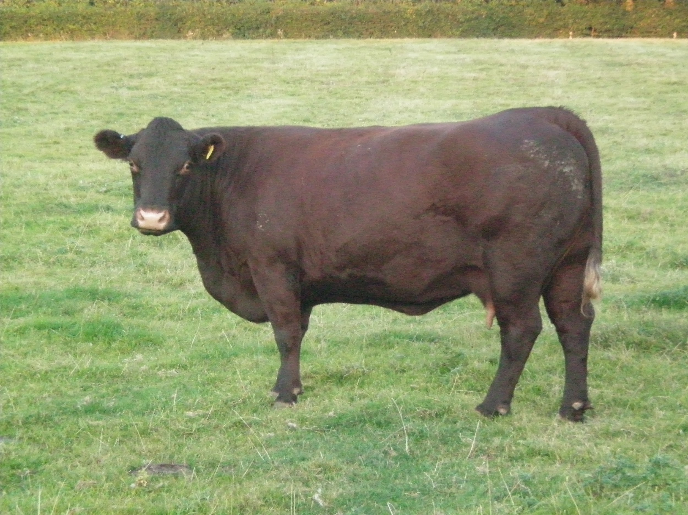
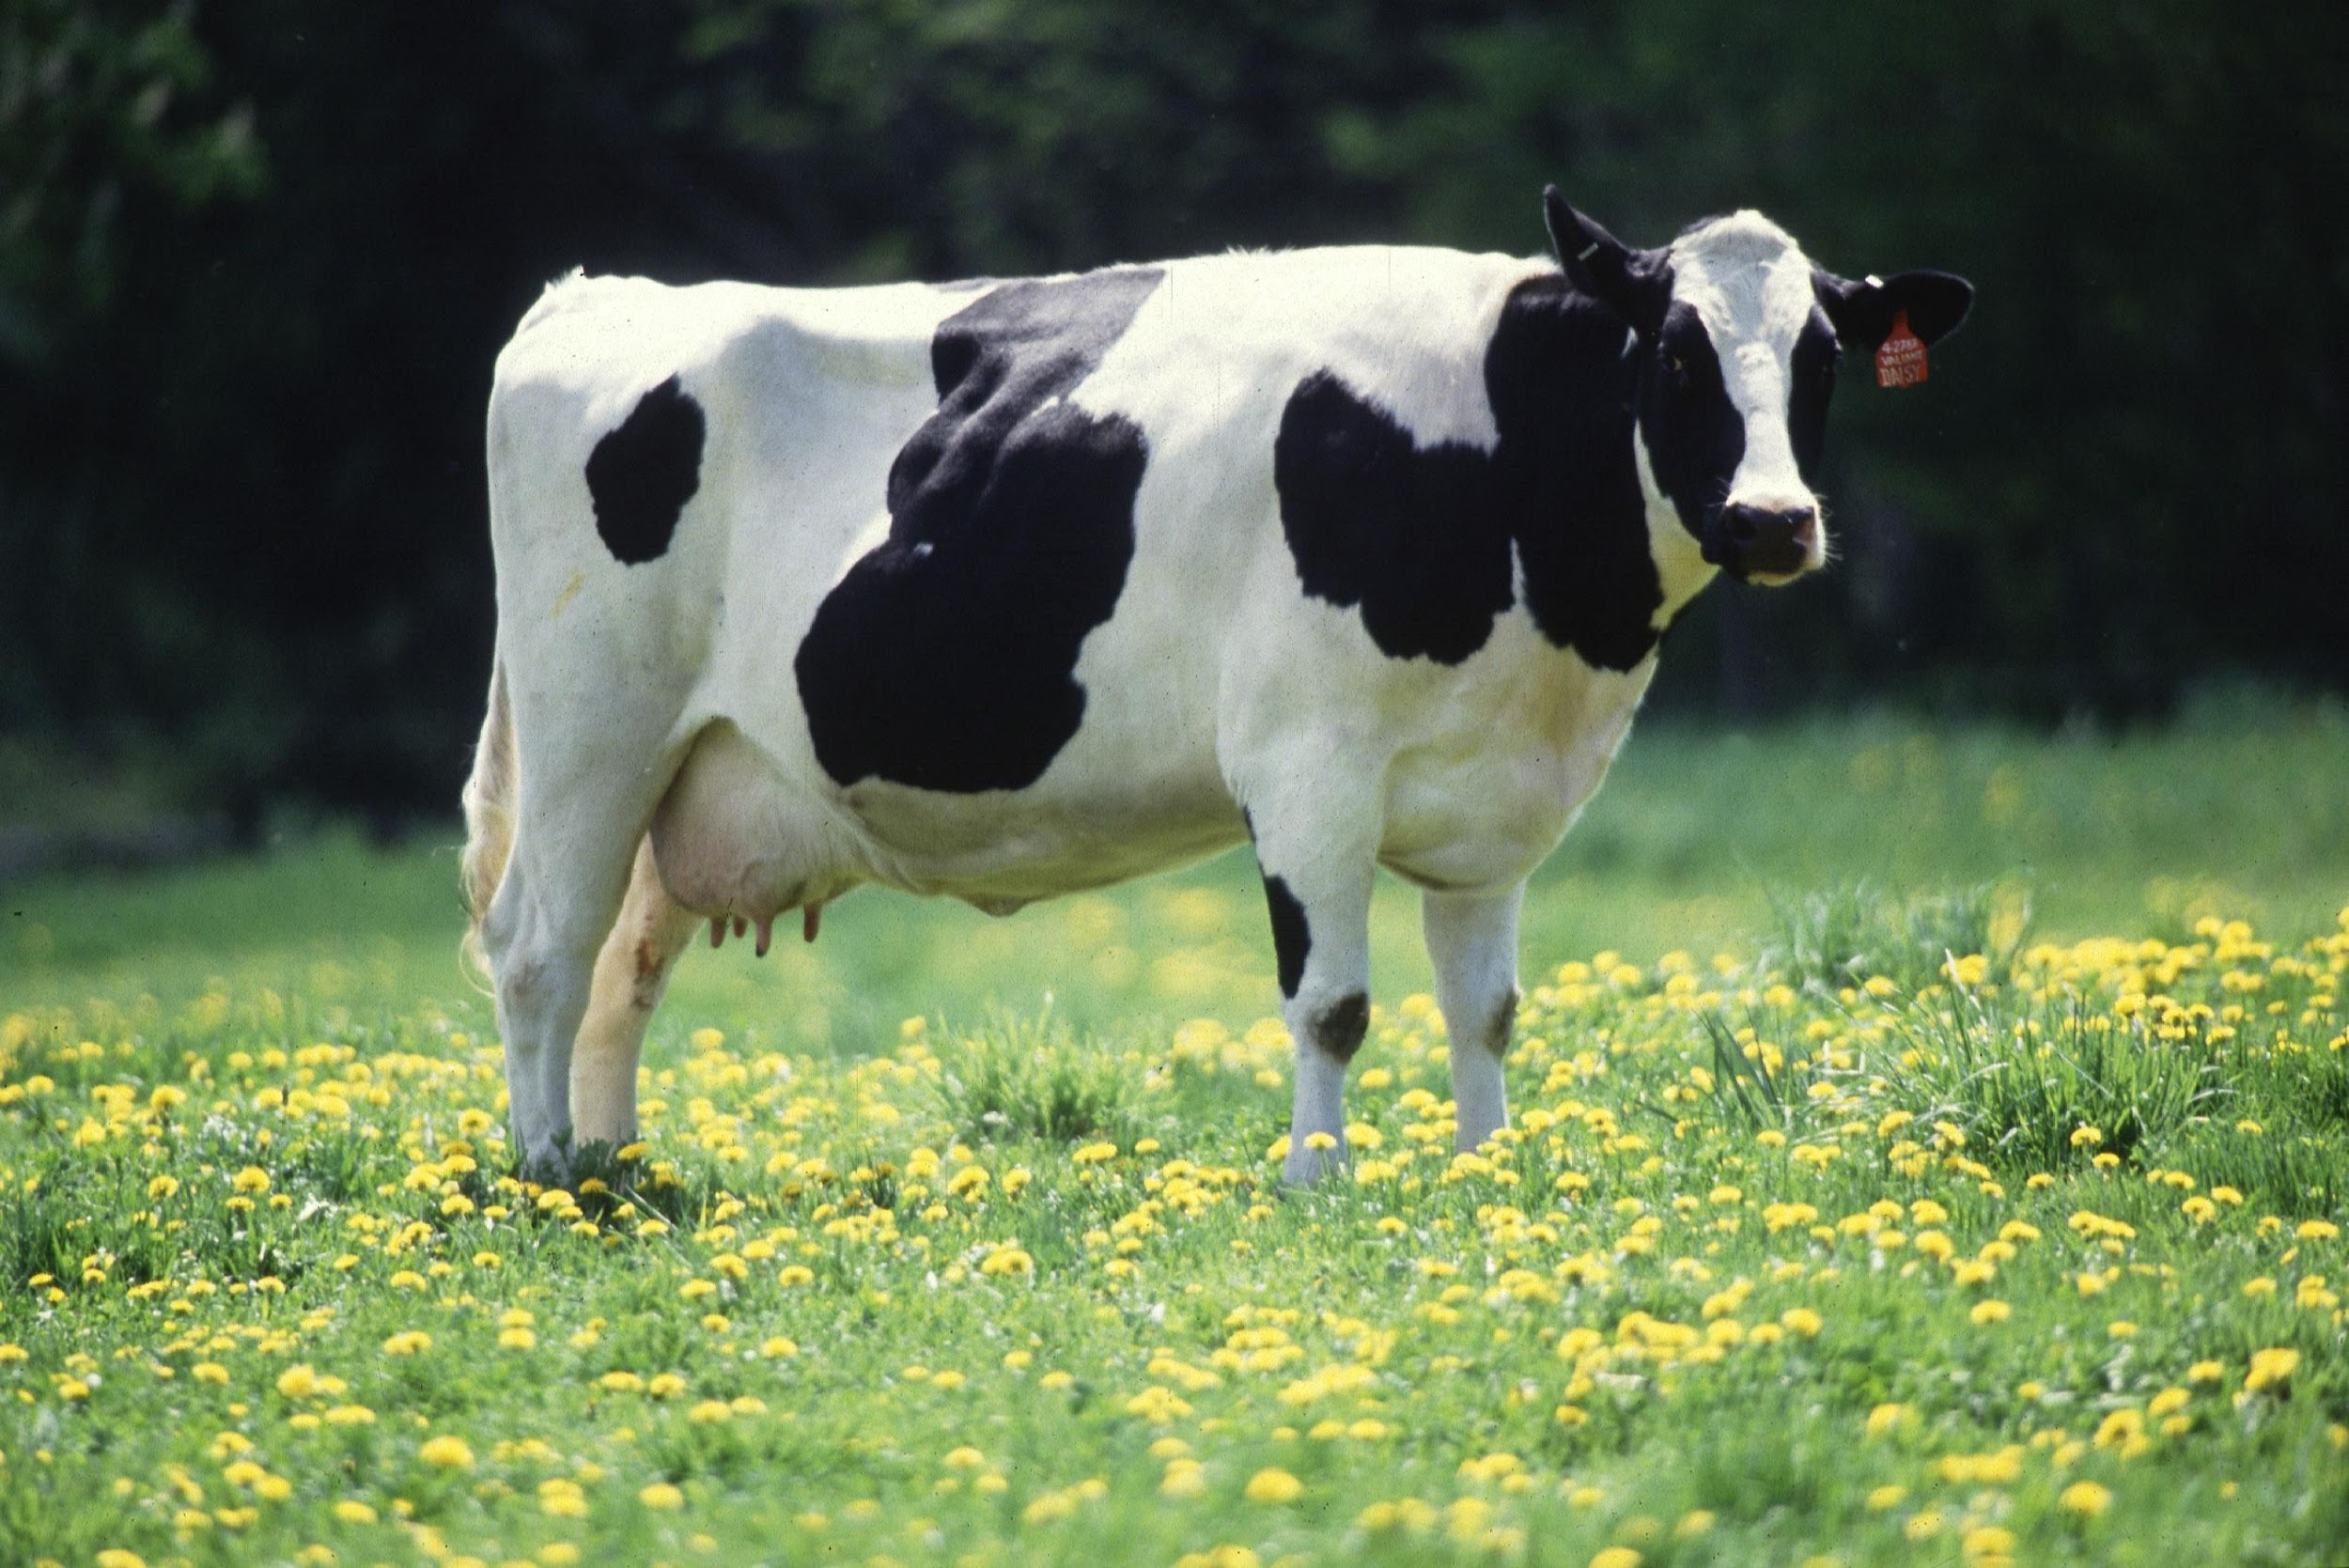
Cattle 101
Charlotte Maxwell, Associate Agriculture and Natural Resources Extension Agent for Goochland and Chesterfield

Slide 2
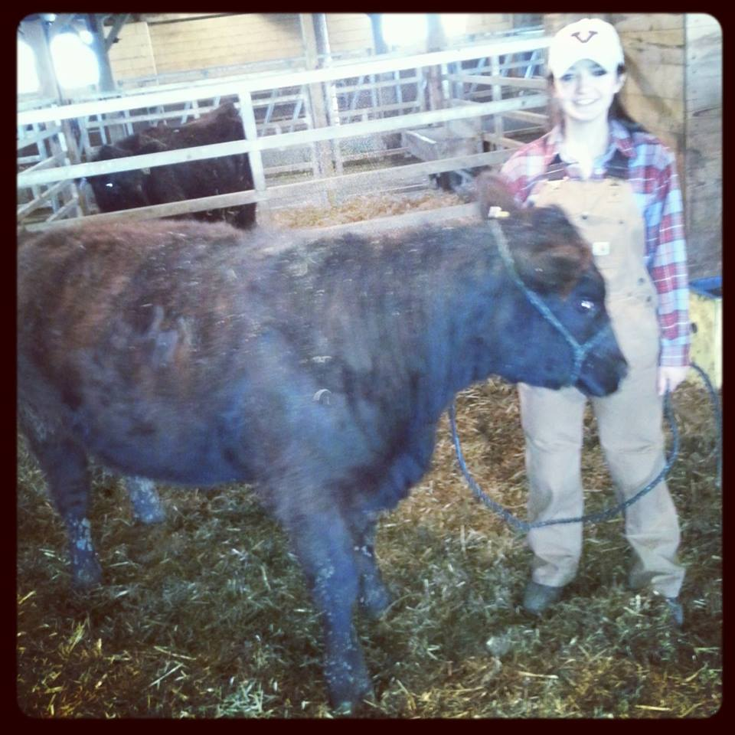

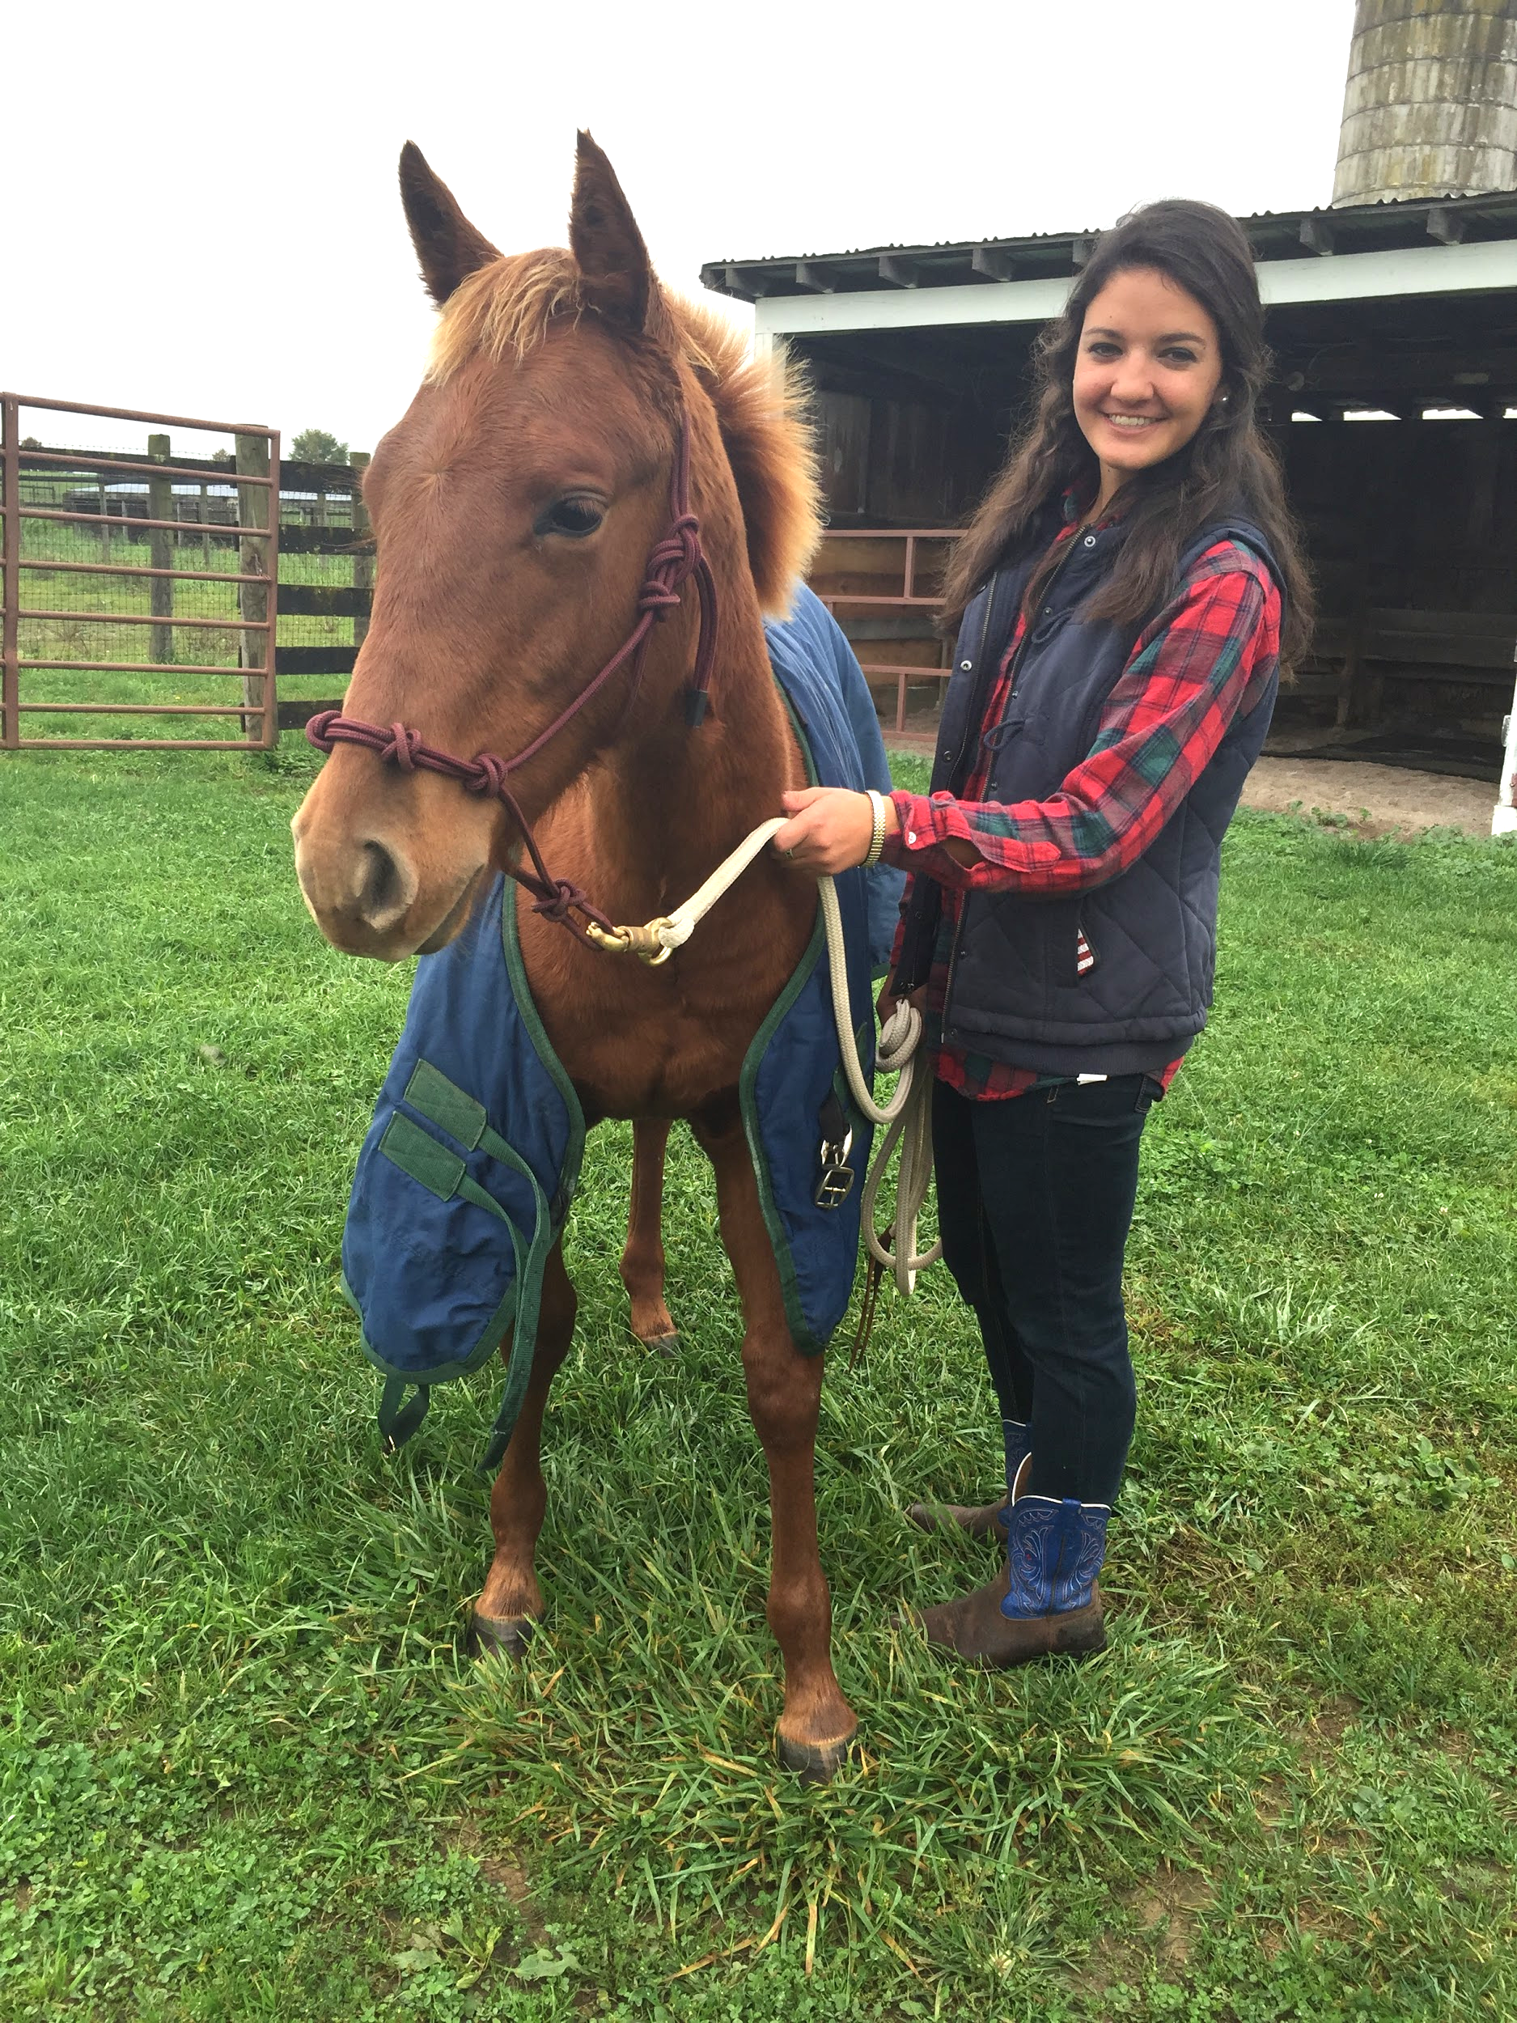
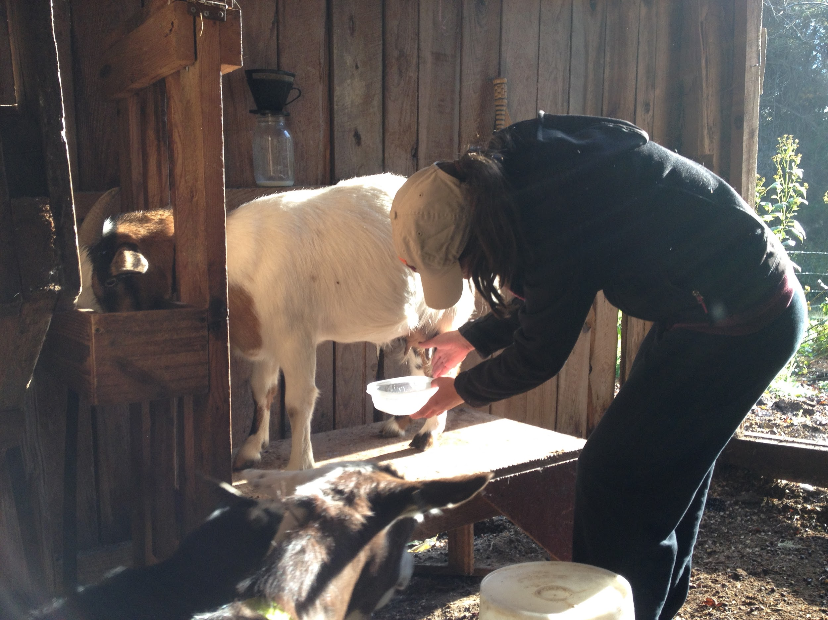
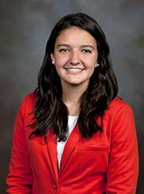
Who am I?

Slide 3

What in the world is an anr extension agent?
Research based knowledge from VSU and VT to you in a way you can understand and use on your farm.
Assessor of community needs
Program and event planner
Management consultant
Weed identifier
“I don’t know, but I know someone who does.”

Slide 4
What’s the process to get the job?
Intern with VCE in college OR ride along with your Extension agent for a day to decide if it’s right for you.
Stalk the VCE website and apply when an opening comes up.
Phone interview if you make it past the initial screening.
  Questions about your work style and if you have done homework on the county
In-person interview if you pass #3.
  PRESENTATION!!!
  Practical Questions

Slide 5
Questions about me or my job?

Slide 6
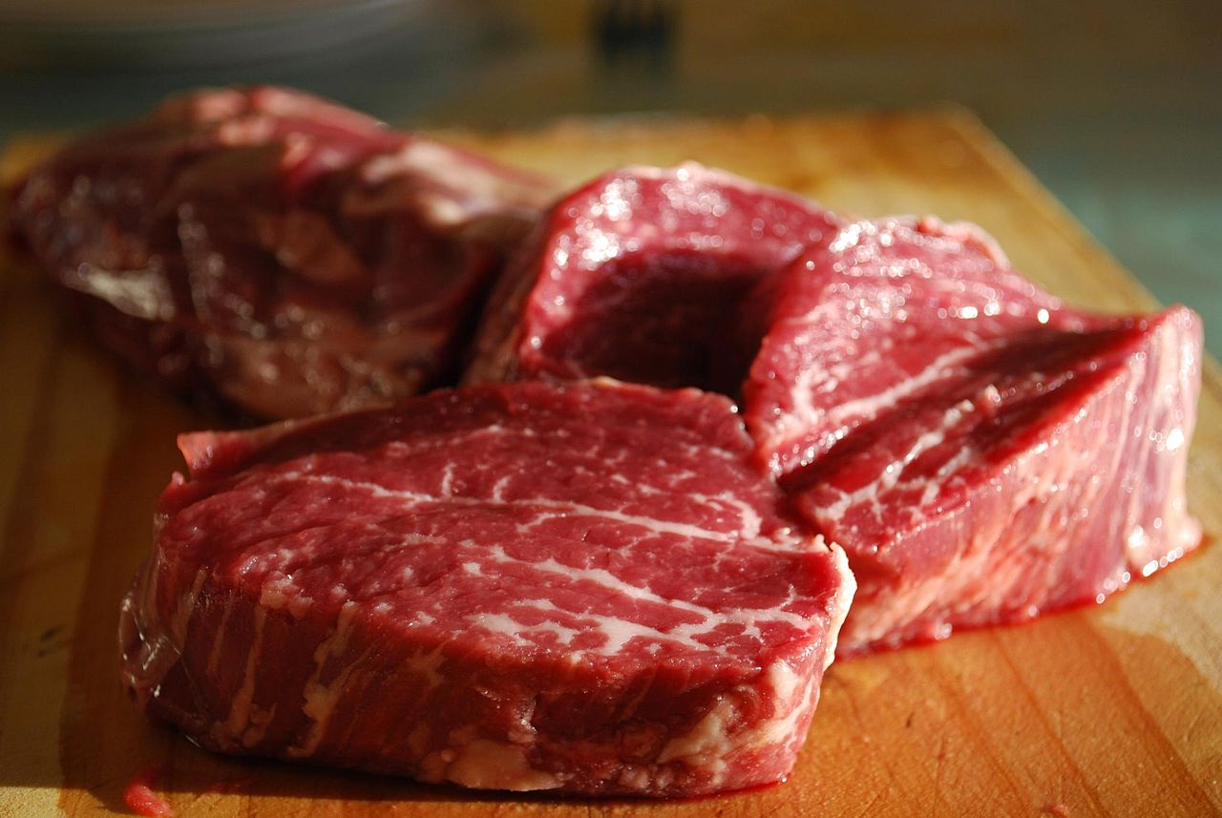
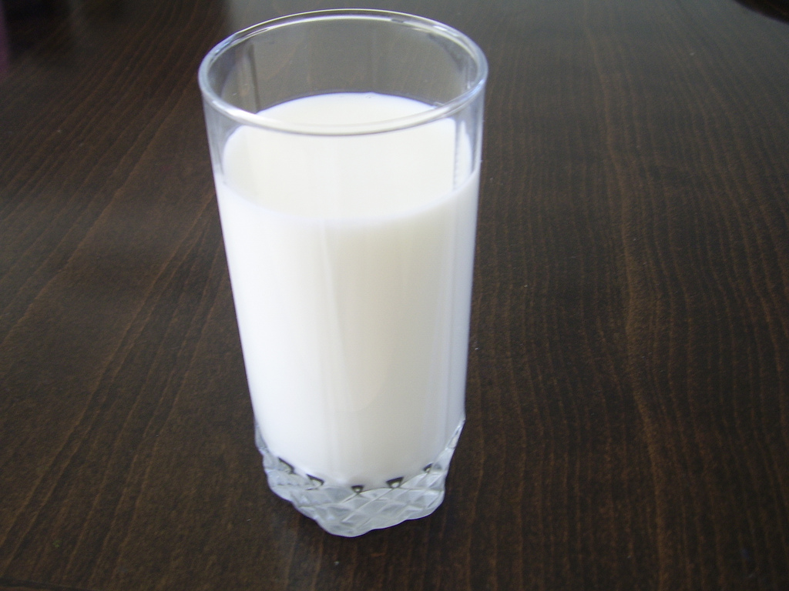
Beef vs. dairy

Slide 7
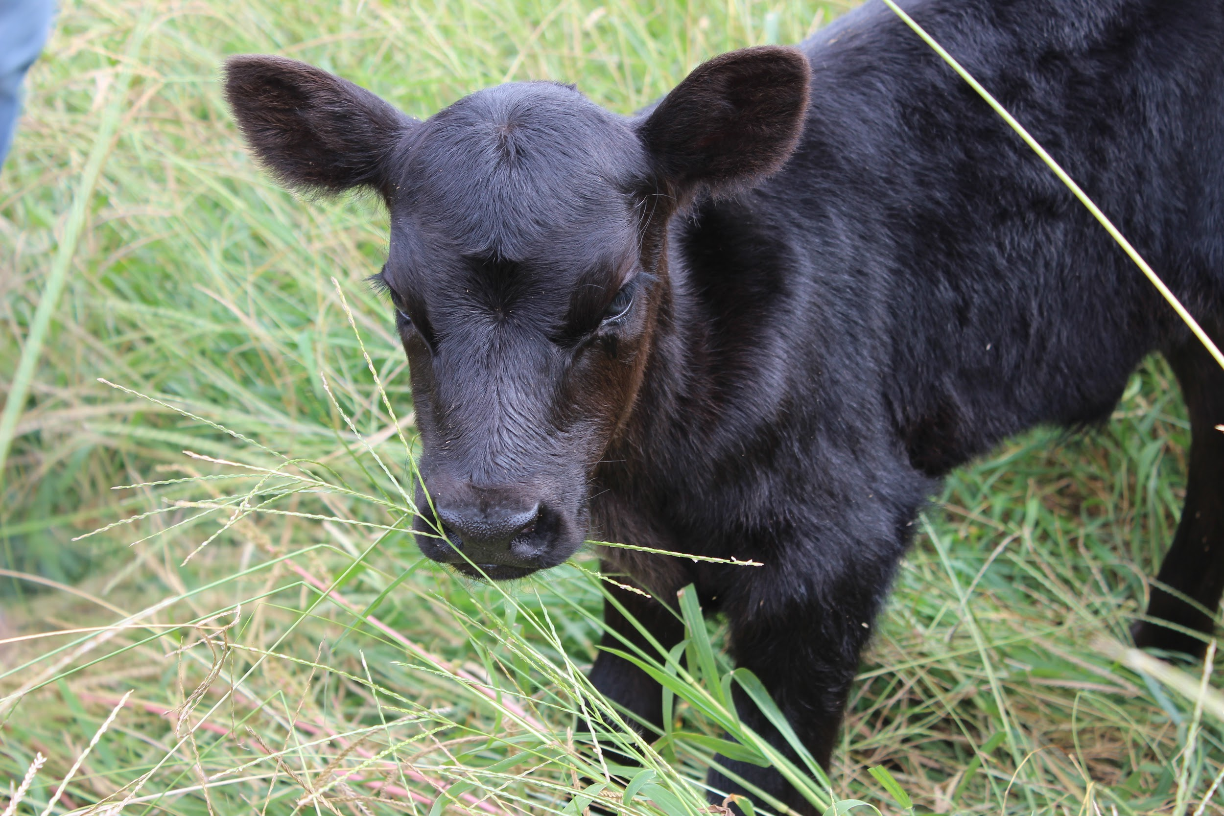
Similarities between beef and dairy cattle
Produce Milk
Meat Production
Ruminants
9 month gestation period
Fed Rations*
Identification

Slide 8
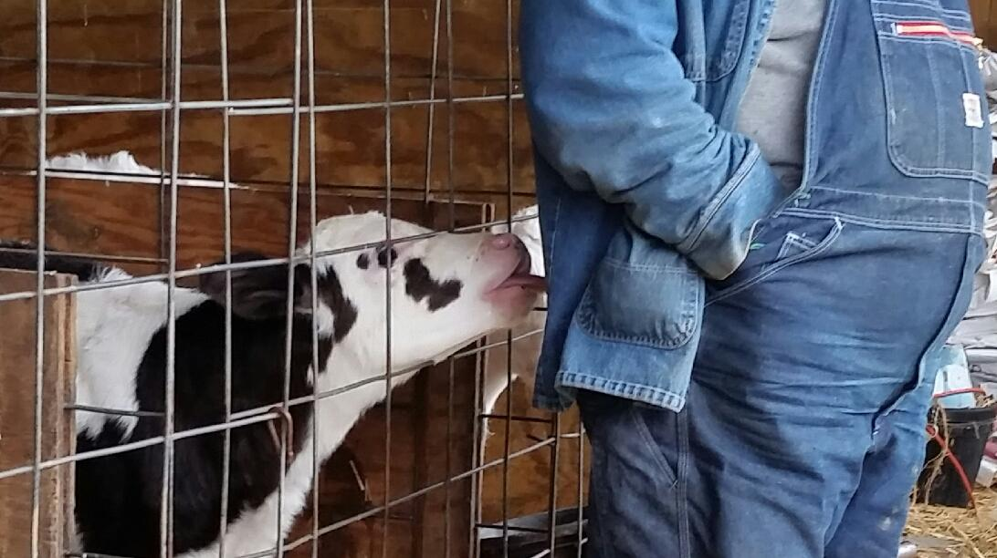
Differences between beef and dairy
Breed Diversity
Body Condition Scores (BCS)
Diet
Production Management

Slide 9
Pop question:
Can you breed a beef cow to a dairy bull?

Slide 10
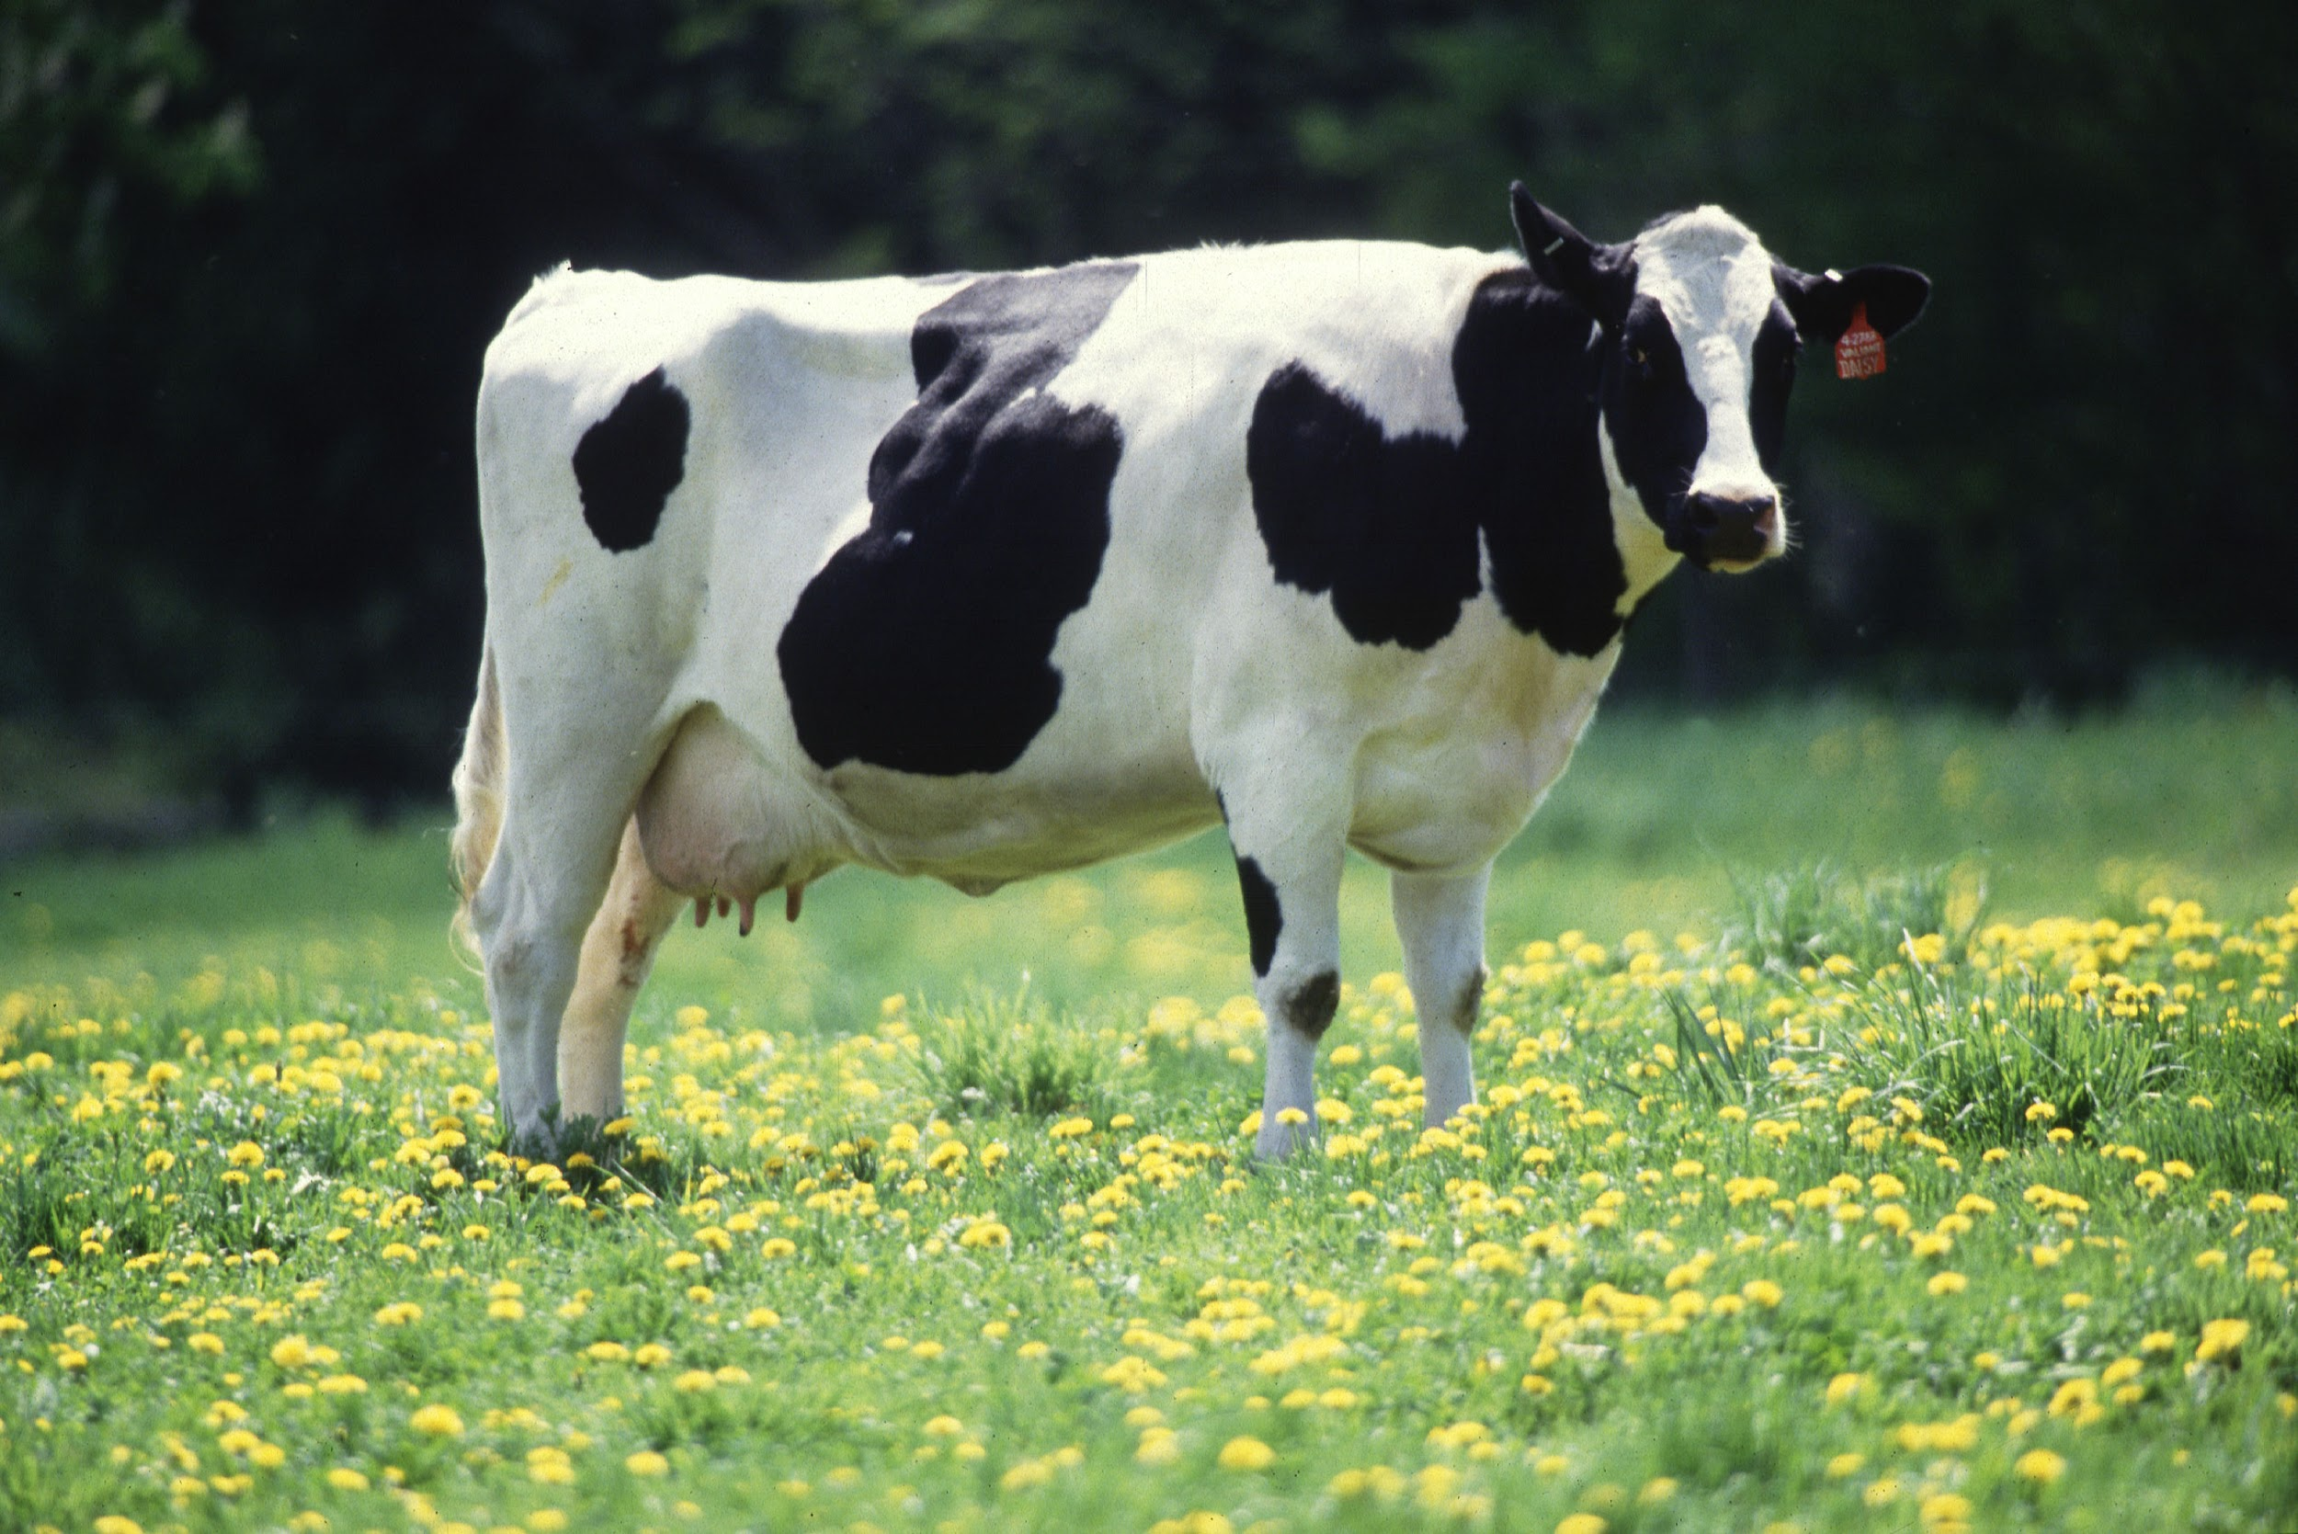
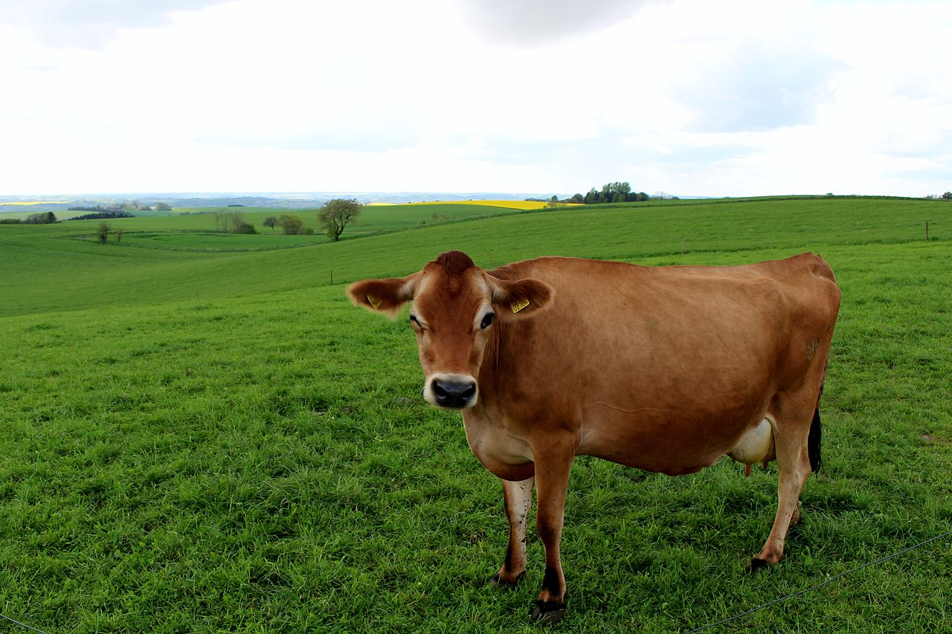
Dairy cattle breeds
HHolstein
Jersey
Notes:
Holstein and Jersey

Slide 11
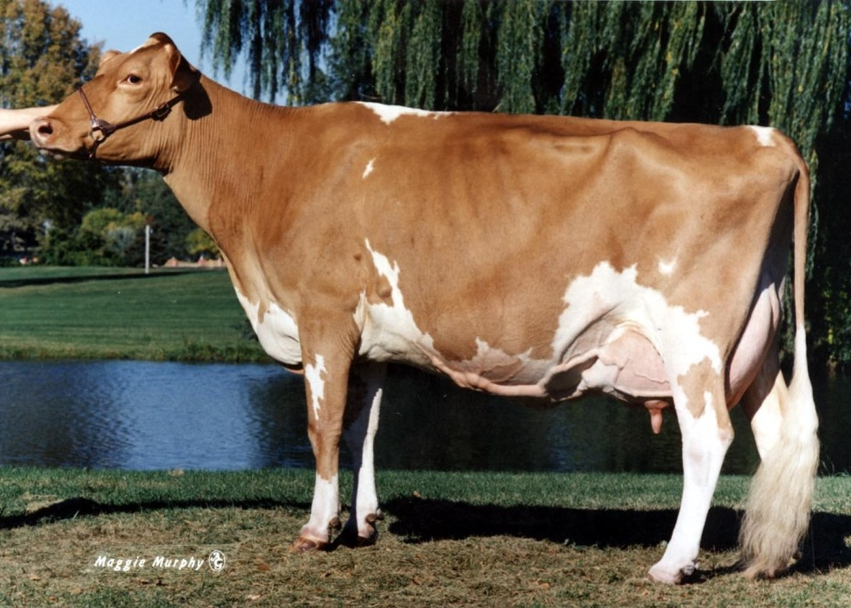
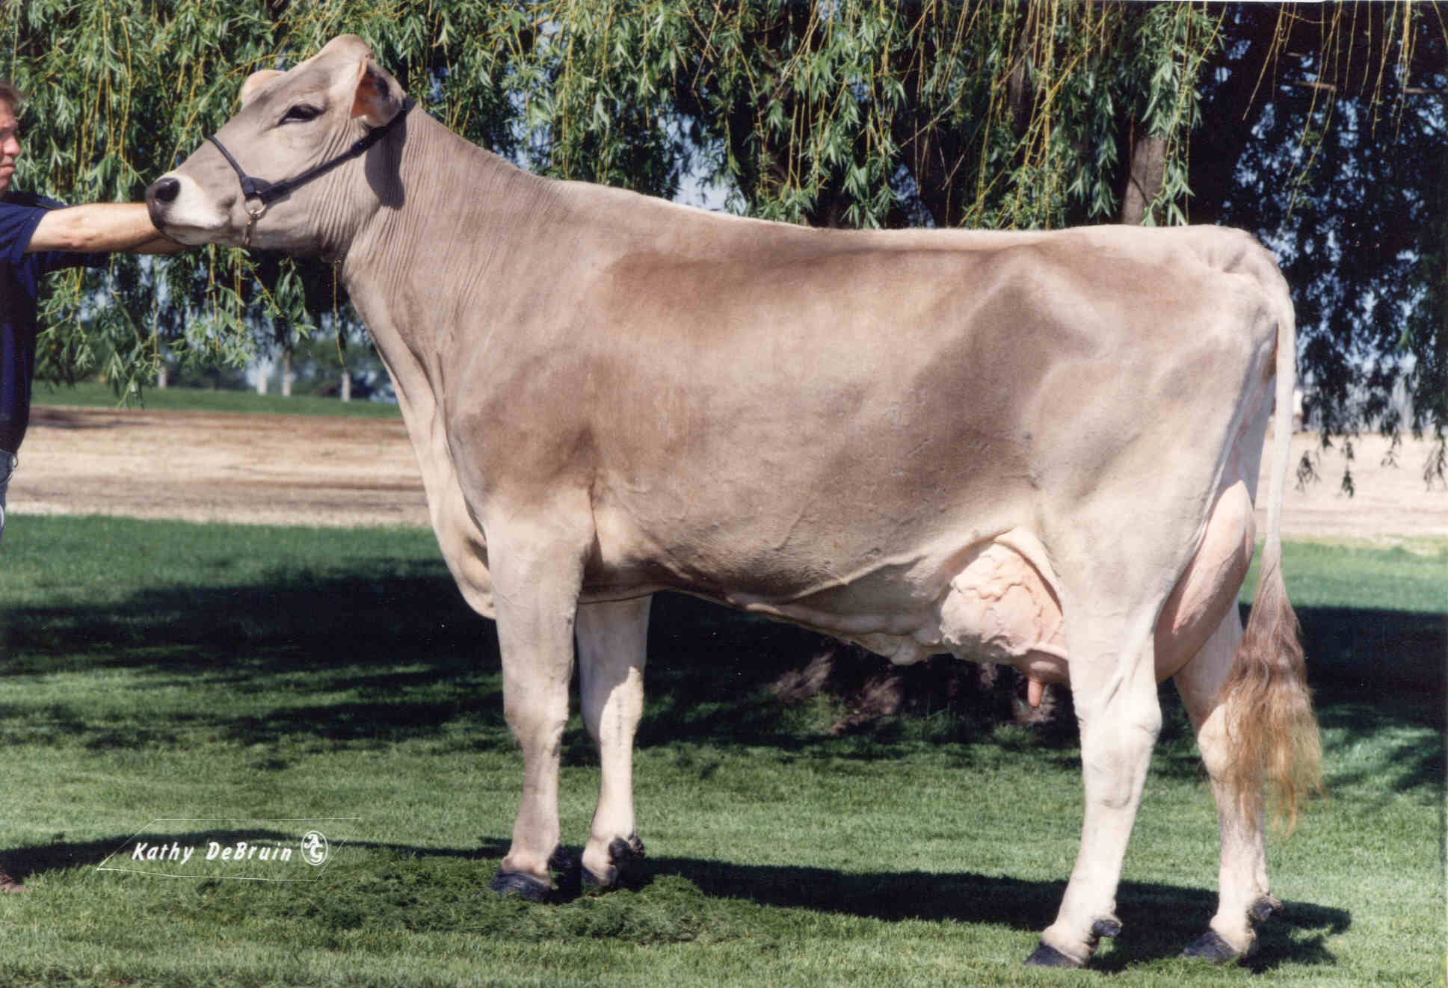
Guernsey
Brown Swiss
Notes:
Guernsey and Brown Swiss

Slide 12
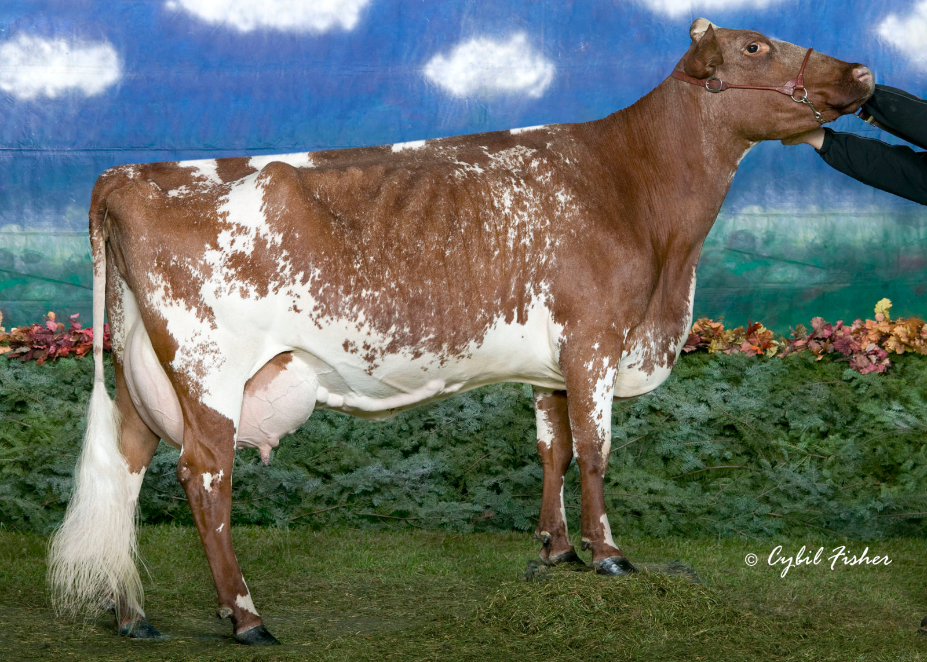
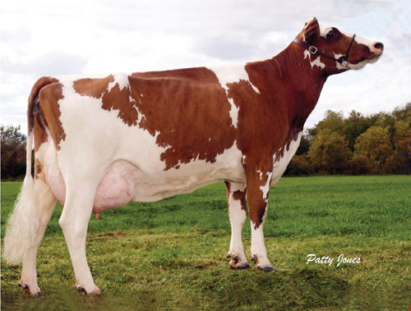
Milking Shorthorn
Ayrshire
Notes:
Milking Shorthorn and Ayrshire

Slide 13
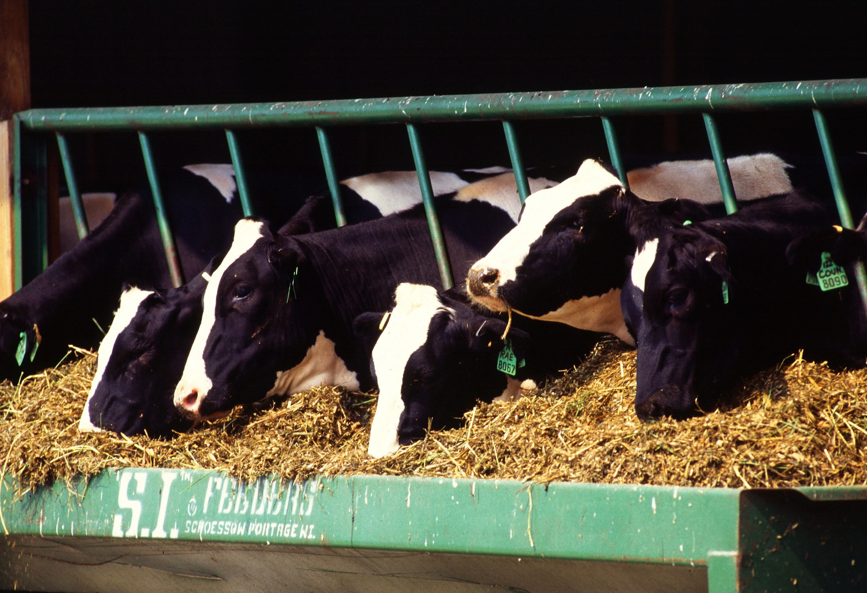
Dairy cattle characteristics
The majority of their energy is dedicated to producing milk, not meat.
Once they reach the age of 2, they will produce a calf each year.
  No calf, no milk.
Tend to be easier to work with than beef cattle.
Larger herd size than most beef cattle.

Slide 14
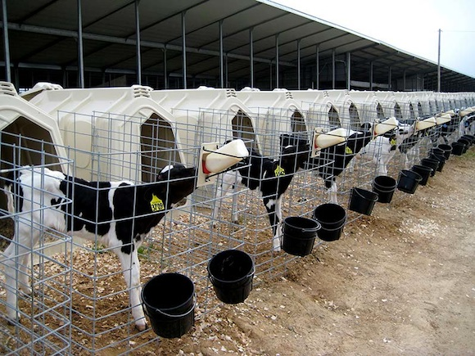
The Lifecycle of a dairy animal- females
Born
Fed colostrum* for the first 3 days and then fed a milk replacer for 4-8 weeks. Grain will be introduced around 7 or 10 days.
At the age of 2 they will have a calf for the first time and start milking.
Considered mature at 5 years old, could be producing 25% more than the first time heifers.

Slide 15
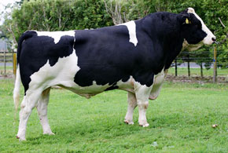
The Lifecycle of a dairy animal- males
Born
Given Colostrum
Castrated if they aren’t going to be retained as a bull*
Sold to a backgrounder OR kept on farm for beef production.

Slide 16
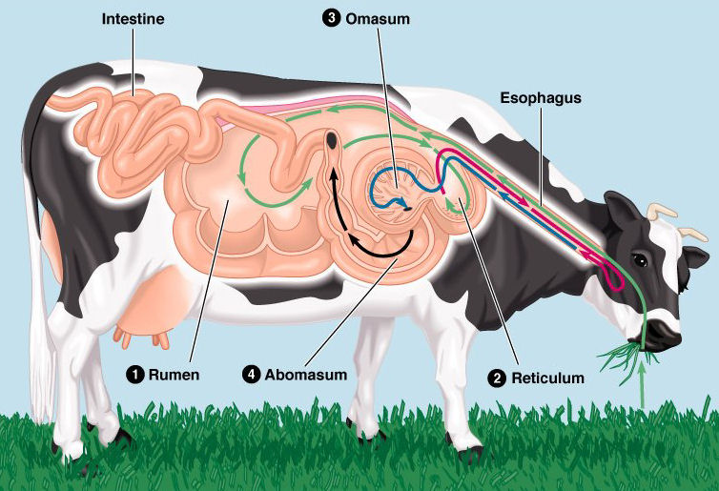
Dairy Cattle nutrition
A mature cow will eat around 100 pounds a day!
Notes:
https://www.midwestdairy.com/farm-life/common-questions/

Slide 17
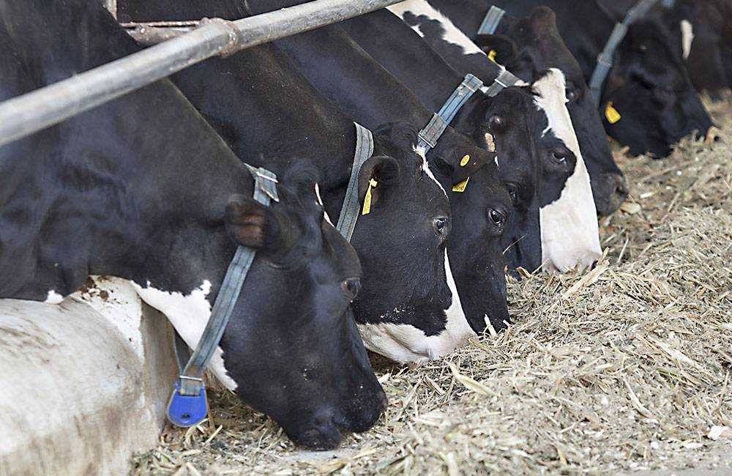
Total mixed ration (tmr)
Good quality forages
Grains
Proteins
Vitamins and Minerals
Notes:
http://www.extension.umn.edu/agriculture/dairy/feed-and-nutrition/feeding-total-mixed-rations/

Slide 18
What breed is this?
What is one characteristic of this breed?

Slide 19
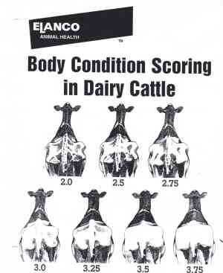
Dairy cattle
body condition scores

Slide 20
Myth: Antibiotics given to cows are found in milk.
Fact: milk from treated cows is thrown out.

Slide 21
Technology in the dairy industry
Robots!
Artificial Insemination
Estrus Detection
Automatic Waterers and Misters
https://www.youtube.com/watch?v=-XI4siKp-nU

Slide 22

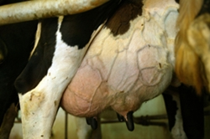
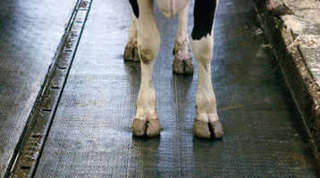
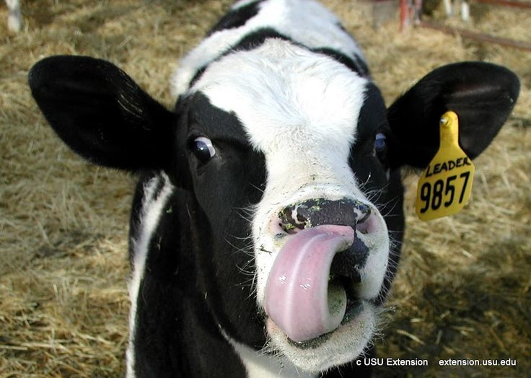

Diseases and health concerns in the dairy industry
Ketosis
Mastitis
Lameness
Fertility
Grass tetany

Slide 23
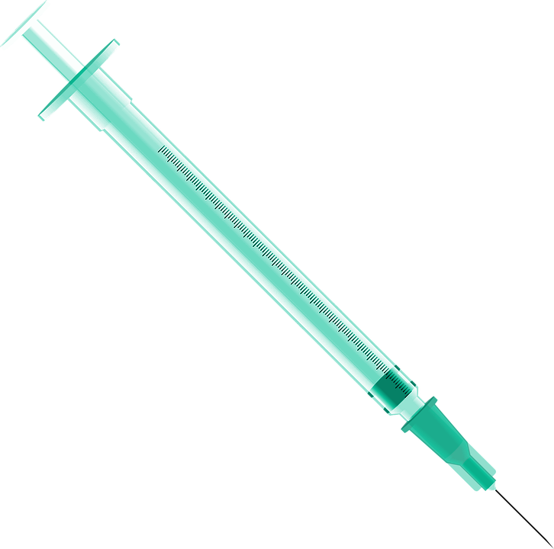
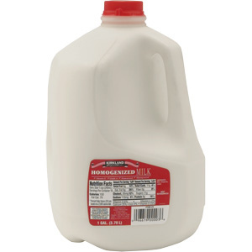
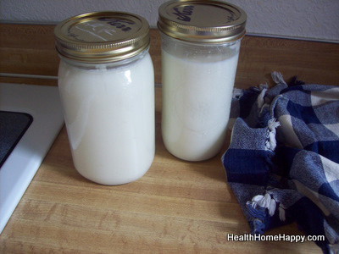
Issues in the dairy industry
Shot injection sites
Raw milk
Price and market
$4.00

Slide 24

The Virginia dairy herd improvement summary activity
Pick a farm.
Calculate how much they would be earning at the current milk price for conventional.
Calculate how much they would be earning at the current organic price for organic.
Calculate their feed costs and labor costs.

Slide 25
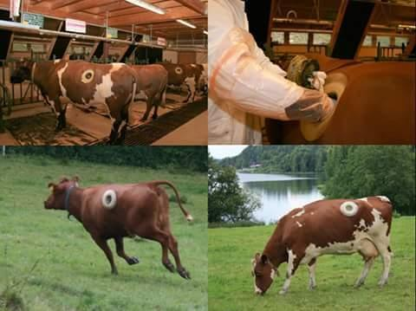
Cannulated Cow

Slide 26
Questions about dairy?

Slide 27
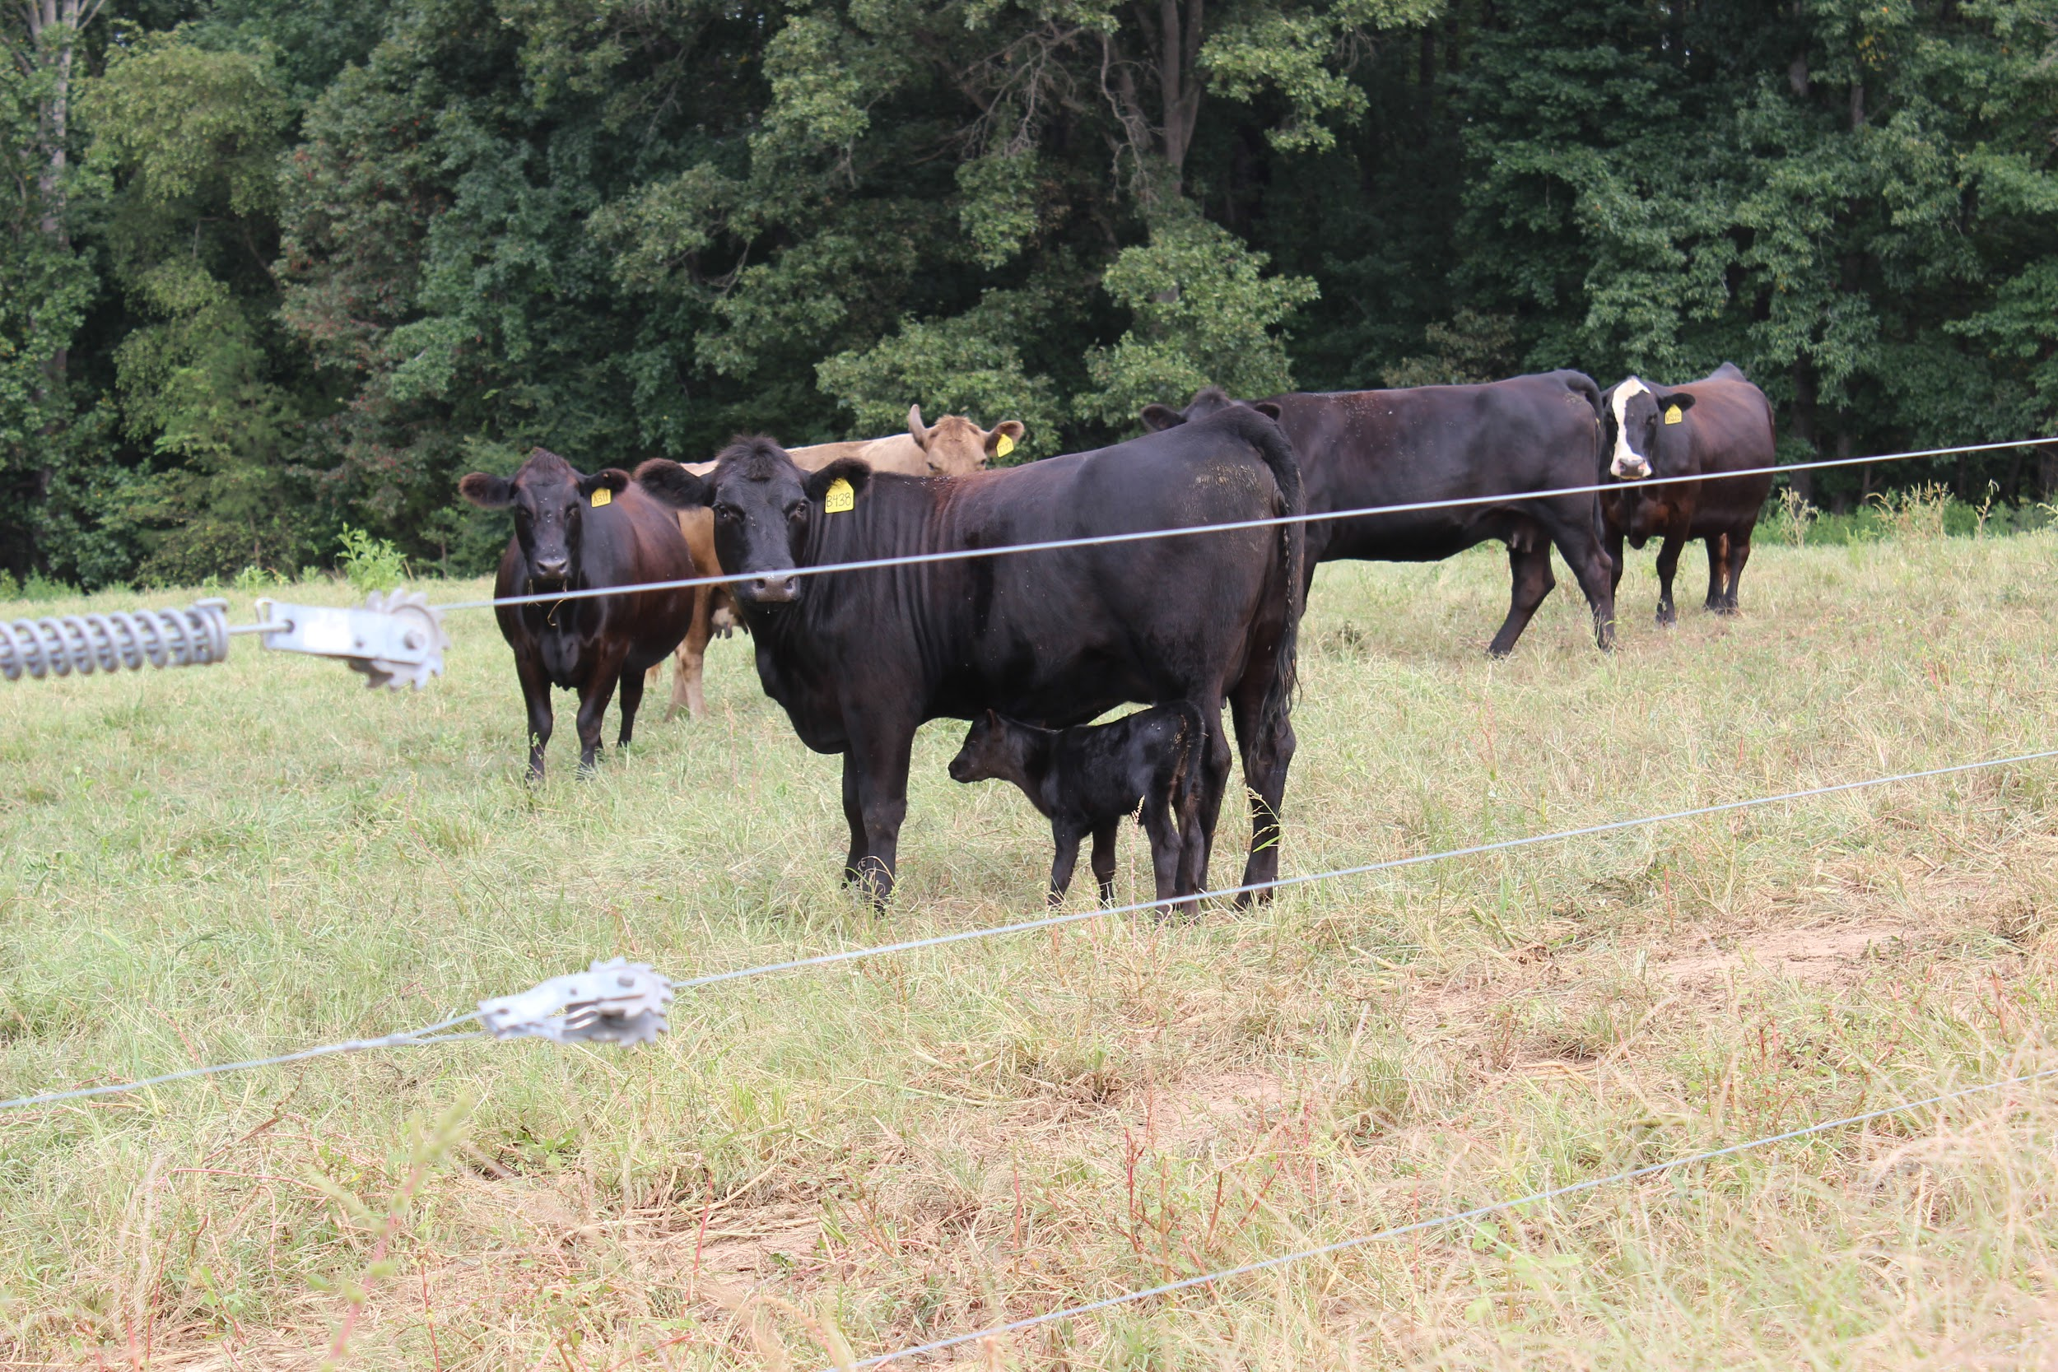
Beef Cattle

Slide 28
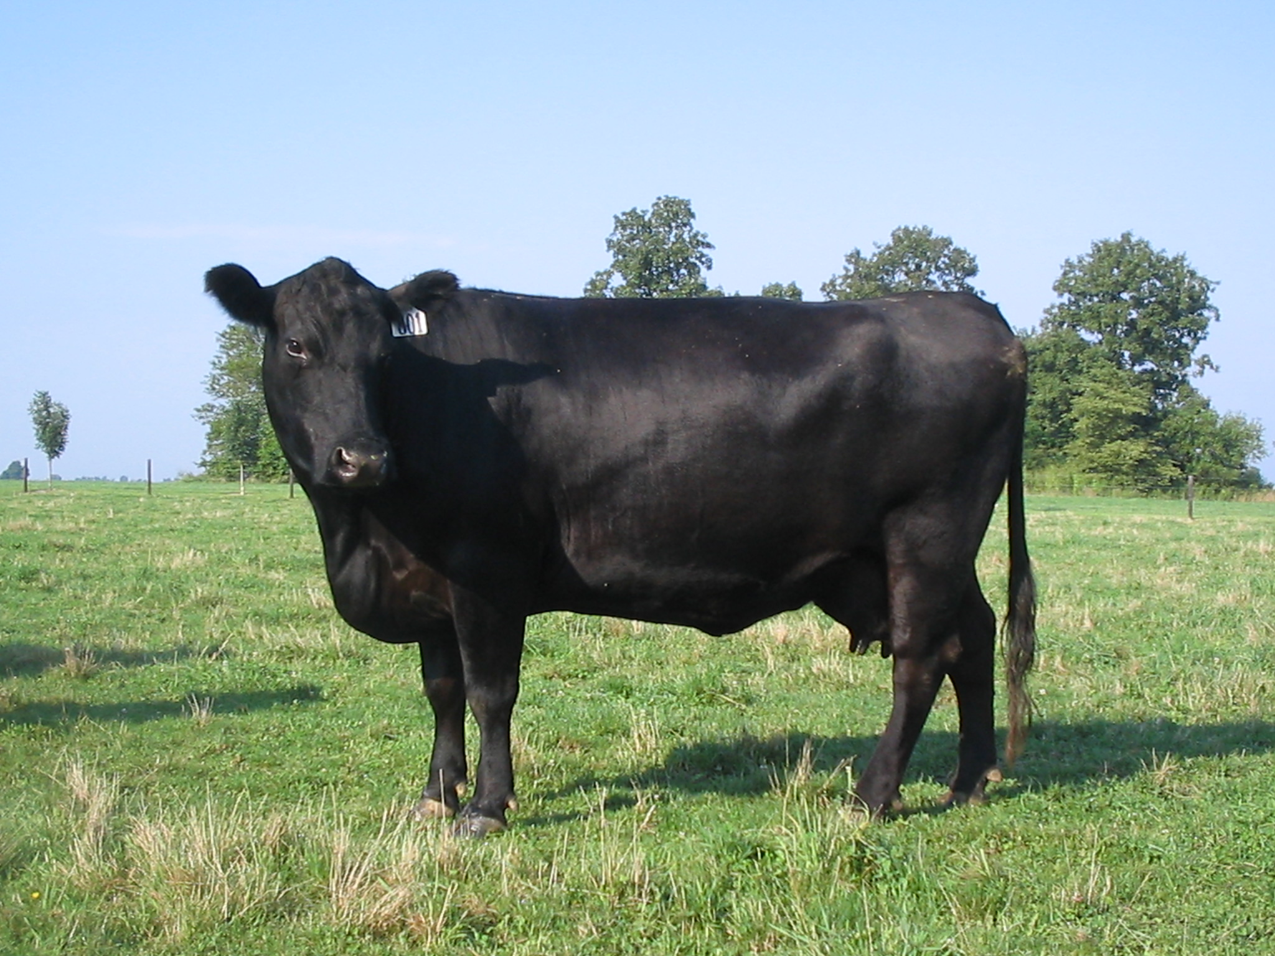
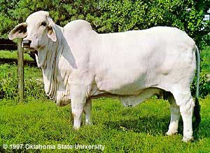
Bos Taurus vs. bos indicus
Angus
Brahman
Notes:
Angus and Brahman

Slide 29
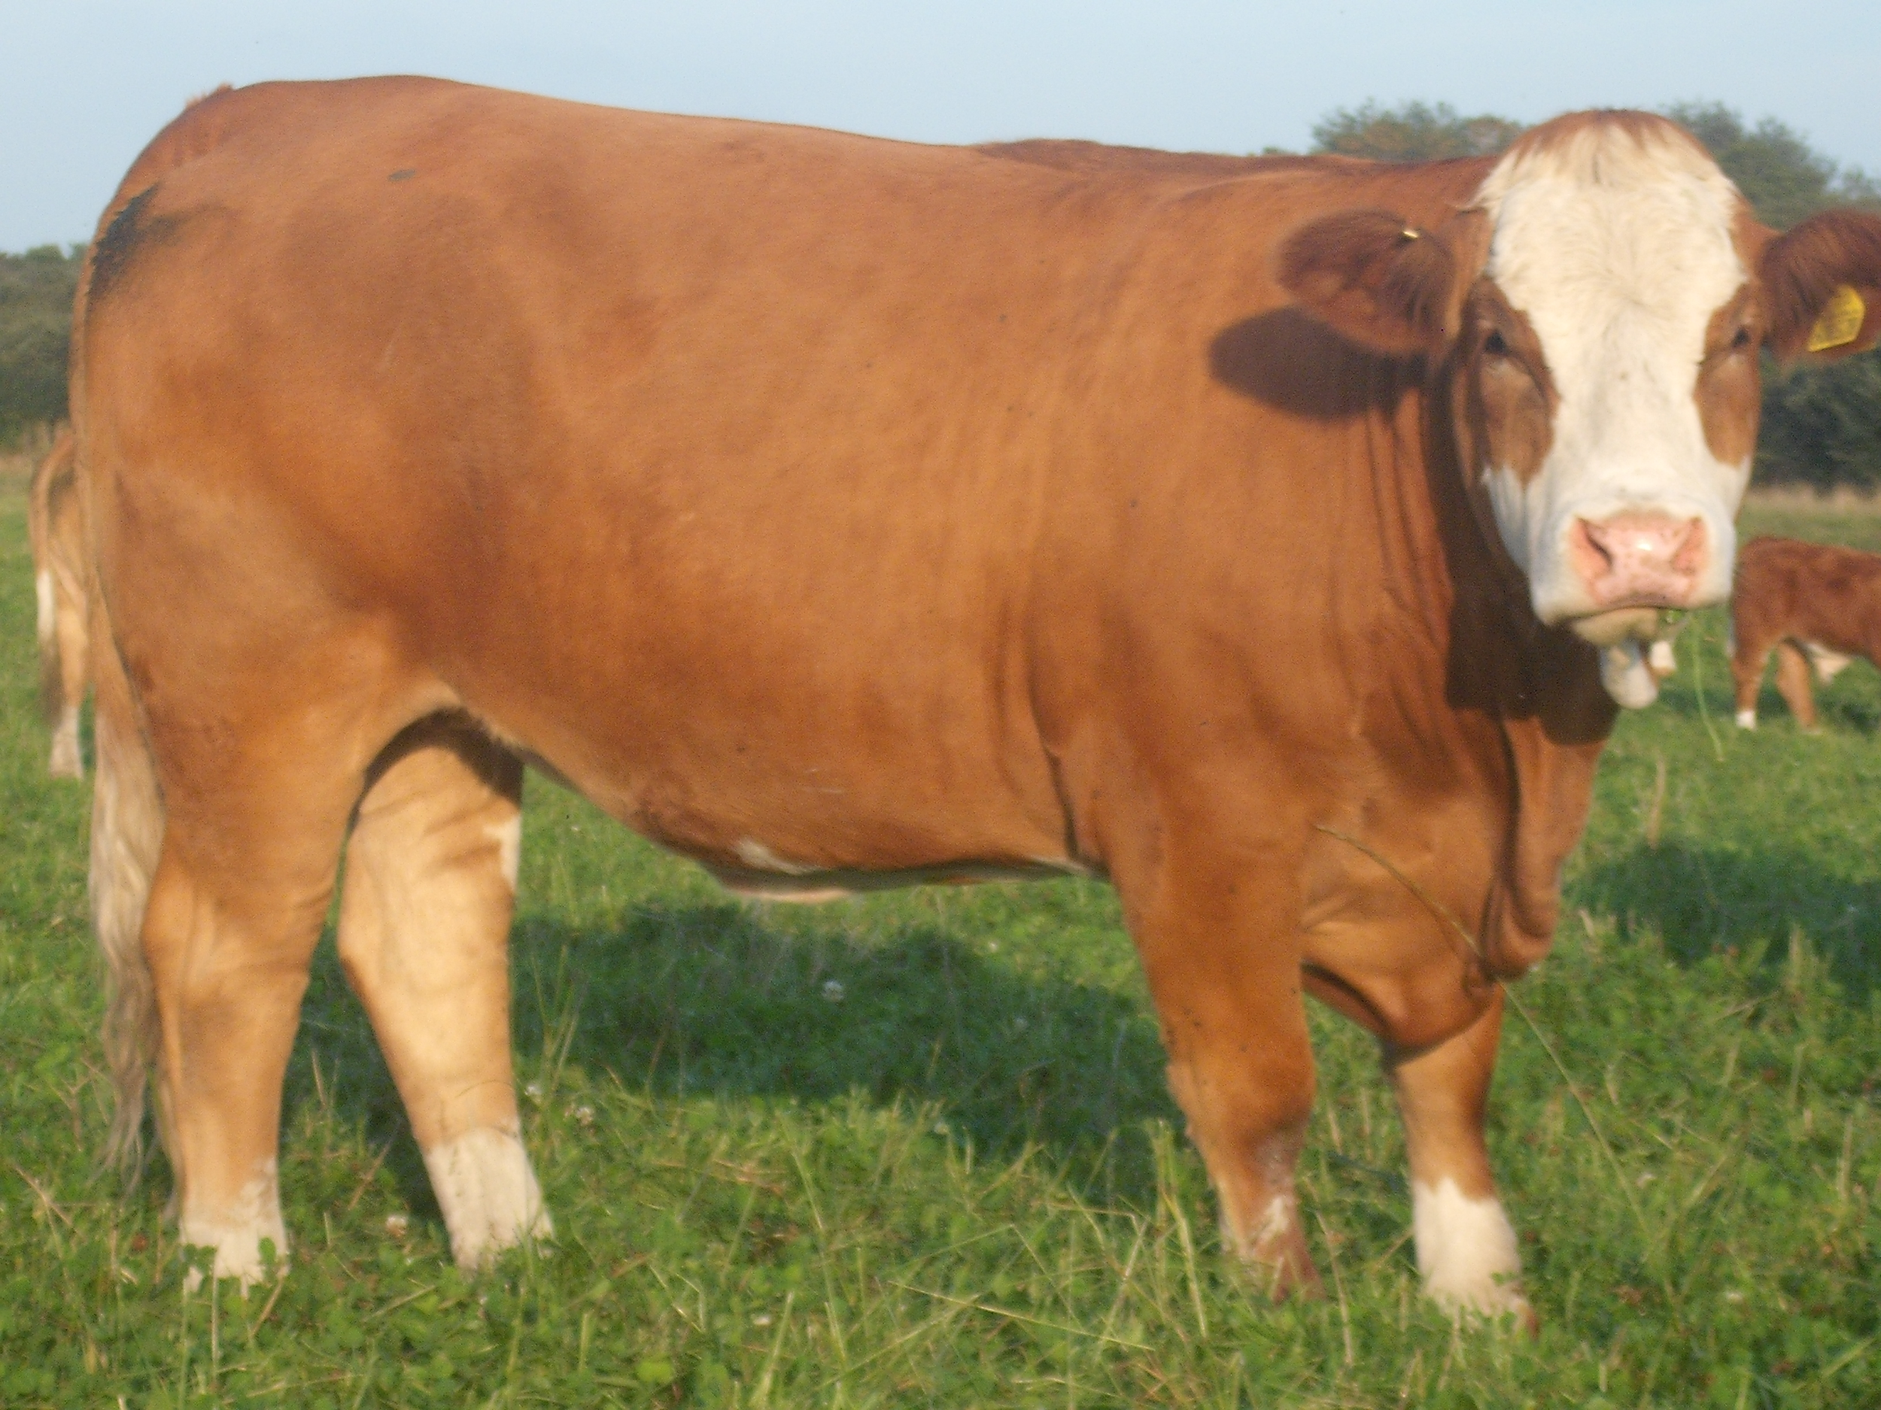
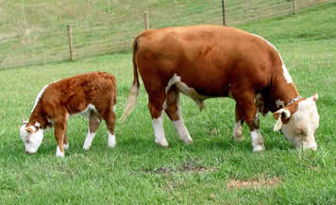
Major beef cattle breeds
Simmental
Hereford
Notes:
Simmental and Hereford

Slide 30
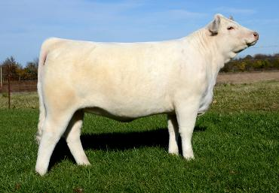
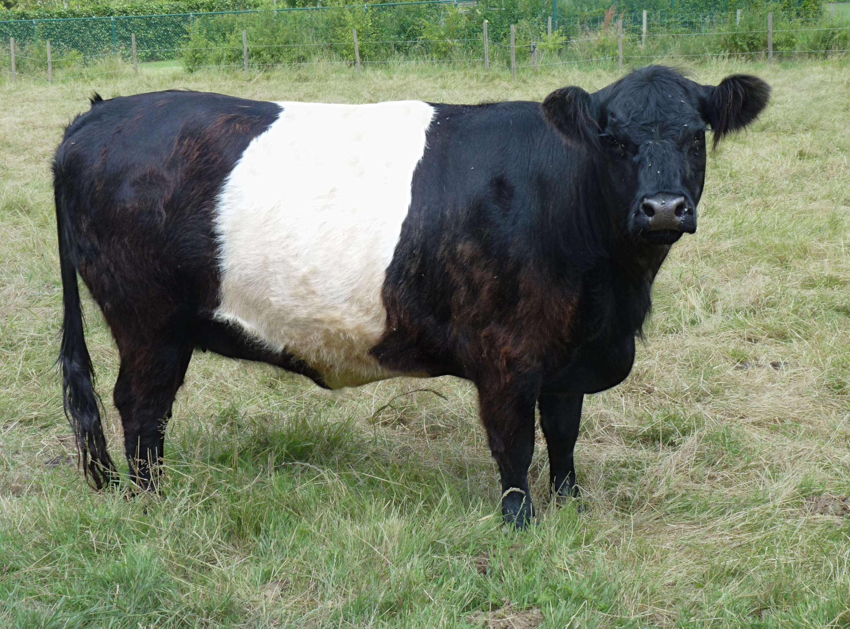
Charolais
Belted Galloway
Notes:
Charolais and Belted Galloway

Slide 31
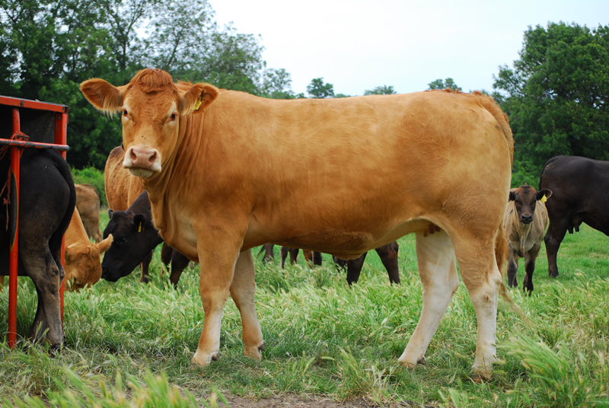
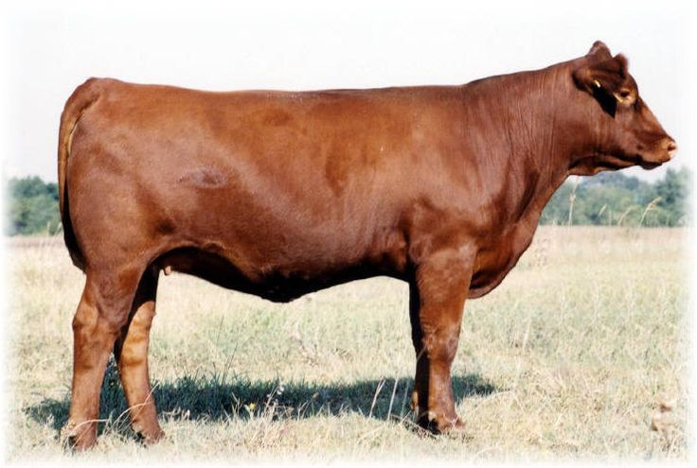
Limousin
Gelbvieh
Notes:
Limousin and Gelbvieh

Slide 32
Pop question: Which breed of cattle is a college team mascot?
*Hint- Texas

Slide 33
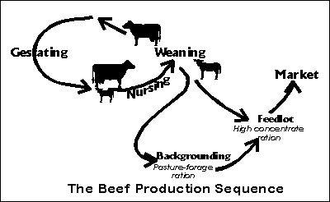
Types of Beef Cattle Production
Cow/ Calf
Feeder/Back-grounder
Feedlot
Does it All!

Slide 34
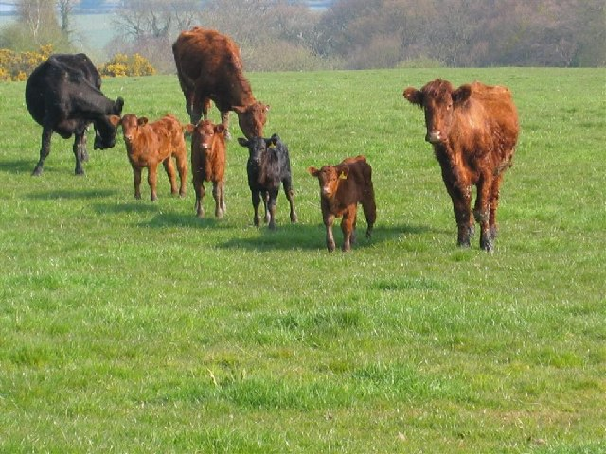
The lifecycle of a beef animal- females
Born
Weaned from Cow at 9 months*
Retiring momma cows sent off to market
  Retain some heifers in herd*
  Sell calves to backgrounder*
  All calves stay
55 days after birth, cows can be rebred.
Heifers are bred for the first time around 2 years old.

Slide 35
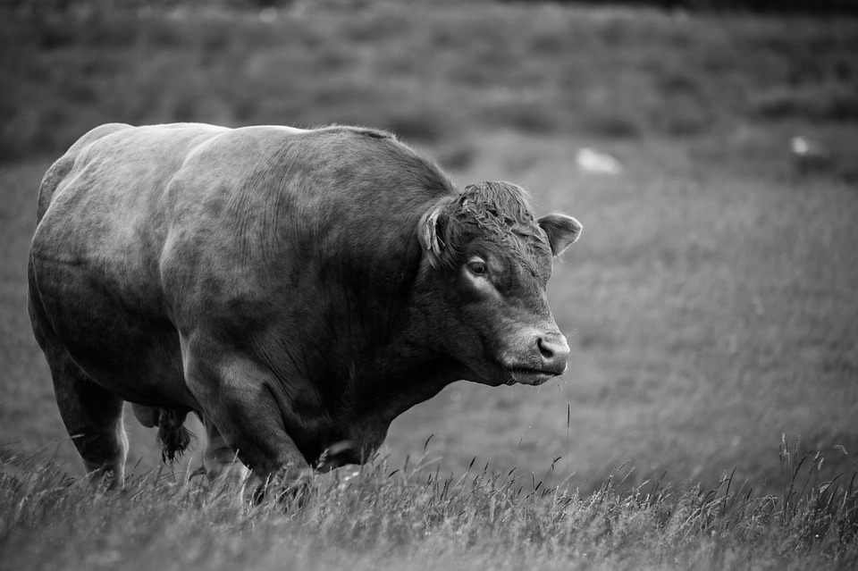
The lifecycle of a beef animal- males
Born
Weaned at about 9 months
Bull calves could be retained as a breeding bull.
Castrated by weaning at the latest*
Steers are sold to backgrounder
  Or kept on the farm until they reach slaughter weight.

Slide 36
True or False: Beef cows spend the majority of their lives in feedlots.

Slide 37
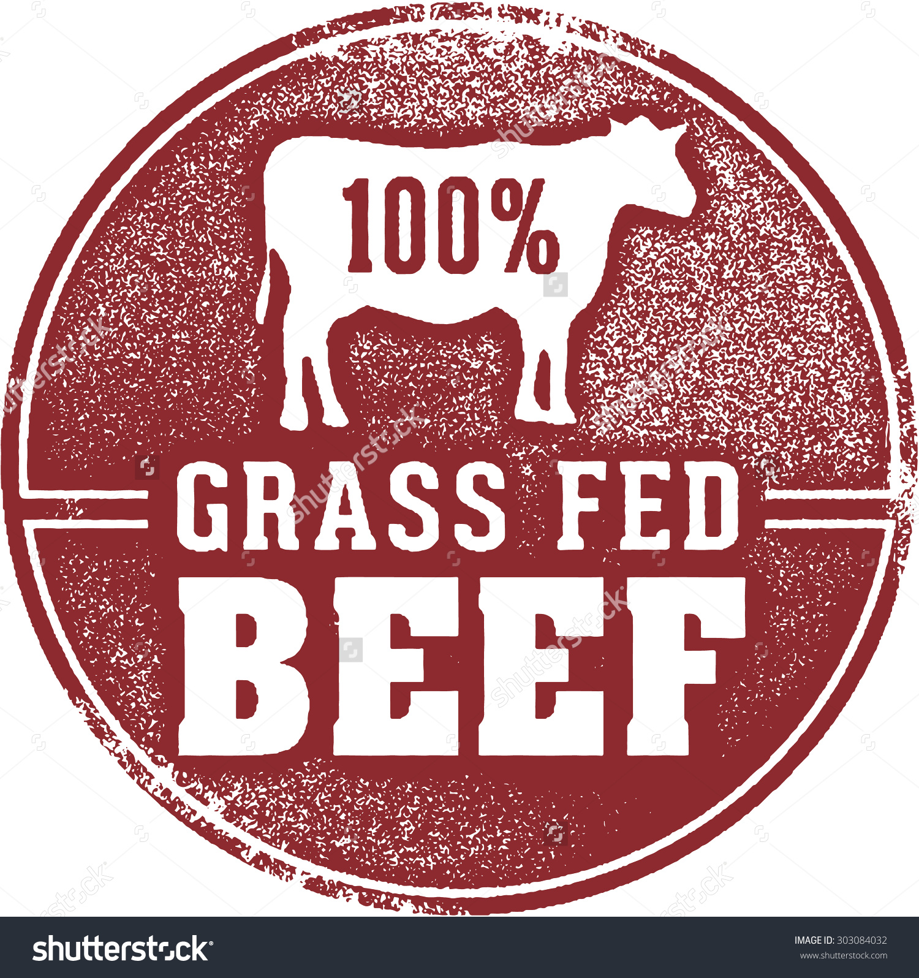
What is “grass fed beef”?
Well...all cows are fed grass for the majority of their lives.
Grass Fed labels should really probably read “Grass Finished”
These animals never go to a feedlot.
USDA AMS withdrew the standards for labeling January 2016.

Slide 38
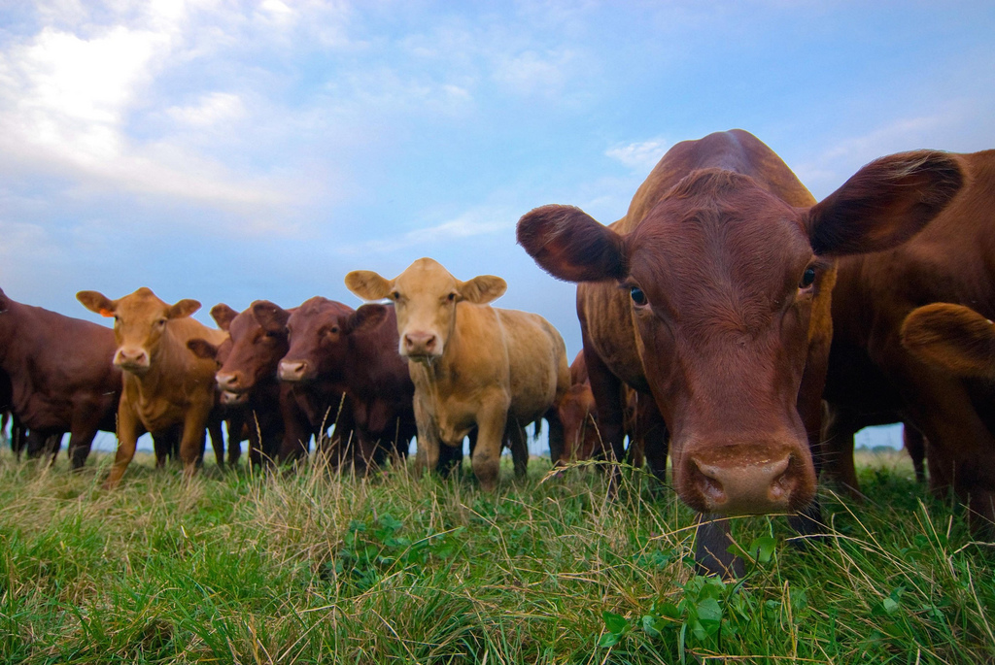
Beef cattle nutrition
Depends on your market.
Can be fed a TMR.
Hay, grass and supplements are the most typical.
Eat 1.4-4.0% of their body weight depending on their life stage.

Slide 39
Name this breed:

Slide 40
Beef Cattle
Body Condition Scores
https://pubs.ext.vt.edu/400/400-795/400-795.html
**Some of these pictures might be hard to look at, please remember that most beef cattle in the United States are between a 3 and 7.**

Slide 41
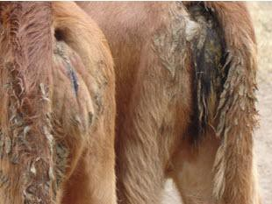
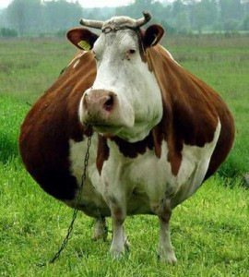
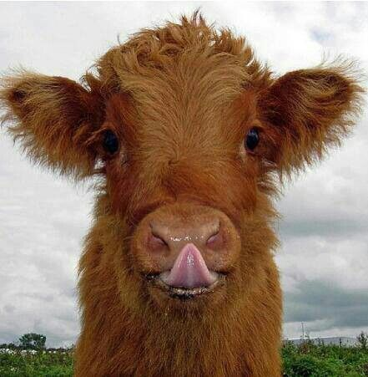
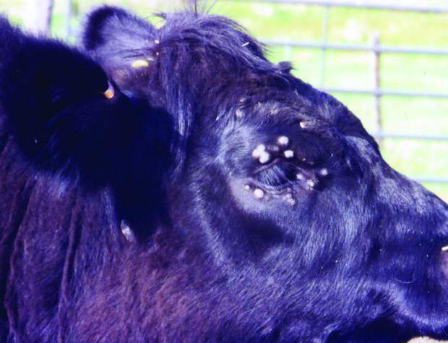
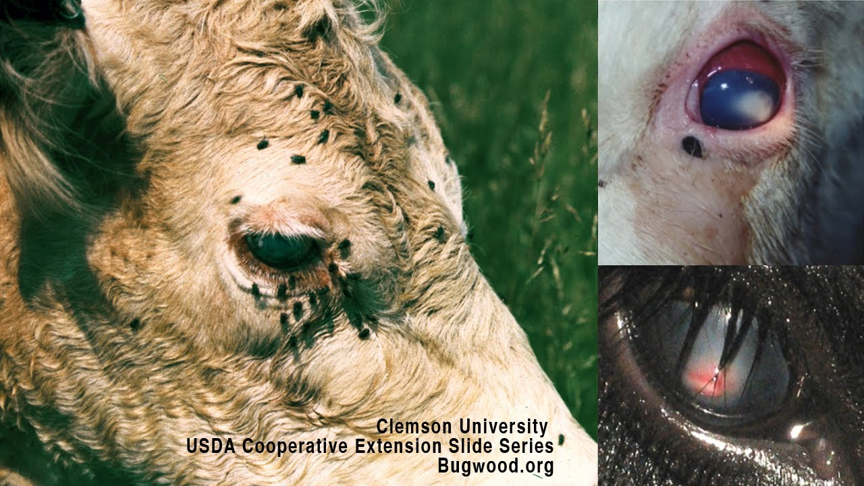
Common diseases or health issues
Scours
bloat
Sinusitis
Warts
Pink Eye

Slide 42
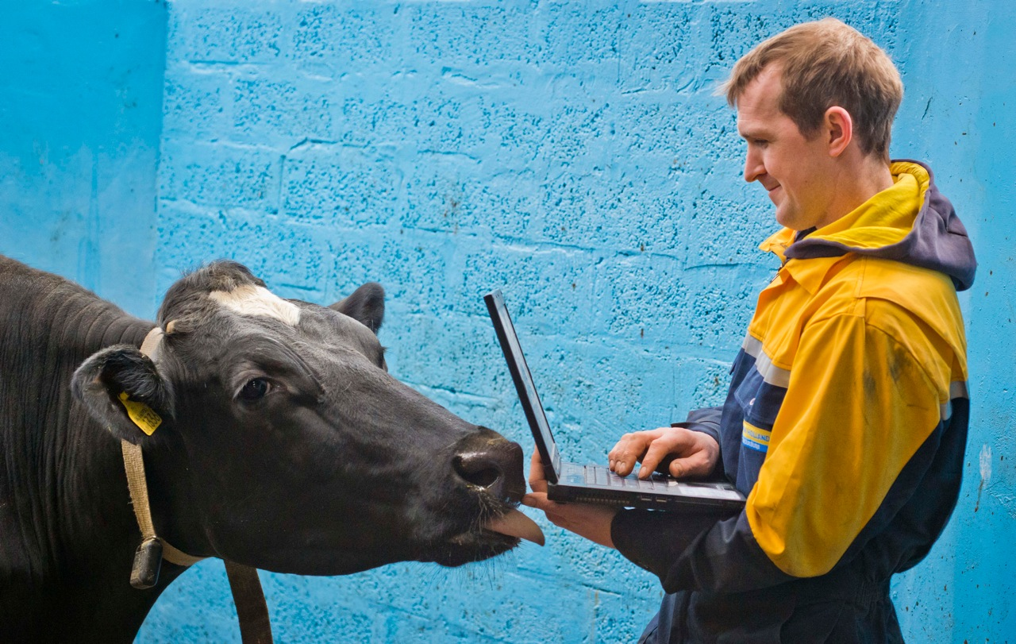
Technology in the beef cattle industry
Breeding Technology
Temporary Fencing
Automatic Waterers
Rumination and Neck Collars

Slide 43
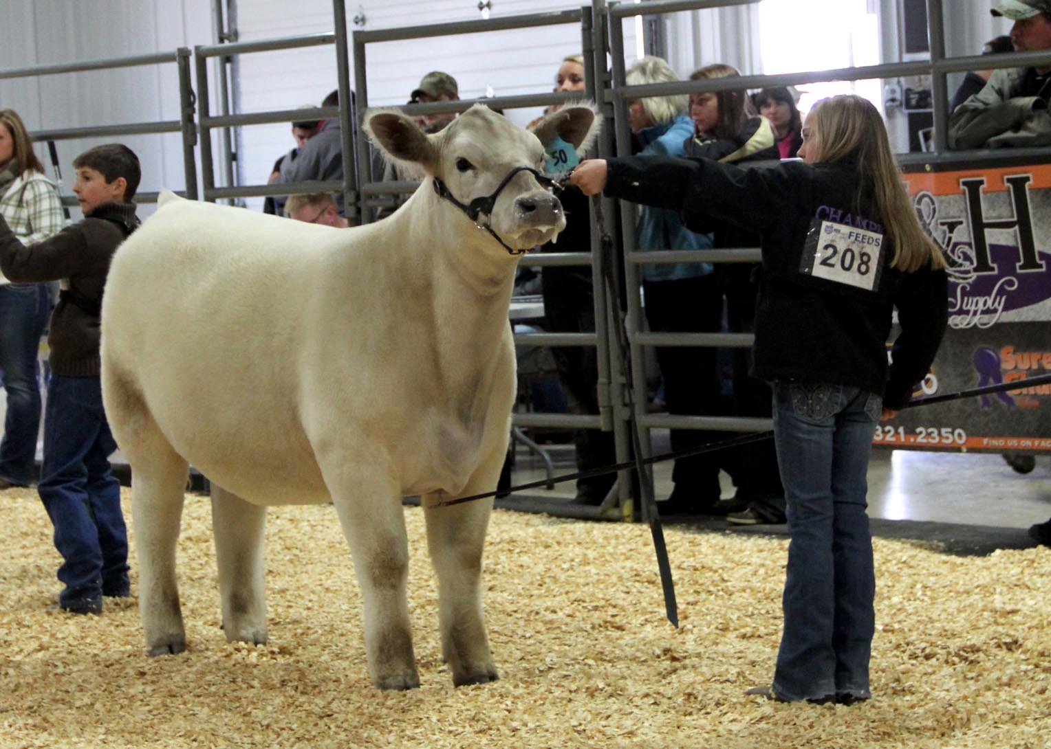
Issues in the beef industry
Veterinary feed directive (VFD)
Injection sites
Environment
Transparency
Market

Slide 44
Pop Question: Which breed of cattle has the nickname “oreo Cattle”?

Slide 45

Cattle prices in the united states
If you’re selling the steer as a whole…
$100/cwt
Animals are usually sent to market at 1,000-1,400 pounds.
If you’re taking your animals to the market…
$4.50/pound of edible product
Can expect to lose at least 40% of live weight.

Slide 46
Scenario practice
You take a group of 15 steers to the local auction. The steers are averaging 700 pounds.You are selling these recently weaned steers to a local backgrounder who will take them for $120/cwt.
How much are you getting per steer and for the group?

Slide 47

Beef quality assurance
BQA was established in 1987 by The Beef Checkoff to provide cattle producers with the tools and training necessary to assure animal health and well-being.
BQA is a preharvest, supply-chain management program that applies the latest science and technology to ensure safe and wholesome beef products for consumers.
Set production standards that can be met or exceeded.
Establish systems for data retention and record keeping.
Provide hands-on training and education for participants.
Provide technical assistance through the Virginia Cattlemen’s Association, Virginia
Beef Industry Council, BQA-certified veterinarians, and BQA-certified Extension agents; offer on-site assistance if desired by producers.
Ensure that all sectors of the industry take responsibility for the production of a safe food product through proper animal care, handling, and management practices.

Slide 48
Questions?

Slide 49
Thank you for having me! The best way to contact me is by e-mail: mcharley@vt.edu

