Slide 1
Project Byron
Leveraging eXist-db for TEI-XML document management
CS5774: Information Storage and Retrieval
Kyle Morgan, Kyle Schutt
Stakeholder: David Radcliffe
Collaborators: Purdom Lindblad, Keith Battleson
December 4, 2012
Virginia Tech

Slide 2
Roadmap
LBT Overview
Background Information
Approach
Future Work
Notes:
- Overview of the old system

Slide 3
Byron Overview
Lord Byron and his Times (LBT)
  Center for Applied Technologies in the Humanities
Large digital archive
Incorporates connections between people
Slow for “popular” people
Notes:
- Overview of the old system

Slide 4
Existing LBT System
More than 300 TEI documents
Six XML Indexes
  Relationships between documents
  Document metadata
XSLT Stylesheets
  XPath queries
  XHTML styling
Notes:
Data structure of the old system

Slide 5
Existing LBT System
XSLT code generated from PHP
Website allows user to:
  Search for references
  Find authors and people
  Find connections between works and people
  Find periodicals

Slide 6
Roadmap
LBT Overview
Background Information
Approach
Future Work
Notes:
- Overview of the old system

Slide 7
TEI
Text Encoding Initiative
Used for digital archives in the humanities
XML format
Moreover, his reasoning as to
<persName>Mr. Moore’s</persName>
conduct with regard to
<persName>Lord Byron’s</persName>
<name type="title" key="LdByron.Memoir">Memoirs</name>
, seems to us to be at once vague and inapplicable.

Slide 8
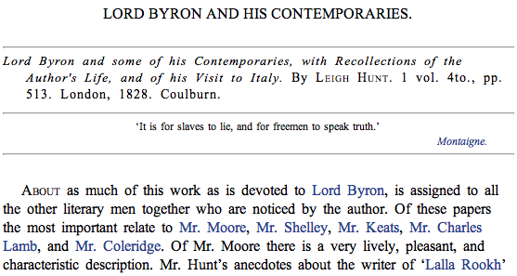
XSLT
Stylesheet for XML documents
Used by LBT to translate TEI XML to XHTML

Slide 9
Roadmap
LBT Overview
Background Information
Approach
Future Work
Notes:
- Overview of the old system

Slide 10
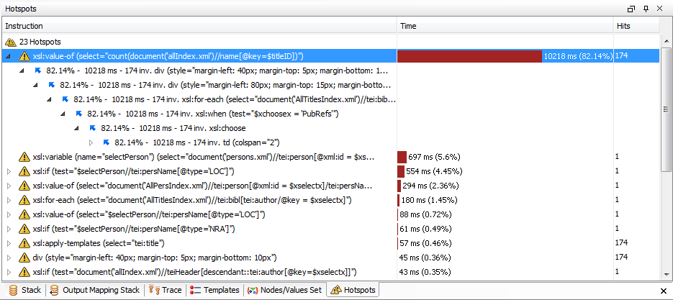
Removing XLST processing
XLST is too slow
Rely on XQuery and CSS instead

Slide 11
Simplify Indexes
AllPersIndex.xml:
<person xml:id="WaScott">
<persName type="First-Last">Sir Walter Scott, baronet</persName>
<persName type="Last-First">Scott, Sir Walter, baronet</persName>
<age> (1771-1832)</age>
<note>
<note>Scottish poet, novelist, antiquary, biographer,
editor, and sheriff.</note>
</note>
</person>
persons.xml:
<person xml:id="WaScott">
<persName>
<roleName type="prefix">Sir</roleName>
<forename>Walter</forename>
<surname>Scott</surname>
</persName>
<birth when="1771-08-15">1771</birth>
<death when="1832-09-21">1832</death>
<sex>m</sex>
<nationality>Scottish</nationality>
<note>Scottish poet, novelist, antiquary, biographer,
editor, and sheriff.</note>
</person>

Slide 12
Preexisting Architecture
Apache HTTP Server
PHP
XSL
Stylesheet
Xpath
TEI
Web
Browser
XSLT Processor
XHTML
Notes:
YCM – eliminates cross browser limitations

Slide 13
Preexisting Architecture
Apache HTTP Server
PHP
XSL
Stylesheet
Xpath
TEI
Web
Browser
XSLT Processor
XHTML
Notes:
YCM – eliminates cross browser limitations

Slide 14
New Architecture
Client-side
Apache HTTP Server
Web Browser
eXist-db
(Index)
CSS
HTML
XQuery
TEI
JavaScript
eXist-db
(RESTful)
Lucene
Notes:
YCM – eliminates cross browser limitations

Slide 15
Technologies
YAHOO! Connection Manager (jQuery)
var transaction = YAHOO.util.Connect.asyncRequest('GET', url, callback, null);
var callback = {
success : function(request) {
if (request.responseText)
$('#content').append(request.responseText);
var xml = request.responseXML;
if (xml) {
var root = xml.documentElement;
var hits = $(root).find("#result-hits").attr("hits");
if (hits) {
currentPage = 1;
pageCount = hits;
retrieveNext(xml.URL);
} else
$("#loader").hide();
} else
$("#loader").hide();
return request.responseText;
},
failure : requestFailed
};
Notes:
YCM – eliminates cross browser limitations

Slide 16
Technologies
CSS/HTML
/* navigation bar style */
#nav_list {
position: fixed;
left: 40px;
top: 250px;
width: 150px;
}
.nav_item {
line-height: 16px;
width: 170px;
margin-top: 8px;
margin-bottom: 0px;
font-size: 12px;
}
<div class="nav_item">
  <a class="green" href="index.html">HOME</a>
</div>
<div class="nav_item">
<a class="green" href="javascript:void(0)" onclick="fetchCorrespondence(vars.person);"> CORRESPONDENCE</a>
</div>
<div class="nav_item">
<a class="green" href="javascript:void(0)" onclick="fetchReferencesToPerson(vars.person);"> REFERENCES TO PERSON</a>
</div>
<div class="nav_item">
<a class="green" href="javascript:void(0)" onclick="fetchReferencesToWorks(vars.person);"> REFERENCES TO WORKS</a>
</div>
Notes:
YCM – eliminates cross browser limitations

Slide 17
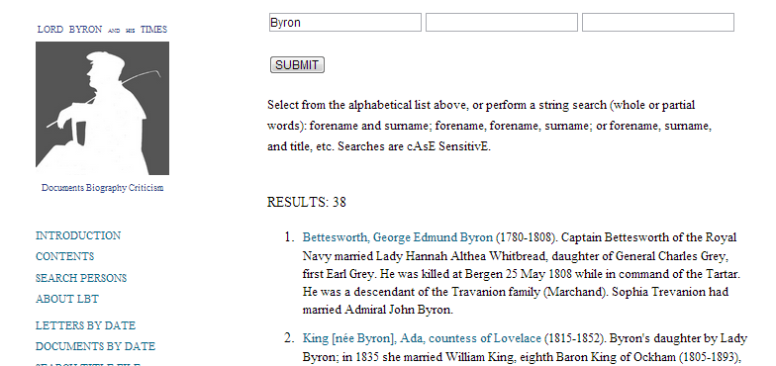
Technologies
XQuery
let $hits := document('/db/LBT/persons.xml') //tei:person/tei:persName[ft:query(., $query)]
for $hit in $hits[position() = ($start + 1 to $end)]
order by ft:score($hit) descending
Notes:
YCM – eliminates cross browser limitations

Slide 18
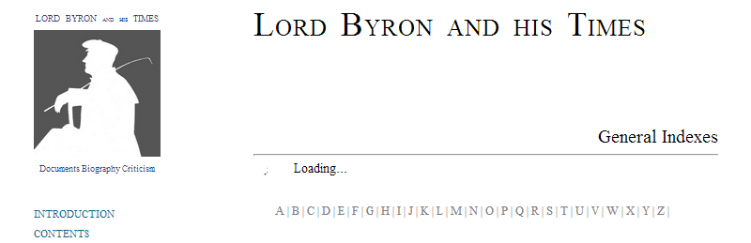
Demonstration

Slide 19
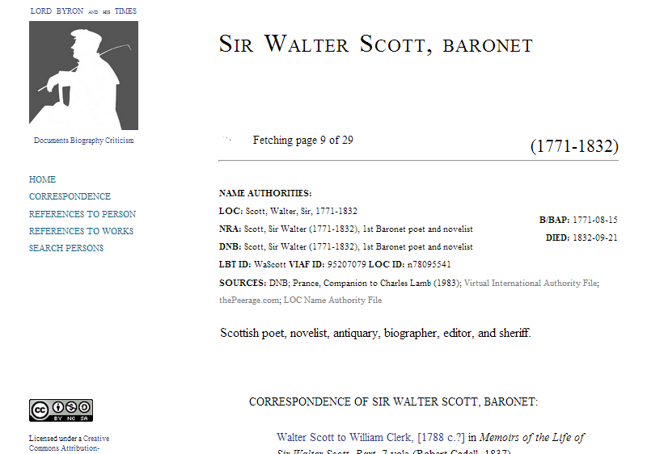
Demonstration

Slide 20
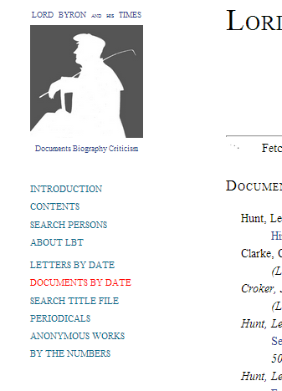
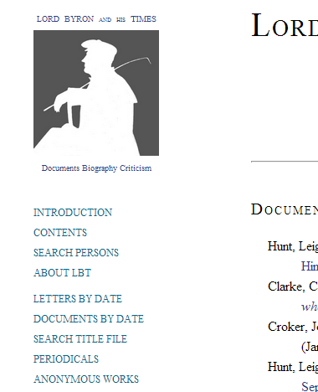
Demonstration

Slide 21
Time-to-display
Test #1
  Display all persons whose last name begin with “S”
Test #2
  Display details of Sir Walter Scott, baronet
Test #3
  Display correspondence of Sir Walter Scott, baronet
  Batch loads vs. One-time
Test #4
  Display all references to person (Sir Walter Scott, baronet)
  Unbatched
Test #5
  Search all documents for the term: “Byron”
Notes:
Use for reference for the next slide

Slide 22
Time-to-display

Slide 23
Future Goals
Roadmap for Further Development
Continue migration to new architecture
  CSS Styling
  XQuery development
Short courses and education on new technologies

Slide 24
References and Links
YAHOO! Connection Manager at http://developer.yahoo.com/yui/connection/

