Slide 1
Agricultural Insurance Conversational Assistant
Last Updated: 5/9/24
By: Kyle Hilgenberg, Saketh Rajesh, An Truong, Michael Shi
CS 4624 CRN: 13416 Multimedia, Hypertext, and Information Access Instructor: Edward A. Fox
Virginia Tech, Blacksburg VA 24061
5/9/2024
Notes:
An

Slide 2
Table of Contents
1 - 3
4-7
8-24
25-28
29-32
33-35
Title, Outline, Overview
Project Design
Implementation
Testing and Documentation
Challenges and Future Work
Acknowledgements, References, and Thanks
Notes:
An

Slide 3
Project Overview
Problem: Choosing agricultural insurance plans is a difficult task to do correctly.
Our Solution: Create a conversational assistant which will aid people in understanding and choosing insurance policy terms [1].
Notes:
An

Slide 4
Project Design
Notes:
saketh

Slide 5
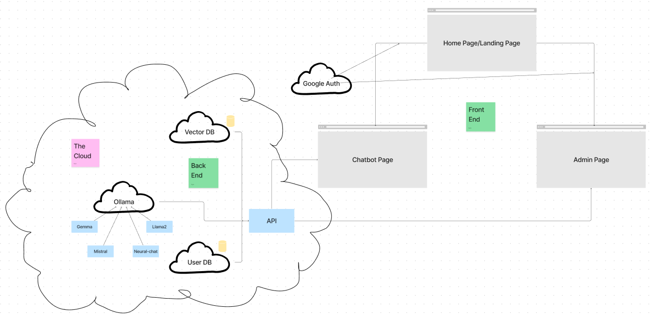
Architecture Model
Notes:
Saketh
Microservice architecture

Slide 6

Try It Out!
(This bar code has been deprecated past summer 2024, other bar codes on pages have been removed)

Slide 7
[Deprecated URL]
(Potentially deprecated past summer 2024)
Notes:
saketh

Slide 8
Frontend
Open Source
Shadcn Component Library
NextJS
Google OAuth
Notes:
saketh

Slide 9
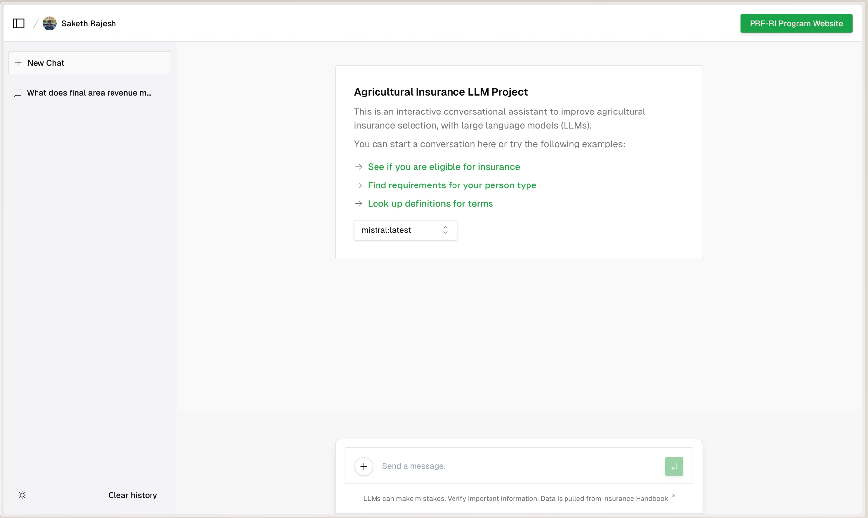
Notes:
saketh

Slide 10
Notes:
saketh

Slide 11
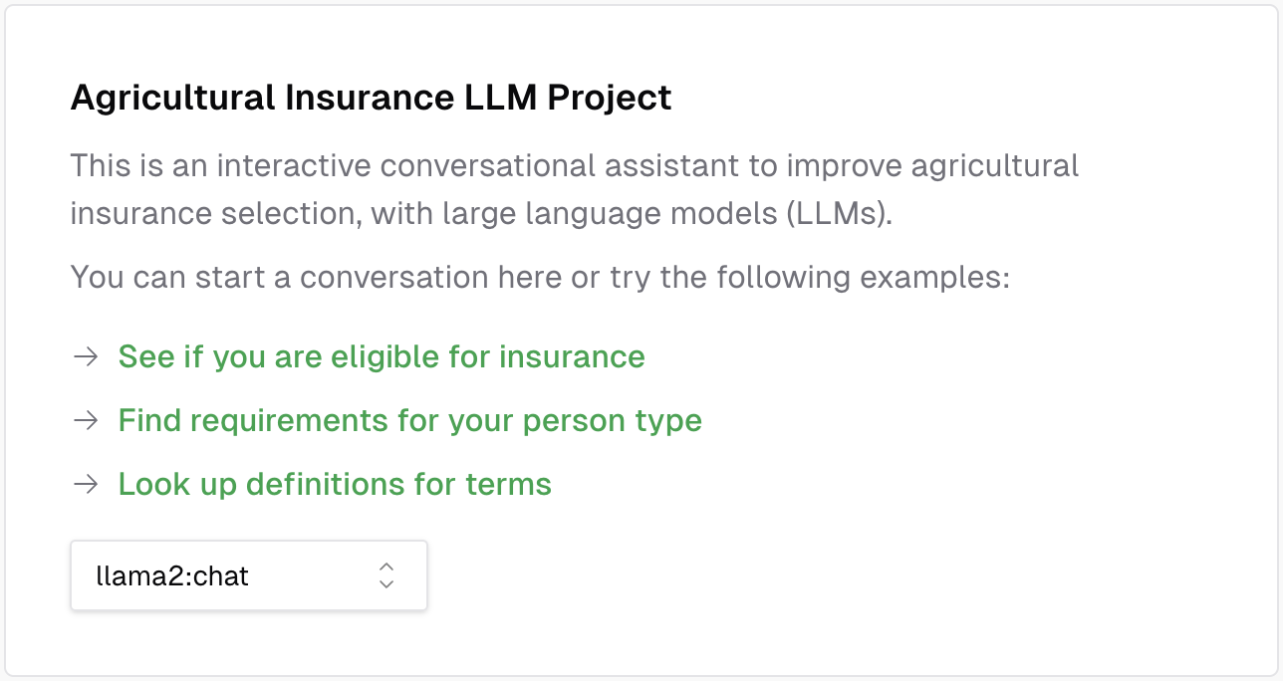
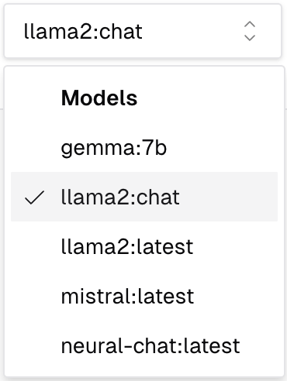
Notes:
saketh

Slide 12
Notes:
saketh

Slide 13
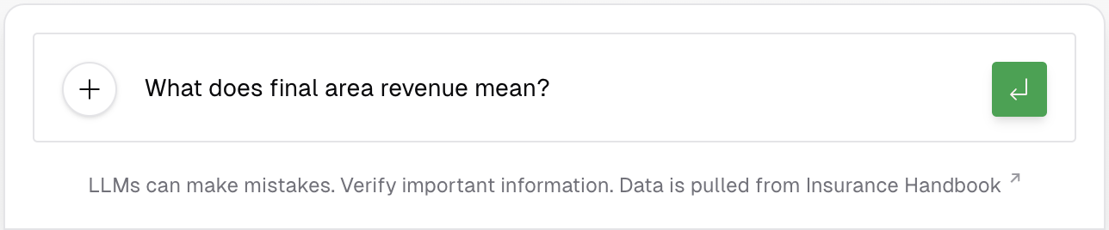
Notes:
saketh

Slide 14
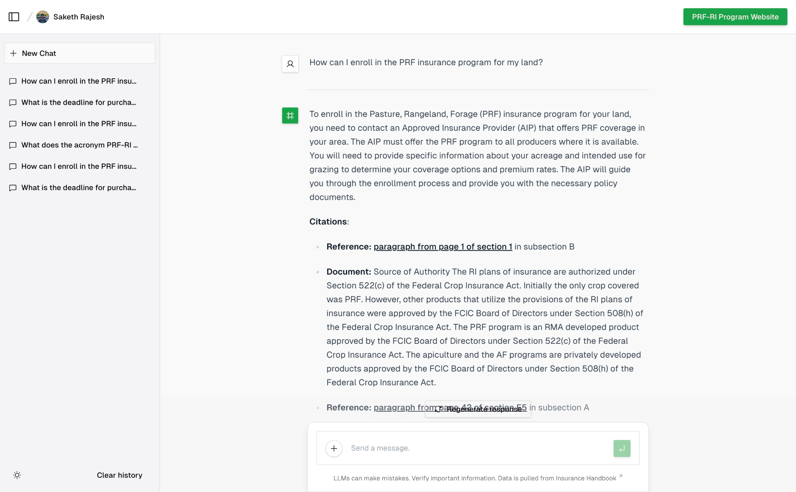

Slide 15
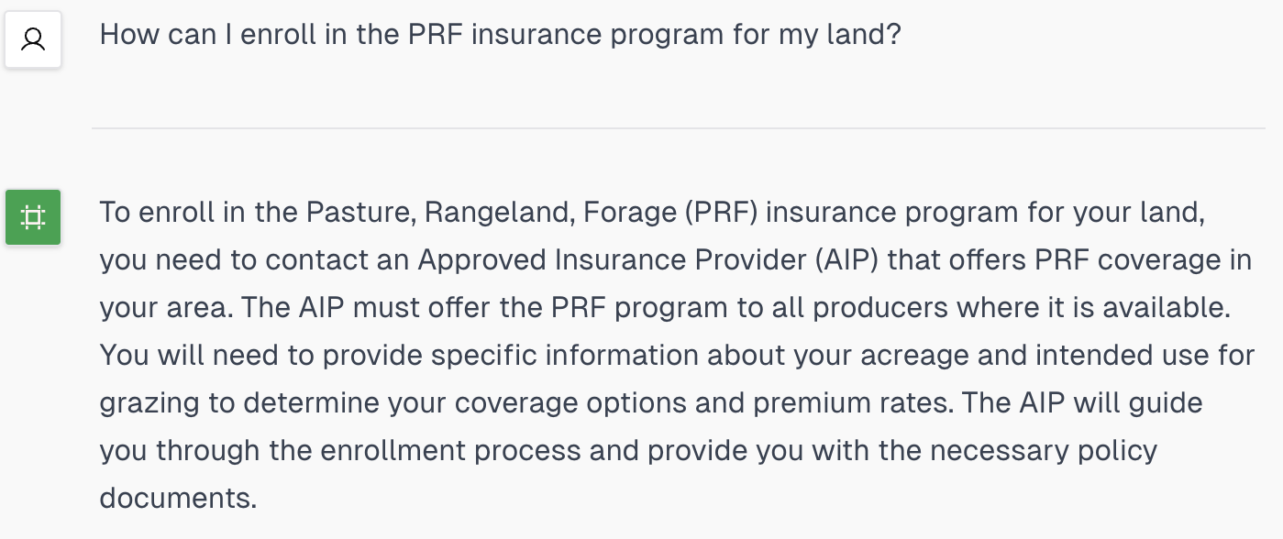
Notes:
saketh

Slide 17
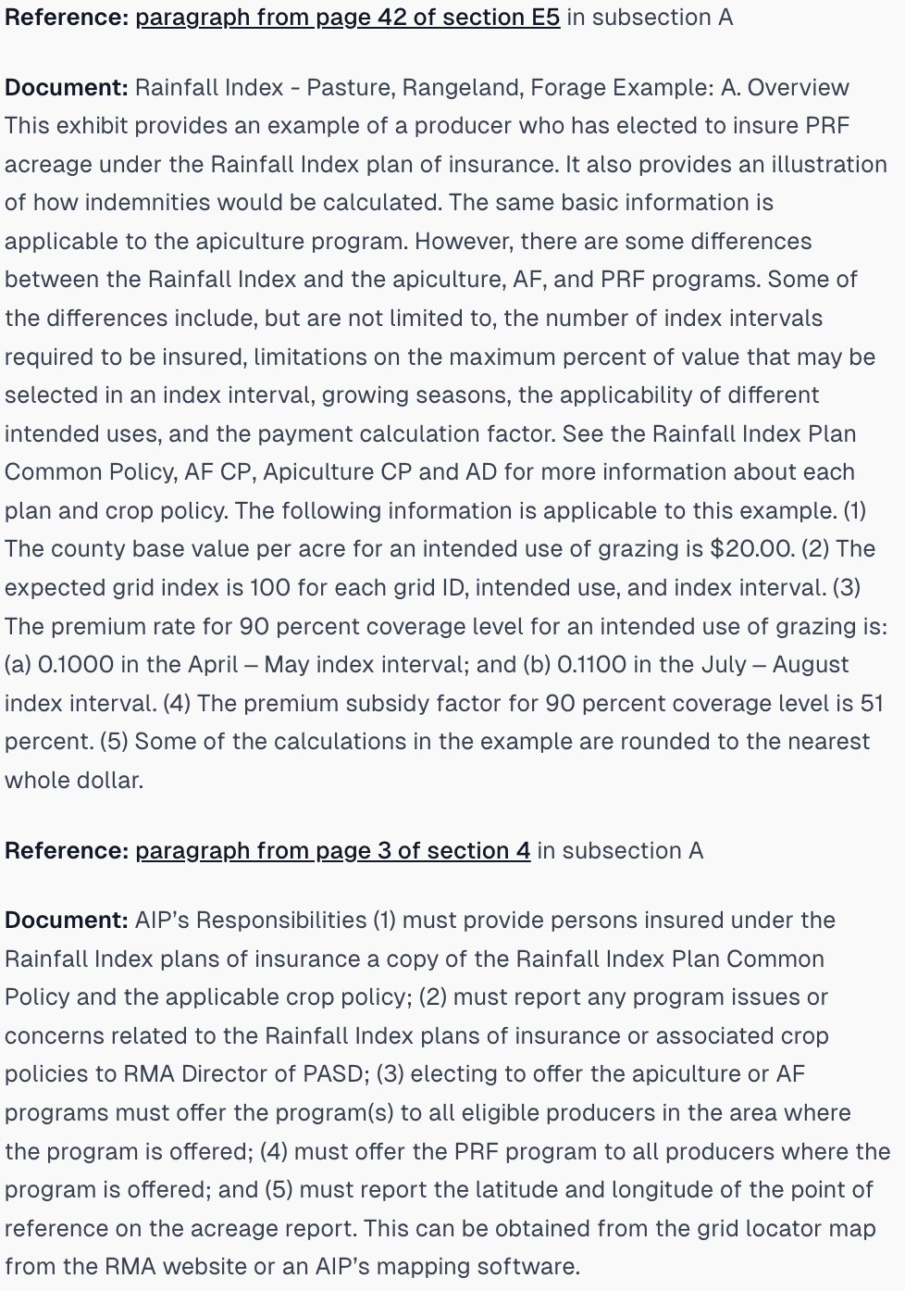

Slide 19
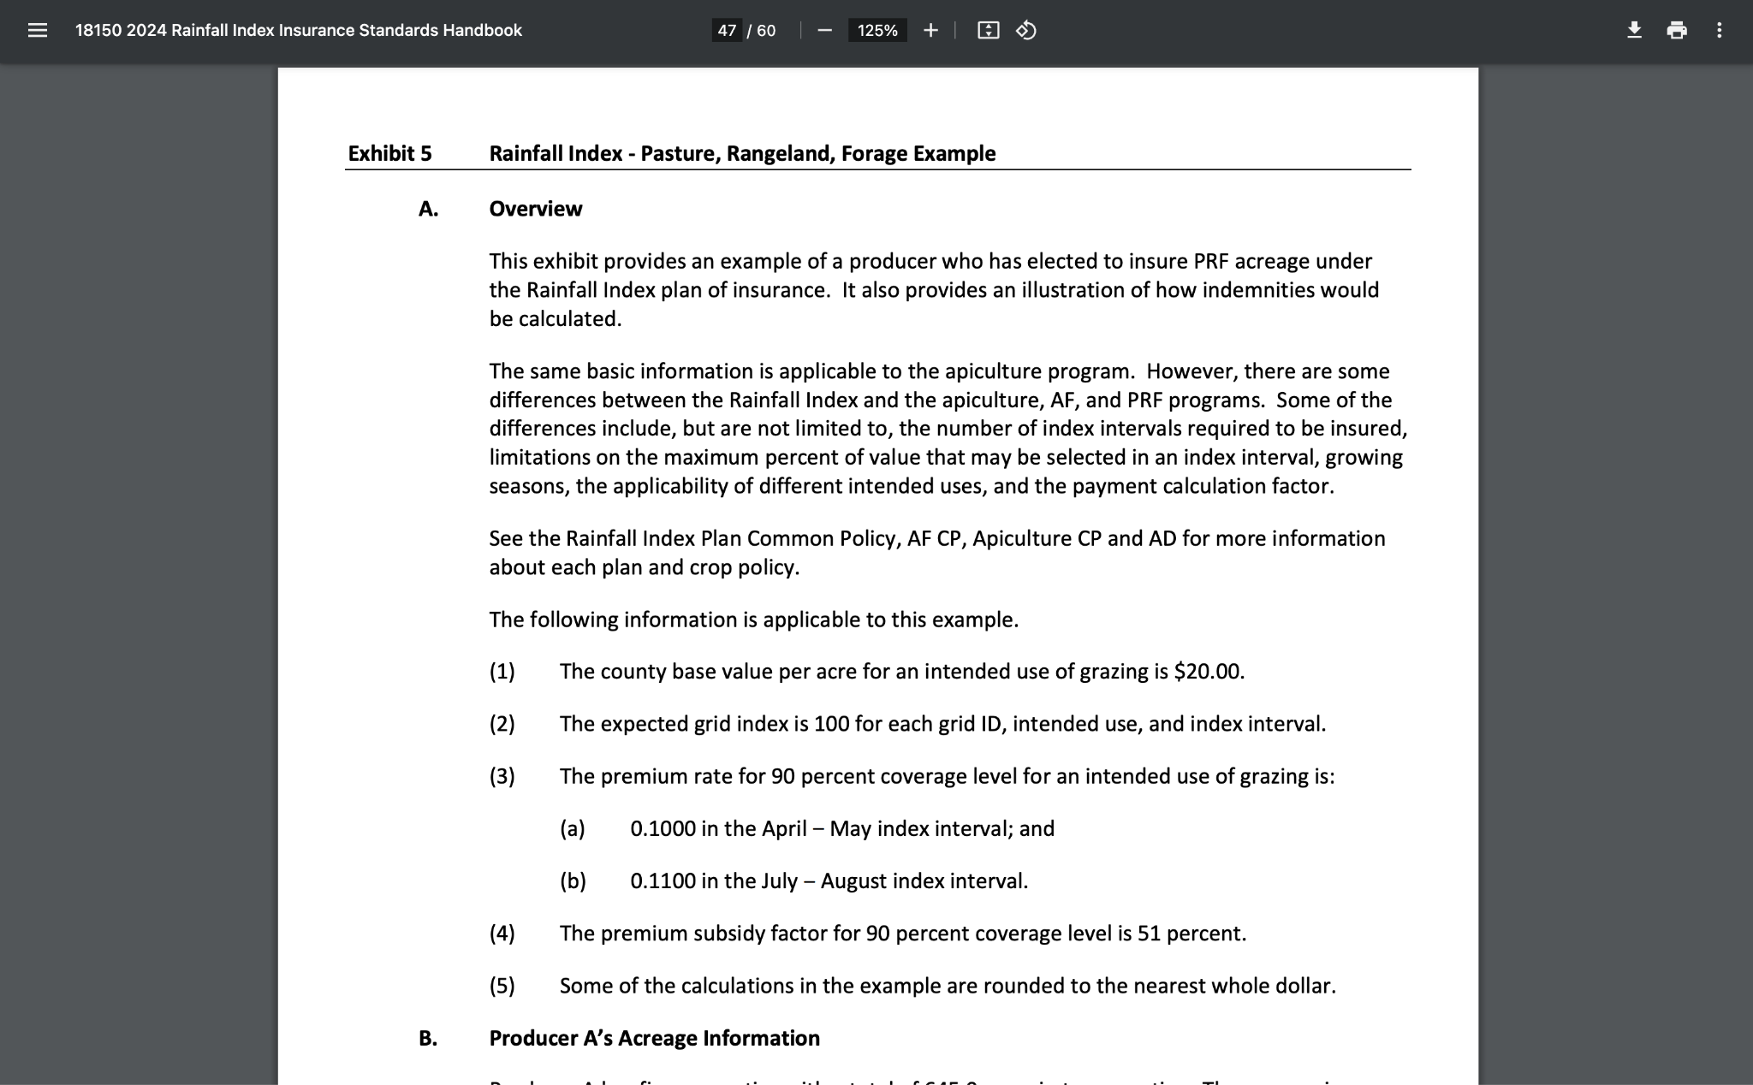

Slide 20
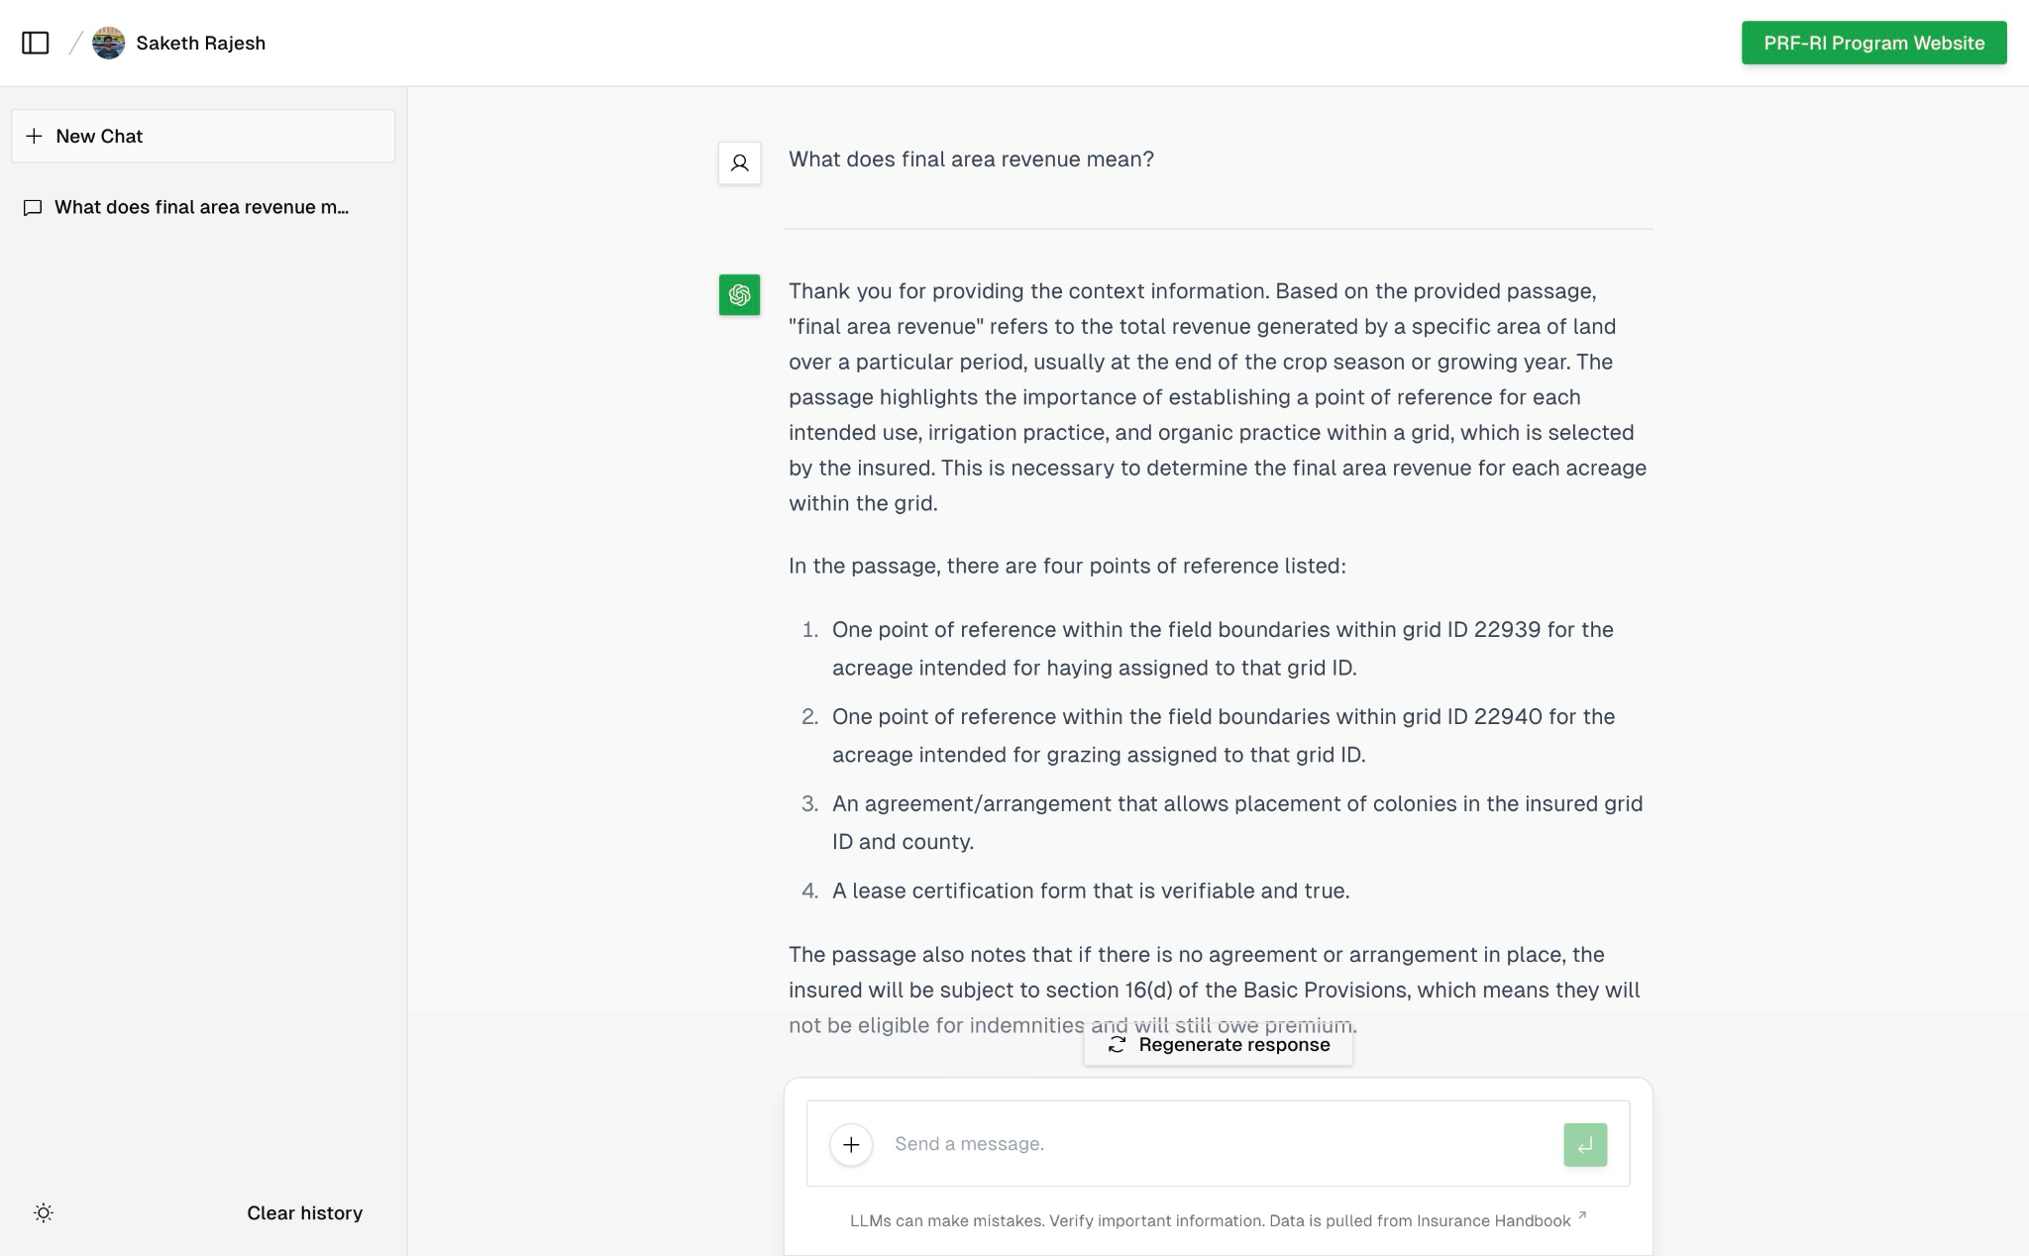
Notes:
saketh

Slide 21
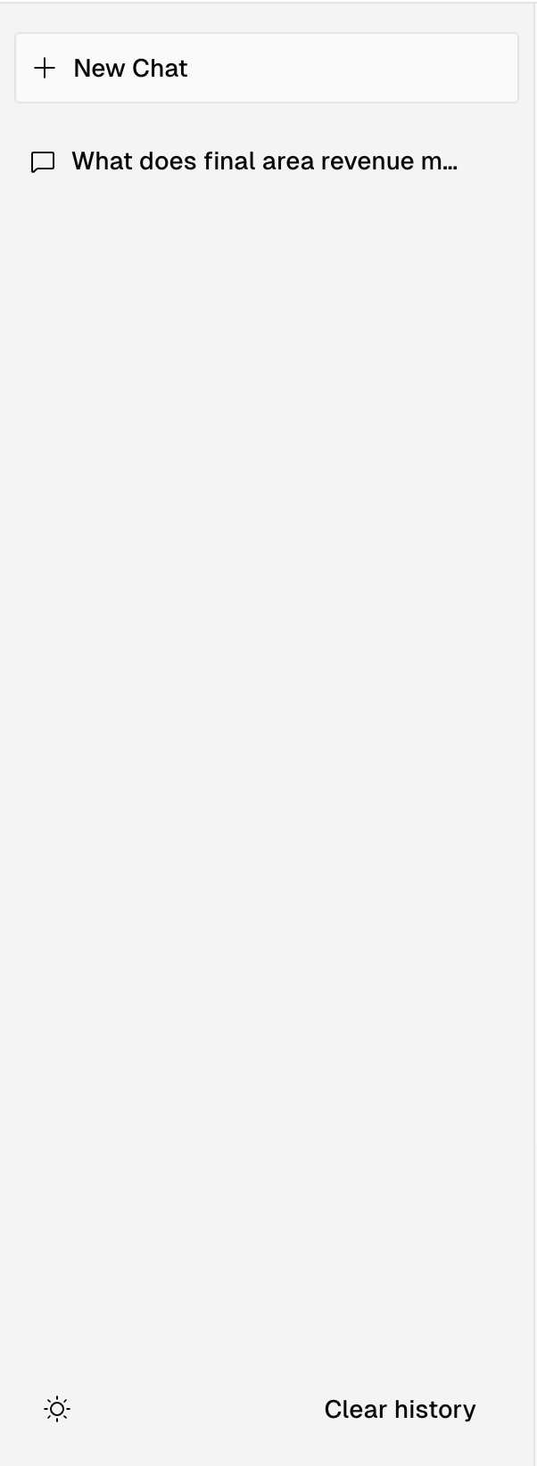
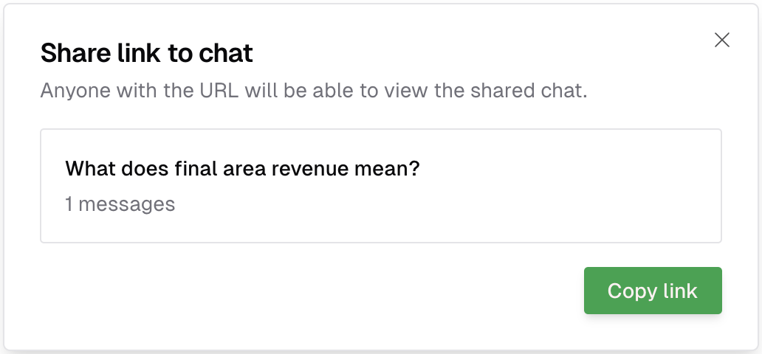
Notes:
saketh

Slide 22
Backend
Flask
Ollama
Redis
Docker
Kubernetes
Notes:
Michael

Slide 23
Key Implementation Details
Utilizing Retrieval-Augmented Generation (RAG)
Question → relevant info (VectorDB) → craft response (LLM)
Ollama to orchestrate LLMs
One package, run/manage several LLMs
Multi-pod configuration on Kubernetes
Frontend, API, Redis, Ollama (LLMs)

Slide 24
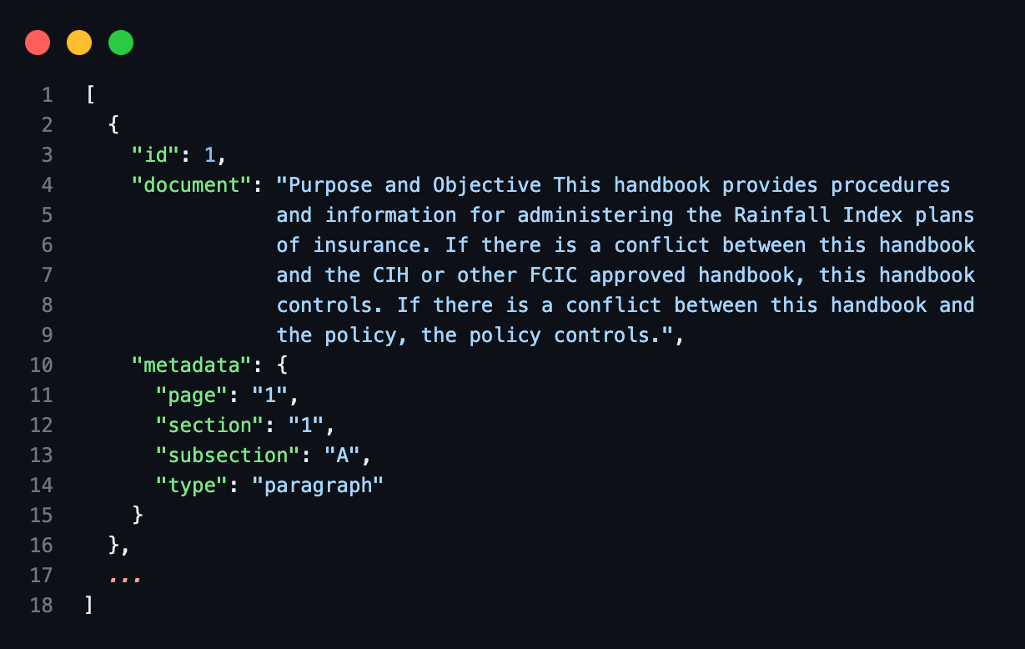
Hand Segmentation

Slide 25
Testing
Notes:
Michael

Slide 26
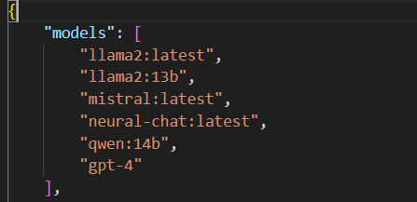
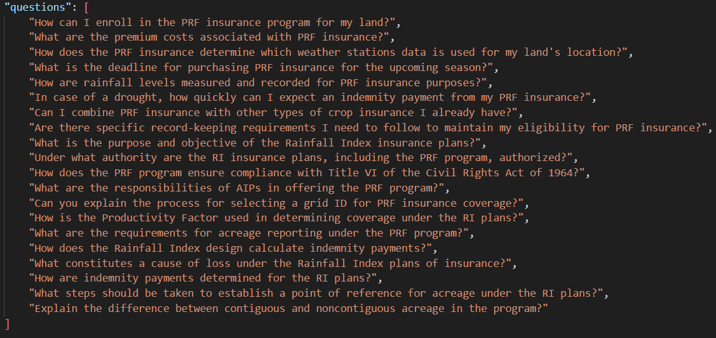
Our Approach

Slide 27
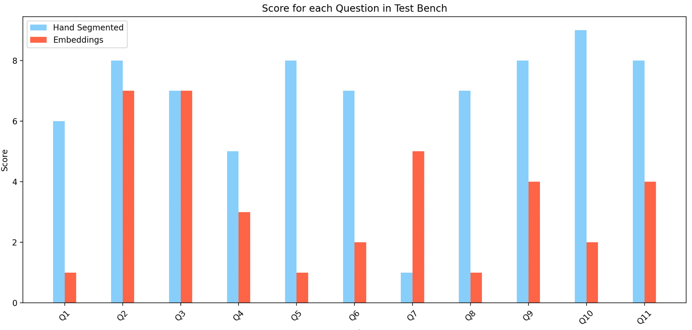
Results

Slide 28
Documentation
Can be found in our VTechworks submission

Slide 29
Challenges

Slide 30
Main Challenges
Assessing response quality of LLMs
Effective testing mechanism

Slide 31
Future Work

Slide 32
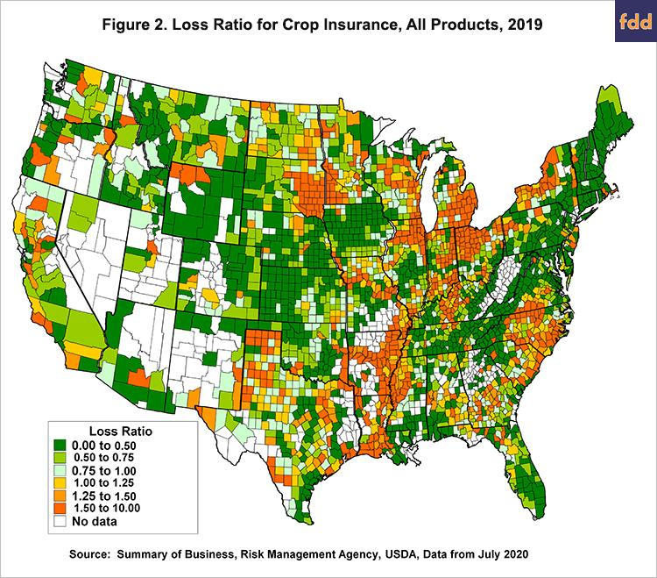
Visualizations
[34]
Serving Images
Generating Images
This Particular Image is From FDD (Foundation for Defense of Democracies)

Slide 33
Acknowledgements
We would like to acknowledge Dr. Edward Fox, Dr. Elinor Benami, Dr. Manoochehr Shirzaei, Ramaraja Ramanujan, and Mehmet Yardimci for the help they have given us with this project.

Slide 34
Citations
[1] Natural Resources Conservation Service, "Range & Pasture," nrcs.usda.gov, April 4, 2024. Available: https://www.nrcs.usda.gov/conservation-basics/natural-resource-concerns/land/range-pasture. Accessed April 14, 2024.
[2] USDA Risk Management Agency, "RAINFALL INDEX INSURANCE STANDARDS HANDBOOK 2024 and Succeeding Crop Years," 2024. Available: https://www.rma.usda.gov/-/media/RMA/Handbooks/Coverage-Plans—18000/Rainfall-and-Vegetation-Index---18150/2024-18150-1-Rainfall-Index-Handbook.ashx?la=en. Accessed February 10, 2024.
[3] GitHub, "vercel/ai-chatbot," April 14, 2024. Available: https://github.com/vercel/ai-chatbot. Accessed April 14, 2024.
[4] OpenAI, "OpenAI API," 2024. Available: https://openai.com/blog/openai-api. Accessed February 15, 2024.
[5] shadcn, "shadcn/ui," 2024. Available: https://ui.shadcn.com/. Accessed February 22, 2024.
[6] Tailwind CSS, "Tailwind CSS - Rapidly build modern websites without ever leaving your HTML," 2023. Available: https://tailwindcss.com/. Accessed March 3, 2024.
[7] Radix UI, "Primitives," 2024. Available: https://www.radix-ui.com/. Accessed February 20, 2024.
[8] Phosphor Icons, "Phosphor Icons," 2024. Available: https://phosphoricons.com/. Accessed February 25, 2024.
[9] Next.js, "Routing: API Routes," nextjs.org, 2024. Available: https://nextjs.org/docs/pages/building-your-application/routing/api-routes. Accessed March 12, 2024.
[10] Mozilla, "HTTP request methods," MDN Web Docs, 2019. Available: https://developer.mozilla.org/en-US/docs/Web/HTTP/Methods. Accessed March 23, 2024.
[11] JavaScript, "Free JavaScript training, resources and examples for the community," Javascript.com, 2016. Available: https://www.javascript.com/. Accessed March 10, 2024.
[12] Ollama development team, "Ollama," 2024. Available: https://ollama.com/. Accessed February 18, 2024.
[13] Flask development team, "API — Flask Documentation (3.1.x)," flask.palletsprojects.com, 2024. Available: https://flask.palletsprojects.com/en/latest/api/. Accessed April 14, 2024.
[14] Amazon Web Services, Inc., "What is RAG? - Retrieval-Augmented Generation Explained," aws.amazon.com, 2024. Available: https://aws.amazon.com/what-is/retrieval-augmented-generation/. Accessed March 15, 2024.
[15] Google Developers, "Using OAuth 2.0 to Access Google APIs," Google Identity Platform, November 12, 2018. Available: https://developers.google.com/identity/protocols/OAuth2. Accessed April 21, 2024.
[16] Redis, "Redis," redis.io, 2023. Available: https://redis.io/. Accessed March 22, 2024.
[17] MIT-HAN Lab, "mit-han-lab/streaming-llm," GitHub, April 15, 2024. Available: https://github.com/mit-han-lab/streaming-llm. Accessed April 15, 2024.
[18] Nextra, "Prompt Engineering Guide," promptingguide.ai, 2024. Available: https://www.promptingguide.ai/. Accessed February 15, 2024.
[19] Chris Richardson, "Microservices.io," microservices.io, 2017. Available: https://microservices.io/. Accessed April 16, 2024.
[20] evchaki, "Vector Database," Microsoft, May 23, 2023. Available: https://learn.microsoft.com/en-us/semantic-kernel/memories/vector-db. Accessed February 21, 2024.
[21] Agricultural Insurance LLM Project Team in CS4624, "Website for Agricultural Insurance LLM Project," Hosted by Virginia Tech Dept. of Computer Science at aginsurancellms
m.endeavour.cs.vt.edu, 2024. Available: https://aginsurancellm.endeavour.cs.vt.edu/sign-in?callbackUrl=https%3A%2F%2Faginsurancellm.endeavour.cs.vt.edu%2F. Accessed April 14, 2024.
[22] Json.org, "JSON," 2019. Available: https://www.json.org/. Accessed March 5, 2024.
[23] Vercel, "Vercel KV," 2024. Available: https://vercel.com/docs/storage/vercel-kv. Accessed April 15, 2024.
[24] Mehmet Oguz Yardimci, "LLMs for Ag. Validation Questions," 2024. Available: https://docs.google.com/document/d/1C9BSmslSrtJzNRFQwtygWR_Jga7KedOQ2Ri7z-ju1MM/edit. Accessed April 14, 2024.
[25] Saketh Rajesh, "LLM Response Table for Ag. Validation Questions" 2024. Available: https://docs.google.com/spreadsheets/d/1AT2IBsHP_71TJpTZt7uaxbdjFnKtvpRkcGWbT6-MPhI/edit#gid=1050921723. Accessed April 14, 2024.
[26] Atlassian, "What is Agile?," 2023. Available: https://www.atlassian.com/agile#:~:text=The%20Agile%20methodology%20is%20a. Accessed March 20, 2024.
[27] Mike Rehkopf, "Scrum Sprints," Atlassian, 2019. Available: https://www.atlassian.com/agile/scrum/sprints. Accessed April 22, 2024.
[28] Docker, "Enterprise Application Container Platform," docker.com, 2024. Available: https://www.docker.com/. Accessed February 23, 2024.
[29] GitLab, "Sign in · GitLab," git.cs.vt.edu, 2024. Available: https://git.cs.vt.edu/users/sign_in. Accessed April 14, 2024.
[30] Kubernetes, "Cluster Architecture," kubernetes.io, 2024. Available: https://kubernetes.io/docs/concepts/architecture/. Accessed March 29, 2024.
[31] GitHub, "About projects (classic)," GitHub Docs, 2024. Available: https://docs.github.com/articles/about-project-boards. Accessed April 14, 2024.
[32] Discord, "Discord — A New Way to Chat with Friends & Communities," 2024. Available: https://discord.com/. Accessed April 19, 2024.
[33] Microsoft, "TypeScript - JavaScript that scales.," Typescriptlang.org, 2015. Available: https://www.typescriptlang.org/. Accessed March 25, 2024

Slide 35
Thanks!
Do you have any questions?

