Slide 1
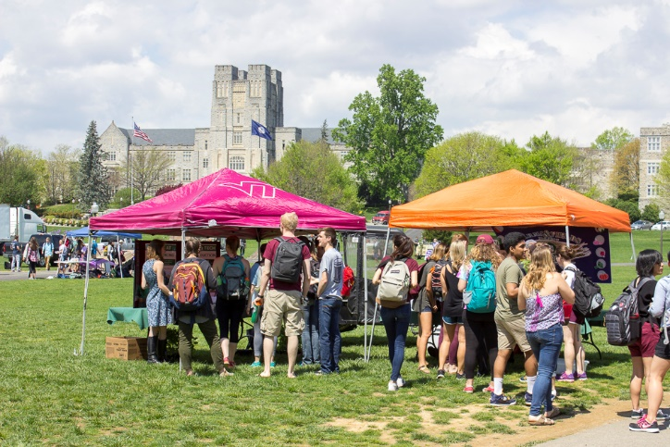
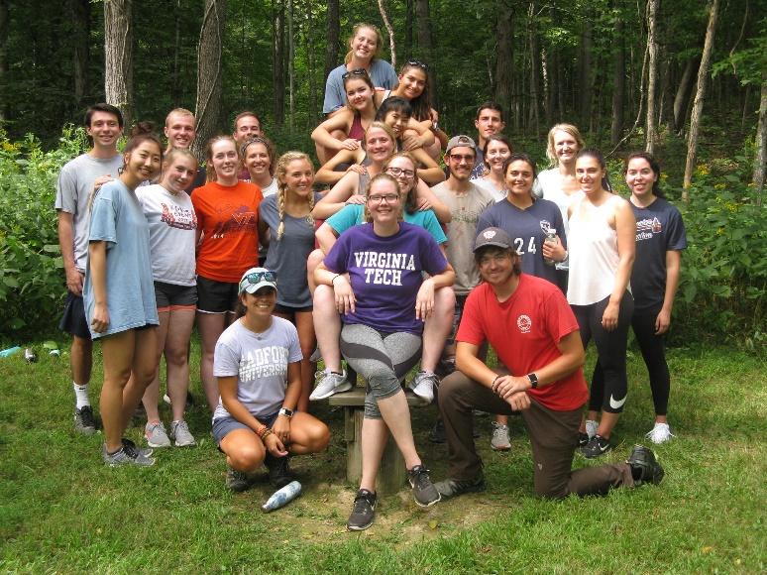
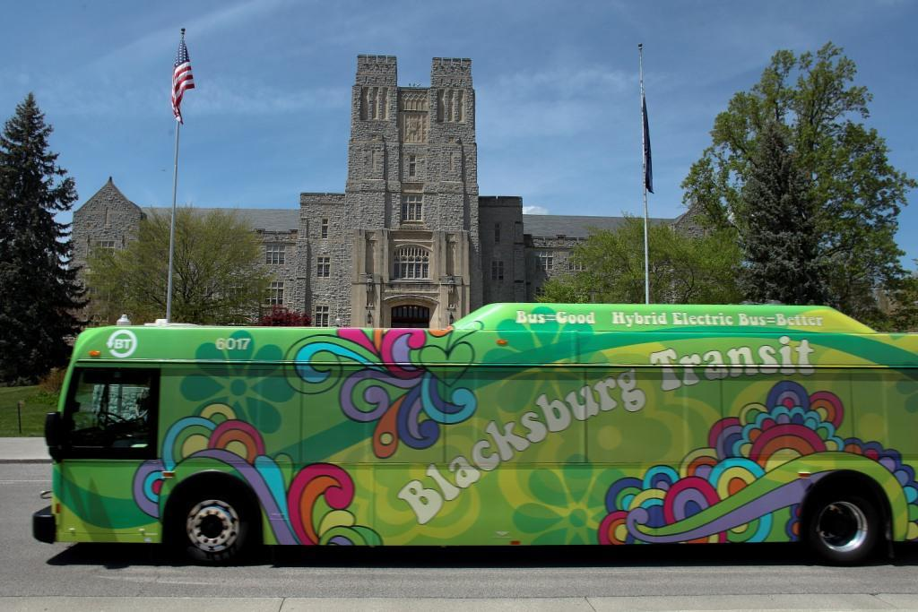
SUSTAINABILITY WEEK 2019
“VT SUSTAINABILITY OPEN FORUM”
Haymarket Theatre
September 16, 2019

Slide 2
VT SUSTAINABILITY OPEN FORUM
Denny Cochrane: Director of the Office of
Sustainability, Facilities Department
Blake Bensman: Sustainability Manager, Division of Student Affairs: Housing & Residence Life and Dining Services
Nick Quint: Transportation Network Manager,
Parking & Transportation

Slide 3
AGENDA
VIRGINIA TECH CLIMATE ACTION COMMITMENT
FACILITIES: Energy, Buildings, Waste Management
STUDENT ENGAGEMENT: Programs, Internships
SUSTAINABLE LIVING: Housing & Residence life Initiatives
DINING SERVICES: Reusable To-Go Program, Local Food, Waste
TRANSPORTATION: Commuter Alternatives Program, Bike/Car/Scooter Share, Bike Hub, Multi Modal Transit Facility
SHARE YOUR IDEAS!

Slide 4
HISTORICAL PERSPECTIVE
AY 2006-07 – Students Seek to Make Sustainability a VT Priority
April 2007 – Energy and Sustainability Committee (E&SC) established
April 2008 – E&SC charged to develop the Virginia Tech Climate Action Commitment (VTCAC) and Sustainability Plan
April 2009 - University Council recommends approval of the VTCAC and accepts the accompanying the Sustainability Plan
June 2009 - VT Board of Visitors unanimously approved the VTCAC
May 2013 - VTCAC revised (Presidential Policy Memo No. 262 Rev 1)

Slide 5
VT CLIMATE ACTION COMMITMENT
Contains Sustainability Aspirations, Goals, and Objectives (14 Points)
“Virginia Tech will Become a Campus Sustainability Leader” (Point #1)
“Maintain a Sustainability Office” (Point #5) to:
  Oversee Implementation of VTCAC & Sustainability Plan
  Track and Report Sustainability Progress
  Coordinate Campus Sustainability Programs
  Manage a Campus-Wide Student Internship Program
  Coordinate communication for campus sustainability initiatives

Slide 6
VT CLIMATE ACTION COMMITMENT
Virginia Tech defines sustainability as the following:
“the simultaneous pursuit of environmental quality, economic prosperity, and social justice and equity, through action, education, and engagement to address current needs without compromising the capacity and needs of future generations.”

Slide 7
ENERGY AND BUILDINGS
US Green Building Council’s LEED Program
(Leadership in Energy and Environmental Design)
  Reduce energy and water consumption
  Increase Energy Efficiency
Virginia Tech will Pursue LEED Silver Certification or Better for all eligible/applicable new buildings and major renovations
Virginia Tech has Registered 32 LEED projects since 2008 at 2.5 million GSF (represents about 20% for our building space)
Five Year Energy Action Plan for existing buildings
  Energy Audit identified 50 “Energy Hogs”
  Energy efficient upgrades - $6million annual savings

Slide 8
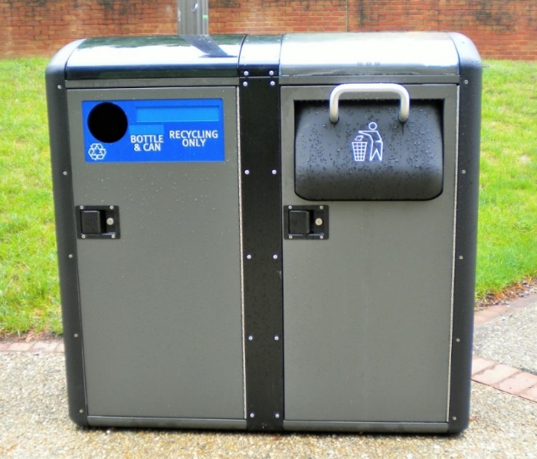
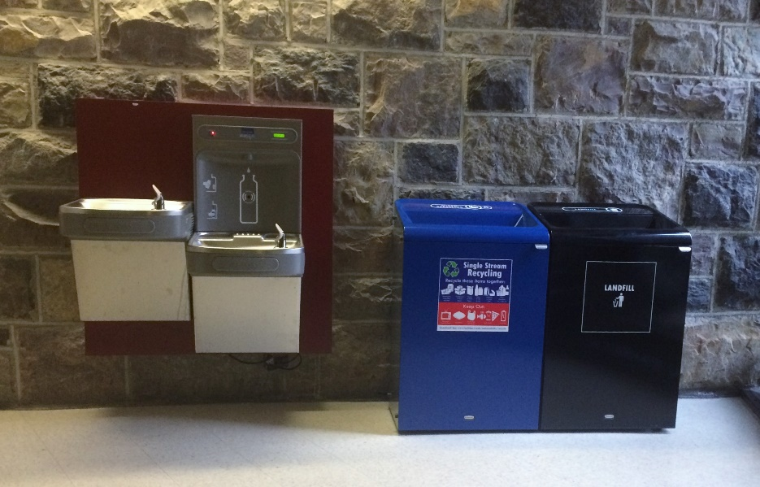
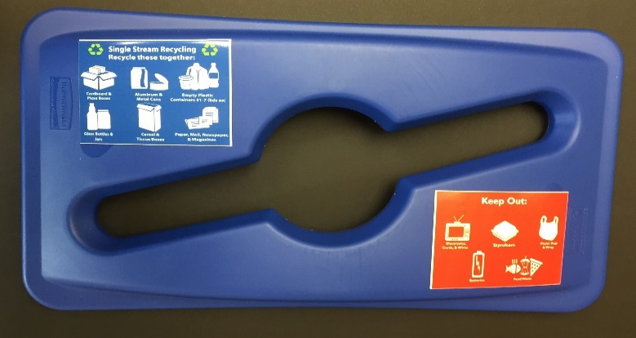
WASTE MANAGEMENT
VT, Blacksburg, Christiansburg, & Montgomery County are primary members of the Montgomery Regional Solid Waste Authority (MRSWA)
“Single Stream” Recycling System with Standard Signage
Waste material goes to MRSWA – Recycling then goes to RDS in Roanoke
Goal is to Minimize Waste and achieve a 50% Recycle Rate (Point #8)
Use variety of Indoor and Outdoor Recycling Containers

Slide 9
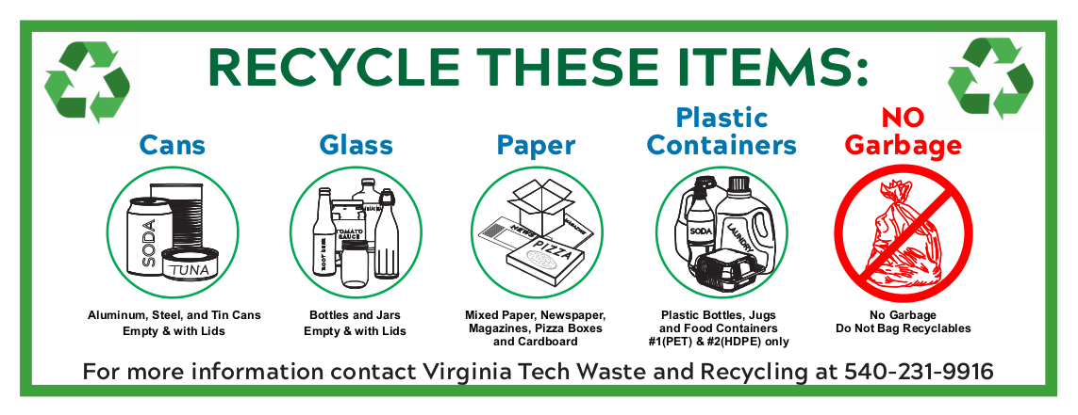
SINGLE STREAM RECYCLING

Slide 10
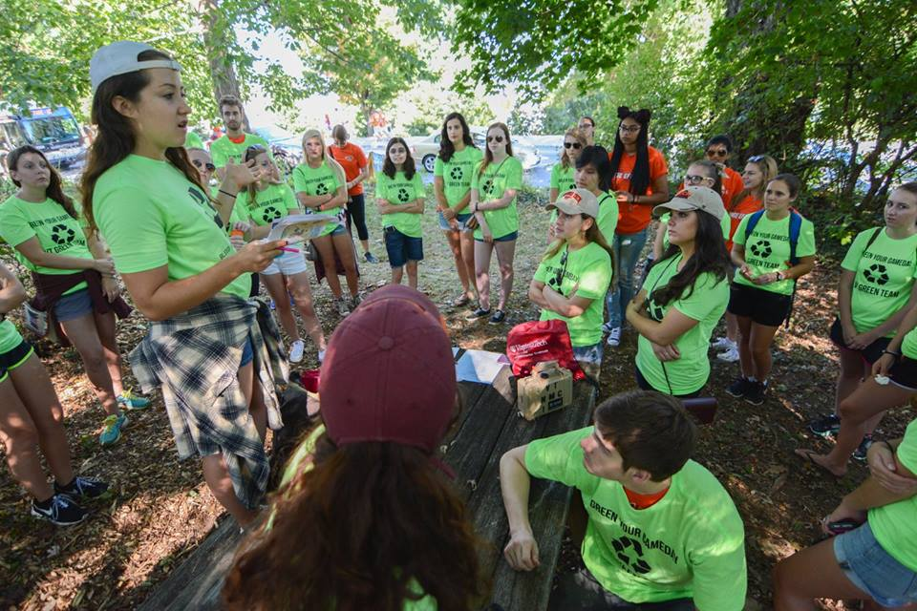
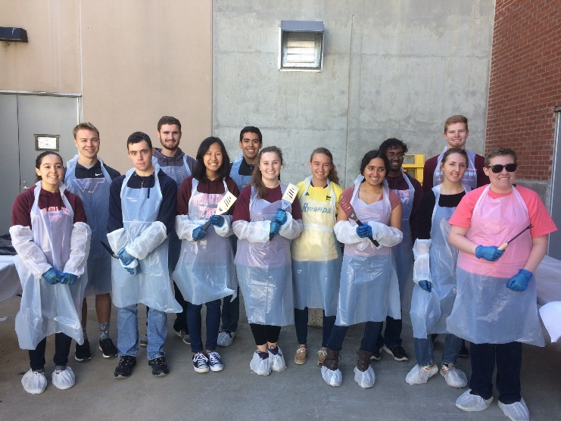
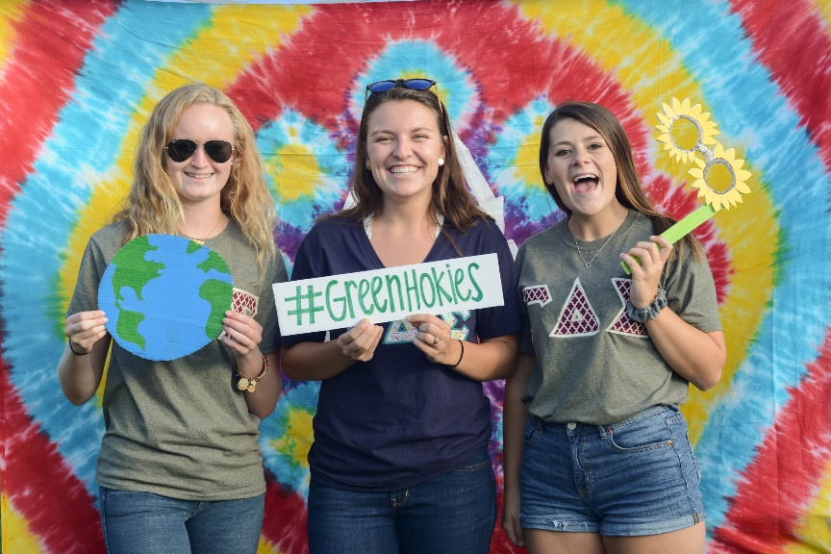
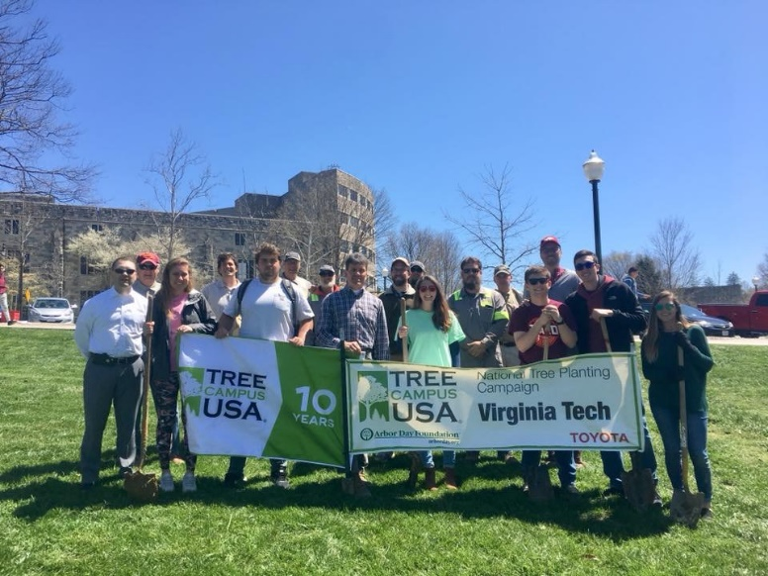
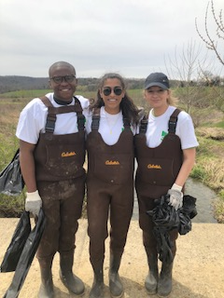
STUDENT ENGAGEMENT: PROGRAMS
Internship Program
Sustainability Week
Earth Week
Sustainability Forums
Green RFP
Green Grads
Gobblerfest

Slide 11
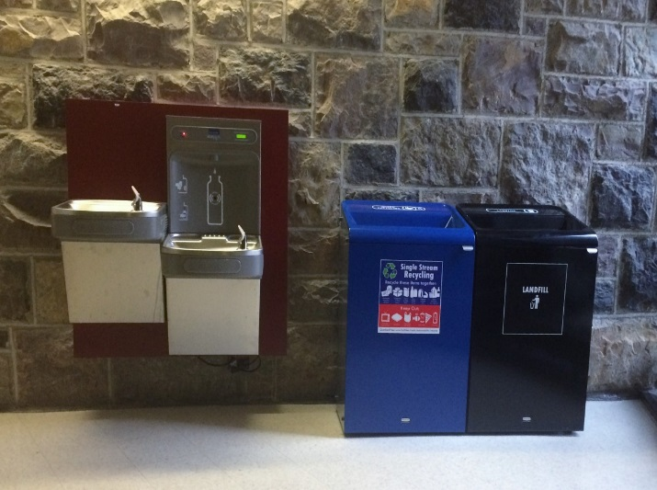
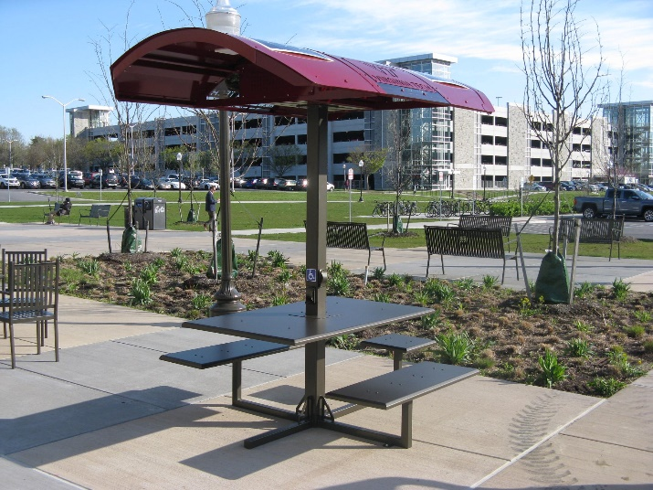
STUDENT ENGAGEMENT: GREEN RFP
  Began Academic Year 2010-2011
  Proposals must support VTCAC
  83 proposals approved($1.2 Million)
  LED lighting, Water Bottle Refill Stations, Solar Tables, Bike Racks, Single Stream Recycle Containers
  2018-2019 includes Math Emporium LEDs, Residence Hall LEDs & Hot Water Upgrades

Slide 12
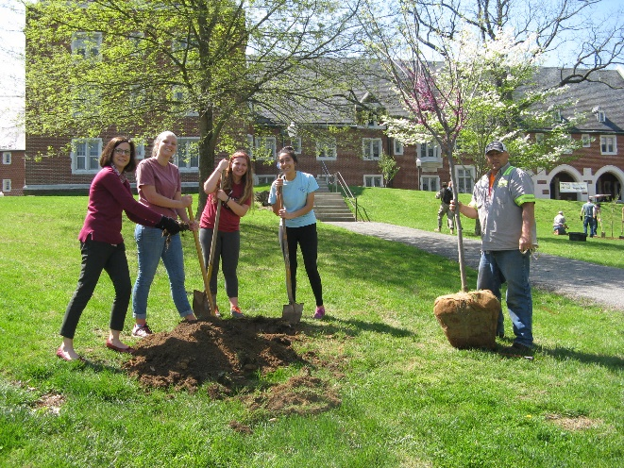
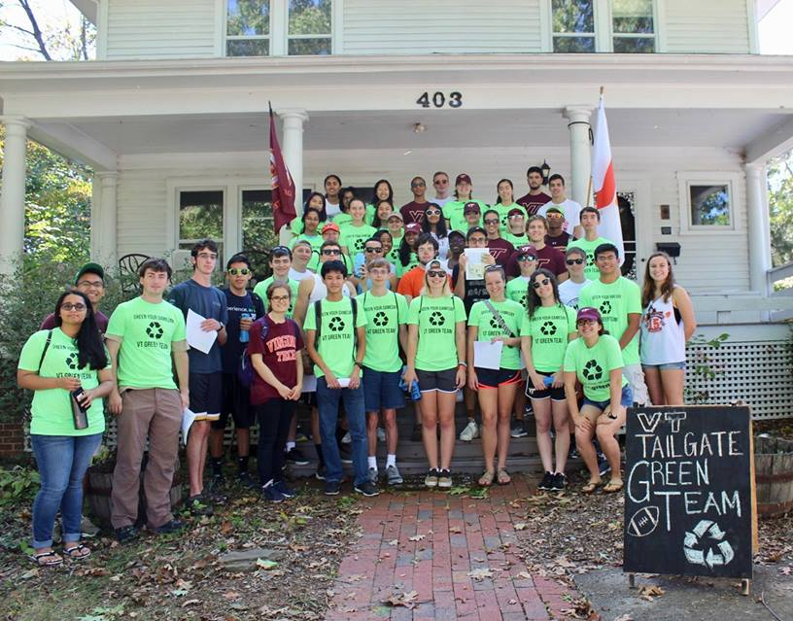
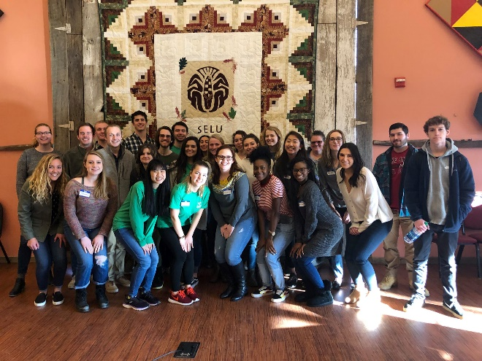
STUDENT INTERNSHIP PROGRAM
Sustainable Behavior Change through
Education, Outreach, Events, and Activities
  Full Academic Year, 10-Hour Commitment Per Week
  20 students serving on 4 Teams: Energy, Water, Food and Waste
  2018-19 Student Intern Program - Governor’s Environmental Excellence Award
Spring Game Green Tailgate
VT-RU Sustainability Seminar
Pop-Up Farmers Market on Drillfield
Tree Planting at Hillcrest Hall

Slide 13
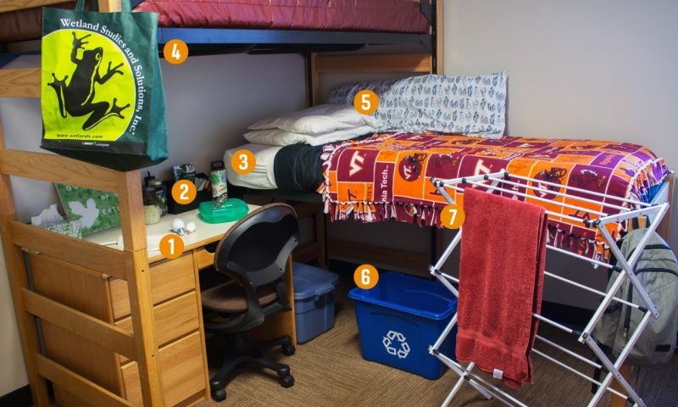

HOUSING & RESIDENCE LIFE
Turn off lights when you leave the room
Use power strips
Place computer in sleep mode when not in use
Wash your clothes with cold water and air dry your clothes when possible, if you do not have a full load of laundry, think about combining with your roommate
Use LED bulbs
Take shorter showers
Report water leaks to maintenance staff
Use reusable utensils, plates, and cups
Notes:
Mention the reusable to go program, the reusable spork that you can get from dining and the reusable water bottle/thermos.

Slide 14
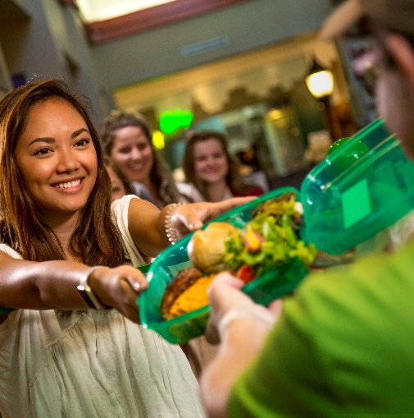
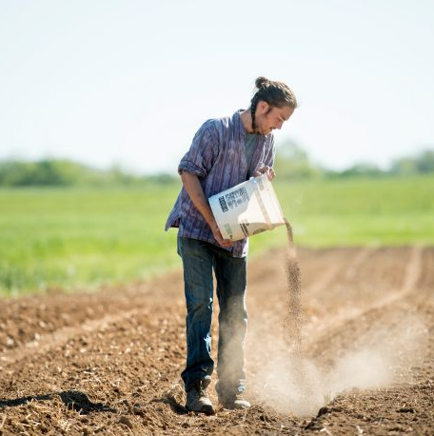
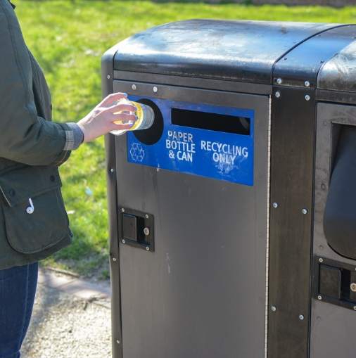



DINING SERVICES
REUSABLE TO-GO PROGRAM
LOCAL & CAMPUS
FOOD SOURCING
WASTE MINIMIZATION
Notes:
Mention the reusable to go program, the reusable spork that you can get from dining and the reusable water bottle/thermos.

Slide 15
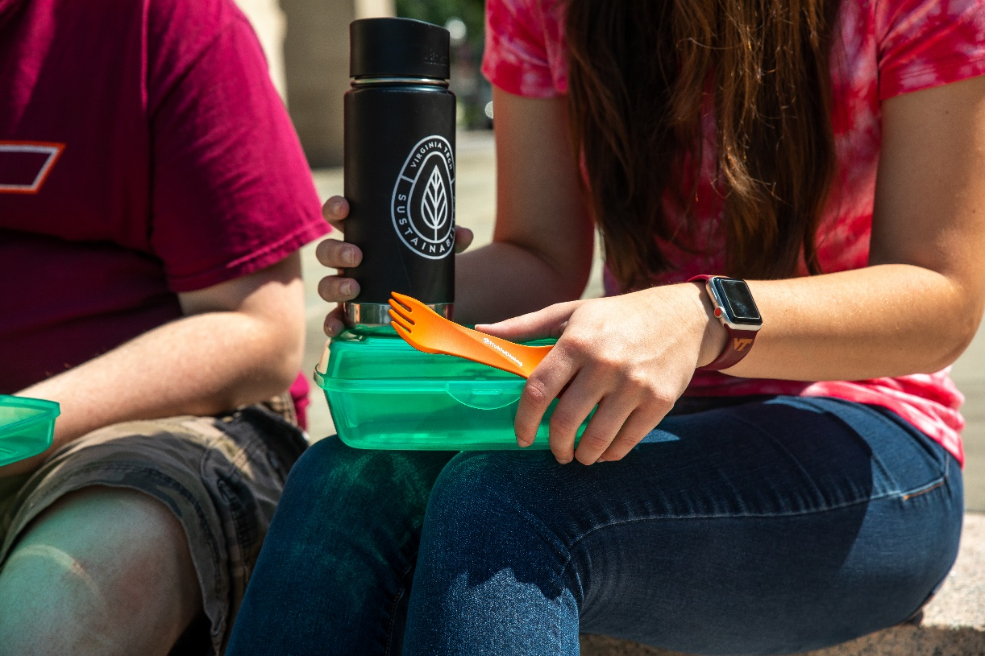
DINING SERVICES
Dining Services Sustainability Focus Areas
Our free reusable to-go program reduces waste to landfill and allows you a sustainable way to eat on the go!
Homefield Farm & campus sourced produce for dining halls
“Farms” restaurant - Owens Food Court
Virginia Tech produced milk, campus sourced from the Dairy Science Complex
Dining Services is 100% Styrofoam free
Dining hall waste minimization
Notes:
Mention the reusable to go program, the reusable spork that you can get from dining and the reusable water bottle/thermos.

Slide 16

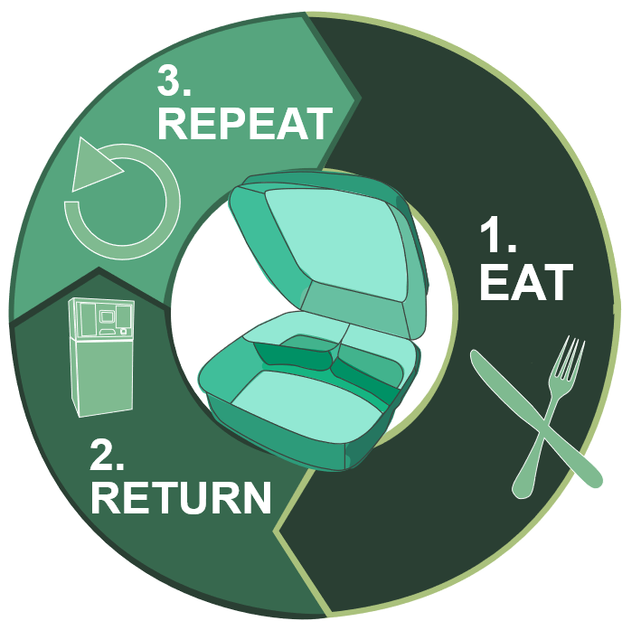
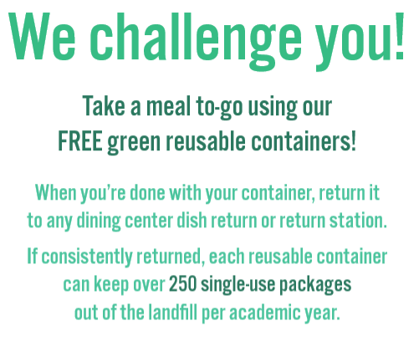
DINING SERVICES
Notes:
Mention the reusable to go program, the reusable spork that you can get from dining and the reusable water bottle/thermos.

Slide 17
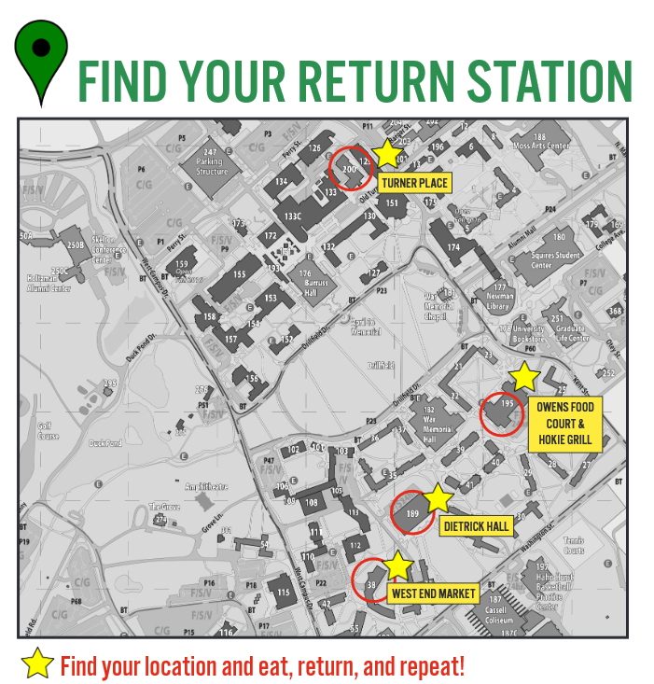
DINING SERVICES
We challenge you to “Choose to Reuse”.
Join us for our “Choose to Reuse” pop-up stations located throughout the academic year at Turner Place, West End Market, Hokie Grill, & Owen’s Food Court.
What’s going on at the “Choose to Reuse” stands?
Interactive “Choose to Reuse” trivia.
A campus-wide pledge to choose to reuse.
A chance to win VT Sustainability
Klean Kanteen reusable bottles.
Notes:
Mention the reusable to go program, the reusable spork that you can get from dining and the reusable water bottle/thermos.

Slide 18
ALTERNATIVE TRANSPORTATION DEPARTMENT OVERVIEW
Alternative Transportation Programs Coordinator
1500 Hour
Positions
Alternative Transportation Interns
Transportation Network Manager
Programs aimed at reducing single occupancy vehicle usage on campus.
Funded through student transportation fee.
Host two major events each year. Participate in over 10 other events.

Slide 19
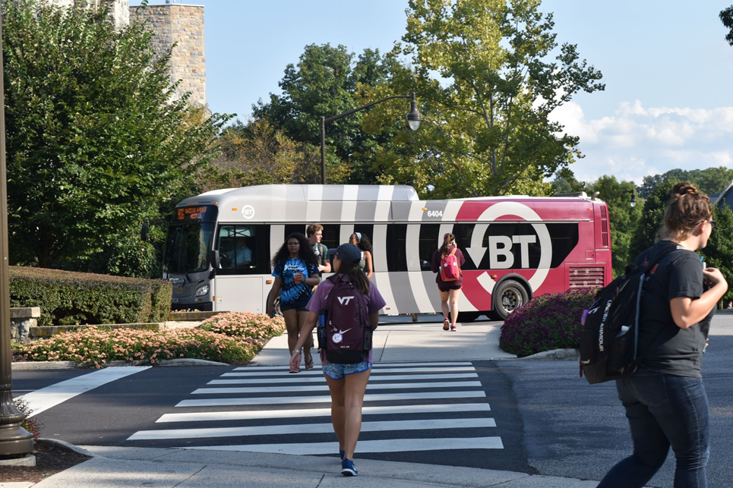
COMMUTER ALTERNATIVES PROGRAM
Bike, Bus, and Walk
  $40 for 16 discounted daily parking permits per semester.
Student and Employee Carpool Programs
  Designated preferred spaces across campus.
Employee Vanpool Program
  Reserved parking space near driver’s work location.

Slide 20
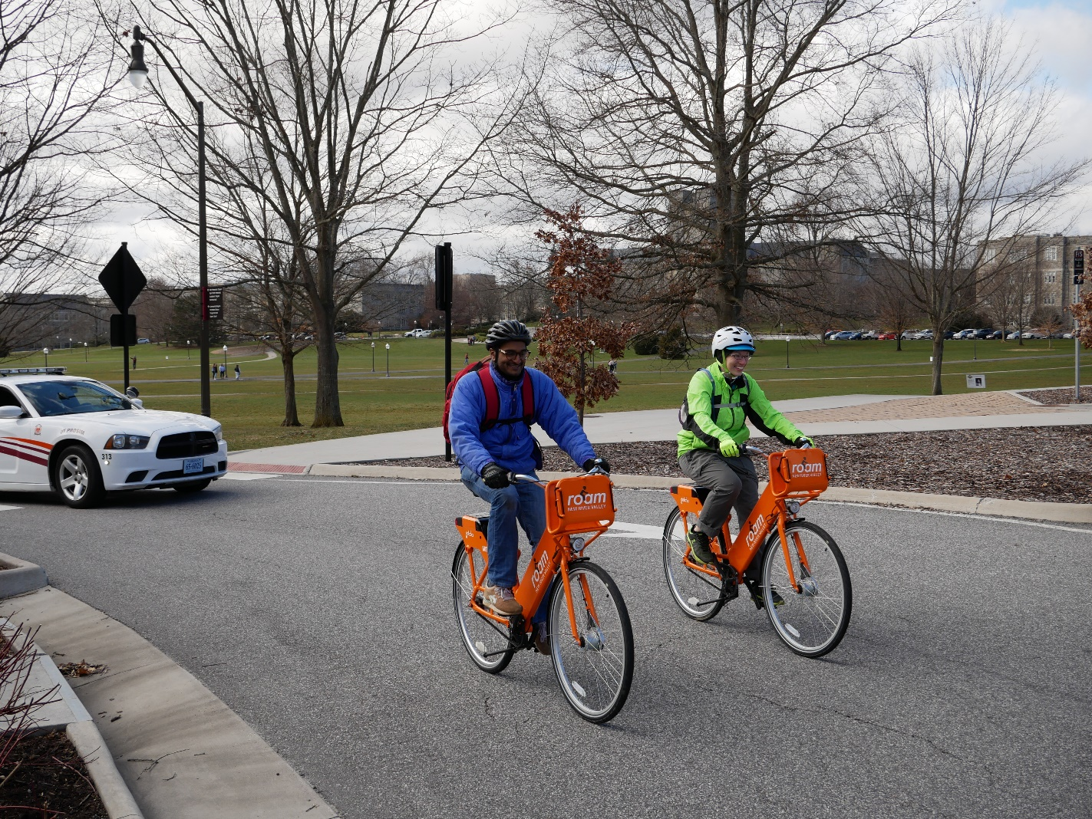
BIKE/CAR/SCOOTER SHARE
Roam NRV Bike Share
  8 stations on campus.
  75 bikes in fleet.
Zipcar
  Hourly or daily rental of nationwide fleet.
  24/7 access to vehicles.
Spin E-Scooters
  VTTI research initiative through June 2020.
  300 scooters on campus.

Slide 21
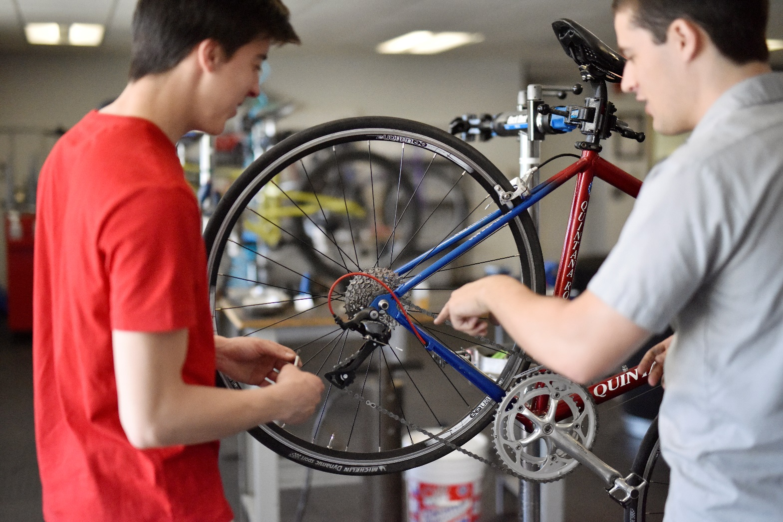
HOKIE BIKE HUB
Free self-service bike repair and maintenance.
Access to specialty tools and informational materials, along with commuting and safety advice.
One-on-one help and attention for a hands-on learning experience.
A social space for Virginia Tech bicyclists.

Slide 22
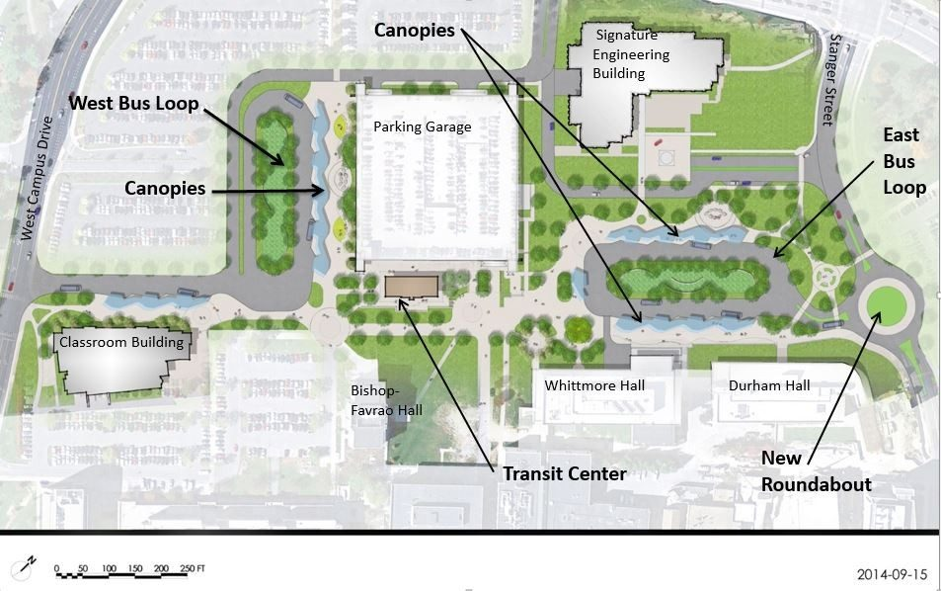
MULTI MODAL TRANSIT FACILITY

Slide 23
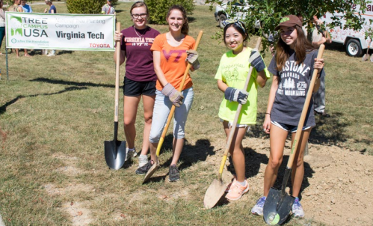
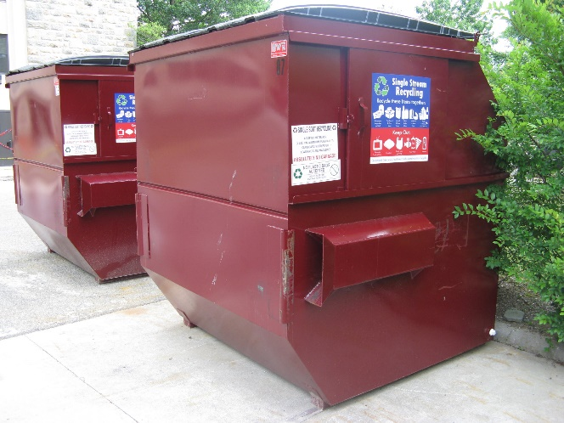
Virginia Tech is Committed to be a “Campus Sustainability Leader"
Students have and can make a difference!
Get involved in Sustainability Programs
Student Internship Opportunities
Dining Services provides many sustainable food options
CY2018: Waste Management Trends Upward
  40% recycling rate
  70% waste diversion rate (out of landfill)
  679 tons of composted food waste

Slide 24
CONTACT INFORMATION
Denny Cochrane, Director of Sustainability, denniscc@vt.edu 540-231-5184
  www.facilities.vt.edu/sustainability
Blake Bensman, Sustainability Manager, DSA, bensman@vt.edu, 540-231-3064
  www.dining.vt.edu/sustainability
Nick Quint, Transportation Network Manager, nquint@vt.edu, 540-231-2701
  www.parking.vt.edu/alternative

Slide 25
SUSTAINABILITY OPEN FORUM
WHAT ARE YOUR IDEAS?

