Slide 1
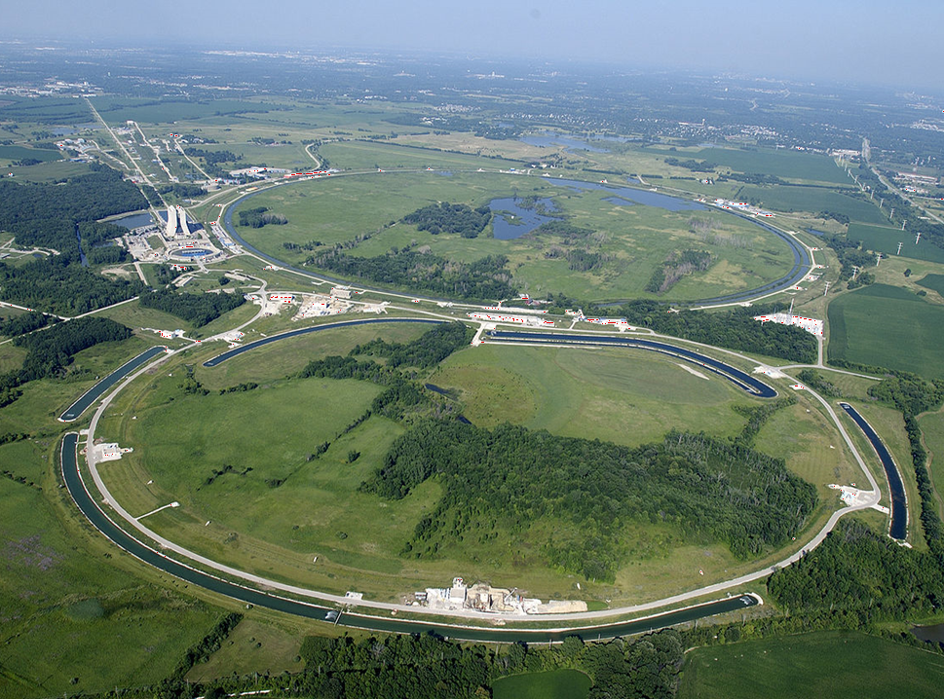
Neutrinos: What are They Good For?
(A whole lot it turns out… sorry to spoil the ending.)
Prof. Jonathan Link
Center for Neutrino Physics, Virginia Tech
Ask-A-Scientist
Fermilab
July 10, 2016

Slide 2

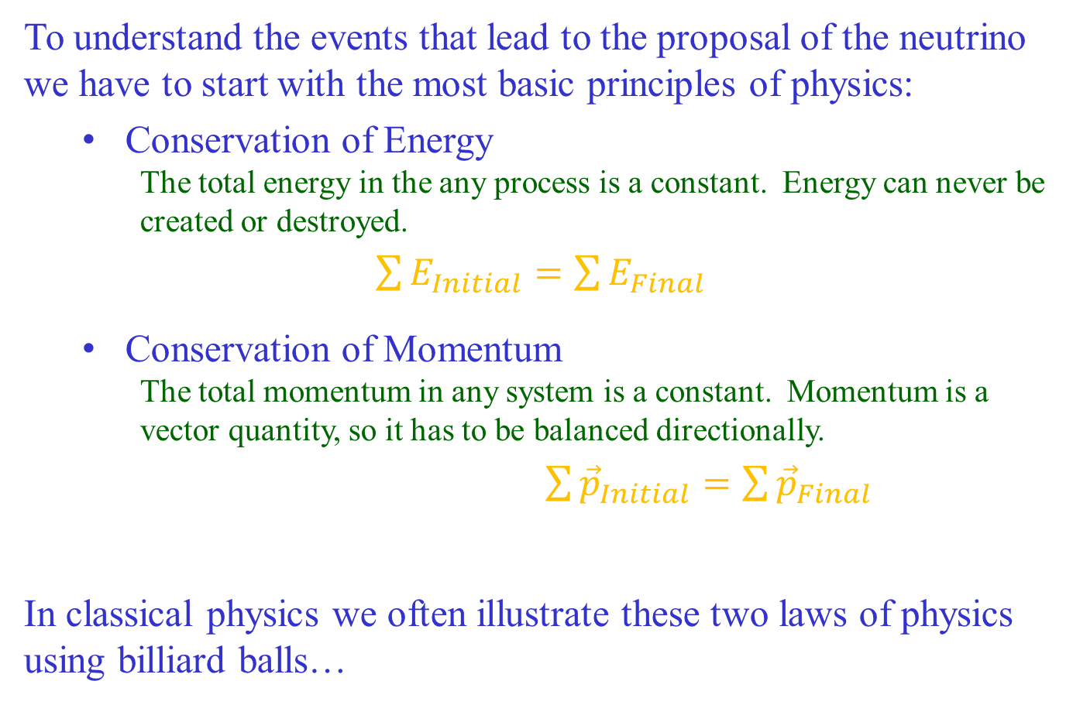

The Neutrino Proposal
To understand the events that lead to the proposal of the neutrino we have to start with the most basic principles of physics:
  Conservation of Energy
    The total energy in the any process is a constant. Energy can never be created or destroyed.
$\sum{E_{Initial}}=\sum{E_{Final}}$
  Conservation of Momentum
    The total momentum in any system is a constant. Momentum is a vector quantity, so it has to be balanced directionally.
$\sum{{\vec{p}}_{Initial}}=\sum{{\vec{p}}_{Final}}$
In classical physics we often illustrate these two laws of physics using billiard balls…
$$\vec{p}=$$
$$m\vec{v}$$

Slide 3





Momentum Conservation
      These are the momentum vectors
      representing the billiard balls
Then $\sum{{\vec{p}}_{Initial}}=\sum{{\vec{p}}_{Final}}$
means ${\vec{p}}_{i}={\vec{p}}_{f1}+{\vec{p}}_{f2}$
$${\vec{p}}_{f2}$$
$${\vec{p}}_{i}$$
$${\vec{p}}_{f1}$$

Slide 4
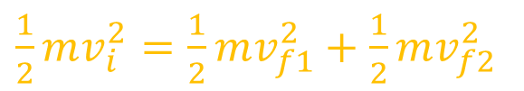


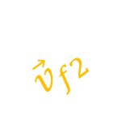





Energy Conservation
      Classically, the energy of a
      billiard ball in motion is: $E=\frac{1}{2}mv^{2}$
Then $\sum{E_{Initial}}=\sum{E_{Final}}$
          means
$${\vec{v}}_{f2}^{2}$$
$${\vec{v}}_{f1}^{2}$$
$${\vec{v}}_{f2}$$
( )²
These balls have the same mass
$${\vec{v}}_{i}^{2}$$
$${\vec{v}}_{f1}$$
$${\vec{v}}_{i}$$
$\frac{1}{2}mv_{i}^{2}=\frac{1}{2}mv_{f1}^{2}+\frac{1}{2}mv_{f2}^{2}$
$v_{i}^{2}=v_{f1}^{2}+v_{f2}^{2}$

Slide 5
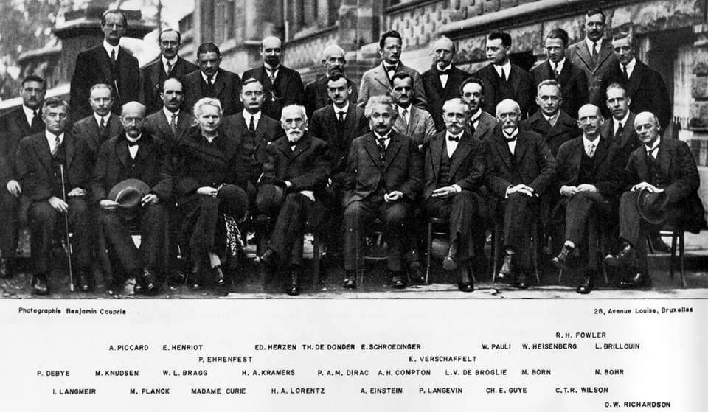
In 1927 they were celebrating the great success of quantum mechanics and relativity…
1927 Solvay Conference

Slide 6
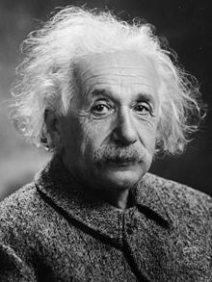










In these new theories the old conservation laws held, with some modifications…
$$E=mc^{2}$$
In relativity, momentum gets a correction factor that is significant only when the velocity is very close to the speed of light (c):
$$\vec{p}=$$
$$m\vec{v}$$
Relativistic correction factor
$$γ$$
Also, we learned that mass is just another type of energy.
So the Conservation of Energy equation gets new terms:
$\frac{1}{2}m_{i}v_{i}^{2}$
$\frac{1}{2}m_{f1}v_{f1}^{2}+$
$+\frac{1}{2}m_{f2}v_{f2}^{2}$
$$+m_{f2}c^{2}$$
$$+m_{i}c^{2}$$
=
$$m_{f1}c^{2}$$
And we can use these new terms to calculate the kinetic energy available to the products of radioactive decay…

Slide 7



      Radioactive Decay
If the initial momentum and kinetic energy are both be zero,
then the outgoing momentum vectors will be balanced
and the kinetic energy will be equal to the excess mass energy.
$${\vec{p}}_{f1}$$
$${\vec{p}}_{f2}$$
Kinetic Energy$=m_{i}c^{2}−m_{f1}c^{2}−m_{f2}c^{2}$

Slide 8
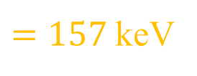

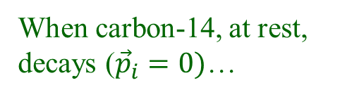
Calculating the Decay Energy
In β-decay a nucleus of atomic number Z changes into one with Z+1 and emits a beta particle, also known as an electron.
¹⁴C
¹⁴N
₆
₇
e⁻
$$m_{{}_{}^{14}C}c^{2}−m_{{}_{}^{14}N}c^{2}−m_{e^{−}}c^{2}$$
$=157$ keV
Excess mass energy
Nitrogen-14 is 28,000× more massive than an electron, so to balance momentum nearly all of this excess should go to the electron.
When carbon-14, at rest, decays (${\vec{p}}_{i}=0)$…
Instead, a range of energies were observed
number of β’s
Observed Energy Spectrum
¹⁴C
¹⁴N
₆
₇
e⁻
the β was expected to be emitted
with this discrete energy.
157 keV
β energy

Slide 9
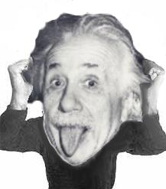
Calculating the Decay Energy
This spectrum, was at the heart of the “β-decay puzzle”
It appeared that energy was not being conserved!
In most cases, some of the energy appeared to be lost!
Sometimes
energy appeared to be conserved…
And sometimes not, by a lot!
number of β’s
157 keV
β energy

Slide 10
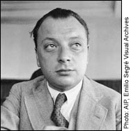
The Neutrino Idea
In 1930 Wolfgang Pauli came up with a solution to this energy crisis.
He proposed a new, but elusive, subatomic
particle which carries away the missing energy.
To match all observations this new particle must have:
  No electric charge
  Zero mass (or at least very nearly), and
  Very weak interaction strength
  (which is why hadn’t been seen before)
Wolfgang Pauli
This was a very bold thing to do since at that time there were only three known particles: the proton, the electron and the photon.

Slide 11



How Does the Neutrino Fix the Energy Problem?
Adding a neutrino does not change the basic energetics of the decay.
But it creates many more ways to distribute the energy among the decay products while balancing momentum…
Sometimes the electron gets the energy,
Sometimes the neutrino gets the energy,
Usually they share the energy.
¹⁴C
¹⁴N
₆
₇
e⁻
ν
$$m_{ν}≈0$$
$$m_{{}_{}^{14}C}c^{2}−m_{{}_{}^{14}N}c^{2}−m_{e^{−}}c^{2}−m_{ν}c^{2}$$
$=157$ keV
¹⁴C
e⁻
¹⁴N
¹⁴C
¹⁴C
₆
¹⁴N
¹⁴N
₇
₆
₇
₆
e⁻
₇
ν
ν
e⁻
ν

Slide 12
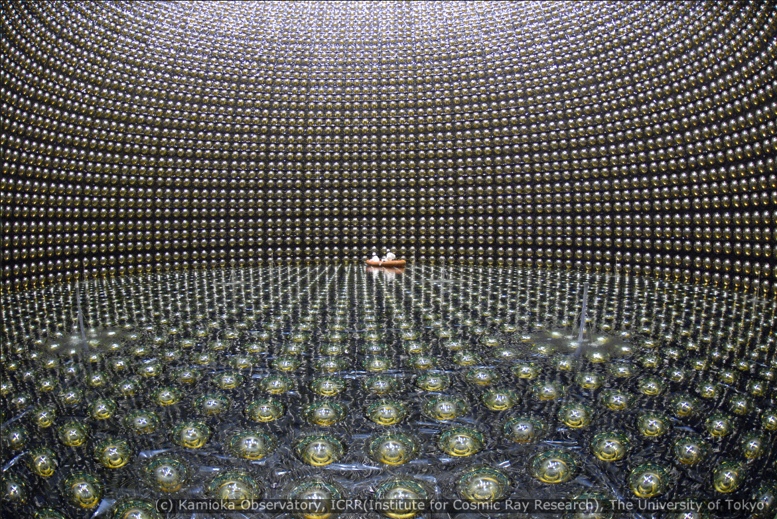

Neutrinos: What are They Good For?
Saving the some of bedrock conservation principles of physics.
The Super-Kamiokande detector in Japan, which was the first to discover neutrino oscillations in 1998. Super-K’s Takaaki Kajita was awarded the 2015 Nobel Prize.

Slide 13

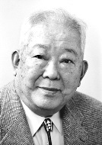
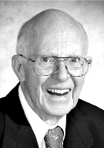
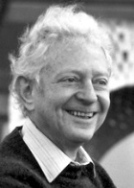
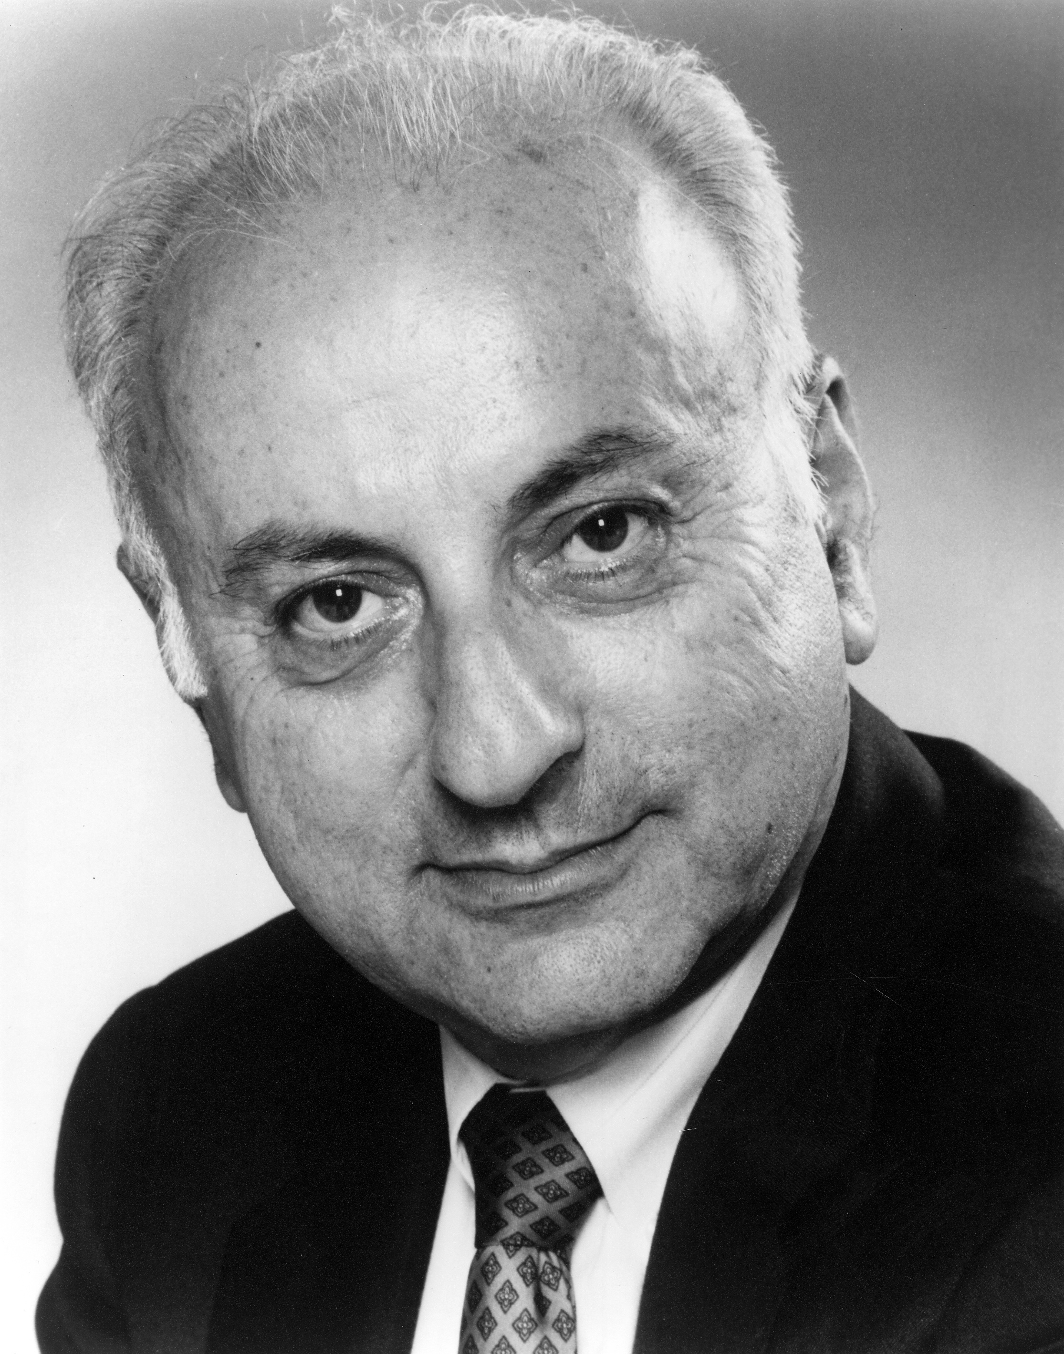
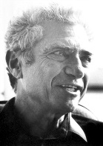
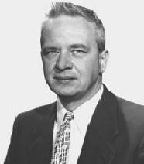
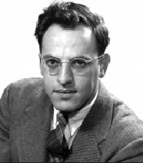
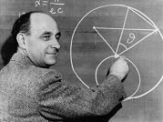
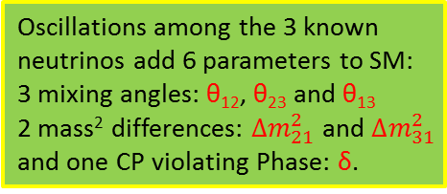
The Neutrino’s History of Discovery
1998: The Super-K experiment discovers neutrino oscillations, proving that neutrino have mass.
Oscillations among the 3 known neutrinos add 6 parameters to SM:
3 mixing angles: θ₁₂, θ₂₃ and θ₁₃
2 mass² differences: $∆m_{21}^{2}$ and $∆m_{31}^{2}$
and one CP violating Phase: δ.
2015
Kajita
1993: LSND observed hint of short-baseline oscillations leading to speculation on the existence of sterile neutrinos.
1968: Ray Davis observes neutrinos from the Sun, using a detector at the Homestake Mine.
1987: Kamiokande, lead by Masatoshi Koshiba, observes neutrinos from Supernova 87A.
Koshiba
2002
1962: Lederman, Schwartz and Steinberger discover that there are at least two types of neutrino.
Ray Davis
Lederman
Schwartz
Steinberger
1988
2002
1956: Reines and Cowan discover the neutrino at the Savannah River Nuclear Reactor.
Clyde Cowan
Fred Reines
1995
1934: Enrico Fermi develops a theory of β-decay based on the neutrino.
1930: Wolfgang Pauli proposes the neutrino to preserve energy conservation in β-decay.

Slide 14
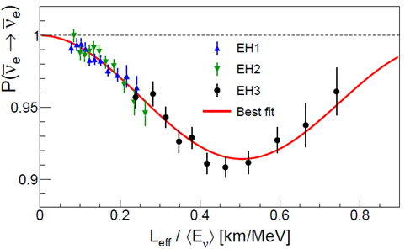

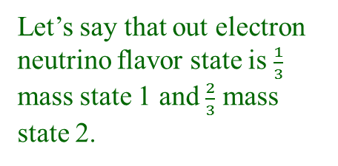
A Digression on Neutrino Oscillations
Neutrino oscillations or neutrino mixing is a direct result of neutrinos having mass, and was the first and still only, indication that they indeed do have mass.
The oscillations occur due to a
mismatch between the three neutrino flavor states and the three mass states.
ν_{μ}
ν_{e}
100%
mix
This is what it looks like in a real experiment.
m₁ m₂
Let’s say that out electron neutrino flavor state is $\frac{1}{3}$ mass state 1 and $\frac{2}{3}$ mass state 2.

Slide 15

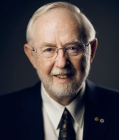
The Neutrino’s History of Discovery
2024:
2012: Reactor Experiment Daya Bay measures the last unknown neutrino mixing angle, θ₁₃.
2002: SNO proves that the Solar Neutrino Puzzle was due to neutrino oscillations.
2000: DONuT Experiment at Fermilab discovers the third neutrino (ν_{τ})
2015
McDonald
1998: The Super-K experiment discovers neutrino oscillations, proving that neutrino have mass.
Oscillations among the 3 known neutrinos add 6 parameters to SM:
3 mixing angles: θ₁₂, θ₂₃ and θ₁₃
2 mass² differences: $∆m_{21}^{2}$ and $∆m_{31}^{2}$
and one CP violating Phase: δ.
2015
Kajita
1993: LSND observed hint of short-baseline oscillations leading to speculation on the existence of sterile neutrinos.
1968: Ray Davis observes neutrinos from the Sun, using a detector at the Homestake Mine.
1987: Kamiokande, lead by Masatoshi Koshiba, observes neutrinos from Supernova 87A.
Koshiba
2002
1962: Lederman, Schwartz and Steinberger discover that there are at least two types of neutrino.
Ray Davis
Lederman
Schwartz
Steinberger
1988
2002
1956: Reines and Cowan discover the neutrino at the Savannah River Nuclear Reactor.
Clyde Cowan
Fred Reines
1995
1934: Enrico Fermi develops a theory of β-decay based on the neutrino.
1930: Wolfgang Pauli proposes the neutrino to preserve energy conservation in β-decay.

Slide 16
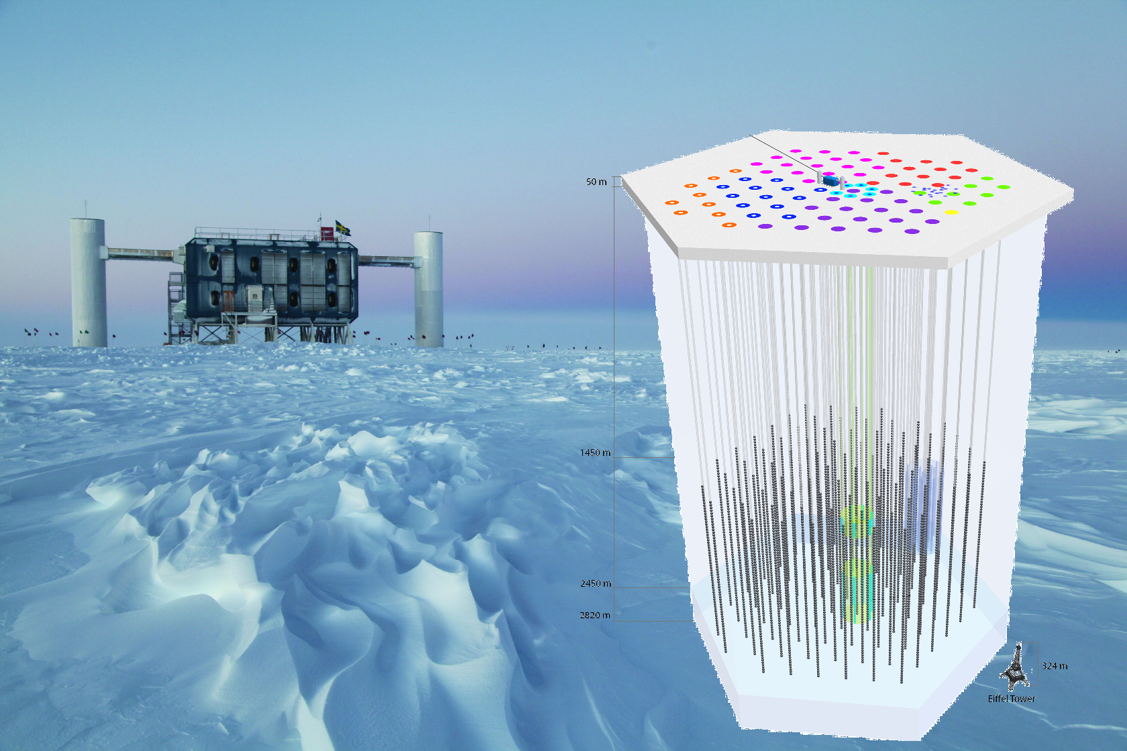
Neutrinos: What are They Good For?
Years of great discoveries and excitement for physicists and labs like Fermilab around the world.
The IceCUBE detector at the South Pole, which made the first to observation of high energy neutrinos from outside the Milky Way using a cubic kilometer of instrumented deep ice.

Slide 17
Applied Neutrino Physics
The same weak interaction that makes neutrinos so hard to see makes them an excellent probe of things that are hidden…
    The core of the sun
    The inner workings of supernovae
    The core and crust of the Earth
    Inside the nuclear reactors of rogue nations
Future advances in neutrino sources and detectors may allow us to send messages through the Earth that can not be jammed.
Notes:
When he invented the neutrino in 1930, Pauli confided to friends that he had done something terrible in inventing a particle that could never be observed.

Slide 18
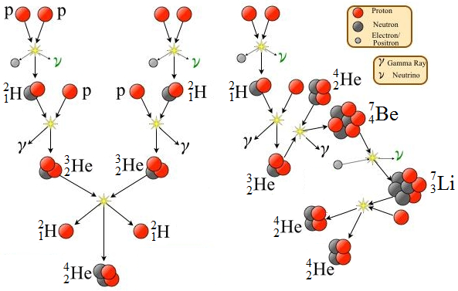
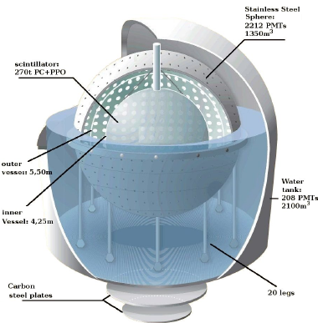
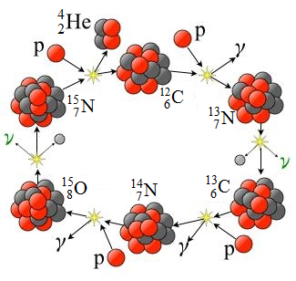
Solar Neutrinos as a Probe of Solar Fusion
Ray Davis did not set out to study neutrino properties. His goal was to test the theory that nuclear fusion is the process that fuels stars like the Sun.
Proton-Proton Fusion Reactions
The Carbon-Nitrogen-Oxygen Cycle
Neutrinos yet to be observed from other processes will tell us about the chemical composition of the Suns core.
Observation of the different solar neutrinos, which can be characterized by their energies, has confirmed the primary processes in solar fusion
The Borexino Detector
located in Italy

Slide 19
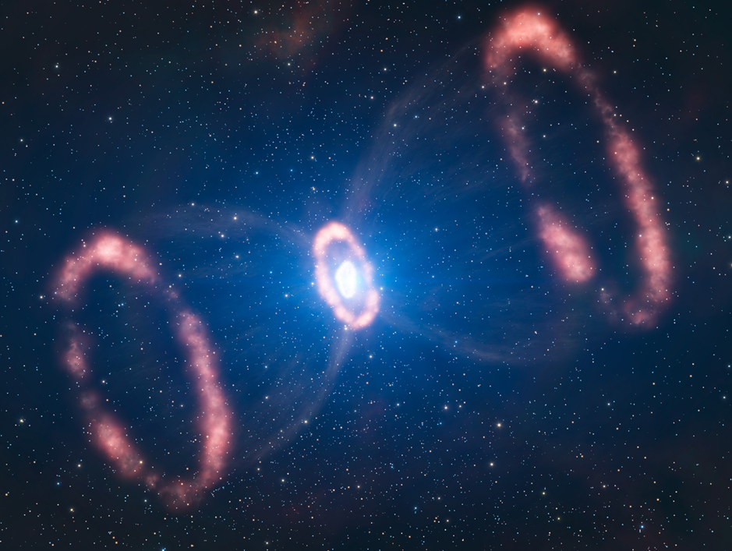
Supernova Neutrinos
Even neutrinos can get briefly trapped in the super dense matter of a core-collapse supernova. Still they come out fairly promptly.
The properties of the detected neutrinos can tell us about what’s happen in the earliest moments of the explosion.

Slide 20


Supernova Neutrinos
Let’s use grape jelly as a stand in for supernova shockwave front.
As the neutrino passes through the shock front, it’s slowed.
The three flavor components are affected differently.
Thus the flavor content measured on Earth can tell us about the evolving density of matter within the explosion.

Slide 21
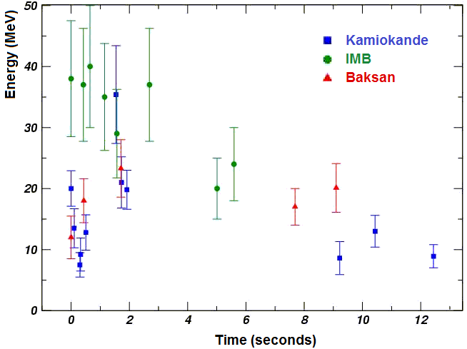
Supernova Neutrinos
Even neutrinos can get briefly trapped in the super dense matter of a core-collapse supernova. Still they come out fairly promptly.
The properties of the detected neutrinos can tell us about what’s happen in the earliest moments of the explosion.
Since the dawn of neutrino physics there has only been one supernova in our neighborhood, SN87A.
Today the worlds collection of supernova neutrino events stands at 24.

Slide 22
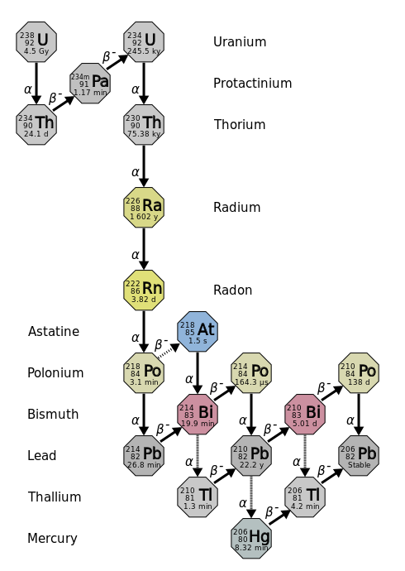
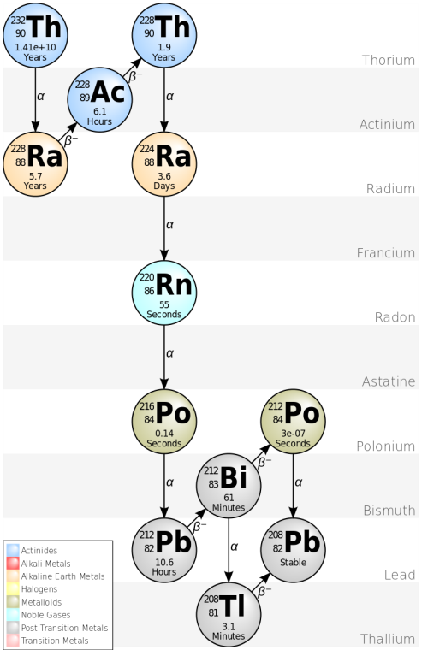
Geo-neutrinos
The Earth’s crust glows with neutrinos. Radioactive isotopes from decay chains of Uranium-238 and Thorium-232 emit neutrinos (actually anti-neutrinos).
Geologists use geo-neutrinos to study the chemical composition of the crust.
Uranium-238 ( ²³⁸U)
Thorium-232 (²³²Th)

Slide 23

Borexino
KamLAND

Slide 24
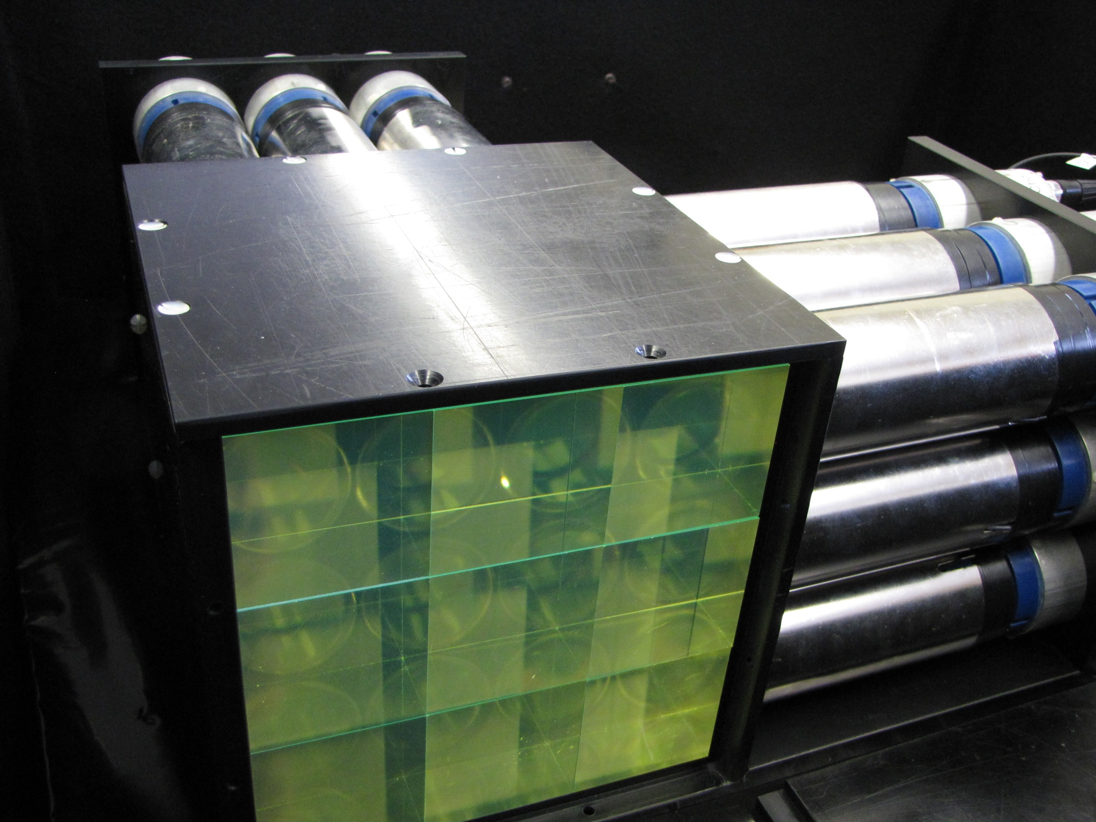
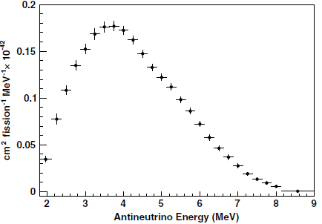

Neutrinos for Nuclear Nonproliferation
Nuclear reactors breed weapons grade nuclear materials.
In the typical power reactor the primary fuel is Uranium-235 (²³⁵U) which is enriched to about 4% relative ²³⁸U.
As the reactor runs, ²³⁸U is slowly converted to isotopes of Plutonium (²³⁹Pu and ²⁴¹Pu).
²³⁹Pu is the most common fissile material in nuclear weapons.
It also burns in the core as a reactor fuel
and this is our hook for nonproliferation.
Subtle differences in the neutrino energy
spectrum from U and Pu isotopes may
allow us to detect an unreported diversion
of plutonium.
Prototype reactor neutrino detector, designed to be robust enough to be deployed at a reactor in a nation that is reluctantly cooperating in a nonproliferation program (think Iran & North Korea).

Slide 25
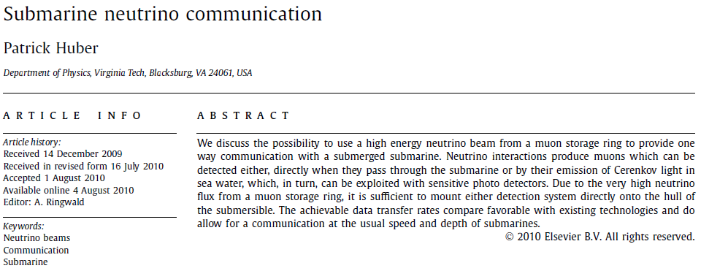
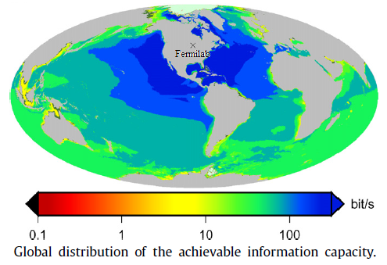
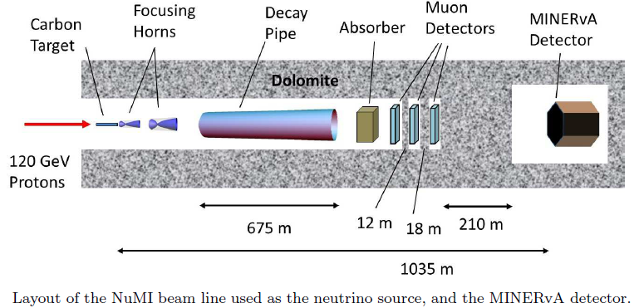
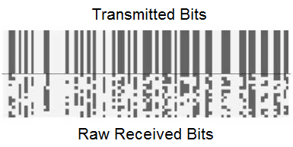
Neutrino Communications
Every few years some crazy physicist reopens the issues of neutrino communications
Two years later, Fermilab’s Minerva experiment received a message in neutrinos
And the message said…
“neutrino”

Slide 26
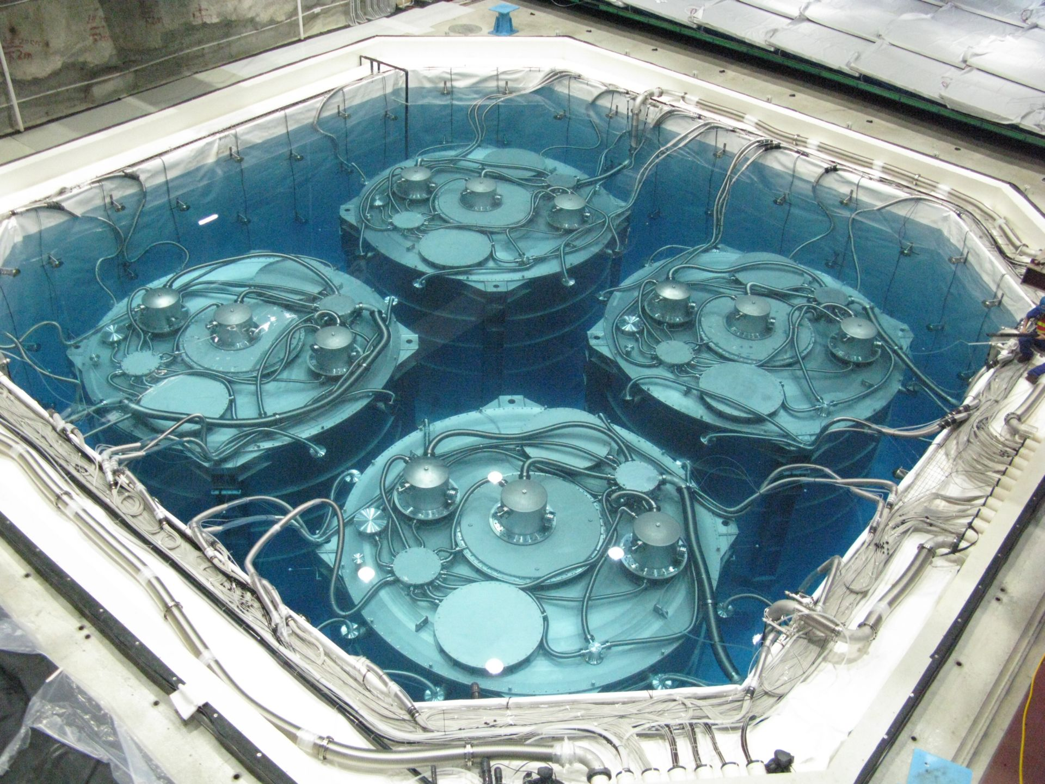
Neutrinos: What are They Good For?
Studying things that would otherwise be hidden from view.
The Daya Bay Reactor Neutrino Experiment, located in China, was the first to observe neutrino oscillations involving the last of three neutrino mixing angles.

Slide 27

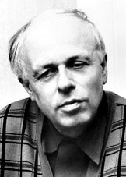
Where Does Stuff Come From?
We live in a universe of matter, not anti-matter.
Yet, the Big Bang Theory predicts that at the moment
of creation equal parts of matter and anti-matter were
made.
Today there is very little anti-matter in the known universe.
This is a good thing. Equal parts matter and anti-matter would eventually annihilate each other
Russian physicist Andrei Sakharov identified three
conditions for matter:
  Baryon number violation.
  Charge symmetry and
  violation
  Interactions out of thermal equilibrium.
Charge Parity-symmetry
(CP violation).
Andrei Sakharov

Slide 28
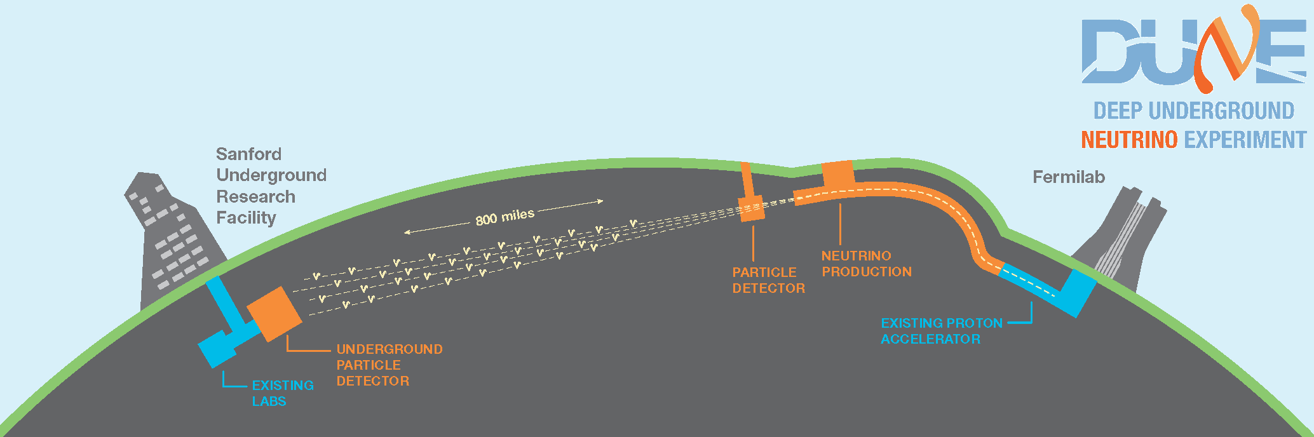
Where Does Stuff Come From?
We known that quarks can violate CP, but the effect is too small to account for the matter/anti-matter asymmetry that we see today.
A relatively new idea, known as leptogenesis, has generated a lot of excitement. It posits that neutrino interactions in the early universe may provide the needed CP violation.
The DUNE experiment will search for CP violation in neutrino oscillations.
DUNE should start around 2025 and run for at least 10 years

Slide 29
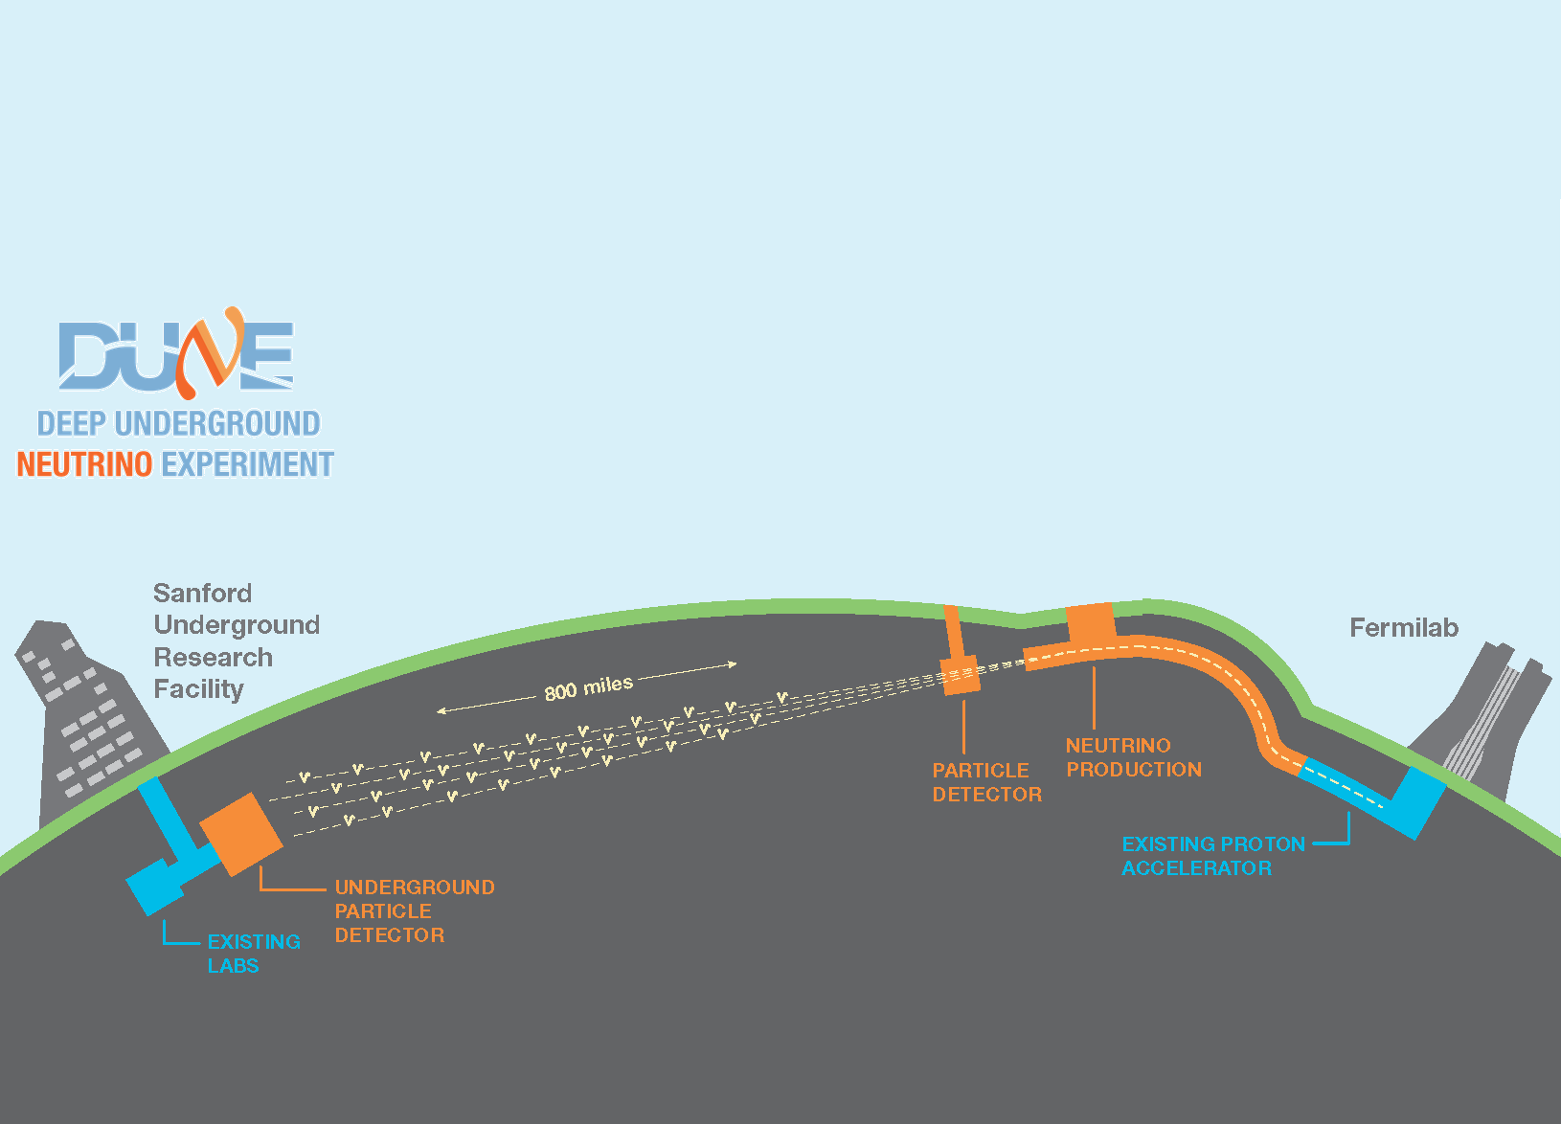
Neutrinos: What are They Good For?
Possibly explaining all of existence...
So stay tuned!
The Proposed DUNE Experiment, which will send a beam of neutrinos from Fermilab to South Dakota in order to search for Charge/Parity violation in neutrino mixing.

Slide 30
Backup Slides

Slide 31
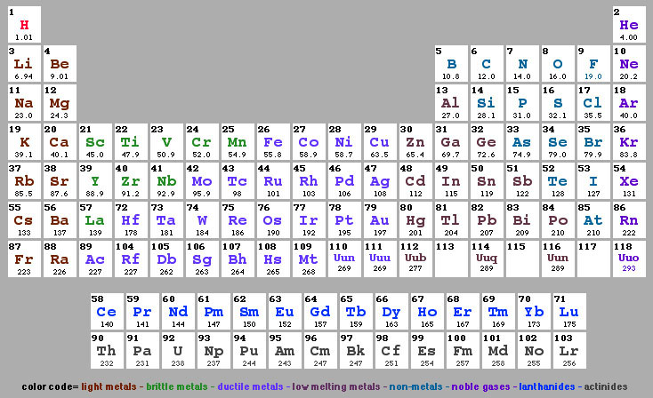
“Periodic Table” of Particle Physics
Particles
Anti-Particles
Just like chemists categorize atoms
→ periodic table:
Light Heavy
u
c
t
Charge
+⅔
-⅔
d
s
b
-⅓
+⅓
ν_{e}
ν_{μ}
ν_{τ}
0
Particle physicists
have “standard model”
of elementary particles
e
−
μ
−
τ
+
+
−
+
-1
+1
Simple model explains what the world is & what holds it together

Slide 32
Oscillations and Neutrinos Mass
Remember: there are three types of neutrinos (ν_{e}, ν_{μ} and ν_{τ}), so we might expect three different masses (m₁, m₂ and m₃)
But neutrinos are quantum mechanical particles → They behave in strange ways
For example: the masses and types don’t have to be aligned. In fact, the masses form a second set of related neutrino types
In quantum mechanics this happens a lot. We use the linear algebra for the rotation of vectors to handle this.
Now and
ν_{μ}
ν₂
ν₁
θ
ν_{e}

Slide 33

Mass → Oscillations
Follow the prescription of quantum mechanics:
  The ν’s are what we physicists call “Wave Functions”
  Their evolution in time is given by the Schrödinger Equation…
  This is the neutrino “Oscillation Probability”
  It has a constant amplitude piece: sin²2θ
  And an oscillatory piece:
  Δm²₁₂ = m₁²-m₂² (Not only need mass, but different masses!)
ν
ν
ν
Schrödinger's Equation
ν
ν
ν

Slide 34

The CHANDLER Detection Method
Positron (e⁺)
$${\overline{ν}}_{e}$$
Neutron
Capture
Detected Light
e⁺
p
n
⁴He
Time
⁶Li
³H
10 ns
~50 μs
200 ns
An electron antineutrino (${\overline{ν}}_{e})$ interacts with a hydrogen nucleus creating a positron and a neutron.
The positron deposits its energy promptly in the plastic scintillator.
The neutron thermalizes and is eventually captured on ⁶Li embedded in the ZnS sheet.
Light from the neutron capture is released slowly making an unmistakable neutron tag.

Slide 35

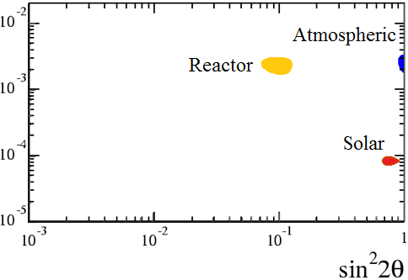
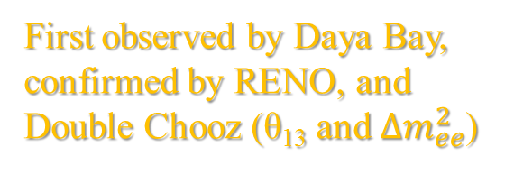


Neutrino Oscillation Data
Seen by Super-K, confirmed by K2K, Minos, T2K and NOvA (θ₂₃ and $∆m_{μμ}^{2}$)
ν_{μ}→ν_{x}
ν_{e}→ν_{x}
First observed by Daya Bay, confirmed by RENO, and Double Chooz (θ₁₃ and $∆m_{ee}^{2}$)
First observed by Ray Davis. Nailed down by Super-K, SNO and KamLAND. Dominated by mixing of mass states 1 and 2 (θ₁₂ and $∆m_{21}^{2}$)
ν_{e}→ν_{x}
The data for the three neutrino mixing model is nearly complete and extraordinarily self-consistent.
Specifically, $∆m_{ee}^{2}$ and $∆m_{μμ}^{2}$, which are different linear combinations of $∆m_{31}^{2}$ and $∆m_{32}^{2}$, agree to within $∆m_{21}^{2}$.

Slide 36

Neutrino Oscillation Data
Seen by Super-K, confirmed by K2K, Minos, T2K and NOvA (θ₂₃ and $∆m_{μμ}^{2}$)
ν_{μ}→ν_{x}
ν_{e}→ν_{x}
First observed by Daya Bay, confirmed by RENO, and Double Chooz (θ₁₃ and $∆m_{ee}^{2}$)
First observed by Ray Davis. Nailed down by Super-K, SNO and KamLAND. Dominated by mixing of mass states 1 and 2 (θ₁₂ and $∆m_{21}^{2}$)
ν_{e}→ν_{x}
The data for the three neutrino mixing model is nearly complete and extraordinarily self-consistent.
Specifically, $∆m_{ee}^{2}$ and $∆m_{μμ}^{2}$, which are different linear combinations of $∆m_{31}^{2}$ and $∆m_{32}^{2}$, did not have to agree to within $∆m_{21}^{2}$.

Slide 37






ν_{e}→ν_{x}
Neutrino Oscillation Data
ν_{μ}→ν_{e}
and Then Some…
Short-Baseline anomalies observed by Reactors, Gallium Source Experiments, T2K LSND and MiniBooNE (θ_{x4} and $∆m_{4x}^{2}$)
Seen by Super-K, confirmed by K2K, Minos, T2K and NOvA (θ₂₃ and $∆m_{μμ}^{2}$)
ν_{μ}→ν_{x}
ν_{e}→ν_{x}
ν_{s}
ν_{s}
First observed by Daya Bay, confirmed by RENO, and Double Chooz (θ₁₃ and $∆m_{ee}^{2}$)
First observed by Ray Davis. Nailed down by Super-K, SNO and KamLAND. Dominated by mixing of mass states 1 and 2 (θ₁₂ and $∆m_{21}^{2}$)
Everything’s better with beacon.
ν_{e}→ν_{x}
Sterile Neutrino
(Bacon Flavor)
The data for the three neutrino mixing model is nearly complete and extraordinarily self-consistent.
Specifically, $∆m_{ee}^{2}$ and $∆m_{μμ}^{2}$, which are different linear combinations of $∆m_{31}^{2}$ and $∆m_{32}^{2}$, did not have to agree to within $∆m_{21}^{2}$.

