Slide 1

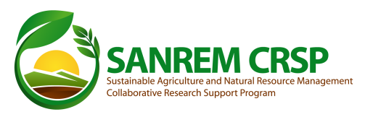


Higher Education to Feed the Future:
the SANREM CRSP Educating
for Sustainable Innovation

Slide 2
Title XII Legislation
Declaration of Policy-Sec. 296(a)
(2) Improved human capacity and institutional resource development for the global application of agriculture and related environmental sciences.

Slide 3
Comparative Advantage of CRSPs in Human Resource Development
Integration of academic, research and outreach in degree training programs
Focus on finding solutions to private and public sector problems
Collaboration with diverse partners (e.g., agribusiness, government institutions, IARCs, NGOs, foundations, etc.)
Long-term institutional collaborative relationships

Slide 4
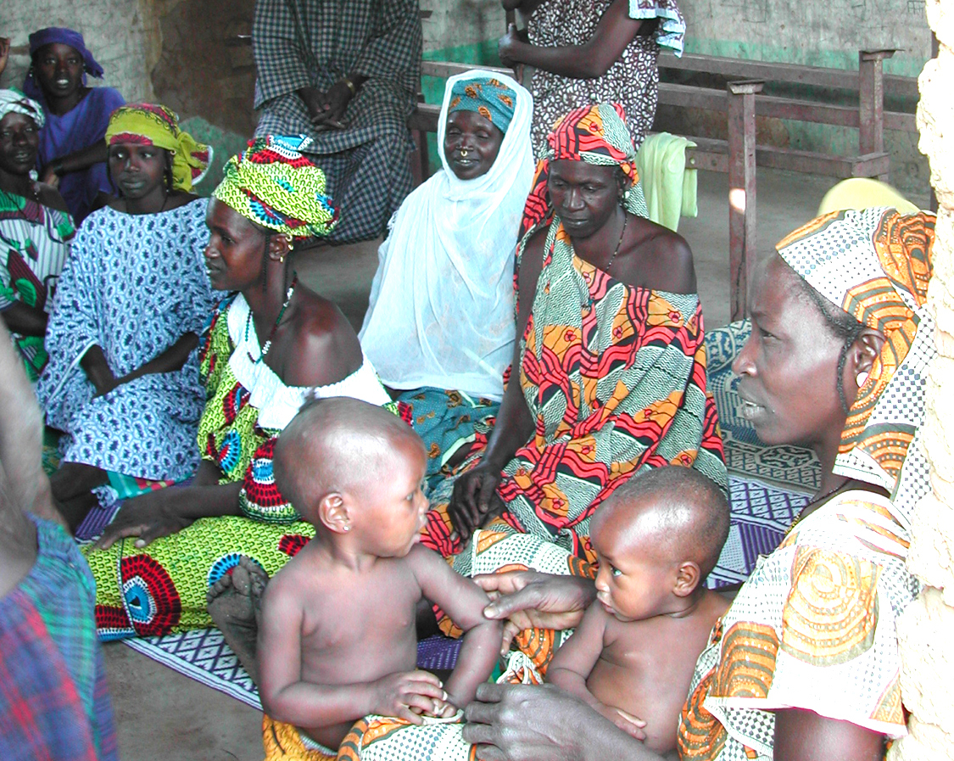
CRSPs Degree Training
Total across nine CRSPs
Total Degrees (BS, MSc and PhD) awarded (1978–2007) 3,145
Total post-graduate degrees awarded (1978–2007) 2,779
Total trainees 3,417
Currently in training 272
Notes:
Achievements by the numbers over 3,400 degrees ; 35-40% women;
Nearly all return to build careers in their home country institution, unlike nearly every other higher education program.
However, many have now retired or been lost to HIV/AIDS
40% continue to collaborate with their major professors 10 years later

Slide 5
Number of degree trainees supported by CRSPs, 1978-2007

Slide 6
Demographics of CRSP Trainees
Degree level 34% PhD, 47% MS, 19% BS
Disciplinary areas Plant sciences, animal sciences, soil sciences, genetics, natural resources, food science, nutrition, social science, agriculture economics, education and extension
Gender 65% male, 35% female
Location of training Training in both U.S. and other countries (nearly 50–50 split)
Country of Origin Nearly 75% from developing countries
(40–50% of trainees from Africa)

Slide 7
SANREM CRSP Phase IV Degree Trainees: Years 1-3
Country | BS |  | MS |  | PhD |  | Total
 | Women | Men | Women | Men | Women | Men
USA | 8 | 4 | 10 | 7 | 8 | 6 | 43
Bolivia | 1 | 4 |  |  | 1 |  | 6
Cambodia |  |  |  | 2 |  | 1 | 3
Ecuador | 3 | 4 | 1 | 1 |  |  | 9
Ghana |  |  |  |  |  | 2 | 2
India |  |  | 3 | 1 | 1 |  | 5
Indonesia |  |  |  |  | 1 |  | 1
Kenya |  |  | 2 | 1 | 1 | 1 | 5
Lesotho |  |  |  | 2 |  |  | 2
Mozambique |  |  |  | 3 |  |  | 3
Nepal |  |  | 1 | 3 |  | 1 | 5
Peru |  |  |  |  | 1 |  | 1
Philippines |  |  | 2 | 1 |  | 2 | 5
Uganda |  |  |  | 2 |  |  | 2
TOTAL | 12 | 12 | 19 | 23 | 13 | 13 | 92
Women = 44 Men = 48

Slide 8
21st Century Land Grant Footprint
Leaves behind:
Intellectual leadership in transdisciplinary negotiation
Strategic and creative partnerships involving all stakeholders
Engaging the next generation of agricultural leaders
Integrates research/teaching/action into locally responsive institutional settings
Existing models appear to be largely NGO-led
Maintains the role of the ‘honest broker’
Educated negotiation
Communicative competence of all partners is critical
Notes:
There is a new emphasis at USAID on science, technology and higher education to combat food insecurity
The land grant university response needs to focus on fostering the conditions for adaptive management at the local level.
< read bullets >
Cross-walking between disciplinary, pragmatic, commercial, and ethical frames of reference may at times require leaps of faith, but the effort can be paid off in sustainable impacts.
Publically funded research and outreach has an important role to play with respect to smallholder farmers (women and men) around the world.

Slide 9
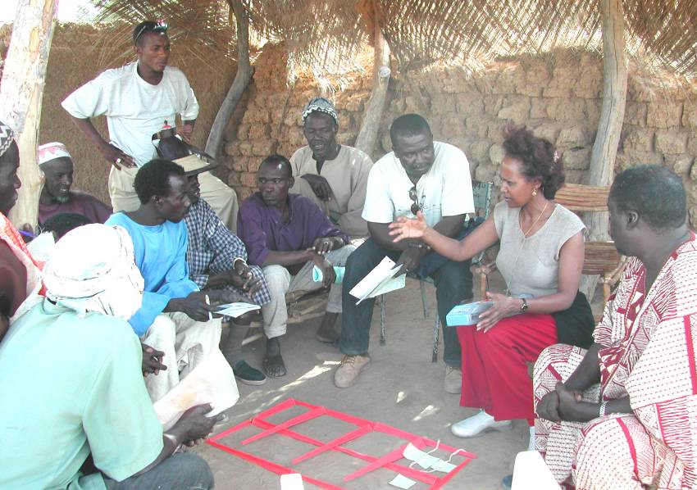
Reflecting on Networks and Technical Change
How should we think about technical change in agriculture?
What is the role of learning in the process of innovation?
Is learning a matter of information transfer resulting in adoption of innovations?
Or, is learning a matter of developing capacities for on-going adaptation?
Whose capacities should be
developed?
Where, in fact, does innovation occur?
Notes:
I think a lot about actor networks and complex adaptive systems.
For a decade, there has been a growing literature generated by scientists outside of agriculture addressing questions of innovation and adaptive management of our global ecosystem?
What are they saying? -- We need to pay attention to questions of:
scale, trans-disciplinarity, non-linearity, social construction, negotiation,
social learning, innovation systems, and adaptive management.
I’ve also been looking at how innovation processes in other fields have been studied.
All this has led me to move beyond the framework of technology transfer.
We need to think in terms of a more dynamic interactive modality.
These days I’m focused on the frame(s) of reference we might use to engage developing country farmers and non-farm stakeholders intellectually and emotionally in the promotion of conservation agriculture.

Slide 10
The Transition to Complex Adaptive Systems
All of science has shifted.
A series of differentiated revolutions for Africa
The mission of the land grant universities is:
learner-focused scholarship
How do we enhance the quality
of host country degree training?
Notes:
“The physicist John Wheeler used the metaphor of a plate glass window [to describe changes in the philosophy of science over the 20th Century]. For centuries science viewed the universe objectively, as if we were separated from it by a pane of plate glass. Quantum theory smashed that glass forever. We have reached in to touch the cosmos. Instead of being the objective observers of the universe we have become participants.”
The idea of using a thermometer to measure the temperature of water involves an exchange of energy with the mercury, thus lowering the temperature of the water.
-----
The second Green Revolution must be adapted for a diversity of circumstances, often involving highly degraded lands, and changing climate patterns, as Staatz and Dembélé say: ‘a series of differentiated revolutions will be needed for Africa’.
-----
Why does the farmer need to know about how agricultural technology works beyond simply how to use it (skill development, practice adoption)? -- S/he may want to use it to solve another problem.
Farmers must learn to be adaptive to changing climate and market circumstances; we need them to interact effectively with us to come up with effective adaptations – waiting for researchers to figure out what he should do next will likely cost him his farm/his livelihood.
-----
Where the ‘learner’ is a productive member of the local community for which the university is responsible

Slide 11
Capacity Building
Multidisciplinary Teams
Participatory Research
Situated Knowledge
Country-prioritized Research
Institutional Partnerships
Locally Adapted Programs
Supporting Local Research Entities
Supporting Local Innovation for Sustainable Intensification
Universal Knowledge
Specialized Research
International Public Goods
Institutional
Individual

Slide 12
Innovations in Graduate Training
New models for graduate degree programs
Joint or dual institutional degree programs
Sandwich programs
Distance education programs
Life-long professional development programs
2. Changes in Graduate Program Structure
Professional training vs. Research focus
Multidisciplinary vs. disciplinary
Value Chain vs. subsector focus
“Designer” graduate programs for target populations
3. Value Addition to Host Country Graduate Programs
Research opportunities in U.S. university laboratories
Internships in U.S. agribusinesses
Participation in U.S. university outreach programs (Land-Grant Model)
U.S. university faculty instruction of courses at HC universities

Slide 13
Now it’s time for your
comments, ideas,
and contributions.

