Slide 1
A Cost Benefit Analysis of Electricity Generation
Heather Thomson
Graduate Student Symposium
June 8, 2015

Slide 2
Cost Benefit Analysis
Social Costs/ Benefits
Private Costs/ Benefits
External Costs/ Benefits

Slide 3
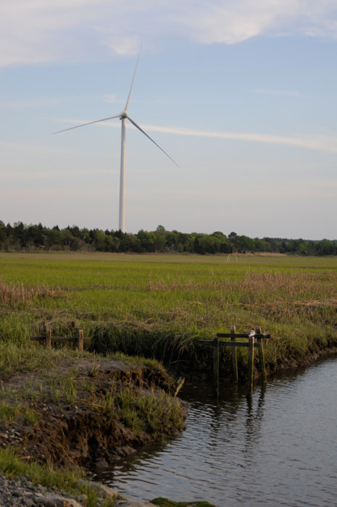
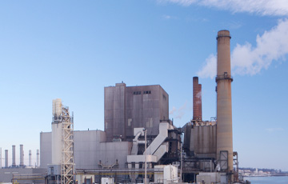
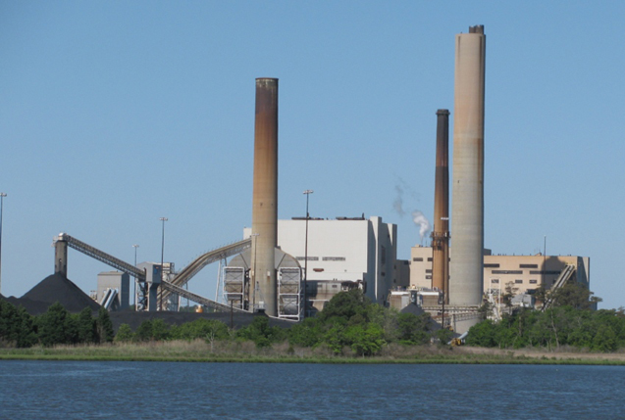
Facilities
College of Earth, Ocean, and Environment, UDel
Edge Moor Natural Gas plant, Calpine
Indian River Power Plant, photo from DNREC

Slide 4
Methodology
Financial Benefits
  Electricity
  Jobs
Financial Costs
  Construction
  Operations and Maintenance (O&M)

Slide 5
Methodology
Environmental Benefits
Environmental Costs
  Air pollution
  Climate Change
  Avian/Bat Mortality
  Fish Kills and Water Use
  Construction
  Upstream
Amenity and Disamenity

Slide 6
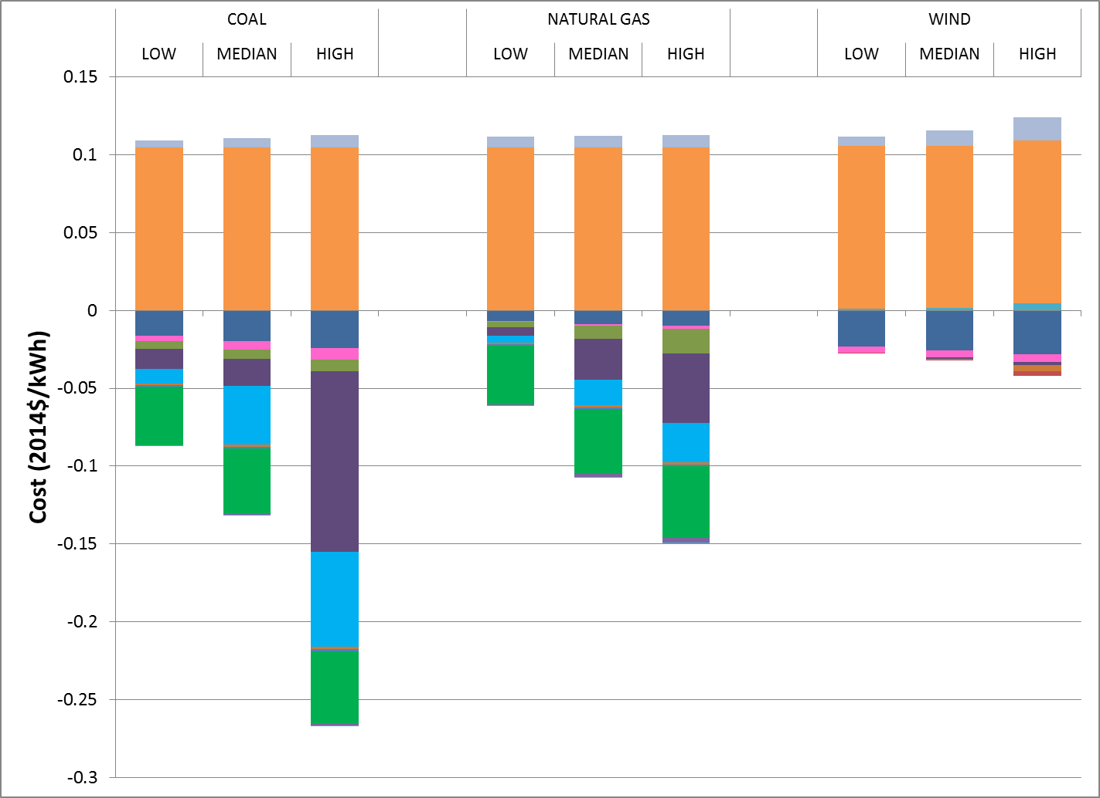
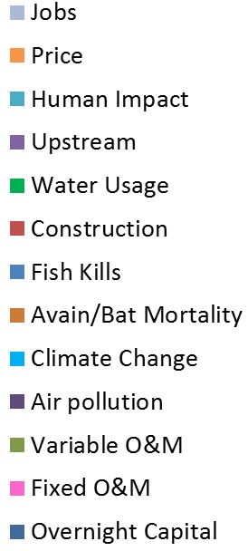

Slide 7
Results
Summation of Costs and Benefits
$2014/kWh | Coal Plant | Natural Gas Plant | Wind Turbine
Low | -0.1187 | -0.0098 | 0.1028
Median | 0.0104 | 0.0235 | 0.1141
High | 0.0501 | 0.0627 | 0.1240

Slide 8
Results
Breakeven Price
Required Price of Electricity for Cost=Benefit
$2014/kWh | Coal Plant | Natural Gas Plant | Wind Turbine
Low | 0.2622 | 0.1420 | 0.0350
Median | 0.1252 | 0.0995 | 0.0206
High | 0.0788 | 0.0526 | 0.0077

Slide 9
Thank You!
Questions?
hthomson@udel.edu

Slide 10
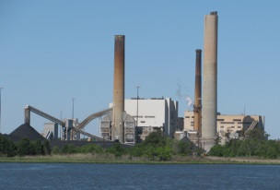



Upstream Stages:
Feedstock and Refining
Downstream Stages:
Operations
TS&D
End-Use
Extraction
TS&D

