Slide 1

KindaRight
Divit Singh
Austin Lopez-Gomez
Client: Blacksburg Web Design
Blacksburg, VA
May 1, 2014
Virginia Tech
CS 4624

Slide 2
Concept
Collaborative environment for artists
Network for artists to meet patrons
Discover new talents

Slide 3
What We’ve Accomplished
Implemented data management for photography
  Tags
  Repositories
  Comments Management
Implemented search system for users and a search system for tags.
Won 2nd Place in Industrial Category at VTURCS.

Slide 4

Profile Page

Slide 5
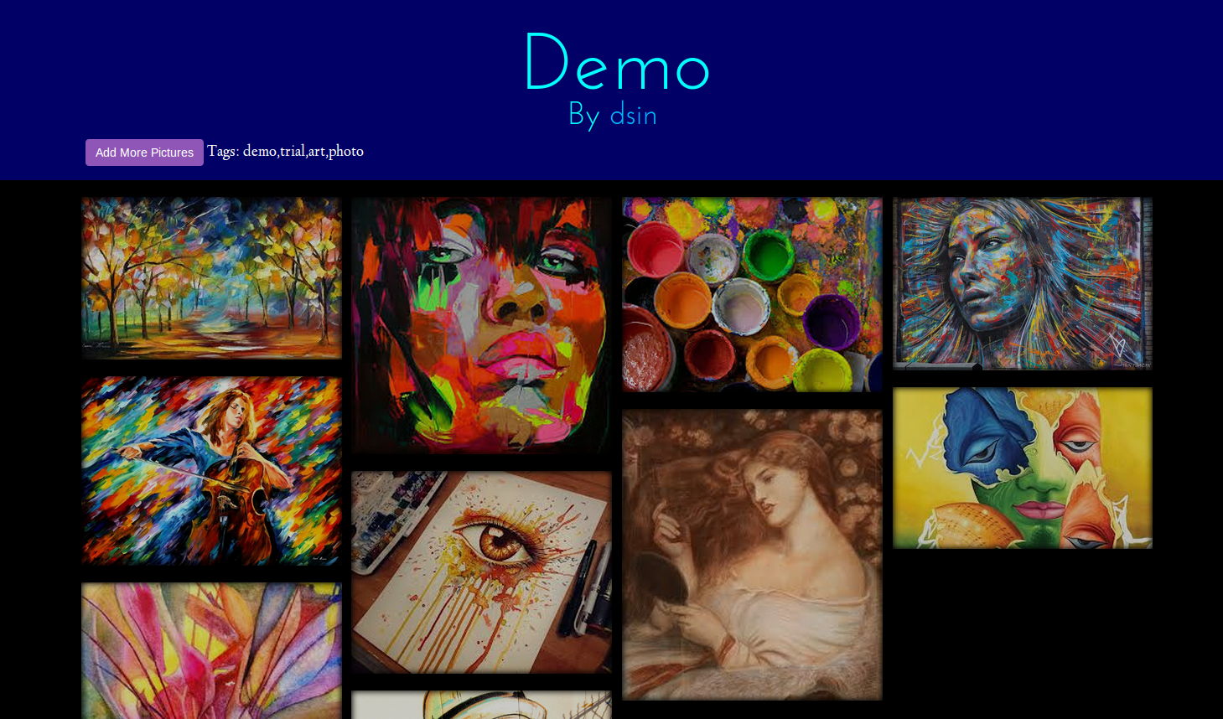
Repository Page

Slide 6
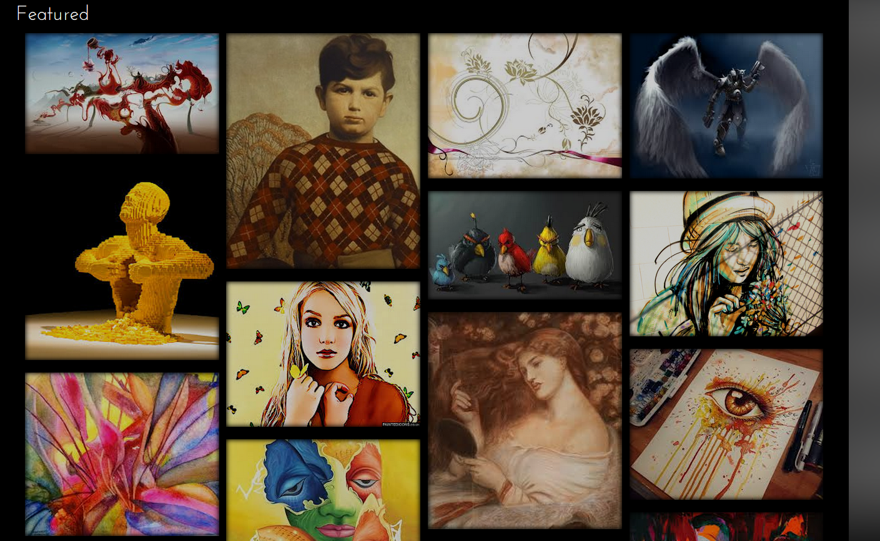
Featured Page
The Featured page pops up on your main home screen and includes pictures from all users. A repository is a group of images with a single, or a select number of contributors.

Slide 7
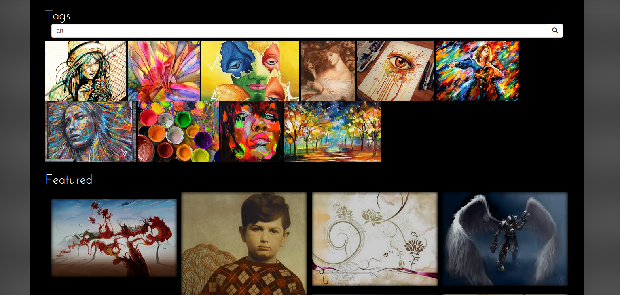
Tag Functionality
Tags are specific words or phrases of Metadata commonly associated within Gives a detailed description of the project the photo’s metadata. We have allowed you to search through the photo for this
Featured can be thought of as most popular, they are not related to tags.

Slide 8
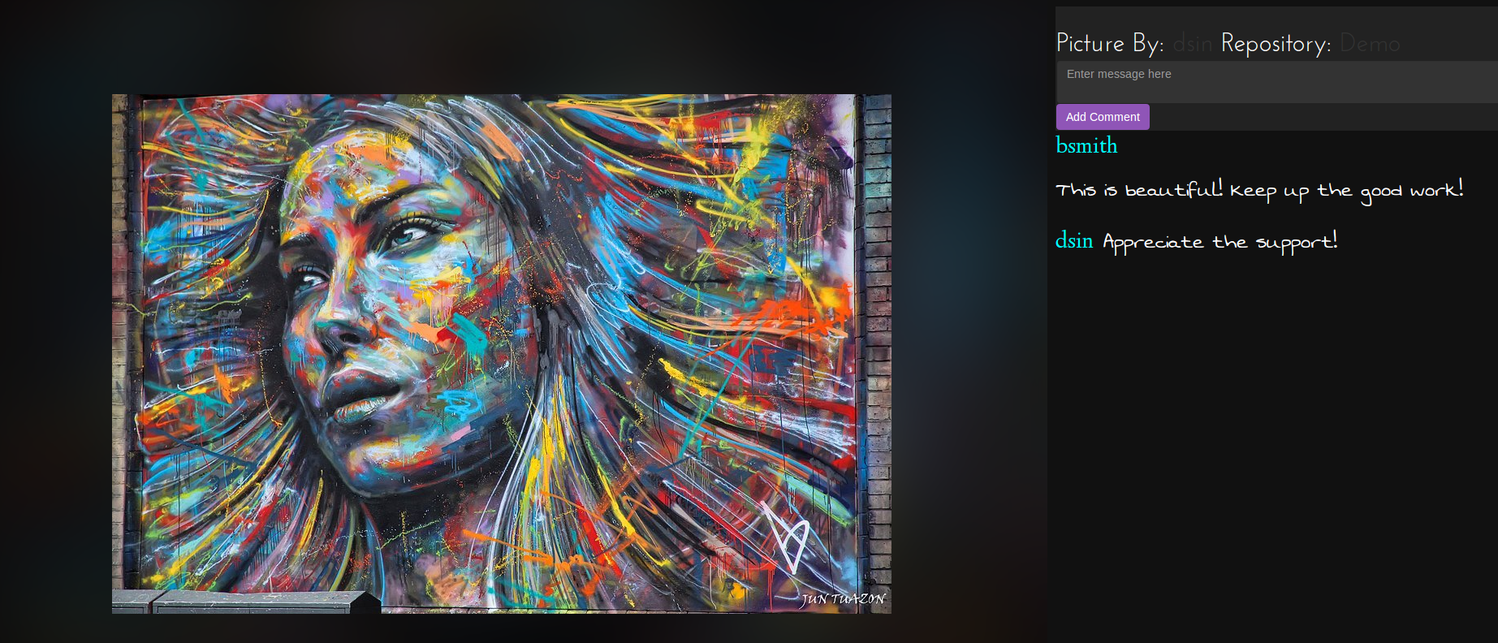
Comment Management System

Slide 9
Lessons Learned
Define a strict API early!
Establish an Agile process (or close to it)
Communication!!!
Define the idea before coding
Test code before pushing to master branch (GitHub)
Don’t be afraid to create new branches (GitHub)
Think carefully before considering database options

Slide 10

Where to Next?
(next items to be implemented)
Finish developing Patron use case
Implement collaboration between users
  Patron $↔$ Artist
Implement commerce functionality
Implement music management
Finish implementing music management

