Slide 1
AI in Cybersecurity
Kevin Song, Shivani Rajasekaran, Vedant Tyagi, Paul Kim
CS 4624: Multimedia, Hypertext, and Information Access
Virginia Polytechnic Institute and State University
Blacksburg, VA 24061
Instructor: Dr. Edward A. Fox
Client: James R. Morris King, Devin M. Wynne
May 9, 2018

Slide 2
Outline
Project Overview
Report Objectives
Limitations
Implementation
  Design
  Results (Console Application)
Potential Future Expansion
Acknowledgments
Notes:
Smart grid, intuition detection concept, ais algorithm, we deci

Slide 3
Project Overview
Deliverable: Technical research report
Project objective:
  Provide a proof of concept implementation of an Artificial Immune System(AIS) for intrusion detection on common Internet protocols used in Smart grid AMI networks such as the Wide Area Network (WAN).
Notes:
The goal of this report is to provide a proof of concept that an AIS can be implemented on smart grid AMI (Advanced Metering Infrastructure) networks and furthermore be able detect intrusions and anomalies in the network data. This report contains a proof of concept implementation of an AIS system for intrusion detection on a theoretical user inputted packet capture (pcap) data containing common Internet protocols used in Smart grid AMI networks. This deliverable will not allow us to create a realistic AIS system but it contains all the processes that are necessary in doing so such as implementation of Negative Selection Algorithm(NSA) and r-chunk bit matching. This proof of concept implementation proves that if the implementation was scaled up it could catch intrusions in WAN in Smart Grid.

Slide 4
Report Objectives
Background
  Smart Grid
  AMI (Advanced Metering Infrastructure)
  IDS (Intrusion Detection System)
  AIS (Artificial Immune System)
    Framework for AIS based IDS
    AIS algorithms
    Negative Selection Algorithm
Proof of concept implementation
Notes:
The report talks about what is Smart Grid and the current Security concerns of the Smart grid
Then the report talks about the AMI and the AMI networks such as the HAN (Home area network), NAN (Neighborhood area network), WAN( Wide area network). We are using wide area network.
The report also mentions the current IDS systems for cyber defense
The report describes what Artificial Immune System is, the framework for AIS based IDS, and the AIS algorithms (specifically Negative Selection Algorithm which we will use in our implementation)
Lastly our report will include a proof of concept implementation which is a theoretical scaled down approach of a real world AIS to catch intrusions in real time network data. We will explain the details of its workings in later sections.
As we mentioned previously, our project is report based. On the report, we included our research about smart grid, AMI, IDS, AIS, Negative Selection

Slide 5
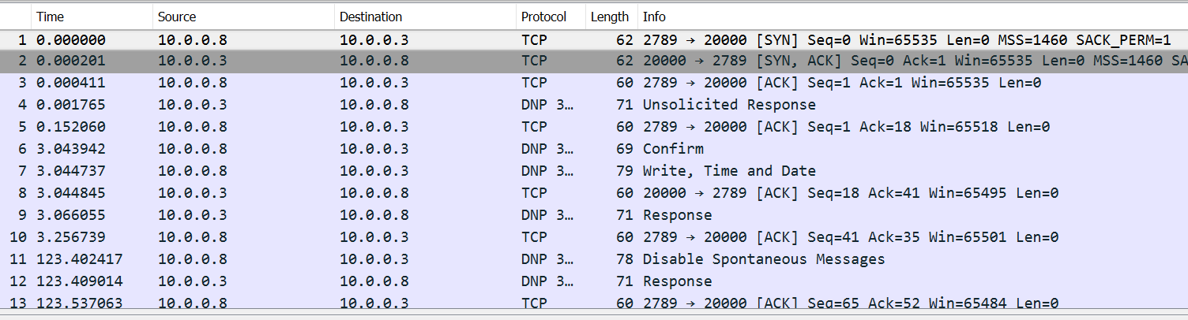
Limitations
Initial goal for the implementation
  Import and read the set of data from pcap file
  Find the complete data handshake among the TCP protocol
  Catch network intrusions in the pcap file
Notes:
Our initial goal for implementation was to read the set of data from pcap file and find data flowing pattern based on the detected complete data handshake among the TCP protocol.
However, we did not have enough AIS resources, and had limited time. And we only had about 100 set of data flowing and only 8 complete handshake in the data set. The data set was not enough to find accurate data pattern. We can get the information of each packet with the built-in function. But, as we can read the packet’s information using Wireshark easily and more clearly, we concluded that it is no necessary to implement just to show the same packet’s information.

Slide 6
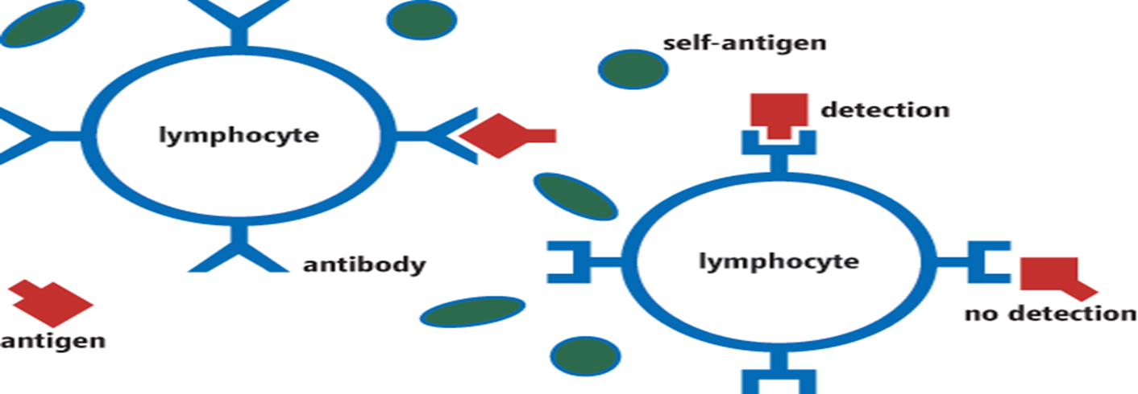
Implementation Design
Visual Studios C# Console application
Algorithm used:
  Negative Selection Algorithm (NSA)
Data used:
  User inputted Transport Control Protocol (TCP) “Handshake” bits
AIS terminology to represent network elements
Notes:
This is a C# console application. This deliverable will not allow us to create a realistic AIS system but it contains all the processes that are necessary in doing so such as implementation of Negative Selection Algorithm(NSA) and r-chunk bit matching. This implementation is a theoretical scaled down approach of a real world AIS to catch intrusions in real time network data. Although for the purposes of constructing an implementation in a timely and feasible manner we will be using theoretical TCP/IP network data which will be user inputted instead of a real time network stream.

Slide 7
Implementation Result
Step 1: Creating the Self-Antigen Set
This self-antigen set represents the bytes in a normal TCP handshake.
48 bits, 3 separate sections of 16 bits each as shown below:
1. Syn flag: 0111000000000010
2. Syn, Ack flag: 0111000000010010
3. Ack flag: 0101000000010000

Slide 8
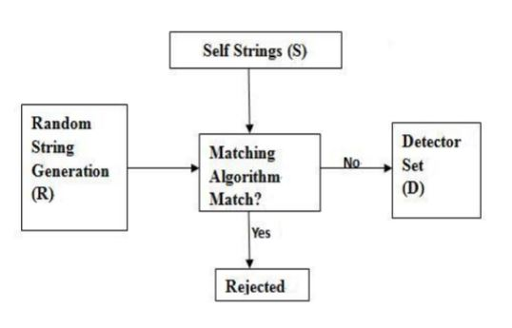
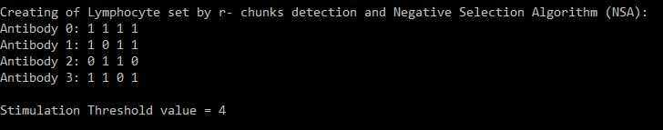
Implementation Result
Step 2: Creating the Lymphocyte set
Antibody detectors
  Random bit array generated
  No antibody can detect a self-antigen
  Antibody not in result set

Slide 9
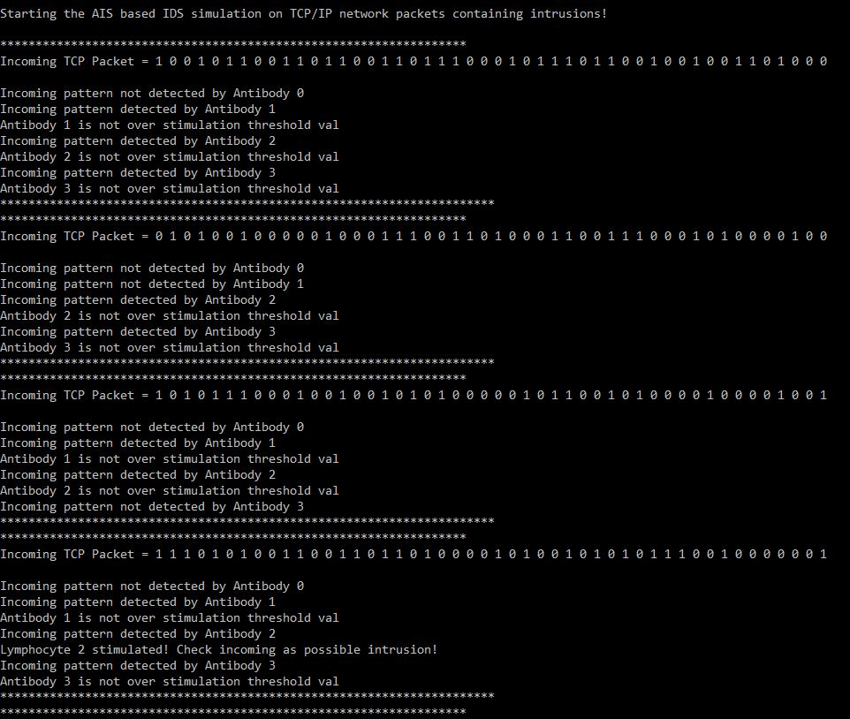
Implementation Result
Step 3: Detecting Intrusions on
incoming packets
Randomly generated TCP “Handshake” packet bits
Knuth Morris Pratt (KMP) algorithm

Slide 10
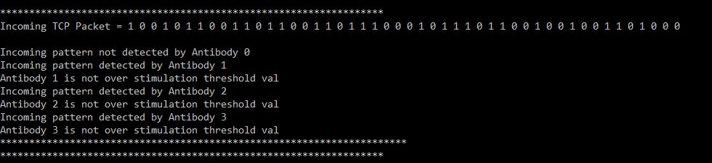
Implementation Result
Step 3: Detecting Intrusions on incoming packets
Iteration 1:

Slide 11
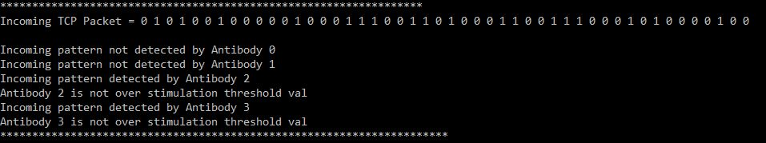
Implementation Result
Step 3: Detecting Intrusions on incoming packets
Iteration 2:

Slide 12
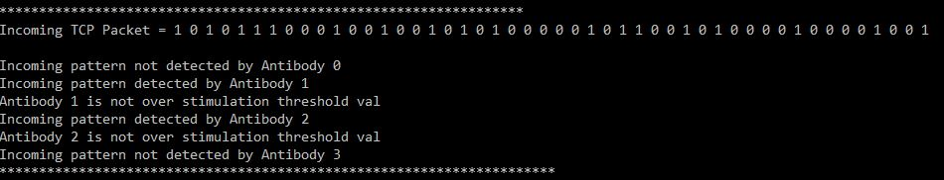
Implementation Result
Step 3: Detecting Intrusions on incoming packets
Iteration 3:

Slide 13
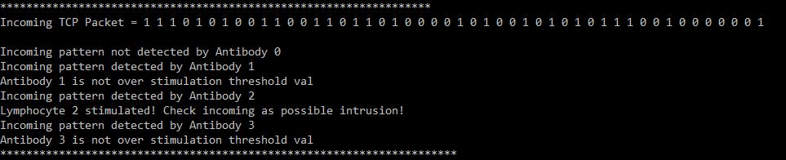
Implementation Result
Step 3: Detecting Intrusions on incoming packets
Iteration 4:

Slide 14


Potential Future Expansion
Future of AIS in Smart Grid Networks:
Scale up the AIS implementation to enable it to run on networks like the WAN in smart grid.
Furthermore, AMI data (which uses TCP/IP network pcap data) can also be able to catch intrusions in the smart grid.
Future of AIS based IDS:
Dendritic Cell Concept
Solve current problems like high false alarm rates
Boosting the efficiency of current systems
Notes:
WAN has TCP/IP data.

Slide 15
Acknowledgments
Dr. Edward Fox
Support by MITRE, including guidance by James Morris King, Devin Wynne
References:
https://msdn.microsoft.com/en-us/magazine/msdnmag0113
http://www.tdworld.com/smart-grid/cybersecurity-and-power-grid-preparing-future
https://www.encyclopedia.com/computing/dictionaries-thesauruses-pictures-and-press-releases/artificial-immune-system
https://www.pymnts.com/startups/2018/cybersecurity-startups-ipo-cybercrime-cyberattacks/
https://www.dreamstime.com/stock-illustration-smart-grid-concept-cloud-computing-technology-image78778053

