Slide 1
VeSPA Website Enhancements and VeSPAbot
Gregory Jenks, Jared Pepin, Andrew Rothwell, Derek Richard

Slide 2
Goals
Enhance site functionality
Make site easier to update and use
Provide Chat Moderator for Twitch Streaming Service

Slide 3
Website Problems/Lessons Learned
None of us knew PHP or Wordpress
Adapting current plugins for our own uses
PHP Limitations from vt hosting
Plugin Compatibility
No ChangeLog

Slide 4
Site Features Added
Email Newsletter
Forum System
Membership System
Custom Login Page
Removed evidence of Wordpress
Video Page for both Twitch and Youtube
Content Generation
Customized member fields

Slide 5
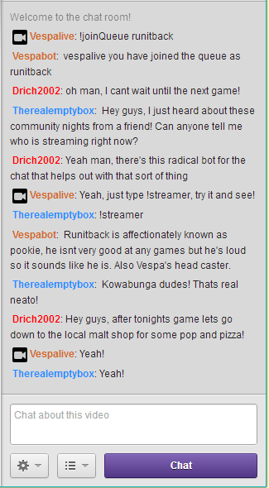
VeSPAbot
IRC bot for the VeSPA Twitch Channel
Increase Chat partipation
Advertise site
Future
  Modules
  Site tie ins

Slide 6
Bot Demo

Slide 7
Bot Problems/Lessons Learned
Problems
  Learning Python
  Libraries
    iterations of the bot
  Threading ontop of IO
Learned
  Python
  Better Design
  Threading on IO can suck

Slide 8
Questions?

