Slide 1
Virginia Tech
University Libraries
Discovery Teams
Spring 2012
Team Theme/Topic
Technology
Team Members
Rebecca Miller
Bruce Obenhaus
Jeremiah Puryear
Jennifer Sparrow

Slide 2
KEY OBSERVATIONS RELATED TO YOUR THEME
(5-6 major trends)
Power outlets
Space to work/Comfort
iPads
Cameras
Space selection based on work preferences

Slide 3
SURPRISING OBSERVATIONS / COMMENTS
(3-5 unexpected things that you encountered)
Maybe three individuals using the Library to look up articles, not just using the internet.
Individuals selecting spaces they expect to be found by others in.
Many students were using multiple devices: laptop and cell phone most common. Sometimes even laptop, iPad/tablet, and cell phone

Slide 4
“WHY THIS SPACE?”
(3-5 qualities that students preferred)
Useful - equipment, help
Atmosphere - quiet/loud, empty/busy
Convenient: proximity to classes/friends

Slide 5
“WHY OTHER SPACES?”
(3-5 qualities that students preferred other locations)
Convenience
Atmosphere
Software

Slide 6
“WHAT HAPPENS IN THIS SPACE?” (or with tools)
(activities, process, how are they using the space/tools)
Assignments - laptops, Internet, Office
Group work - laptops, internet, iMovie
Studying - laptops
Texting - cellphones

Slide 7
THINGS TO FOLLOW-UP ON
(3-5 things that need more research)
Discover what other software/services are available elsewhere
Determine need for large displays for group work. May want to consider wireless projection options
What equipment would students check out (power cables, laptops, were both mentioned)

Slide 8
ANYTHING ELSE YOU WANT TO SHARE
Many spaces were crowded or near capacity
Many students were connected via cell phones for texting in addition to their laptops for work
Some tables were groups of students working together, some were just individuals working at the same table due to lack of space to spread out.

Slide 9
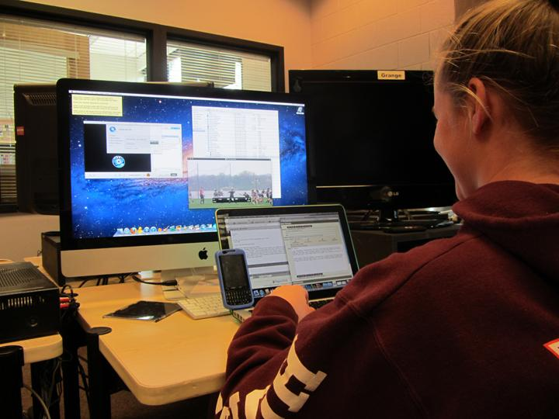
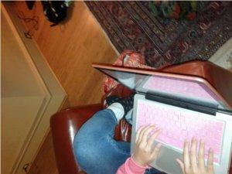
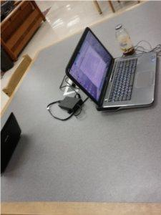
PHOTOS

