Slide 1

AIChatbotWebsite
Tyler Buxton, Aaron Gomez, Jared Melini, Patrick Johnson
CS4624 - Multimedia, Hypertext, and Information Access, Dr. Edward A. Fox
Virginia Tech, Blacksburg VA 24061, 05.09.2024

Slide 2
Outline
1. Introduction
2. Models/Figures
3. Final Pages
4. General Information
5. Demo
6. Q&A

Slide 3
INTRODUCTION

Slide 4
Background
▪ Episodic Future Thinking (EFT)
▪ AI Assisted Healthcare
▪ Scalability and Cost-Effectiveness

Slide 5
Problem
▪ No User Interface
▪ No Usability Support
▪ No Data Collection

Slide 6
Motivation
▪ Create Secure Website
▪ Guide User Through Process
▪ Advance Research in AI and Health

Slide 7
Client
Sareh Ahmadi, Ph.D. Student, Department of CS
Dr. Edward Fox, Advisor
Field of Artificial Intelligence

Slide 8
MODELS / FIGURES

Slide 9
Summarized UML
GPT-4
React
Quart
Anonymizer
Qualtrics
Notes:
Add more stuff here, provide safe website

Slide 10
Frontend
Start
Qualtrics/Login
Home
Usability Survey
Qualtrics
Continuous
Finished
Header
Task Stepper
Notes:
From Dr. Fox. Sl. 10: Please update to reflect the final sequencing. To start, one may have login, or else Qualtrics and then login. To end, the website calls Qualtrics and does not do anything after that.

Slide 11
Backend
User
id | String (primary key)
password_hash | String
survey_id | String
messages | List[Message]
eft_cues | List[Cue]
usability_assessment | String
Message
id | String (primary key)
user_id | String (foreign key)
content | String
role | String
timestamp | Integer
Notes:
Add more stuff here, provide safe website

Slide 12
Backend
Cue
id | String (primary key)
user_id | String (foreign key)
content | String
timeframe | String
Event
id | String (primary key)
user_id | String (foreign key)
action | String
timestamp | Datetime
Notes:
Add more stuff here, provide safe website

Slide 13
Final Pages

Slide 14
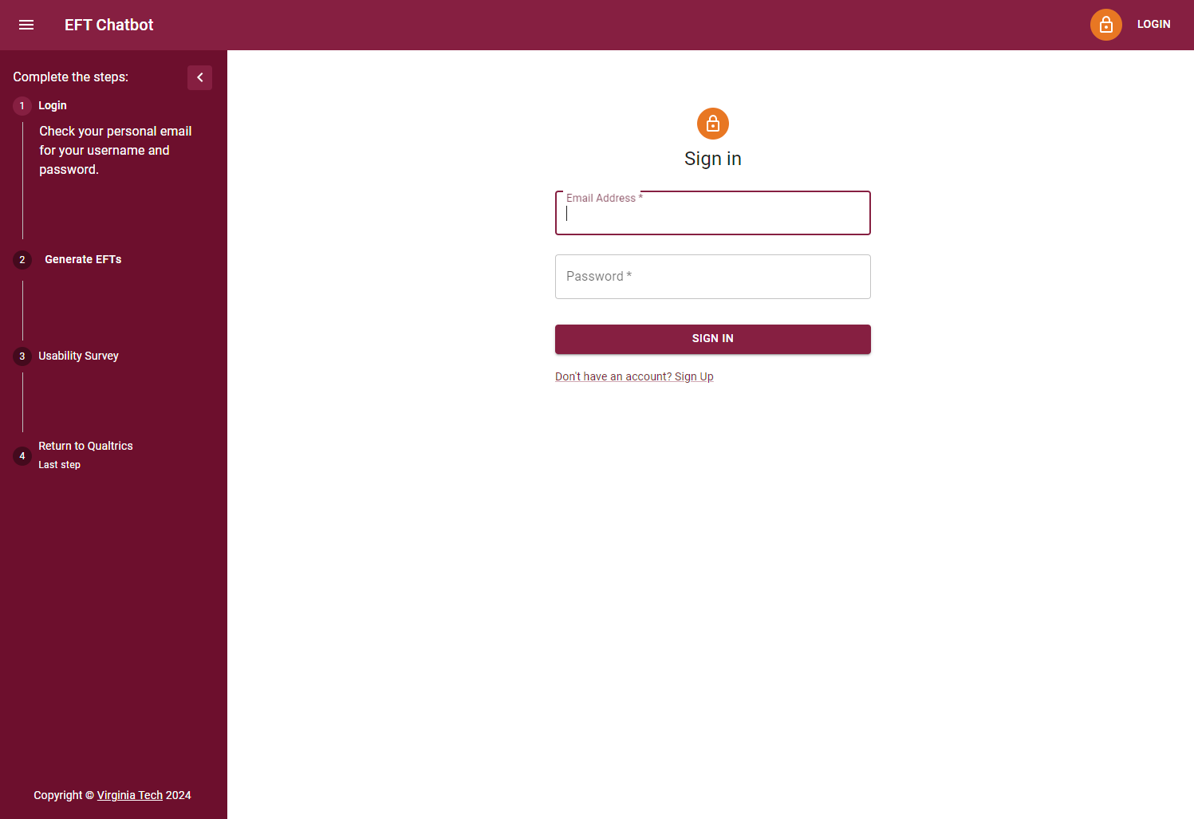
Login

Slide 15
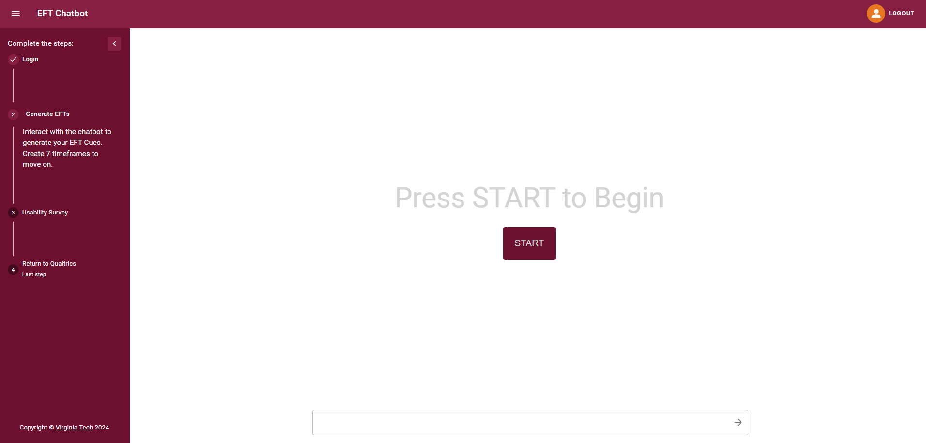
Home - Start

Slide 16
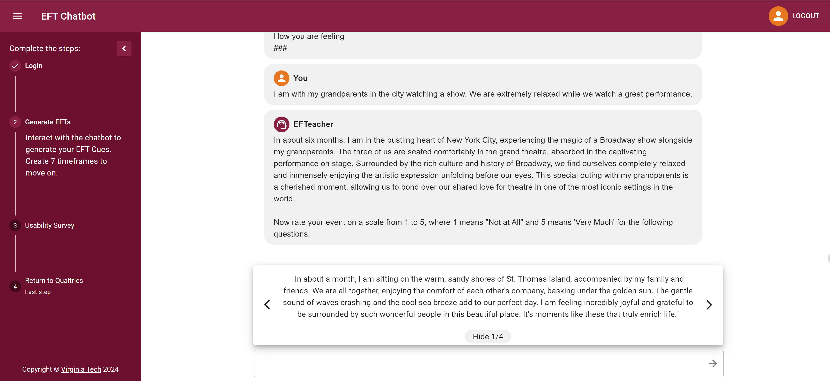
Home - Chatbot

Slide 17
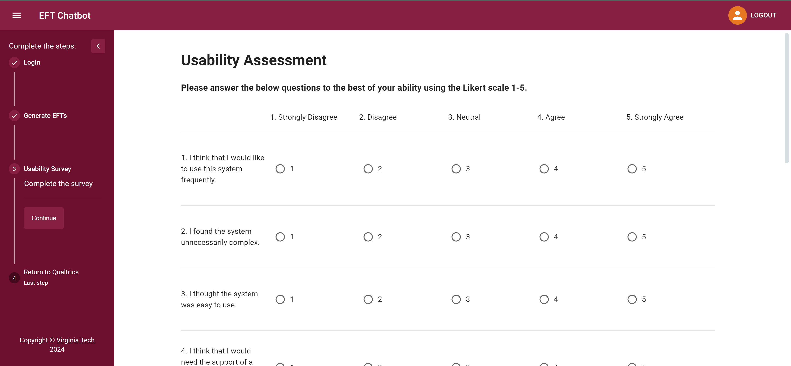
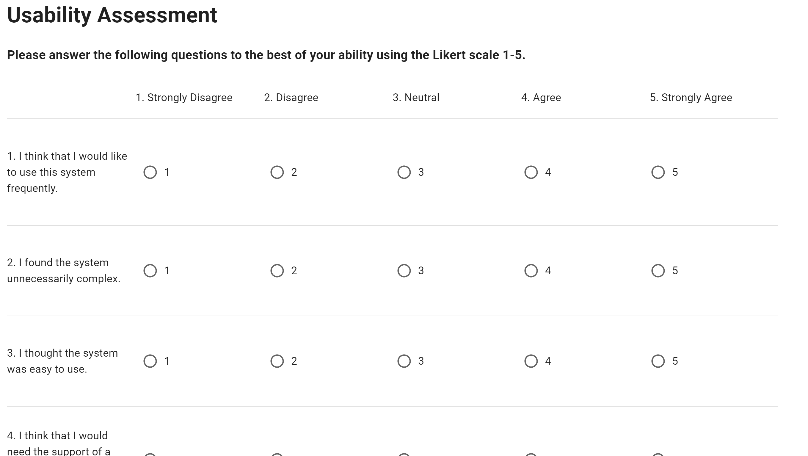
Usability Assessment

Slide 18
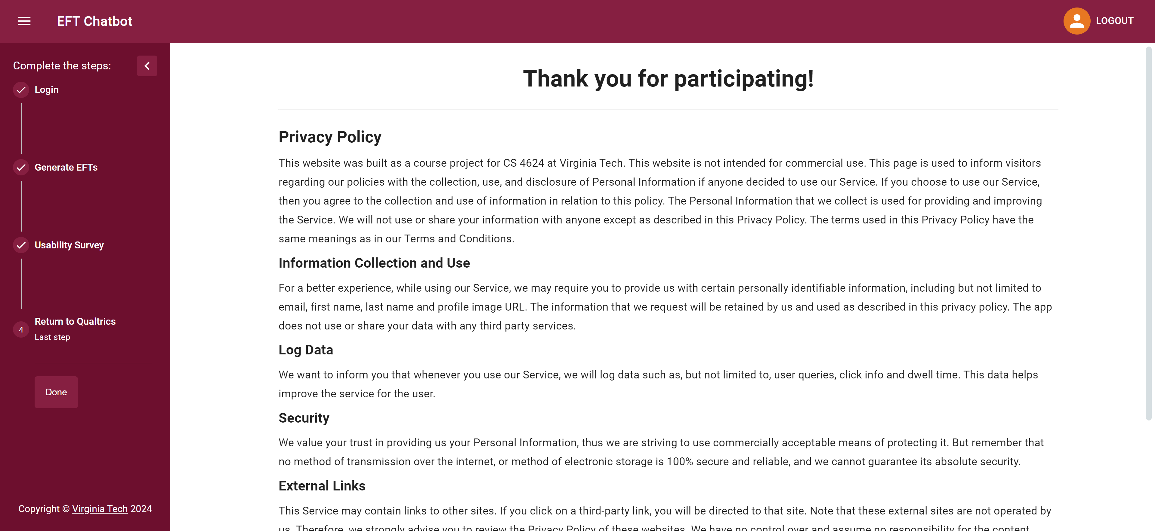
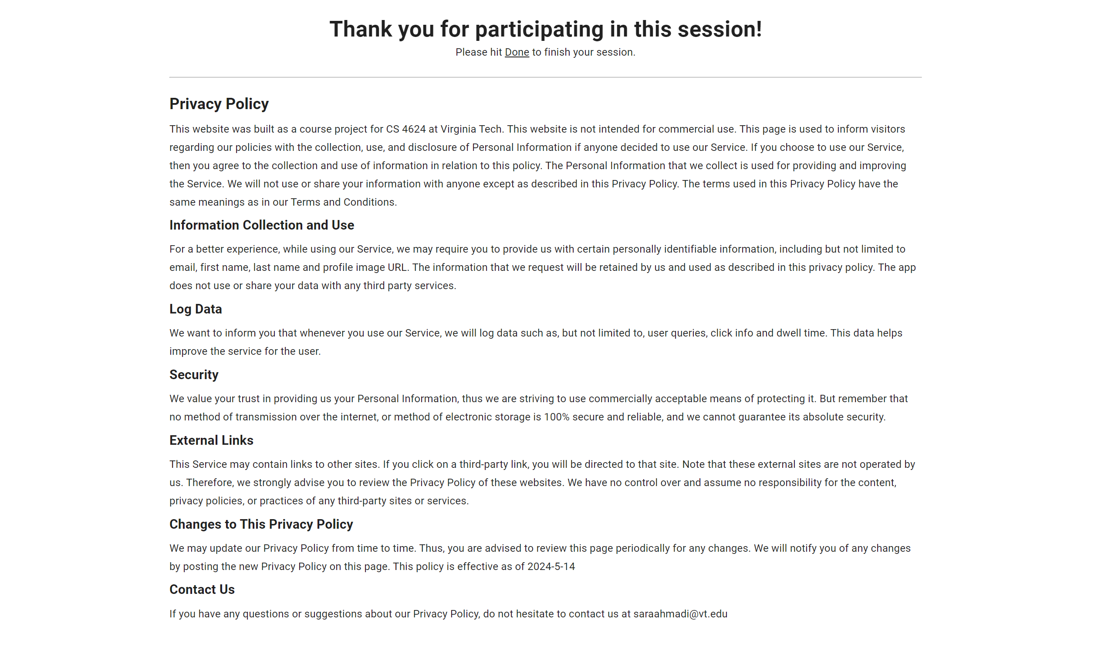
Finished Page – Return to Qualtrics

Slide 19
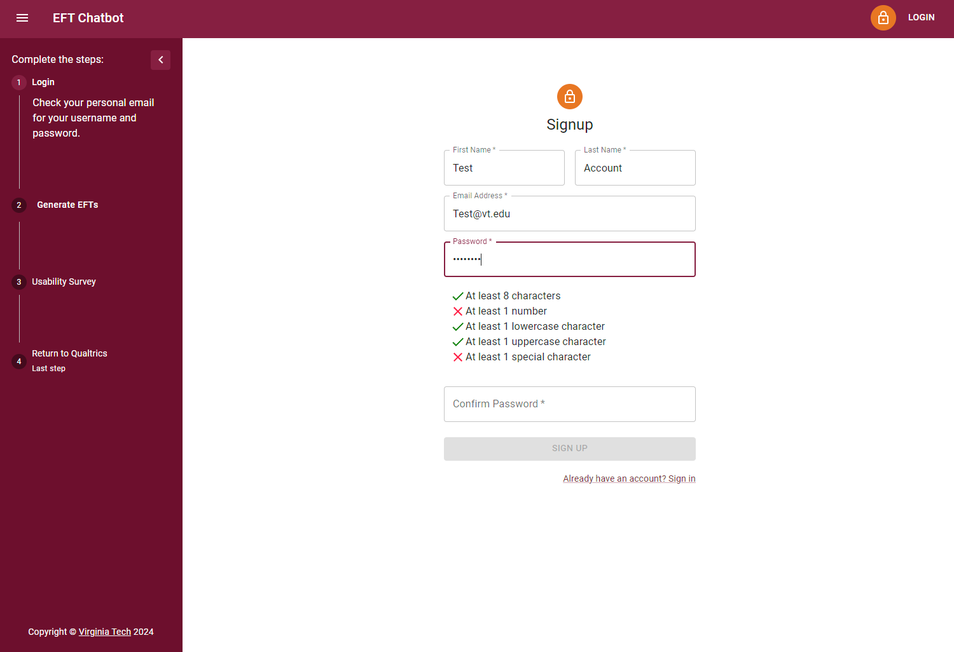
Sign up – Development Only

Slide 20
GENERAL INFORMATION

Slide 21
Timeline
Jan/Feb
Environment Set Up
Report & Presentation
March
Docker Image to Server
April/May
OpenAI
Qualtrics Routing
Ollama Model
Presentation 2
Final Report & Presentation
Finalize Production
Notes:
Add more stuff here, provide safe website

Slide 22
Issues Along the Way
▪ Connecting to Qualtrics
▪ Using Previous Code Base
▪ Getting Access to Virtual Machine
▪ Getting Access to Azure
Notes:
Add more stuff here, provide safe website

Slide 23

Future Work
▪ Testing with Real Users
▪ Password Recovery
https://www.securecloudaas.com/services/infrastructure-solutions/ms-azure/
Notes:
Add more stuff here, provide safe website

Slide 24
References
Acknowledgements​
▪ Sareh Ahmadi – Client
▪ Satvik Chekuri – GTA
▪ Edward Fox – Professor
Simplilearn. (2023, November 7). Top artificial intelligence stats you should know about in 2024. Simplilearn.com.
https://www.simplilearn.com/artificial-intelligence-stats-article
2. McGranahan, Mary Kate, and Sunday Ubur. (2023, December 17), Final Report CS 5604: Information Storage and Retrieval.
https://vtechworks.lib.vt.edu/items/d158c9dd-4068-4f26-8541-0b6678e1f139

Slide 25
Q&A

