Slide 1

Visualizing eTextbook Study Sessions
CS 4624: Multimedia and Hypertext
Mohamed Farag
02/14/2023
Anoushka Deshmukh, Abilash Pradeep, Nick Grifasi, Nischal Dinesh, Yashwanth Narem
Virginia Tech, Blacksburg VA 24061

Slide 2

Outline
Overview
Requirements
Design
Set Up
Testing/Evaluation
Lessons Learned
Future Work
Acknowledgements/References

Slide 3
Overview
Generating a web page, with a variety of visualizations and tools to help the educator, or user understand all aspects of openDSA user patterns, logs and time spent.
1. Raw Student Data
2. Translated CSV File
3. Visualization Dashboard
Notes:
In this project, our goal is to implement a web interface to visualize interactions generated from students' study sessions using OpenDSA content, so that instructors can conveniently understand how their students learn from OpenDSA and identify possible improvements to their learning process.

Slide 4
Requirements
Dashboard should be easy to understand
Must represent the three states
  Readings
  Visuals
  Exercises
Each visualization should be per user, per session

Slide 5
Design
TranslationScript
HTML Dashboard
Simplified CSV
Visualization Script

Slide 6
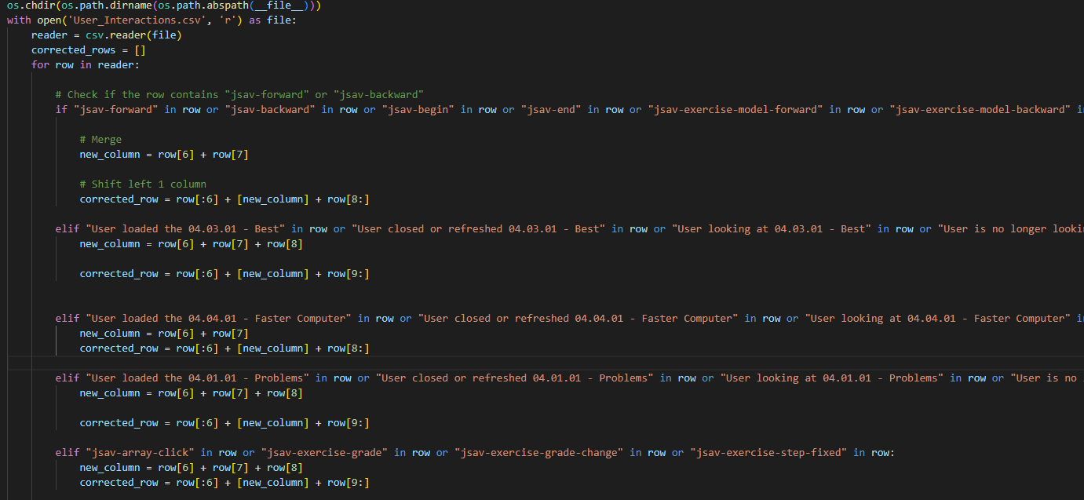
Data Cleaning
Interaction logs had different pandas column headers
Time formatting: "%Y-%m-%d %H:%M:%S"
  Needs to be in "%m/%d/%Y %H:%M"
Problem columns:
Notes:
The main aspect of data collection we needed was time, for the weighted edge graph visualizations weighted on time. So time formatting had to be modified to accommodate our SQL data. A lot of the data from SQL had comma delimited rows that did no adequately fit.

Slide 7
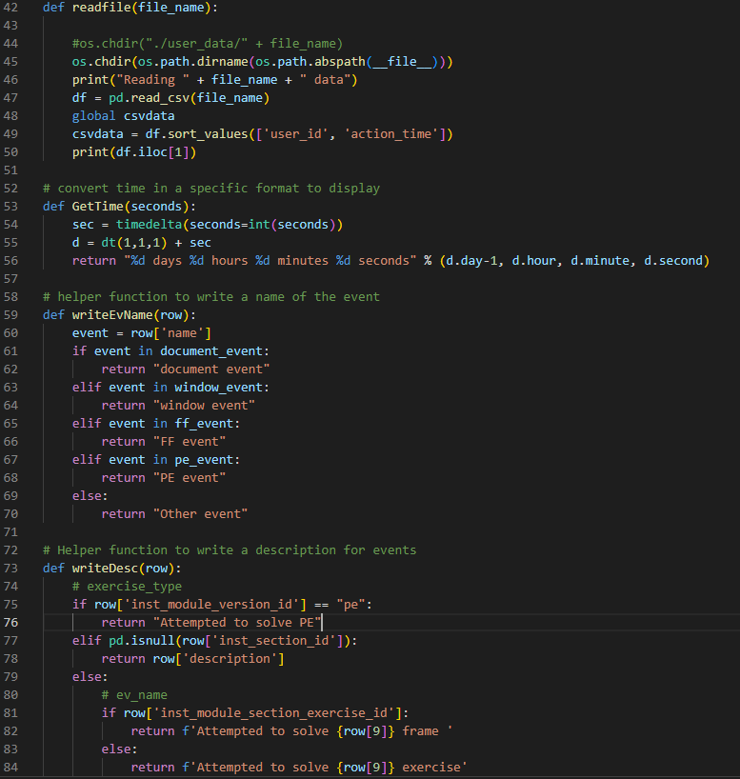
Backend: Set up
Reading in the raw data
Collecting timestamp information
Parsing event information
Translating event data
Calculating time spent on any given action

Slide 8
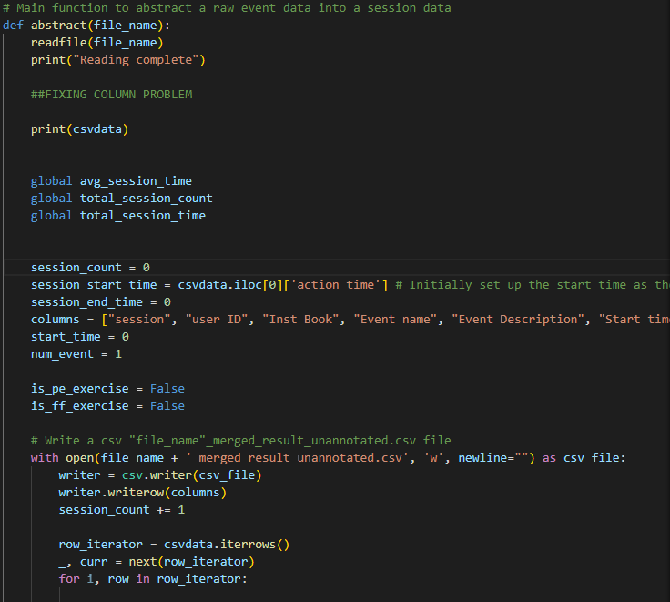
Backend: Main function
Main Function to abstract a raw data event into a session data
Reads from given Interaction.csv, writes to a new csv “file_name”_merged_result_unannotated.csv file.

Slide 9
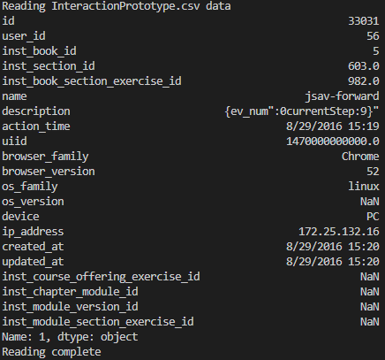
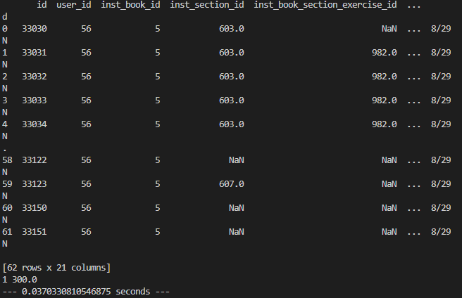
Abstracting_script.py output
InteractionsPrototype.csv -> InteractionsPrototype_merged_result_unannotated.csv

Slide 10
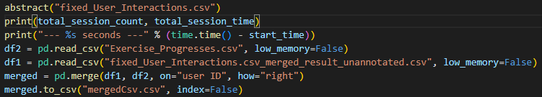
Merging Interaction and Exercise csv’s
Abstracting_Script.py parses User_Interactions.csv
The other csv from the database is Exercise_Progresses.csv
These two csv’s must be merged to visualize the data
The resulting file is mergedCsv.csv, a very large 2.8gb file that has merged data from the two csvs. The data is now ready to be visualized.
Notes:
Along with user_interactions.csv, there is also another csv exercise_progresses.csv that contains information related to specific exercises the student was working. Including scores, steps of the exercise.

Slide 11
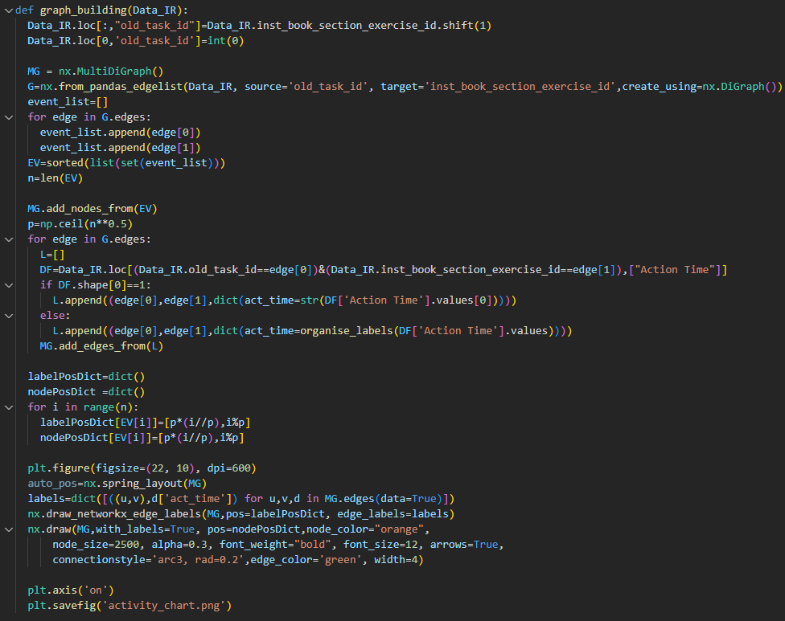
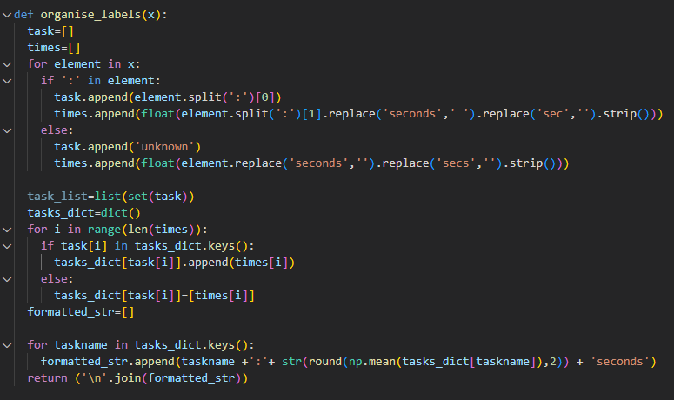
Frontend: Visualization Code
Visualizations created using networkx library

Slide 12

Frontend: Pyscript
Pyscript is a tool that allows you to create frontend web applications using Python
We will be creating the dashboard with html/css, and adding our visualization code inside the <py-script> tags.

Slide 13
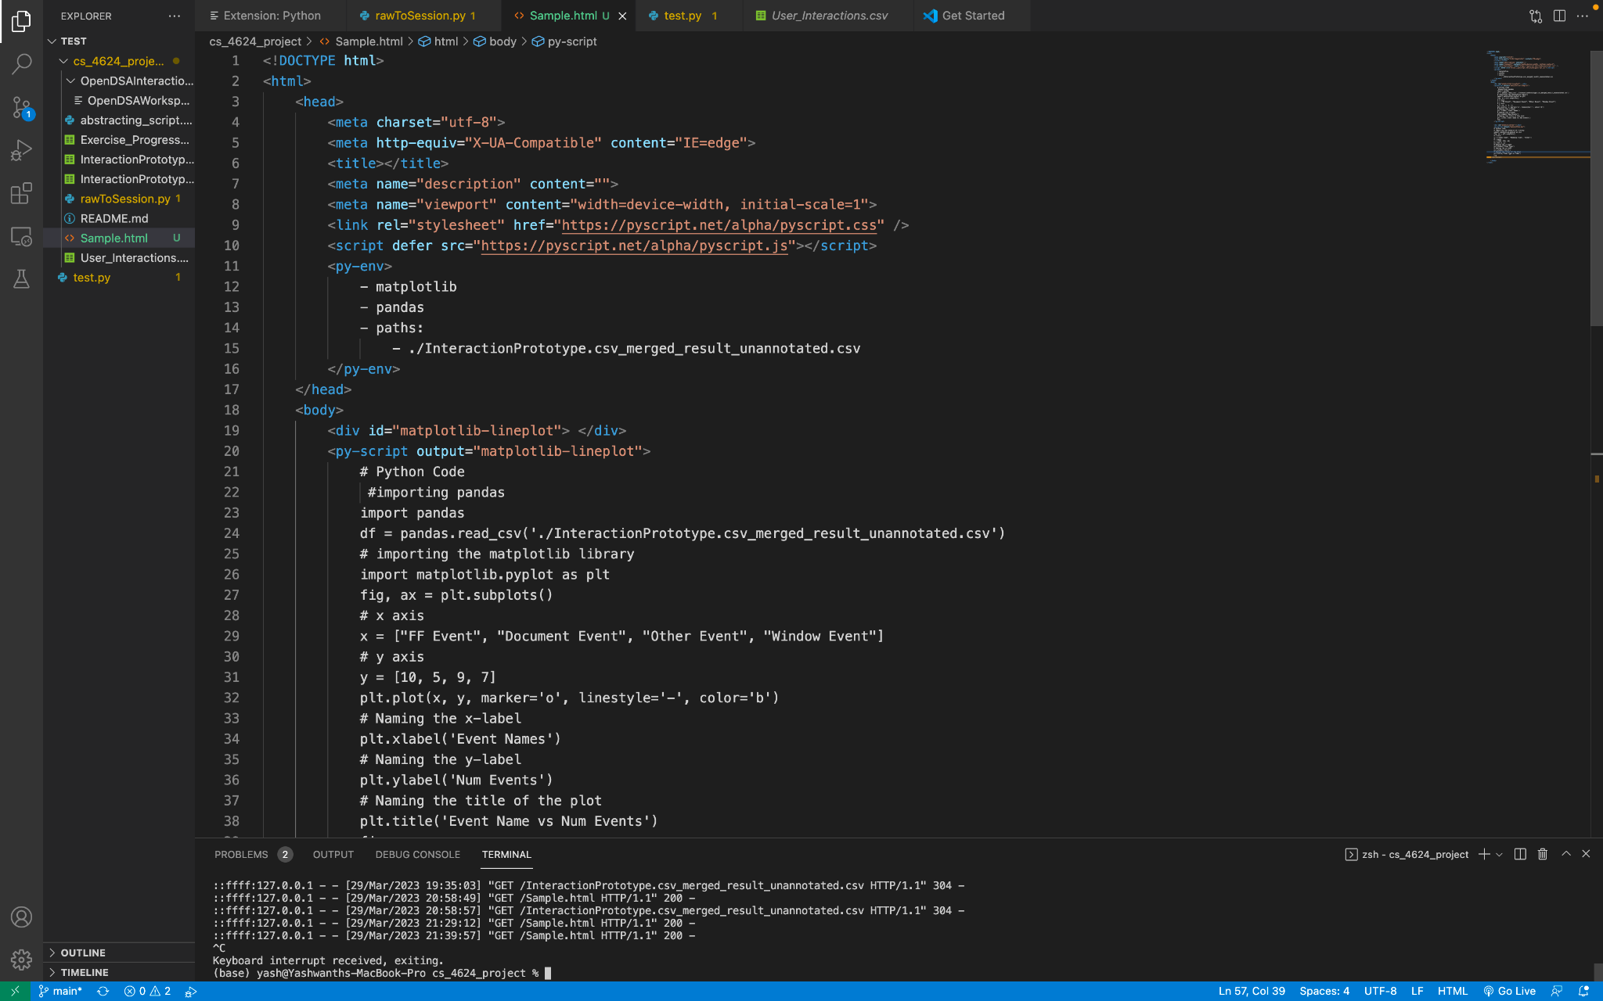
Frontend: Pyscript

Slide 14
Front End: HTML Site
The Dashboard site features tabbed panes for each visualization(s)
For movement between changes between a single set of exercise visualizations a additional set of buttons will be placed to toggle this.

Slide 15
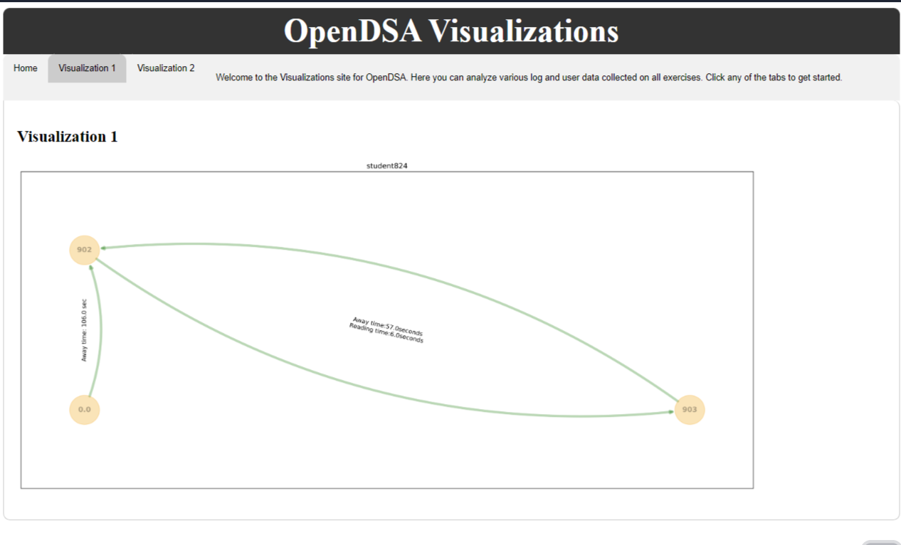
Front End: HTML Site

Slide 16
Initial Proof of Concept
Student 1305: Session 3
7:00 AM
Readings
8:00 AM
Visuals
8:15 AM
Exercises
7:50 AM
7:30 AM
Notes:
so this was our initial proof of concept,
we wanted the visual to display 3 states with arrows between them signaling the times at which a user accessed each state

Slide 17
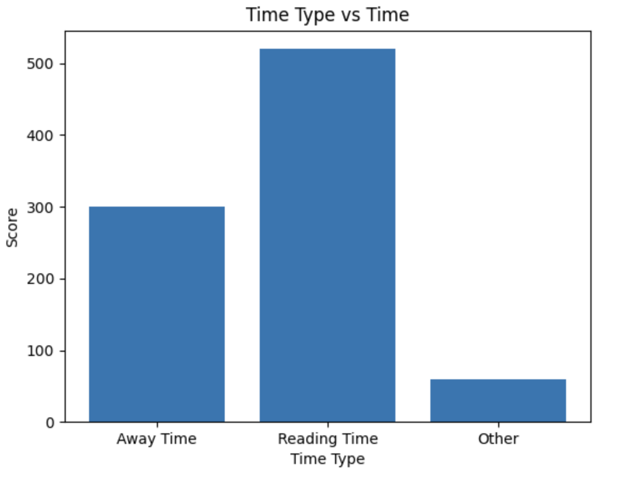
Prototype Visualization 1.1
Notes:
this was the first visual we came up with, pretty crude in the sense that it did not display much other than the state and the score (total time spent in each state in seconds)

Slide 18
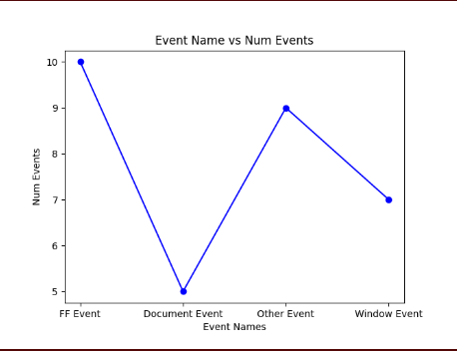
Prototype Visualization 1.2
Notes:
this was the second visual we came up with, instead of displaying the state directly, we displayed them in terms of events (FF = away from screen, document, window = interaction with visual, other = miscellaneous)

Slide 19
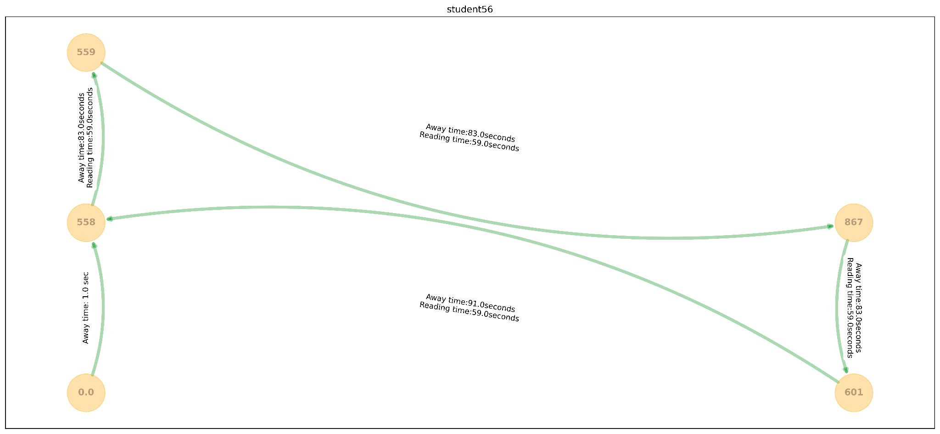
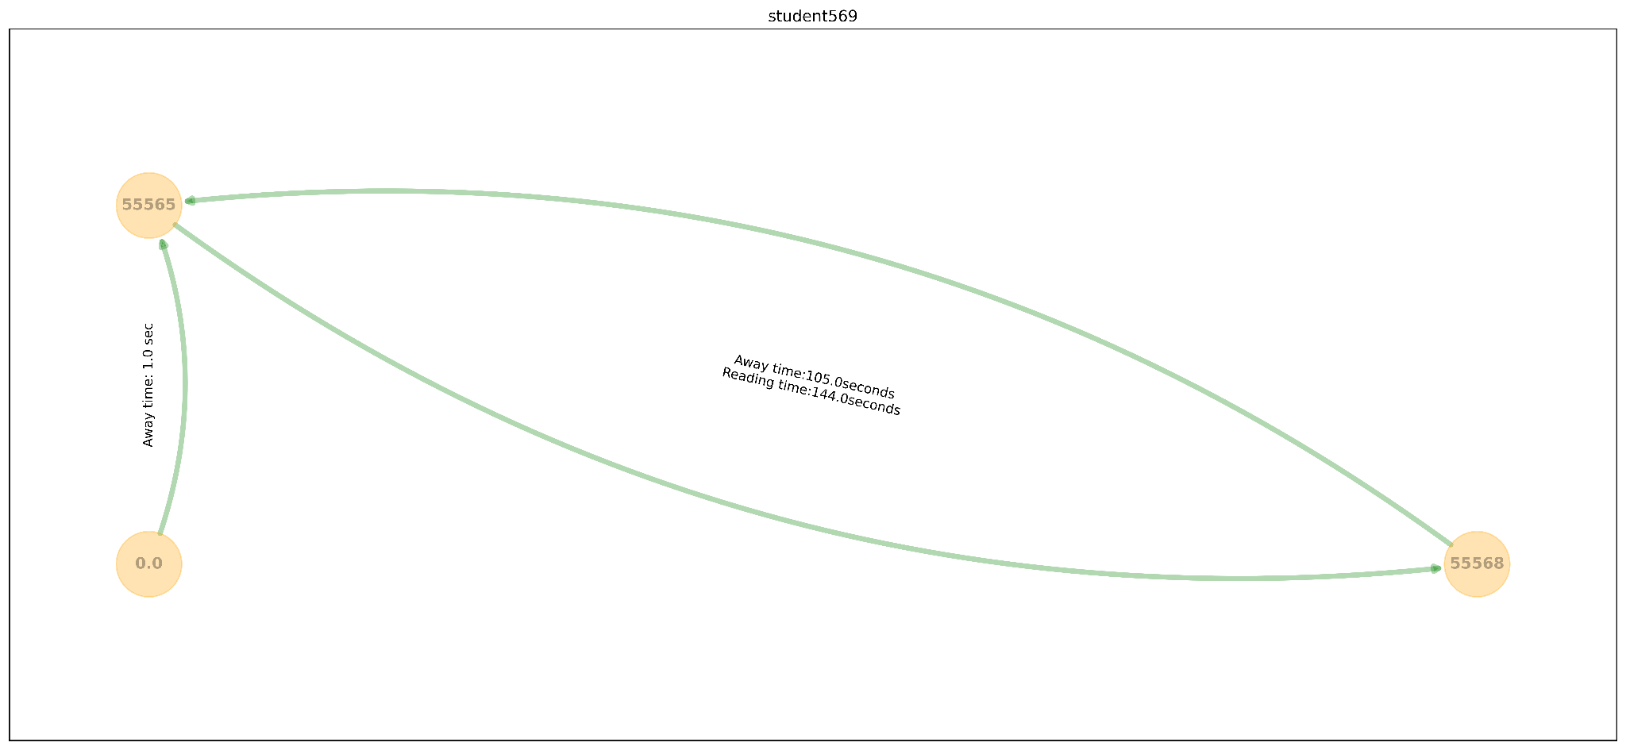
Prototype Visualization 2.1
Notes:
This is final version of the visual we came up with. The number within the orange circle represents the exercise id and the green arrow represents the progression of the exercise. From here you can see the student56 started from the front page, began with exercise 558 spending a total of 59 seconds actively reading the exercise and 83 seconds away from the tab, moved on to 867, then 601, and finally back to 558 again.

Slide 20
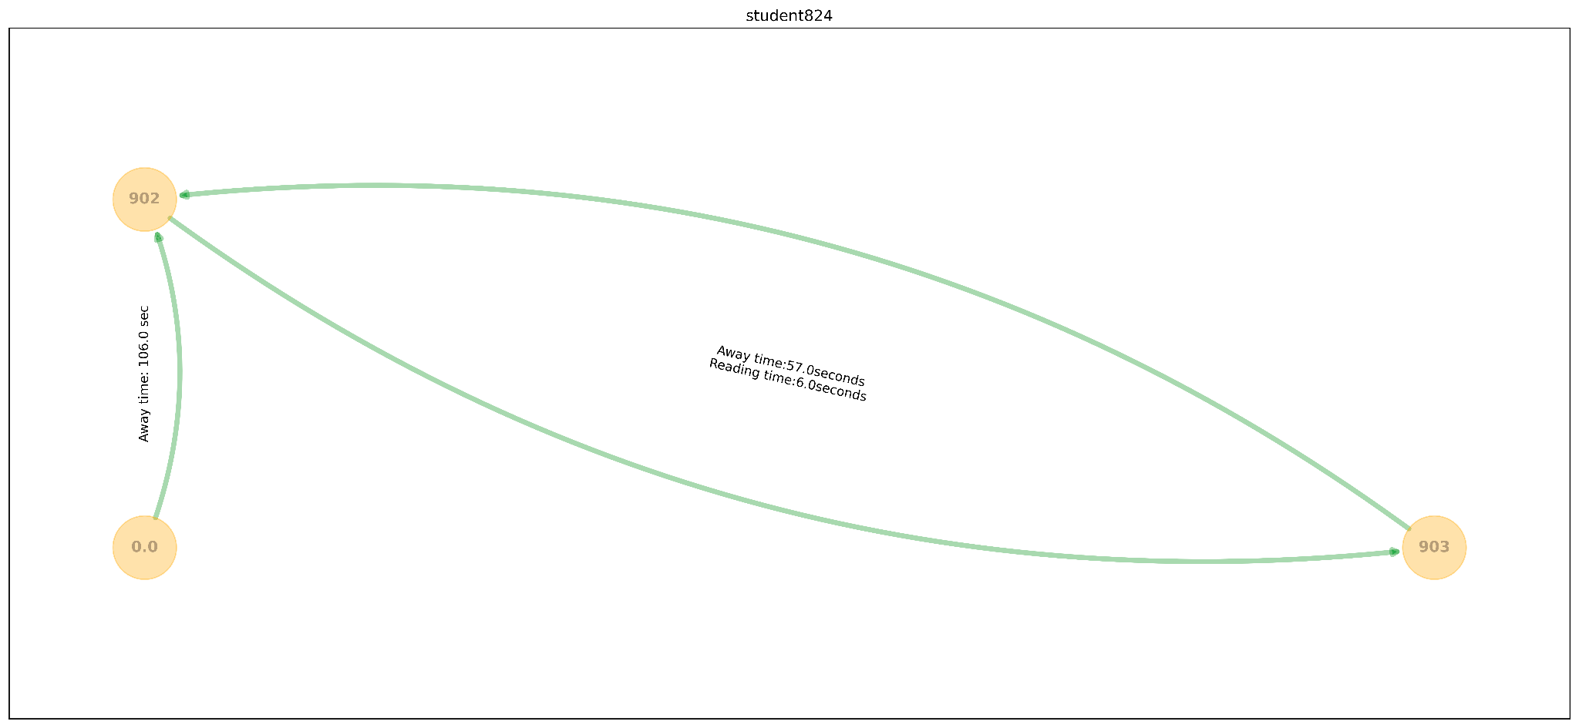
Prototype Visualization 2.2
Notes:
This is the prototype for student824. Unlike before, the student was away from the tab at the start (prior to beginning any exercise), started on 902 and directly skipped to 903 without completion, then went back to 902.

Slide 21
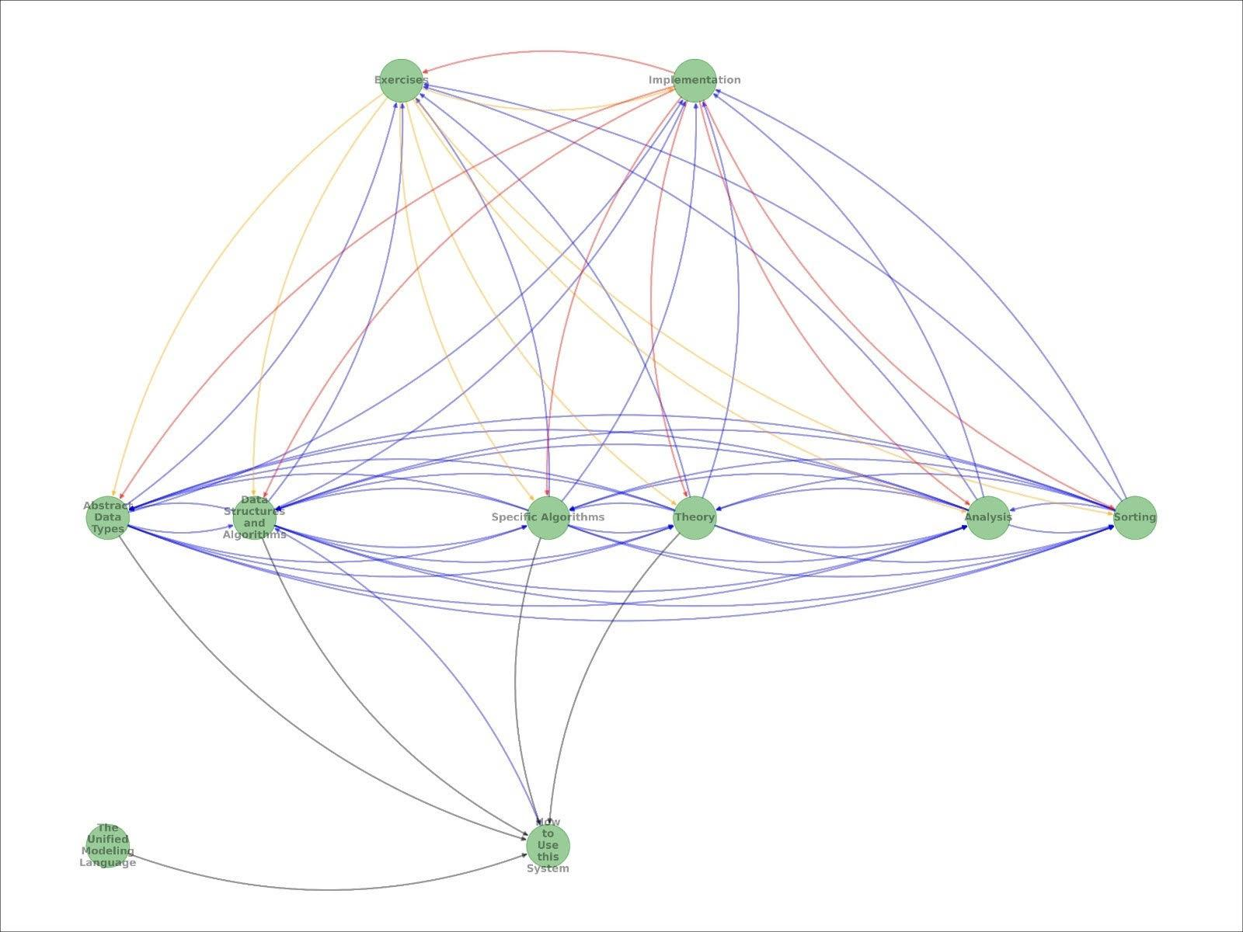
Future Work Prototype
Nuanced Visualizations with more than three states

Slide 22
Set Up
git clone https://git.cs.vt.edu/nickgrifasi/cs_4624_project.git
cd .\cs_4624_project\ | python3 abstracting_script.py
  Runs the abstracting_script.py. Line 338: abstract(“file_name”). We will be reading files from stdin in the future.
python -m ‘http.server’ 8080
http://127.0.0.1:8080/pyscript.html
  Runs the html file in your local host. We will extending this functionality with a command that creates a local server for online and easier file access.

Slide 23
Testing & Evaluation
Meeting all cases
  Including unexpected behavior
Testing NULL input
Testing improperly formatted input
Ensuring all values are read and parsed
Preventing issues with the HTML viewing

Slide 24
Lessons Learned
Accounting for unexpected user behavior
Issues with file formatting being altered
Documenting all steps and edits
Merging data files for output
Script compatibility
Managing file sizes
Notes:
New edits included in orange

Slide 25
Future Work
Drawing conclusions from data
  Applying the program to different courses
  Understanding patterns between courses
  What activities do students do most
  Comparing student behavior to course grades
Gauging feedback from course instructors on usability
Evaluating ease of use

Slide 26

Acknowledgements
Mohammed Farghally
Ph.D., Computer Science and Applications
Virginia Tech, 2016
mfseddik@vt.edu
https://sites.google.com/a/vt.edu/mfseddik_website/Education

Slide 27
References
[1] - Heo, Samnyeong. “Analyzing Student Session Data in an ETextbook.” VTechWorks Home, Virginia Tech, 18 July 2022, https://vtechworks.lib.vt.edu/handle/10919/111286.
[2] - Client meetings: Mohammed Farghally

