Slide 1
Clustering and Topic Analysis
CS 5604 Final Presentation
December 12, 2017
Virginia Tech, Blacksburg VA 24061

Slide 2
Acknowledgments
Global Event and Trend Archive Research (GETAR) project, supported by NSF IIS-1619028
Integrated Digital Event Archiving and Library (IDEAL) project supported by NSF IIS-1319578
CS5604 GTA Liuqing Li, Instructor Edward A. Fox

Slide 3
Team Members
Topic Analysis
Clustering
Ashish Baghudana
Shruti Shetty
Aman Ahuja
Ashish Malpani
Rammohan Chintha
Mo Yang
Pavan Bellam
Prathyush Sambaturu

Slide 4
Overview
Use topic analysis and clustering algorithms to find sub-themes and similar patterns in collections of webpages and tweets about real world events
Pull and clean documents
Topic Analysis
Clustering
Store results in HBase

Slide 5
Overview
Classify Documents into Real World Events
Preprocessing
Topic Analysis: LDA
Clustering: K-means
Topic Names
Topic Probability
Cluster Name
Cluster Probability
HBase

Slide 6
Topic Analysis

Slide 7
A (really) brief overview of topic models
Topic models discover “abstract” topics in a collection of documents where a topic is a group of “semantically similar” words.
Mainly latent Dirichlet allocation (LDA) or its variants
  Probabilistic algorithm
  Optimized via Gibbs Sampling or Expectation Maximization
LDA assumes documents a mixture over topics and topics a mixture over words

Slide 8




Tech Stack - Python++
Database Access
Topic Modeling
Data Extraction & Visualization
Data retrieval and upload pipelines written using the Python library happybase.
Preprocess tokenized data using NLTK for stopword and punctuation removal. Allow custom pipelines. Use multi-core support from gensim for LDA.
Extract topics for each document and visualize topic clusters for each collection
NLTK
happybase
pyLDAvis
Notes:
An alternate stack includes PySpark for LDA implementation

Slide 9
Alternate Tech Stacks
Scala + Spark + MLLib is an alternate stack
  Might scale better for larger datasets
  However, lacks the visualization and evaluation mechanisms that are built into gensim and pyLDAvis
Gotchas
  PySpark + Spark + MLLib
    does not implement the class DistributedLDAModel
    LDAModel does not implement several important methods such as: topTopicsPerDocument(), logPerplexity() and topicCoherence()
Python + Gensim is best suited (multi-core support really helps!)

Slide 10
Preprocessing Pipeline (where the magic happens)
Built a fast and customizable preprocessing pipeline.
Tokenizer
Mappers
Filters
Use NLTK’s word_tokenize if using <document>:clean-text
Use CommaTokenizer or SemicolonTokenizer if using <document>:clean-tokens
Map tokens to a different form. Examples include:
LowercaseMapper
PorterStemmer
WordnetLemmatizer
Filter out specific tokens. Examples include:
StopwordFilter
PunctuationFilter
LengthFilter
ASCIIFilter
CollectionFilter

Slide 11
Collection Filter - Customizing for each collection
Certain words occur repeatedly in each document and can be regarded as stop words for that collection
Solar Eclipse 2017
Hurricane Irma
solar | eclipses | facebook
eclipse | subnav | twitter
totality | aug | published
tse | august | username
eclipse2017 | account | password
hurricane | sept | business
irma | september | insider
national | csbn | guardian
global | reuters | subscribe
us | florida | bloomberg

Slide 12
Developer Manual
Topic Modeling is end-to-end integrated as a single script with several built-in options
usage: lda.py [-h] -c COLLECTION_NAME -t TOPICS [TOPICS ...] [-p] [--table_name TABLE_NAME] (-hb | -f FILE) [-l LOGS] [-a ALPHA] [-b BETA] [-i ITER] [--save_dir SAVE_DIR] [--tokenizer TOKENIZER] [--mappers MAPPERS [MAPPERS ...]] [--filters FILTERS [FILTERS ...]] [--filter_words FILTER_WORDS]
Run LDA on a given collection
required arguments:
-c COLLECTION_NAME, --collection_name COLLECTION_NAME
Collection name
-t TOPICS [TOPICS ...], --topics TOPICS [TOPICS ...]
Number of topics to run the model on
-p, --preprocess Preprocess data
--table_name TABLE_NAME
Table name for HBase
-hb, --hbase Get collection from HBase
-f FILE, --file FILE File name for tokens
preprocessing arguments to be added when using -p flag:
--tokenizer TOKENIZER
Tokenizer to use
--mappers MAPPERS [MAPPERS ...]
Mappers to use
--filters FILTERS [FILTERS ...]
Filters to use
--filter_words FILTER_WORDS
Filename with words to filter out
optional arguments:
-h, --help show this help message and exit
-l LOGS, --logs LOGS Log directory
-a ALPHA, --alpha ALPHA
Alpha hyperparameter
-b BETA, --beta BETA Beta hyperparameter
-i ITER, --iter ITER Number of iterations
--save_dir SAVE_DIR Save directory for topic models

Slide 13
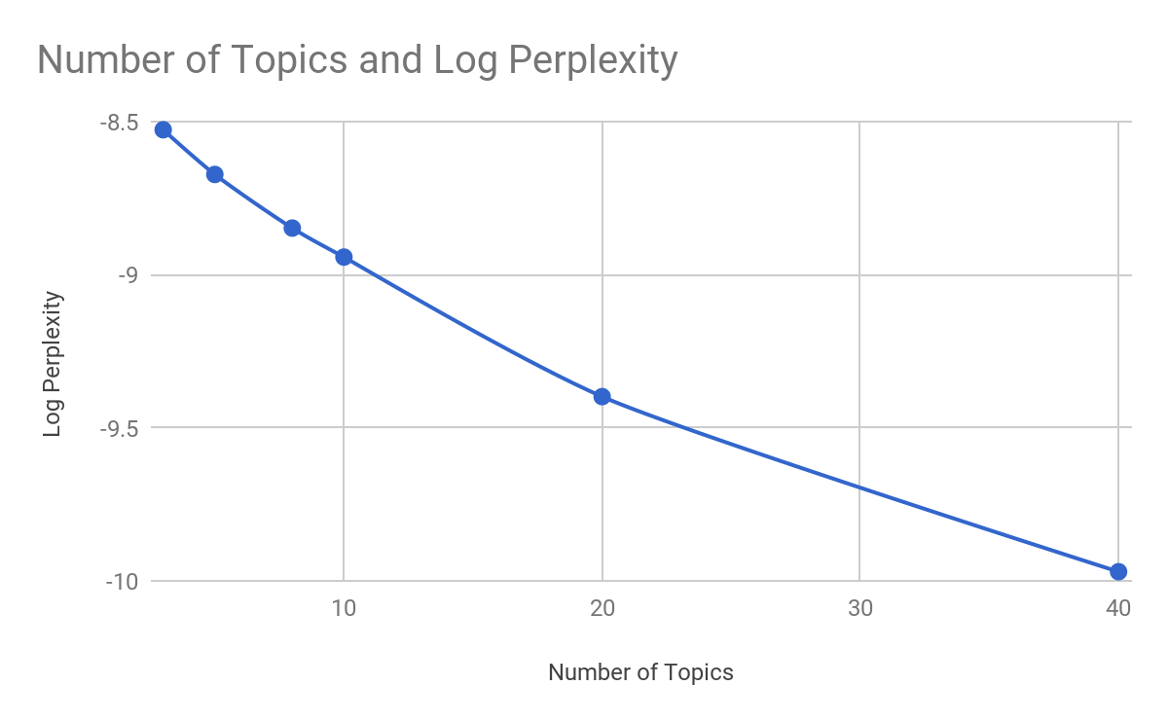
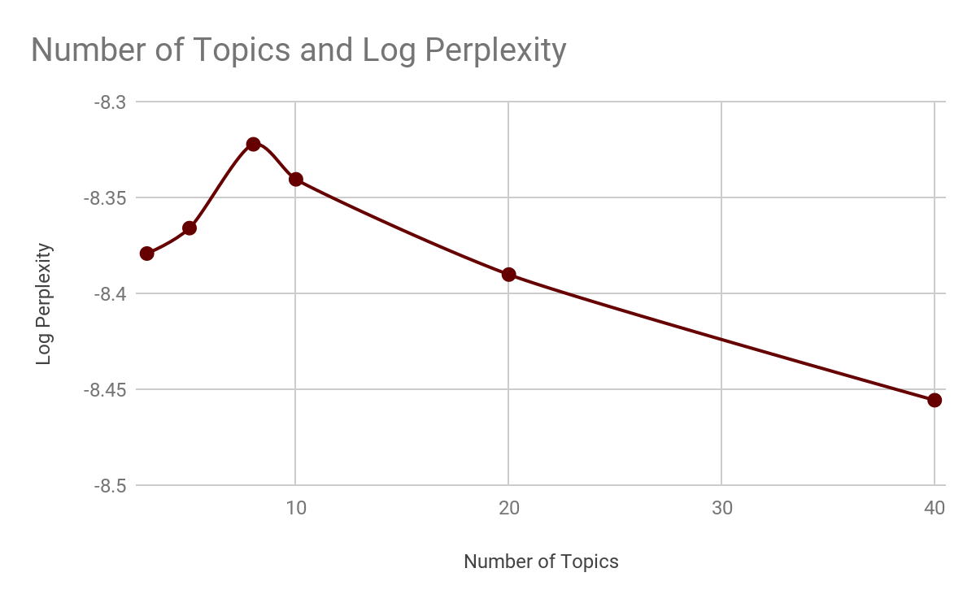
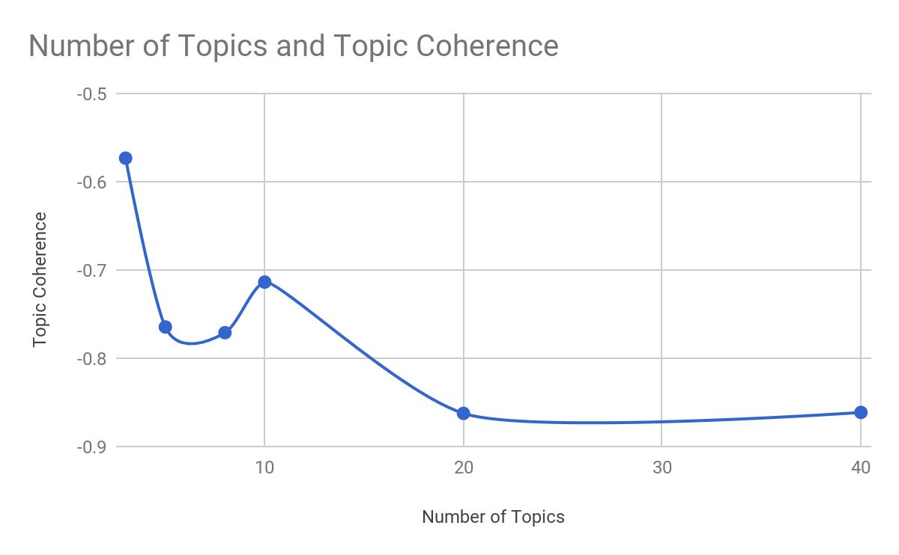
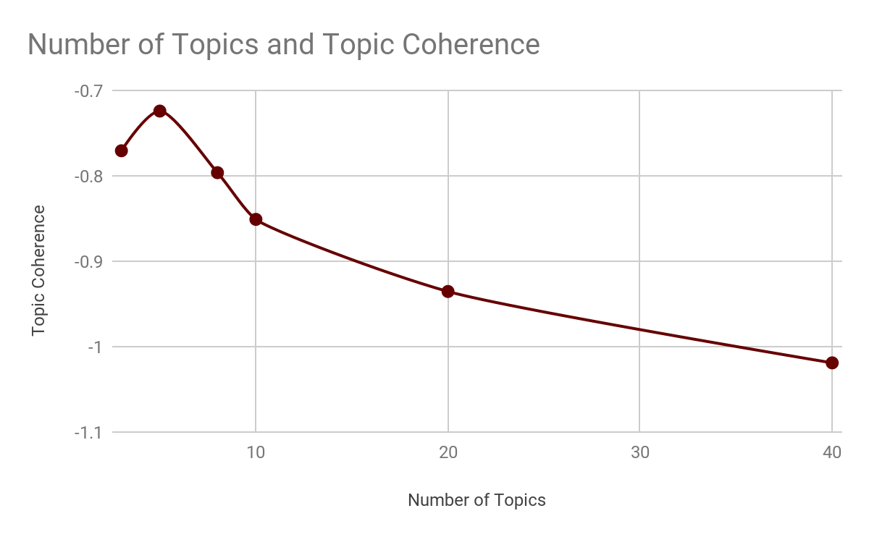
Choosing the Right Number of Topics
Solar Eclipse Webpages
Hurricane Irma Webpages

Slide 14
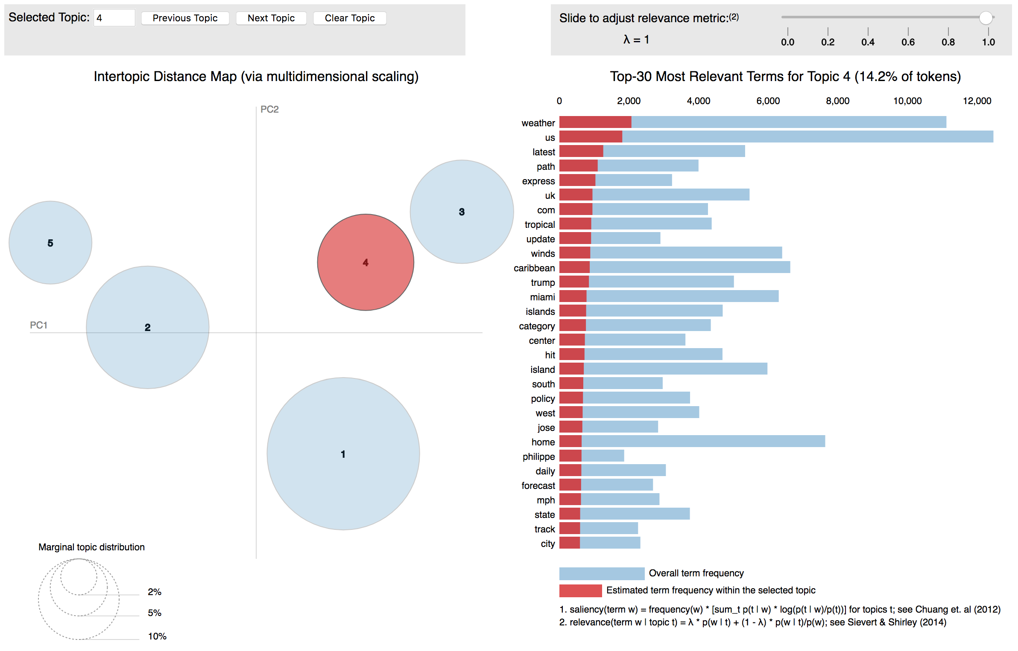
Visualizing Topics

Slide 15
Naming Topics
Once we finalize on the number of topics, each “topic” has to be named. We follow two strategies:
Automatic Naming
  Choose the first non-repeating word in the topic-word distribution (sorted by probability)
  Suitable for large number of topics
Manual Naming
  Look at top words manually to decide topic name
  Suitable for small number of topics

Slide 16
Solar Eclipse: Tweets
eclipse | safety | pictures | experience | midflight | forecast | exo
sun | view | photos | truly | catch | cloud | exo
moon | look | pictures | remarkable | breathtaking | shadow | totaleclipse
block | glass | photobomb | beautiful | mid | weather | thepowerofmusic
watch | don’t | timelapse | breathtaking | flight | path | planet
cover | eye | space | great | international | rain | message
totality | watch | lifetime | pretty | space | outside | verexo
circle | safely | live | happy | wow | forecast | que
These results aren’t perfect however. Despite strict filtering, we see words like trumpresign and president in the list.

Slide 17
Computational Complexity
 | Collection Size | Preprocessing | Model Creation | Log Perplexity | Topic Coherence
Hurricane Irma (Webpages) | 2714 | 56s | 1m:07s | 1m:01s | 3s
Solar Eclipse (Webpages) | 722 | 16s | 41s | 19s | 2s
Solar Eclipse (Tweets) | 2667726 | 11m28s | 16m14s | 24m13s | 55s
* Models trained with 500 iterations and 10 topics each
+ Preprocessing is faster on local machines because of SSDs

Slide 18
HBase Fields
We populate:
topic:topic-list
topic:probability-list
topic:display-topicnames
How these are used:
The front-end team uses display-topicnames as a facet in their interface
It is also possible to use probability scores for recommending similar documents

Slide 19
Shortcomings and Improvements
Automatic elimination of collection-specific stop-words
  Currently requires manual curation
Crowd experiments to decide topic names and coherence
  Topic names decided either naively or based on the experimenter’s judgement
  Better to use the class strength to crowdsource annotations
Topic modeling visualizations can be part of front end
  pyLDAvis provides visualizations of the documents in a cluster via a MDS algorithm
  Could be part of the faceted search
Joint models for Tweets and Webpages

Slide 20
Clustering

Slide 21
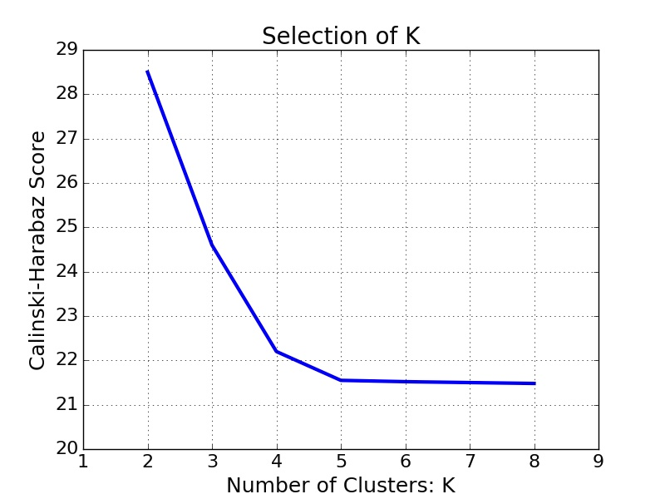

A brief overview of Clustering
Clustering categorize data into clusters such that objects grouped in same cluster are similar to each other according to specific metrics
K-means Algorithm
  Elbow method to find number of K
  Clustering based on cosine similarity

Slide 22



Tech Stack
DataBase Access:
Data retrieval and upload pipelines written using the Python library happybase.
Clustering:
Preprocess tokenized data using NLTK for stopword and punctuation removal.
Scala and Spark for used for Clustering
Result Evaluation & Visualization:
Python and matplotlib are used for calculating inter-/intra-cluster similarity and plotting the results
happybase

Slide 23
Developer Manual
Create a Scala Package using
sbt-package
And submit the generated jar to Spark
Spark-submit <jar file> <input file>
For large datasets,performance metrics like driver memory can be enhanced

Slide 24
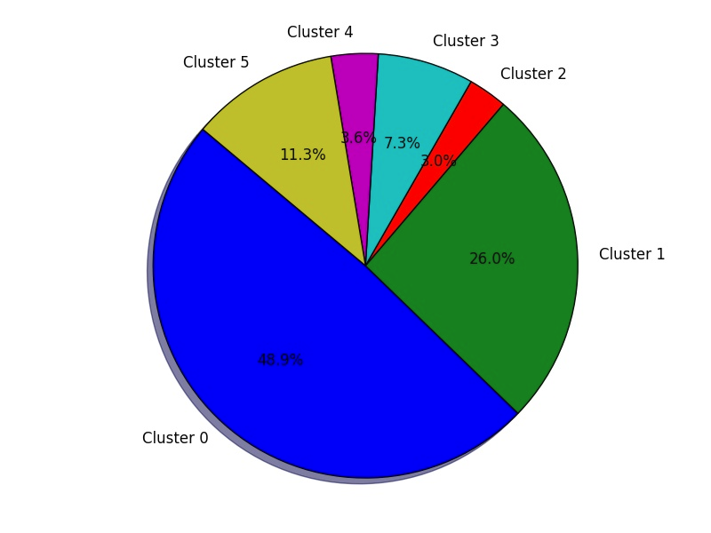
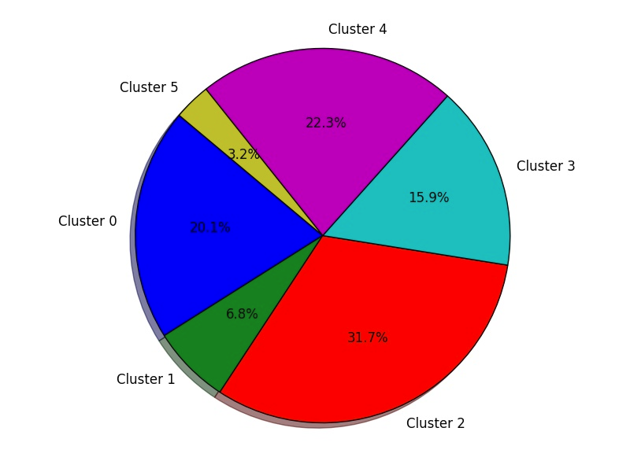
Clustering Results
“Solar Eclipse” Tweets
“Solar Eclipse” Webpages

Slide 25
Similarity Analysis
“Solar Eclipse” Webpages
 | Cluster 0 | Cluster 1 | Cluster 2 | Cluster 3 | Cluster 4 | Cluster 5
Cluster 0 | 0.235892 | 0.057602 | 0.095294 | 0.077461 | 0.067748 | 0.087039
Cluster 1 | 0.057602 | 0.579325 | 0.092020 | 0.083038 | 0.081589 | 0.076596
Cluster 2 | 0.095294 | 0.092020 | 0.146127 | 0.105437 | 0.095530 | 0.099726
Cluster 3 | 0.077461 | 0.083038 | 0.105437 | 0.176871 | 0.077173 | 0.086996
Cluster 4 | 0.067748 | 0.081589 | 0.095530 | 0.077173 | 0.111608 | 0.084908
Cluster 5 | 0.087039 | 0.076596 | 0.099726 | 0.086996 | 0.084908 | 0.714758
Average intra-cluster similarity: 0.33
Average inter-cluster similarity: 0.08

Slide 26
Naming Clusters by Frequent words
K-means just returns clusters of documents, but does not name the clusters
We can name each cluster by looking at a handful of documents in the cluster manually, which can be tedious in Big Data scenario
Therefore,
- we determine the most frequent words in all documents within a cluster
- name the cluster based on a few very frequent words in the cluster
(Assumption: The frequent words in the cluster describe the information in the documents within the cluster)

Slide 27
Clusters in “Solar Eclipse” Tweets and Webpages
Cluster ID | Cluster Name for Tweets | Cluster Name for Webpages
0 | DiamondRing | EclipseChasers
1 | WatchEclipse | AjcEclipseNews
2 | SafeEclipse | EclipseScience
3 | ExoPlanetMusic | BusinessInsiderEclipseArticles
4 | MidFlightEclipse | Eclipseville
5 | NonEnglish | MuseumEclipse

Slide 28
HBase Fields
We populate:
cluster:cluster-list
cluster:cluster-probability
cluster:display-clusternames
Script and Command:
Python hbase_write_cluster.py [Cluster_Result].csv
Cluster_Result: Document_ID, Cluster_Name, Cluster_Probability

Slide 29
Shortcomings and Improvements
Cluster Probability
  We set it as “1” because we only did hard clustering
Comparison with other clustering algorithm
  Hierarchical Clustering
  Density-based Clustering

Slide 30
Questions?
Code Repository: https://github.com/ashishbaghudana/cs5604
https://github.com/yuan9/CS5604_CTA

