Slide 1

Veterans and Broadband Access in Virginia:
Implications for healthcare planning
and policy
Virginia Tech Institute for Policy and Governance
Mary Beth Dunkenberger, Principal Investigator
Suzanne Lo, Project Manager

Slide 2
Veterans Applied Research & Support
VWWP 2010 needs assessment
  Examined the needs and experiences of Virginia Veterans
    Focus on OIF and OEF veterans
    Utilized scientific inquiry methods – mixed methods
    Contextualized for multiple factors
VWWP Data Management Support
Participation in SAMHSA Veteran and Military Family Policy Academy
Current Examination of Impact of Broadband on Veterans’ Healthcare

Slide 3
What is the challenge?
Veterans are faced with wide-ranging and complex health needs. Veterans residing in rural areas tend to be in poorer health, resulting in higher rates of chronic health conditions, as compared to the general population.
Broadband is increasingly being utilized to meet and improve Veteran mental and physical health needs.
Programs and policies remain fragmented and institutionally grounded rather than individually focused

Slide 4

Broadband-Based Health Services
Broadband (Wired)
Telehealth
Telemedicine
Electronic Health Records
Health Information Exchange
Notes:
Background on broadband-based health services:
1. Broadband: High-speed Internet access (e.g. DSL, Cable, Fiber, etc) providing two-way data transmission with advertised speeds of at least 768 kbps downstream and 200 kbps upstream to end users. (definition per National Telecommunications Information Administration)
2. Telehealth: The use of electronic information and telecommunications technologies to support and promote long-distance clinical health care, patient and professional health-related education, public health, and health administration.
3. Telemedicine: Telemedicine is a type of Telehealth and involves the use of electronic communication and information technologies to provide or support clinical care at a distance (i.e. patient counseling, patient exams and chronic disease monitoring, case management and supervision of rural medical residents and health professions students from a distance).
4. Electronic Health Records: Digital records of patient health information generated by one or more encounters in any care delivery setting.
5. Health Information Exchange: Health information exchange (HIE) is the electronic movement of health-related information among organizations according to nationally recognized standards. The goal of health information exchange is to facilitate access to and retrieval of clinical data to provide safer, timelier, efficient, effective, equitable, patient-centered care.
6. Broadband-Based Health Services: This includes Health Information Exchange, Electronic Health Records, Telehealth and Telemedicine.

Slide 5
Current Research Focus
  Research Aim: To examine broadband access and utilization that impacts Virginia Veterans’ health services and access to services.
Research Objective: Enhance Virginia leaders’ and policymakers’ ability to leverage broadband resources and policies to address the healthcare needs of Veterans
Multiphase Research Process:
1. Secondary Data Gathering
2. Stakeholder Engagement – Validation of Research Questions
3. Primary Data Gathering
4. Stakeholder Engagement – Validation of Recommendations
Notes:
To begin, the research team conducted an analysis of secondary information…..

Slide 6
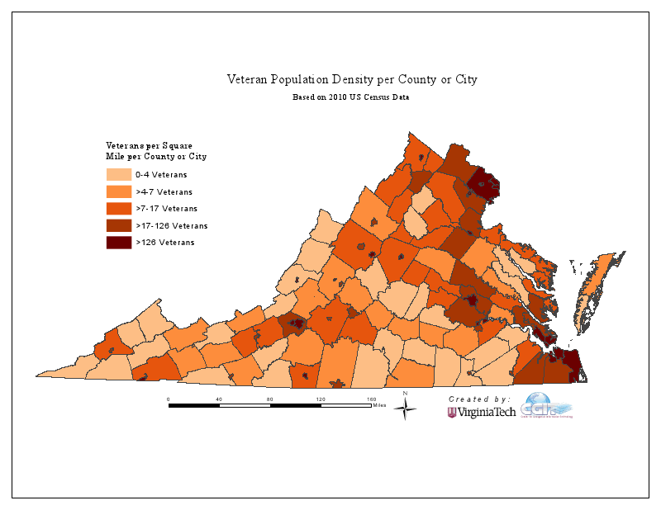
Veterans comprise 13% of Virginia’s Population

Slide 7
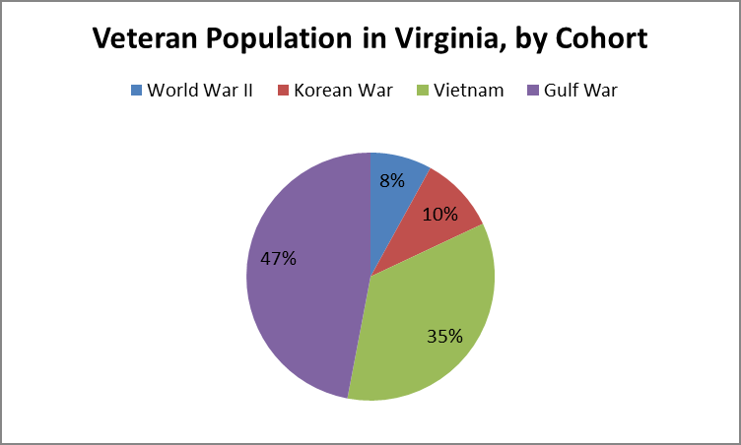
Era of Service Cohorts
2012 American Community Survey – US Census

Slide 8
Contextual Attributes of Veterans
Rural Virginia Veterans have….
  higher rates of reported depression, traumatic brain injury (TBI), substance abuse and post-traumatic stress disorder (PTSD).
  higher rates of chronic health conditions such as diabetes and hypertension.
  less access to medical center or specialist care.
Virginia Wounded Warrior Program, 2010.
Notes:
Similar to other state and national findings

Slide 9


Contextual Attributes of Veterans
55% are 55 years of age or older
Younger Veterans
Higher demand for care coordination and specialty services
Higher levels of multiple disabilities
  Physical, mental, head injuries, post-traumatic stress disorder
Health Access: Insurance & Payer Source –
Qualifying for VHA care depends on...
whether the Veteran has wartime service
service related disability, and/or
the length of the Veteran’s military service.
Source: U.S. Dept. of Veterans Affairs
Notes:
The type and amount of VA benefits are affected by a variety of factors.
The two most important factors are….

Slide 10
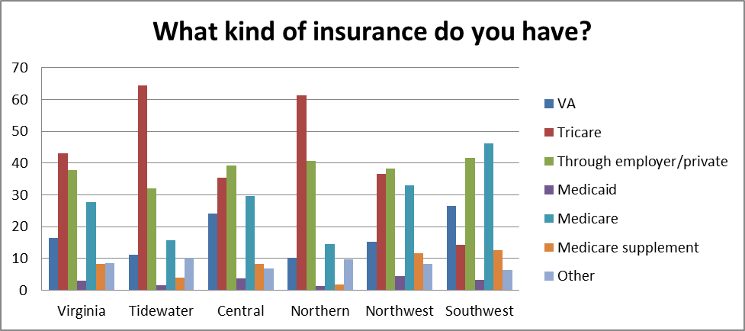
Type of insurance by VWWP region
Virginia Wounded Warrior Program, 2010.
Notes:
Highlight all the different types of insurances that Veterans could have.
Tidewater and Northern more urban, others are more rural

Slide 11
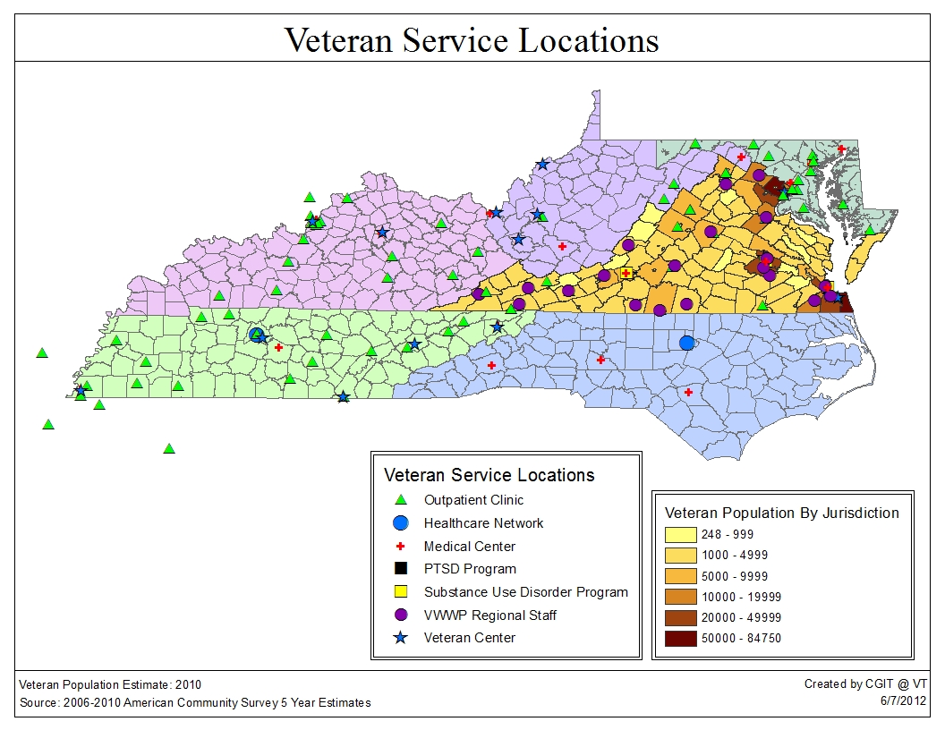
Health facilities/program locations serving Veterans
Notes:
I don’t think we need this slide – but I think it is pretty.
include VA facilities in VISN 5, 6 & 9, and VWWP regional programs.

Slide 12
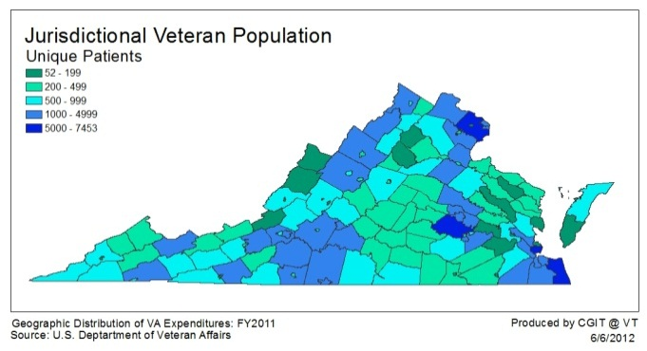
In 2011, 131,322 Veterans received treatment at a Virginia-based VA health facility.
Notes:
This shows how many Veterans are receiving care outside of VA health facility. (There are ~749,609 total veterans)
Only 15 - 20% of Virginia Veterans

Slide 13
Priority Health Service Needs of Veterans
Inclusiveness and Accessibility of Healthcare
Availability of Healthcare
Coordination of Health Services
Cultural Competency of Healthcare Providers
Obtaining and Maintaining Eligibility for Services
Virginia Wounded Warrior Program, 2010.

Slide 14
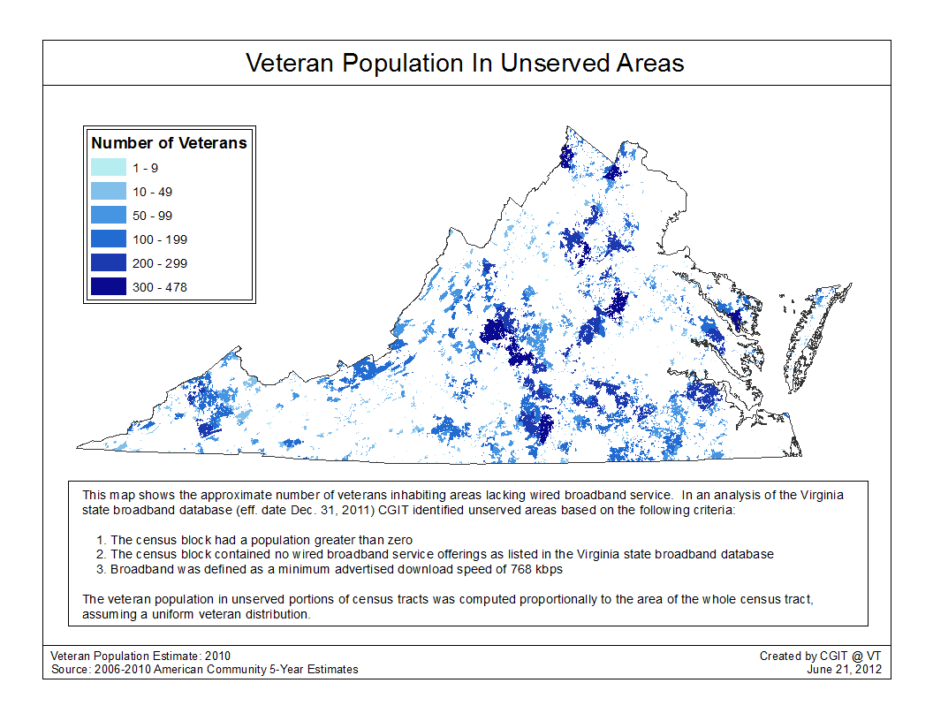
Proportion of Veterans in areas without wired broadband.
Notes:
We looked at wired broadband because this is what is necessary for most of telemedicine today.

Slide 15
Possibilities with Broadband:
Improved virtual and real information systems and networks
Improved service provider coordination and partnerships (centralized case managers)
Electronic Health Records (EHR)
Virtual Lifetime Electronic Record (VLER)
Clinical Video Telehealth (CVT)
Improved Cultural Competence
Improved mechanisms for services
Virginia Wounded Warrior Program, 2010.
Notes:
Literature Review: background on what is happening with EHR, VLER and CVT

Slide 16
Ongoing Research
Multiple Perspective Approach
Providers of Veterans’ health services
Veterans themselves
Policies/program structures that influence utilization rates
Continuous Learning Loops
Engaged stakeholders, funders and partners
Informed discourse – (Dr. Haynie)
Bridging the Divide
Identification of program and policy gaps
Implementation strategies that are culturally and contextually relevant and appropriate
Notes:
And currently to further the research the research team is…..

Slide 17
Preliminary Findings
Services and payer sources remain fragmented for all healthcare – ACA implementation may worsen in short term
Critical mass needed for sustained use of Telehealth/ Telemedicine
  Demand
  Payer Source
  Intrastate licensing of providers a major barrier to care
  Interoperability between VA and community providers a challenge
  Cost savings and improved access to services to be realized
  Digital generation more comfortable with broadband enabled technologies

Slide 18

Project Partners
Contact Information:
Mary Beth Dunkenberger
Senior Program Director/Research Faculty
Suzanne Lo
Project Manager/ Research Faculty
Virginia Tech Institute for Policy and Governance
School of Public and International Affairs
205 West Roanoke Street
Blacksburg, VA, 24061
540-231-3979
losu@vt.edu

