Slide 1


Copyright & OER “Lite”!
a shortened introduction to copyright and open licenses
for authors and curators who have sharing in mind
A work in progress by Anita Walz arwalz@vt.edu @arwalz
Assistant Director of Open Education and Scholarly Communication Librarian, University Libraries at Virginia Tech
“I Can’t Believe It’s Not Ice Pops” June 25, 2021
[International Copyright-Literacy Event with Playful Opportunities for Practitioners and Scholars]
© Ice cream by MeritArt CC BY 3.0 https://thenounproject.com/search/?q=popcicle&i=2246076

Slide 2
Open Educational Resources
Open Educational Resources (OER) are freely and publicly available teaching, learning, and research resources that reside in the public domain or have been released under an intellectual property license that permits their free use, reuse, modification, and sharing with others.
They include full courses, course materials, modules, textbooks, streaming videos, tests, software, and any other tools, materials, or techniques used to support access to knowledge." - Hewlett Foundation

Slide 3

Why this presentation?
© I don’t know by Andrew Doane CC BY 3.0 https://thenounproject.com/term/perplexed/2159663/

Slide 4

Visual reinforcement, fun, repetition, and inviting inquiry
-> Learning!
+ Retention, I hope.
© Researchers by Sumit Saengthong CC BY 3.0 https://thenounproject.com/search/?q=ponder&i=2800652

Slide 5
Learning objectives
Describe what can be under copyright, how it gets there, and that copyright lasts a long time.
Apply the following information: Everything is created by someone – and much it is still owned by someone. – to contexts that matter (e.g. student work and things we find “free online).
Locate and interpret the “terms of use” for example items
Identify different formats/displays of Creative Commons licenses on works found on the web / or items in the wild
List five allowable cases in which something can be incorporated into one’s OER
  Demonstrate ability to identify what clearly can be used, and what is still murky [the edges of one’s knowledge]
  Identify next “need to know” items
Articulate that marking and citing public domain, fair use, used-with-permission/released under an open license, and attributing CC-licensed works is important, even if one does not yet have this skill.

Slide 6
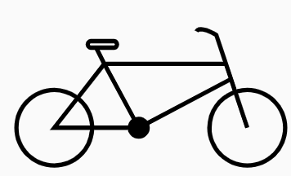
Making it personal. Who owns a bicycle?
© BBicycle by Fahmihorizo - CC BY 3.0 https://thenounproject.com/search/?q=bicycle&i=1272852

Slide 7
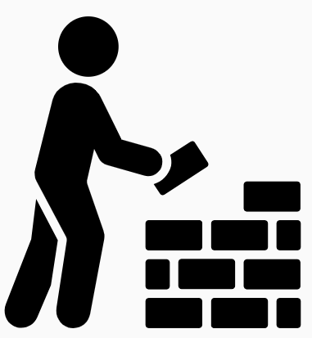
Two Dilemmas when creating with sharing (open licensing) in mind
May I use portions of others’ original works in my open educational resource? How do I do this legally, ethically, and technically?
I want others to use my work in flexible ways. Of what do I need to be mindful when planning to create and share my work?
© Build by Adrien Coquet CC BY 3.0 (flipped) https://thenounproject.com/search/?q=build&i=2085889

Slide 8
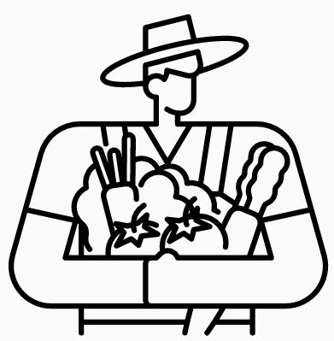

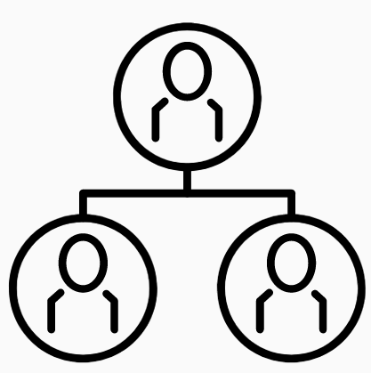
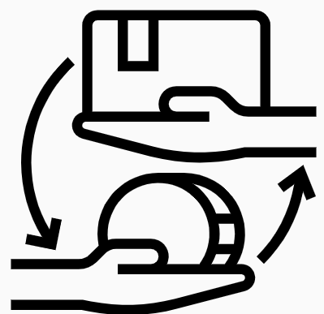
What are copyrights?
A bundle of different rights authors automatically get from creating original works. Relevant here:
Copy
Create copies with changes
Distribute
Unlike vegetables, copyrights last your whole life
+ 70 years
A commodity: The author may retain, sell, donated, and/or license irrevocably -- or for limited times or uses parts of or the whole bundle.
© Harvest by Chattapat CC BY 3.0 https://thenounproject.com/search/?q=harvest&i=3973361
© Family by Andrei Yushchenko CC BY 3.0 https://thenounproject.com/search/?q=family+tree&i=2558850
© Cemetary by Victoruler CC BY 3.0 https://thenounproject.com/search/?q=graveyard&i=3339647
© Trade by Wichi Wi CC BY 3.0 https://thenounproject.com/search/?q=trade&i=3683592

Slide 9
By the way . . . these rights are exclusive to the creator
At the point of creation, an author has a time-bound monopoly over a bundle* of different rights. Authors automatically get from creating original works. Relevant here:
Copy
Create copies with changes
Distribute
* a few other rights exist that are not discussed here

Slide 10




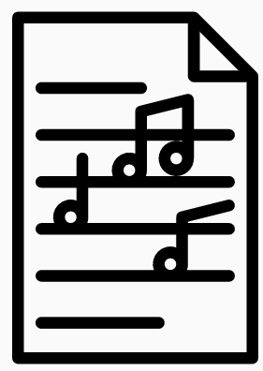
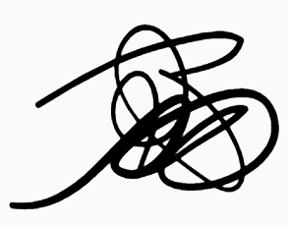
How copyrights are created
Automatically in copyright when made Not in copyright
Ideas, facts (data*), common knowledge
Narrative, image, song… that you don’t record
Works clearly donated to the Public Domain
Published in the US pre-1925*
Created by U.S. Government employees*
Creative works in a fixed medium
(even when a © mark is not added!)
© Sculptor by Krisada CC BY 3.0 https://thenounproject.com/search/?q=sculptor&i=1059044
© Document by IconMark CC BY 3.0 https://thenounproject.com/search/?q=document&i=3536167
© Photography by monkik CC BY 3.0 https://thenounproject.com/search/?q=photography&i=2588421
© Save by PrimeIcons CC BY 3.0 https://thenounproject.com/search/?q=save&i=1929682
© Scribble by Alice Noir CC BY 3.0 https://thenounproject.com/search/?q=scribble&i=713357
© Music sheet by iconixar CC BY 3.0 https://thenounproject.com/search/?q=sheet+music&i=3478850

Slide 11

Who is a copyright holder?
You are!
Your students
People and organizations that created
things you read, watch, and listen to in
any medium, including the internet.
© Man in the mirror by HeadsOfBirds CC BY 3.0 https://thenounproject.com/search/?q=mirror+reflection&i=1221065

Slide 12

Categorizing works you may want to integrate into your own
My original work
Someone else’s work
Works marked as Public Domain or created by a U.S. Gov Employee, or published in the U.S. pre 1925
If you did not sell or give away exclusive rights, use it as you wish.
Do you have enough rights to justify your use? You’ll need to research the terms of use for this item.
Use it as you wish [in the U.S.]
Citing your source is good scholarly practice but not legally required.
Uh oh . . . .
© Bucket by Ema Dimitrova, BG - CC BY 3.0 https://thenounproject.com/term/bucket/71705/
© BBicycle by Fahmihorizo - CC BY 3.0 https://thenounproject.com/search/?q=bicycle&i=1272852 n,

Slide 13
Making it personal. Who owns a bicycle?
© BBicycle by Fahmihorizo - CC BY 3.0 https://thenounproject.com/search/?q=bicycle&i=1272852

Slide 14
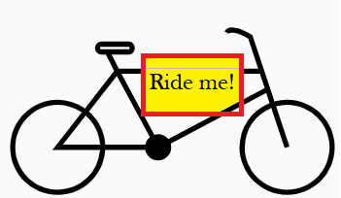
Categorizing works you may want to integrate into your own
My original work
Someone else’s work
Works marked as Public Domain or created by a U.S. Gov Employee, or published in the U.S. pre 1925
If you did not sell or give away exclusive rights, use it as you wish.
Do you have enough rights to justify your use? You’ll need to research the terms of use for this item.
Use it as you wish [in the U.S.]
Citing your source is good scholarly practice but not legally required.
Assume © unless otherwise noted
The terms of use (if there are any) may permit your use.
© Bucket by Ema Dimitrova, BG - CC BY 3.0 https://thenounproject.com/term/bucket/71705/
© BBicycle (adapted) by Fahmihorizo - CC BY 3.0 https://thenounproject.com/search/?q=bicycle&i=1272852

Slide 15

Why we are such big fans of open licenses
Unlimited ice cream cones
(aka non-rivalrous goods)
© BBicycle (adapted) by Fahmihorizo - CC BY 3.0 https://thenounproject.com/search/?q=bicycle&i=1272852
© icecream by agus raharjo CC BY 3.0 https://thenounproject.com/search/?q=ice+cream+cone&i=3816148

Slide 16
What to do when you don’t have enough rights (or are not sure that you have enough rights)
Obtain permission. When, where, how much + may I release this under the same open license as my work?
Consider asserting a fair use*. Use less, smaller, lower resolution. . . only as much as is necessary.
Use a work in a different or transformative* way than it was intended. Add value to the work.
Look for alternatives: Find openly-licensed or Public Domain equivalent material that meets the same need.
Create original work. Take your own picture. Make your own drawing. Put the idea in your own words. [and cite it!]

Slide 17
A work in progress. . .
Comments and suggestions are welcome.
Anita Walz arwalz@vt.edu

