Slide 1
Boy Scout Medical Record System for Blue Ridge Mountain Council
By John Kurlak, Pat Whelan, Zack Greer, and Mauricio De La Barra
April 30, 2012
CS 4624: Multimedia, Hypertext, and Information Access
Notes:
Zoey

Slide 2

Overview
Project motivation
Our solution
Problems we encountered
Lessons we learned
Demonstration
Notes:
Mauricio

Slide 3

Project Motivation
Current system
  Five forms
  Lots of repeated information
  On paper
Proposed system
  One form
  Automatic data propagation
  Online
  Automated backups
  Digital photos
Notes:
Mauricio

Slide 4

Preliminary Steps
Contacted client (Greg Harmon)
Architected solution
Mapped out database
Normalized database
Notes:
Pat

Slide 5
Database Design
Tables
  address
  driverInformation
  emergencyContact
  employee
  employerReportForm
  firstAidLog
  healthOfficer
  incidentInformationEntry
  incidentInformationReport
  incidentLog
  othersToIncident
  patientCareReport
  person
  photo
  scout
  user
  vehicleInformation
  witnessesToIncident
Notes:
Pat

Slide 6
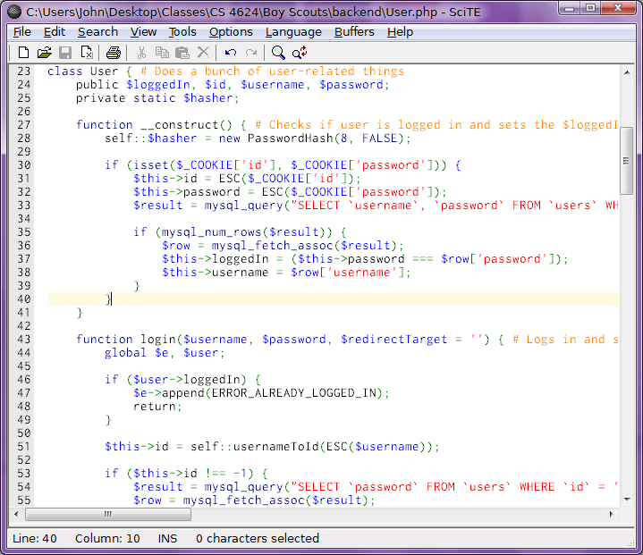
Website Design/Solution
Drafted design in Photoshop
Coded everything up
  Used HTML5, CSS, JavaScript (jQuery), Object-Oriented PHP, and MySQL
  Wrote over 120 pages of code
Notes:
John

Slide 7

Features
Features
  Online injury forms
    Input validation
    Automatic data propagation
    Photo uploader
  User account system
    Login
    Register
    Change Password
    Delete User
    Logout
Notes:
John

Slide 8

Features (Continued)
Features
  View Reports
    Downloadable
    Printable
  Search Reports
  Manual and automated data backups
    Compressed with gzip
Notes:
Zoey

Slide 9
Features (Continued)
Features
  Offline form saving and delayed submission
    Used HTML5 application cache feature
  Automatic output minification
  Client- and server-side user input validation
  Robust error handling
  Secure
    phpass library (per-user, salted bcrypt password hashes) to combat rainbow tables and password crackers
    Prepared SQL queries to prevent SQL injections
    Sanitized output to prevent XSS attacks
Notes:
Mauricio

Slide 10
Problems We Encountered
Learning curve regarding domain knowledge
Indecisiveness about architectural decisions
  Application versus website
  MySQL versus PostgreSQL
Tediousness of creating the database and normalizing it
Non-responsiveness of technical contact
Brokenness of HTML5 application cache technology
Notes:
Zoey

Slide 11
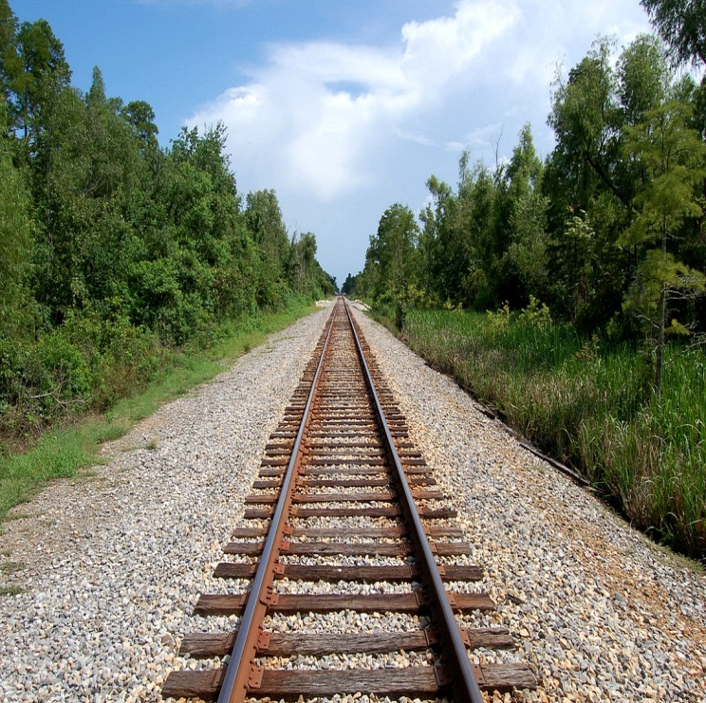
Lessons We Learned
It is good to obtain domain knowledge before starting work
Constant collaboration with a client is necessary
Drafting a plan with milestones and tasks is helpful for meeting deadlines
Writing modular code is extremely beneficial
Good documentation is mandatory
Notes:
Pat

Slide 12
Demonstration
Website!
Notes:
John

Slide 13
References
Images
  http://www.5thgearconsulting.com/images/paperwork.png
  http://www.bethanyofbainbridge.org/images/boy_scouts_logo.gif
  http://discountgeeks.com/images/stock/data_backup_file_copy.jpg
  http://www.eweek.com/images/stories/slideshows/ipad_security_enterprise/ipad02.jpg
  http://icons.iconarchive.com/icons/harwen/pleasant/256/Search-icon.png
  http://www.edupic.net/Images/Math/railroad_tracks414.JPG

