Slide 1



Investigation of Dynamic Loading for 13.2 MW Downwind Pre-Aligned Rotor
NAWEA 2015 Symposium
Virginia Tech in Blacksburg, VA
June 9-11, 2015
Chao Qin (Research Associate)
Eric Loth (Professor)
Sang Lee (Post-Doctoral Researcher)
Patrick Moriarty (Senior Engineer)

Slide 2
Outline
Extreme-scale issues & Force alignment
Pre-Alignment & Impact of this design
FAST simulations & main results
Discussion & Conclusion

Slide 3
Increasing sizes lead to increasing mass & increasing exponents (2.5+) once gravity loads start to dominate
Crawford Fit (~D^{2.1})

Slide 4
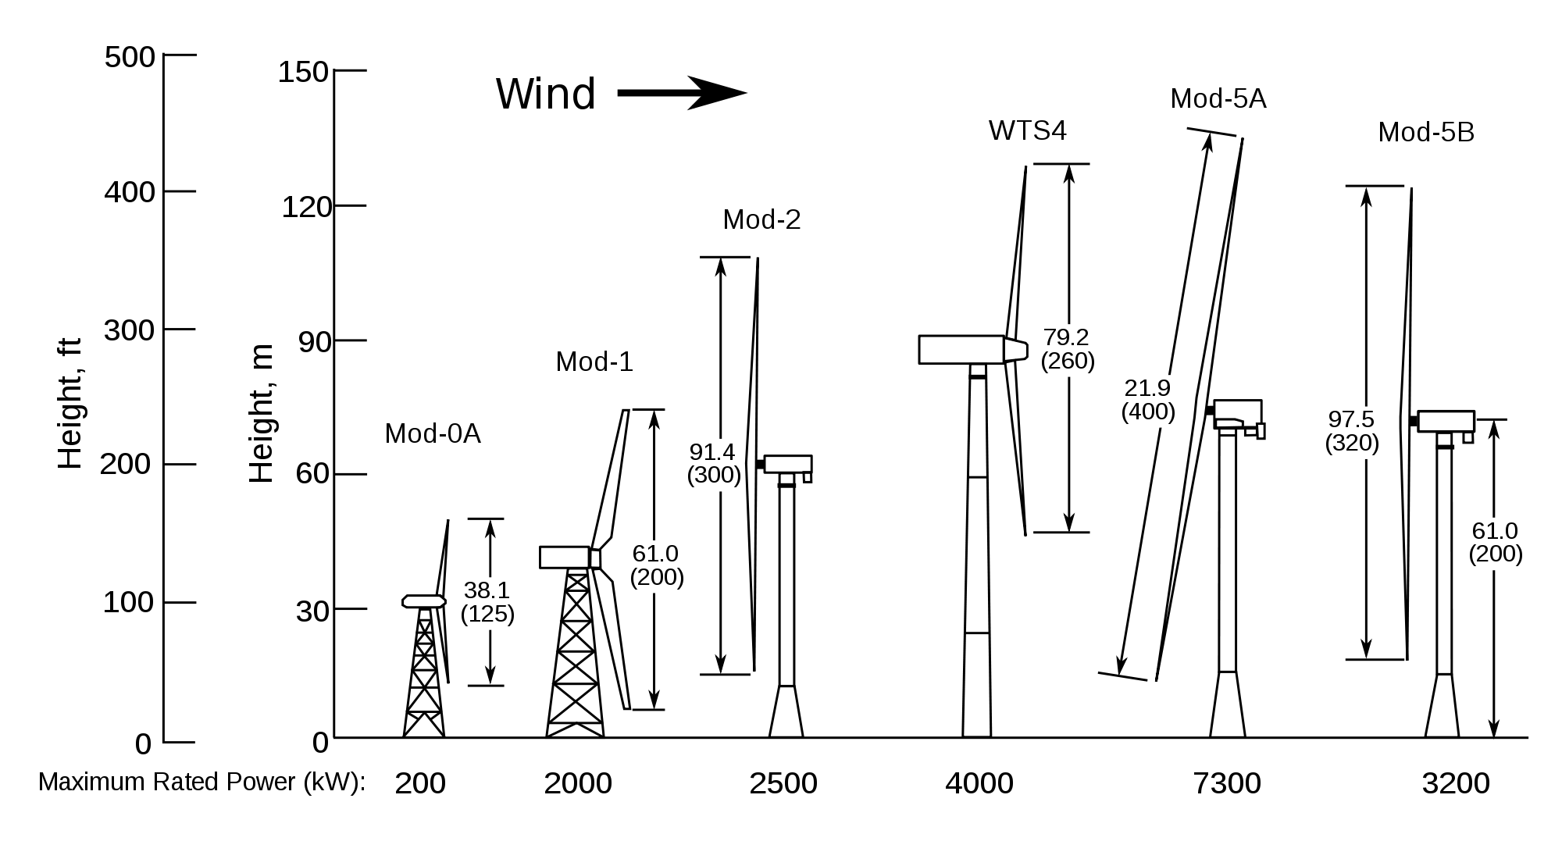
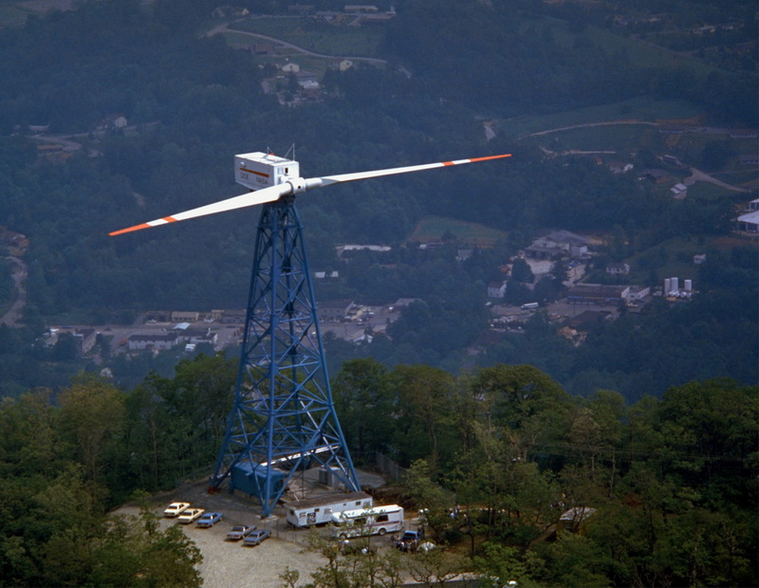
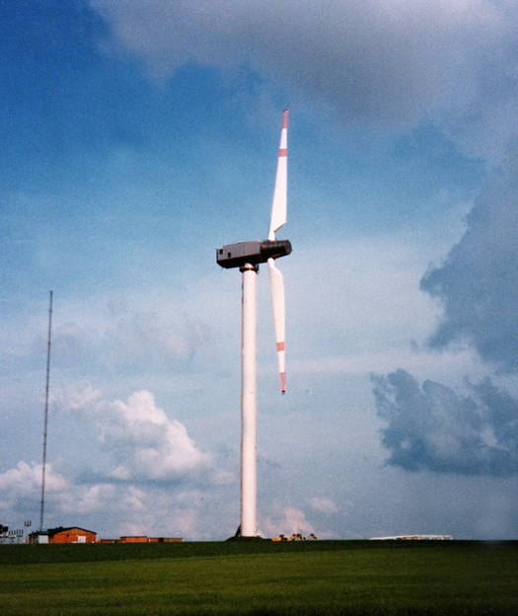
NASA Wind Turbines

Slide 5
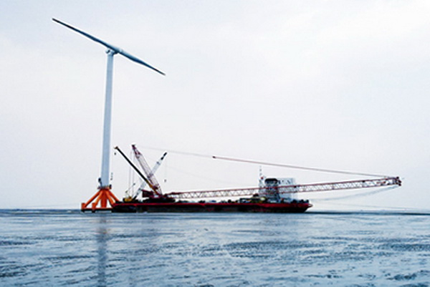
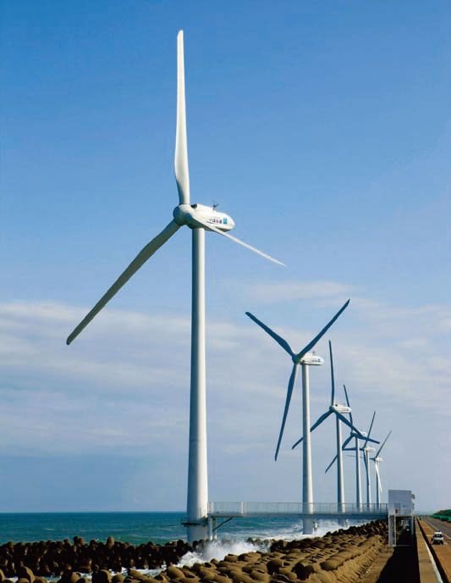
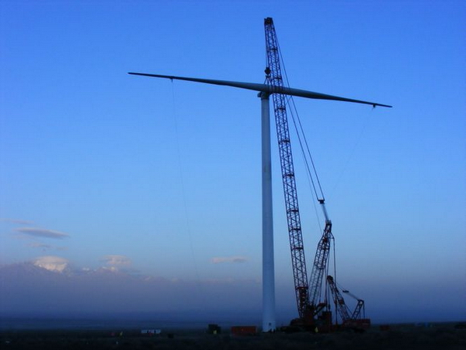
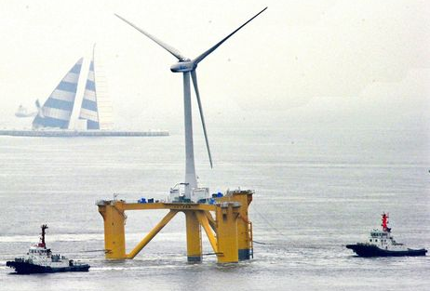
SCD 3.0
Kamisu DAIICHI Wind Farm
Hitachi 2.0/80
SCD 6.0

Slide 6
Rotor size trends
Early evaluations of new wind turbine concept
Larger turbines mean more energy captured
Increased MW reduces “plant” &“utility-integration” costs
Next great frontier: “extreme-scale” off-shore wind turbine systems
Reduce the rotor mass and satisfy tower clearance requirement

Slide 7
Pre-Aligned Concept

Slide 8
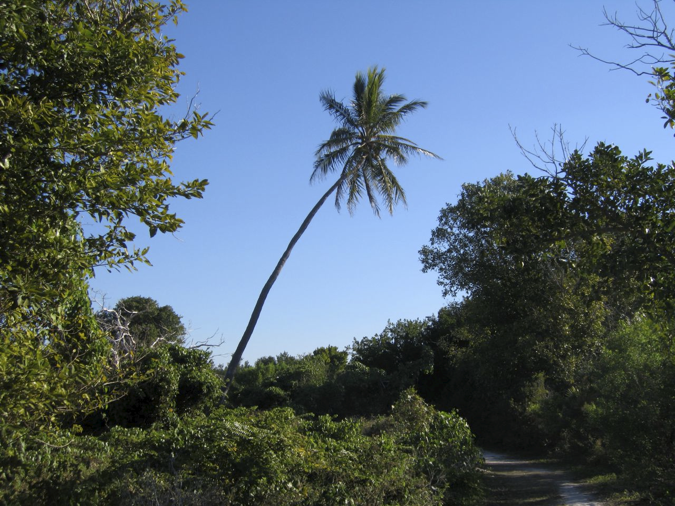
Bio-Inspiration
Fix load alignment to reduce cantilever moments

Slide 9
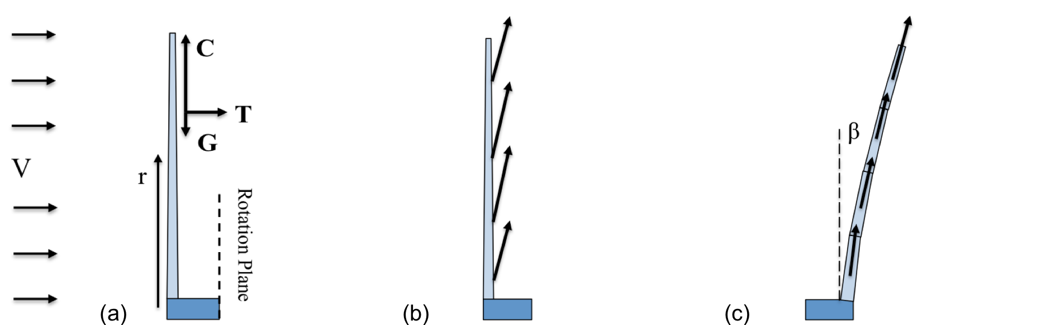
Wind Turbine Forces
Conventional vs. Load-Aligned
Load combination of centrifugal (C), gravity (G), and thrust (T) aligned along the blade path via downwind coning

Slide 10
Method & Test Conditions

Slide 11
Methodology
Aeroelastic simulator FAST, an open source code developed at NREL, is employed to predict loads acting on HAWT blades
Reference turbine is Sandia 13.2 MW upwind turbine with 100 m blades
Damage equivalent loads (DEL) of the blades, calculated by MLife code, are used to address impacts of different designs on fatigue

Slide 12
Sandia 13.2 MW Reference
Rated wind speed V_{rated}, = 11.3 m/s
Blade: SNL100-00 (117 Mg)
Conventional design: U3, U2, D2
Pre-aligned design: D2PA, D2PAL
Modify Drivetrain and control system
Turn on pitch and variable-speed controllers
Turn off tower shadow and potential flow
Calculate damage equivalent loads (DELs)

Slide 13
Case parameters and main outputs in FAST Simulation
Case | Blade Mass (Mg) | Rotor Mass (Mg) | Cone (deg) | α (deg) | Teeter | ω (rpm) | Cp (-) | λ (-)
U3 | 114.2 | 342.6 | -2.5 | 0.0 | No | 7.44 | 0.459 | 7.06
U2 | 114.2 | 228.4 | -2.5 | -1.8 | No | 8.93 | 0.458 | 8.47
D2 | 114.2 | 228.4 | 2.5 | -1.8 | No | 8.93 | 0.458 | 8.47
D2PA | 114.2 | 228.4 | 17.5 | -1.8 | No | 8.93 | 0.418 | 7.90
D2PAt | 114.2 | 228.4 | 17.5 | -1.8 | Yes | 8.67 | 0.388 | 7.86
D2PALt | 125.6 | 251.2 | Stretch blade by 10% |  |  | 8.93 | 0.395 | 8.93

Slide 14
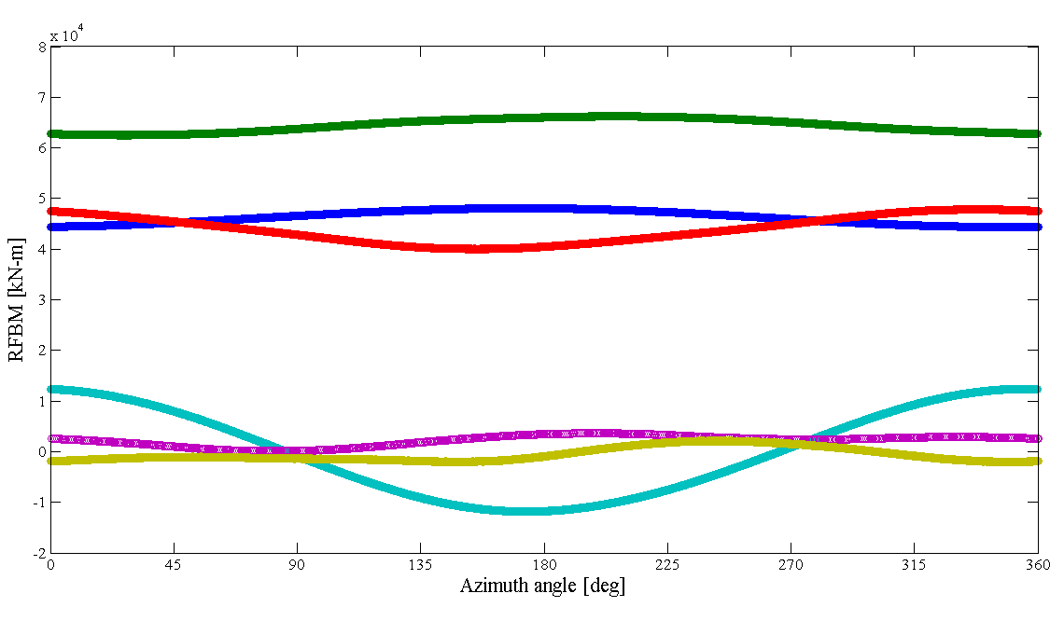
U2
D2
U3
D2PA
D2PAt
D2PALt

Slide 15
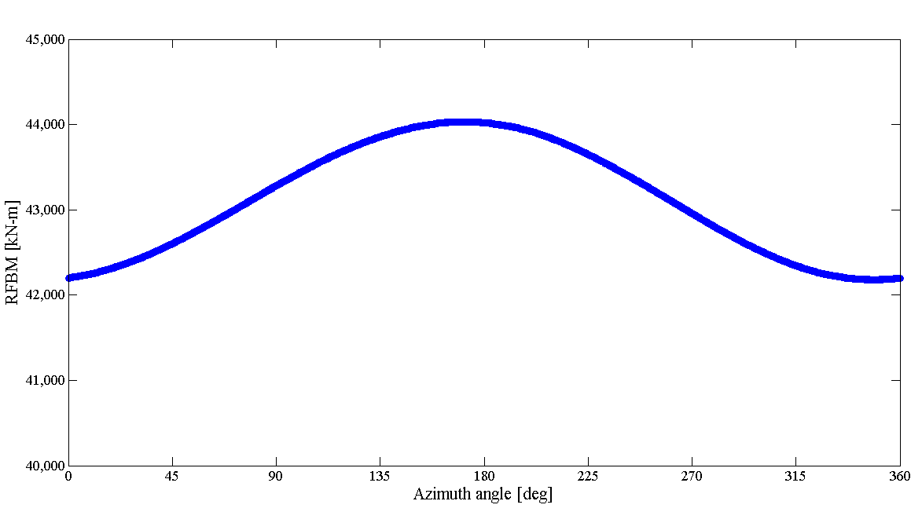
M _{max}
M _{a}
M _{m}
M _{min}

Slide 16
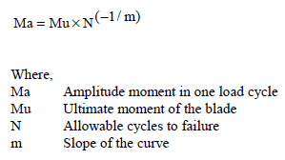
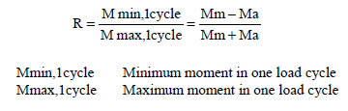
M-N Curve + Goodman Diagram
R = -1
M_{a}
(M_{m} = 0)
M_{a}
R
Assume DEL = M_{a, R=-1}
M_{a, R=-1}
(M_{m}, M_{a})
N
M_{m}

Slide 17
Case parameters and main outputs in FAST Simulation
Case | Rotor Mass (Mg) | Cone (deg) | α (deg) | Teeter | ω (rpm) | Cp (-) | Pwr (MW) | RFBM (kNm) | DEL (kNm)
U3 | 342.6 | -2.5 | 0.0 | No | 7.44 | 0.459 | 13.20 | 4.62E4 | 8.84E3
U2 | 228.4 | -2.5 | -1.8 | No | 8.93 | 0.458 | 13.20 | 6.44E4 | 3.79E4
D2 | 228.4 | 2.5 | -1.8 | No | 8.93 | 0.458 | 13.20 | 4.39E4 | 1.73E4
D2PA | 228.4 | 17.5 | -1.8 | No | 8.93 | 0.418 | 11.09 | 155 | 2.01E4
D2PAt | 228.4 | 17.5 | -1.8 | Yes | 8.67 | 0.388 | 10.29 | 606 | 2.85E3
D2PALt | 251.2 | Stretch blade by 10% |  |  | 8.93 | 0.395 | 13.20 | -581 | 3.41E3

Slide 18
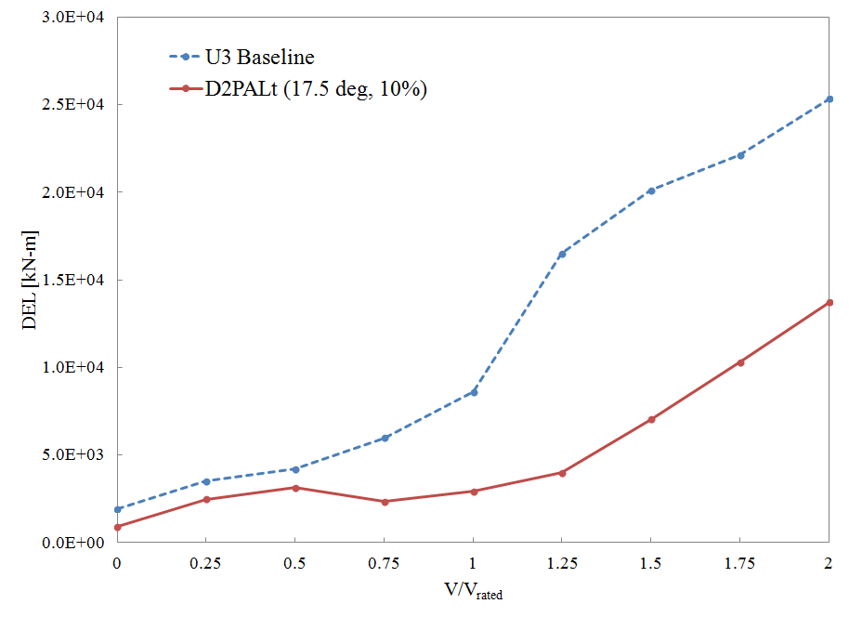

Slide 19
CONCLUSIONS
Steady-state analysis of D2PAt allows substantial reduction in flapwise bending moment for 13.2MW wind turbine blades at rated wind condition
Stretching blade length by 10% can make up the power losses
Pre-aligned design has lower DELs at different steady wind speeds than conventional three-bladed design, but it has two blades that requests rotor running at a higher rpm
Much more work needed to determine relative feasibility for force-aligned downwind systems
Tower shadow
Turbulent wind condition
Control system
IEC standard tests
SNL100-02 blades

Slide 20

Question and Comment

Slide 21
Manufacturer & Model |  | Year | Commercial Availability | Location | Rated Power (MW) | Blade Number | Rotor Diamter (m) | Comments
Smith-Putnam |  | 1941 | Prototype | Castleton, VT | 1.25 | 2 | 53 | First MW wind turbine. 1100 hrs. Blade failure.
GE MOD-1 |  | 1979 | Prototype | Howard Knob, NC | 2 | 2 | 61 | World's second multi-MW wind turbine. Sponsored by DOE and administered by NASA. Operated at least 18 months but full operating history is unknown.
Hamilton-Standard WTS-3 |  | 1981 | Prototype | Sweden | 3 | 2 | 78 | Sucessfully operated for 11 years.
Hamilton-Standard WTS-4 |  | 1982 | Prototype | Wyoming | 4 | 2 | 79.2 | World record for power output for over 20 years.
GROWIAN I |  | 1983-1988 | Prototype / FAILURE | Germany | 3 | 2 | 100 | The most famous, most discussed and criticised German federal research project.
Wind Turbine Company WTC-1000 |  | Around 2000 | Unknown / 250, 500kW Prototype | Colorado / California | 1 | 2 | 54.3 | A modern update of Smith-Putnam. Compared to 3-blade upwind ones, head weight reduces by one-half and manufacturing costs reduce by one-third.
Aerodyn / Ming Yang | SCD 3.0 | 2011 | Available | South China Sea | 3 | 2 | 110 | Off-shore. Designed by Aerodyn and manufactured by Chinese licencee Ming Yang.
 | SCD 6.0 | 2013 | Prototype | China | 6.5 | 2 | 140
 | SCD 8.0 |  | Prototype in Development |  | 8 | 2 | 168
Carter Wind Energy |  |  | Planned |  | 10-50 | 2 |  | Scale-up 300-500kW products.
Hitachi HTW 2.0/80 |  | ~2010 | Available | Fukushima, Japan | 2 | 3 | 80 | Experimental off-shore floating wind farm project begins in 2012. In second term, 7-MW wind turbines will be added between 2013 and 2015.
Hitachi HTW 5.0/126 |  | 2013-2015 | Prototype in Development | Kamisu City, Japan | 5 | 3 | 126 | A demonstration prototype is under construction.
Nautica Windpower AFT |  | 2017 | Concept / Prototype |  |  | 2 |  | Advanced Floating Turbine. Digital prototype. A 1/3-scale version with a 35- m rotor is expected by 2013.
Subaru 80/2.0 |  |  | Available |  | 2 | 3 | 80 | Manufactured by Fuji Heavy Industries. Designed for strong wind. Special attention is being given to withstand the heavy typhoon in Japan.
SWAY |  |  | Prototype | Norway | 2.5-12 | 3 |  | NREL is collaborating with SWAY. The SWAY 1/5 scale prototype has a 13-m rotor on a 29-m tower, with a large portion of the tower beneath the ocean surface.

Slide 22
Planed Simulation Progress
Generate Wind Input Profile
TurbSim
FAST Simulation
Sandia 13.2 MW wind turbine
Fatigue Analysis
Weibull distribution
Goodman Correction
IEC Standards
SNL100-02 blades
Controller from NREL 5 MW turbine
Upwind /downwind
Pre-cone angles
Life-time DELs
MLife
Rainflow cycles
Short-term DELs

