Slide 1

Sustainable Energy:
Institute for Critical Technology and Applied Science (ICTAS)
Shashank Priya
Director, Energy and Materials Initiative and
ICTAS Sustainable Energy Thrust Leader
Dennis Grove
Program Manager, Sustainable Energy and Sustainable Water Thrusts

Slide 2
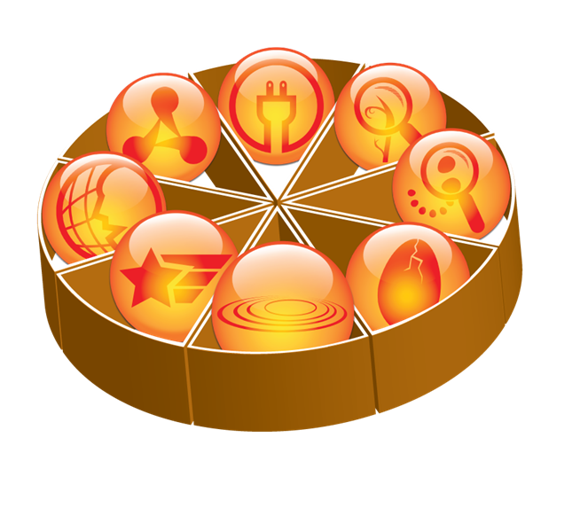
ICTAS
Vision: To become among the top-rated institutes, globally, focused on transformative, interdisciplinary research (IDR) towards a sustainable future.
Major investments in high-impact, interdisciplinary/transdisciplinary research at the intersection of engineering, the sciences - physical, social and life - and the humanities
An investment institute – we support IDR efforts through:
Seed research projects and centers
Instrumentation
Facilities
Administrative and management support
Notes:
We aim to “increase research capacity at VT”
Return on Investment = Research dollars for VT!

Slide 3
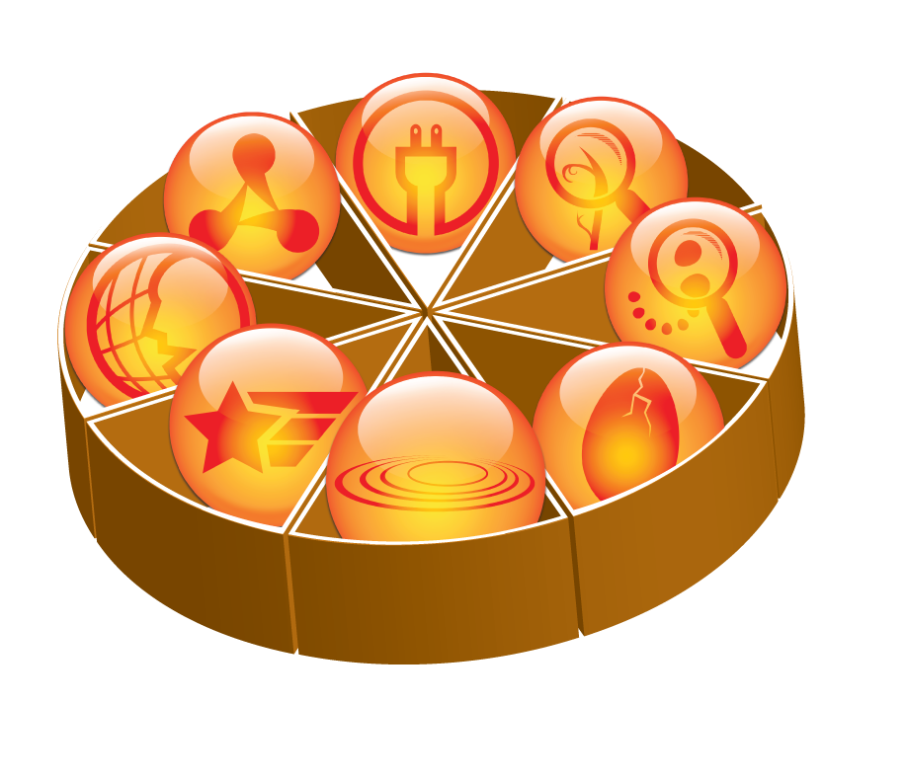
Research Thrusts
Sustainable Energy
Nano-Bio Interface
Renewable Materials
Nanoscale Science & Eng.
Doctoral Scholars - Students
JFC – Junior Faculty
TSTS – Senior Faculty
Cognition / Comm.
Emerging Research
National Security
Sustainable Water
109 RFP projects funded since FY2011
~$5.5M funding last 3 years (FY14-FY16)
59 Doctoral Scholars since 2007
Notes:
Easy slide to drop

Slide 4
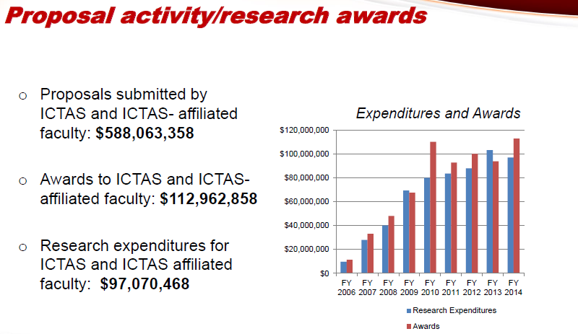

Slide 5

ICTAS support of
Wind and Water Energy Projects
Understanding the Distortion of Atmospheric Turbulence Approaching a Wind Turbine, Devenport PI
Bio-Inspired Technique for the Reduction of Wind Turbine Trailing Edge Noise, Devenport PI
Turbulence in real environments: performance and impact on large scale wind energy, Lowe, PI
Bio-inspired solutions for quieter wind turbines and better wildlife preservation, Ma PI
Geotechnical Survey Strategies for Cost-efficient Ocean Renewable Energy Early Site Characterization, Stark PI
Morphodynamic and Ecological Impacts of Marine Hydrokinetic Energy Extraction: A Multiscale, Interdisciplinary Approach, Xiao PI
$480,000
Notes:
The slide lists direct funding of wind and water energy projects through annual RFP (JFC, TSTS, and Grant Match).
Total amount of direct ICTAS investment is ~$0.5M!

Slide 6
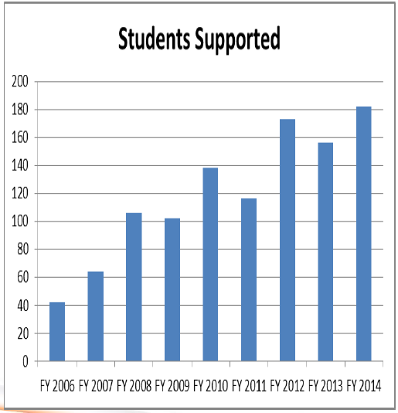
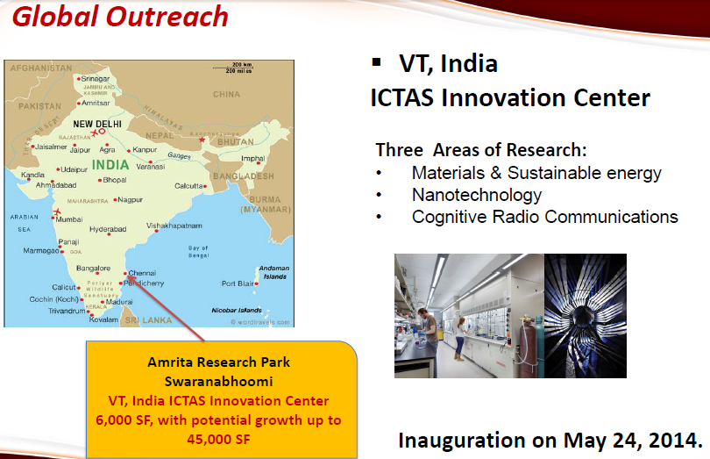
UK
Chile
Ghana
Australia

Slide 7
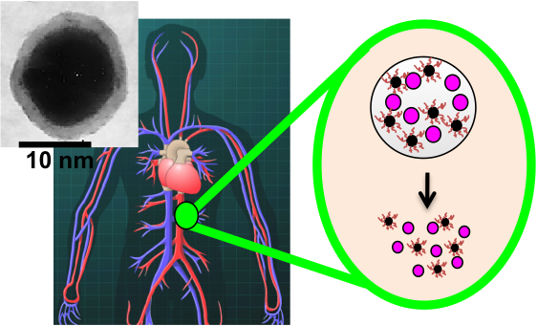
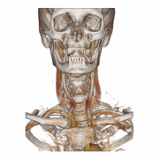
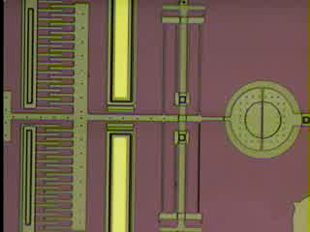
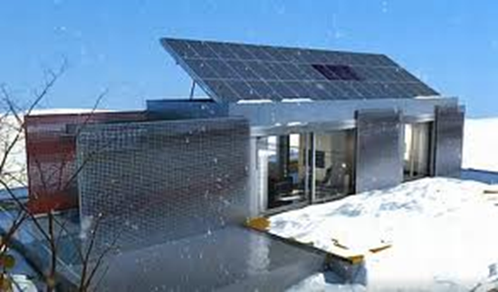
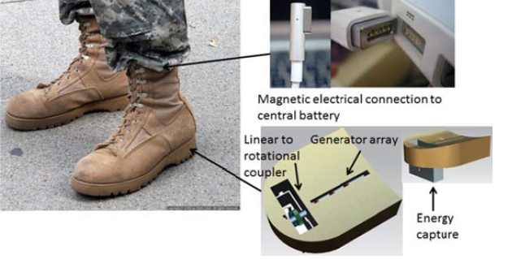
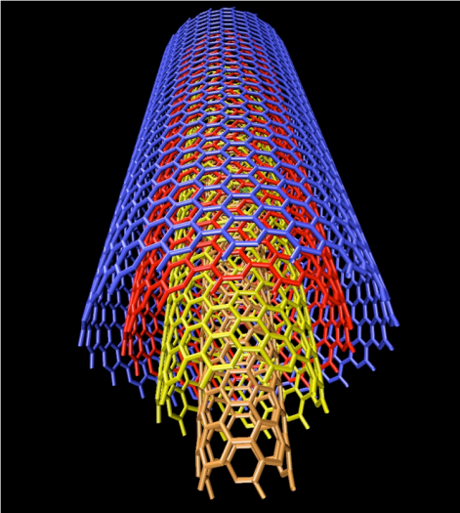
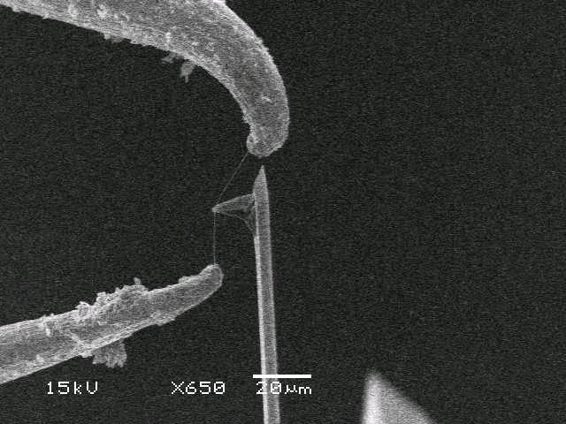
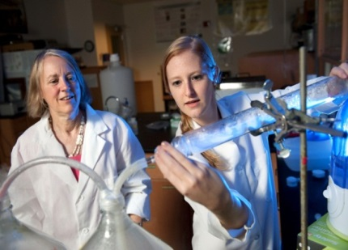

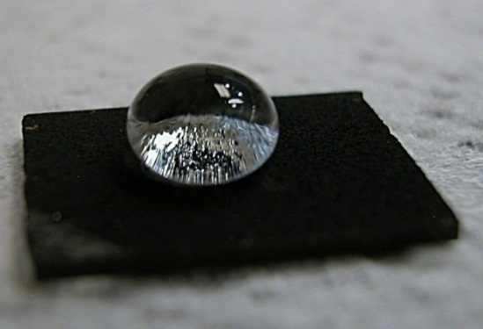

ICTAS RESEARCH
Notes:
Hydrophobic nanostructured material, carbon nanotubes = NanoScale Science and Engineering
Hume, GUSS (Ground Unmanned Support Surogate) = National Security
Kelly Hall wireless test bed, red dotes are wireless nodes = Cognition and Communication
Researchers in lab coats (Andrea Dietrich) = Sustainable Water
Lumenhaus, energy harvesting boots = Sustainable Energy
Skeleton, blood vessels in body (drug delivery) = NanoBio Interface
Missing = Renewable Materials, Emerging Technologies

Slide 8
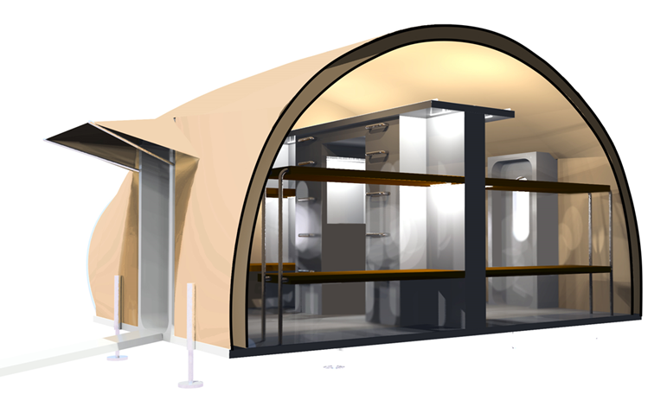
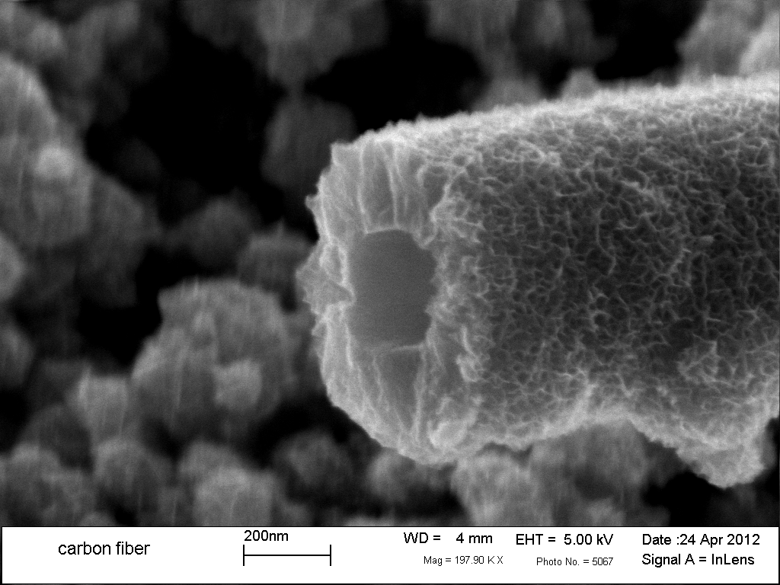
ICTAS Sustainable Energy Thrust
Dedicated to discovering alternative energy resources based on renewable fuels or the efficient harvesting of energy from the natural world.
Wind and Water Power
Center for Power Electronic Systems
NSF I/UCRC Center for Energy Harvesting Materials and Systems
Photovoltaic Technology
Electrochemical Energy Conversion and Storage
Advanced Combustion/Biomass
Waste Water Treatment/Energy Recovery
Energy Efficient Buildings
US Army – Natick
Self-sustaining Living Module
Nano-porous Carbon Fibers for Energy Storage
Notes:
Self-sustaining Living Module (SLiM)
modular, quickly deployable, energy efficient structure for forward operating bases
Designed for US Army Natick
Nano-porous Carbon Fibers for Energy Storage
Common polymer with thermal treatment
Improved oxygen and ions transport across membrane

Slide 9
CPES Renewable Energy and Nanogrids
Mini-Consortium
Work Scope:
PV Systems
Wind Power
Battery Storage
Nanogrid Architectures
Hybrid Electric Vehicles
Energy Management
Solid State Lighting

Slide 10



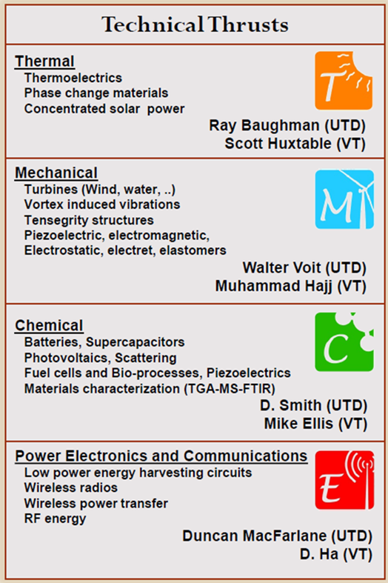




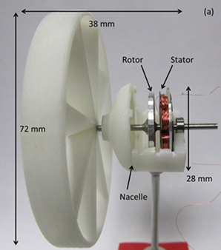




Center for Energy Harvesting Materials and Systems
NSF Industry/University Cooperative Research Center
Research Highlights
Demonstrated world’s best power density for micro-wind turbine
Demonstrated world’s highest piezoelectric sensitivity for vibration energy harvesting
Filed patent on inductive energy harvesting technology

Slide 11
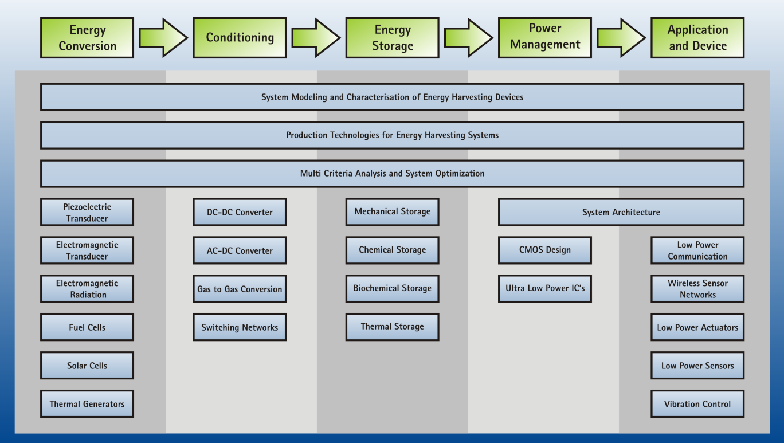


Slide 12
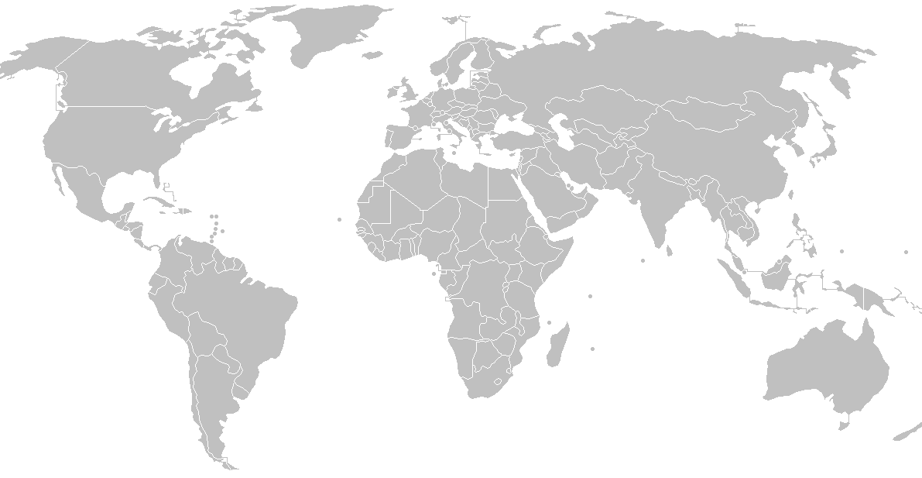
CEHMS Sites
McMaster University, Canada
Korea University, South Korea
Utah State University
Virginia Tech, Lead
Leibniz University, Germany
University Texas, Dallas
PSG College of Technology, India
Austral University, Chile
Notes:
Current and potential CEHMS sites
CEHMS has international scope

Slide 13

Center for Renewable Energy and Aerodynamic Testing
Researchers devoted to enabling wind and water power at utility scale
Nationally recognized expertise
World-leading Facility
Notes:
Nationally recognized expertise – CFD, aerodynamics, aeroacoustics
World-leading Facility – Stability Wind Tunnel
ICTAS supported formation of CREATe, continues to support financially and through team/collaboration-building

Slide 14
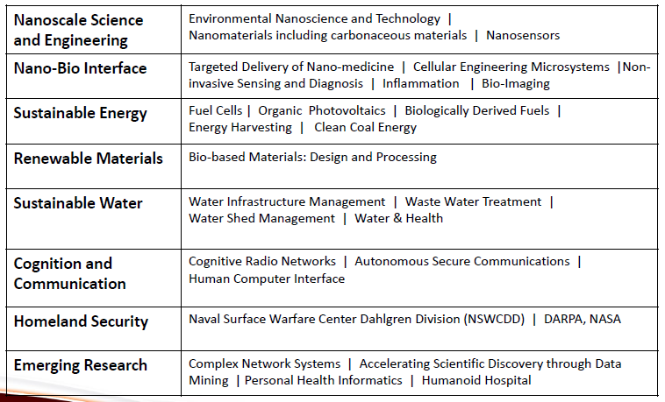
Summary
Dennis Grove, MS, MBA
ICTAS Program Manager
Sustainable Energy and Sustainable Water Thrusts
dgrove@vt.edu
Office: 540-231-3353
Cell: 540-553-4349

