Slide 1
Distributed Digital Preservation Workshop for ETDs
Gail McMillan, Virginia Tech
Martin Halbert, Emory University
Bill Donovan, Boston College
MetaArchive Cooperative
12th International Symposium on ETDs
University of Pittsburgh
June 10, 2009
Notes:
Welcome to the 2nd ETD Preservation Workshop. Your instructors are: Gail Mc….. Martin Halbert, Director of Digital Programs and Systems at the Emory University Libraries since 1997. Active in Digital Library Federation and National Science Digital Library activities… He’s going to give you an overview of concepts and activities which comprise our distributed digital preservation network, including its infrastructure. He’ll also tell you about the various rolls that members of the MC play.
Bill Donovan,
Boston College and one of our newest MetaArchive Cooperative members so he’s going to share with you what its like to join forces with established members like VT and Emory.
Our goal today is to share with you information we feel is necessary to establish a sound preservation program and describe how the MC, can meet your institution’s needs so that you can consider joining with us to preserve ETDs and better ensure that they will be available for the long term.

Slide 2
Instructors
Gail McMillan
  Director, Digital Library and Archives
  University Libraries, Virginia Tech
Martin Halbert
  Director, Digital Programs and Systems, Emory University
  President, MetaArchive Services Group
Bill Donovan
  Digital Imaging Librarian, Boston College
  Manager of Digitization Lab in the O'Neill Library
  ETD Administrator

Slide 3
Attendees
30 universities
2 national libraries
5 vendors
Africa, Europe, Latin America, Middle East, North America
Notes:
30 from universities around the world: 2 graduate school deans, 1 library dean
2 national libraries: Canada, Mali
5 vendor representatives: 2 company presidents (VTLS, ProQuest, Ex Libirs, OpenThesis)

Slide 4
Agenda
ETDs and preservation needs: Survey Results
Distributed digital preservation network (DDPN) overview
  MetaArchive Cooperative and the NDLTD preservation strategy
Collection Management for preservation readiness
  Organizing your ETD collections
  Metadata: Conspectus Database
MetaArchive Cooperative and its members
New member’s perspective: Boston College
Notes:
We are informal and welcome your questions and comments. Please don’t hesitate to let us know if we start using jargon that you’re not familiar with.
The rest of the 1st 20 Min: GMc: ETD Preservation Survey Results: It demonstrates the need for the NDLTD Preservation Strategy. In your packet: NDTLD Preservation Plan. Meant to provide enough detail about ETD Preservation Network.
15 min: MH: Overview of private distributed preservation networks based on the LOCKSS software, and how the MetaArchive Cooperative operates.
.
Break about 10:15—just 15 minutes. WHERE ARE THE BATHROOMS?
30 min: GMc: Highlights of good ETD collection organization for preservation readiness, metadata for ETD collections—MetaArchive Conspectus Database. Intellectual property.
30 min: MH: Review: Charter, membership agreement, and MC members’ responsibilities
15 in: BD: What’s it like to be a new member of the MetaArchive: Boston College’s perspective

Slide 5
ETDs and Preservation Needs
Gail McMillan
Digital Library and Archives
Virginia Tech
Notes:
We are here because we agree that preservation is too big for individual institutions to solve in isolation. A Preservation system requirement: no single point of failure. With colleagues at Louisville, Georgia Tech, and Florida State, we banded together under Martin’s leadership to cooperatively address this challenge. But, we asked, “Where are the good models?

Slide 6
What is Digital Preservation?
Systematic management of digital works over an indefinite period of time
  Processes and activities that ensure the continued access to works in digital formats
  Requires ongoing attention--constant input of resources: effort, time, money
  Technological and organizational change are obstacles for preserving beyond a few years.
Notes:
What is digital preservation? It is the systematic management of computerized information over an indefinite period of time. It demands continual attention and this constant input of effort, time, and money to handle technological and organization change is the main stumbling block for preserving digital information beyond a few years. I believe that the most effective preservation succeeds by replicating copies of digital content in secure, distributed locations over time because security reduces the likelihood that any single cache will be compromised and distribution reduces the likelihood that the loss of any single cache will lead to a loss of the preserved content. A single organization is unlikely to have the capability to operate several geographically dispersed and securely maintained servers. Inter-institutional agreements must be put in place or there will be no commitment to act in concert over time.
, Martin. MetaArchive presentation to SCHEV LAC, March 28, 2008.

Slide 7
NDLTD Preservation Strategy: MetaArchive Cooperative
MetaArchive is a PLN: Private LOCKSS (i.e., distributed preservation) Network
Programmatically harvests ETDs from partners
  Secure access: only authorized partners’ servers
Preserves ETDs among partners’ servers
  Low cost to administer and run
  Standard hardware, open-source software
  Audits and repairs ETDs as needed
ETD Preservation Network is a Dark Archive.

Slide 8
ETD Preservation Survey
Gauge the digital library community’s interest in an ETD-specific archive
6 academic listservs
  ARL, ASERL, CGS, DLF
  NDLTD, ETD
14 multiple-choice and short answer questions
Dec. 13, 2007 - April 10, 2008
96 completed surveys

Slide 9
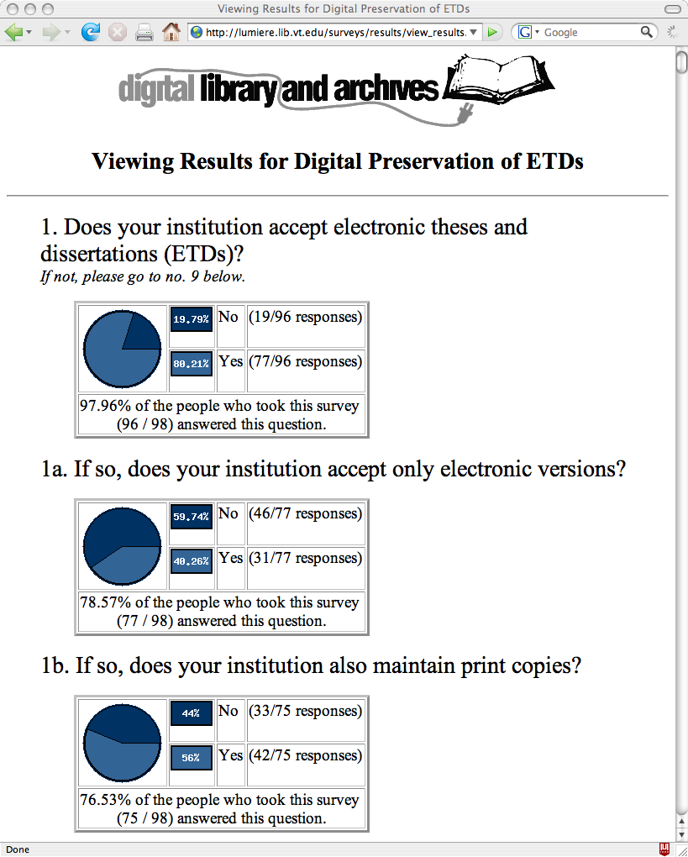
Notes:
Over three-fourths of the survey responses came from universities that accept ETDs. Over one-third of those respondents also reported that their institutions accept just the electronic formats while just over half of them also maintain print copies. It was expected that institutions with active ETD initiatives would be keeping up with relevant issues through the NDLTD or ETD listservs so it is not surprising that more of those universities accept ETDs. However, a smaller percentage of those institutions accept only electronic versions.

Slide 10
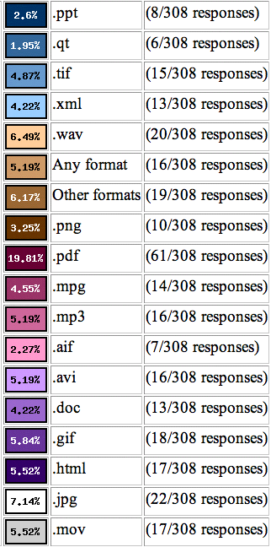
ETD File Formats
85% PDF
30% JPG
27% WAV
24% GIF
23% HTML, MOV
21% AVI, MP3
MetaArchive Conspectus Database
Notes:
The survey sought to determine the file formats that institutions accept with ETDs because this is an important element of preservation planning and of future format migration considerations. The MetaArchive is format agnostic, ingesting all file formats into its DDPN. The range of file formats that comprise ETDs at the survey respondents’ universities, matches those the MetaArchive has already ingested and those that were corrupted and rebuilt during extensive network testing.
Such information as file formats along with other metadata is tracked through the MetaArchive Conspectus Database, which contains each institution’s detailed descriptions of the collections in the DDPN. The metadata is used for a variety of purposes such as administration of the network (management, harvesting, maintenance, and recovery), public understanding of the collections, and future activities such as format migration.

Slide 11
Platforms and Institutional Repositories hosting ETDs
26% DSpace
13% ETD_db
3% Fedora
1% Eprints
29% Locally developed systems
29% Others
Notes:
As anticipated, ETDs are hosted by a variety of platforms and repositories.
Others mentioned were CONTENTdm, DigitalCommons, DigiTool, and ProQuest.

Slide 12
Structure of ETD Collections
25% Subject-like categories
21% Everything-in-one
21% Year
9% Accessibility
7% Degree
It’s best to group ETDs into discrete and finite units such as annual cumulations.
Notes:
There is a little less variety in the way collections of ETDs are structured.
Most frequently ETDs were organized by subject-like categories according to departments, colleges, or disciplines, according to 25% of the responses. Tied for the second most common collection organization, 21% each, were everything-in-one-collection and collections based on the year the degree was granted. The three other categories chosen were accessibility (9%), degree (7%), and author (5%). (12% of the responses did not address the question.)

Slide 13
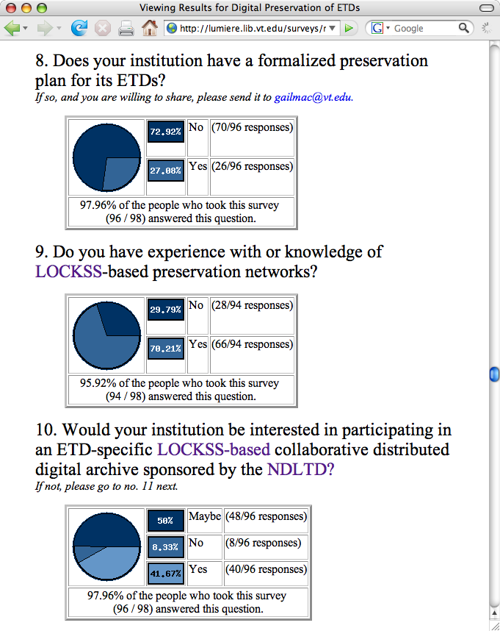
Notes:
Conclusion The survey responses indicated that ETD collections exist at 80% of their universities. However, a shocking 74% of those universities lack formal preservation plans for their ETD collections. This chasm demonstrates the dire need for a preservation strategy such as that offered by the MetaArchive Cooperative. Any preservation strategy will have to accommodate a broad range of file formats, repository systems, and ETDs in varied organizational structures.
An ETD-specific LOCKSS-based collaborative DDPN sponsored by the NDLTD is of interest to the majority of survey respondents. And a distributed digital preservation network may be a particularly good fit for an international organization such as the NDTLD as well as the fact that two-thirds of the responding universities already have experience with LOCKSS.
Not only did this survey demonstrate the need for and interest in a formal preservation strategy for ETDs, the majority of survey respondents also want to participate in the preservation activities, not just off-load their ETDs into a secure archive maintained by others. If this interest in preservation network participation becomes linked with the respondents’ interests in an open or dim archive, it will cause the MetaArchive to reexamine one of its founding principles—the separation of access from preservation in its distributed digital archive. But the NDTLD is now in a position offer guidelines for long-term preservation of ETDs.

Slide 14
NDLTD Preservation Strategy
NDLTD and MetaArchive Cooperative
  Help higher education institutions provide long-term open access to ETDs
  Institutions can achieve this goal by becoming part of the ETD Preservation Network.
Participate in an NDLTD MetaArchive Preservation Network Workshop
Join: NDLTD and MetaArchive

Slide 15
NDLTD Preservation Strategy http://scholar.lib.vt.edu/theses/preservation/
Hardware
Software
Access
Intellectual Property
Organizing ETD Collections
Standards
Harvest Frequency
Institutional Workflow

Slide 16
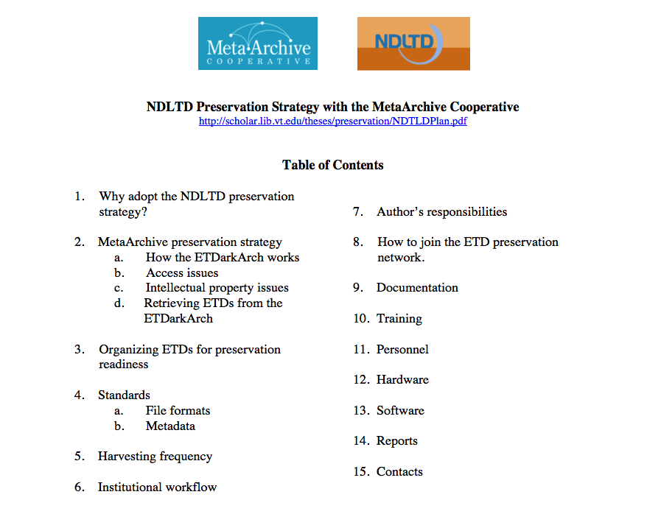

Slide 17
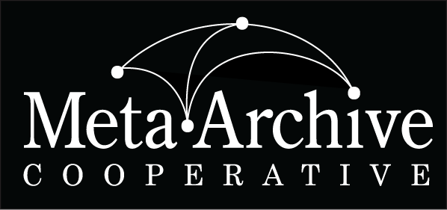
MetaArchive and Distributed Preservation
Dr. Martin Halbert
President, MetaArchive Cooperative
Distributed Digital Preservation for ETDs Workshop
University of Pittsburgh
Pittsburgh, PA
Wednesday, June 10, 2009

Slide 18
Session Questions
What is the MetaArchive Cooperative? Why did we form it?
What is distributed digital preservation? Why is it important for ETD preservation?
What is LOCKSS? How does MetaArchive use the LOCKSS software?

Slide 19
What led to MetaArchive?
Planning meetings by librarians and archivists in 2002-2003 on concerns about preserving digital archives
Sense that we needed to do something practical to help each other preserve our data
Not based on studies, just the observation of our anxieties about keeping our (expensive) digital materials preserved and viable.

Slide 20
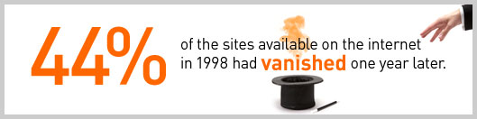
The Data Loss Problem
From NDIIPP Website on the Importance of Digital preservation
(http://www.digitalpreservation.gov/importance/):

Slide 21
The Gap in Digital Preservation Programs
66% of cultural heritage institutions (academic libraries, archives, art museums, public libraries, and other similar kinds of institutions) report that no one is responsible for digital preservation activities
30% of all archives have been backed up one time or not at all
Source: 2005 NEDCC Survey by Bishoff and Clareson

Slide 22
The Need for Collaborative Approaches
“The increased number and diversity of those concerned with digital preservation—coupled with the current general scarcity of resources for preservation infrastructure—suggests that new collaborative relationships that cross institutional and sector boundaries could provide important and promising ways to deal with the data preservation challenge. These collaborations could potentially help spread the burden of preservation, create economies of scale needed to support it, and mitigate the risks of data loss.”
- The Need for Formalized Trust in Digital Repository Collaborative Infrastructure
NSF/JISC Repositories Workshop (April 16, 2007)

Slide 23
Backups versus Digital Preservation
What differentiates a schedule for data backups from a digital preservation program?
Backups are tactical measures. Backups are typically stored in a single location (often nearby or collocated with the servers backed up) and are performed only periodically. Backups are designed to address short-term data loss via minimal investment of money and staff time resources. Backups are better than nothing, but not a comprehensive solution to the problem of preserving information over time.
Digital preservation is strategic. Preserving information over long periods requires systematic attention rather than benign neglect or unthinking actions.

Slide 24
Institutional Repositories versus Digital Preservation
What differentiates an IR program from a distributed digital preservation program?
The IR is not distributed. The IR is a centralized approach aimed at managing information flow within the institution. It typically does not attempt to securely cache prioritized content at multiple geographically dispersed sites.
DDP mobilizes efforts of multiple institutions. A digital preservation program entails a geographically dispersed set of secure caches of critical information. A true digital preservation program will require multi-institutional collaboration and at least some ongoing investment to realistically address the issues involved in preserving information over time.

Slide 25
Secure and Distributed Cache Networks
Why are the characteristics of geographically distribution and security so important? This strategy maximizes survivability of content in both individual and collective terms:
Security reduces the likelihood that any single cache will be compromised.
Distribution reduces the likelihood that the loss of any single cache will lead to a loss of the preserved content.
By creating a collaborative network for secure and distributed preservation, a group can also work together on more complex issues such as format migration.

Slide 26
Both Technical and Organizational Networking are Required
A single cultural heritage organization is unlikely to have the capability to operate several geographically dispersed and securely maintained servers
Collaboration between institutions on technological solutions is essential
Similarly, inter-institutional agreements must be put in place or there will be no commitment to act in concert over time

Slide 27
Shared Archiving Fails without a Pre-coordinated DDP Network in Place
Lessons from the NDIIPP Archive Ingest and Handling Test (AIHT) and other shared archiving experiments:
Encounter many unexpected incompatibilities because of different systems and data packaging
Realization that much of the cost in preserving digital material is in coordinating the organizational and institutional imperatives of preservation, and not the technological costs of storage space

Slide 28
MetaArchive
A distributed digital preservation cooperative for digital archives
Established under the auspices of and with funding from the National Digital Information and Infrastructure Preservation Program (NDIIPP) of the Library of Congress
A functioning DDP network and cooperative for libraries and other cultural memory organizations
Sustained by cooperative fee memberships, LC contracts, and other sponsored funding
Provides training and models for other groups to establish similar distributed digital preservation networks
Fosters broader awareness of digital preservation issues

Slide 29
MetaArchive Phase I (2004-2007)
Developed a working model for distributed digital preservation (DDP) in which institutions with shared subject domain focus mobilize for mutual benefit
Developed a technical solution for DDP based on a reuse of LOCKSS technology, in the form of a separate network with higher capacity nodes
Created an administrative nonprofit corporation
Began preserving via DDP hundreds of collections from many different organizations

Slide 30
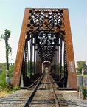

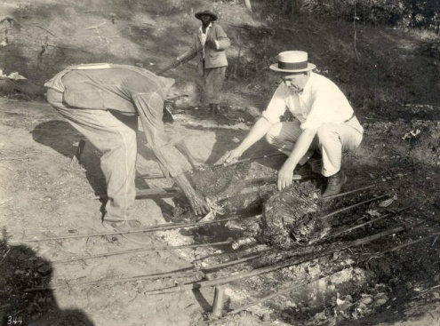
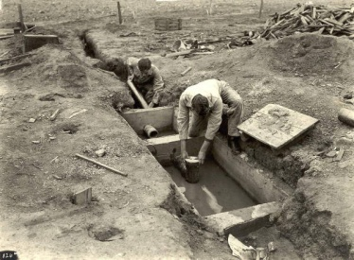
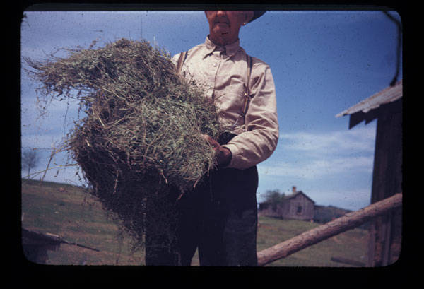
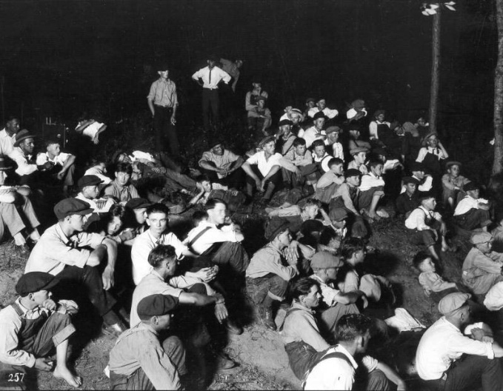
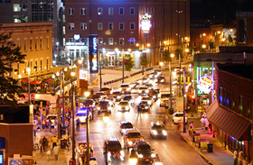
Collection Variety
Collections include:
  Images
  Text files
  Multimedia files
  Datasets
  Program executables

Slide 31
MetaArchive Founding Members

Slide 32
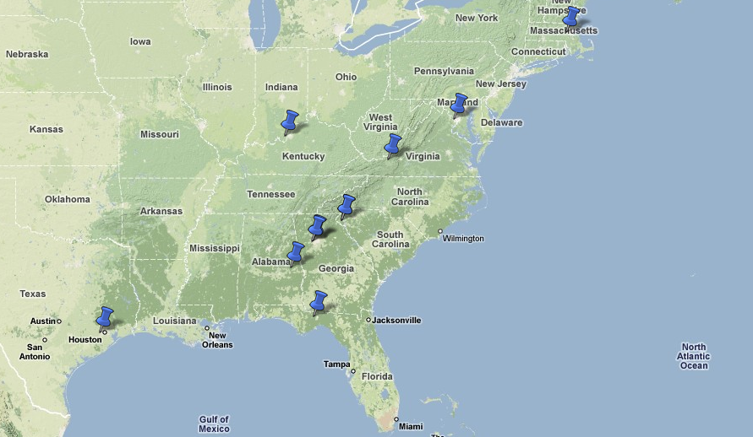
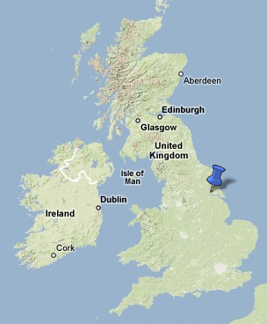
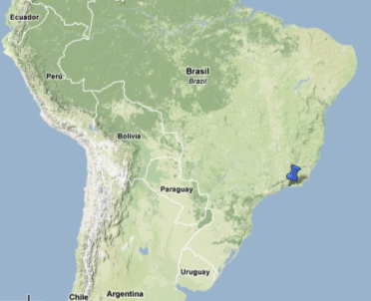
Membership Distribution
10 US Members
+ Lib. of Congress
2 Overseas Members

Slide 33
Current Members
Auburn University
Boston College
Clemson University
Emory University
Florida State University
Folger Shakespeare Library
Georgia Tech
Library of Congress (Sponsor)
Pontifical Catholic University of Rio de Janeiro
Rice University
Hull University Wilberforce Institute
University of Louisville
Virginia Tech

Slide 34
Catalytic Efforts
Began hosting workshops in distributed digital preservation strategies in 2007
  Instruct new MetaArchive members in processes
  Advise other groups considering DDP approaches
Assisted in creation of two additional DDPNs
  Alabama – state digitization projects
  Arizona – state government records

Slide 35
Technology: Building on Top of LOCKSS as a Solution for Preserving Digital Archives
Conspectus Database (Original)
  Curators enter collection level entries for collections
  Meant to be used for cooperative prioritization in DDP selection and decision-making activities
  Not interactive with some key MetaArchive systems (Cache Manager, Ingest Plugins)
Second Generation Conspectus Database
  Now in development
  Integrates operation of all network functions
  Being designed in concert with guidance from other PLNs, hopefully in ways that enable re-use

Slide 36
Organizational Agreements and Models
Developed a new cooperative with guidance from both legal team, librarians, and intellectual property specialists
Created core organizational documents in 2006: charter, membership agreement, papers of incorporation, business plans, etc.
Allows members to understand their commitment and liability clearly

Slide 37
Collection Foci: Growing Archives in Subject & Genre Domains
Southern Digital Culture (initial collecting area, founding members were Southeastern)
Transatlantic Slave Trade Historical Data (made cooperative international)
Electronic Theses and Dissertations (inter-consortia strategic alliance with NDLTD)
Early Modern Literature (broad new area, with Folger Shakespeare Library as cornerstone)
Additional archives in planning stages

Slide 38
Active Collaborations with
Other Efforts
LOCKSS (collaborative development of LOCKSS Cache Manager)
Data-PASS Alliance (developing in-common standard for Private LOCKSS network interoperation standard and tools)
ECHO DEPository Project (PLN interoperation standard using HandS)
SDSC Chronopolis (PLN/ SRB interoperation testing and bridges)

Slide 39
MetaArchive Phase II (2007-2010)
Established additional distributed archives
Became international with the addition of Hull University in UK
Doubled in size 2008-2009, and plan to double in size each year for next three years
With funding from NHPRC will now provide consulting and outreach services on the MetaArchive model for DDP services

Slide 40
Institutional Roles
Preservation Sites are entities responsible for the ongoing activity of preserving digital content. At a minimum, every preservation site must include responsible staff and a node server of the relevant preservation network. Preservation sites collectively comprise a preservation network.
Development Sites are responsible for technical development of the computer systems that enable the preservation network. Obviously, development sites may also be preservation sites and/or contributing sites.
Contributing (Content) Sites are institutions that need to preserve digital content, and therefore decide to contribute digital content into the preservation network. The preservation network acts for the common good to preserve the at-risk content submitted by the contributing sites. Contributing sites may also be preservation sites.

Slide 41
Factors to Consider
What level of participation are new MetaArchive members interested in? Running a node? Simply using the existing network?
Metadata for items must be reposited as well, in a way that enables recovery in the case of need
Whose job is this going to be in the organization?
What are the highest priority items for distributed digital preservation?

Slide 42
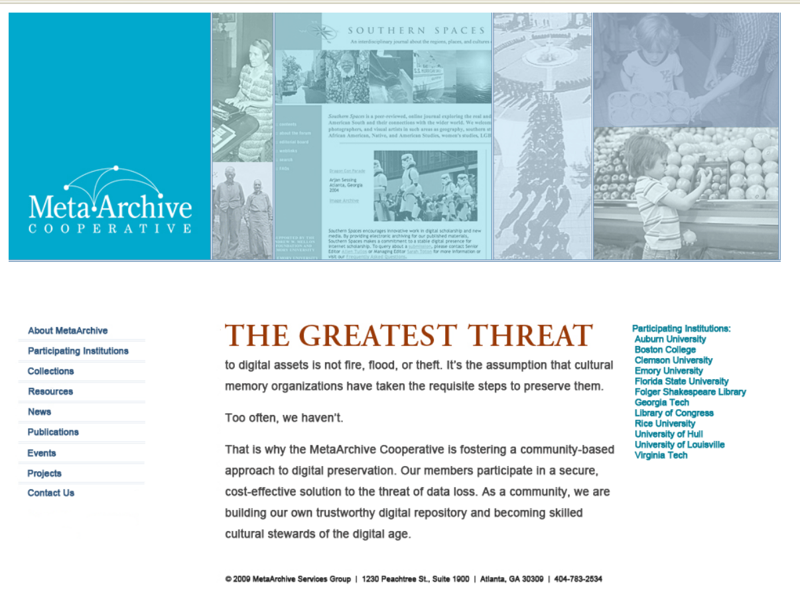

Slide 43
The NDLTD/MetaArchive
ETD Archive
Dr. Martin Halbert
President, MetaArchive Cooperative
Distributed Digital Preservation for ETDs Workshop
University of Pittsburgh
Pittsburgh, PA
Wednesday, June 10, 2009

Slide 44
Session Questions
Overview of the pilot program for the NDLTD/MetaArchive ETD Archive
Goals
Timeline
Scenarios for preserving ETD collections
Roles and responsibilities of new pilot project collaborators
How to participate

Slide 45
NDLTD/MetaArchive ETD Archive
Pilot Program - Goals
Analyze and understand different scenarios for offering MetaArchive preservation services for NDLTD members (hubs vs. cloud)
Test and document procedures and practices for NDLTD members to use MetaArchive network for preservation purposes
Model joint NDLTD/MetaArchive membership fees
Soliciting wider NDLTD involvement as of ETD 2009

Slide 46
NDLTD/MetaArchive ETD Archive
Program - Timeline
Jul 2009:
  Selecting additional program participants
Nov 2009:
  Concluding pilot project and transitioning to standard operations
Mar 2010:
  Hope to move forward on next steps for tools development

Slide 47
Scenarios Explored for Preserving ETD Collections
Hub and Spoke Model
  Identify small number of NDLTD/MetaArchive service providers who will offer preservation functions for all NDLTD members
Cloud
  Do not differentiate NDLTD/MetaArchive nodes
  Build up more joint members

Slide 48
Seeking Additional NDLTD/MetaArchive Members
Looking for additional participants
Collaborators must join MetaArchive (low cost!) in addition to NDLTD
Participants may either run a node or help model contributing member
procedures
ideally, would like new members willing to participate in development of tools

Slide 49
NDLTD/MetaArchive ETD Archive
Pilot Program - How to Participate
Decide if you want to participate in the NDLTD ETD preservation program
What member level are you interested in?
If interested, contact Gail McMillan (gailmac@vt.edu)

Slide 50
ETD Collections
Management for Preservation Readiness
Gail McMillan
Digital Library and Archives
Virginia Tech
Notes:
This is really about organization and much of it has to do with virtual organizing or what we’ve come to call Data Wrangling.
Appendices A and B in the NDLTD Preservation Strategy with the MetaArchive Cooperative
This part of the workshop will provide a detailed overview of how to prepare a collection for harvesting and ingest into the preservation archive, including how collections should be organized and documented, the creation of collection-level metadata using the conspectus tool and we’ll touch on intellectual property issues.

Slide 51
Best Practices:
Unique Directory Names
Standardized, uniform, easy to decipher
Timestamps
  etd-mmddyyyy-tttttt
  http://scholar.lib.vt.edu/theses/available/etd-10022007-144864
  ETD submitted on Oct. 2, 2007at 2:48:64 pm
Use same naming convention for scanned and born-digital ETDs

Slide 52
Best Practices: File Names
etd.pdf
  If file names are not unique, directory names must be unique
  May not be good for local management
Lastname_initials_doctype_year.format
  McMillanGM_T_1981.pdf
  SoundararajanS_D_2010.pdf
  SoundararajanS_D_2010_copyright.pdf

Slide 53
Best Practices: Archival Units
Discreet static (unchanging) units
  Annual ingest into preservation caches
>10 GB
  Divide annual directories into subunits
Notes:
Archival Units = LOCKSS jargon: AUs
SIPs: Submission Ingest Packages

Slide 54
Best Practices: Triage for ETDs
Inconsistent practices in directory structures, metadata, and file naming conventions
Rename, rearrange files or
Creative strategies needed
Adapt the existing situation to find, harvest, and ingest the files into the preservation network
Notes:
Identifying and correcting these problems will, of course, help not only with preservation, but also to improve local access.
rearrange files into a predictable order so that the ingestion path can be clearly defined

Slide 55
Best Practices: Triage for ETDs
How?
  Recognize there is a problem.
  Stop poor and practices.
  Isolate the problem files.
Data wrangling
  Define problem
  Adopt good (preservation) strategies.
    Create a direct path for ingest into preservation network
    Everything that doesn’t follow best-practices becomes one Archival Unit
Notes:
Identifying and correcting these problems will, of course, help not only with preservation, but also to improve local access.
rearrange files into a predictable order so that the ingestion path can be clearly defined

Slide 56
Best Practices: Web Accessible
Keep ETDs on live, spinning discs
Not on CDs or other static storage devices
Avoid problems: finding those discs, loading them onto spinning discs, rectifying errors and failed media
  Even gold CDs regularly fail!
Declining cost of online storage
Notes:
ETDs record the research and scholarship of the institution’s graduate students and, consequently, its faculty, and are deemed of importance to preserve, either now or at some future time,.
Live versus Static Media
Store it ETDs on live, spinning discs, not on CDs or other static storage devices.
Eliminates having to find those discs, load them onto spinning discs, rectify errors and failed media.
IP= internet Protocol: deliver packets from the source host to the destination host solely based on their addresses. Enables NDLTD preservation partners with specified internet addresses only to access restricted and withheld/embargoed ETDs.
IF the correctly worded manifest page is in place and gives permission

Slide 57
Best Practices: Web Accessible
Public
NDLTD preservation partners only
  Restricted and Withheld/Embargoed ETDs
  Add IPs to server’s firewall to enable access
Permission
  “LOCKSS system has permission to collect, preserve, and serve this Archival Unit”
Notes:
Live versus Static Media
Store it ETDs on live, spinning discs, not on CDs or other static storage devices.
Eliminates having to find those discs, load them onto spinning discs, rectify errors and failed media.
IP= internet Protocol: deliver packets from the source host to the destination host solely based on their addresses. Enables NDLTD preservation partners with specified internet addresses only to access restricted and withheld/embargoed ETDs.
IF the correctly worded manifest page is in place and gives permission

Slide 58
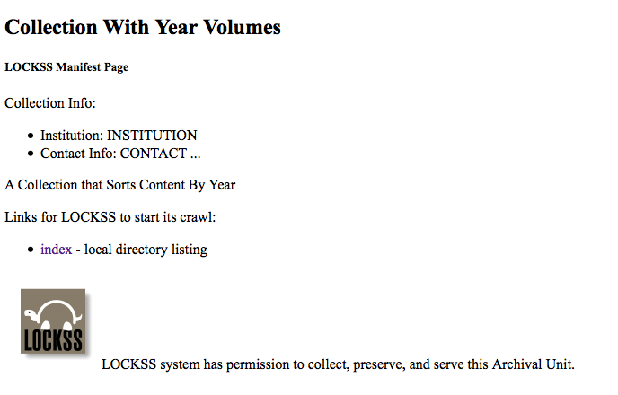

Slide 59
Best Practices: Metadata Discipline
Describe the institution’s individual ETDs
  ETD MS: ETD Metadata Standard
    http://www.ndltd.org/standards/metadata/etd-ms-v1.00-rev2.html
  MARC: MAchine Readable Cataloging
    http://www.worldcat.org/
Describe the institution’s ETD collection
  MetaArchive Conspectus Database
    http://www.metaarchive.org/conspectus

Slide 60
MetaArchive Conspectus Database
Overview of each collection being preserved in the ETD Dark Archive
  Descriptive information
  Network administration information
  Public awareness function
  Future considerations, e.g., format migration
Collection-level Metadata Specification
  Thoroughly defines the metadata elements
  http://metaarchive.org/pdfs/conspectus_md_2005.html
Notes:
See Appendix B, p. 14-16 of the NDLTD Preservation Strategy

Slide 61
MetaArchive Conspectus:
Descriptive Data
Details explaining the ETD collection to be preserved
  Title: formal name of the ETD collection
  Alternative Title: other names for the collection
  Description: explain or define the collection
  Subjects: describe the collection using terms from a thesaurus or controlled vocabulary

Slide 62
MetaArchive Conspectus: URI
Uniform Resource Identifier: usually a locator (URL) or name (URN)
  Collection’s URI
  Institution identifier: university assigned control number for the collection
  Is available via: public URL

Slide 63
MetaArchive Conspectus: Coverage
Describe the collection in space and time
  Spatial Coverage: geographical location--place or areas associated with the collection
  Temporal Coverage: time periods associated with the collection
  Accumulation Date Range: span of dates when the collection was assembled
  Contents Date Range: dates of creation of the digital collection

Slide 64
MetaArchive Conspectus:
Accrual Information
Details about the anticipated growth of the ETD collection
  Accrual Periodicity: frequency with which items will be added to the collection
    Daily, Weekly, Monthly, …No longer adding
  Accrual Policy: approach adopted to add items to the collection or anticipated growth

Slide 65
MetaArchive Conspectus:
Data Description
Formatting, size and language information
  Format Characteristics: physical or digital characteristics of the files in the collection
    audio: wav image: jpg text: pdf video: mpeg
  Language of the content of the collection
  Type: genre or category of the content of the collection
    Text, sound, datasets, software, animation, etc.
  Extent: size or duration of the entire collection

Slide 66
MetaArchive Conspectus:
Rights and Ownership
Description of the collection’s intellectual property
  Creator: originator of the ETD collection
  Publisher: entity responsible for making the ETDs available
  Rights: statement about who owns the copyright
  Access Rights: statement of restrictions placed on the collection, including allowed users, charges, etc.
    Restricted Unrestricted
  Custodial History: changes in ownership, custody of the collection, integrity and interpretation; provenance
  Manifestation: reformatting quality attribute
    Access Preservation Replacement

Slide 67
MetaArchive Conspectus:
Related Resources
Use of and references for the collection
  Associated publications
  Subcollections
  Supercollections
  Catalog or description
  Cataloged status
  Associated collections
Notes:
Expanded descriptions on p 16 of NDLTD Preservation Strategy

Slide 68
MetaArchive Conspectus:
Harvesting Information
Details about the web crawl that will gather the files into the ETD Dark Archive
  Harvest Procedure: Web crawl or OAI harvest
  Plugin Identifier: URI or URL
  Extra Parameters: Archival Units, e.g., year = 2007
  LOCKSS Manifest Page: permission to preserve
  OAI provider
  Risk Rank: designates the degree to which the collection is in jeopardy (5 choices from extreme to low risk)
  Risk Factors: describe the reason this collection is endangered.

Slide 69
MetaArchive and its Members: Roles and Responsibilities
Dr. Martin Halbert
President, MetaArchive Cooperative
Distributed Digital Preservation for ETDs Workshop
University of Pittsburgh
Pittsburgh, PA
Wednesday, June 10, 2009

Slide 70
Session Questions
MetaArchive Charter and Membership Agreement
Three types of membership that that are available
Associated fees and responsibilities

Slide 71
MetaArchive Charter, Membership Agreement , and Host Nonprofit
Charter is a formative agreement that lays out the conceptual roles and responsibilities of participants
Membership agreement is between new members and MetaArchive’s administrative nonprofit corporation
  Agreement to preserve content for specified period
  Pledge to not intentionally harm the
  network

Slide 72
Three Membership Levels
Contributing Site Members: Do not run infrastructure, simply use the network to preserve content
Preservation Site Members: Operate a MetaArchive network node for specified period, using it to preserve content
Sustaining Site Members: Operate a node and participate in leadership of
cooperative

Slide 73
Associated Fees and Other Responsibilities
Two Membership Levels:
  Preservation Site Members ($1,000/year): Ability to reposit content in the shared network infrastructure
  Sustaining Site Members ($5000/year): Above, plus seat on the Steering Committee and participation in directing the cooperative
All members are obligated to provide and operate a minimal server on the network and accept at least as much content from others as they themselves reposit into the network
50 GB of network storage; adding content beyond specified base means adding incremental network storage fees of $2/GB per three year period
Membership commitment is in three year increments
Membership fees are reduced for members joining both NDLTD and MetaArchive simultaneously

Slide 74
Individual Roles
Program Managers are leaders that accept responsibility for coordinating the activities of a digital preservation network.
Data Wranglers are programmers and other technically adept workers that prepare local digital archives for ingestion into a preservation network.
System Administrators are staff members that maintain individual preservation node servers of the relevant preservation network.
Selectors are staff that identify and prioritize content to be preserved. They will most often be knowledgeable concerning the content of an institution’s digital archives, and may have been the same individuals that originally created or acquired the archives.

Slide 75
Archive Ingest Process
A “Plugin” is written for collections selected for preservation
Plugins are programs describing rules and structure for the “archival unit”
Either local staff or MetaArchive staff write these plugins and install them in the network
At least 6 dispersed sites are selected for repositing the archival unit
Caching process begins, with updates following if necessary

Slide 76
Requirements for Operating a Node
Be able to bring up and maintain a Linux server over time
Task local staff with both program management and systems administration duties, and preferably data wrangling as well
Contribute content and monitor system functioning occasionally
Sign membership agreement and pay membership dues

Slide 77
MetaArchive
A New Member’s Perspective
Bill Donovan
Digital Imaging Librarian, ETD Administrator
Boston College

Slide 78
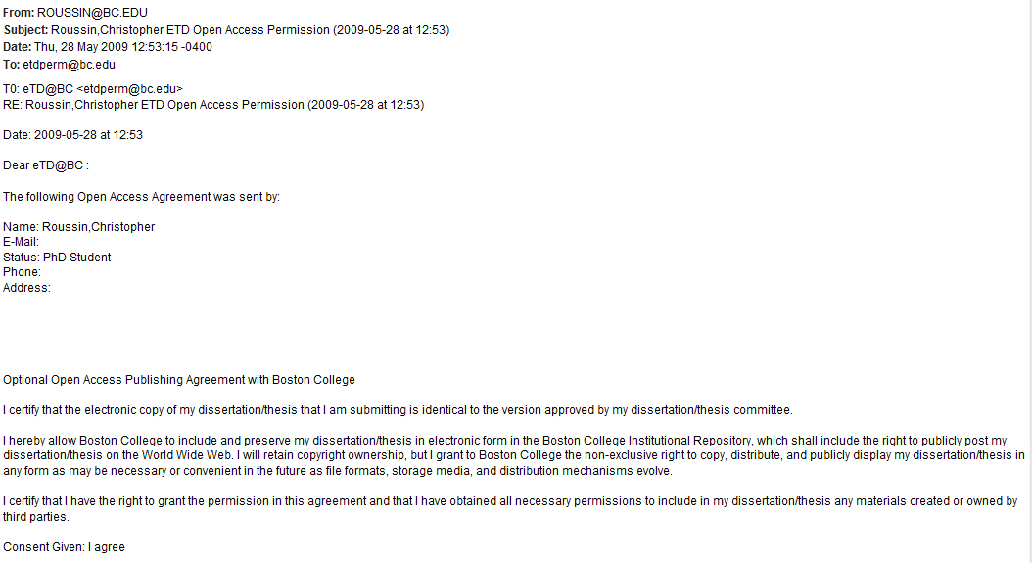
Open Access permission

Slide 79
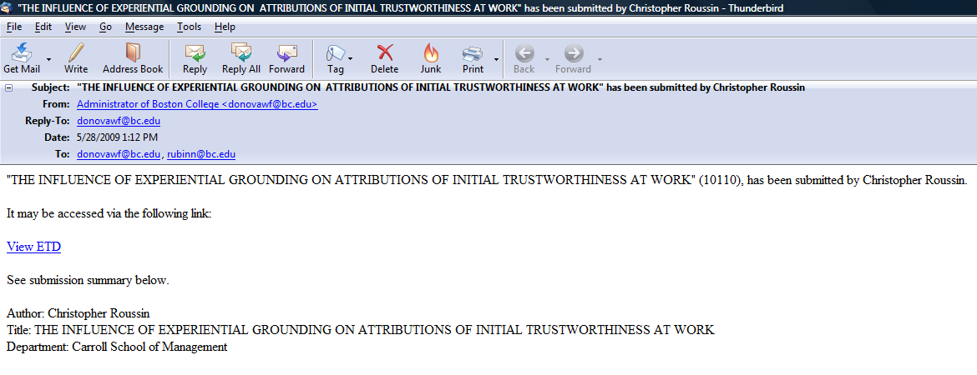
ETD submission notification

Slide 80
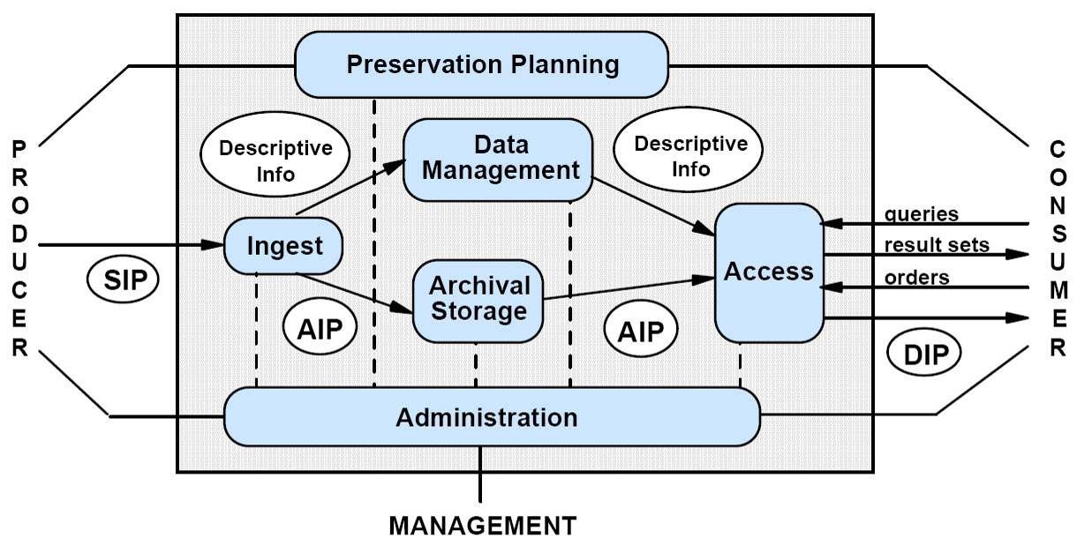
Open Archival Information System
Figure 4-1: OAIS Functional Entities, adapted from: “Reference Model for an Open Archival Information System” CCSDS 650.0-B-1 (2002)
Notes:
OAIS “Open Archival Information System” --- In last 6 yr, has become a ubiquitous standard among practitioners of digital preservation --- describes an architecture that supports DP.
But OAIS is a very generic system for preserving any type of digital information.
OAIS does not provide a detailed plan for implementation --- that is our job!!! OAIS is a useful guide to help think through all of the key components and functions that a digital archives would need to have. We will need to “map” the generic model to the specific needs of Boston College.
The “mapping” might go something like this:
Think of the left side of the OAIS diagram as collection development
Think of the right side of the OAIS diagram as access services
From left to right: 1) Selection; 2) Digitization; 3) Cataloging; 4) Storage; 5) Access
“Producer” could be the Digitization Lab or the Media Center (or purchased or “born-digital”)
“Consumer” could be a student or a faculty member, or anyone with access to the World Wide Web (only true for open access materials)
“Master files” and complete metadata are stored in the archives; patron encounters only the metadata for searching and discovery, and then accesses “derivative files” (JPEGs, not TIFFs)

Slide 81
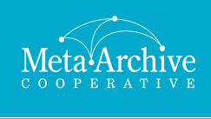
Distributed Digital Preservation
Emory
University
Virginia
Tech
Florida
State
University
Georgia
Tech
Boston
College
Rice
University
Notes:
As part of our strategy for digital preservation, Boston College has joined the MetaArchive Cooperative.
As one member has said:
“Backups are tactical measures. Digital preservation is strategic.”
This alliance of universities will jointly create the infrastructure and tools that will be needed to ensure that their digital collections will remain viable, in perpetuity. Each university’s digital archive will house not only its own collections but also some of the other universities’ collections.
On a regular schedule, each collection will be compared with all of its replications in order to detect and correct any corrupted digital content.
These are “dark” archives, i.e. non-BC institutions will preserve BC’e ETD collection --- but will not provide any access (access via BC only).

Slide 82
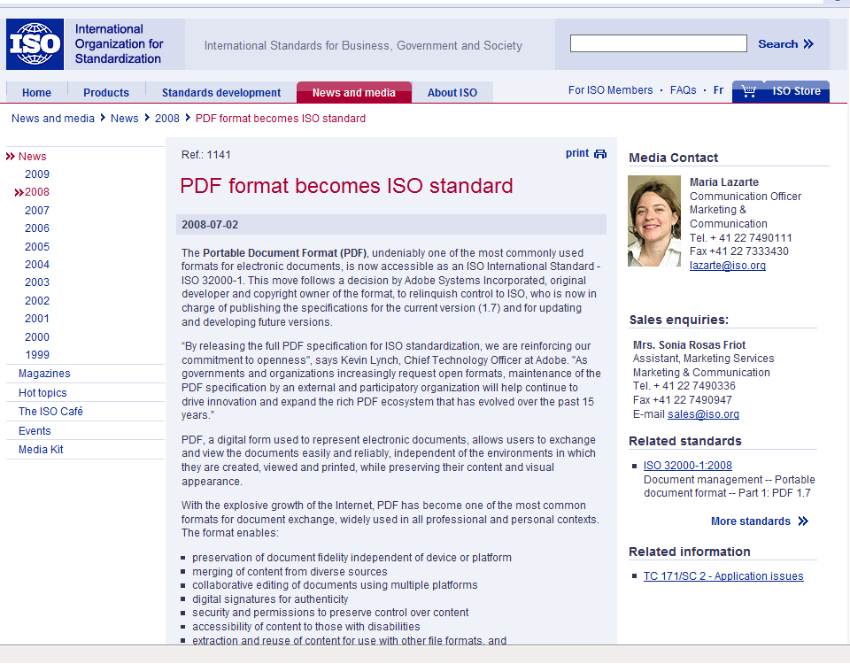
Preservation file formats

Slide 83
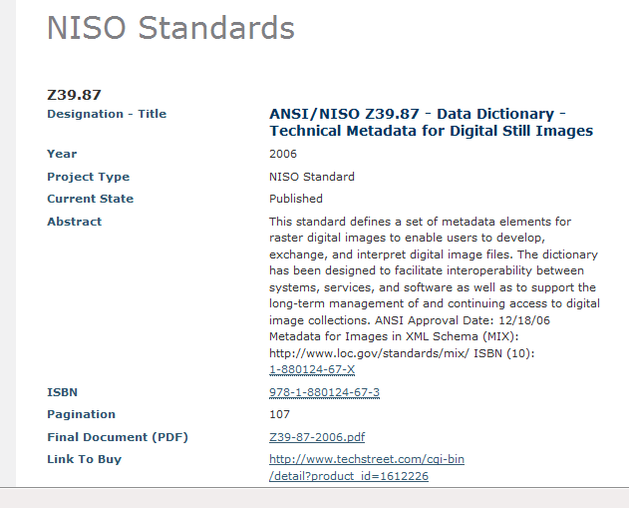
Preserving visual appearance

Slide 84
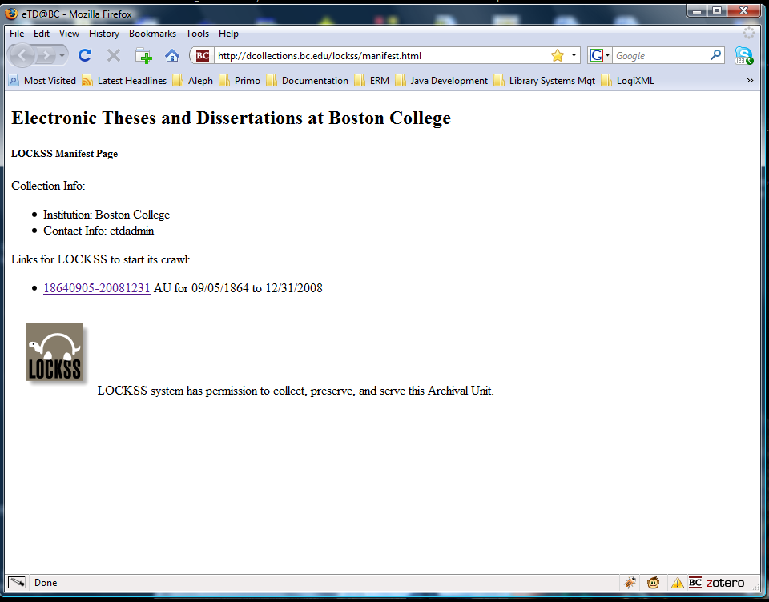

Slide 85
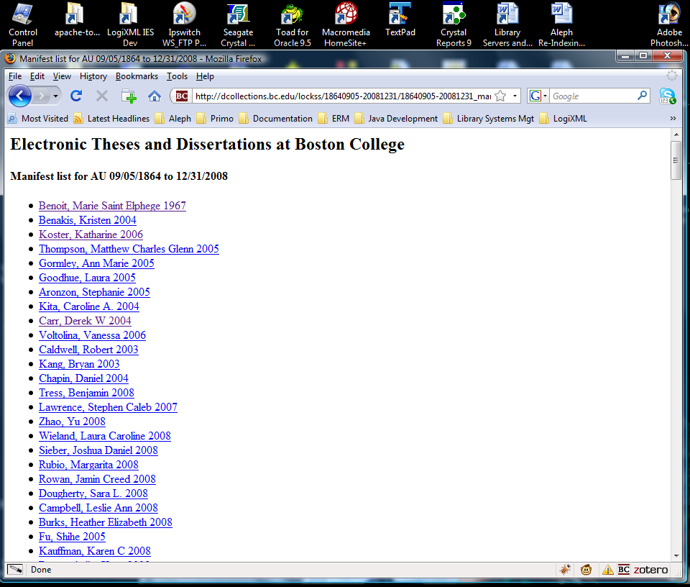

Slide 86
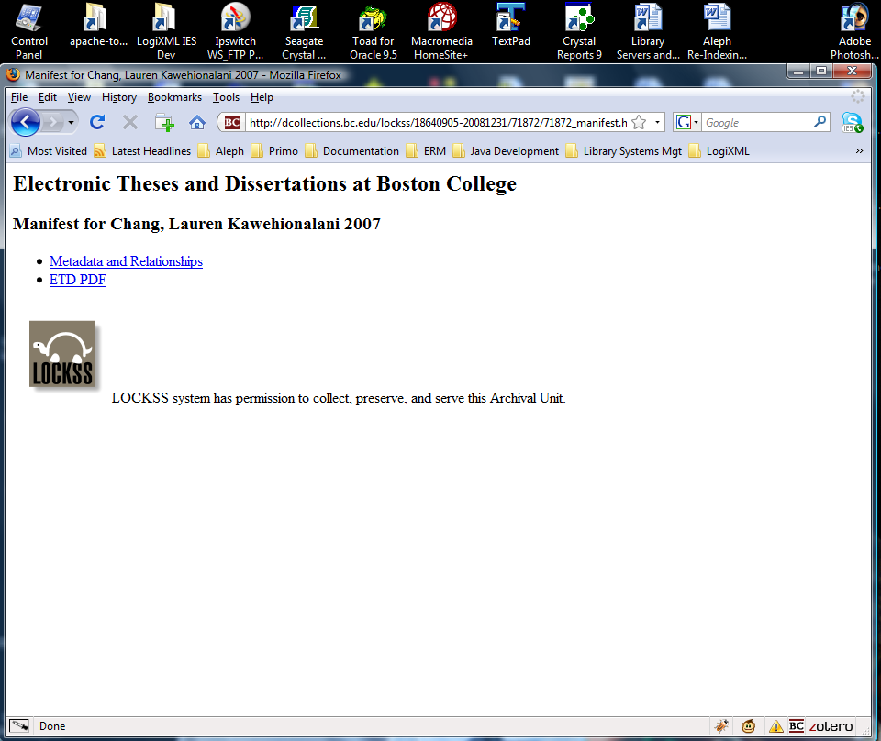
http://dcollections.bc.edu/webclient/DeliveryManager?metadata_request=true&GET_XML=1&pid=71872
http://dcollections.bc.edu/webclient/DeliveryManager?pid=71872

Slide 87
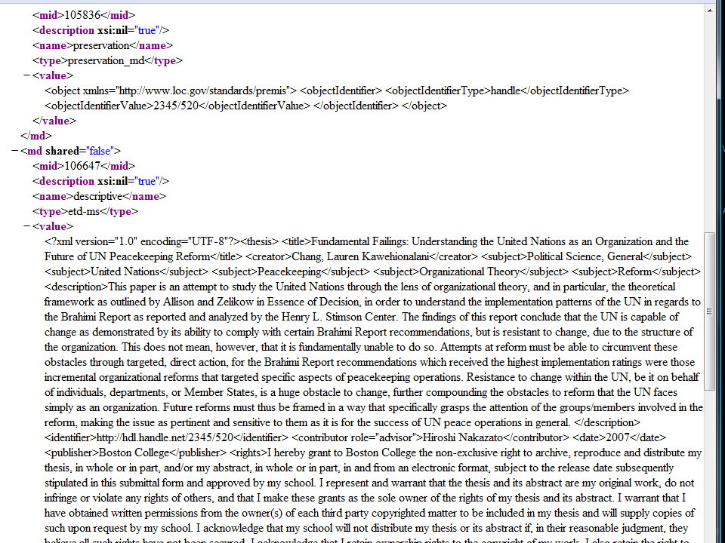

Slide 88
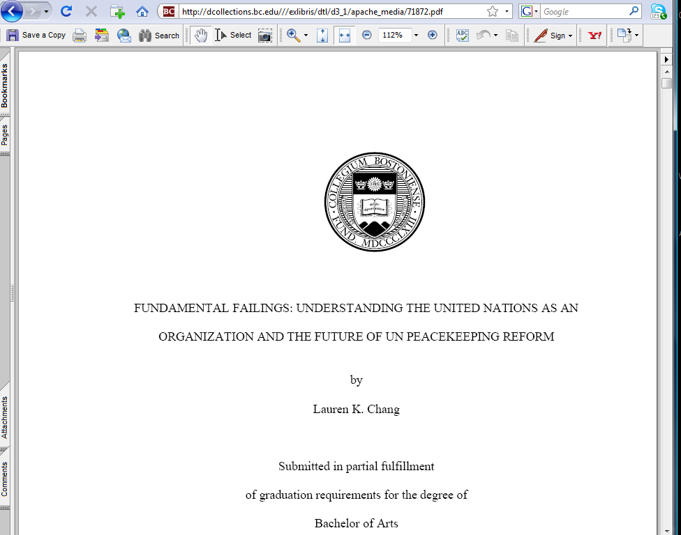

Slide 89
Questions and Answers
Contact information:
Gail McMillan (gailmac@vt.edu)
Martin Halbert (+1-404-727-2204)
Katherine Skinner (kskinne@emory.edu)

