Slide 1
Automated Students' short answers assessment
CS 4624: Multimedia, Hypertext, and Information Access
Professor Farag
Nov. 16th
Team 10: Mathew Padath, Wenmiao Wang, Ryan McGovern, Westin Jiang, Yifei Wan

Slide 2
Outline
Introduction
Timeline
Tech Stack
System Architecture/Dataflow
Features
Demo
Future Development
Client Acknowledgement/Questions?
Notes:
To outline our presentation, we will begin with the introduction, timeline and tech stack. We will then move on to the system architecture, features and a live demo. Finally we will end by presenting future developments, our client acknowledgement, and answering any questions if needed.

Slide 3

Introduction
Problem: Manually grading written responses is labor-intensive and time consuming for educators.
Solution: We’ve designed and implemented a web application that automatically assesses, provides scores, and gives feedback for computer science-related short answer responses.
Scope: Our web app is applicable to surveys, quizzes, and exams of all types. It is not limited to only computer science questions and can be used for any subject as long as a teacher answer file is provided.

Slide 4

Timeline
Our final design for our dataset is a .tsv file containing the teachers answers for the provided questions.
Uses a pre-existing deep learning model (Roberta Large) for grading as well as a database using MongoDB to store previous submissions and provide file accessibility.
Includes a web application developed using ReactJS. Provides an interactive environment for uploading submissions and receiving feedback.
Dataset
Backend
Frontend
Start
Developed a foundation for the dataset. Created designs for Frontend and Backend functionality.
Implemented the Backend deep learning model, began developing the Frontend, and adapted the dataset to coincide with newer versions.
The Dataset, Frontend, and Backend were integrated together. This final version is a fully functional auto-grader at all levels.
Submit our VTechWorks final report.
Future
Presentation 1
Sept. 21st
Presentation 2
Oct. 24th
Final Presentation
Nov. 16th

Slide 5


Tech Stack
React
Frontend
Used to help build user interfaces
Flask API
Used to help develop web applications, integrated with database
Python Backend
MongoDB
Database
NoSQL database, used to store the previous submissions
Notes:
So for our Tech Stack, we use React JS as our frontend. This is used to help us build the user interface. We use javascript to implement the functionality and css files to design the UI of the page. For our python backend, we use Flask to build the web API. And it also used to integrated with the database. We use MongoDB as our database, in order to store the previous submissions from users. So users can view the history of their submissions.

Slide 6
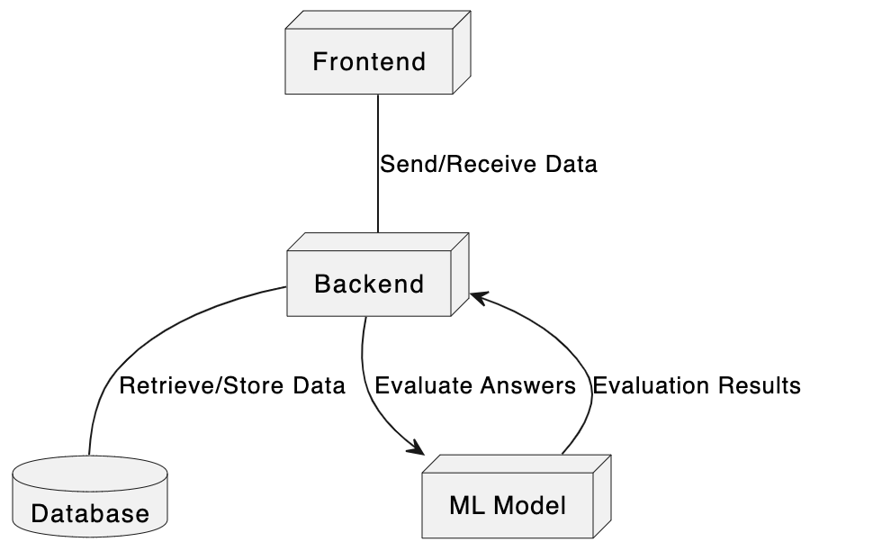
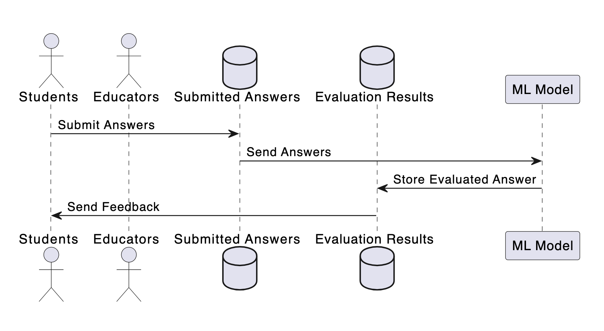
System Architecture/Dataflow
Notes:
Having explored our tech stack, let's now turn our attention to the system's architecture, which plays a pivotal role in how our application operates. At its core, the architecture is designed for simplicity and efficiency. The process begins at the frontend, where users input teacher and student answers in .tsv file format. Once the data is entered, clicking the 'Grade' button initiates a sequence of events: the frontend communicates with the backend, which in turn activates our Machine Learning model. This model is the backbone of our grading system, designed to assess and grade the submissions accurately. After processing, the results are displayed on the frontend for immediate viewing. Additionally, users have the option to download these results in a detailed .txt file format, offering deeper insights into the grading. Another key component of our architecture is the database, which plays a crucial role in storing previous submissions, allowing us to maintain a record of past performances and enhance our system's learning capabilities. This streamlined data flow, from the initial input to the final output, underscores the effectiveness of our system's architecture in handling and processing information efficiently.

Slide 7
How does the System come up with the score?
Grading Logic
Embeddings
Deep-Learning Model
Notes:
Next, I will focus on how we used embeddings and the deep-learning model to come up with the students' grades for the short-answer questions. First, the grading logic in the AutoGrader class is designed to assess student responses by comparing them to the concepts of the model answer. The process begins by breaking down the student's answer into phrases and then computing the semantic similarity between each phrase and the concepts in the model answer. Semantic Similarity is determined by using a deep learning model to generate embeddings for each phrase and the model concepts. The similarity score is calculated using cosine similarity, which measures the cosine of the angle between the two vectors in the embedding space. If the similarity for a concept exceeds a certain threshold (0.6 in our project), the concept is considered to be successfully detected in the student's answer. The final grade is computed as the proportion of detected concepts to the total number of concepts in the model answer, multiplied by a scaling factor (10 in our project). This grade is then rounded to the nearest whole number to represent the student's performance.
As I mentioned before, we used the embeddings in our automated short-answer assessment tool. Embeddings are dense vector representations of text that capture the semantic meaning of words, phrases, or sentences. In the AutoGrader class, embeddings are generated by the SentenceTransformer model, which is a modification of the RoBERTa model fine-tuned for sentence-level tasks. When the compute_similarity method is called, it uses this model to convert the input sentences (student's phrase and model concept) into embeddings. These embeddings are high-dimensional vectors that encode the input text in such a way that semantically similar phrases are placed closer together in the vector space. Consequently, by computing the cosine similarity between embeddings, we can obtain a measure of how semantically close two pieces of text are.
The SentenceTransformer model used in the AutoGrader class is a pre-trained deep-learning model based on the RoBERTa architecture. RoBERTa is a variation of BERT (Bidirectional Encoder Representations from Transformers), which is a transformer-based model designed to understand the context and relationships between words in a sentence. The model is pre-trained on a large corpus of text and fine-tuned on sentence similarity and paraphrase identification tasks, which makes it particularly well-suited for semantic similarity comparison. In this application, the model is used to generate embeddings for both the student's answer and the model answer's concepts. The effectiveness of this model lies in its ability to capture the nuances of language and produce embeddings that reflect the underlying meaning of the text, allowing for accurate semantic comparisons.
By utilizing this advanced deep learning model, the AutoGrader can perform nuanced grading that goes beyond keyword matching, evaluating the student's understanding of concepts by considering the semantic content of their answers.

Slide 8
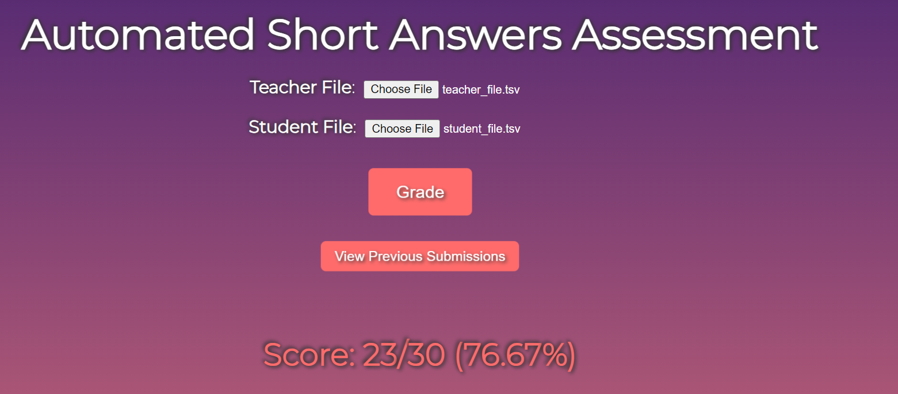
Feature 1 - Display the Brief Score in Web App
Notes:
Next, I will provide an overview of our key features. The primary feature involves displaying a concise score summary within our web application. Upon uploading the 'teacher_file' and 'student_file', followed by the grading process, the application presents the student's score. For instance, in the given example, the student has achieved a score of 23 out of a possible 30. Additionally, the web app calculates and displays the student's grade as a percentage.

Slide 9
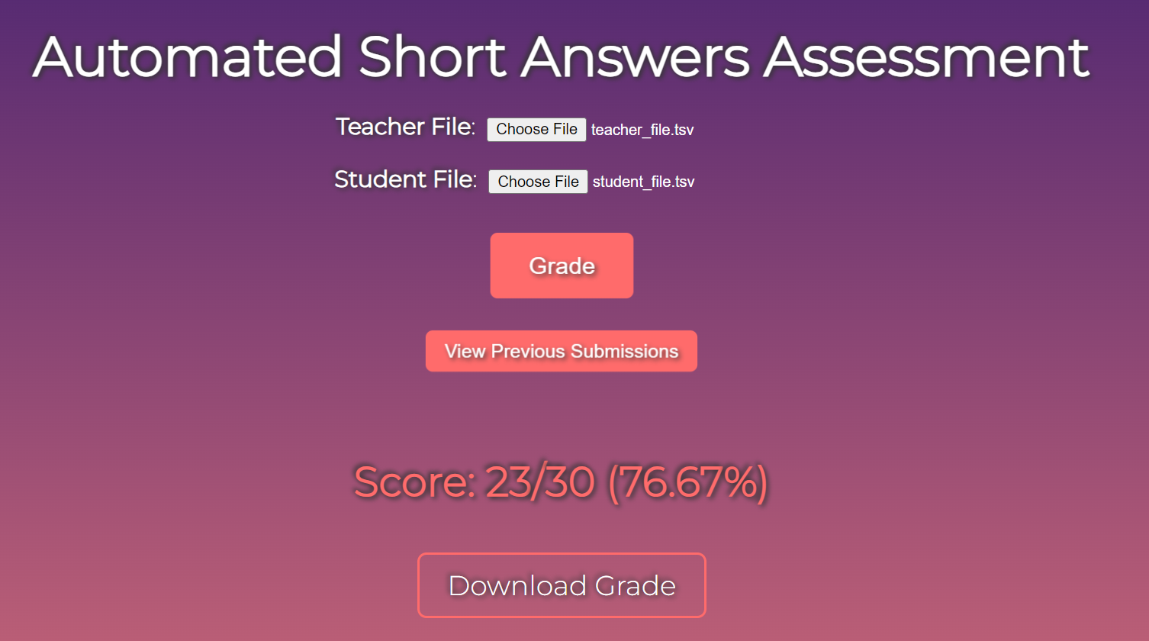
Feature 2 - Download the Grade with Details
Notes:
The second feature enables users to download a detailed Grade Report directly from the web application. This report provides comprehensive insights into the grading outcomes.

Slide 10
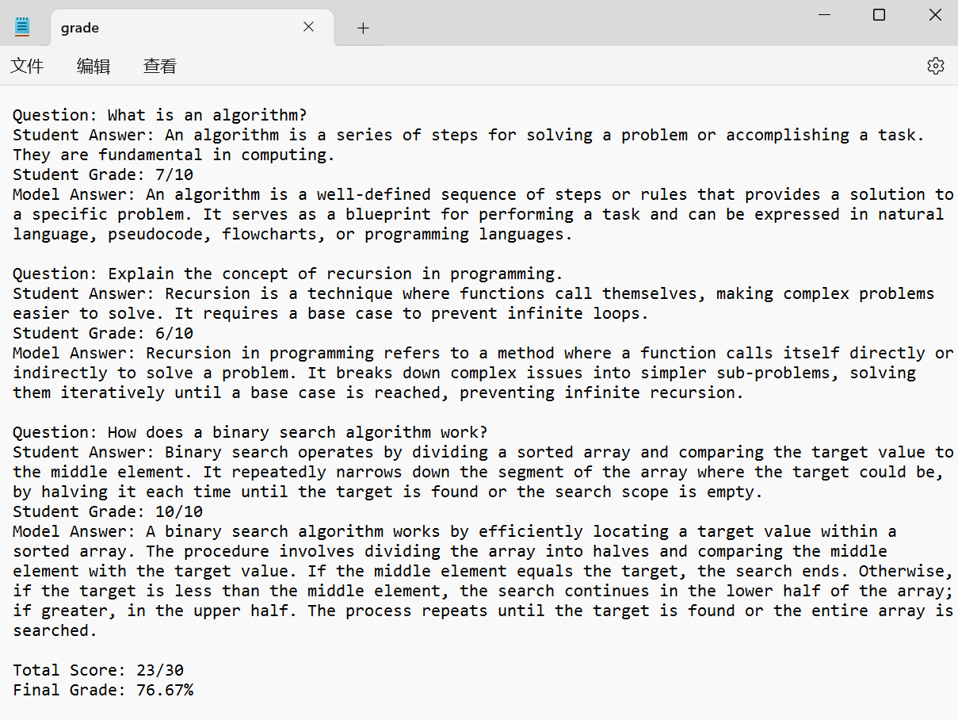
Feature 2 - Download the Grade with Details
Notes:
The Detailed Grade Report includes each question, the student's response, the grade awarded for that response, and the model answer. Additionally, the report summarizes the total score achieved and presents the final grade as a percentage.

Slide 11
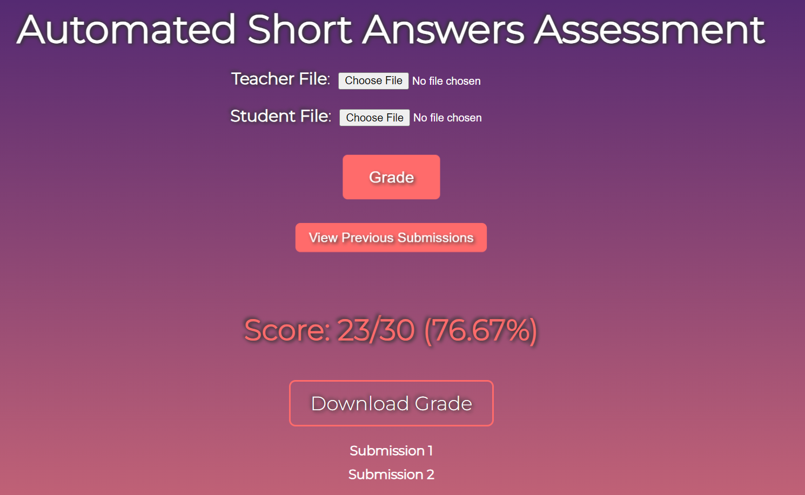
Feature 3 - View the Previous Submissions in Web App
Notes:
The third feature is that the user can view the previous submissions. For example, after clicking the view previous submissions button, the user will see the submission 1, submission 2, and so on. And then clicking the submission 1

Slide 12
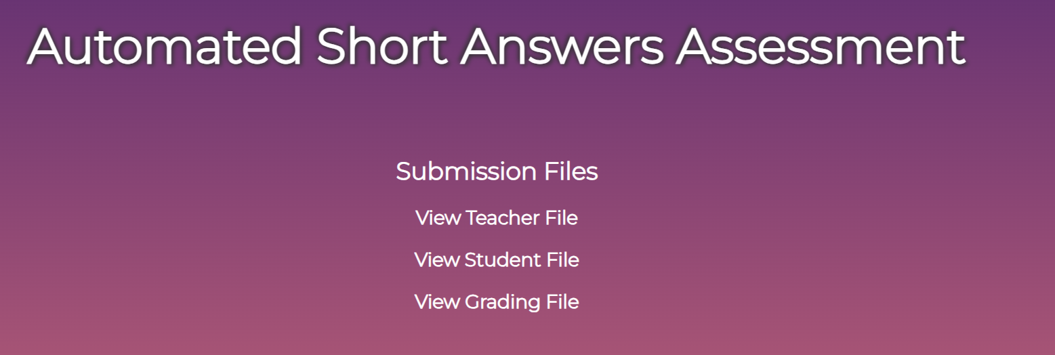
Feature 3 - View the Previous Submissions in Web App
Notes:
The user can see the previous submission files separately. Click the view teacher file button, then you will see the details of this file.

Slide 13
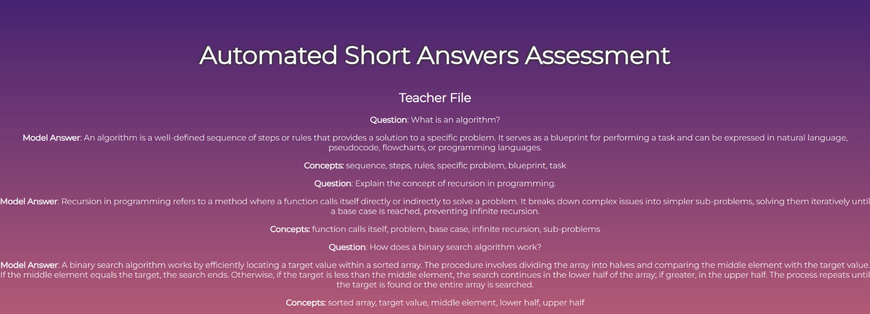
Feature 3 - View the Previous Submissions in Web App

Slide 14
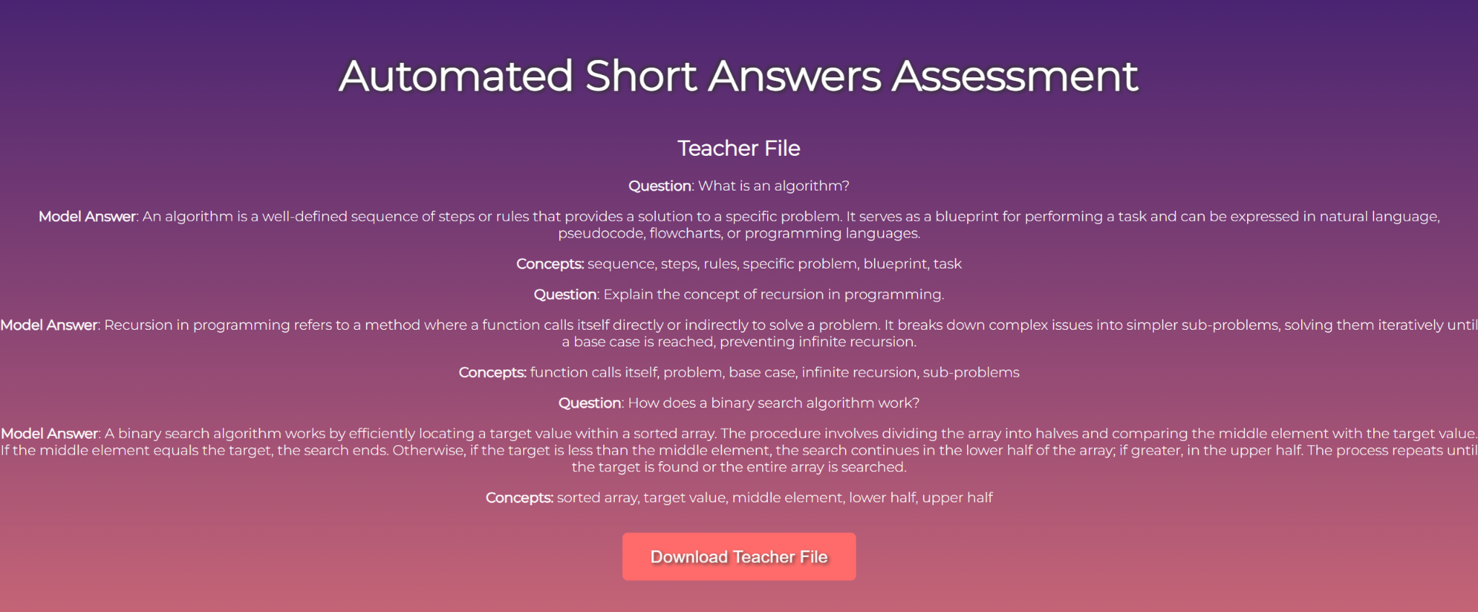
Feature 4 - Download the Previous Submissions from Web App
Notes:
The final feature allows the users to download all historical documents, including past versions of the 'teacher file', 'student file', and the corresponding grade reports. Here is just an example of teacher file. We will show the entire feature in the demo.

Slide 15
Demo

Slide 16
Future Development
Looking into the future, we would like to:
Implement a new approach
Allow for other file types to be uploaded
Update the functionality and appearance of the web application
Notes:
For future developments, we would aim to implement a new approach, as discussed in a recent meeting with our client. This involves implementing a dataset-driven strategy for training our deep learning models. This version would show a large advancement over our current framework.
We would also like to allow for other file types to be uploaded for both the teacher and student files. This would allow for more accessibility when submitting and grading.
Finally, we would like to update the functionality and appearance of the web app to allow scrolling, standardized formatting, and improved design features.

Slide 17

Client Acknowledgement
Mohamed Farag
mmagdy@vt.edu
Dr. Farag is a research associate in the Center for Sustainable Mobility (CSM):
Ph.D. degree in Computer Science from Virginia Tech in 2016
M.Sc. degree in Computer Science from the Arab Academy for Science, Technology, and Maritime Transport (AAST) in Alexandria, Egypt, in 2010

Slide 18
Questions?

