Slide 1

Master Health Literacy:
A Participant-Focused Program in Development
Michelle Pasier, Kiri DeBose, Virginia Pannabecker
Acknowledgements: Thank you to Erin Dreelin, Inga Haugen, and Charlotte Selbo
for their contributions to this project.
This presentation is available via VTechWorks: https://vtechworks.lib.vt.edu/handle/10919/79663
This presentation is licensed CC BY SA 4.0 for reuse: https://creativecommons.org/licenses/by-sa/4.0/
Notes:
Image: CC0 - https://pixabay.com/en/medicine-biology-healthcare-dna-163707/

Slide 2

Project Members
Project Planners
Kiri DeBose, Head of the Veterinary Medicine Library (kdebose@vt.edu)
Inga Haugen, Agriculture, Life Science, and Scholarly Communication
Librarian (ihaugen@vt.edu)
Virginia (Ginny) Pannabecker, Associate Director, Research Collaboration and Engagement (vpannabe@vt.edu)
Graduate Student Project Assistants
Erin Dreelin, MA Education, Curriculum & Instruction (derin@vt.edu)
Michelle Pasier, MS Life Science (m1pasier@vt.edu)
Charlotte Selbo, Master of Public Health graduate student (cselbo@vt.edu)

Slide 3

Background: Master Health Literacy Initiative
Beyond Boundaries Innovation Project
Provide skills, training, & tools to navigate deluge of information & misinformation in the area of health
Create a sustainable and scalable program that can be utilized by others
  Model MHL using existing Extension “Masters” programs
Environmental scan: Determine current landscape of other programs
  Explore format and learning objects to move forward
Notes:
Many of us face anxiety and uncertainty when it comes to health concerns. To help address this, three librarians at a research university are working with partners to develop a Master Health Literacy (MHL) volunteer program modeled after national extension programs such as ‘Master Gardener,’ and the Texas A&M AgriLife Extension’s Master Wellness Volunteer program. The MHL program will provide scaffolded health literacy content and guided self-directed learning to support individuals in growing knowledge and skills, and to empower community members to access and apply information for personal and community well being. An internal grant funded student positions to conduct a literature review and environmental scan for evidence-based program development.
Image CC0: http://maxpixel.freegreatpicture.com/Word-Data-Deluge-Binary-Dataset-Data-Binary-System-2728121

Slide 4

Background: Goal of the Project
Inspiration from Community Outreach Health literacy & Wellness programs:
Texas A&M AgriLife Extension’s Master Wellness Volunteer Program
How would ours be different?
Focus on information literacy skills
  Navigating through Dr. Google to find Dr. PubMed & Dr. Mayo Clinic
Create communities of people who can network and build from each other and pursue additional critical thinking skills
Notes:
Texas A&M’s program is a great example. Later in the presentation we’ll highlight a few more as well.

Slide 5
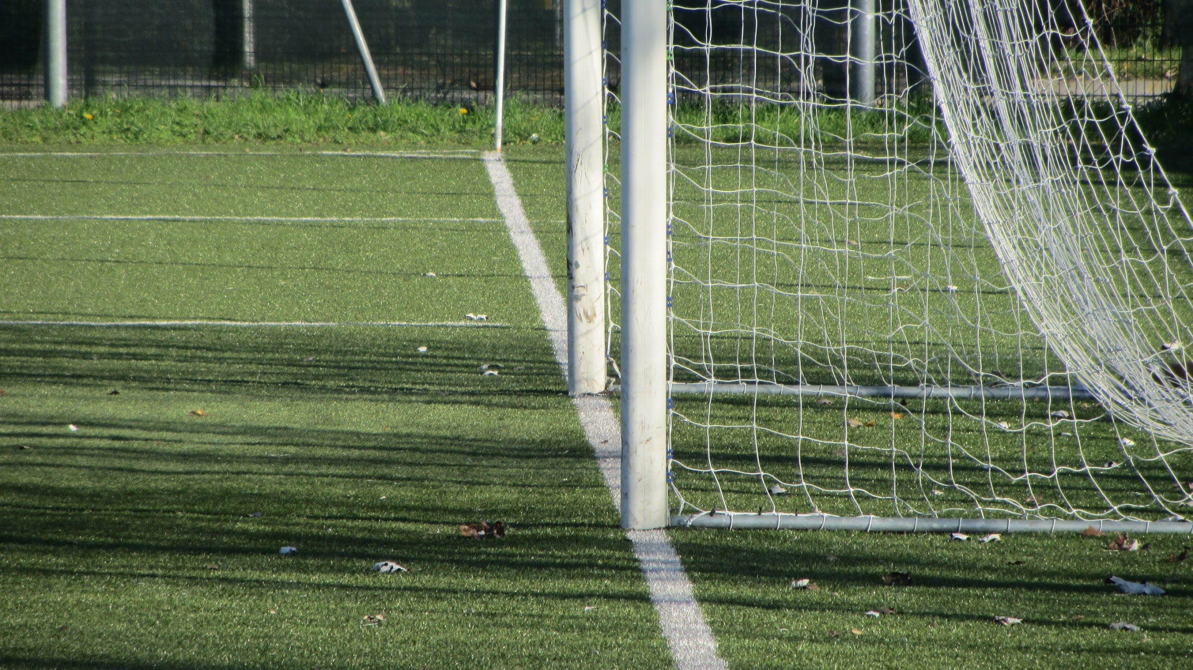
5 Goals as part of vision
Programmatic scaffolding to enhance critical and information literacy skills.
Incorporate aspects of data literacy
Provide training for participants to collect and apply information and data about/for themselves and/or their communities.
Participants are able to apply critical thinking skills to describe, investigate, and evaluate complex, controversial, and/or contradictory health-related topics.
Participants share project result in a format of their choosing (blog post, presentation, community action, etc.)

Slide 6
Upon completion of the program:
Define a need for themselves and/or within their community
Identify potential partners with whom to build an action plan to address the need (as appropriate)
Identify appropriate, credible sources to utilize when developing a knowledge base about the project/topic
Determine accessibility to required resources (e.g. public awareness of open / free access, and services available through land grant universities, the state Library of Virginia, and local public libraries)
Gather information and collect data for evidence in an appropriate and ethical manner
Synthesize evidence in an appropriate and ethical manner
Describe recommendations and possible next steps
Determine appropriate dissemination outlets to publicize efforts
Identify stakeholders that could develop or influence relevant policies or programs (as appropriate)
Notes:
Outcomes, learning objectives - a lot, this is why scaffolding!

Slide 7

Methods: How we got started
To guide the program development we reached out to campus partners. We met with and talked to faculty and graduate student partners in:
Population Health Sciences
Agricultural Extension
Student Health
Funding was applied for and received via an internal Beyond Boundaries Innovation grant from University Libraries, Virginia Tech

Slide 8
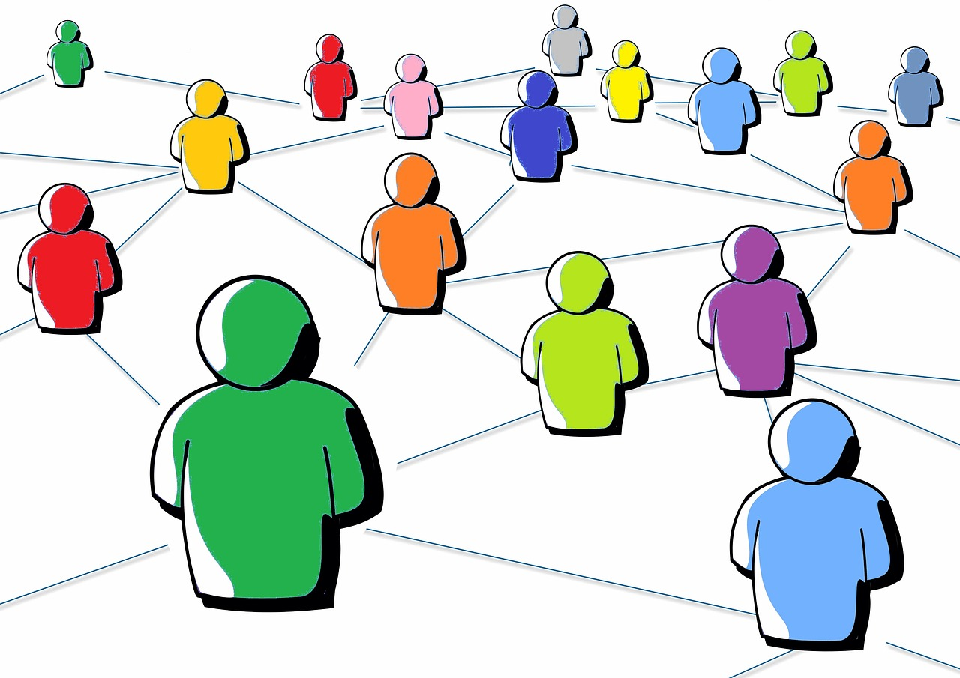
Methods: Project start and set up
Three students project assistants
Literature review
Environmental scan
Project set up
Shared platform and documents
  Google drive
Data management and collection plan: planned and discussed data elements for project ahead of time; piloted data collection methods; goal reporting methods
Notes:
Three students hired: conduct literature review and environmental scan of programs and educational materials to apply findings towards an initial program outline.
logistically aspects of project (MLP) - what we looked into and how we did (esp. me/own experience)
Image from https://pixabay.com/en/social-media-social-networks-2314696/

Slide 9

Results: Defining the Need
Effective use of the healthcare system
Half of high school graduates do not have the skills needed for effective use¹
Health information is not presented in a way that is accessible by most Americans¹⁻³
Teach to be accessible and to grant accessibility to others
Multiple reasons of less than ideal
healthcare system use
Best improvement is by community
improvement model⁴
Notes:
https://pixabay.com/en/update-upgrade-renew-improve-1672350/

Slide 10

Results: Past success
Teaching and training
Providing knowledge and the skills to pass it on
  System of feedback and correction to improve current skills
  Skills to tackle topics
  Ideally, application of skills to any topic
  Work with existing resources, structures, organizations in community
Notes:
https://pixabay.com/en/group-team-feedback-confirming-2822423/

Slide 11
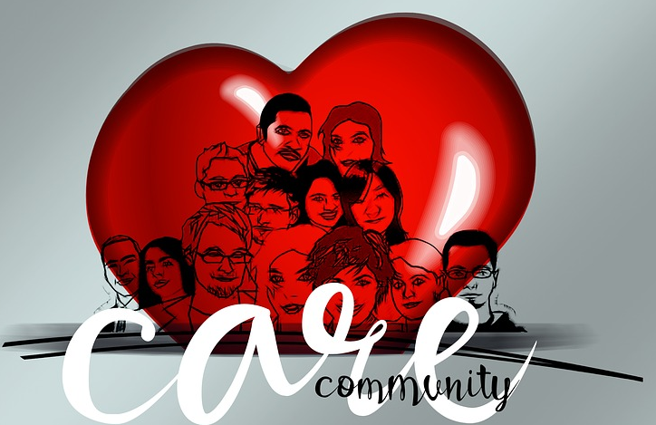
Results: Best Approaches
Individual & community: program helps individuals help communities - adds to skills they already have
Institutional trust: involves community in each step
Online vs. in person: access & strength of connection
Where to start: background information and skills
Teaching method: how to approach a problem, existing resources, how to do research
Discussion: teach skills, practice together
Volunteer outreach: involve in each step,
getting involved in meaningful ways
Cost, assessment, logistics
Notes:
Along with this slide, note that these best approaches were chosen for highlighting because they also address many of the issues noted as things to avoid in the literature such as, highlighting community versus just individual solutions, and ensuring diversity of groups for outreach, as well as broad accessibility of the program; online versus in-person training options - advantages and disadvantages of each - use both to best effect, ...
https://pixabay.com/en/bless-you-heart-human-group-2070882/

Slide 12
Results: Selected Program Websites and Materials
Program Websites
Junior Master Wellness Volunteer - Mississippi State University
Master Wellness Volunteer Program - Texas A&M
Latino Health Access - Nonprofit organization in California
Urban Health Initiative - Emory University
Materials
Medical Library Association list of Top Health Websites
National Action Plan to Improve Health Literacy - Appendix B
-what individuals can do to improve their own health literacy and health literacy in their communities
HRSA List of Culture, Language and Health Literacy Resources
Notes:
https://pixabay.com/en/group-team-feedback-confirming-2822423/

Slide 13
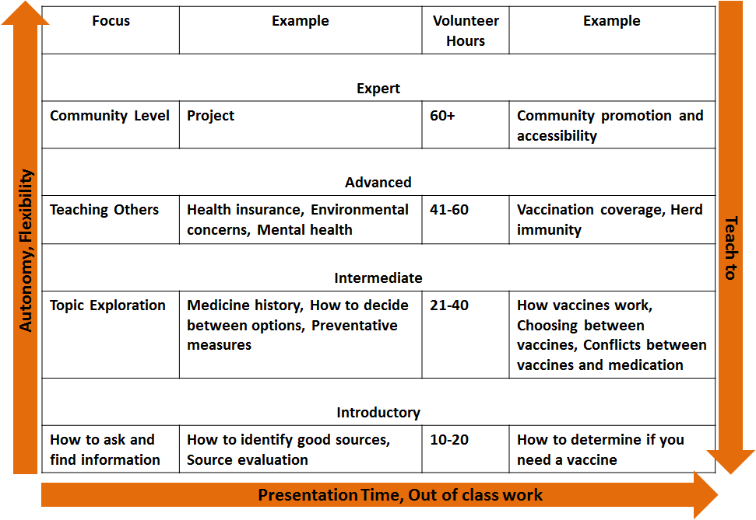
Program Outline

Slide 14

Demonstrated need indicated from research to date
Program capacity to serve various constituencies.
Modifications to project plan based on literature review and scan include:
  To scaffold the types of information, sources, and skills to address various experience
  Add training to support final program projects.
Notes:
The literature review and environmental scan results and conversations with stakeholders indicate a demonstrated need.
This program has the capacity to serve various constituencies.
Based on literature review findings, we have made modifications to our original ideas; in particular to scaffold the types of information, sources, and skills for initial program content to address various levels of participant experience.
We will also add training to support final program projects.
As next steps, we will work with partners to develop and implement a pilot program in 2018.

Slide 15
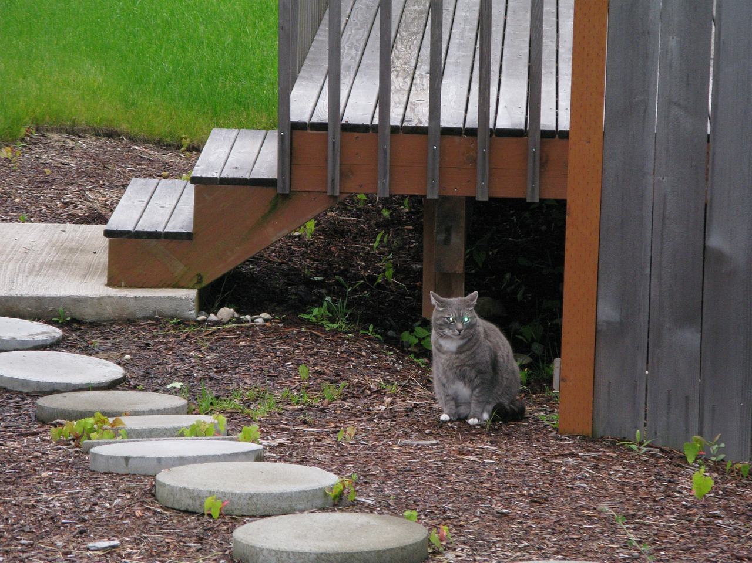
Next Steps
Pilot program in 2018
Finalize program mission & goals
Hire student to develop modules and workshops
Pilot with communities - potential partners identified:
  Urban: Roanoke
  Rural: Shawsville
Assess the pilot program and make adjustments

Slide 16

Pulling it all together - Back to the big picture
Focus heavily on research components
  Not 5 questions to ask your doctor; plenty of those already!
Develop analytical information literacy skills
  Arm oneself with credible knowledge sources
  Improve self-awareness of options as discuss with doctor best options for his/her situation
  Provide for “better” conversations with doctors as have better baseline understanding of condition
Create a community to scaffold levels of literacy
  Beginners move to intermediaries
  and volunteer to help with beginners
  Advanced help with intermediaries
Ultimate goal (or fantasy)
Provide program where community
level health needs can be addressed
Notes:
Dr. Google ---- navigating to find Dr. PubMed, Dr. Mayo Clinic, etc.,

Slide 17
Images
Most images used in this presentation are public domain (CC0) licensed images sourced from Pixabay, Pexels, and Max Pixel. The image from Wikimedia Commons is under a CC-BY-SA-3 license.
Slide 1: https://pixabay.com/en/medicine-biology-healthcare-dna-163707/
Slide 2: http://maxpixel.freegreatpicture.com/Word-Data-Deluge-Binary-Dataset-Data-Binary-System-2728121
Slide 3:http://maxpixel.freegreatpicture.com/Word-Data-Deluge-Binary-Dataset-Data-Binary-System-2728121
Slide 4: http://maxpixel.freegreatpicture.com/Wind-Rose-East-Direction-South-North-Compass-West-1209398
Slide 5: https://www.pexels.com/photo/football-goal-pitch-sport-171271/
Slide 7: https://www.pexels.com/photo/people-coffee-meeting-team-7096/
Slide 8:https://pix abay.com/en/social-media-social-networks-2314696/
Slide 9: https://pixabay.com/en/update-upgrade-renew-improve-1672350/
Slide 10: https://pixabay.com/en/group-team-feedback-confirming-2822423/
Slide 11: https://pixabay.com/en/bless-you-heart-human-group-2070882/
Slide 13: Image created by M. Pasier
Slide 14: M1-L3C: https://upload.wikimedia.org/wikipedia/commons/3/32/CONCLUSION.JPG
Slide 15: https://pixabay.com/p-665869/?no_redirect
Slide 16: https://pixabay.com/en/castle-pie-in-the-sky-sky-clouds-1255846/
Slide 19: https://pixabay.com/en/question-question-mark-board-school-2709670/

Slide 18
References
Kutner, M., Greenberg, E., Jin, Y., & Paulsen, C. (2006). The health literacy of America’s adults: Results from the 2003 National Assessment of Adult Literacy (NCES 2006-483). Washington, DC: U.S. Department of Education, National Center for Education Statistics.
Nielsen-Bohlman, L., Panzer, A. M., & Kindig, D. A. (Eds.). (2004). Health literacy: A prescription to end confusion. Washington, DC: National Academies Press.
Rudd, R. E., Anderson, J. E., Oppenheimer, S., & Nath, C. (2007). Health literacy: An update of public health and medical literature. In J. P. Comings, B. Garner, & C. Smith. (Eds.), Review of adult learning and literacy (vol. 7) (pp 175–204). Mahwah, NJ: Lawrence Erlbaum Associates.
Ross, W., Culbert, A., Gasper, C., Kimmey, J. (2009). A Theory-Based Approach to Improving Health Literacy.
No notes in this presentation, but also a key reference worth highlighting:
Blanton, B., A.W. Crall, M.D. Prysby, D.T. Mellor, and T. Brown. 2014. Virginia Master Naturalist Strategic Planning Report, 2015-2020. Virginia Master Naturalist Program: Charlottesville, VA. 161p.
This conference presentation is available via VTechWorks: https://vtechworks.lib.vt.edu/handle/10919/79663

Slide 19

Questions?
Our questions for you:
How would you approach this type of program?
Have you been involved with a similar program, and if so, do you have suggestions for us?

