Slide 1
Crisis Text Summarization
Group 2: Tarek Shah, Francesco Crisafulli, Aniket Sonnakul, Farhan Mohammed, Santiago Guadiamos
CS 4624: Multimedia, Hypertext and Information Access
Instructor: Dr. Mohamed Farag
Virginia Tech, Blacksburg VA 24061, 4/22/2024
Notes:
Farhan

Slide 2
Overview
Project Overview
System Architecture
Frontend
  Features
Backend
  Web Scraper
  Text Summarizers
  Input Functionality
Demo
Challenges
Future Progress
Acknowledgements
References
Notes:
Farhan

Slide 3
Project Overview
Description
  Use deep-learning/transformer- and rule- based text summarizers to summarize the text of crisis event webpages.
Main Deliverable
  A website that takes crisis event-related set of webpages as input and generates the corresponding summary.
Notes:
Aniket

Slide 4
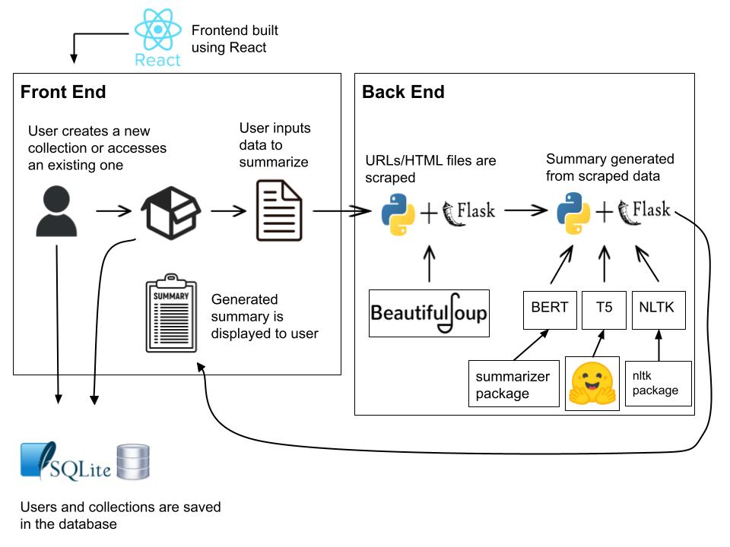
System Architecture
User inputted data can be in the form of
  A zip file of text files with raw text data
  A text file of URLs
  A zip file of HTML files
Generated summaries are saved to corresponding collection
Notes:
Francesco

Slide 5
Front-End
Features
  Login/logout functionality
  Create a collection
  Document upload
    Zip file of text files
    Text file of URLs
    Zip file of HTML files
  Choose which summarizer to generate the summary (T5/BERT/NLTK)
  Update existing collections
Notes:
Tarek

Slide 6
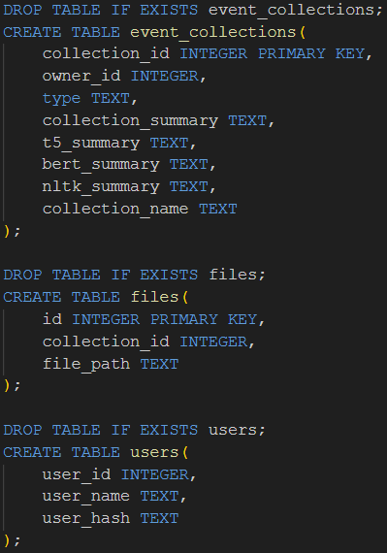
Back-End (Database)
Modular SQLITE implementation
Collection Table
File Table
User Table
Notes:
Francesco

Slide 7
Back-End (Scraper)
Web Scraper
  Extracts paragraph text
  Outputs raw text
  Multi-URL input
Notes:
Farhan

Slide 8
Back-End (Summarizers)
Text Summarizers
  T5
    Follows a unified framework for NLP tasks (text-to-text)
  BERT
    Using library (Summarizer) that fine-tunes BERT for summarization
  NLTK
    Uses rule-based NLP approach
Notes:
Tarek

Slide 9
Back-End (Input Functionality)
Zip file of text files
  Extracts all .txt files to storage path
Text file of URLs
  Iteratively scrapes each URL
  Writes each scraped text to a new file
  File name based off URL
Zip file of HTML files
  Reads each unzipped file individually
  Parses HTML to output text
Notes:
Aniket

Slide 10
Demo
http://localhost:3000/
Notes:
Tarek

Slide 11
Challenges
Bugs
  UTF-8 encoding
Dependencies
  Too many!
Testing
  BERT
Notes:
Farhan

Slide 12
Future Progress
Add frontend aesthetics to improve user experience
Suggestions for future groups:
  Add more text summarizers
  Fine tune the existing summarizers to generate better summaries
    Improve the speed of the BERT summarizer
  Dockerization
Notes:
Santiago

Slide 13
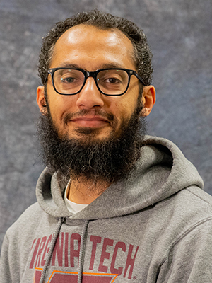
Acknowledgements
We would like to thank our client, Dr. Mohamed Farag, for providing us with his help and support throughout the project.
mmagdy@vt.edu
Notes:
Santiago

Slide 14
References
www.turing.com/kb/5-powerful-text-summarization-techniques-in-python
realpython.com/beautiful-soup-web-scraper-python/
www.techtarget.com/searchenterpriseai/definition/BERT-language-model
learnopencv.com/text-summarization-using-t5/
Notes:
Santiago

Slide 15
Questions?

