Slide 1


Chapter 9
Formulate Innovation Strategy
Strategic Management
MGT 4394
Notes:
These slides serve as a study guide for “Chapter 9: Formulate Innovation Strategy” in Strategic Management and Case Analysis: An Integrated Approach ©Lori Anderson, Dirk Buengel, and Joseph J. Simpson, which is provided at https://doi.org/10.21061/strategicmanagementandcaseanalysis under an open license, Creative Commons BY NC-SA 4.0. The slides are also provided at https://hdl.handle.net/10919/138831 under the same open license, Creative Commons BY NC-SA 4.0.
Note to Instructors: These study guides are intended to be a concise and comprehensive accompaniment that follows the logic of the textbook. Our intention is to support you in your instruction and is based on our experience that it can be easier and quicker to remove slides you do not want to include than to create additional slides.

Slide 2

Study Guide
These slides serve as a study guide for “Chapter 9: Formulate Innovation Strategy” in Strategic Management and Case Analysis: An Integrated Approach by Lori Anderson, Dirk Buengel, and Joseph J. Simpson, which is provided under an open license, Creative Commons BY NC-SA 4.0. The slides are also provided under the same open license, Creative Commons BY NC-SA 4.0.
Notes:
Note to students: These study guides are intended to be a concise and comprehensive accompaniment that follows the logic of the textbook and may support your learning, mastery, and application of these concepts. They are are intended to supplement, not replace, your review of the textbook and any other sound study strategies you have made, such as taking notes to support your most effective learning.

Slide 3
Learning Objectives, 1 of 2
After engaging with this chapter, you will understand and be able to apply the following concepts to formulating innovation strategies.
Innovation strategy
Entrepreneurial orientation
The importance of innovation
The types of innovation
Footholds
The ways innovation relates to business-level strategies
First movers and fast followers

Slide 4
Learning Objectives, 2 of 2
After engaging with this chapter, you will understand and be able to apply the following concepts to formulating innovation strategies.
Product life cycle
Crossing the chasm
Cooperative moves
Responding to innovation in the market
Measuring innovation performance
Why technology strategy is important to business graduates
Ultimately, this chapter equips you to analyze innovation strategy.

Slide 5
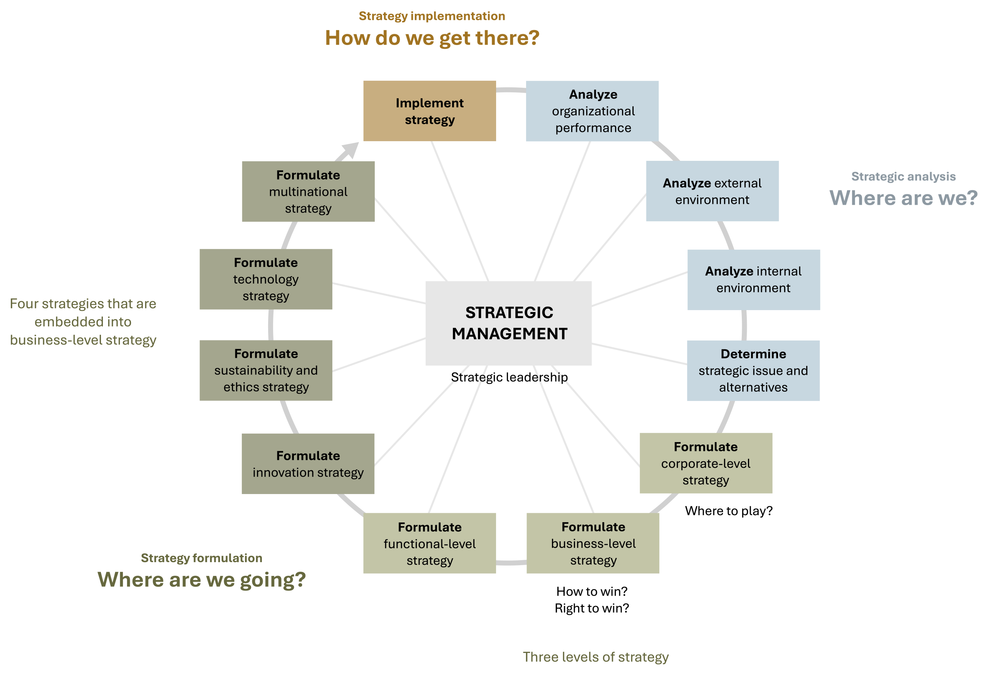
Innovation Strategy in the AFI Framework
Figure 1.3: The analysis, formulation, implementation (AFI) framework [Kindred Grey. 2025. CC BY-NC-SA.]

Slide 6
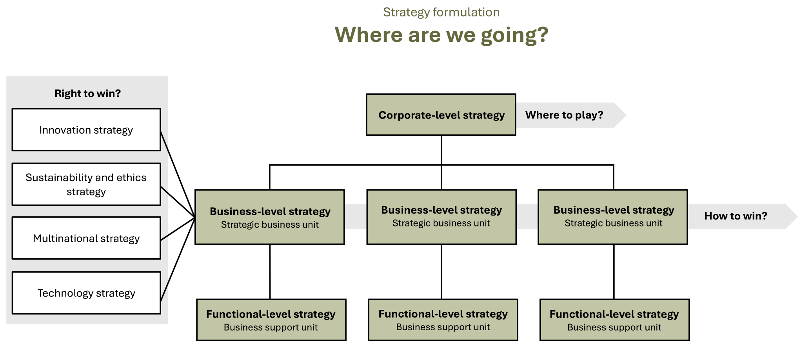
Innovation Strategy in Strategy Formulation
Figure 1.5: Strategy formulation [Kindred Grey. 2025. CC BY-NC-SA.]

Slide 7
Strategy Formulation: Where Are We Going?
Strategic management’s foundations rest in three essential questions that align with the three stages of strategic management:
Strategic analysis: Where are we?
Strategy formulation: Where are we going?
Strategy Implementation: How are we going to get there?
Like all strategy formulation, innovation strategy addresses the question of where a firm is going.

Slide 8
Innovation Strategy: Embedded into Business-Level Strategy
Strategy can be described as a firm’s answer to three critical strategic questions that every organization needs to answer.
Corporate-level strategy: Where to play?
Business-level strategy: How to win?
Strategies embedded into business-level strategies: Right to win?
Innovation strategy
Sustainability and ethics strategy
Technology strategy
Multinational strategy

Slide 9
Strategy: Outside-In Perspective
When strategic management leaders and managers formulate strategy, they focus on an outside-in perspective.
All successful strategies are driven by outside-in perspectives, including corporate-level and business-level strategy as well as the strategies embedded in business-level strategies, such as innovation, sustainability and ethics, technology, and multinational strategies.

Slide 10
VUCA
This means that companies need to carefully monitor their external environment, analyzing trends and developing strategies that are forward-looking.
Firms must navigate an external environment that is volatile, uncertain, complex, and ambiguous (VUCA), where change and disruption have become the new normal.

Slide 11
Innovation Strategy: Right to Win?, 1 of 4
Strategy can be described as a firm’s answer to three critical strategic questions that every organization needs to answer.
Corporate-level strategy: Where to play?
Business-level strategy: How to win?
Strategies embedded into business-level strategies: Right to win?
Innovation strategy
Sustainability and ethics strategy
Technology strategy
Multinational strategy

Slide 12
Innovation Strategy: Right to Win?, 2 of 4
Innovation strategy is the first strategy you learn that is embedded in business-level strategy at the strategic business unit level of a firm.
Strategies that are embedded in business-level strategies address the “Right to win?” question.
This right is supported by truly differentiating and valuable resources, capabilities, and core competencies that are unique for the specific organization.
The right to win needs to be clearly anchored in business-level strategy because it is in strategic business units where a firm decides how it wants to win in its chosen markets.

Slide 13
Innovation Strategy: Right to Win?, 3 of 4
All companies have the ambition to win in their chosen markets. They want to gain market share, increase revenue and profit, and enter new markets and regions, among other barometers of success.
However, strategy is more than a wish list of what a company would ideally want to do and achieve.
Strategy is a company-specific roadmap for navigating in its industry, directing how a firm moves from its current state toward the firm’s vision.

Slide 14
Innovation Strategy: Right to Win?, 4 of 4
Has our strategic business unit formulated a differentiating, company-specific, evidence-based innovation strategy that is anchored in our SBU’s business-level strategy, helps us successfully navigate our VUCA environment, is supported by differentiating and valuable resources, capabilities, and core competencies that are unique to us, and directs our progress from our current state toward our vision?
Are we earning our right to success by implementing an excellent innovation strategy?

Slide 15
Innovation Strategy: Check Your Understanding So Far
Definition:
Answers: “Where are we going?” in relation to innovation 💡
Embedded in business-level strategy 🏢 at the strategic business unit level
Addresses the “Right to win?” 🏆 - how to succeed in chosen markets
Purpose:
Provide a company-specific roadmap 🗺️ for moving from current state to vision 🎯
Monitor & adapt to external environments 🌍 (trends, opportunities, threats)
Account for VUCA conditions - Volatile ⚡, Uncertain ❓, Complex 🔄, Ambiguous 🤔
Importance:
Shapes competitive advantage 🥇 through innovation
Drives new product/service creation 🛠️ and continuous improvement 🔧
Expands market reach 🌐, including new & untapped markets 🏝️
Key Takeaway:
A strong innovation strategy is essential for long-term success 📈, guiding firms toward sustainable growth 🌱 and a leading market position 🏅
Notes:
1. Definition & Core Question
"Where are we going?" - Innovation strategy defines the future direction of a company in terms of product, service, and process development.
It’s not just about creating something new-it’s about aligning innovation with the company’s overall business strategy so that innovation supports the firm’s competitive position.
Example: Tesla’s innovation strategy goes beyond electric cars-it includes autonomous driving, energy storage, and AI integration, all tied to its vision of a sustainable future.
2. Embedded in Business-Level Strategy
Innovation strategy operates at the strategic business unit (SBU) level and must integrate with corporate goals.
For large organizations, SBUs often have different innovation focuses (ex: Apple’s iPhone team vs. its Services division).
This ensures innovation decisions-like resource allocation, partnerships, and R&D priorities-are consistent with broader market positioning.
3. "Right to Win"
This concept asks: Why should customers choose us over competitors?
Innovation must create a distinctive capability-a competitive edge that is hard for rivals to replicate.
Example: Dyson’s “right to win” is its engineering expertise in airflow technology, enabling premium pricing and brand loyalty.
4. Purpose of Innovation Strategy
Company-specific roadmap - Defines the pathway from current capabilities to the vision for the future.
Adaptation to external environments – Regularly scanning for market trends, emerging technologies, regulatory changes, and customer needs.
Addressing VUCA:
Volatile (rapidly changing markets-ex:., AI tools emerging monthly)
Uncertain (unpredictable regulations in fintech or healthcare)
Complex (global supply chains, multi-country operations)
Ambiguous (new technologies with unclear applications, ex, blockchain in healthcare)
5. Importance
Shaping Competitive Advantage – Sustained innovation is one of the few advantages that can’t be easily copied.
Driving New Product/Service Creation – Allows for both breakthrough innovations (radical change) and incremental improvements (continuous value addition).
Expanding Market Reach – Entering new and untapped markets, sometimes by adapting existing innovations for different customer segments.
Example: Netflix moving from DVD rentals to streaming, then into original content production.
6. Key Takeaway
A robust innovation strategy:
Ensures long-term survival in competitive industries.
Positions a company as a market leader through adaptability.
Balances visionary thinking with practical implementation.

Slide 16
Entrepreneurial Orientation, 1 of 2
Entrepreneurial orientation is characterized by three core traits: innovativeness, proactiveness, and risk-taking.
Innovativeness represents a company’s willingness to experiment with new ideas, products, or processes.
New
Proactiveness refers to a firm’s ability to anticipate and act on future opportunities rather than simply reacting to external changes.
Quick
Risk-taking involves the willingness to invest in uncertain ventures and explore new territories, even when the outcomes are unknown.
Bold
Notes:
Definition & Scope
Entrepreneurial Orientation (EO) is a firm-level mindset that guides how a company identifies opportunities, takes risks, and innovates to achieve growth and competitive advantage.
EO applies to:
Entrepreneurship: New ventures starting from scratch.
Intrapreneurship: Innovation within established organizations.
It is not just about having ideas - it’s about having the processes, culture, and leadership commitment to act on them.
Three Core Traits
Innovativeness
Willingness to support and invest in new ideas, experimentation, and creative problem-solving.
Often involves R&D spending, adoption of new technologies, and development of unique products or services.
Example teaching point: Compare a tech startup developing a disruptive app vs. a traditional company reluctant to change.
Proactiveness
The ability to anticipate future market needs and act ahead of competitors.
Involves market scanning, trend analysis, and scenario planning.
Example: Netflix shifting from DVD rentals to streaming before most competitors recognized the trend.
Risk-Taking
Willingness to commit resources to uncertain initiatives with potentially high rewards.
Could involve entering unfamiliar markets, developing unproven products, or making large-scale investments without guaranteed returns.
Example: Tesla investing heavily in EV manufacturing before widespread market adoption.
Strategic Benefits
Adaptability: Helps companies pivot when market conditions shift.
Growth: Supports entry into new markets and expansion of product lines.
Sustained Competitive Advantage: Differentiates the firm through unique offerings and faster market responses.
Case Example: UPS
Innovativeness: Developed route-optimization AI to minimize miles driven, saving time, fuel, and costs.
Proactiveness: Invested in alternative-fuel delivery trucks before fuel prices spiked or regulations demanded it.
Risk-Taking: Funded last-mile innovation projects (ex: electric cargo bikes in urban areas) without certainty of ROI.
Key Takeaway for Students
EO is not just for founders - business graduates in any role can contribute to an entrepreneurial culture by identifying opportunities, pitching ideas, and supporting innovation projects.
Understanding EO principles equips graduates to work effectively in both startup and corporate settings, enhancing career mobility.

Slide 17
Entrepreneurial Orientation: Innovativeness, 1 of 2
Innovativeness refers to the drive to embrace creativity and experimentation.
Some innovations are incremental, building on existing skills to make small improvements, while others are more radical, demanding new skills and potentially rendering old ones obsolete.
The goal of innovativeness is to develop new products, services, or processes.
Companies that excel in innovation typically outperform those that fail to prioritize it, gaining a competitive edge and enhancing overall performance.
Notes:
Innovativeness
Core Concept: Innovativeness measures a firm’s willingness to explore novel ideas, experiment, and embrace change. It’s not only about invention-it’s about applying creativity to products, services, processes, or business models.
Types of Innovation:
Incremental Innovation – Small, continuous improvements (ex: updating app interfaces, improving logistics algorithms).
Radical Innovation – Game-changing shifts that redefine markets (ex: iPhone introduction, ride-sharing platforms like Uber).
Architectural Innovation – Reconfiguring existing technologies into new markets.
Disruptive Innovation – Introducing solutions that start in niche markets and overtake incumbents.
Strategic Importance: A culture of innovativeness enables firms to stay relevant, maintain competitive advantage, and meet evolving customer needs.
Examples:
UPS ORION System – Uses AI to optimize delivery routes, saving fuel and time.
Apple’s User Research – Drives product refinements based on direct customer feedback.
Atlassian’s Passion Projects – Encourages employees to dedicate time to creative problem-solving.

Slide 18
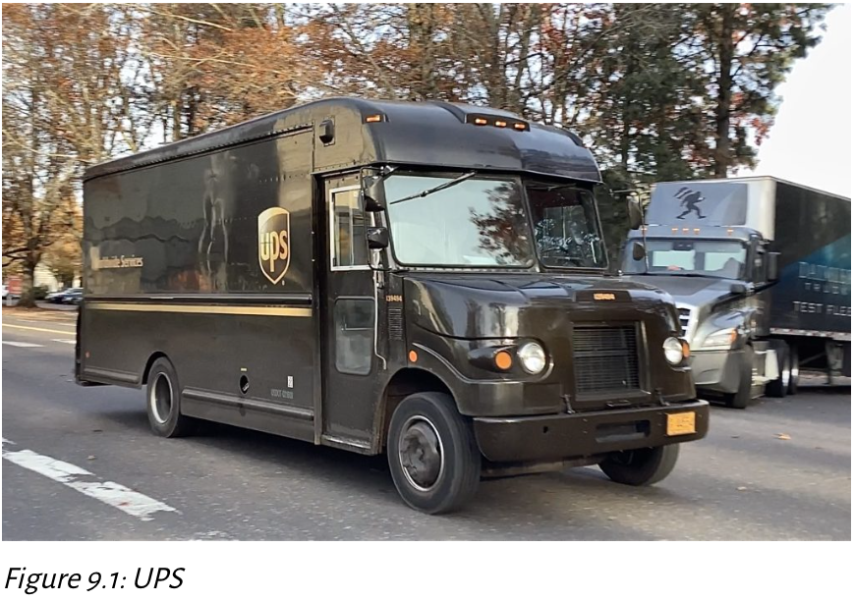
Entrepreneurial Orientation: Innovativeness, 2 of 2
UPS embodies Innovativeness by proactively adopting route-optimization AI, investing in alternative-fuel delivery trucks, and innovating last-mile solutions to improve efficiency and sustainability
© Trimetwes fan1003. 2024. CC BY-SA 4.0. UPS delivery truck image

Slide 19

Entrepreneurial Orientation: Proactiveness
Proactiveness refers to the ability to anticipate and act on future needs rather than merely responding to events as they unfold.
Proactive organizations are opportunity-driven, identifying and capitalizing on emerging trends before competitors.
Tesla’s early investment in electric vehicles. Long before the market for EVs was fully established, Tesla anticipated a shift toward sustainable transportation and positioned itself as a leader in the industry.
© Ivan Radic. 2019. CC BY 2.0. Tesla car badge image
Notes:
Proactiveness
Core Concept: Proactiveness reflects a firm’s ability to anticipate future market needs, trends, and challenges—acting before competitors do. It’s strategic foresight in action.
Key Behaviors:
Constant environmental scanning for opportunities and threats.
Launching products early to establish market dominance.
Making bold investments before demand peaks.
Strategic Importance: Proactiveness reduces reaction time, enables first-mover advantages, and signals market leadership.
Examples:
Tesla’s Early EV Push – Established dominance before traditional automakers caught up.
Shopify’s Early E-Commerce Tools – Gained traction before online retail became mainstream.
3. Google Maps Case Study Integration
Proactiveness: Predictive routing and real-time traffic updates anticipate user needs before they arise, minimizing delays.
Innovativeness: Continuous feature rollouts, such as AR-based navigation, enhance user experience and differentiate from competitors.
4. Classroom Discussion Prompts
How can innovativeness and proactiveness complement each other in competitive markets?
Can a company be proactive without being innovative, or innovative without being proactive?
Which industries rely most heavily on these traits, and why?

Slide 20

Entrepreneurial Orientation: Risk Taking
Risk-taking involves pursuing bold actions rather than opting for conservative or cautious strategies.
Netflix’s decision to transition from DVD rentals to streaming services, a move that required significant investment and foresight at a time when streaming technology was still in its infancy. This bold shift not only redefined how people consume media but also established Netflix as a global entertainment powerhouse,
none of which would be possible if Netflix had not taken the risk of changing its entire business model.
Figure 9.2: Netflix [Freestocks website. 2018. Pexels license. Person holding a remote control (Pexels image)
Notes:
Risk-Taking
Risk-taking in a business context involves deliberate, calculated moves into areas with uncertainty-often where there is no guarantee of success, but the potential rewards justify the gamble. It’s not reckless behavior; rather, it’s a strategic decision based on research, foresight, and readiness to adapt.
Key Drivers of Risk-Taking:
Market Disruption: Entering a new market before it’s proven profitable (ex: Netflix’s pivot from DVDs to streaming when internet speeds were still inconsistent).
Technology Adoption: Investing in untested technology (ex: Tesla’s Gigafactory before large-scale EV adoption).
Geographic Expansion: Entering unfamiliar regions with cultural, political, or logistical challenges (ex: BP’s deepwater oil projects).
Why It Matters: Firms that never take risks often stagnate and fall behind competitors. However, excessive risk without mitigation strategies can lead to failure. The goal is risk management, not risk avoidance.

Slide 21
Entrepreneurial Orientation: Intrapreneurship, 1 of 3
The spirit of entrepreneurship is not confined to startups or garage-born businesses.
Some of the most impactful innovations come from individuals working within large organizations who challenge the status quo, pushing for the development of groundbreaking products or services.
Notes:
Intrapreneurship is acting like an entrepreneur within an established organization—bringing startup-style creativity, ownership, and agility to corporate environments.
Core Aspects:
Innovation From Within: Employees are encouraged to create new products, processes, or services without leaving the company.
Resource Leverage: Intrapreneurs benefit from the parent company’s resources, brand, and networks, giving them an advantage over external startups.
Cultural Enablement: Requires leadership support, freedom to experiment, and tolerance for failure.
Notable Examples:
3M’s Post-it Notes: Born from a failed adhesive experiment, developed into one of 3M’s top-selling products.
Google Maps: Originated as an internal project at Google before scaling globally.
Netflix’s Streaming Innovation: Initiated by internal teams exploring how to deliver content digitally.
Teaching Note
To help students connect the dots:
Emphasize that risk-taking fuels opportunity capture but must be balanced with data-driven decision-making.
Highlight that intrapreneurship thrives in supportive environments-companies need to invest in culture and infrastructure that empower employees to innovate.
Discuss how risk-taking and intrapreneurship often overlap: many intrapreneurial projects involve entering untested markets or using emerging technologies, inherently carrying risk.

Slide 22
Entrepreneurial Orientation: Intrapreneurship, 2 of 3
These employees may not be founders, but they act with the same determination and creativity to bring their ideas to fruition, often reshaping the company’s future in the process.
This form of entrepreneurship within an organization is known as intrapreneurship. Unlike traditional entrepreneurship, intrapreneurs innovate from within, navigating the complexities of large organizational structures to drive change.

Slide 23
Entrepreneurial Orientation: Intrapreneurship, 3 of 3
Companies that foster intrapreneurship often gain a competitive advantage by leveraging their existing resources, capabilities, and core competencies to develop new products and services without needing to acquire or merge with external firms.
Internal development
Rather than solely seeking growth through acquisitions, firms like Apple and Google have created cultures that encourage employees to think and act entrepreneurially, resulting in innovations like the iPhone and Google Maps, both developed internally.

Slide 24
Entrepreneurial Orientation, 2 of 2
EO dimension | Definition | Example
Innovativeness | Tendency to engage in and support new ideas, experimentation, and creative processes that lead to the development of new products, services, or processes | Apple’s Apple Watch, developed through a culture of innovation and cross-functional experimentation, blending health tracking, communication, and design to redefine wearable technology
Proactiveness | The ability to anticipate and act on future needs rather than merely responding to events as they unfold | Tesla’s early investment in electric vehicles. Long before the market for EVs was fully established, Tesla anticipated a shift toward sustainable transportation and positioned itself as a leader in the industry.
Risk-taking | Involves pursuing bold actions rather than opting for conservative or cautious strategies | Netflix’s decision to transition from DVD rentals to streaming services, a move that required significant investment and foresight at a time when streaming technology was still in its infancy
Figure 9.3: The three dimensions of entrepreneurial orientation

Slide 25
EO for Individuals & Building EO
EO for Individuals 🙋‍♂️🙋‍♀️
Traits apply to personal career growth.
High EO = more creativity, adaptability, and opportunity spotting.
Works in all industries, from tech to traditional services.
Building EO 🛠️
For Executives: Align rewards with innovation, track creative output, manage debt wisely.
For Individuals: Take initiative, propose ideas, and act ahead of market changes.

Slide 26
Why Innovate?
Purpose: Stay ahead, avoid complacency, and keep customers engaged
Tech 💻: Apple & Samsung → frequent product upgrades boost demand
Streaming 📺: Netflix → personalization & interactive content keeps users hooked
Automotive (Tesla) ⚡: Electric vehicles, autonomous tech, over-the-air updates
Other Sectors 🌍:
Pharma → R&D for life-saving treatments (ex: cancer, & Alzheimer’s)
Startups → Renewable energy, electric mobility, plant-based food innovations (ex: Tender Food’s fiber-spinning tech)
Lesson 📌: Works across cost leadership, differentiation, and blue ocean strategies
© Ivan Radic. 2019. CC BY 2.0. Tesla car badge image

Slide 27
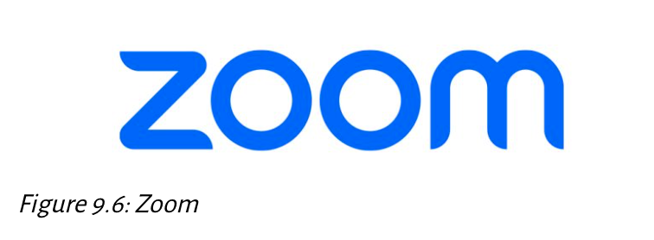
Speed, Action, & Opportunity
Challenge: Hyper-competitive markets demand quick, reasonable decisions
“He who hesitates is lost” -> waiting for perfect info can cost opportunities
Continuous Learning 📚: Take action, adjust based on feedback
Case Study (Zoom) 💬: Rapid scaling during pandemic captured market before rivals adapted
Key Takeaways 💡:
Innovation + strategy = long-term advantage
Speed + adaptability = sustained success
Zoom website. 2011. Public domain. Zoom logo image
Notes:
1. Why Speed Matters in Business
Hyper-competitive markets mean that customer preferences, technologies, and competitor moves can change rapidly.
If a company hesitates, competitors can seize market share before it even reacts.
First-mover advantage is often less about who’s first and more about who acts effectively and adapts faster.
2. Decision-Making Under Uncertainty
The quote “He who hesitates is lost” reflects the risk of over-analyzing instead of acting.
Perfect information is almost never available—leaders must balance speed with reasonable decision-making.
In strategy, waiting too long can be more damaging than making a small error early and correcting it.
3. Continuous Learning in Action
Definition: Acting quickly, gathering feedback, and adjusting course based on real data.
This is tied to the “lean startup” mindset—launch, learn, and iterate instead of aiming for perfection upfront.
Avoids paralysis by analysis and keeps companies aligned with real-world conditions.
4. Case Study: Zoom
Pre-pandemic: Zoom was a growing but relatively niche video conferencing platform.
Pandemic hit: Demand exploded for remote work tools. Zoom rapidly scaled up infrastructure to handle the surge.
They expanded capacity, improved security, and rolled out features faster than competitors like Skype and Teams could respond.
Key lesson: Market share often goes to the company that can scale and adapt the fastest, not necessarily the one with the most advanced tech initially.
5. Key Takeaways for Students
Innovation + Strategy = Long-Term Advantage Innovation by itself isn’t enough-it must align with the company’s long-term positioning and competitive edge.
Speed + Adaptability = Sustained Success It’s not enough to act fast-you must also pivot when new information arises.
Successful leaders in the modern economy think in weeks and months, not just years.
6. How to Apply This as a Business Graduate
In corporate roles: Be prepared to make recommendations even without perfect data. Show that you can back them up with logic and adapt if things change.
In entrepreneurship: Use rapid prototyping and early customer feedback to refine ideas.
In consulting: Recognize when clients are stalling decisions and help them weigh calculated risks.

Slide 28
First Movers 🚀 vs. Fast Followers ⚡
First Mover 🚀
First to launch a product/service in a new market
Fast Follower ⚡
Enters right after the first mover, learning from their wins & mistakes
Notes:
1. Definitions
First Mover: A company that is the first to launch a product or service in a new market. They set the initial market standards and often define the category.
Fast Follower: A company that enters the market shortly after the first mover. They learn from the first mover’s successes and failures, often improving on the original concept.
2. First Mover – Benefits
Early Market Dominance & Brand Recognition
Establishes strong market share before competitors enter.
Builds brand awareness and loyalty while the market is still forming.
Technological Leadership & Shaping Market Expectations
Sets the technical and functional standards for the industry.
Competitors often need to follow their lead to be relevant.
Customer Loyalty & Long-Term Advantage
Early adopters develop brand attachment.
Lock-in effects (customers invested in a product ecosystem) can create barriers for competitors.
Examples:
Apple with early personal computers.
KFC’s successful expansion into China before most Western fast-food competitors.
3. First Mover – Risks
High R&D & Marketing Costs
Being first often requires heavy investment in innovation, product development, and consumer education.
Market Education Required
Must spend resources informing consumers about why the product is needed and how it works.
Risk of Product Failure
If the market isn’t ready or the product is flawed, the investment can fail.
Examples: Apple Newton (early PDA that failed), Google Glass.
4. Fast Followers – Advantages
Avoid costly mistakes made by first movers.
Benefit from market education done by the first mover.
Can innovate on the original idea to make it more attractive or cost-effective.
5. Strategic Implications
First Mover Strategy is best for:
Companies with strong R&D capabilities, high risk tolerance, and resources to educate the market.
Fast Follower Strategy is best for:
Companies with agile operations and the ability to quickly adapt proven concepts.
6. Key Takeaway
Choosing between being a first mover or a fast follower depends on the company’s resources, market readiness, and ability to innovate or adapt quickly. While first movers aim for long-term dominance, fast followers can still achieve significant market share without incurring the initial heavy risks.

Slide 29
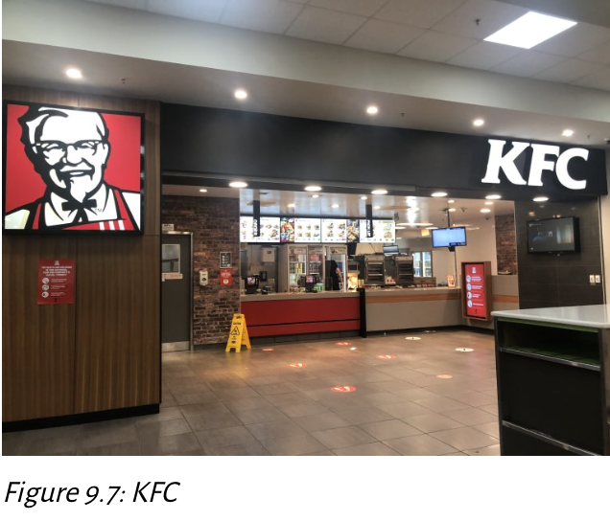
First Movers 🚀 Benefits and Risks
First Mover – Benefits ✅:
Early market dominance & brand recognition 🏆
Technological leadership & ability to shape market expectations 🛠️
Customer loyalty & potential for long-term advantage ❤️
Examples: Apple (early PCs), & KFC in China 🍗
First Mover – Risks ⚠️:
High R&D & marketing costs 💸
Market education required 📚
Risk of product failure (Apple Newton, Google Glass) ❌
© Alison Newman. 2021. CC BY-SA 4.0.
KFC exterior image
Kentucky Fried Chicken (KFC) was the first Western fast-food chain to enter China, building strong relationships with local officials, which allowed it to become the top fast-food chain in that market.
Notes:
1. Definitions
First Mover: A company that is the first to launch a product or service in a new market. They set the initial market standards and often define the category.
Fast Follower: A company that enters the market shortly after the first mover. They learn from the first mover’s successes and failures, often improving on the original concept.
2. First Mover – Benefits
Early Market Dominance & Brand Recognition
Establishes strong market share before competitors enter.
Builds brand awareness and loyalty while the market is still forming.
Technological Leadership & Shaping Market Expectations
Sets the technical and functional standards for the industry.
Competitors often need to follow their lead to be relevant.
Customer Loyalty & Long-Term Advantage
Early adopters develop brand attachment.
Lock-in effects (customers invested in a product ecosystem) can create barriers for competitors.
Examples:
Apple with early personal computers.
KFC’s successful expansion into China before most Western fast-food competitors.
3. First Mover – Risks
High R&D & Marketing Costs
Being first often requires heavy investment in innovation, product development, and consumer education.
Market Education Required
Must spend resources informing consumers about why the product is needed and how it works.
Risk of Product Failure
If the market isn’t ready or the product is flawed, the investment can fail.
Examples: Apple Newton (early PDA that failed), Google Glass.
4. Fast Followers – Advantages
Avoid costly mistakes made by first movers.
Benefit from market education done by the first mover.
Can innovate on the original idea to make it more attractive or cost-effective.
5. Strategic Implications
First Mover Strategy is best for:
Companies with strong R&D capabilities, high risk tolerance, and resources to educate the market.
Fast Follower Strategy is best for:
Companies with agile operations and the ability to quickly adapt proven concepts.
6. Key Takeaway
Choosing between being a first mover or a fast follower depends on the company’s resources, market readiness, and ability to innovate or adapt quickly. While first movers aim for long-term dominance, fast followers can still achieve significant market share without incurring the initial heavy risks.

Slide 30
Fast Followers ⚡ Benefits and Risks
Fast Follower – Benefits ✅:
Lower risk – learn from first mover’s mistakes 📊
Improve products with better features or cost efficiency 🔧
Reduced development costs & faster entry 🏃‍♂️
Examples: Sony & Samsung (wireless earbuds), LCD leaders (Samsung, LG)
Fast Follower – Risks ⚠️:
Lack of market leadership or weaker brand 🌱
Seen as imitators 🌀
Less control over industry direction
Key Takeaways 💡:
First movers can win big but face high uncertainty
Fast followers can refine & scale faster, but rarely dominate brand perception
Long-term success depends on resources, patents, and strategic planning 🔑
Some advantages fade quickly; others (like Pfizer’s Viagra patent) can last years 📜
Notes:
1. Definition
Fast Follower: A company that quickly enters a market after the first mover.
They learn from the first mover’s mistakes, improving on the original product or service, and often enter with fewer risks.
2. Benefits
Lower Risk
Avoids the trial-and-error costs of the first mover.
Uses market feedback from the first mover’s launch to make better decisions.
Product Improvement
Can add better features, improve quality, or make products more cost-efficient.
Example: Samsung refining smartphone features after Apple’s early launches.
Reduced Development Costs & Faster Entry
R&D is shorter and cheaper because the groundwork (market research, customer education) has already been done by the first mover.
Examples
Sony & Samsung: Entered wireless earbuds market after Apple AirPods, offering better battery life or lower prices.
Samsung & LG: Became leaders in LCD TVs after initial industry pioneers.
3. Risks
Lack of Market Leadership
The first mover may already have established a dominant brand and loyal customer base, making it harder for followers to stand out.
Perception as Imitators
Seen as copying rather than innovating, which can hurt brand reputation.
Less Control Over Industry Direction
Industry standards and expectations are often set by the first mover, leaving followers to adapt rather than lead.
4. Key Takeaways
First Movers can win big but face high uncertainty.
Fast Followers can scale faster and more efficiently, but usually don’t dominate brand perception.
Long-term success depends on resources, patents, and strategic planning.
Advantage Duration varies:
Some fade quickly (ex: tech features that competitors can copy fast).
Others last years (ex: Pfizer’s Viagra patent).
5. Strategy Insight
Fast followers often succeed when:
They enter quickly enough to ride the market wave.
They differentiate through price, features, or distribution.
They avoid direct confrontation with the first mover’s strengths.

Slide 31
Innovation Framework: Four Types of Innovation, 1 of 2
The innovation framework that considers two key dimensions of innovation
whether the innovation addresses an existing market or creates a new market
whether the innovation utilizes existing technology or introduces new technology
There are four types of innovation that firms can leverage to drive growth and competitive advantage
Incremental
Disruptive
Architectural
Radical

Slide 32
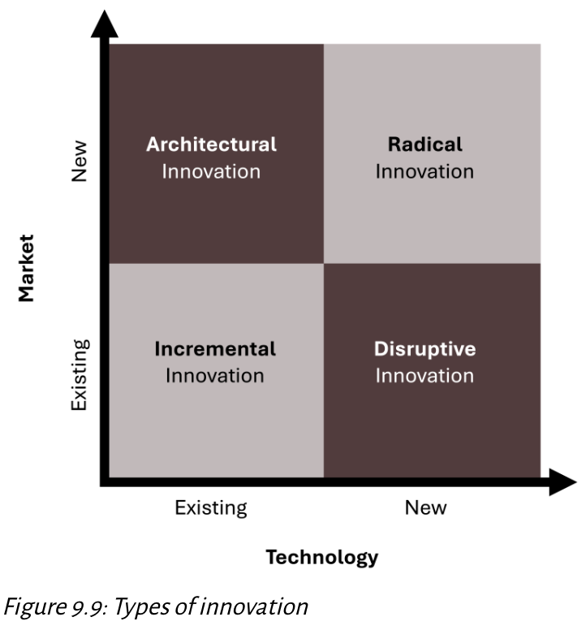
Innovation Framework: Four Types of Innovation, 2 of 2
Framework Factors:
Market focus: Existing vs. New market 🌍
Technology: Existing vs. New tech ⚙️
The Four Types:
Incremental → Existing tech, existing market
Disruptive → New product/service for underserved market, eventually challenges incumbents
Architectural → Existing tech, new market
Radical → New tech, new market 🚀
[Kindred Grey. 2025. CC BY-NC-SA.]

Slide 33
Incremental Innovation
Incremental Innovation: Existing technology + Existing market
Improves existing products/services using current tech for current customers
Examples:
Toyota – updated safety/hybrid features 🚗
Samsung – better screens, processors, cameras 📱
Coca-Cola – Zero Sugar, smaller bottles 🥤
Advantage: Retains loyalty, steady growth, low risk
Notes:
2. Disruptive Innovation
Definition:
Involves new technology or products entering an existing market, often starting at a niche or low-end segment.
Gradually moves upmarket and displaces established players.
Key Features:
Starts simpler and more affordable, appealing to overlooked customers.
Improves over time until it becomes mainstream.
Examples:
Netflix vs. Blockbuster: Netflix’s streaming model replaced physical rental stores.
Digital cameras replacing film: Made traditional film photography largely obsolete.
Spotify replacing CDs: Changed music consumption from ownership to streaming access.
Advantages:
Redefines Competition: Changes the rules of the game.
Market Leadership Shift: Can dethrone dominant companies.
Scalable Growth: Can rapidly gain market share as it improves.
3. Strategic Insights for Students
Incremental Innovation is safe but slow-ideal for maintaining position, not for reshaping industries.
Disruptive Innovation is risky but high-reward-can transform markets but often faces early challenges.
Both types can coexist: a company may incrementally improve existing products while investing in disruptive tech to future-proof against competitors.
Blockbuster Case Lesson: Incremental improvements (ex: more DVDs, better store layouts) could not compete with disruptive changes like Netflix's online model. Failure to adapt led to market exit.

Slide 34
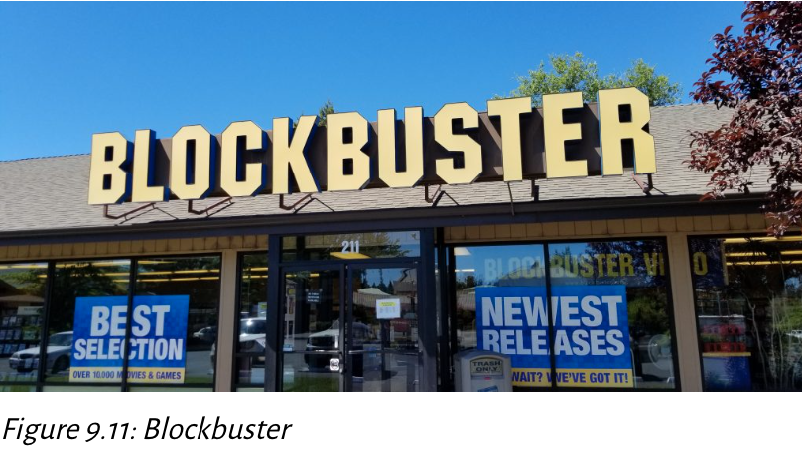
Disruptive Innovation
Disruptive Innovation: New technology + Existing market
Starts in niche/low-end markets, grows to disrupt mainstream
Often simpler & more affordable at first, then improves over time
Examples:
Netflix disrupts Blockbuster 🎬
Digital cameras replaces film 📸
Spotify replaces CDs 💿
Advantage: Redefines competition, can dethrone market leaders
© Coasterlover1994. 2018. CC BY-SA 4.0. Blockbuster Video storefront photo
Notes:
1. Incremental Innovation
Definition:
Involves improving existing products/services using current technology within the same market.
Focus is on evolutionary changes, not radical shifts.
Key Features:
Enhances product safety, performance, or user experience without fundamentally changing the offering.
Retains existing customer base by meeting familiar needs but with improved quality.
Examples:
Toyota: Updates to safety features, hybrid engine improvements
Samsung: Upgraded screens, processors, and cameras
Coca-Cola: Introduction of Zero Sugar, smaller and more convenient bottles
Advantages:
Customer Loyalty: Keeps existing customers satisfied.
Steady Growth: Low risk, predictable returns.
Low Risk: Avoids market shocks because the audience is already familiar with the brand.

Slide 35

Architectural Innovation
Architectural Innovation: Existing technology + New market
Repackages known tech into new formats for new audiences
Examples:
Smartwatches from smartphone tech ⌚
Peloton - bike + internet + live classes 🚴
Solar garden lights ☀️💡
Advantage: Expands reach without inventing from scratch
Figure 3.1: Peloton
©Steve Jurvetson. 2017. CC BY 2.0. Peloton reception area image
Notes:
Architectural Innovation (Existing Tech + New Market)
Definition: Takes known technology and repurposes it into a new format or configuration to serve a new audience or use case. This is not about inventing from scratch-it’s about rearranging existing components creatively.
Key Points:
Repackaging, Not Reinventing: Uses existing technology in a novel way to solve a different problem or reach a new group of customers.
Market Expansion: Often opens up new markets that were previously untapped, without heavy R&D investment.
Lower Technical Risk: Since the technology already exists, the technical uncertainty is low, but market acceptance can still be a challenge.
Examples:
Smartwatches (built from smartphone tech)
Peloton (combines stationary bike, internet connectivity, and live classes)
Solar Garden Lights (solar panels + LED tech used for outdoor lighting)
Advantages:
Expands reach without starting from zero.
Can achieve fast go-to-market because the core technology is proven.
Lower cost compared to radical innovations.

Slide 36
Radical Innovation
Radical Innovation: New technology + New market
Breakthrough tech that creates entirely new industries
Examples:
Airplane ✈️
AI in healthcare & finance 🤖
MRI machines 🏥
Apple AirPods 🎧
Advantage: First-mover dominance, high barriers for competitors
Notes:
Radical Innovation (New Tech + New Market)
Definition: Introduces breakthrough technology that enables entirely new industries or markets. High uncertainty but also the potential for massive disruption and market creation.
Key Points:
True Breakthrough: Often driven by scientific or engineering advances, not just product tweaks.
Industry Creation: Can make existing solutions obsolete and set new industry standards.
High Barriers to Entry: Competitors find it hard to catch up due to patents, know-how, or sheer complexity.
Examples:
Airplane – revolutionized travel, created the aviation industry.
Artificial Intelligence in Healthcare & Finance – transforming diagnosis, fraud detection, and risk modeling.
MRI Machines – advanced medical imaging.
Apple AirPods – pioneered a premium, seamless wireless earbud experience that reshaped consumer audio.
Advantages:
First-Mover Dominance: Sets the rules and expectations in a brand-new industry.
High Entry Barriers: Patents, capital requirements, and know-how make it difficult for late entrants to compete.

Slide 37
Footholds 🪨
A foothold is a small but strategic entry point a company creates in an unfamiliar market to gain insights, test the waters, and prepare for expansion.
Purpose:
Learn local consumer behavior 🛒
Test products/services before scaling ⚙️
Reduce risk in new market entry 🛡️
Common in architectural & radical innovations
Examples:
IKEA – opens 1 store in a new country (ex: Japan) before expanding 🏬
Merck – acquired SmartCells for diabetes research 💊
Microsoft – bought Mojang (Minecraft) to strengthen gaming presence 🎮
Amazon – acquired Whole Foods to enter grocery retail 🥦
Key Takeaway:
Footholds let firms enter new markets strategically, adapting before large-scale commitment
Notes:
Definition
A foothold is a small but strategic entry point in an unfamiliar market. It allows a company to:
Gain insights into the market
Test products/services
Reduce risk before committing to large-scale operations It’s like “dipping your toes in the water before diving in.”
Purpose & Benefits
Learn local consumer behavior
Understand cultural, social, and purchasing differences.
Identify what resonates with customers before scaling.
Test products/services before scaling
Soft launches help determine demand, product-market fit, and necessary adjustments.
Reduce risk in new market entry
Limits financial exposure if the market proves unprofitable or unstable.
Link to Innovation Types
Frequently used in architectural & radical innovations where uncertainty is higher.
Examples
IKEA → Opens one store in a new country (e.g., Japan) before rolling out nationwide.
Merck → Bought SmartCells for diabetes research to explore biotech potential
Microsoft → Acquired Mojang (Minecraft) to grow gaming market share
Amazon → Bought Whole Foods to enter grocery retail
Key Takeaway
Footholds allow firms to enter new markets strategically, adapting to local conditions before making large-scale commitments. This minimizes risk and builds knowledge, giving companies a better chance of sustainable success.

Slide 38
Innovation & Business-Level Strategy
Differentiation Approach
Focus: Product & service innovation (customer-facing)
Approach: High R&D investment, first-to-market mindset
Goal: Continuous upgrades, unique features, premium pricing
Innovation Types Used: Incremental, disruptive, architectural, radical – all aimed at customer experience
Examples: High-tech devices, high-end fashion 👗
Cost Leadership Approach
Focus: Process innovation & operational efficiency ⚙️
Approach: Lean operations, standardized processes, cost reduction
Goal: Lower costs → competitive pricing advantage 💲
Innovation Types Used: Incremental, disruptive, architectural, radical – all aimed at internal efficiency
Examples: Large-scale manufacturing, logistics optimization 🚚
Typical Role: Fast follower, capitalizing on first movers’ ideas
Key Takeaways
Differentiation = innovate externally → customer value
Cost Leadership = innovate internally → cost advantage
All firms use multiple innovation types, but focus differs based on business-level strategy
Notes:
1. Differentiation Strategy
Focus:
Innovation is aimed at customer-facing products/services to make them stand out from competitors.
Approach:
High R&D investment.
First-to-market mindset - launching new ideas before competitors.
Goal:
Offer continuous upgrades and unique features.
Charge premium pricing by providing added value.
Innovation Types Used:
All 4 types (Incremental, Disruptive, Architectural, Radical).
Always aimed at improving customer experience.
Examples:
High-tech devices like Apple iPhones.
High-end fashion brands that release exclusive designs.
Key Insight:
Differentiation = Innovate externally → increases customer value.
2. Cost Leadership Strategy
Focus:
Process innovation and operational efficiency rather than product features.
Approach:
Lean operations.
Standardized processes.
Cost reduction at every stage.
Goal:
Lower costs → competitive pricing advantage.
Innovation Types Used:
All 4 types (Incremental, Disruptive, Architectural, Radical).
Aimed at internal efficiency rather than customer-facing novelty.
Examples:
Large-scale manufacturing (Toyota lean production).
Logistics optimization (Amazon warehouse automation).
Typical Role:
Fast follower – watches first movers, then copies/improves at lower cost.
Key Insight:
Cost Leadership = Innovate internally → increases cost advantage.
3. Key Takeaways
Both strategies use multiple innovation types, but the direction differs:
Differentiation → external focus on customer value.
Cost leadership → internal focus on cost control.
Understanding which strategy a company follows helps explain where they invest in innovation and how they compete.

Slide 39
Product Life Cycle
When a new product is introduced to the market, it typically follows a progression through four distinct stages that represent the product life cycle.
These stages are the same for all types of products, from high-tech gadgets like virtual reality headsets to everyday items like cleaning solutions.
Product life cycle stages apply primarily to:
architectural innovation (a product in a new market that uses an existing technology)
radical innovation (a product in a new market that introduces new technology)
disruptive innovation (a product introduced in a new market that uses new technology).
The four product life cycle stages are
Introduction
Growth
Maturity
Decline
Notes:
1. Introduction Stage
Characteristics:
Sales: Low - product is just entering the market.
Costs: High cost per customer due to marketing, development, and distribution setup.
Profits: Typically negative because of high investment and low sales volume.
Customers: Mostly innovators and early adopters willing to try new products.
Competition: Few or no competitors - market is not yet proven.
Key Challenges:
Building awareness and educating consumers.
Overcoming skepticism and convincing customers to try the product.
Strategies:
Heavy promotional campaigns.
Limited distribution - often in select markets.
2. Growth Stage
Characteristics:
Sales: Increase rapidly as the product gains acceptance.
Costs: Drop per customer because of economies of scale.
Profits: Rise significantly as revenue outpaces costs.
Competition: Increases - other firms enter to capture market share.
Opportunities:
Establish brand loyalty before market saturation.
Expand into new segments and geographic areas.
Strategies:
Improve features and expand product variations.
Broaden distribution and possibly adjust pricing strategies.
3. Maturity Stage
Characteristics:
Sales: Reach peak levels - growth rate slows or plateaus.
Costs: Lowest cost per customer due to maximum efficiency.
Profits: Highest but may start to flatten or slightly decline.
Market: Saturated; most potential customers already own the product.
Competition: Stable but intense - differentiation becomes essential.
Challenges:
Maintaining interest and avoiding commoditization.
Strategies:
Product improvements, rebranding, or bundling.
Loyalty programs to retain customers.
4. Decline Stage
Characteristics:
Sales: Drop as demand falls.
Costs: Remain low per customer, but revenue declines sharply.
Profits: Decrease - may turn negative if not managed.
Customers: Shrinking base - product may appeal only to niche markets.
Competition: Declines - weaker players exit the market.
Options for Firms:
Discontinue the product and phase out support.
Reduce costs and harvest remaining profits.
Find new uses or reposition the product to extend its life.
Visual Note:
The bell curve in the figure represents the rise and fall of sales over time.
The time axis shows how long it typically takes to move through the stages - this can vary widely by industry.
Firms that manage transitions well can extend the growth and maturity stages and delay decline.

Slide 40
Four Stages of the Product Life Cycle, 1 of 2
Introduction – Low sales, high costs, innovative customers, few competitors
Growth – Sales rise, costs per customer drop, profits increase, more competitors
Maturity – Peak sales, lowest costs, high profits, market saturation, stable competition
Decline – Falling sales, shrinking customer base, profits drop, fewer competitors
Notes:
1. Introduction Stage
Characteristics:
Sales: Low - product is just entering the market.
Costs: High cost per customer due to marketing, development, and distribution setup.
Profits: Typically negative because of high investment and low sales volume.
Customers: Mostly innovators and early adopters willing to try new products.
Competition: Few or no competitors - market is not yet proven.
Key Challenges:
Building awareness and educating consumers.
Overcoming skepticism and convincing customers to try the product.
Strategies:
Heavy promotional campaigns.
Limited distribution - often in select markets.
2. Growth Stage
Characteristics:
Sales: Increase rapidly as the product gains acceptance.
Costs: Drop per customer because of economies of scale.
Profits: Rise significantly as revenue outpaces costs.
Competition: Increases - other firms enter to capture market share.
Opportunities:
Establish brand loyalty before market saturation.
Expand into new segments and geographic areas.
Strategies:
Improve features and expand product variations.
Broaden distribution and possibly adjust pricing strategies.
3. Maturity Stage
Characteristics:
Sales: Reach peak levels - growth rate slows or plateaus.
Costs: Lowest cost per customer due to maximum efficiency.
Profits: Highest but may start to flatten or slightly decline.
Market: Saturated; most potential customers already own the product.
Competition: Stable but intense - differentiation becomes essential.
Challenges:
Maintaining interest and avoiding commoditization.
Strategies:
Product improvements, rebranding, or bundling.
Loyalty programs to retain customers.
4. Decline Stage
Characteristics:
Sales: Drop as demand falls.
Costs: Remain low per customer, but revenue declines sharply.
Profits: Decrease - may turn negative if not managed.
Customers: Shrinking base - product may appeal only to niche markets.
Competition: Declines - weaker players exit the market.
Options for Firms:
Discontinue the product and phase out support.
Reduce costs and harvest remaining profits.
Find new uses or reposition the product to extend its life.
Visual Note:
The bell curve in the figure represents the rise and fall of sales over time.
The time axis shows how long it typically takes to move through the stages - this can vary widely by industry.
Firms that manage transitions well can extend the growth and maturity stages and delay decline.

Slide 41
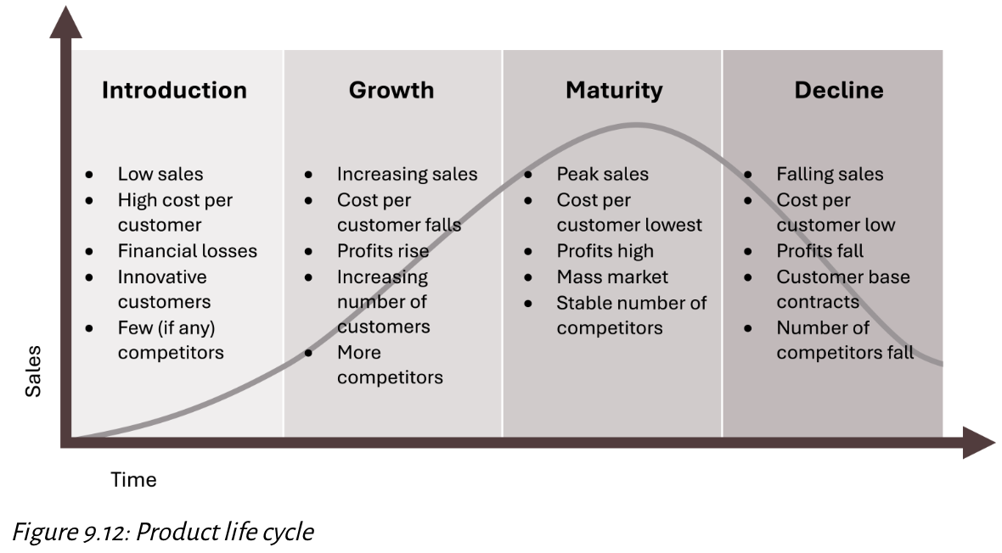
Four Stages of the Product Life Cycle, 2 of 2
The bell curve shape reflects the rise and fall of sales over time
Kindred Grey. 2025. CC BY-NC-SA.
Notes:
1. Introduction Stage
Characteristics:
Sales: Low - product is just entering the market.
Costs: High cost per customer due to marketing, development, and distribution setup.
Profits: Typically negative because of high investment and low sales volume.
Customers: Mostly innovators and early adopters willing to try new products.
Competition: Few or no competitors - market is not yet proven.
Key Challenges:
Building awareness and educating consumers.
Overcoming skepticism and convincing customers to try the product.
Strategies:
Heavy promotional campaigns.
Limited distribution - often in select markets.
2. Growth Stage
Characteristics:
Sales: Increase rapidly as the product gains acceptance.
Costs: Drop per customer because of economies of scale.
Profits: Rise significantly as revenue outpaces costs.
Competition: Increases - other firms enter to capture market share.
Opportunities:
Establish brand loyalty before market saturation.
Expand into new segments and geographic areas.
Strategies:
Improve features and expand product variations.
Broaden distribution and possibly adjust pricing strategies.
3. Maturity Stage
Characteristics:
Sales: Reach peak levels - growth rate slows or plateaus.
Costs: Lowest cost per customer due to maximum efficiency.
Profits: Highest but may start to flatten or slightly decline.
Market: Saturated; most potential customers already own the product.
Competition: Stable but intense - differentiation becomes essential.
Challenges:
Maintaining interest and avoiding commoditization.
Strategies:
Product improvements, rebranding, or bundling.
Loyalty programs to retain customers.
4. Decline Stage
Characteristics:
Sales: Drop as demand falls.
Costs: Remain low per customer, but revenue declines sharply.
Profits: Decrease - may turn negative if not managed.
Customers: Shrinking base - product may appeal only to niche markets.
Competition: Declines - weaker players exit the market.
Options for Firms:
Discontinue the product and phase out support.
Reduce costs and harvest remaining profits.
Find new uses or reposition the product to extend its life.
Visual Note:
The bell curve in the figure represents the rise and fall of sales over time.
The time axis shows how long it typically takes to move through the stages - this can vary widely by industry.
Firms that manage transitions well can extend the growth and maturity stages and delay decline.

Slide 42
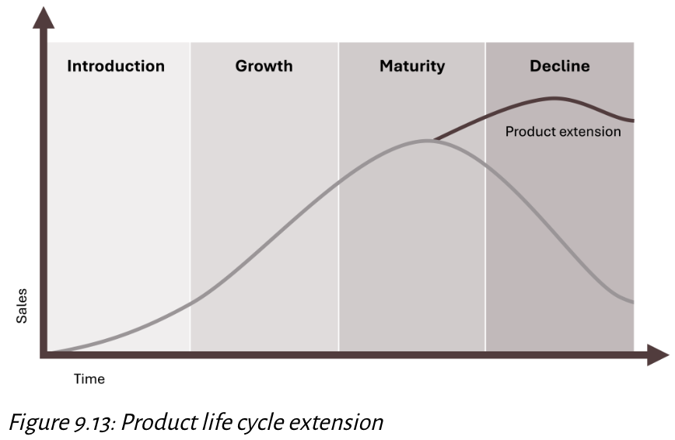
Extending the Life Cycle, 1 of 2
Kindred Grey. 2025. CC BY-NC-SA.
Notes:
Definition & Purpose
Extending the product life cycle means taking deliberate actions to delay the Decline stage of the Product Life Cycle (PLC).
This is usually achieved through incremental innovation - small but meaningful updates or improvements to an existing product.
Goal: Refresh customer interest, maintain competitiveness, and restart a mini growth phase without creating an entirely new product.
Key Strategies
Product Upgrades
Introduce new versions with enhanced features, design tweaks, or performance improvements.
Example: Apple’s iPhone upgrades each year add incremental changes like better cameras, improved processors, or new colors.
Model Refreshes
Revamp product lines to appear modern and competitive without reinventing them.
Example: Toyota & Ford launch new car models or facelifts (minor design + tech upgrades) to keep customers engaged.
Repositioning
Market an existing product to a new audience or for a new use case (not shown in the slide but often relevant).
Benefits
Customer Engagement Keeps the brand relevant and visible in the market.
Revenue Boost Encourages existing customers to repurchase and attracts new buyers.
Market Defense Makes it harder for competitors to capture market share by offering fresher alternatives.
Restarts Growth Can shift the sales curve upward temporarily, effectively extending the Maturity stage.
Risks
Over-Saturation / Customer Fatigue
Too many updates too frequently may cause customers to tune out or feel pressured to upgrade unnecessarily.
Example: Smartphone fatigue from yearly releases.
Cannibalization
New version may take sales away from your older products instead of growing total sales.
This can be especially harmful if the older version was still profitable.

Slide 43
Extending the Life Cycle, 2 of 2
Companies delay decline by updating or improving products (incremental innovation)
Examples:
Apple – Regular iPhone upgrades
Toyota & Ford – New car models to maintain competitiveness
Benefits
Refreshes customer interest, restarts growth phase
Risks:
Over-saturation or customer fatigue from too-frequent updates
Possible cannibalization of existing products
Notes:
Definition & Purpose
Extending the product life cycle means taking deliberate actions to delay the Decline stage of the Product Life Cycle (PLC).
This is usually achieved through incremental innovation - small but meaningful updates or improvements to an existing product.
Goal: Refresh customer interest, maintain competitiveness, and restart a mini growth phase without creating an entirely new product.
Key Strategies
Product Upgrades
Introduce new versions with enhanced features, design tweaks, or performance improvements.
Example: Apple’s iPhone upgrades each year add incremental changes like better cameras, improved processors, or new colors.
Model Refreshes
Revamp product lines to appear modern and competitive without reinventing them.
Example: Toyota & Ford launch new car models or facelifts (minor design + tech upgrades) to keep customers engaged.
Repositioning
Market an existing product to a new audience or for a new use case (not shown in the slide but often relevant).
Benefits
Customer Engagement Keeps the brand relevant and visible in the market.
Revenue Boost Encourages existing customers to repurchase and attracts new buyers.
Market Defense Makes it harder for competitors to capture market share by offering fresher alternatives.
Restarts Growth Can shift the sales curve upward temporarily, effectively extending the Maturity stage.
Risks
Over-Saturation / Customer Fatigue
Too many updates too frequently may cause customers to tune out or feel pressured to upgrade unnecessarily.
Example: Smartphone fatigue from yearly releases.
Cannibalization
New version may take sales away from your older products instead of growing total sales.
This can be especially harmful if the older version was still profitable.

Slide 44
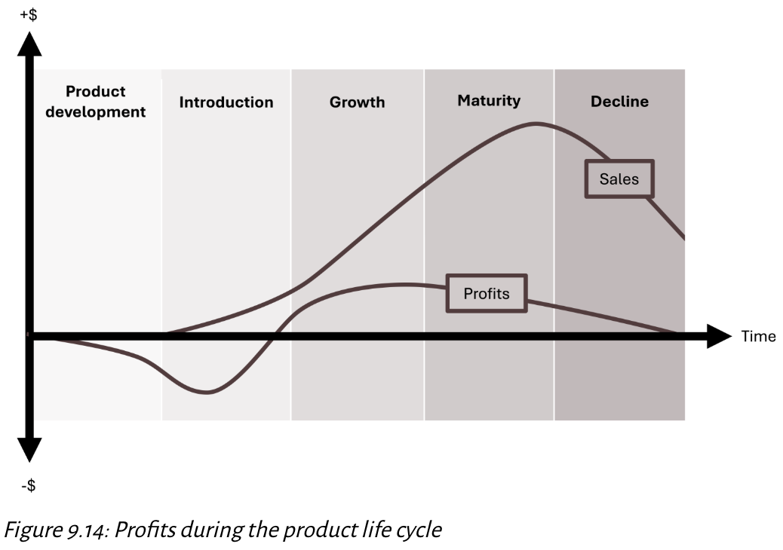
Profits During the Product Life Cycle, 1 of 2
Kindred Grey. 2025. CC BY-NC-SA.

Slide 45
Profits During the Product Life Cycle, 2 of 2
R&D Phase – Negative profits, high investment
Introduction – Low sales, heavy marketing costs
Growth – Sales increase, profitability begins
Maturity – Peak sales & profits, but price competition squeezes margins
Decline – Sales and profits drop, exit or consolidation possible
Note: companies can push profits back up during maturity/decline by extending the product life cycle through incremental innovation (connect to Slide 2 examples: Apple, Toyota, Ford)

Slide 46
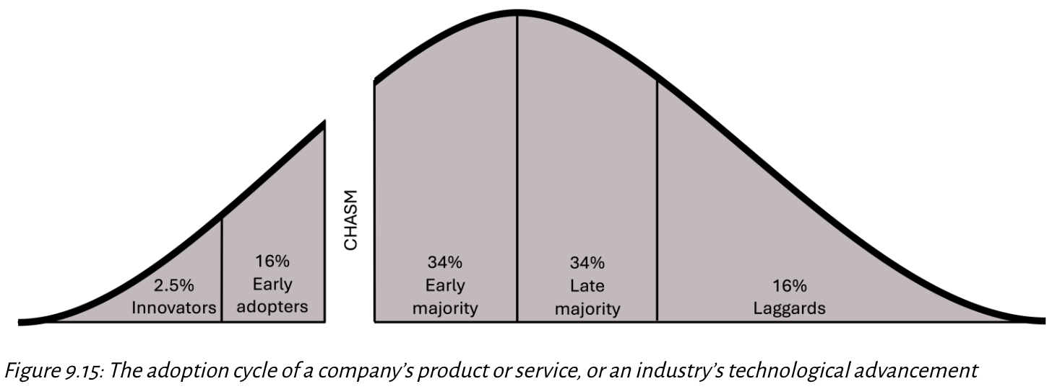
Crossing the Chasm, 1 of 2
Kindred Grey. 2025. CC BY-NC-SA.

Slide 47
Crossing the Chasm, 2 of 2
Definition: Critical stage when a new product/service/technology moves from early adopters to mainstream market (early majority)
Significance: Success becomes more certain after crossing the chasm
Five Adoption Stages:
Innovators (2.5%) – First to try, technology enthusiasts
Early Adopters (13.5%) – Visionaries, influence others
Early Majority (34%) – Pragmatic, need proof of success
Late Majority (34%) – Skeptical, wait for wide adoption
Laggards (16%) – Last to adopt, resistant to change
Challenges: Requires different marketing strategies to appeal to pragmatic mainstream consumers
Examples:
Success: Electric Vehicles moving toward mainstream adoption
Failure: Google Glass unable to reach early majority

Slide 48
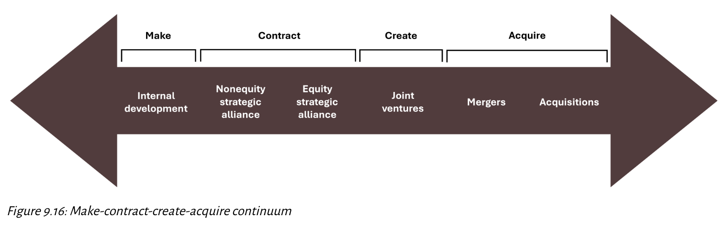
Cooperative Moves: Make-Contract-Create-Acquire Continuum, 1 of 2
Kindred Grey. 2025. CC BY-NC-SA.

Slide 49
Cooperative Moves: Make-Contract-Create-Acquire Continuum, 2 of 2
In today’s business environment, cooperation is as critical as competition.
It allows firms to share resources, enter new markets, and leverage each other’s strengths.
Framework: The make-contract-create-acquire continuum shows strategies from internal growth to full acquisition.

Slide 50
Make: Internal Development
Build capabilities in-house using a firm’s own resources, core competencies, and innovative culture
Encourages intrapreneurship-employees act like entrepreneurs inside the company
Example: Apple designs its own hardware/software ecosystem rather than outsourcing
Pros: Full control, proprietary knowledge retained
Cons: Slower, higher investment required
Notes:
1. Overview of Cooperative Strategies
Cooperative strategies are methods where companies work together to achieve shared objectives while maintaining separate ownership (except in acquisitions).
They allow firms to combine resources, share knowledge, enter new markets faster, and create competitive advantages they may not achieve alone.
Three main types covered here:
Contract → Strategic alliances
Create → Joint ventures
Acquire → Mergers & acquisitions
2. Strategic Alliances (“Contract”)
Definition:
A formal agreement between two or more independent firms to collaborate while keeping their own identities.
Examples:
Starbucks + Spotify (music streaming partnership to enhance in-store experience)
Nike + Apple (Nike+ technology integration into Apple products)
Merck + PAREXEL (pharma + research service collaboration)
Benefits:
Access to shared expertise and technology.
Expands customer reach without full ownership.
Lower risk and cost compared to acquisitions.
Risks:
Information leakage: Proprietary knowledge may be unintentionally shared.
Misaligned goals: Partners may have different strategic priorities, leading to conflict or inefficiency.
3. Joint Ventures (“Create”)
Definition:
Two or more companies form a new, jointly owned entity with shared decision-making, profits, and responsibilities.
Examples:
Google + Fiat Chrysler → Self-driving car development.
Sony + Ericsson → Mobile phone business.
Benefits:
Combines complementary strengths for innovation (ex: one partner provides technology, the other provides manufacturing).
Can accelerate entry into new markets or industries.
Risks:
Cultural conflicts: Differences in management styles, corporate cultures, and priorities can cause friction.
Governance disputes: Decision-making power may be uneven or contested.
4. Mergers & Acquisitions (“Acquire”)
Mergers:
Two relatively equal companies combine to form a single, larger firm.
Example: T-Mobile + Sprint → Expanded network coverage and market share.
Acquisitions:
A larger company buys and absorbs a smaller company.
Example: Google buys Fitbit → Expands into wearable technology and health tracking.
Benefits:
Immediate boost in market share and competitive strength.
Eliminates or absorbs competitors.
Can gain valuable assets, talent, and intellectual property.
Risks:
High failure rate (70–90%) due to poor integration planning, culture clashes, or unrealistic synergy expectations.
Potential customer loss and employee turnover if integration is poorly managed.
5. Key Takeaways for Students
Strategic alliances are lower-risk and flexible but require trust and alignment.
Joint ventures are more integrated than alliances but risk governance disputes.
Mergers & acquisitions offer rapid growth but carry high integration risk.
Choosing the right cooperative strategy depends on company resources, market conditions, and long-term goals.

Slide 51
Contract: Strategic Alliances
Agreement to collaborate while remaining independent
Examples
Starbucks + Spotify
Nike + Apple
Merck + PAREXEL
Benefits: Shared expertise, expanded customer base
Risks: Potential info leakage, misaligned goals
Notes:
1. Overview of Cooperative Strategies
Cooperative strategies are methods where companies work together to achieve shared objectives while maintaining separate ownership (except in acquisitions).
They allow firms to combine resources, share knowledge, enter new markets faster, and create competitive advantages they may not achieve alone.
Three main types covered here:
Contract → Strategic alliances
Create → Joint ventures
Acquire → Mergers & acquisitions
2. Strategic Alliances (“Contract”)
Definition:
A formal agreement between two or more independent firms to collaborate while keeping their own identities.
Examples:
Starbucks + Spotify (music streaming partnership to enhance in-store experience)
Nike + Apple (Nike+ technology integration into Apple products)
Merck + PAREXEL (pharma + research service collaboration)
Benefits:
Access to shared expertise and technology.
Expands customer reach without full ownership.
Lower risk and cost compared to acquisitions.
Risks:
Information leakage: Proprietary knowledge may be unintentionally shared.
Misaligned goals: Partners may have different strategic priorities, leading to conflict or inefficiency.
3. Joint Ventures (“Create”)
Definition:
Two or more companies form a new, jointly owned entity with shared decision-making, profits, and responsibilities.
Examples:
Google + Fiat Chrysler → Self-driving car development.
Sony + Ericsson → Mobile phone business.
Benefits:
Combines complementary strengths for innovation (ex: one partner provides technology, the other provides manufacturing).
Can accelerate entry into new markets or industries.
Risks:
Cultural conflicts: Differences in management styles, corporate cultures, and priorities can cause friction.
Governance disputes: Decision-making power may be uneven or contested.
4. Mergers & Acquisitions (“Acquire”)
Mergers:
Two relatively equal companies combine to form a single, larger firm.
Example: T-Mobile + Sprint → Expanded network coverage and market share.
Acquisitions:
A larger company buys and absorbs a smaller company.
Example: Google buys Fitbit → Expands into wearable technology and health tracking.
Benefits:
Immediate boost in market share and competitive strength.
Eliminates or absorbs competitors.
Can gain valuable assets, talent, and intellectual property.
Risks:
High failure rate (70–90%) due to poor integration planning, culture clashes, or unrealistic synergy expectations.
Potential customer loss and employee turnover if integration is poorly managed.
5. Key Takeaways for Students
Strategic alliances are lower-risk and flexible but require trust and alignment.
Joint ventures are more integrated than alliances but risk governance disputes.
Mergers & acquisitions offer rapid growth but carry high integration risk.
Choosing the right cooperative strategy depends on company resources, market conditions, and long-term goals.

Slide 52
Create: Joint Ventures
Partners form a new entity with shared decision-making & profits
Example: Google + Fiat Chrysler (self-driving cars)
Benefits: Combine strengths for faster innovation
Risks: Cultural conflicts, governance disputes
Notes:
1. Overview of Cooperative Strategies
Cooperative strategies are methods where companies work together to achieve shared objectives while maintaining separate ownership (except in acquisitions).
They allow firms to combine resources, share knowledge, enter new markets faster, and create competitive advantages they may not achieve alone.
Three main types covered here:
Contract → Strategic alliances
Create → Joint ventures
Acquire → Mergers & acquisitions
2. Strategic Alliances (“Contract”)
Definition:
A formal agreement between two or more independent firms to collaborate while keeping their own identities.
Examples:
Starbucks + Spotify (music streaming partnership to enhance in-store experience)
Nike + Apple (Nike+ technology integration into Apple products)
Merck + PAREXEL (pharma + research service collaboration)
Benefits:
Access to shared expertise and technology.
Expands customer reach without full ownership.
Lower risk and cost compared to acquisitions.
Risks:
Information leakage: Proprietary knowledge may be unintentionally shared.
Misaligned goals: Partners may have different strategic priorities, leading to conflict or inefficiency.
3. Joint Ventures (“Create”)
Definition:
Two or more companies form a new, jointly owned entity with shared decision-making, profits, and responsibilities.
Examples:
Google + Fiat Chrysler → Self-driving car development.
Sony + Ericsson → Mobile phone business.
Benefits:
Combines complementary strengths for innovation (ex: one partner provides technology, the other provides manufacturing).
Can accelerate entry into new markets or industries.
Risks:
Cultural conflicts: Differences in management styles, corporate cultures, and priorities can cause friction.
Governance disputes: Decision-making power may be uneven or contested.
4. Mergers & Acquisitions (“Acquire”)
Mergers:
Two relatively equal companies combine to form a single, larger firm.
Example: T-Mobile + Sprint → Expanded network coverage and market share.
Acquisitions:
A larger company buys and absorbs a smaller company.
Example: Google buys Fitbit → Expands into wearable technology and health tracking.
Benefits:
Immediate boost in market share and competitive strength.
Eliminates or absorbs competitors.
Can gain valuable assets, talent, and intellectual property.
Risks:
High failure rate (70–90%) due to poor integration planning, culture clashes, or unrealistic synergy expectations.
Potential customer loss and employee turnover if integration is poorly managed.
5. Key Takeaways for Students
Strategic alliances are lower-risk and flexible but require trust and alignment.
Joint ventures are more integrated than alliances but risk governance disputes.
Mergers & acquisitions offer rapid growth but carry high integration risk.
Choosing the right cooperative strategy depends on company resources, market conditions, and long-term goals.

Slide 53
Acquire: M&As
Mergers: Two equals combine
Example: : T-Mobile + Sprint
Acquisitions: Larger firm buys smaller one
Example: Google buys Fitbit
Benefits: Market share boost, competitor elimination
Risks: High failure rate (70–90%), cultural mismatches
Notes:
1. Overview of Cooperative Strategies
Cooperative strategies are methods where companies work together to achieve shared objectives while maintaining separate ownership (except in acquisitions).
They allow firms to combine resources, share knowledge, enter new markets faster, and create competitive advantages they may not achieve alone.
Three main types covered here:
Contract → Strategic alliances
Create → Joint ventures
Acquire → Mergers & acquisitions
2. Strategic Alliances (“Contract”)
Definition:
A formal agreement between two or more independent firms to collaborate while keeping their own identities.
Examples:
Starbucks + Spotify (music streaming partnership to enhance in-store experience)
Nike + Apple (Nike+ technology integration into Apple products)
Merck + PAREXEL (pharma + research service collaboration)
Benefits:
Access to shared expertise and technology.
Expands customer reach without full ownership.
Lower risk and cost compared to acquisitions.
Risks:
Information leakage: Proprietary knowledge may be unintentionally shared.
Misaligned goals: Partners may have different strategic priorities, leading to conflict or inefficiency.
3. Joint Ventures (“Create”)
Definition:
Two or more companies form a new, jointly owned entity with shared decision-making, profits, and responsibilities.
Examples:
Google + Fiat Chrysler → Self-driving car development.
Sony + Ericsson → Mobile phone business.
Benefits:
Combines complementary strengths for innovation (ex: one partner provides technology, the other provides manufacturing).
Can accelerate entry into new markets or industries.
Risks:
Cultural conflicts: Differences in management styles, corporate cultures, and priorities can cause friction.
Governance disputes: Decision-making power may be uneven or contested.
4. Mergers & Acquisitions (“Acquire”)
Mergers:
Two relatively equal companies combine to form a single, larger firm.
Example: T-Mobile + Sprint → Expanded network coverage and market share.
Acquisitions:
A larger company buys and absorbs a smaller company.
Example: Google buys Fitbit → Expands into wearable technology and health tracking.
Benefits:
Immediate boost in market share and competitive strength.
Eliminates or absorbs competitors.
Can gain valuable assets, talent, and intellectual property.
Risks:
High failure rate (70–90%) due to poor integration planning, culture clashes, or unrealistic synergy expectations.
Potential customer loss and employee turnover if integration is poorly managed.
5. Key Takeaways for Students
Strategic alliances are lower-risk and flexible but require trust and alignment.
Joint ventures are more integrated than alliances but risk governance disputes.
Mergers & acquisitions offer rapid growth but carry high integration risk.
Choosing the right cooperative strategy depends on company resources, market conditions, and long-term goals.

Slide 54
Responding to Innovation in the Market
Quick Responses
Multipoint Competition
Respond to Market Disruptions
Mutual Forbearance
Fighting Brands
Co-Location
Co-Opetition

Slide 55
Responding to Market Disruptions
🆚 Disruption responses:
Stick with tradition
Barnes & Noble in response to Amazon
Counterattack differently
Apple & Dell
Match competitor’s move
Merrill Lynch launched its own online trading platform
Notes:
Disruption Responses
When a company faces disruptive innovation or a competitive threat, it must choose how to respond. The three main strategies are:
a. Stick with Tradition
Definition: Maintain existing products, services, and business models despite new market changes.
When to Use: If the company has a loyal customer base, a strong brand identity, or believes the disruption will not be sustainable.
Example: Barnes & Noble continuing to focus on physical bookstores despite the growth of e-books.
Risks: May lead to loss of relevance if disruption becomes dominant in the market.
b. Counterattack Differently
Definition: Respond to disruption by innovating in a different way rather than directly copying the competitor.
Goal: Differentiate instead of imitating, appealing to different customer needs.
Example: Apple vs. Dell - Instead of matching Dell’s low-cost PC model, Apple invested in design, premium branding, and ecosystem integration.
Benefits: Allows the company to stand out without entering a price war.
c. Match Competitor’s Move
Definition: Replicate the disruptor’s strategy or product to protect market share.
Example: Merrill Lynch introducing online trading to compete with emerging internet-based brokers.
Risks: Can lead to commoditization; must still find ways to add unique value.

Slide 56
Quick Reactions; Multipoint Competition; Mutual Forbearance
⚡ Quick Reactions → Fast responses prevent rivals from gaining early advantages
Ex: Samsung vs. Apple in foldables and wearables
🌐 Multipoint competition → same rivals in multiple markets
Ex: RJR vs. Philip Morris
🤝 Mutual Forbearance → Sometimes rivals avoid costly fights
Notes:
Quick Reactions
Definition: The ability of a company to respond rapidly to a competitor’s move, preventing the rival from building an early advantage.
Purpose: Reduces the time competitors have to capitalize on new products, technology, or market openings.
Example:
Samsung vs. Apple in foldables and wearables: Samsung quickly pushes foldable phones and wearables into the market, forcing Apple to accelerate its product development to remain competitive.
Key Insights:
Speed is critical in industries where technology changes fast.
Slow response can lead to loss of market share and perceived innovator status.
Requires agile operations, decision-making flexibility, and readiness to act.
Multipoint Competition
Definition: Occurs when the same rivals compete against each other in multiple product categories or geographic markets.
Dynamic:
Competitive actions in one market can influence actions in another market.
Rivals often keep track of each other’s behavior across all markets they share.
Example:
RJR vs. Philip Morris: Competing in multiple tobacco product categories and global regions.
Implications:
Creates a web of interconnected competition-firms may retaliate in one market for a competitor’s aggressive move in another.
Increases complexity of strategy because actions in one area can have ripple effects.
Mutual Forbearance
Definition: A situation in which rivals decide-explicitly or implicitly-not to engage in aggressive competition to avoid mutually damaging price wars or costly battles.
Why It Happens:
Both companies recognize that aggressive competition could hurt profits in all shared markets.
Maintaining a stable competitive balance can be more profitable long-term.
Example Context:
Two airlines competing on multiple routes might avoid undercutting prices to preserve profitability.
Strategic Benefit:
Helps preserve margins and reduces volatility.
Can foster more predictable market conditions.
Risk:
Overly cautious approaches can slow innovation and allow new entrants to disrupt the market.

Slide 57
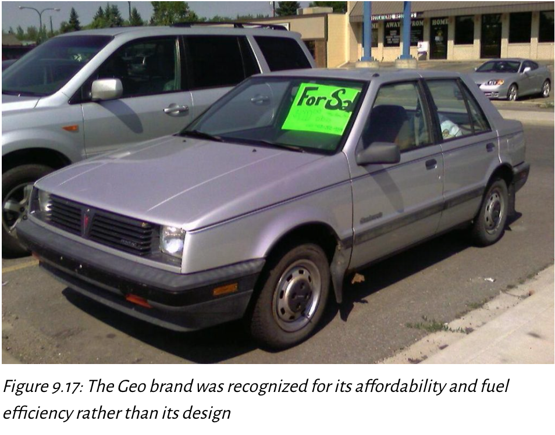
Fighting Brands
Fighting Brands protect market share with lower-priced offerings
Failures: GM Geo, BA’s Go, SAS’s Snowflake
Successes: Toyota Scion, Unilever Axe
dave_7. 2008. CC BY-SA 2.0. KFC and Baskin-Robbins image
Notes:
Fighting Brands
Definition: A lower-priced product line introduced by a company to protect market share against low-cost competitors. These brands target price-sensitive customers, preventing them from switching to rival offerings.
Purpose:
Maintain overall company market share.
Avoid directly lowering the main brand’s price (which could damage brand image or profitability).
Serve as a defensive move in competitive markets.
Key Characteristics:
Often stripped-down versions of higher-end products.
Focus on affordability, not premium features.
Sometimes marketed under a different brand name to avoid diluting the parent brand.
Examples & Lessons:
Failures:
GM Geo – Affordable and fuel-efficient but lacked design appeal.
BA’s Go – British Airways’ low-cost airline, failed due to unclear positioning and market mismatch.
SAS’s Snowflake – Scandinavian Airlines’ budget brand that couldn’t gain traction.
Successes:
Toyota Scion – Targeted young buyers with affordable, stylish cars.
Unilever Axe – Captured the youth market with strong brand personality and affordable pricing.
Risks:
Can cannibalize the main brand’s sales.
If poorly executed, can harm brand perception.
Must maintain clear market segmentation to avoid confusion.

Slide 58
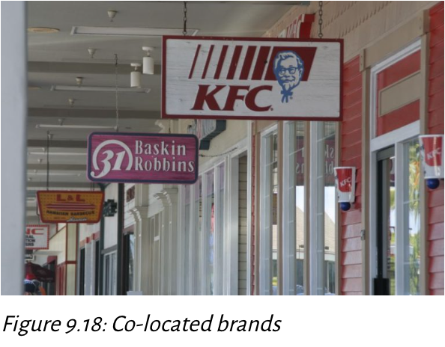
Co-Location
📍Co-location = situating complementary brands together to boost traffic
Example: Dunkin’ + Baskin-Robbins, Hilton hotel pairs, retail clusters
© Hirohisat. 2007. CC BY-SA 3.0. https://commons.wikimedia.org/wiki/File:KFC_and_Baskin_31_Robins.jpg
Notes:
Co-Location
Definition: Placing complementary brands or businesses in the same physical location to mutually increase customer traffic.
Purpose:
Leverage shared customer bases.
Reduce marketing costs by benefiting from each other’s visibility.
Increase sales by making it more convenient for consumers to access related products/services.
Key Features:
Works best when the co-located brands target similar audiences but offer different products or services.
Can occur in the same store, side-by-side locations, or in a shared facility.
Examples:
Dunkin’ + Baskin-Robbins - Combines coffee and donuts with ice cream to attract both breakfast and dessert crowds.
Hilton hotel pairs - Multiple hotel brands under one roof to serve different traveler segments.
Retail clusters - Outlet malls or shopping centers where complementary brands are grouped together.
Benefits:
Increased customer exposure.
Shared overhead and operational efficiencies.
Cross-selling opportunities.
Risks:
If one brand has a poor reputation, it may negatively affect the other.
Competition between co-located brands offering overlapping products.
3. Key Takeaways for Students
Fighting brands are a defensive pricing and market retention strategy; co-location is a traffic and synergy strategy.
Both approaches aim to strengthen market position but work in different ways:
Fighting brands = protect market share from low-cost threats.
Co-location = boost foot traffic and complementary sales.
Strategic execution and clear brand positioning are crucial for both to succeed.

Slide 59
Co-Opetition
📍Co-opetition =firms can simultaneously collaborate and compete
Examples:
Microsoft and Samsung compete directly in the electronics market, but they have also partnered to integrate Microsoft’s software into Samsung devices.
Ford and Volkswagen fiercely compete in the global car market, and they have joined forces in the development of electric vehicles and autonomous driving technologies.
Notes:
2. Co-Opetition
A hybrid strategy that blends cooperation and competition.
Key Concept:
Companies collaborate in certain areas to create value ("grow the pie") but still compete in others ("divide the pie").
Works best when:
Collaboration accelerates innovation.
Partners share complementary strengths.
Both parties benefit without completely erasing competitive dynamics.
Examples:
Microsoft + Samsung – Partnership on Android-related patents while competing in devices.
Google + Apple – Collaboration on integrating Google apps into iOS while competing in mobile OS markets.
Ford + VW – Joint work on electric and autonomous vehicle technologies while still competing in the auto market.
3. Benefits of Disruption Response & Co-Opetition
Increased Market Share: Collaboration can open access to new customers and markets.
Improved Innovation Speed: Shared R&D reduces time to market.
Reduced Competitive Risk: Partnerships can prevent destructive competition and costly legal battles.

Slide 60
Measuring Innovation Performance, 1 of 2
Measure | Description | Purpose
Percentage of sales from new products/services | Evaluates the percentage of sales generated from products or services launched within a specific time frame. | Indicates the contribution of recent innovations to overall revenue.
Success ratio | Compares the number of successful innovations to the total number of initiatives undertaken. | Assesses the efficiency and effectiveness of the innovation process.
Innovation output | Measures the percentage of product sales that were new to the market. | Tracks how much of the company’s sales come from new innovations.
Figure 9.19: Measures of innovation strategy and investment effectiveness

Slide 61
Measuring Innovation Performance, 2 of 2
Assesses both success of new initiatives and impact on business outcomes
Combines short-term performance metrics with long-term strategic value
Key approaches:
% of sales from new products/services → shows contribution to revenue
Success ratio → measures efficiency of innovation process
Innovation output → % of sales from new-to-market products

Slide 62
Advanced Metrics & Strategic Impact,1 of 2
Measure | Description | Purpose
Innovation quality (forward citations) | Measures the number of forward citations to patents, indicating technological impact. | Assesses the technological significance and impact of innovations.
Revenue growth from new products/services | Tracks revenue growth directly attributed to innovations in products or services. | Highlights how much innovation drives top-line growth.
Return on invested capital (ROIC) | Calculates the return on capital invested in innovation-related projects. | Provides insight into the profitability of innovation investments.
Net present value (NPV) of innovation portfolio | Estimates the long-term financial return from innovation projects. | Helps prioritize and manage innovation investments for future growth.
Figure 9.19: Measures of innovation strategy and investment effectiveness

Slide 63
Advanced Metrics & Strategic Impact, 2 of 2
Innovation Quality (forward citations): measures technological impact
Revenue Growth from New Products/Services: How innovation drives top-line growth
Return on Invested Capital (ROIC): profitability of innovation investments
Net Present Value (NPV) of innovation portfolio: long-term financial return
These metrics help prioritize, manage, and justify innovation projects

Slide 64
Analyze Innovation Strategy
6. As appropriate to the case, analyze strategies: Corporate-level, business-level, innovation, sustainability and ethics, technology, and multinational strategies.
Use strategic management analytical frameworks to analyze, interpret, and evaluate strategies.
Ensure line of sight and congruence within analysis of each strategy.

Slide 65
Why Innovation Strategy Matters for Business Graduates
💡 Drives Functional-Level Decisions:
Embedded in business-level strategy, directly shaping marketing, IT, and accounting roles
First mover vs. fast follower strategies influence day-to-day tasks for managers
Innovation type (incremental, disruptive, architectural, radical) determines data needs from functional managers
🏢 Impact in Large Companies:
Business support unit managers must align work with the strategic business unit’s innovation approach
Collaboration with executives to implement functional strategies tied to innovation goals
🏬 Impact in Small Companies
Close interaction with executives responsible for innovation from the start
Greater hands-on role in strategy execution and decision-making
🧠 Consulting & Entrepreneurial Roles
Internal/external consultants need deep knowledge of innovation strategy to advise executives effectively
Entrepreneurs rely on innovation strategy fluency to launch, grow, and adapt their businesses

Slide 66
Demonstrate Your Knowledge, Skills, and Competence, 1 of 2
Use these questions to test your knowledge of the chapter:
Describe innovation strategy and its relationship to business-level strategy.
Explain entrepreneurial orientation (EO) and three core traits that make up EO. Explain intrapreneurship and its relationship to entrepreneurship. Are you more likely to demonstrate your EO through being an entrepreneur or an intrapreneur?
Describe why innovation is important for companies. Discuss the risks for companies that fail to innovate.
Explain in detail first movers and fast followers and the benefits and risks of each.
Describe the innovation framework, including the two key factors that are central to the framework and the resulting four types of innovation.
Explain footholds and how these relate to innovation.

Slide 67
Demonstrate Your Knowledge, Skills, and Competence, 2 of 2
Explain how firms that use cost leadership and differentiation approach innovation differently. Discuss how a value chain analysis can support cost leadership differentiation.
Describe the product life cycle and its four stages. Explain how the product life cycle can be extended. Describe the relationship of profits to the product life cycle. Give an example.
Describe what crossing the chasm means. Give an example.
Using the make-contract-create-acquire continuum, describe how companies may cooperate.
There are multiple ways firms can respond to innovation in the market. Explain these in detail, and give an example of each.
Refer to figure 9.19 and ensure you understand each measure and their purpose and can use them in a case analysis. If there are any areas you need to study further, we encourage you to do this now because you use these concepts throughout the course.
Describe how competence with innovation strategy is relevant and important to you.

