Slide 1
3D Weather Visualisation
Virginia Tech Blacksburg, VA, 24061
Sarah Nimitz, Duke Forsyth, Andrew Knittle
Client: Zachary Duer Trevor White
CS 4624 4/28/2016

Slide 2
Overview
Worked with Zachary Duer and Trevor White
Portions of a larger project
The Cube
3D Doppler radar data
Unity and C#

Slide 3
Structural Overview
Backend System
Client-Created Systems
Frontend System
Statement Parsing
Controller
2D Doppler Renderer
3D Doppler Renderer
User Interface
Statement Parsing
Doppler Radar Data

Slide 4
Frontend:
From the front end the user chooses where to be positioned in 3D Space using a tablet
Done through Unity built interface
Simple UI for simple movement
Big buttons because the screen is hard to see with goggles
4 buttons to move in 4 directions
1 button to bring the user back to the center

Slide 5
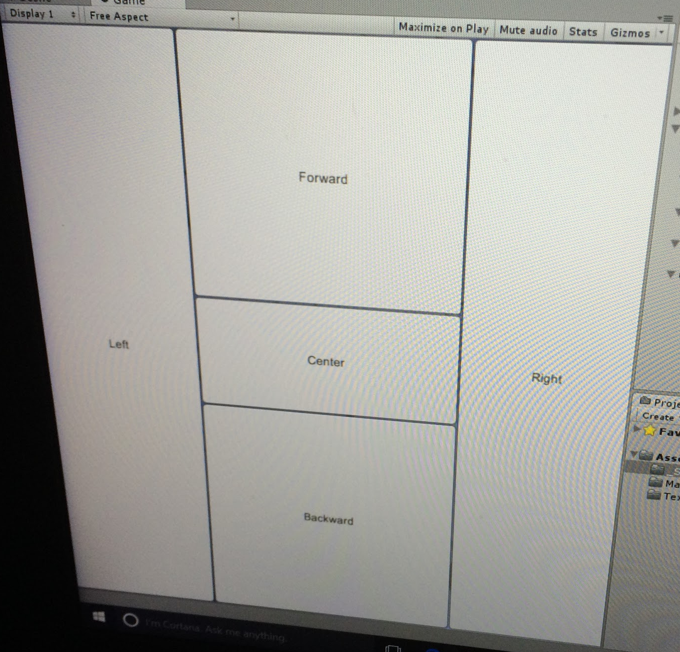
Frontend: UI Representation
Move
Forward
Move Left
Back to Center
Move Backward
Move
Right

Slide 6
Frontend: Logic
Unity Editor provides API
Each button had a corresponding C# script that moves the user.
The code for each button only differs between directions to move
Update gets called after every move by the user
The user’s position is then updated to the current position and then writes out the position in a formatted data file
The file will then be used by the client's software so that VR and/or AR goggles can update the user’s POV in the 3D scene

Slide 7
Frontend: Logic Flow
Update File
Client Side Software
Button
Read File
Button Press

Slide 8
Clients’ Work
Trevor White takes the warning information
Renders onto 2D doppler data
Allows users to interact with warnings
Displays related severe weather statements
Allows user to step back to previous timeframe
Zachary Duer takes input from Trevor’s program
Renders 3D doppler data in Unity
Uses augmented reality/virtual reality headset

Slide 9
Polling
The main website: http://warnings.cod.edu/
Controller
Parsing
Web Crawler
Polling Class
Reverse Class
Storage
...
Downloads Files

Slide 10
Parsing
Files from College of DuPage broken into statements
They sort by publication time
We sort by relevant warning
Statements parsed for
Publication Time
Warning ID
Warning Duration
etc
Warning objects created/updated/stored
Active warnings tracked

Slide 11
322
WFUS54 KOUN 201940
TOROUN
OKC027-051-087-109-202015-
/O.NEW.KOUN.TO.W.0024.130520T1940Z-130520T2015Z/
BULLETIN - EAS ACTIVATION REQUESTED
TORNADO WARNING
NATIONAL WEATHER SERVICE NORMAN OK
240 PM CDT MON MAY 20 2013
THE NATIONAL WEATHER SERVICE IN NORMAN HAS ISSUED A
* TORNADO WARNING FOR...
NORTHWESTERN MCCLAIN COUNTY IN CENTRAL OKLAHOMA...
SOUTHERN OKLAHOMA COUNTY IN CENTRAL OKLAHOMA...
NORTHEASTERN GRADY COUNTY IN CENTRAL OKLAHOMA...
NORTHERN CLEVELAND COUNTY IN CENTRAL OKLAHOMA...
* UNTIL 315 PM CDT
* AT 238 PM CDT...NATIONAL WEATHER SERVICE METEOROLOGISTS DETECTED A
SEVERE THUNDERSTORM CAPABLE OF PRODUCING A TORNADO. THIS DANGEROUS
STORM WAS LOCATED NEAR NEWCASTLE...AND MOVING EAST AT 20 MPH.
IN ADDITION TO A TORNADO...LARGE DAMAGING HAIL UP TO GOLF BALL SIZE
IS EXPECTED WITH THIS STORM.
* LOCATIONS IMPACTED INCLUDE...
NORMAN...MOORE...NEWCASTLE...BRIDGE CREEK AND VALLEY BROOK.
PRECAUTIONARY/PREPAREDNESS ACTIONS...
TAKE COVER NOW IN A STORM SHELTER OR AN INTERIOR ROOM OF A STURDY
BUILDING. STAY AWAY FROM DOORS AND WINDOWS.
&&
LAT...LON 3522 9740 3519 9771 3530 9775 3543 9744
TIME...MOT...LOC 1940Z 248DEG 19KT 3526 9766
$$
30

Slide 12
322
WFUS54 KOUN 201940
TOROUN
OKC027-051-087-109-202015-
/O.NEW.KOUN.TO.W.0024.130520T1940Z-130520T2015Z/
BULLETIN - EAS ACTIVATION REQUESTED
TORNADO WARNING
NATIONAL WEATHER SERVICE NORMAN OK
240 PM CDT MON MAY 20 2013
THE NATIONAL WEATHER SERVICE IN NORMAN HAS ISSUED A
* TORNADO WARNING FOR...
NORTHWESTERN MCCLAIN COUNTY IN CENTRAL OKLAHOMA...
SOUTHERN OKLAHOMA COUNTY IN CENTRAL OKLAHOMA...
NORTHEASTERN GRADY COUNTY IN CENTRAL OKLAHOMA...
NORTHERN CLEVELAND COUNTY IN CENTRAL OKLAHOMA...
* UNTIL 315 PM CDT
* AT 238 PM CDT...NATIONAL WEATHER SERVICE METEOROLOGISTS DETECTED A
SEVERE THUNDERSTORM CAPABLE OF PRODUCING A TORNADO. THIS DANGEROUS
STORM WAS LOCATED NEAR NEWCASTLE...AND MOVING EAST AT 20 MPH.
IN ADDITION TO A TORNADO...LARGE DAMAGING HAIL UP TO GOLF BALL SIZE
IS EXPECTED WITH THIS STORM.
* LOCATIONS IMPACTED INCLUDE...
NORMAN...MOORE...NEWCASTLE...BRIDGE CREEK AND VALLEY BROOK.
PRECAUTIONARY/PREPAREDNESS ACTIONS...
TAKE COVER NOW IN A STORM SHELTER OR AN INTERIOR ROOM OF A STURDY
BUILDING. STAY AWAY FROM DOORS AND WINDOWS.
&&
LAT...LON 3522 9740 3519 9771 3530 9775 3543 9744
TIME...MOT...LOC 1940Z 248DEG 19KT 3526 9766
$$
30
322
WFUS54 KOUN 201940
TOROUN
OKC027-051-087-109-202015-
/O.NEW.KOUN.TO.W.0024.130520T1940Z-130520T2015Z/
Station ETN
BULLETIN - EAS ACTIVATION REQUESTED
TORNADO WARNING
NATIONAL WEATHER SERVICE NORMAN OK
240 PM CDT MON MAY 20 2013
Warning Type
Publication Time
* UNTIL 315 PM CDT
Expiration Time
Warning Vertices
Time Degrees Speed Location
LAT...LON 3522 9740 3519 9771 3530 9775 3543 9744
TIME...MOT...LOC 1940Z 248DEG 19KT 3526 9766

Slide 13
Writing to File
Warnings
2013
Statement text stored in file
Stores statements without warnings
Accessible at later time
Stored in format “YEAR\SSSS####MMDD”
YEAR - Four-digit year of publication
SSSS - Station issuing the warning
#### - Event Tracking Number (ETN)
MM - Month of warning start
DD - Day of warning start
Log of warning start/end times
Unlinked statements separated
“YEAR\SSSSMMDD”
Year, Station, Month, Day
Unlinked
KOUN0520
Station: KSHV
Month: 05 (May)
Day: 20
WarningLog
KOUN00240520
Station: KOUN
ETN: 0024
Month: 05 (May)
Day: 20

Slide 14
Acknowledgements
Zachary Duer for allowing us to work on the frontend
Trevor White for teaching us about severe weather statements, and allowing us to work on the backend
College of DuPage for their server and collection of severe weather statements

