Slide 1
Social Interactome Recommender Team
Colin Gray
Andrew Baehre
Trevor Kinaman
CS 4624: Multimedia and Hypertext
Virginia Tech, Blacksburg, VA
May 3, 2016
Notes:
Add date and meta data

Slide 2

Social Interactome
Study on people trying to recover from addictions using private social network website called Friendica
Kept track of via their posts, messages, and surveys
Users take surveys to provide information about their recovery
Notes:
Picture is bad new picture
“Private social network”
Combine 1st 2 bullets
Derive data from posts, messages, and surveys

Slide 3
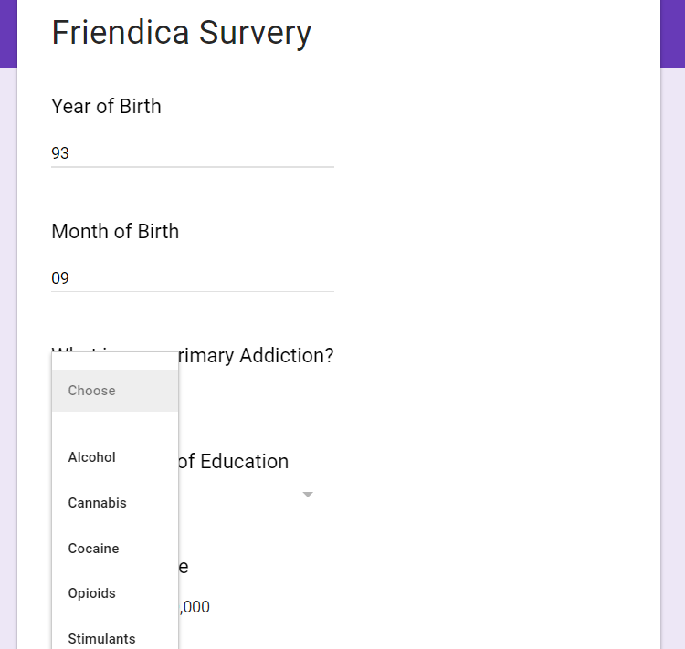
Parsing the Survey Results
Take initial CSV file from survey results
Parse results
Output CSV with numerical and binary values
Notes:
Take out the 2nd bullet
Add the survey questions
Add the processed survey

Slide 4
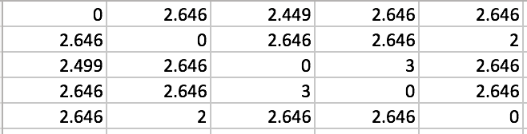
Similarity Matrix
Each of the users on the two axes
Values correspond to the likeness
Used for recommendations
Notes:
Show small part of the output csv
then max flow
Make lattice network picture with values between people

Slide 5
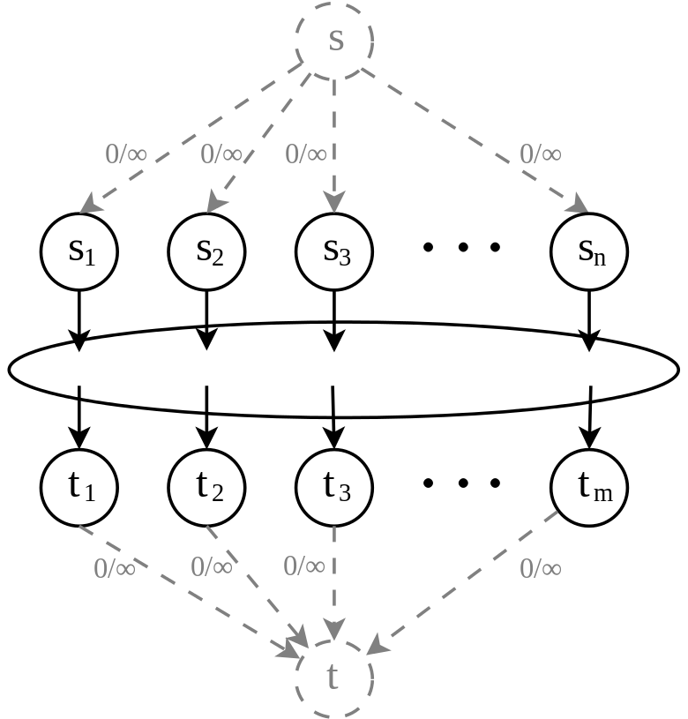
Max Flow

Slide 6
Lattice Network
2.645
Person 1
Person 2
2.449
Person 3
2.449
Person 4
Person 5
2.645

Slide 7
What’s Been Done
Parsed survey results
Made two different algorithms
Computed similarity matrices
Tested our output

Slide 8
What’s Next?
Improving the algorithms
Work with Abigail Bartolome for extra data
Collaborative Recommender
More Testing

Slide 9
Acknowledgements
Prashant Chandrasekar
Dr. Fox
Dr. Franck
NIH Grant 1R01DA039456-01
Notes:
NIH grant include number

