Slide 1
Russian Flu
Sam Fisher, Josh Horn, Johanna Pinsirikul, Taylor Sims
Client: Tom Ewing

Slide 2
Introduction
Track the Russian Flu (1889-1890)
Translation Team
  Articles in German, Spanish, Russian to English
CS Team
  Create website to view and search articles
  Multimedia to display large amounts of data

Slide 3
Our Work (Solr)
Define document fields in schema.xml
Search configuration in solrconfig.xml
  Facets, Drop-Down Bar, Searchable Fields
Indexed data
  Tab-separated .csv file
  Automatic upload?

Slide 4
Our Work (Blacklight)
Configured Blacklight
  Facets, Search Results
  Color Scheme
  Images

Slide 5
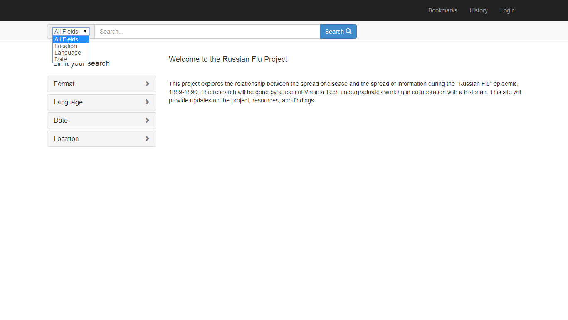
Original Prototype

Slide 6
Current Interface

Slide 7
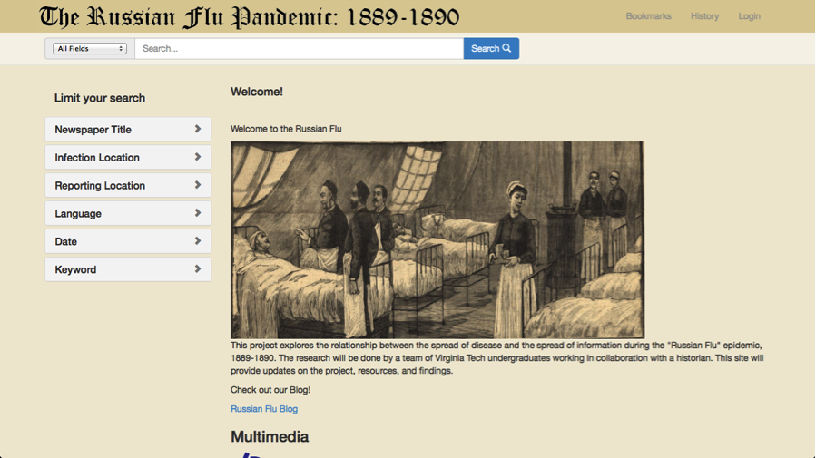

Slide 8
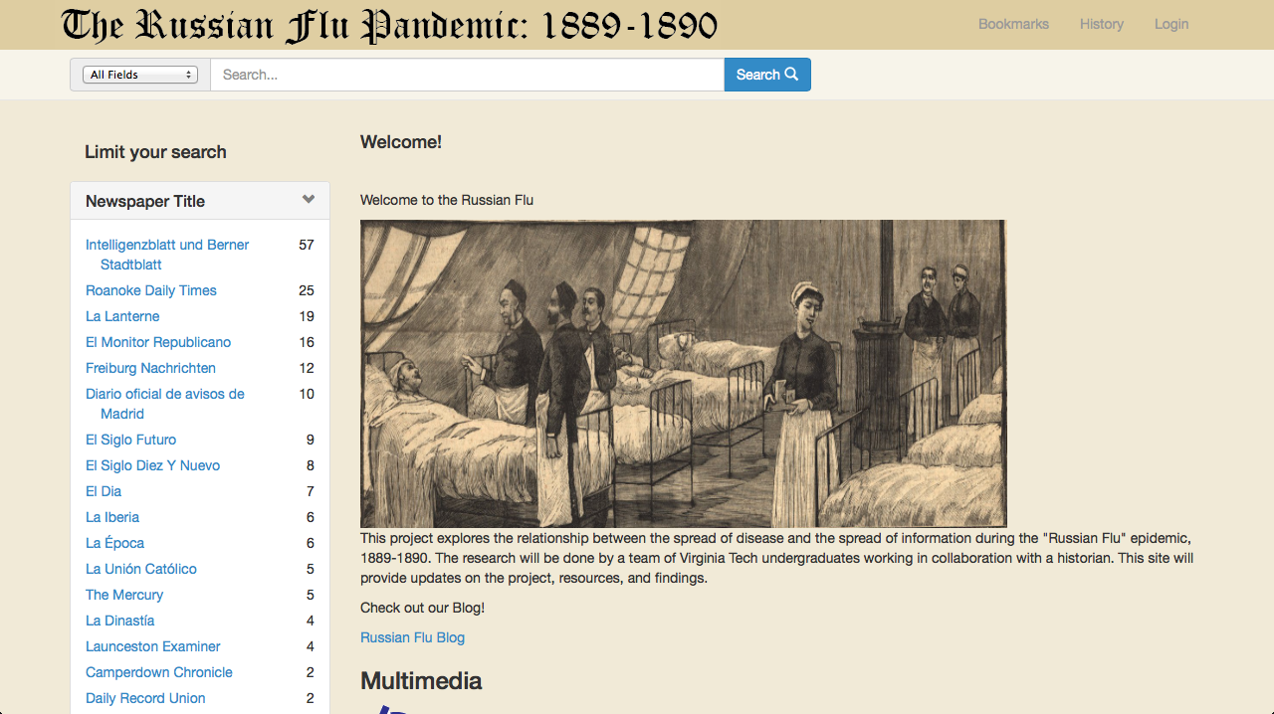
Current Interface

Slide 9
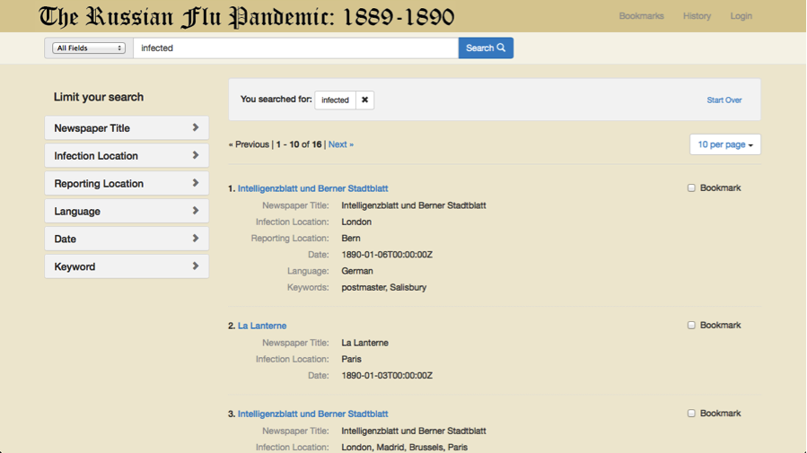

Slide 10
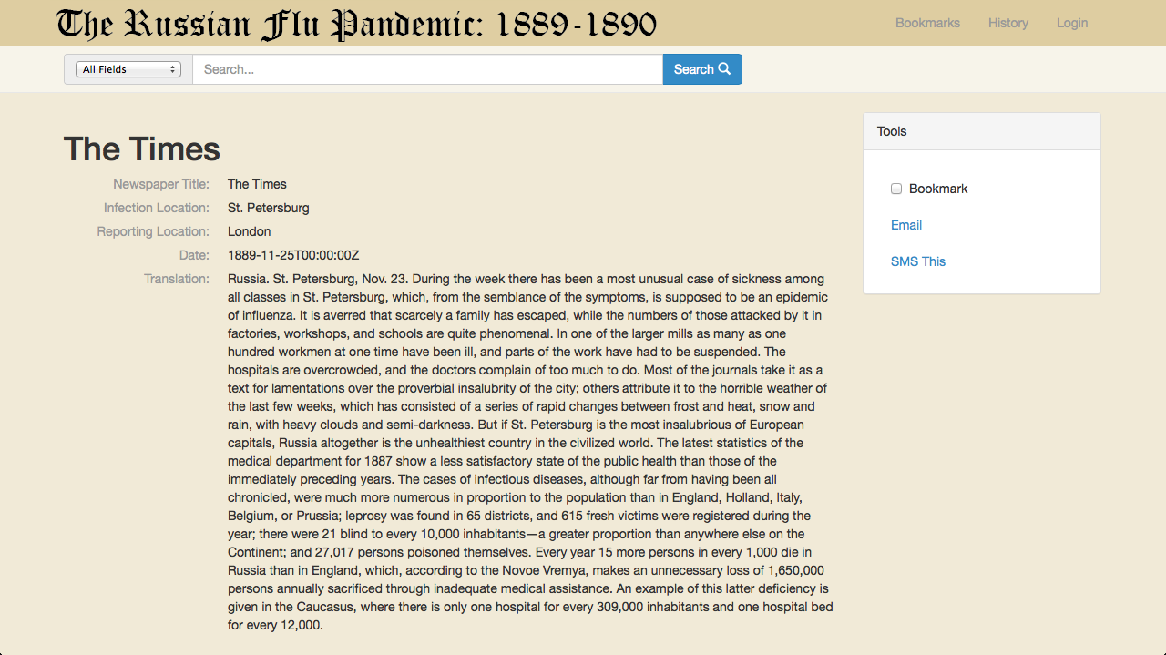

Slide 11
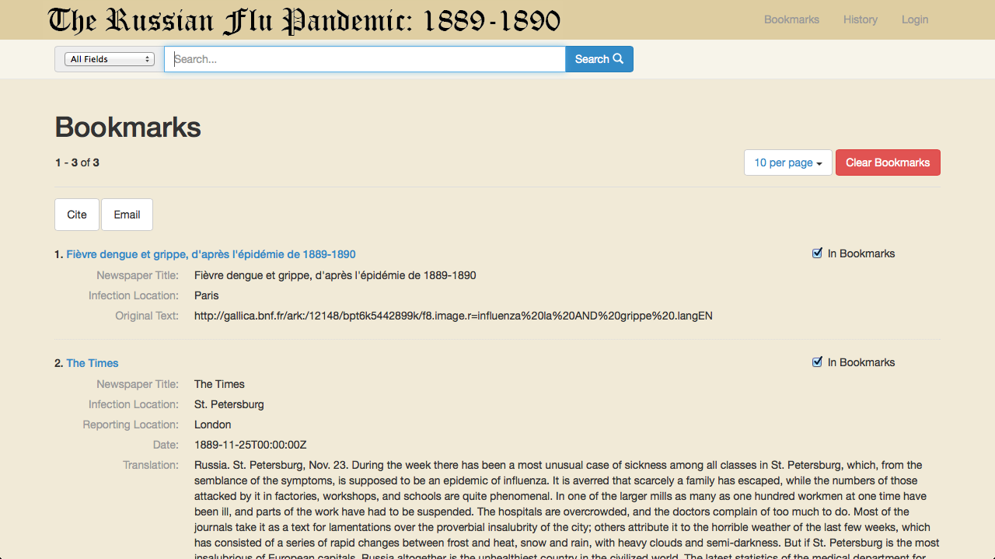

Slide 12
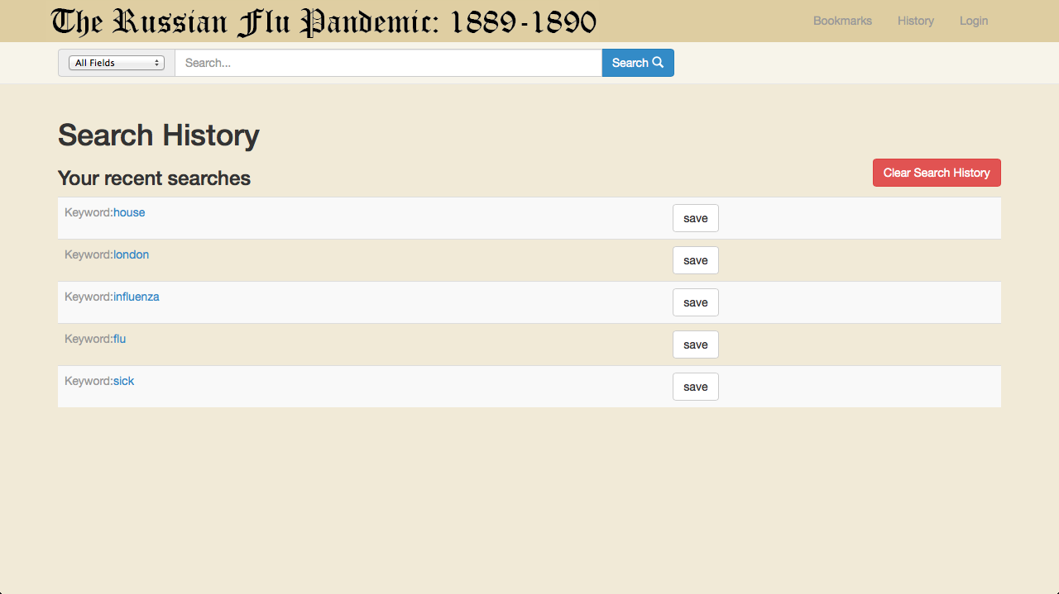

Slide 13
Extras
Find different ways to display the data gathered by the translation team
Found some multimedia solutions for future work

Slide 14
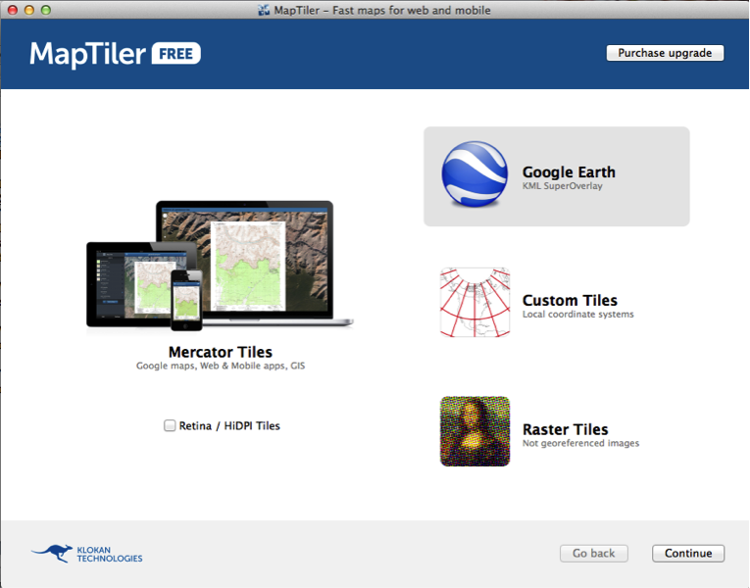
MapTiler

Slide 15
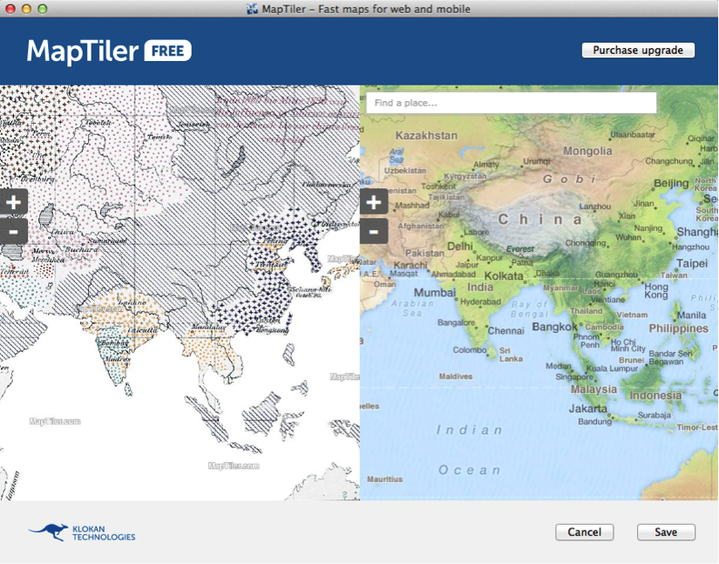
MapTiler

Slide 16
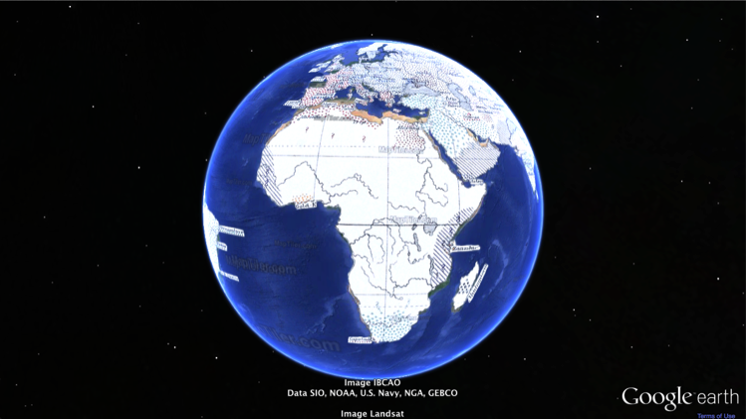
MapTiler

Slide 17
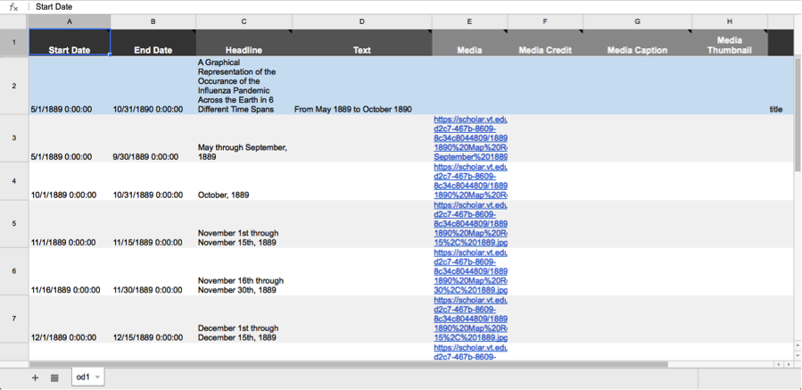
Timeline

Slide 18
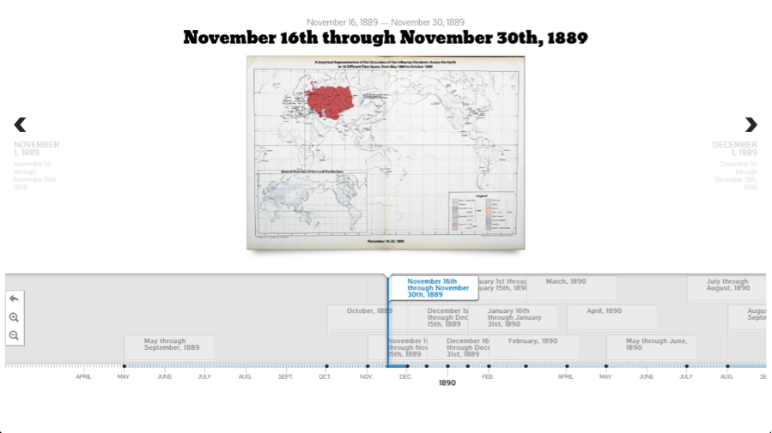
Timeline

Slide 19
Problems Faced
- Did not get access to a server until April 1st
- Communication with translation teams
- Solr/Blacklight Issues
- Linking to a new page
- Date display
- Multiple Keywords

Slide 20
Lessons Learned
- Get a faster start on the project
- Better explanations to non CS members about things like formatting
- Find people and resources on subjects that are new to us

Slide 21
Future Plans
- Client would like to get another CS group for next semester
- Client wants to implement map features
- Get thumbnail images to show in search
- Continue to add more articles

