Slide 1

Chapter 3
Stakeholder Motivations for Sustainable Property Management Practices
Unless otherwise noted, this slide deck is (c) Erin A. Hopkins.
It is released under a Creative Commons Attribution NonCommercial ShareAlike 3.0 license (CC BY NC-SA 3.0).

Slide 2
Chapter Sections
3.1 Introduction
3.2 Building Owners
3.3 Property Management Companies
3.4 Tenants
3.5 Vendors
3.6 Communities
3.7 Conclusion

Slide 3
Learning Objectives
Identify key stakeholders in sustainable property management operations
Identify motivations for building owners to adopt sustainable property management practices
Identify motivations for property management companies to adopt sustainable property
management practices
Identify motivations for tenants to adopt sustainable property management practices
Identify motivations for vendors to adopt sustainable property management practices
Identify motivations for communities to adopt sustainable property management practices

Slide 4
3.1 Introduction
Collaboration is key

Slide 5
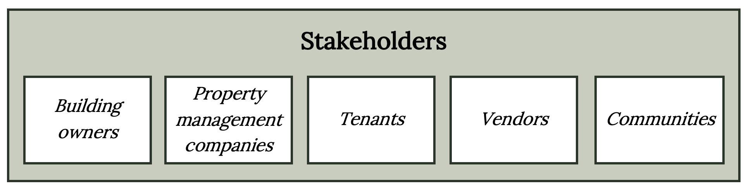
Stakeholders
Figure 3.1: Key stakeholders in sustainable property management operations. Kindred Grey. 2023. CC BY 4.0.

Slide 6
3.2 Building Owners
typically holds the most influence over green building initiative decisions

Slide 7
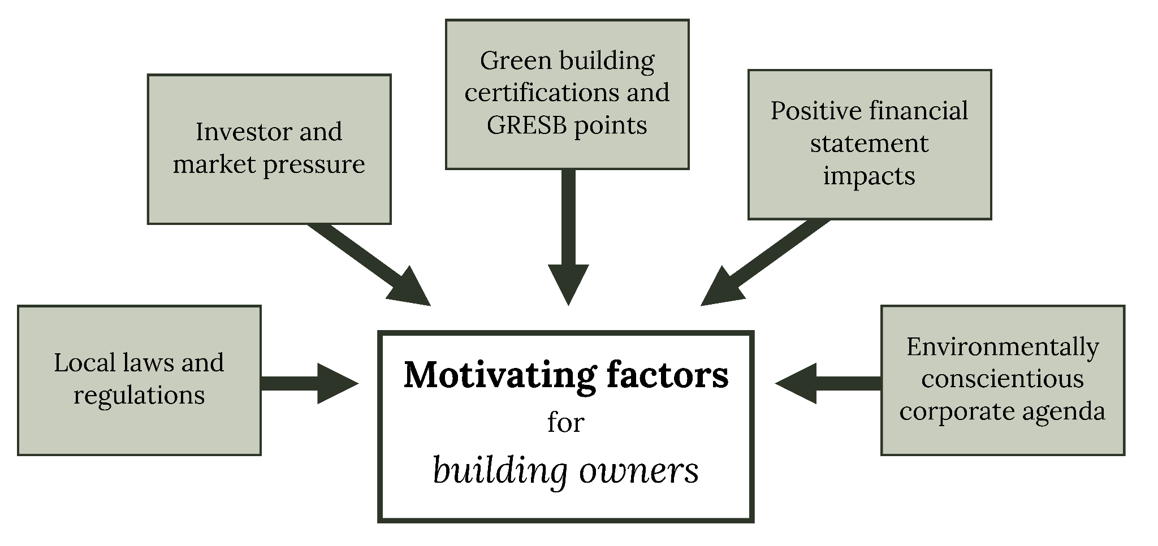
Common motivating factors for building owners
Figure 3.2: Common motivating factors for building owners. Kindred Grey. 2023. CC BY 4.0.

Slide 8
Common Building Owner Barriers
●Uncertainty in time and cost to implement sustainable initiatives
●Lack of market demand in some markets
●Investment in energy efficient appliances and fixtures if the tenant pays for their own utilities and the tenants’ cost savings are not fully capitalized into the rental rate

Slide 9
3.3 Property Management Companies
Sustainable property management responsibilities can be outlined in the management agreement

Slide 10
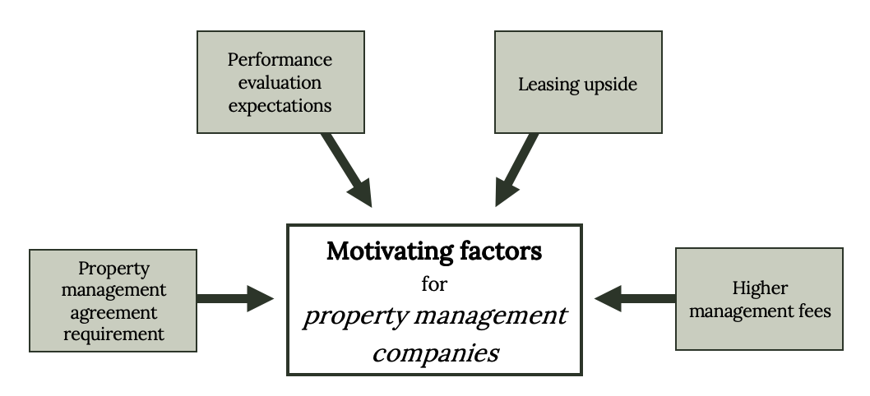
Common motivating factors for property management companies
Figure 3.3: Common motivating factors for property management companies. Kindred Grey. 2023. CC BY 4.0.

Slide 11
3.4 Tenants

Slide 12
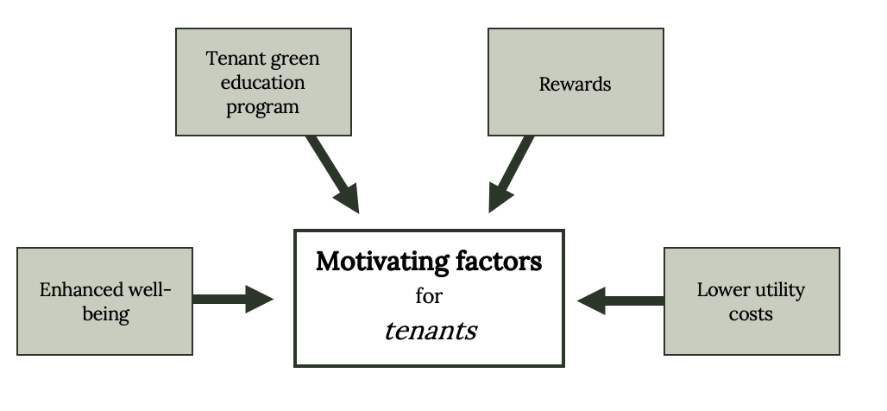
Common motivating factors for tenants
Figure 3.4: Common motivating factors for tenants. Kindred Grey. 2023. CC BY 4.0.

Slide 13
3.5 Vendors

Slide 14
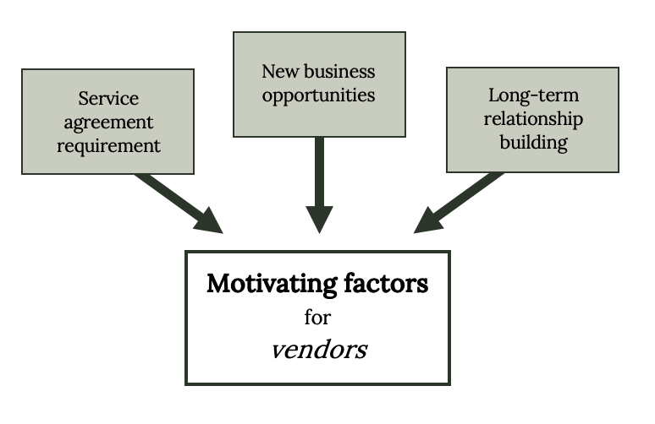
Common motivating factors for vendors
Figure 3.6: Common motivating factors for vendors. Kindred Grey. 2023. CC BY 4.0.

Slide 15
3.6 Communities

Slide 16
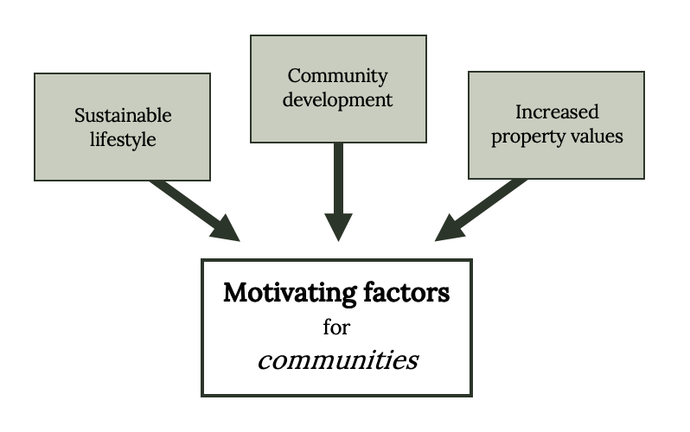
Common motivating factors for communities
Figure 3.7: Common motivating factors for communities. Kindred Grey. 2023. CC BY 4.0.

Slide 17
3.7 Conclusion
Collaboration occurs through mutual respect and understanding of motivations
Speaking each other’s language and addressing these motivations not only builds relationships, it helps all key stakeholders be more socially responsible and cultivate greener communities

Slide 18
Chapter Activity
Use link below to access the Database of State Incentives for Renewables & Efficiency
https://www.dsireusa.org/
Enter your hometown zip code on the homepage to find incentives for renewables & efficiency in your area
From the list provided, choose an incentive and answer the following:
  Name of the incentive
  State/Territory of the incentive
  Category of the incentive
  Policy/Incentive Type
  When it was created
  When it was last updated
  The goal of the incentive

